Slide 1
Antennas & Receivers in Radio Astronomy
Mark McKinnon

Slide 2
Outline
Context
Types of antennas
Antenna fundamentals
Reflector antennas
Mounts
Optics
Antenna performance
Aperture efficiency
Pointing
Polarization
Receivers

Slide 3
Importance of the Antenna Elements
Antenna amplitude pattern causes amplitude to vary across the source.
Antenna phase pattern causes phase to vary across the source.
Polarization properties of the antenna modify the apparent polarization of the source.
Antenna pointing errors can cause time varying amplitude and phase errors.
Variation in noise pickup from the ground can cause time variable amplitude errors.
Deformations of the antenna surface can cause amplitude and phase errors, especially at short wavelengths.

Slide 4
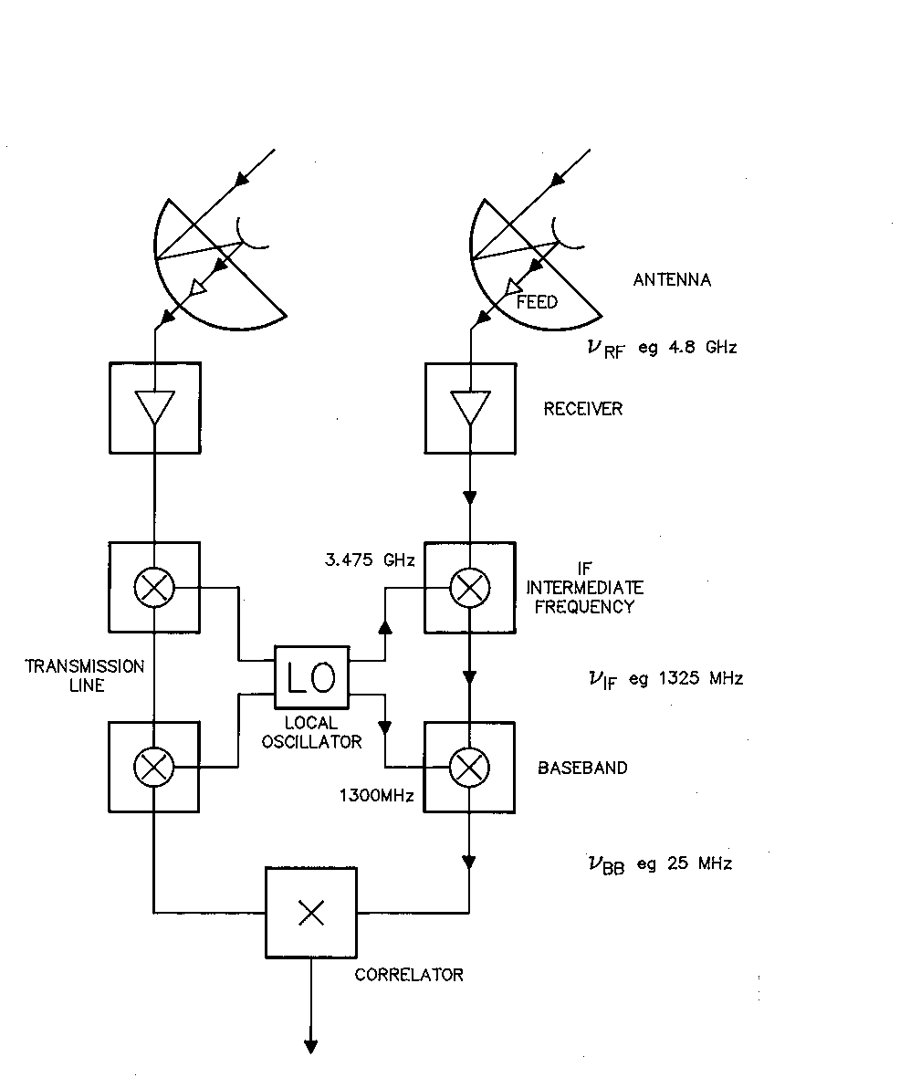
VLA @ 4.8 GHz (C-band)
Interferometer Block Diagram
Antenna
Front End
IF
Back End
Correlator
Key
Amplifier
Mixer
X
Correlator

Slide 5
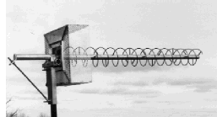
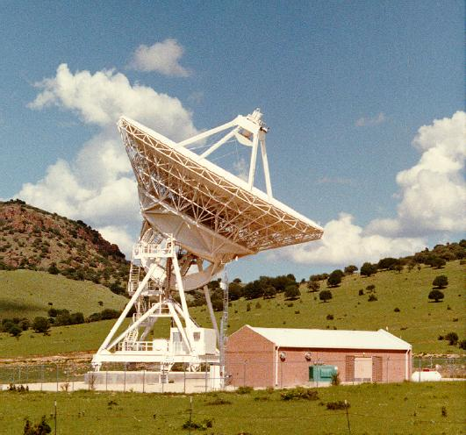
Types of Antennas
Wire antennas
Dipole
Yagi
Helix
Small arrays of the above
Reflector antennas
Hybrid antennas
Wire reflectors
Reflectors with dipole feeds
Yagi
Helix

Slide 6
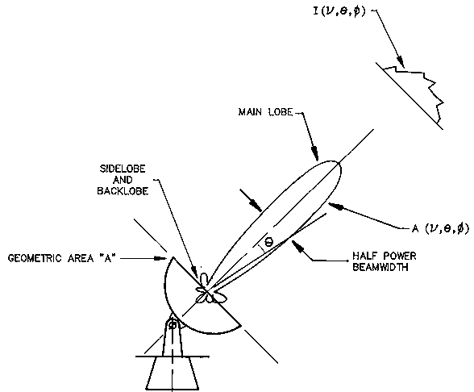
Basic Antenna Formulas
Effective collecting
area A(ν,θ,φ) m²
On-axis response A₀ = ηA
= aperture efficiency
Normalized pattern
(primary beam)
A(ν,θ,φ) = A(ν,θ,φ)/A₀
Beam solid angle
Ω_{A}= ∫∫ A(ν,θ,φ) dΩ
^{all sky}
A₀ Ω_{A} = λ²
λ = wavelength, ν = frequency

Slide 7
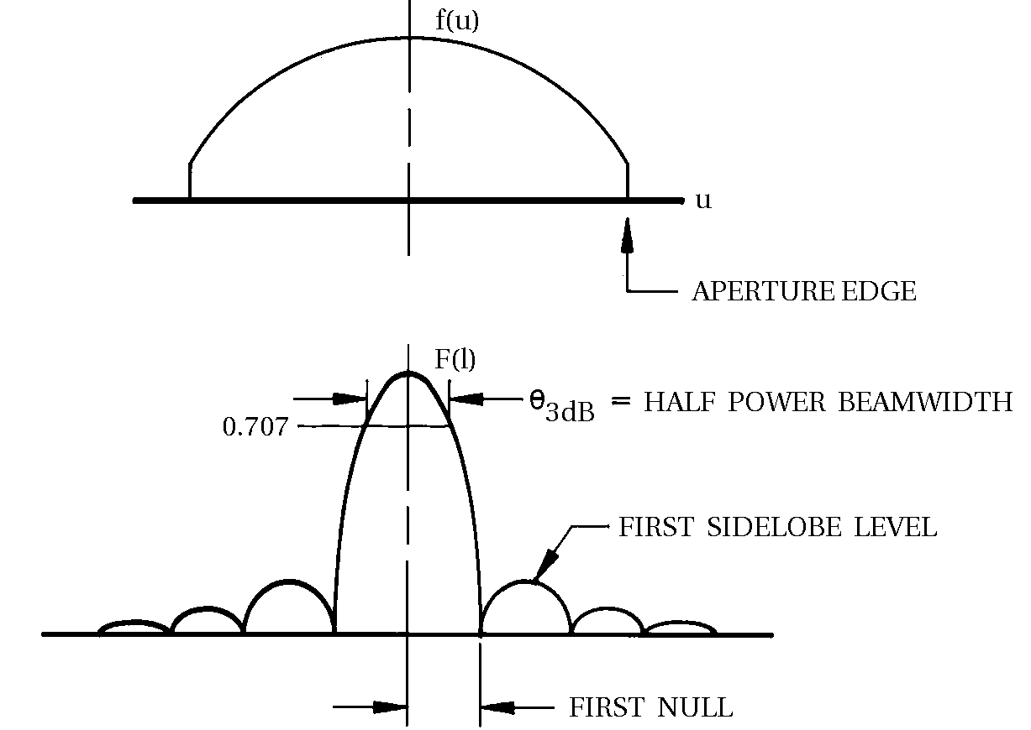
Aperture-Beam Fourier Transform Relationship
What determines the beam shape?
f(u,v) = complex aperture field distribution
u,v = aperture coordinates (wavelengths)
F(l,m) = complex far-field voltage pattern
l = sinθcosφ , m = sinθsinφ
F(l,m) = ∫∫_{aperture}f(u,v)exp(2πi(ul+vm))dudv
f(u,v) = ∫∫_{hemisphere}F(l,m)exp(-2πi(ul+vm))dldm
For VLA: θ_{3dB} = 1.02/D, First null = 1.22/D,
D = reflector diameter in wavelengths

Slide 8
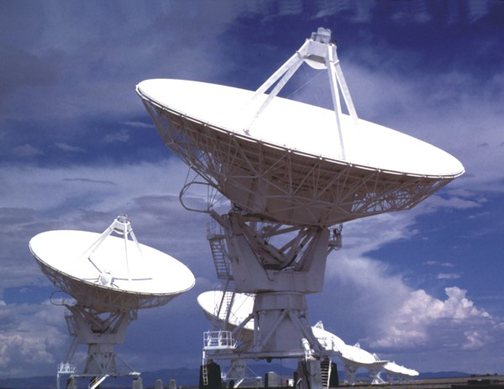
Antenna Mounts: Altitude over Azimuth
Advantages
Cost
Gravity performance
Disadvantages
Zone of avoidance
Beam rotates on sky

Slide 9
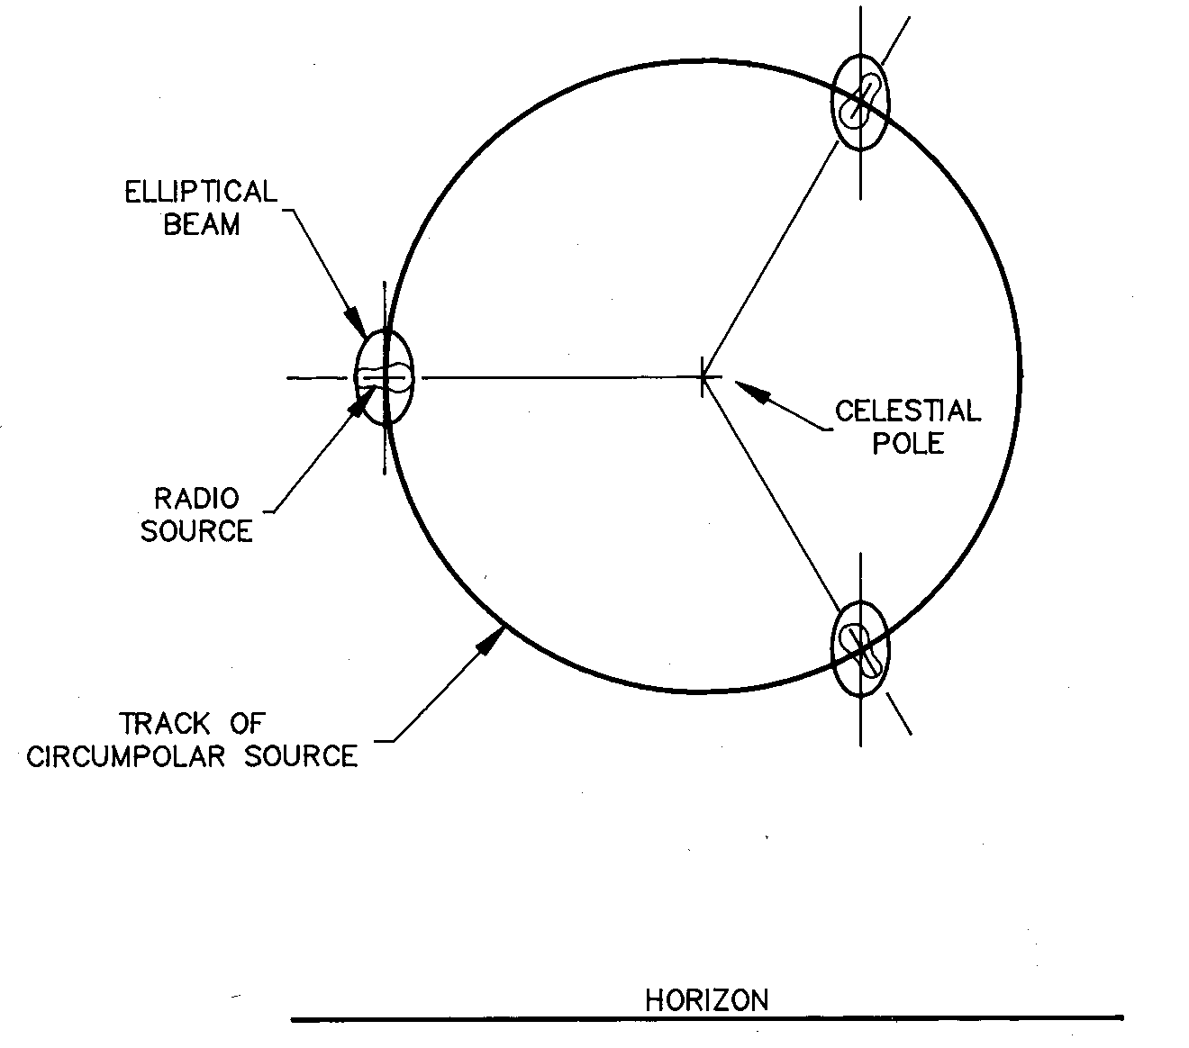
Beam Rotation on the Sky
Parallactic angle

Slide 10
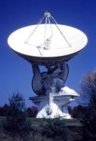
Antenna Mounts: Equatorial
Advantages
Tracking accuracy
Beam doesn’t rotate
Disadvantages
Cost
Gravity performance
Sources on horizon at pole

Slide 11
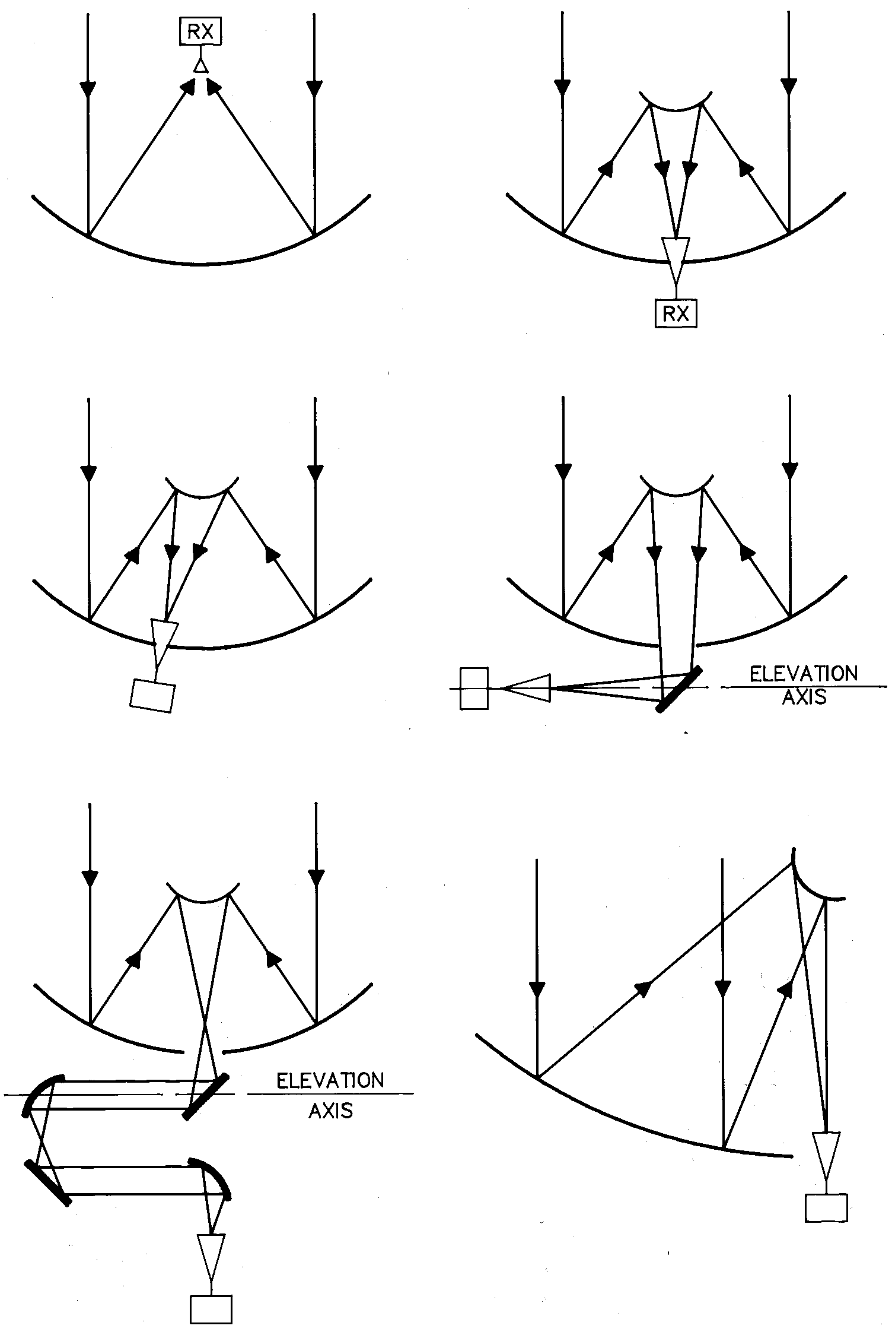
Reflector Optics
Prime focus
Offset Cassegrain
Beam Waveguide
Cassegrain focus
Naysmith
Dual Offset

Slide 12
Reflector Optics: Limitations
Prime focus
Over-illumination (spillover) can increase system temperature due to ground pick-up
Number of receivers, and access to them, is limited
Subreflector systems
Can limit low frequency capability. Feed horn too large.
Over-illumination by feed horn can exceed gain of reflector’s diffraction limited sidelobes
Strong sources a few degrees away may limit image dynamic range
Offset optics
Support structure of offset feed is complex and expensive

Slide 13
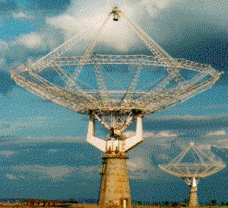
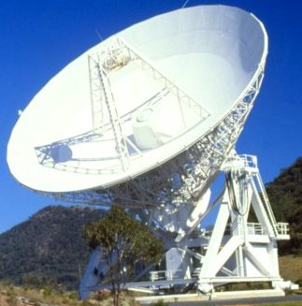
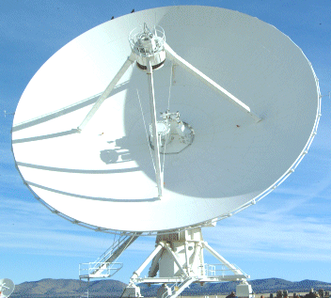
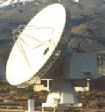
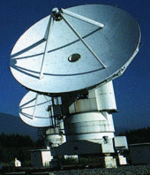
Reflector Optics: Examples
Prime focus Cassegrain focus
(GMRT) (AT)
Offset Cassegrain Naysmith
(VLA) (OVRO)
Beam Waveguide Dual Offset
(NRO) (GBT)

Slide 14
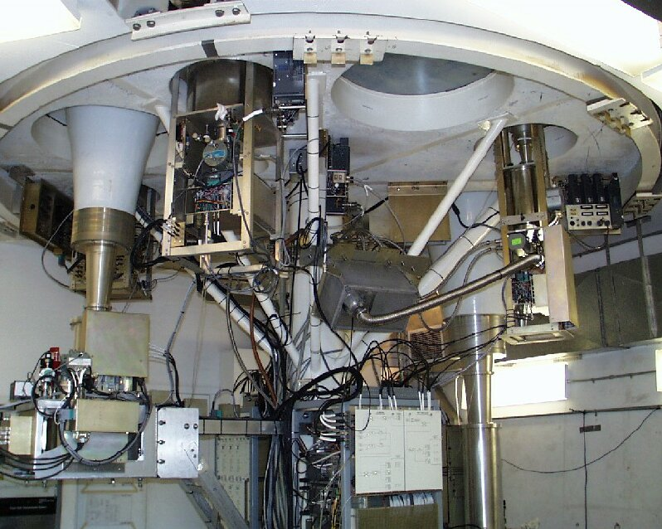
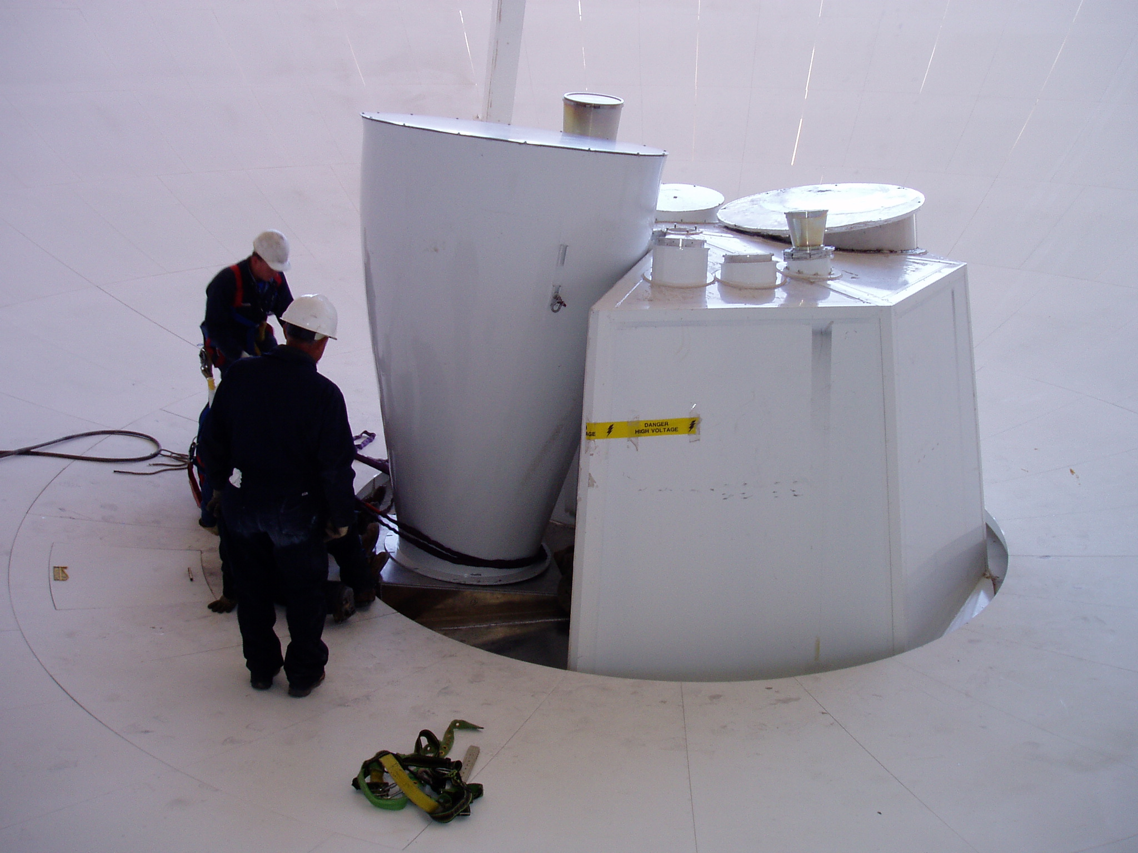
Feed Systems
GBT
VLA
EVLA

Slide 15
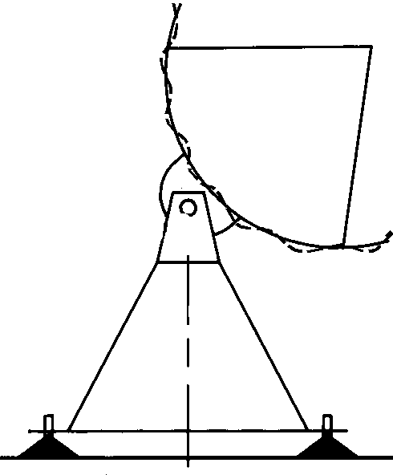
Antenna Performance: Aperture Efficiency
On axis response: A₀ = ηA
Efficiency: η = η_{sf} . η_{bl} . η_{s} . η_{t} . η_{misc}
η_{sf} = Reflector surface efficiency
Due to imperfections in reflector surface
η_{sf} = exp(−(4πσ/λ)²) e.g., σ = λ/16 , η_{sf} = 0.5
η_{bl} = Blockage efficiency
Caused by subreflector and its support structure
η_{s} = Feed spillover efficiency
Fraction of power radiated by feed intercepted by subreflector
η_{t} = Feed illumination efficiency
Outer parts of reflector illuminated at lower level than inner part
η_{misc}= Reflector diffraction, feed position phase errors, feed match and loss
rms error σ

Slide 16
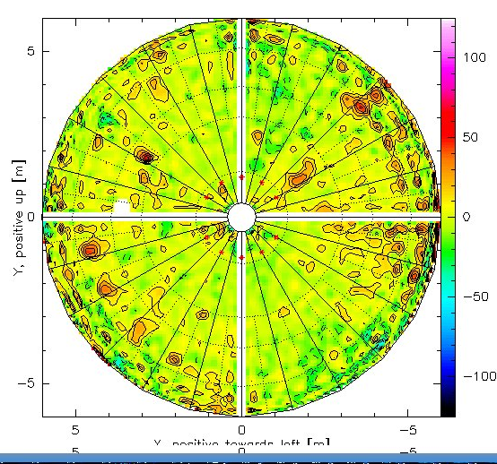
Surface of ALMA Vertex Antenna
Surface measurements of DV02 made with holography
Measured surface rms =10um

Slide 17
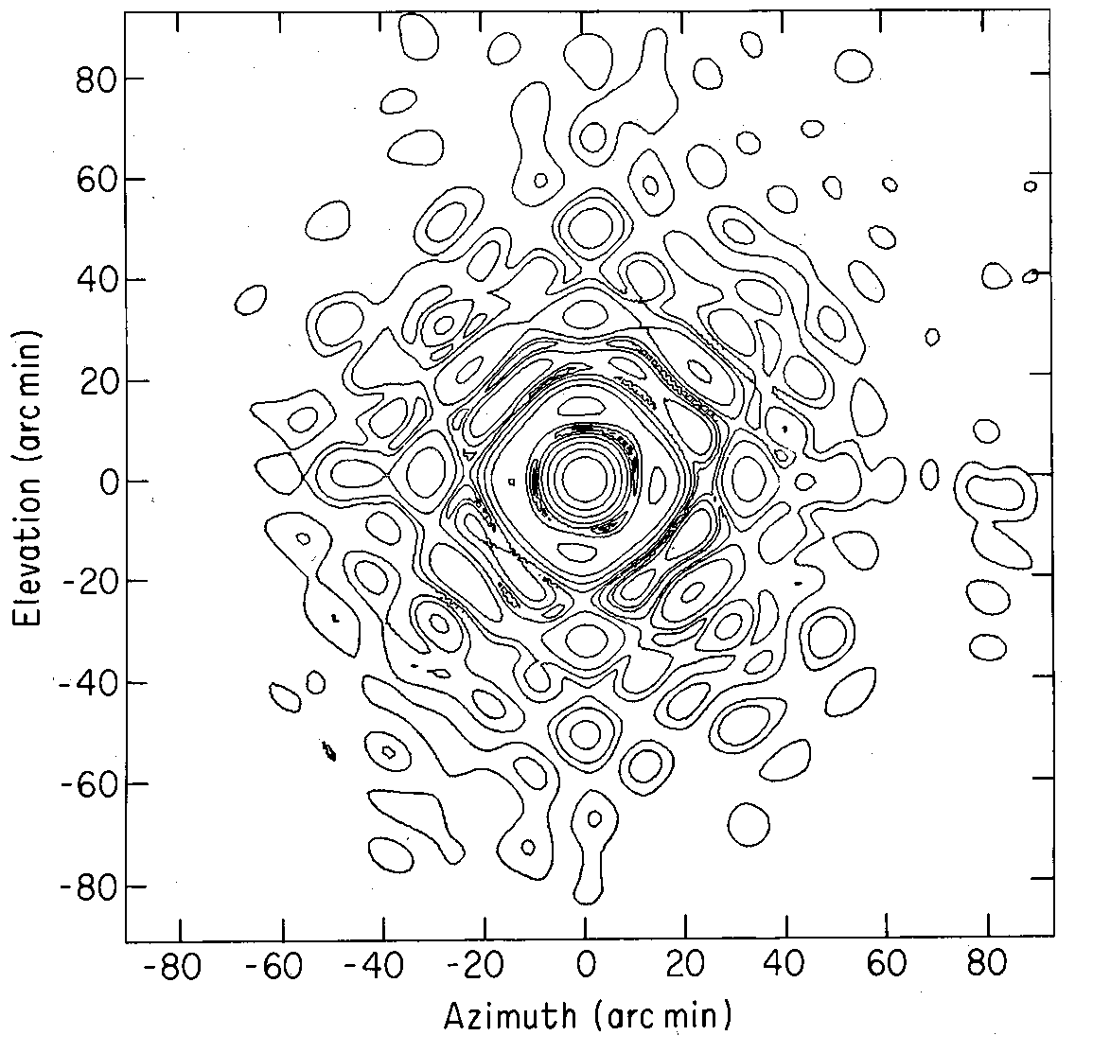
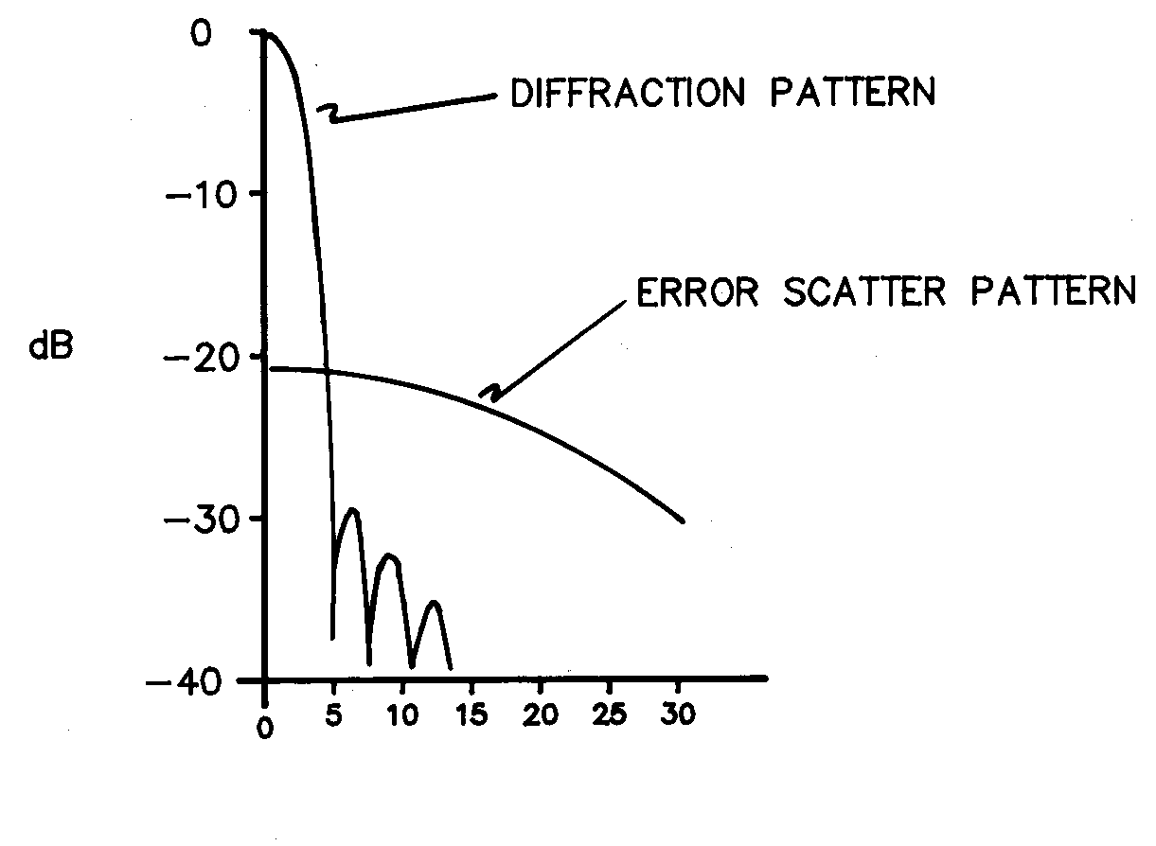
Antenna Performance: Aperture Efficiency
Primary Beam
l=sin(θ), D = antenna diameter in contours:−3,−6,−10,−15,−20,−25,
wavelengths −30,−35,−40 dB
dB = 10log(power ratio) = 20log(voltage ratio)
VLA: θ_{3dB} = 1.02/D, First null = 1.22/D Voltage radiation pattern, |F(l,m)|
πDl

Slide 18
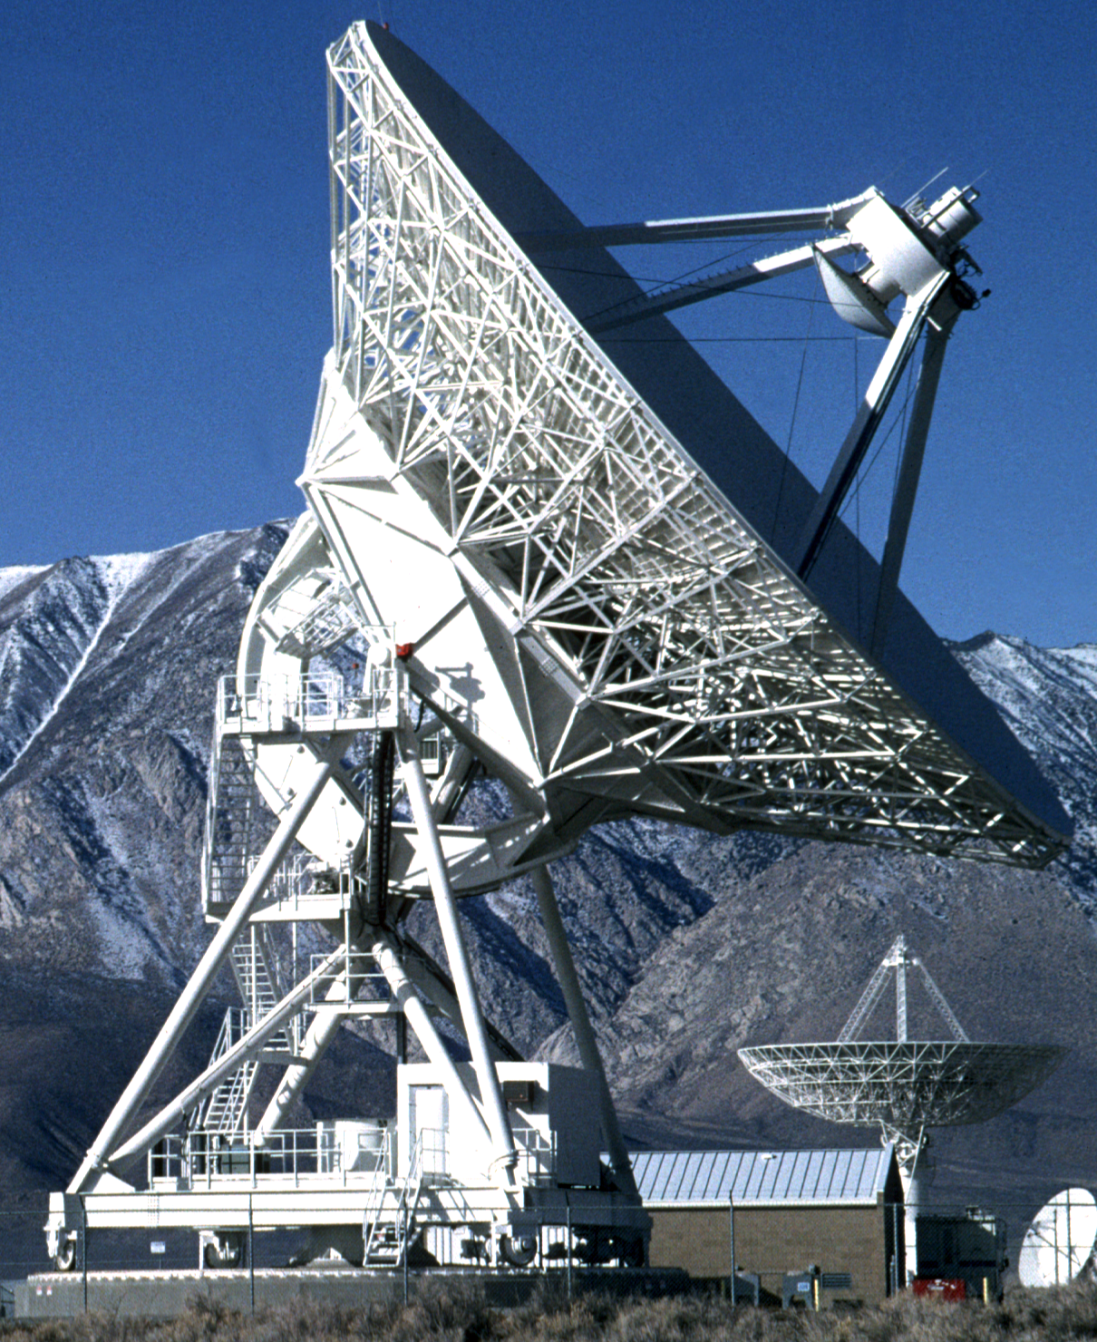
Antenna Pointing: Practical Considerations
Subreflector mount
Reflector structure
Quadrupod
El encoder
Alidade structure
Rail flatness
Foundation
Azimuth encoder

Slide 19
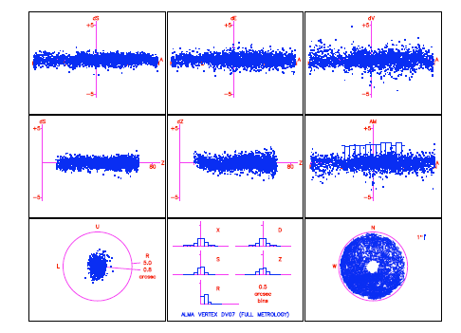
Pointing: ALMA Vertex Antennas
All-sky optical pointing on DV07 completed April 1-14
All-sky results (spec = 2” RMS)
0.77 ± 0.12” RMS at OSF
0.84 ± 0.13” RMS scaled to AOS
All-sky and offset pointing within specifications!
DV07 pointing residuals: Mangum, N. Emerson,
Mundnich & Stenvers
Notes:
All-sky involved 26 pointing runs with 2691 individual star measurements

Slide 20
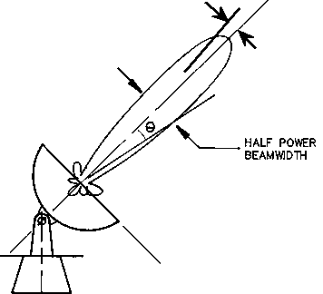
Antenna Performance: Pointing
Pointing Accuracy
Δθ = rms pointing error
Often Δθ < θ_{3dB} /10 acceptable,
because A(θ_{3dB} /10) ~ 0.97
BUT, at half power point in beam
A(θ_{3dB} /2 ± θ_{3dB} /10)/A(θ_{3dB} /2) = ±0.3
For best VLA pointing use Reference Pointing.
Δθ = 3 arcsec = θ_{3dB} /17 @ 50 GHz
Δθ
θ_{3dB}
Primary beam A(θ)

Slide 21
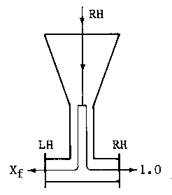
Antenna Performance: Polarization
Antenna can modify apparent polarization properties of the source:
Antenna structure
Symmetry of the optics
Reflections in the optics
Curvature of the reflectors
Quality of feed polarization splitter
Constant across the beam
Circularity of feed radiation patterns
No instrumental polarization on-axis,
But cross-polarization varies across the beam …

Slide 22
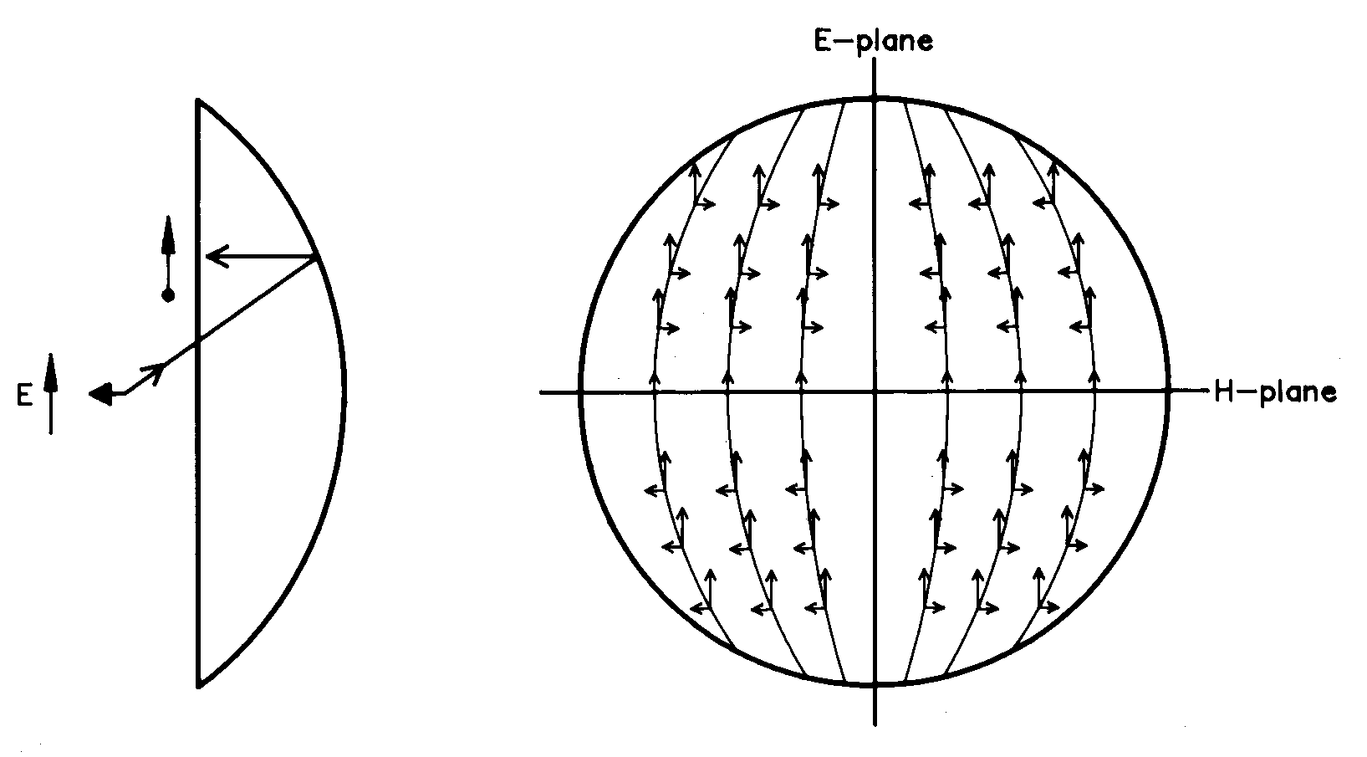
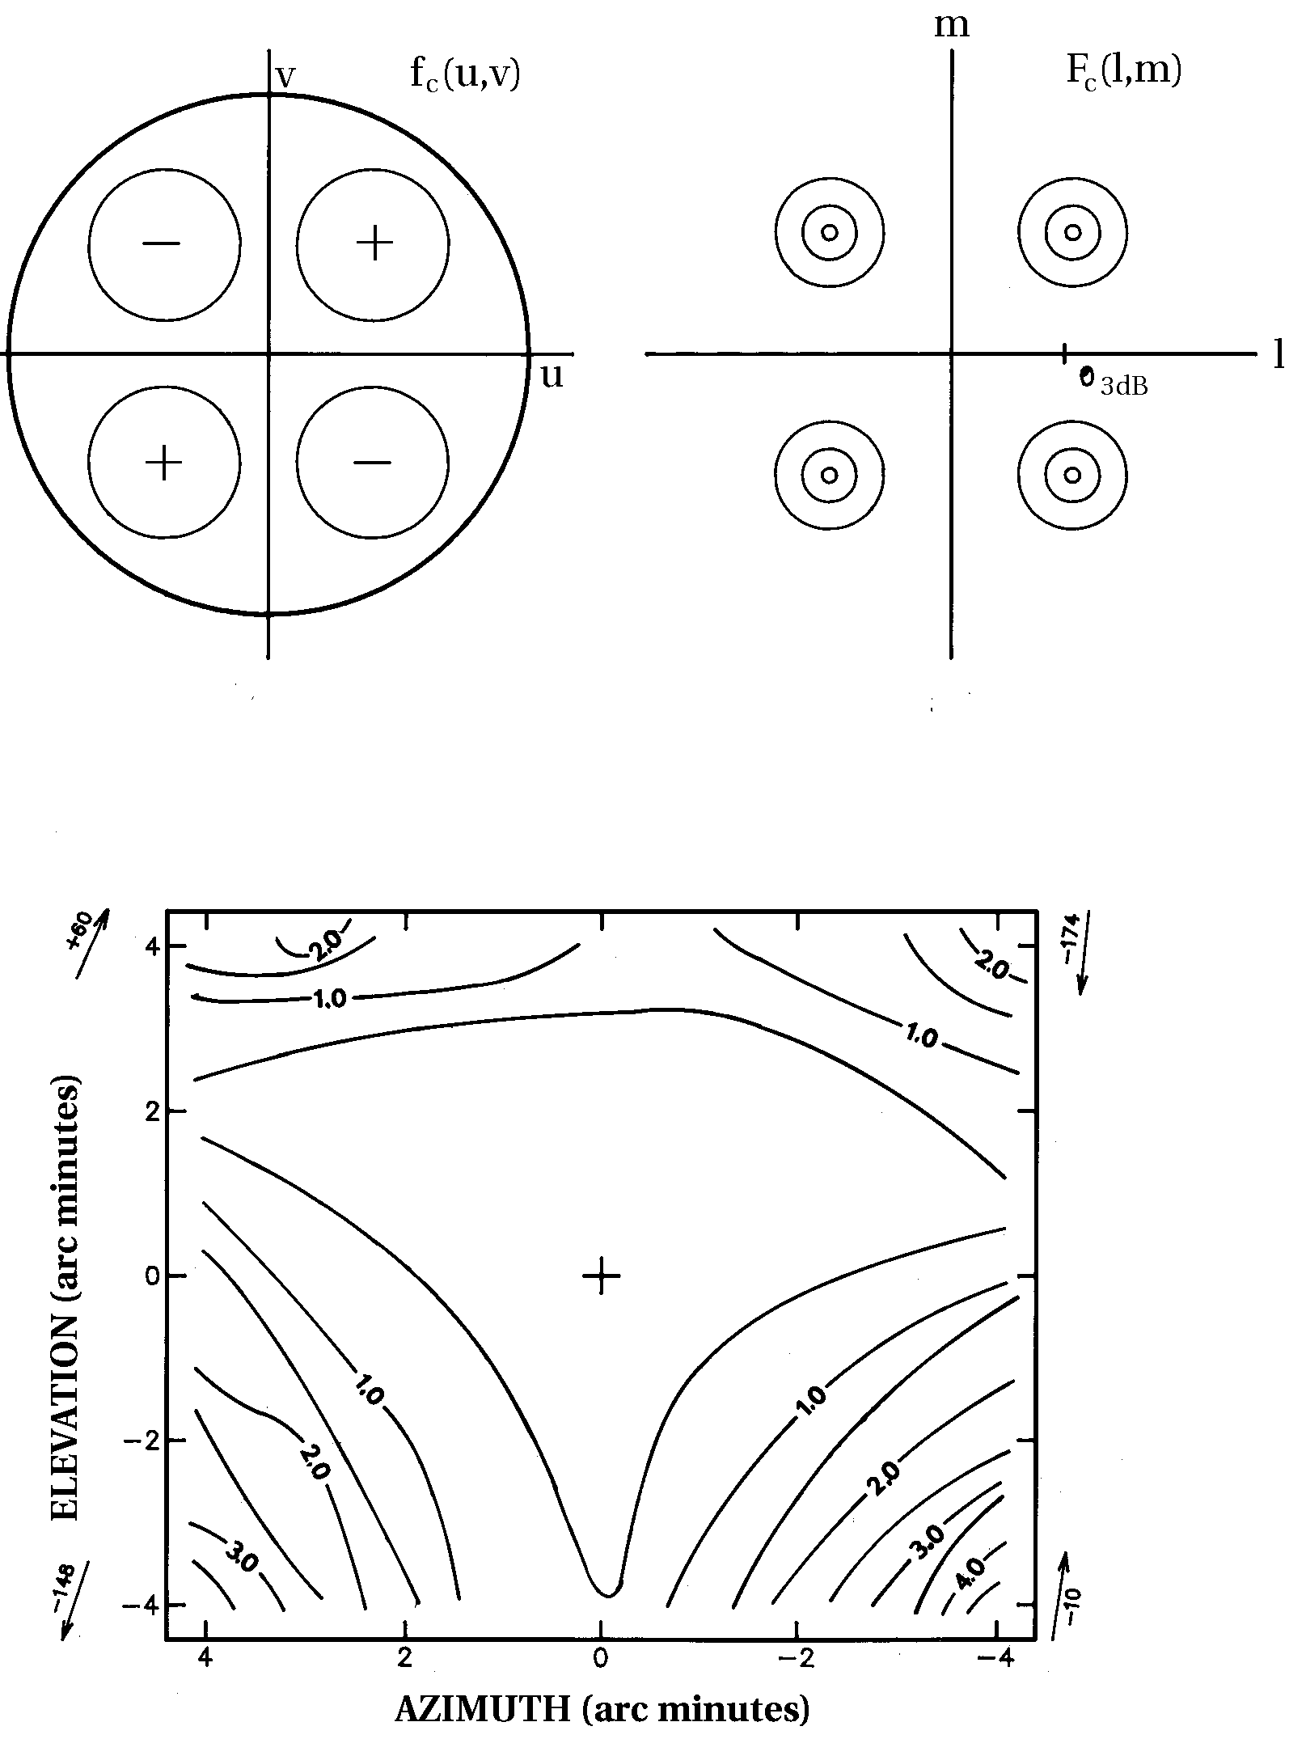
Off-Axis Cross Polarization
Cross-polarized
aperture distribution
Cross-polarized
primary beam
Field distribution in aperture of paraboloid fed by electric dipole
VLA 4.8 GHz cross-polarized
primary beam

Slide 23
Receivers: Noise Temperature
Reference received power to the equivalent temperature of a matched load at the input to the receiver
Rayleigh-Jeans approximation to Planck radiation law for a blackbody
P_{in} = k_{B}T Δν (W)
k_{B} = Boltzman’s constant (1.38*10⁻²³ J/ºK)
When observing a radio source, T_{total} = T_{A} + T_{sys}
Tsys = system noise when not looking at a discrete radio source
T_{A} = source antenna temperature

Slide 24
Receivers: SEFD
EVLA Sensitivities
T_{A} = ηAS/(2k_{B}) = KS
S = source flux (Jy)
SEFD = system equivalent flux density
SEFD = Tsys/K (Jy)
Band (GHz) | η | T_{sys} | SEFD
1-2 | .50 | 21 | 236
2-4 | .62 | 27 | 245
4-8 | .60 | 28 | 262
8-12 | .56 | 31 | 311
12-18 | .54 | 37 | 385
18-26 | .51 | 55 | 606
26-40 | .39 | 58 | 836
40-50 | .34 | 78 | 1290

Slide 25
EVLA Q-Band (40-50 GHz) Receiver
Dewar
Tripler/Mixer Assembly Spacek
3XM45-8.4-0.1L/R
RF=40-50 GHz
DC-Block
Inmet
8055H
0.01-18 GHz
Isolator
MICA
T-708S40
8-18 GHz
Integrated
Isolator
Dorado
4IWN45-1A
(UG38 → UG599)
Post-AmpModule
Caltech
3XM45-8.4-0.1L/R
RF=40-50 GHz
Remove
Dorado
4IWC45-1
NRAO
CDL
RCP
24dB
35dB
40-50 GHz
LNA
x3
40-50
GHz
T_{Cal}
Magic-T
MDL
22TH12B
Noise/COM
NC 5222
ENR > 20 dB
Limiting LO Amplifier
Norden
N03-4010
Pol
Atlantic
Microwave
AMC 1233
Septum Polarizer
& Cal Coupler
Variable
Attenuator
NRAO
Noise
Diode
LO Splitter
MAC Tech
18 dBm
PA8207-2F
16.0-19.3 GHz
16.0-19.5 GHz
P_{Out} = 21.0 ± 0.5 dBm
for ±6 dBm input
0∀3 dBm
Isolator
Mica
T-610S10
10-20 GHz
T_{Cal}
x3
LNA
35dB
LCP
24dB
Old
Pamtech
KYG2121-K2
(w/g)
NRAO
CDL
Some New
Isolator
Dorado
4IWN45-1A
(UG38 → UG599)
Post-AmpModule
Caltech
3XM45-8.4-0.1L/R
RF=40-50 GHz
Tripler/Mixer Assembly Spacek
3XM45-8.4-0.1L/R
RF=40-50 GHz
DC-Block
Inmet
8055H
0.01-18 GHz
Isolator
MICA
T-708S40
8-18 GHz
New

