Slide 1
ERROR RECOGNITION
& IMAGE ANALYSIS
Gustaaf van Moorsel (NRAO)
Ed Fomalont (NRAO)

Slide 2
INTRODUCTION
Why are these two topics – ‘Error Recognition’ and ‘Image Analysis’ in the same lecture?
-- Error recognition is used to determine defects in the (visibility) data and image during and after the ‘best’ calibration, editing, etc.
-- Image analysis describes the almost infinite ways in which useful insight, information and parameters can be extracted from the image.
Perhaps the two topics are related to the reaction one has when looking at an image after ‘good’ calibration, editing, self-calibration, etc.
If the reaction is:

Slide 3
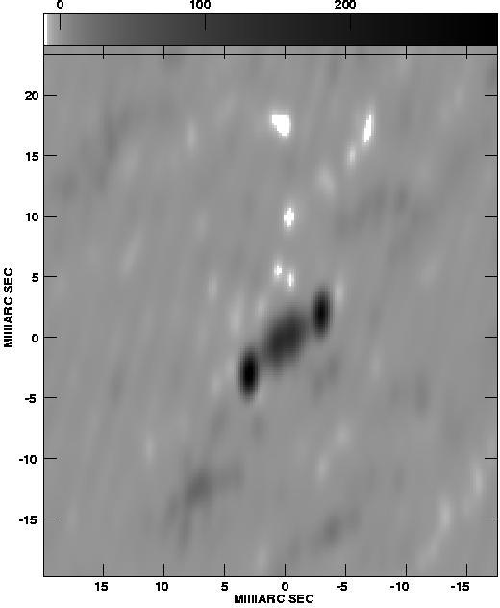
OBVIOUS IMAGE PROBLEMS
Rats!!
This can’t be right. This is either the most remarkable radio source ever, or I have made an error in making the image.
Clear signs of problems:
Image rms > expected rms
Unnatural features in the image
How can the problems be found and corrected?
mJy scale
milliarcsec

Slide 4
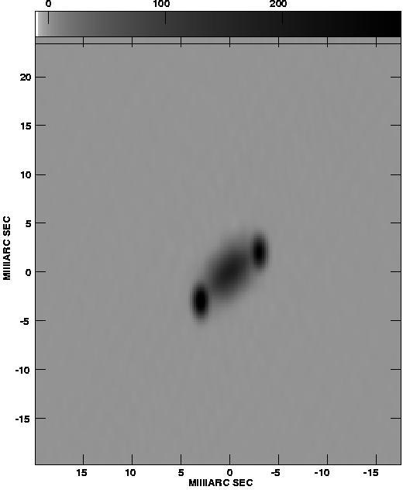
HIGH QUALITY IMAGE
Great!!
After lots of work, I can finally analyze this image and get some interesting scientific results.
What were defects?
Two antennas had 10% calibration errors, and one with a 5 deg error, plus a few outlier points.
This part of the lecture.
How to find the errors and remove them.
milliarcsec

Slide 5
GENERAL PROCEDURE
We assume that the data have been edited and calibrated reasonably successfully (earlier lectures). Self-calibration is sometimes necessary.
So, the first serious display of an image leads one—
to inspect again and clean-up the data repeating some or all of the previous reduction steps.
  removal of one type of problem can reveal next problem!
once all is well, proceed to image-analysis and obtaining scientific results from the image.
But, first a digression on data and image display. First:
Images

Slide 6
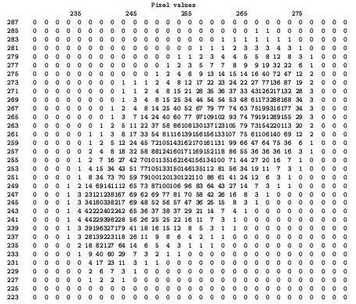
IMAGE DISPLAYS (1)
Digital image
Numbers are
proportional to
the intensity
Good for very
slow links; rarely used anymore

Slide 7
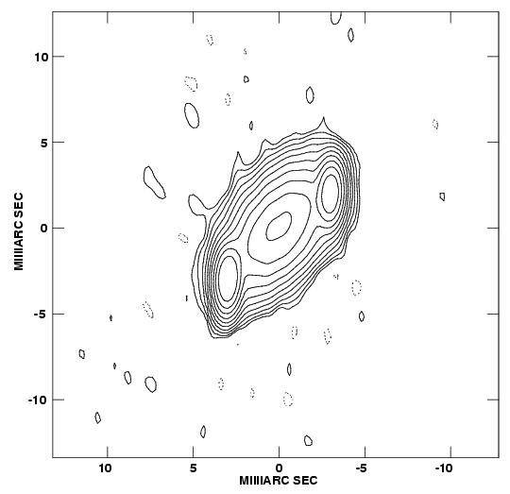
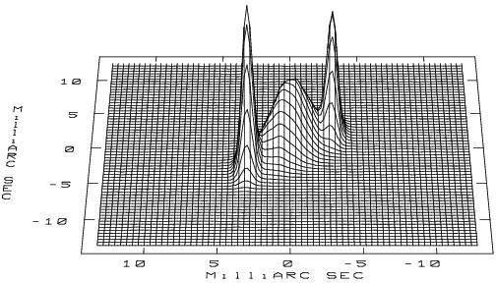
IMAGE DISPLAYS (2)
Contour Plot
  Profile Plot
These plots are easy to reproduce and printed
Contour plots give good representation of faint emission.
Profile plots give a good representation of the bright emission and faint ripples.

Slide 8
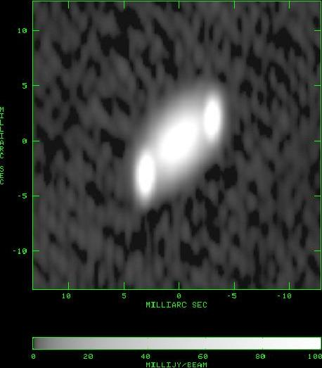
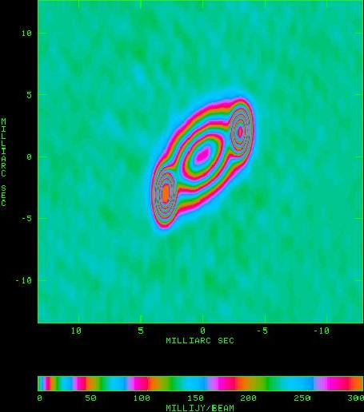
IMAGE DISPLAYS (3)
Grey-scale Display
Color Display
  Profile Plot
Contour Plot
TV-based displays are most useful and interactive:
Grey-scale shows faint structure, but not good for high dynamic
range and somewhat unbiased view of source
Color displays more flexible; e.g. pseudo contours

Slide 9
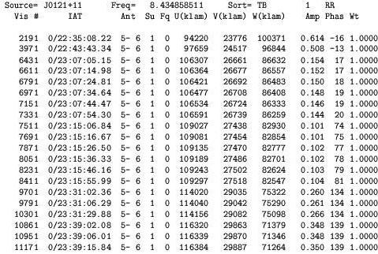
DATA DISPLAYS(1)
List of u-v Data
Very primitive display, but sometimes worth-while: e.g. , can search on e.g.
Amp > 1.0, or large Wt. Often need precise times in order to flag the data appropriately.

Slide 10
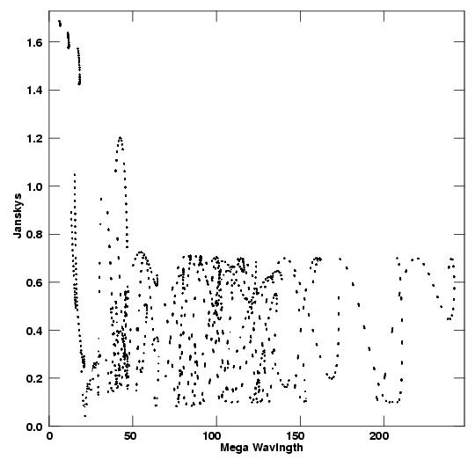
DATA DISPLAYS(2)
Visibility Amplitude versus Projected uv spacing
General trend of data.
Useful for relatively strong sources.
Triple source model. Large
component cause rise at
short spacings.
Oscillations at longer spacings suggest close double.
(see Non-imaging lecture)
Jy
Mega Wavelength

Slide 11
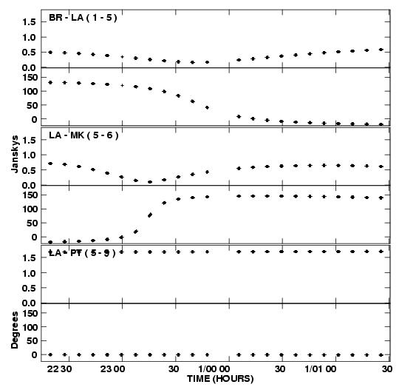
DATA DISPLAYS(3)
Jy
Deg
Jy
Deg
Jy
Deg
Visibility amplitude and
phase versus time for
various baselines
Good for determining the
continuity of the data
Should be relatively smooth
with time
Outliers are obvious.
Long baseline
        Short baseline
Time in d/hh mm

Slide 12
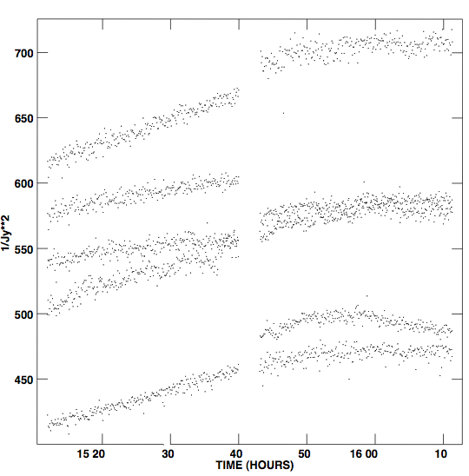
DATA DISPLAYS(4)
Weights of antennas 4 with 5,6,7,8,9
All u-v data points have a weight.
The weight depends on the antenna
sensitivity, measured during the
observations
The amplitude calibration values also
modify the weights.
Occasionally the weight of the
points become very large, often
caused by subtle software bugs.
A large discrepant weight causes the
same image artifacts as a large
discrepant visibility value.
Please check weights to make sure
they are reasonable.

Slide 13
IMAGE PLANE OR DATA (U-V) PLANE INSPECTION?
Errors obey Fourier transform relationship
  Narrow feature in uv plane <-> wide feature in image plane
  Wide feature in uv plane <-> narrow feature in image plane
    Note: easier to spot narrow features
  Orientations are orthogonal
  Data uv amplitude errors <->symmetric image features
  Data uv phase errors <-> asymmetric image features
  An obvious defect may be hardly visible in the transformed plane
  A small, almost invisible defect may become very obvious in the transformed plane

Slide 14
GOLDEN RULE OF FINDING ERRORS
---Obvious outlier data (u-v) points:
  100 bad points in 100,000 data points gives an 0.1% image error
  (unless the bad data points are 1 million Jy)
  LOOK at DATA to find gross problem (you’d be hard pressed to find it in the image plane other than a slight increase in noise)
  ---Persistent small data errors:
  e.g. a 5% antenna gain calibration error is difficult to see
  in (u-v) data (not an obvious outlier), but will produce a
  1% effect in image with specific characteristics (more later).
  USE IMAGE to discover problem
  ---Non-Data Problems:
  Perfect data but unstable algorithms. Common but difficult
  to discern

Slide 15
ERROR RECOGNITION IN THE U-V PLANE
  Editing obvious errors in the u-v plane
  ---Mostly consistency checks assume that the visibility cannot change much over a small change in u-v spacing
  ---Also, double-check gains and phases from calibration processes. These values should be relatively stable.
See Summer school lecture notes in 2002 by Myers
See ASP Vol 180, Ekers, Lecture 15, p321

Slide 16
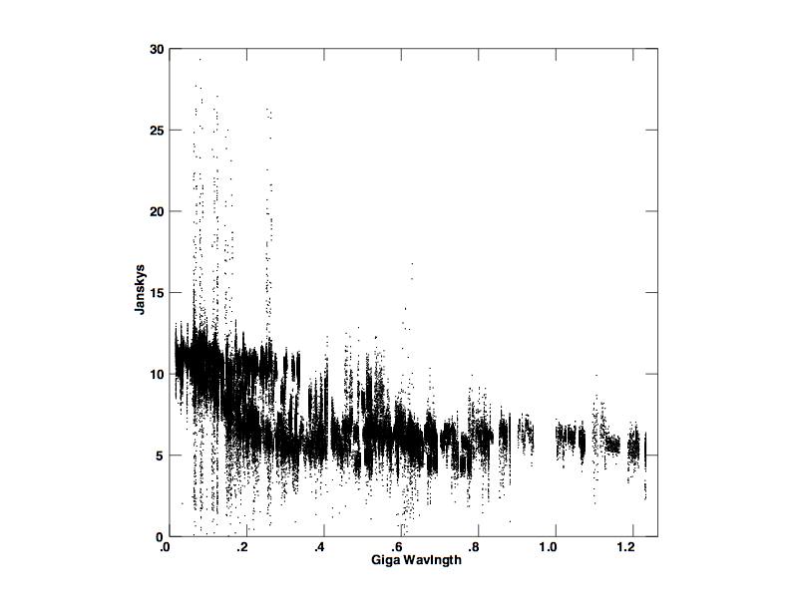
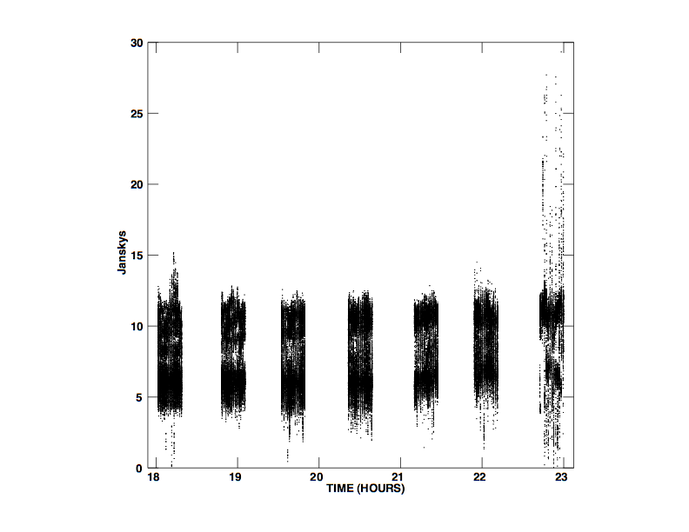
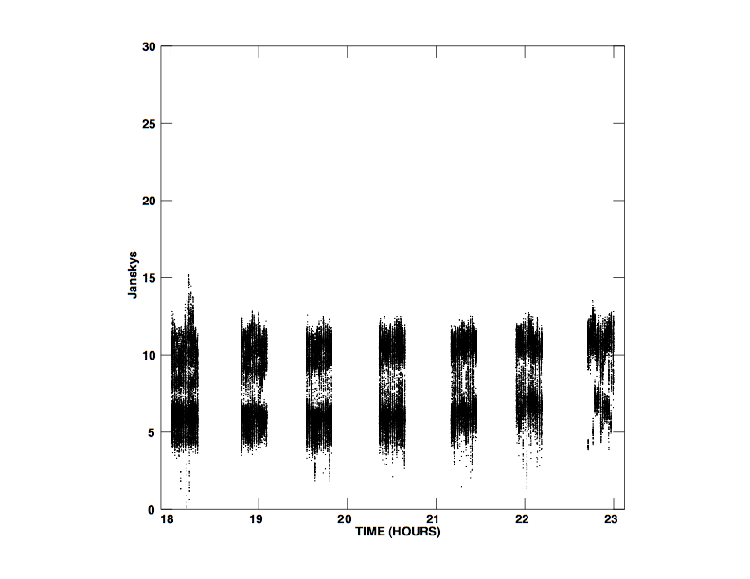
VISIBILITY AMPLITUDE PLOTS
Amp vs. uvdist
Amp vs. time
Amp vs. uvdist shows outliers
Amp vs. time shows outliers in last scan
Amp vs. time without ant 7 should good data
(3C279 VLBA data at 43 GHz)
Amp vs. time, no ant 7

Slide 17
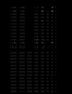
VISIBILITY AMPLITUDE RASTERS
BASELINE
Ant 1 2 3 4 5 6 7 8
(Last two scans from previous slide)
Use AIPS task TVFLG, CASA viewer
Raster scan of baseline versus time
immediately shows where the bad
data are
Pixel range is 5 to 20 Jy
Bad data can be flagged with an
interactive clipping control
T
I
M
E

Slide 18
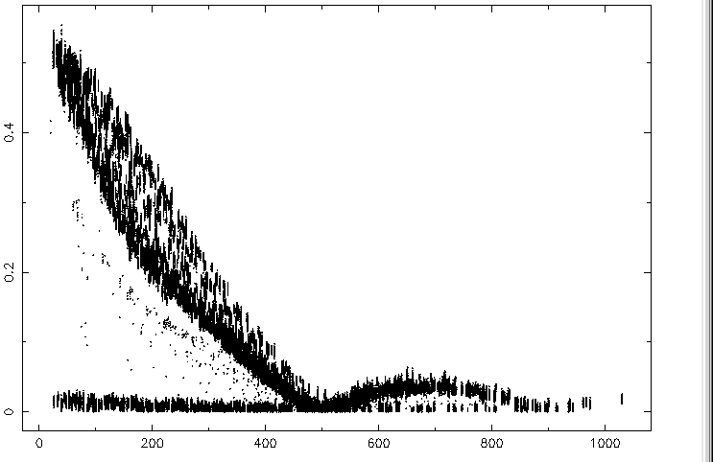
Example Edit – plotms
(2)
Fourier transform of nearly symmetric Jupiter disk
Jansky
bad
Kilo-wavelength
Butler lecture: Solar System Objects

Slide 19
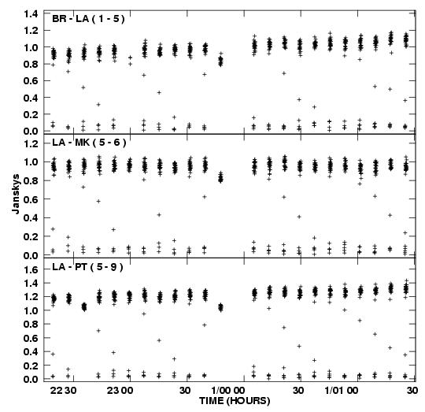
Drop-outs at Scan Beginnings
Often the first few points
of a scan are low. E.g.
antenna not on source.
Software can remove these
points (aips,casa ‘quack’)
Flag extension:
Should flag all sources in
the same manner even
though you cannot see
dropout for weak sources

Slide 20
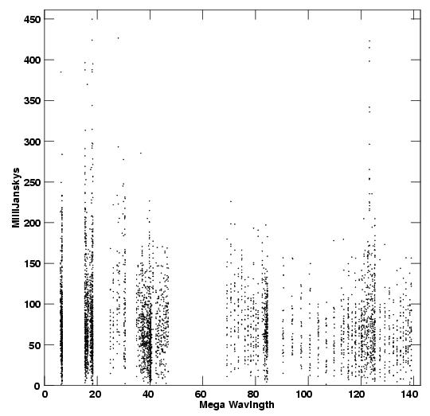
Editing Noise-dominated Sources
No source structure
information is detected.
Noise dominated.
All you can do is remove
outlier points above
0.3 Jy. Precise level
not important as long
as large outliers
removed.

Slide 21
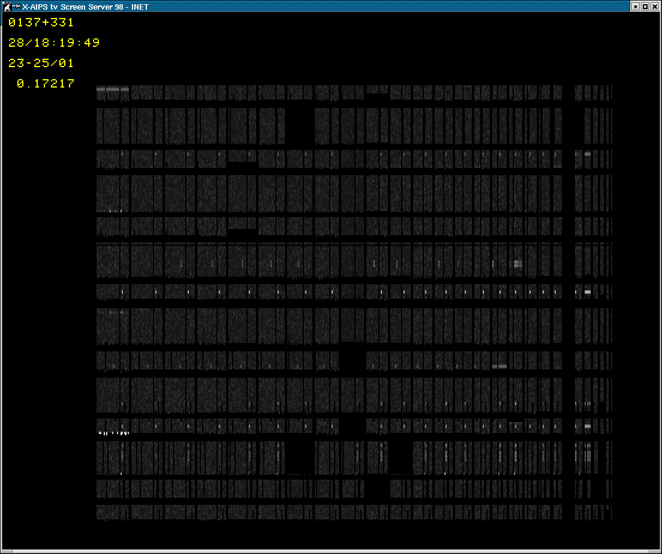
USING TVFLG (VIEWER) DISPLAY on a source
ANT-23 problems
Plot amplitude rms
<--Time
quack these!
Baseline-->

Slide 22




RFI Excision
35 km
12 km
3 km baseline
before
after
RFI environment worse on short baselines
Several 'types': narrow band, wandering, wideband, ...
Wideband interference hard for automated routines
AIPS tasks FLGIT, FLAGR, and CASA flagdata, mode=‘rfi’
Automation is crucial for WIDAR (wide band, lots of data)
Time
Frequency
AIPS: SPFLG

Slide 23
ERROR RECOGNITION IN THE IMAGE PLANE
Some Questions to ask:
Noise properties of image:
Is the rms noise about that expected from integration time?
Is the rms noise much larger near bright sources?
Are there non-random noise components (faint waves and ripples)?
Funny looking Structure:
Non-physical features; stripes, rings, symmetric or anti-symmetric
Negative features well-below 4xrms noise
Does the image have characteristics in the dirty beam?
Image-making parameters:
Is the image big enough to cover all significant emission?
Is cell size too large or too small? ~4 points per beam okay
Is the resolution too high to detect most of the emission?

Slide 24
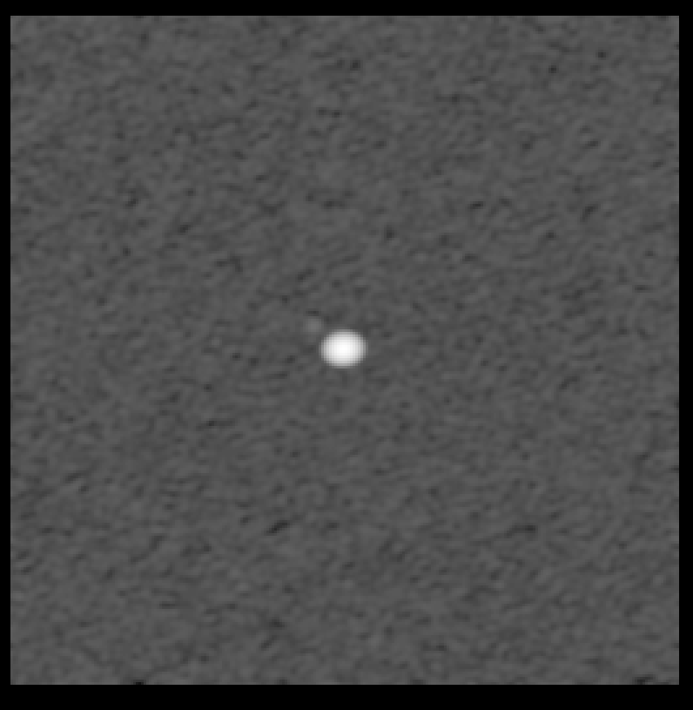
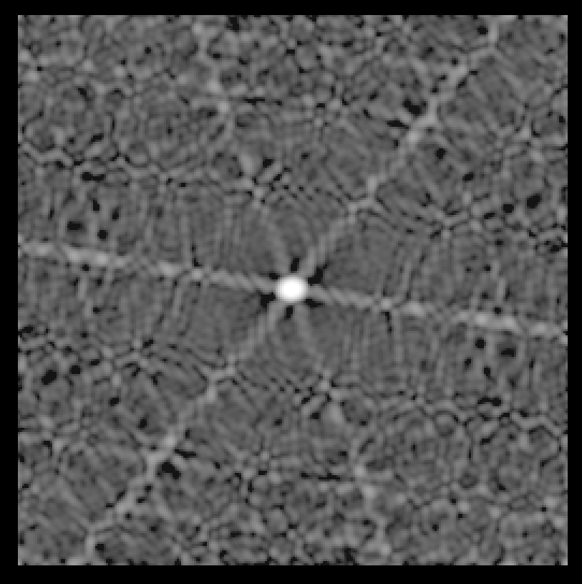
EXAMPLE 1
Data bad over a short period of time
Results for a point source using VLA. 13-5min observation over 10 hr.
Images shown after editing, calibration and deconvolution.
no errors:
max 3.24 Jy
rms 0.11 mJy
10% amp error for all antennas for 1 time period
rms 2.0 mJy
6-fold symmetric pattern due to VLA “Y”.
Image has properties of dirty beam.

Slide 25
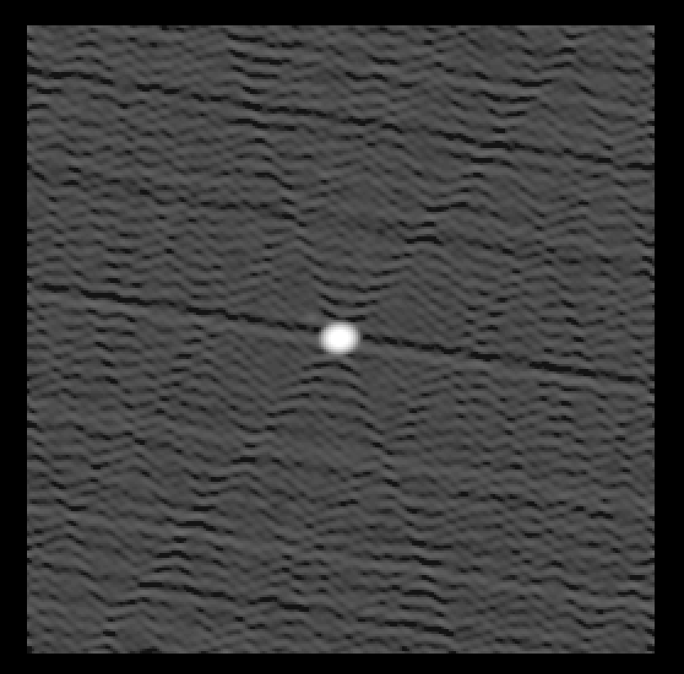
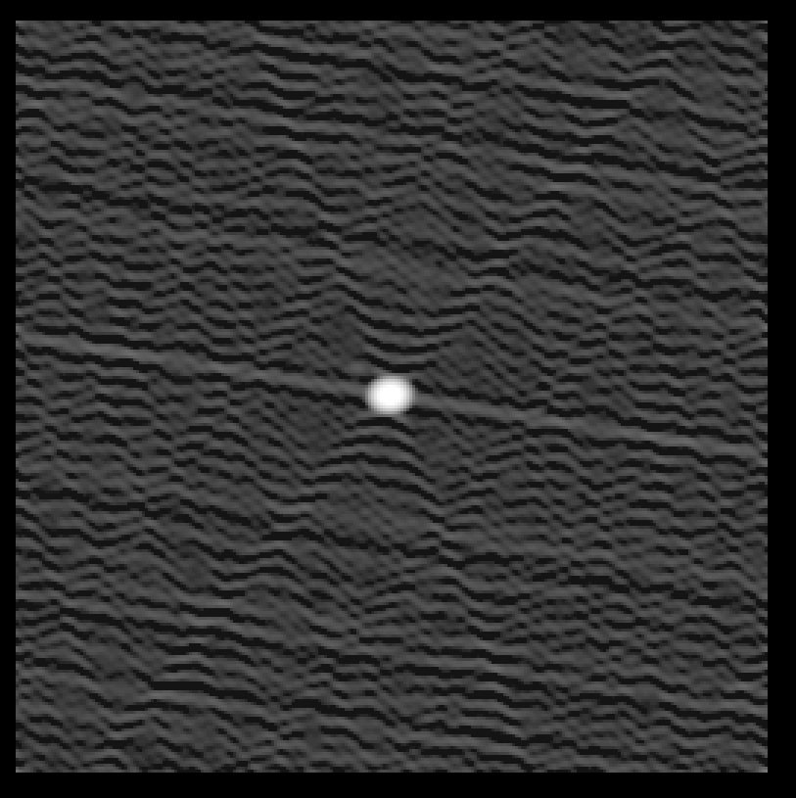
EXAMPLE 2
Short burst of bad data
Typical effect from one bad antenna
10 deg phase error for one antenna at one time
rms 0.49 mJy
20% amplitude error for one antenna at one time
rms 0.56 mJy (self-cal)
anti-symmetric ridges
symmetric ridges

Slide 26
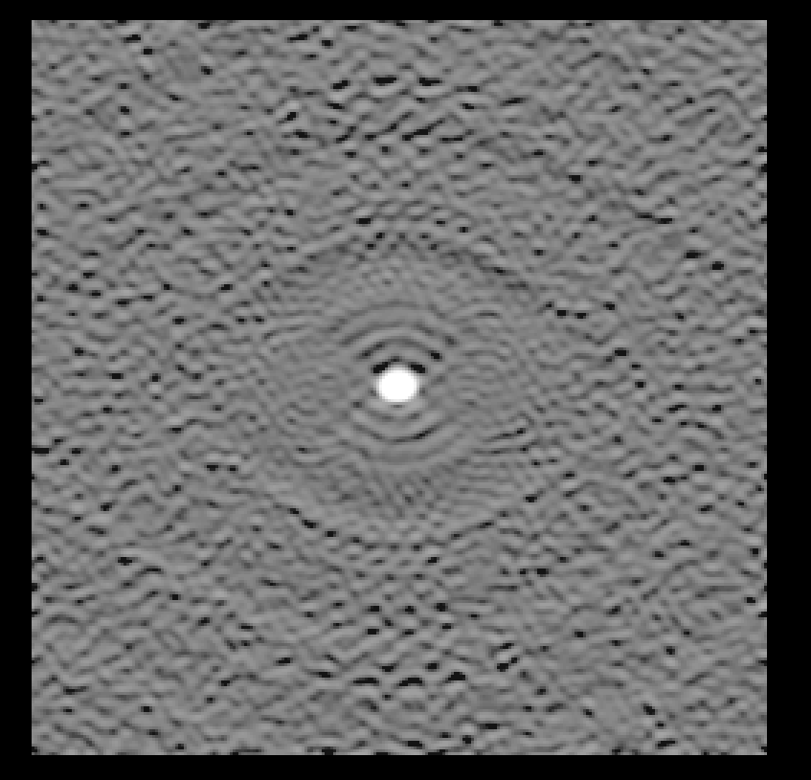
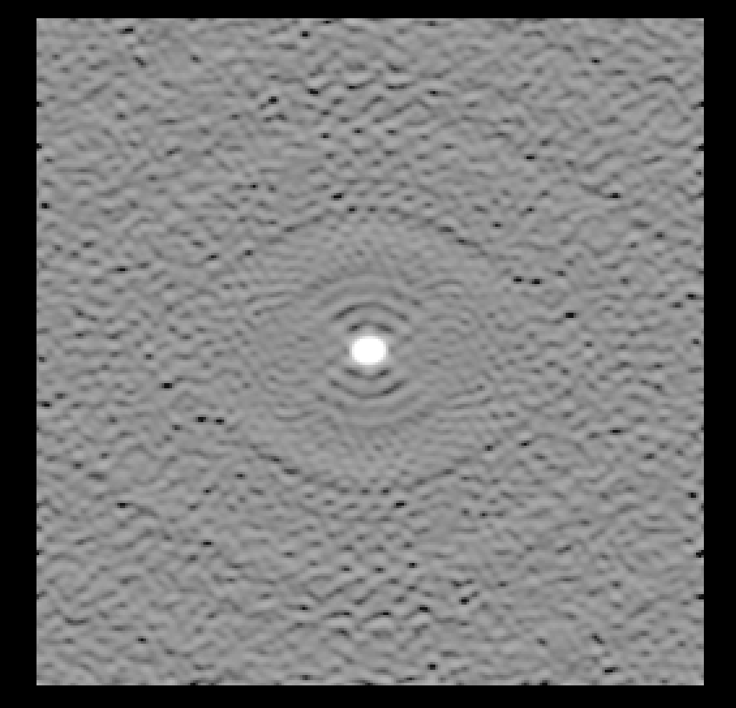
EXAMPLE 3
Persistent errors over most of observations
NOTE: 10 deg phase error to 20% amplitude error
cause similar sized artifacts
10 deg phase error for one antenna all times
rms 2.0 mJy
20% amp error for one antenna all times
rms 2.3 mJy
rings – odd symmetry
rings – even symmetry

Slide 27
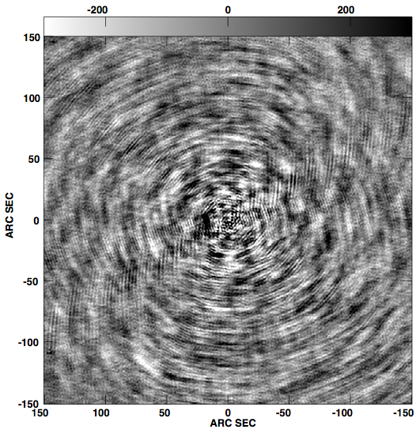
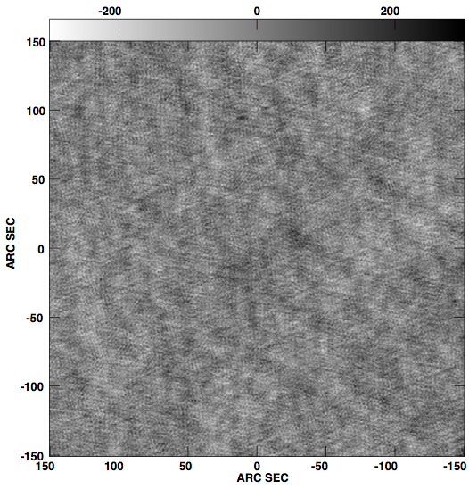
EXAMPLE 4
Spurious Correlator Offset Signals
Occasionally correlators produce ghost signals or cross talk signals
Occurred during change-over from VLA to EVLA system
Symptom: Garbage near phase center, dribbling out into image
Image with correlator offsets
Image after correlation of offsets
μJy

Slide 28
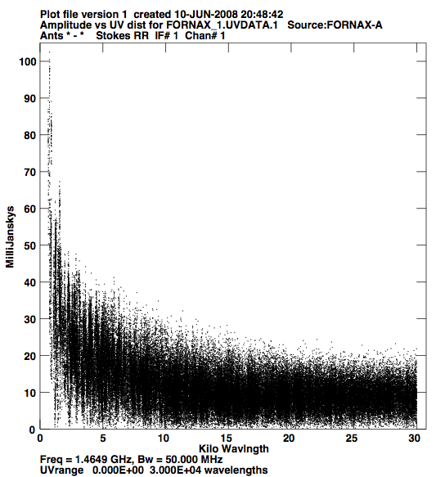
DECONVOLUTION ERRORS
Even if the data are perfect, image errors and uncertainties will occur because the (u-v) coverage is not adequate to map the source structure.
The extreme rise of visibility at the short
spacings makes it impossible to image
the extended structure. You are better
of imaging the source with a cutoff
below about 2 kilo-wavelengths
Get shorter spacing or single-dish data

Slide 29
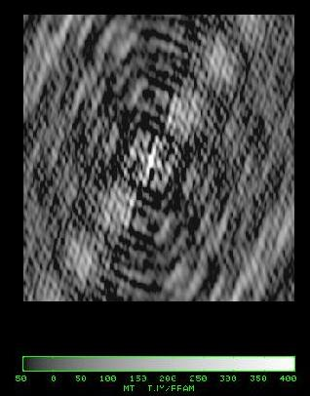
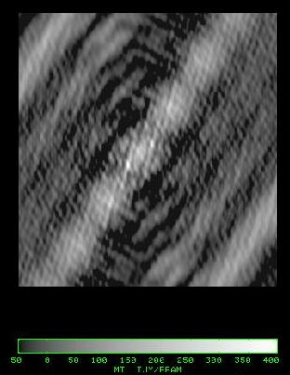
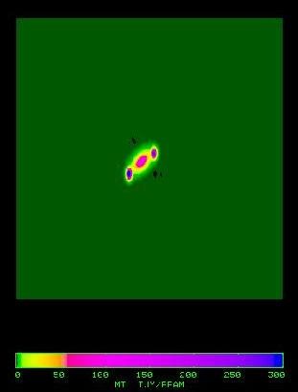
DIRTY IMAGE and BEAM (point spread function)
Dirty Beam Dirty Image Source Model
The dirty beam has large, complicated side-lobe structure.
It is often difficult to recognize any details on the dirty image.
An extended source exaggerates the side-lobes.
5% in dirty beam becomes 20% for extended source

Slide 30
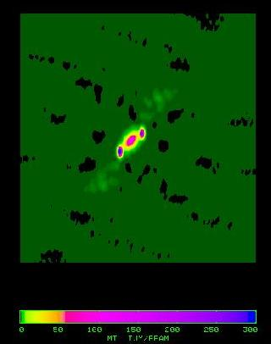
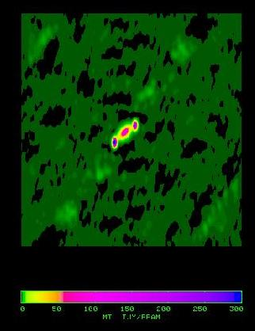
CLEANING WINDOW SENSITIVITY
Tight Box Middle Box Big Box Dirty Beam
One small clean One clean box Clean entire
box around all emission inner map quarter
Make box as small as possible to avoid cleaning noise interacting with sidelobes

Slide 31
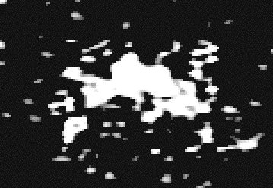
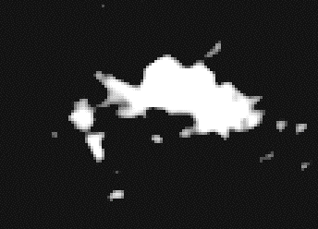
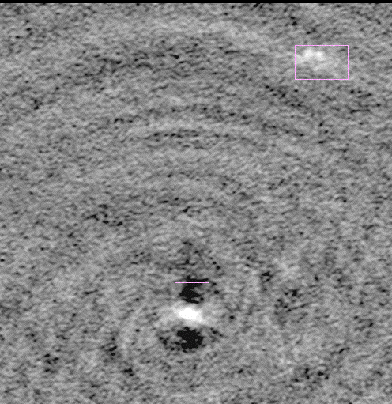
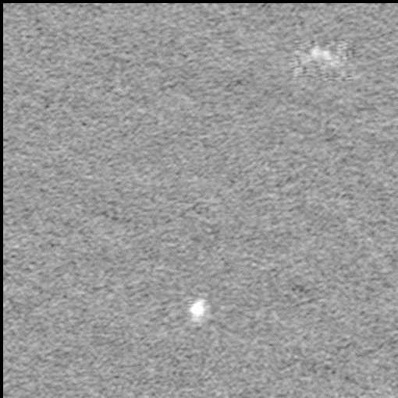
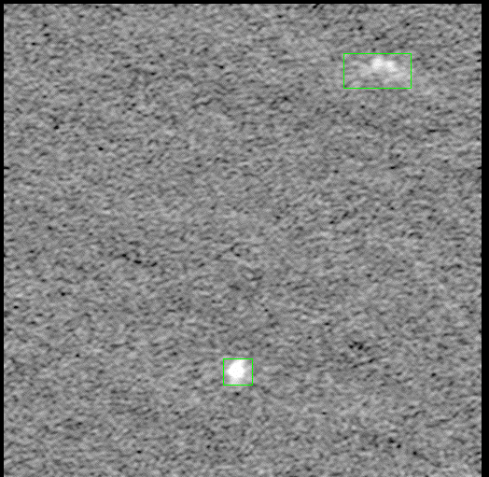
How Deep to Clean?
Under-cleaned Over-cleaned Properly cleaned
Residual sidelobes
dominate the noise
Background is thermal
noise-dominated;
no "bowls" around
sources.
Emission from
second source sits
atop a negative "bowl"
Regions within
clean boxes
appear "mottled"

Slide 32
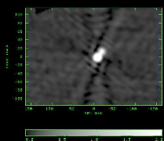
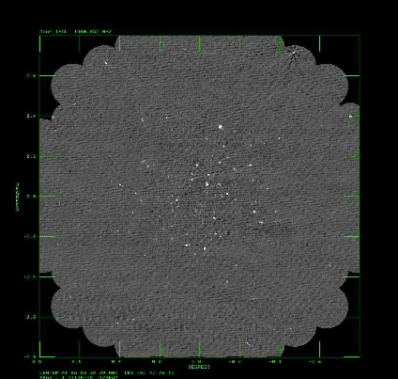
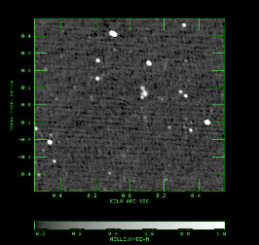
Chandra Deep Field South
FINDING HIDDEN BAD DATA
Source to NE in first
Primary beam sidelobe
See Lectures Bhatnagar and Ott on
Wide-field Imaging, and Perley on High Dynamic Range Imaging
Chandra Deep Field South
Peak = 45 mJy, rms = 0.02 mJy
Center of Field

Slide 33
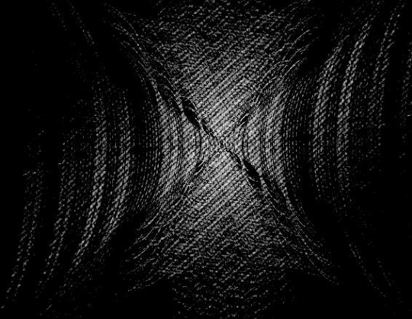
Fourier Transform Dirty Image
Shows the u-v
data as gridded
just before imaging
Diagonal lines caused
by structure in field
A few odd points are
not very noticeable

Slide 34
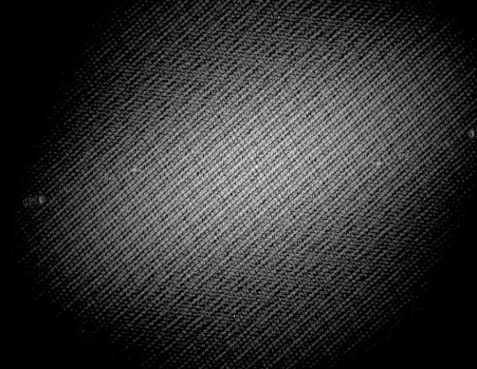
Fourier Transform Clean Image
Shows the u-v
data from clean
image.
Diagonal lines still
present. Notice
that clean does an
interpolation in the
u-v plane between
u-v tracks.
The odd points are
smeared, but still
present. These
produce the low
level ripples.

Slide 35
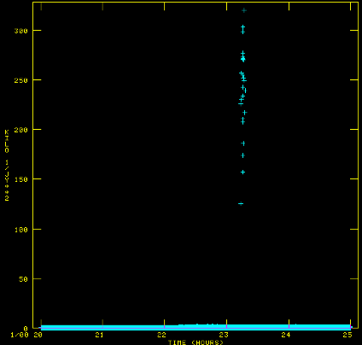
Bad weighting of a few u-v points
After a long search through the
data, about 30 points out of
300,000 points were found to
have too high of a weight
by a factor of 100.
Effect is <1% in image.
Cause??
Sometimes in applying calibration
produced an incorrect weight
in the data. Not present in
the original data.
These problems can sneak up
on you. Beware.

Slide 36
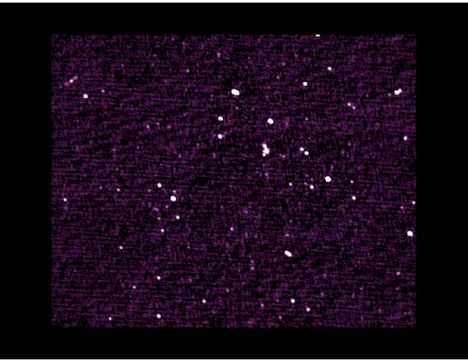
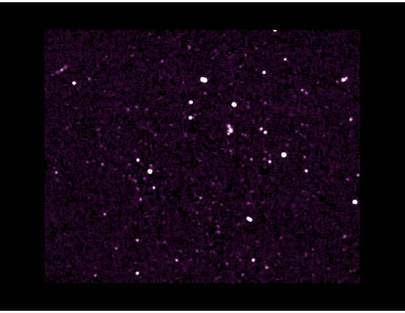
Improvement of Image
Removal of low level ripple improves detectability of faint sources
Before editing After editing

Slide 37
SUMMARY OF ERROR RECOGNITION
  Source structure should be ‘reasonable’, the rms image noise
as expected, and the background featureless. If not,
UV data
Look for outliers in u-v data using several plotting methods.
Check calibration gains and phases for instabilities.
Look at residual data (uv-data - clean components)
IMAGE plane
Do defects resemble the dirty beam?
Are defect properties related to possible data errors?
Are defects related to possible deconvolution problems?

Slide 38
IMAGE ANALYSIS
Gustaaf van Moorsel
Ed Fomalont

Slide 39
IMAGE ANALYSIS
Input: Well-calibrated data-base producing a
high quality image
Output: Parameterization and interpretation
of image or a set of images
This is very open-ended
Depends on source emission complexity
Depends on the scientific goals
Examples and ideas are given.
Many software packages, besides AIPS
and Casa (e.g.. IDL, DS-9) are available.

Slide 40
IMAGE ANALYSIS OUTLINE
Multi-Resolution of radio source.
Parameter Estimation of Discrete Components
Polarization Data
Image Comparisons
Positional Registration

Slide 41
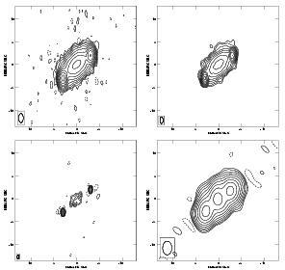
IMAGE AT SEVERAL RESOLUTIONS
Different aspect of source
structure can be see at
various resolutions, shown
by the ellipse in the lower
left corner of each box.
SAME DATA USED FOR
ALL IMAGES
For example,
Outer components are small
from SU resolution
There is no extended
emission from low resolution
  Natural
Uniform
Super-uniform
Low
Milli-arcsec

Slide 42
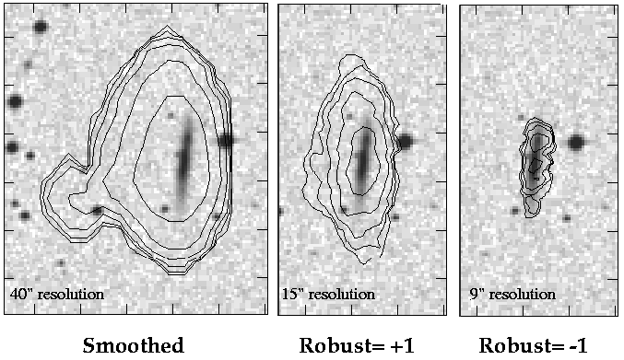
Imaging and Deconvolution of Spectral Line Data:
Type of weighting in imaging
HI contours overlaid on optical images of an edge-on galaxy

Slide 43
PARAMETER ESTIMATION
Parameters associated with discrete components
Fitting in the image
  Assume source components are Gaussian-shaped
  Deep cleaning restores image intensity with Gaussian-beam
  True size * Beam size = Image size, if Gaussian-shaped. Hence, estimate of true size is relatively simple.
Fitting in (u-v) plane
  Better estimates for small-diameter sources
  Can fit to any source model (e.g. ring, disk)
  (see non-imaging analysis)
Error estimates of parameters
  Simple ad-hoc error estimates
  Estimates from fitting programs

Slide 44
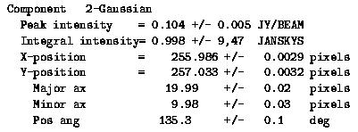
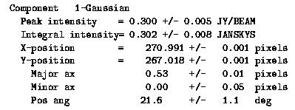

IMAGE FITTING
    AIPS task: JMFIT
    Casa tool
    imfit

Slide 45


(U-V) DATA FITTING
Amp and phase vs. time for three baselines
Contour image with model fits
Jy
Deg
Jy
Deg
Jy
Deg
milliarcsec
milliarcsec
Time
    DIFMAP has good u-v fitting algorithm
    Fit model directly to (u-v) data Contour display of image
    Compare model to data Ellipses show true component
    size. (super-resolution?)
Greg Taylor, Monday June 14, “Non-image Data Analysis”

Slide 46

COMPONENT ERROR ESTIMATES
P = Component Peak Flux Density
σ = Image rms noise P/σ = signal/noise = S
B = Synthesized beam size
θ_{ι} = Component image size
ΔP = Peak error = σ
ΔX = Position error = B / 2S
Δθ_{ι} = Component image size error = B / 2S
θ_{t} = True component size = (θ_{ι}² –B²)^{1/2}
Δθ_{t} = Minimum component size = B / S^{1/2}
eg. S=100 means can determine size of B/10

Slide 47

FORNAX-A Radio/Optical field
Comparison and Combination of Images of Many Types
Radio is red
Faint radio core
in center of
NGC1316
Optical in
blue-white
Frame size is
60’ x 40’

Slide 48




LINEAR POLARIZATION
  I –
I
I Q U
arcsec arcsec arcsec
  Multi-purpose plot
  Contours: I,Q,U Pol
  Grey scale: P Pol
  sqrt (Q²+U²) - noise
  Line segments – P angle
  atan2(0.5*Q/U)

Slide 49


COMPARISON OF RADIO/X-RAY IMAGES
Contours of radio intensity at 5 GHz
Dots represent X-ray Intensity (photons) between 0.7 and 11.0 KeV
Contours of radio intensity at 5 GHz
Color intensity represents X-ray intensity smoothed to radio resolution
Color represents hardness of X-ray (average weighted frequency)
Blue - soft (thermal)
Green - hard (non-thermal)
arcsec

Slide 50




SPECTRAL LINE REPRESENTATIONS
Intensity Image
Sum of velocity
Amount of HI
Red high,
Blue low
Average velocity
Red low vel
Blue high vel
Rotation
Second moment
Velocity width
Turbulence?

Slide 51

Visualizing Spectral Line Data: Channel Images
Greyscale+contour representations of individual channel images

Slide 52

Visualizing Spectral Line Data: Channel Images
Velocity
Right Ascension
Declination
↑
↑
↑

Slide 53
IMAGE REGISTRATION AND ACCURACY
Separation Accuracy of Components on One Image due to residual phase errors, regardless of signal/noise:
Limited to 1% of resolution
Position errors of 1:10000 for wide fields, i.e. 0.1” over 1.4 GHz PB
Images at Different Frequencies:
Multi-frequency. Use same calibrator for all frequencies.
Watch out at frequencies < 2 GHz when ionosphere can
produce displacement. Minimize calibrator-target separation
Images at Different Times (different configuration):
Use same calibrator for all observations. Daily troposphere changes can produce position changes up to 25% of the resolution.
Radio versus non-Radio Images:
Header-information of non-radio images often much less
accurate than that for radio. For accuracy <1”, often have
to align using coincident objects.

Slide 54

DEEP RADIO / OPTICAL COMPARISON
Grey-Scale:
Optical emission
faintest is 26-mag
Contours:
Radio Emission
faintest is 10 μJy

Slide 55



Radio Source Alignment at Different Frequencies
Self-calibration at each frequency aligns maximum at (0,0) point
Frequency-dependent structure causes relative position of maximum to change
Fitting of image with components can often lead to proper registration
43 GHz: res = 0.3 mas
23 GHz: res = 0.6 mas
15 GHz: res = 0.8 mas
A
A
A
B
B
B
(Reid Lecture on Astrometry)

Slide 56
IMAGE ANALYSIS: SUMMARY
Analyze and display data in several ways
Adjust resolution to illuminate desired interpretation, analysis
Parameter fitting useful, but try to obtain error estimate
Fitting in u-v plane, image plane
Comparison of multi-plane images tricky (Polarization and
Spectral Line)
Use different graphics packages, methods, analysis tools
Registration of a field at different frequencies or
wave-bands can be subtle.
Often use ad hoc methods by aligning ‘known’ counterparts

