Slide 1
Principles of Interferometry
Rick Perley, NRAO/Socorro

Slide 2
Topics
Images: Brightness, Units, Definitions
The Role of Sensors and Antennas
The Need for Interferometry
The Quasi-Monochromatic, Stationary, Radio-Frequency, Single Polarization Interferometer
Complex Visibility and its relation to Brightness
The Effects of Finite Bandwidth
The Effects of Rotating Frames – The Tracking Interferometer
Frequency Conversions – LOs, IFs, and all of that
Direction Cosines, Geometry, and the Fourier Transform Relation
The (u,v) Plane and Spatial Frequency Coverage

Slide 3
Images: Definitions, Units, etc.
Imaging in astronomy implies ‘making a picture’ of celestial emission.
We design instruments to provide a map of the brightness of the sky, at some frequency, as a function of RA and Dec.
In physics (and astronomy), brightness (or specific intensity) is denoted I_{ν,t}(s), and expressed in units of: watt/(m² Hz ster).
It is the power received, per unit solid angle from direction s, per unit collecting area, per unit frequency at frequency ν.
To get a better feel for this, imagine a ‘sensor’, which is isotropic and lossless, which collects power from incoming EM radiation, and converts it to an electrical waveform.

Slide 4
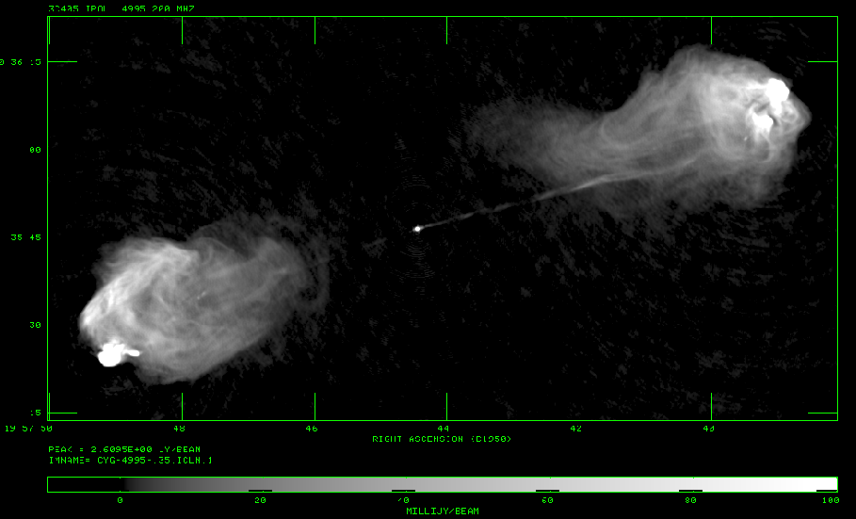
Images – Definitions, Units.
Imaging in astronomy implies ‘making a picture’ of celestial emission.
We design instruments to make a map of the brightness of the sky, at some frequency, as a function of RA and Dec.
In astronomy, brightness (or specific intensity) is denoted I_{ν,t}(s).
Brightness is defined as the power received per unit frequency dν at a particular frequency ν, per unit solid angle dΩ from direction s, per unit collecting area dA.
The units of brightness are in terms of (spectral flux density)/(solid angle): e.g:
watt/(m² Hz Ster)
Image of Cygnus A at λ = 6cm.
The units are in Jy/beam.
1Jy = 10⁻²⁶ watt/(m² Hz)
Here, 1 beam = 0.16 arcsec²

Slide 5
Intensity and Power.
Imagine a distant source of emission, described by brightness I_{ν}(s) where s is a unit direction vector.
Power from this emission passes through our (isotropic) collector – denoted here a ‘sensor’.
The increment of power, dP, (watts) delivered is written
The total power received (or delivered) is a suitable integral over frequency, area, and angle, accounting for variations in the responses.
Solid Angle
Sensor
Filter
Power collected
dΩ
s
dΑ
dν
dP

Slide 6
Why Interferometry?
The simple device just described defines a ‘total power radio telescope’.
Conceptually simple – power in, power out.
But the angular resolution of a single antenna is limited by diffraction to:
In ‘practical’ units:
For arcsecond resolution, we need km-scale antennas, which are obviously impractical.
We seek a method to ‘synthesize’ a large aperture by combining signals collected by separated small apertures.
in radians,
λ and D in the same units

Slide 7
The Role of the Sensor
Consider radiation from direction s from a small elemental solid angle, dΩ, at frequency ν within a frequency slice, dν.
In this case, the electric field properties (amplitude, phase) of the incoming wave are stationary over timescales of interest (seconds), and we can write the field at this position as
The purpose of a sensor (a.k.a. ‘antenna’) and its electronics is to convert this E-field to a voltage, V_{ν}(t), which can be conveyed to a remote location.
This voltage must be a faithful replica of the originating electric field, preserving its amplitude E and phase φ.

Slide 8
The Fundamental Interferometer
We ignore the gain of the electronics and the collecting area of the sensors – these are calibratable items (‘details’).
We seek a relation between the characteristics of the product of the voltages from two separated antennas and the distribution of the brightness of the originating source emission.
To establish the basic relations, I consider first the simplest interferometer:
  Fixed in space – no rotation or motion
  Quasi-monochromatic
  Single frequency throughout – no frequency conversions
  Single polarization (say, RCP).
  No propagation distortions (no ionosphere, atmosphere …)
  Idealized electronics (perfectly linear, perfectly uniform in frequency and direction, perfectly identical for both elements, no added noise, …)

Slide 9
The Stationary, Quasi-Monochromatic
Radio-Frequency Interferometer
s
s
The path lengths from sensors
to multiplier are assumed equal!
Geometric
Time Delay
b.s
b
A Sensor
X
multiply
average
Unchanging
Rapidly varying,
with zero mean

Slide 10
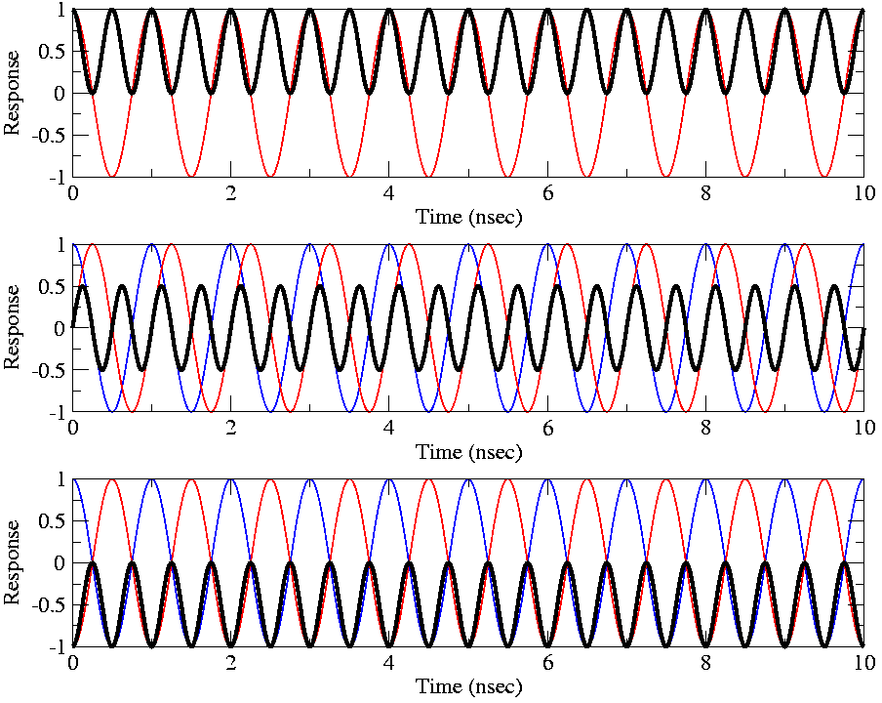
Examples of the Signal Multiplications
The two input voltages are shown in red and blue, their product is in black.
The output is the average of the black trace.
In Phase:
b.s = nλ, or τ_{g} = n/ν
Quadrature Phase:
b.s=(n +/- ¼)λ,
τ_{g} = (4n +/- 1)/4ν
Anti-Phase:
b.s=(n +/- ½)λ
τ_{g} = (2n +/- 1)/2ν

Slide 11
Some General Comments
The averaged product R_{C} is dependent on the received power, P = E²/2 and geometric delay, τ_{g}, and hence on the baseline orientation and source direction:
Note that R_{C} is not a a function of:
  The time of the observation -- provided the source itself is not variable!)
  The location of the baseline -- provided the emission is in the far-field.
  The actual phase of the incoming signal – the distance of the source does not matter, provided it is in the far-field.
The strength of the product is also dependent on the antenna areas and electronic gains – but these factors can be calibrated for.

Slide 12
Pictorial Illustrations
To illustrate the response, expand the dot product in one dimension:
Here, u = b/λ is the baseline length in wavelengths, and θ is the angle w.r.t. the plane perpendicular to the baseline.
Consider the response R_{c}, as a function of angle, for two different baselines with u = 10, and u = 25.
s
θ
α
b

Slide 13
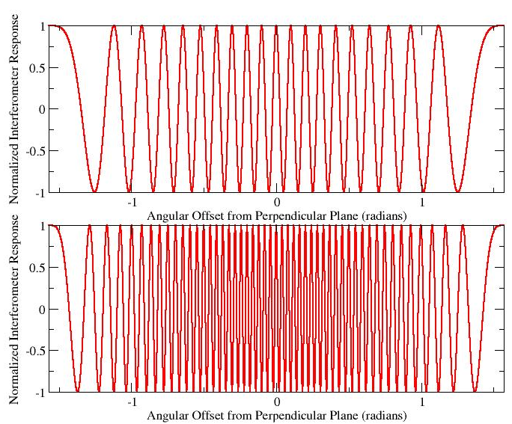
Whole-Sky Response
-10
-8
-5
-3
0
2
5
7
9
10
Top:
u = 10
There are 20 whole fringes over the hemisphere.
Bottom:
u = 25
There are 50 whole fringes over the hemisphere
-25
25

Slide 14
From an Angular Perspective
θ
0
3
Top Panel:
The absolute value of the response for u = 10, as a function of angle.
The ‘lobes’ of the response pattern alternate in sign.
Bottom Panel:
The same, but for u = 25.
Angular separation between lobes (of the same sign) is
δθ ~ 1/u = λ/b radians.
5
7
9
10

Slide 15
Hemispheric Pattern
The preceding plot is a meridional cut through the hemisphere, oriented along the baseline vector.
In the two-dimensional space, the fringe pattern consists of a series of coaxial cones, oriented along the baseline vector.
As viewed along the baseline vector, the fringes show a ‘bulls-eye’ pattern – concentric circles.

Slide 16
The Effect of the Sensor
The patterns shown presume the sensor has isotropic response.
This is a convenient assumption, but (sadly, in some cases) doesn’t represent reality.
Real sensors impose their own patterns, which modulate the amplitude, and phase, of the output.
Large sensors (a.k.a. ‘antennas’) have very high directivity (very useful for some applications).

Slide 17
The Effect of Sensor Patterns
Sensors (or antennas) are not isotropic, and have their own responses.
Top Panel: The interferometer pattern with a cos(θ)-like sensor response.
Bottom Panel: A multiple-wavelength aperture antenna has a narrow beam, but also sidelobes.

Slide 18
The Response from an Extended Source
The response from an extended source is obtained by summing the responses at each antenna to all the emission over the sky, multiplying the two, and averaging:
The averaging and integrals can be interchanged and, providing the emission is spatially incoherent, we get
This expression links what we want – the source brightness on the sky, I_{ν}(s), – to something we can measure - R_{C}, the interferometer response.
Can we recover I_{ν}(s) from observations of R_{C}?

Slide 19
A Schematic Illustration in 2-D
The correlator can be thought of ‘casting’ a cosinusoidal coherence pattern, of angular scale ~λ/b radians, onto the sky.
The correlator multiplies the source brightness by this coherence pattern, and integrates (sums) the result over the sky.
λ/b
Orientation set by baseline geometry.
Fringe separation set by (projected) baseline length and wavelength.
  Long baseline gives close-packed fringes
  Short baseline gives widely-separated fringes
Physical location of baseline unimportant, provided source is in the far field.
λ/b rad.
Source
brightness
− + − + − + −
Fringe Sign

Slide 20
But One Correlator is Not Enough!
The correlator response, R_{c}:
is not enough to recover the brightness. Why?
Suppose that the source of emission has a component with odd symmetry:
I_{ν}(s) = -I_{ν}(-s)
Since the cosine fringe pattern is even, it’s elementary to show that
Hence, we need more information if we are to completely recover the source brightness.

Slide 21
Odd and Even Functions
Any real function, I(x,y), can be expressed as the sum of two real functions which have specific symmetries:
  An even part:
  An odd part:
I_{E}
I_{O}
I
=
+

Slide 22
Why Two Correlations are Needed
The integration of the cosine response, R_{c}, over the source brightness is sensitive to only the even part of the brightness:
since the integral of an odd function (I_{O}) with an even function (cos x) is zero.
To recover the ‘odd’ part of the intensity, I_{O}, we need an ‘odd’ fringe pattern. Let us replace the ‘cos’ with ‘sin’ in the integral:
since the integral of an even times an odd function is zero.
To obtain this necessary component, we must make a ‘sine’ pattern.

Slide 23
Making a SIN Correlator
We generate the ‘sine’ pattern by inserting a 90 degree phase shift in one of the signal paths.
s
s
b.s
b
A Sensor
X
90º
multiply
average

Slide 24
Define the Complex Visibility
We now DEFINE a complex function, the complex visibility, V, from the two independent (real) correlator outputs R_{C} and R_{S}:
where
This gives us a beautiful and useful relationship between the source brightness, and the response of an interferometer:
Under some circumstances, this is a 2-D Fourier transform, giving us a well established way to recover I(s) from V(b).

Slide 25
The Complex Correlator
A correlator which produces both ‘Real’ and ‘Imaginary’ parts – or the Cosine and Sine fringes, is called a ‘Complex Correlator’
  For a complex correlator, think of two independent sets of projected sinusoids, 90 degrees apart on the sky.
In our scenario, both components are necessary, because we have assumed there is no motion – the ‘fringes’ are fixed on the source emission, which is itself stationary.
One can use a single correlator if the inserted phase alternates between 0 and 90 degrees, or if the phase cycles through 360 degrees. In this latter case, the coherence pattern sweeps across the source, and the complex visibility would be defined by the amplitude and phase of the resulting sinusoidal output.

Slide 26
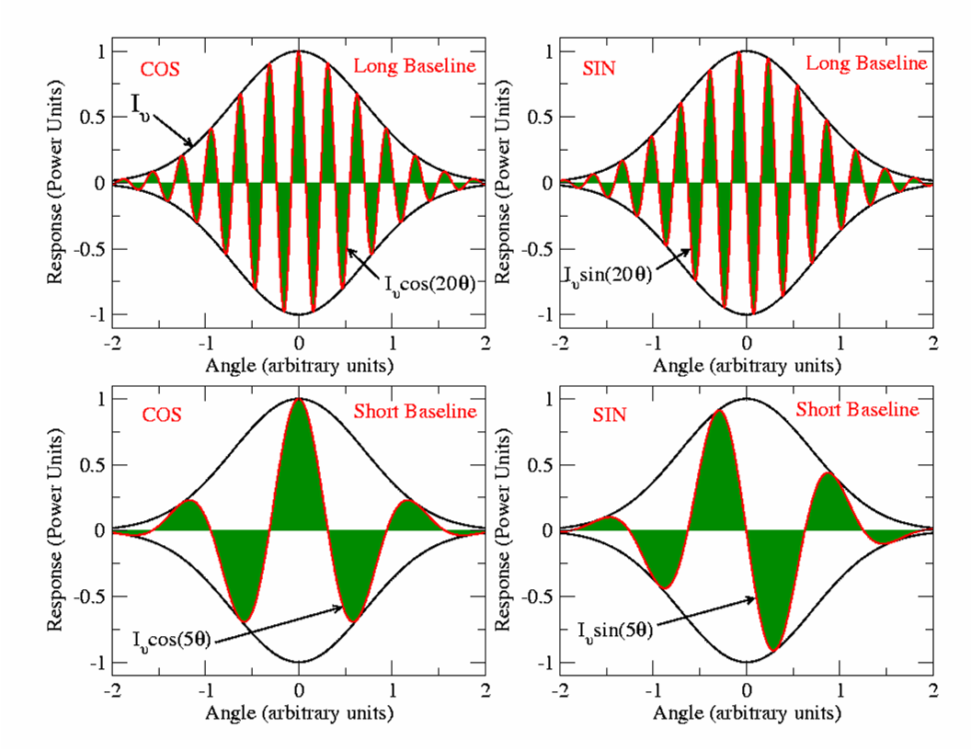
Picturing the Visibility
The source brightness is Gaussian, shown in black.
The interferometer ‘fringes’ are in red.
The visibility is the integral of the product – the net dark green area.
R_{C}
R_{S}
Long Baseline
Long
Baseline
Short Baseline
Short
Baseline

Slide 27
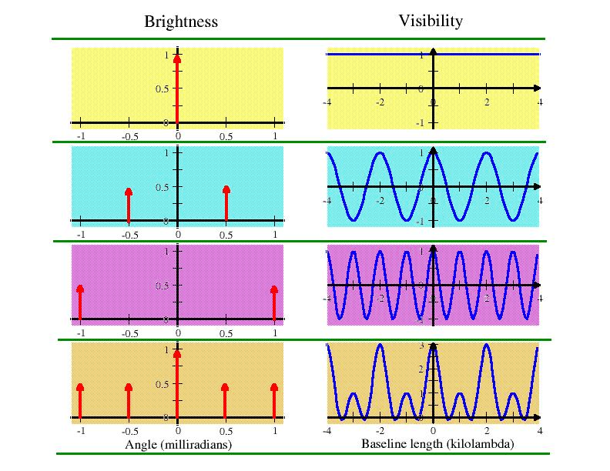
Examples of Brightness and Visibilities
Brightness and Visibility are Fourier pairs.
Some simple and illustrative examples make use of ‘delta functions’ – sources of infinitely small extent, but finite total flux.

Slide 28
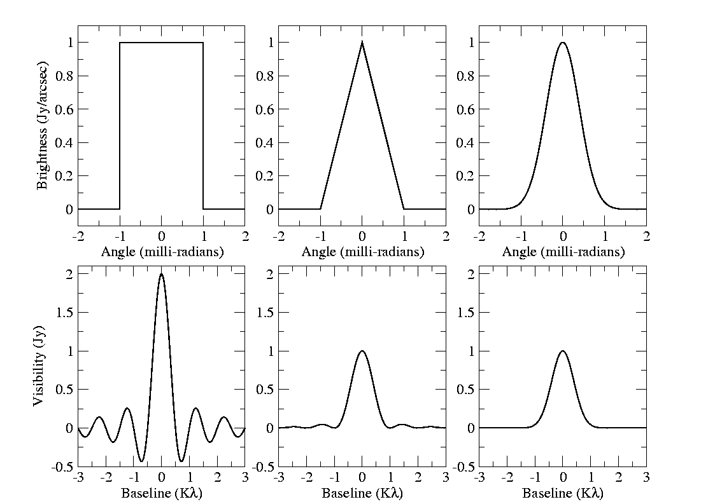
More Examples of Visibility Functions
Top row: 1-dimensional even brightness distributions.
Bottom row: The corresponding real, even, visibility functions.
I_{ν}(θ)
V_{ν}(u)

Slide 29
Basic Characteristics of the Visibility
For a zero-spacing interferometer, we get the ‘single-dish’ (total-power) response.
As the baseline gets longer, the visibility amplitude will in general decline.
When the visibility is close to zero, the source is said to be ‘resolved out’.
Interchanging antennas in a baseline causes the phase to be negated – the visibility of the ‘reversed baseline’ is the complex conjugate of the original.
Mathematically, the Visibility is Hermitian, because the Brightness is a real function.

Slide 30
Comments on the Visibility
The Visibility is a function of the source structure and the interferometer baseline length and orientation.
Each observation of the source with a given baseline length and orientation provides one measure of the visibility.
Sufficient knowledge of the visibility function (as derived from an interferometer) will provide us a reasonable estimate of the source brightness.

Slide 31
The Effect of Bandwidth.
Real interferometers must accept a range of frequencies. So we now consider the response of our interferometer over frequency.
To do this, we first define the frequency response functions, G(ν), as the amplitude and phase variation of the signal over frequency.
The function G(ν) is primarily due to the gain and phase characteristics of the electronics, but can also contain propagation path effects.
Δν
G
ν₀
ν

Slide 32
The Effect of Bandwidth.
To find the finite-bandwidth response, we integrate our fundamental response over a frequency width Δν, centered at ν₀:
If the source intensity does not vary over the bandwidth, and the instrumental gain parameters G are square and real, then
where the fringe attenuation function, sinc(x), is defined as:

Slide 33
The Bandwidth/FOV limit
This shows that the source emission is attenuated by the spatially variant function sinc(x), also known as the ‘fringe-washing’ function.
The attenuation is small when:
which occurs when the source offset θ is less than: (exercise for the student)
The ratio ν₀/Δν is the inverse fractional bandwidth – for the EVLA, this ratio is never less than ~500.
The fringe attenuation is infinite (i.e. no response) when
Independent of frequency!!!

Slide 34
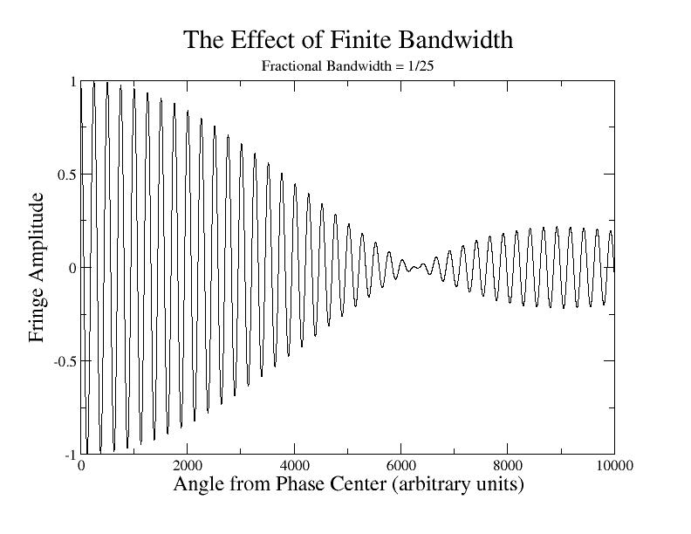
Bandwidth Effect Example
For a square bandpass, the bandwidth attenuation reaches a null at an angle equal to the fringe separation divided by the fractional bandwidth: Δν/ν₀.
If Δν = 2 MHz, and B = 35 km, then the null occurs at about 27 degrees off the meridian. (Worst case for EVLA).
Fringe Attenuation function:
Note: The fringe-washing function depends only on bandwidth and baseline – not on frequency.

Slide 35
Observations off the Meridian
In our basic scenario (stationary source, stationary interferometer), the effect of finite bandwidth can strongly attenuate the visibility from sources far from the meridional plane.
Suppose we wish to observe an object far from that plane?
One solution is to use a very narrow bandwidth – this loses sensitivity, which can only be made up by utilizing many channels – feasible, but computationally expensive.
Better answer: Shift the fringe-attenuation function to the center of the source of interest.
How? By adding time delay.

Slide 36
Adding Time Delay
s₀
s
s₀
s
S₀ = reference
direction
S = general
direction
τ₀
τ_{g}
b
A sensor
X
τ₀
The entire fringe pattern has been shifted over by angle
sin θ = cτ₀/b

Slide 37
Illustrating Delay Tracking
Top Panel:
  Delay has been added and subtracted to move the delay pattern to the source location.
Bottom Panel:
  A cosinusoidal sensor pattern is added, to illustrate losses from a fixed sensor.

Slide 38
Observations from a Rotating Platform
Real interferometers are built on the surface of the earth – a rotating platform. From the observer’s perspective, sources move across the sky.
Since we know how to adjust the interferometer to move its coherence pattern to the direction of interest, it is a simple step to continuously move the pattern to follow a moving source.
All that is necessary is to continuously slip the inserted time delay, with an accuracy δτ << 1/Δν to minimize bandwidth loss.
For the ‘radio-frequency’ interferometer we are discussing here, this will automatically track both the fringe pattern and the fringe-washing function with the source.
Hence, a point source, at the reference position, will give uniform amplitude and zero phase throughout time (provided real-life things like the atmosphere, ionosphere, or geometry errors don’t mess things up … ☺ )

Slide 39
Time Averaging Loss
So – we can track a moving source, continuously adjusting the delay, to prevent bandwidth losses.
This also ‘moves’ the cosinusoidal fringe pattern – very convenient!
From this, you might think that you can increase the time averaging for as long as you please.
But you can’t – because the convenient tracking only works perfectly for the object ‘in the center’.
All other sources are moving w.r.t. the fringes …

Slide 40
Time-Smearing Loss Timescale
Simple derivation of fringe period, from observation at the NCP.
Turquoise area is antenna primary beam on the sky – radius = λ/D
Interferometer coherence pattern has spacing = λ/B
Sources in sky rotate about NCP at angular rate:
ω_{e} =7.3x10⁻⁵ rad/sec.
Minimum time taken for a source to move by λ/B at angular distance θ is:
This is 10 seconds for a 35-kilometer baseline and a 25-meter antenna.
Source
ω_{e}
θ
NCP
λ/D
Interferometer
Fringe Separation
λ/B
Primary Beam Half Power

Slide 41
Time-Averaging Loss
In our scenario moving sources and a ‘radio frequency’ interferometer, adding time delay to eliminate bandwidth losses also moves the fringe pattern.
A major advantage of ‘tracking’ the target source is that the rate of change of visibility phase is greatly decreased – allowing us to integrate longer, and hence reduce database size.
How long can you integrate before the differential motion shifts the source through the fringe pattern?
Worst case: (whole hemisphere): t = λ/(Bω_{e}) sec = 83 msec at 21 cm.
Worst case for EVLA: t = D/(Bω_{e}) = 10 seconds. (A-config., max. baseline)
To prevent ‘delay losses’, your averaging time must be much less than this.

Slide 42
The Heterodyne Interferometer:
LOs, IFs, and Downcoversion
This would be the end of the story (so far as the fundamentals are concerned) if all the internal electronics of an interferometer would work at the observing frequency (often called the ‘radio frequency’, or RF).
Unfortunately, this cannot be done in general, as high frequency components are much more expensive, and generally perform more poorly than low frequency components.
Thus, most radio interferometers use ‘down-conversion’ to translate the radio frequency information from the ‘RF’, to a lower frequency band, called the ‘IF’ in the jargon of our trade.
For signals in the radio-frequency part of the spectrum, this can be done with almost no loss of information.
But there is an important side-effect from this operation in interferometry, which we now review.

Slide 43
Downconversion
At radio frequencies, the spectral content within a passband can be shifted – with almost no loss in information, to a lower frequency through multiplication by a ‘LO’ signal.
Sensor
LO
Filtered
IF Out
RF In
IF Out
X
Filter
P(ν)
P(ν)
P(ν)
ν
ν_{LO}
ν
ν
Original Spectrum
Lower and Upper Sidebands, plus LO
Lower Sideband Only
This operation preserves the amplitude and phase relations.

Slide 44
Signal Relations, with LO Downconversion
τ_{g}
E cos(ω_{RF}t)
X
ω_{LO}
φ_{LO}
X
Multiplier
Local
Oscillator
Phase
Shifter
E cos(ω_{IF}t-φ_{LO})
τ₀
Complex Correlator
(ω_{RF}=ω_{LO}+ω_{IF})
X
E cos(ω_{IF}t−ω_{RF}τ_{g})
E cos(ω_{IF}t−ω_{IF}τ₀-φ_{LO})
Not the same phase as the RF interferometer!

Slide 45
Recovering the Correct Visibility Phase
The correct phase is: ω_{RF}(τ_{g}-τ₀).
The observed phase is: ω_{RF}τ_{g} – ω_{IF}τ₀ – φ_{LO}.
These will be the same when the LO phase is set to:
This is necessary because the delay, τ₀, has been added in the IF portion of the signal path, rather than at the frequency at which the delay actually occurs.
The phase adjustment of the LO compensates for the delay having been inserted at the IF , rather than at the RF.

Slide 46
A Side Benefit of Downconversion
The downconversion interferometer allows us to independently track the interferometer phase, separate from the delay compensation.
Note there are now three ‘centers’ in interferometry:
  Sensor (antenna) pointing center
  Delay (coherence) center
  Phase tracking center.
All of these which are normally at the same place – but are not necessarily so.

Slide 47
Geometry – 2-D and 3-D Representations
To give better understanding, we now specify the geometry.
Case A: A 2-dimensional measurement plane.
Let us imagine the measurements of V_{ν}(b) to be taken entirely on a plane.
Then a considerable simplification occurs if we arrange the coordinate system so one axis is normal to this plane.
Let (u,v,w) be the coordinate axes, with w normal to this plane. All distances are measured in wavelengths.
The components of the unit direction vector, s, are:

Slide 48
Direction Cosines
w
The unit direction vector s is defined by its projections (l,m,n) on the (u,v,w) axes. These components are called the Direction Cosines.
s
n
θ
β
α
l
v
m
The baseline vector b is specified by its coordinates (u,v,w) (measured in wavelengths). In this special case,
b
u

Slide 49
The 2-d Fourier Transform Relation
Then, νb.s/c = ul + vm + wn = ul + vm, from which we find,
which is a 2-dimensional Fourier transform between the projected brightness and the spatial coherence function (visibility):
And we can now rely on a century of effort by mathematicians on how to invert this equation, and how much information we need to obtain an image of sufficient quality. Formally,
With enough measures of V, we can derive an estimate of I.

Slide 50
Interferometers with 2-d Geometry
Which interferometers can use this special geometry?
  a) Those whose baselines, over time, lie on a plane (any plane).
    All E-W interferometers are in this group. For these, the w-coordinate points to the NCP.
      WSRT (Westerbork Synthesis Radio Telescope)
      ATCA (Australia Telescope Compact Array)
      Cambridge 5km telescope (almost).
  b) Any coplanar 2-dimensional array, at a single instance of time.
      VLA or GMRT in snapshot (single short observation) mode.
What's the ‘downside’ of 2-d arrays?
  Full resolution is obtained only for observations that are in the w-direction.
    E-W interferometers have no N-S resolution for observations at the celestial equator.
    A VLA snapshot of a source will have no ‘vertical’ resolution for objects on the horizon.

Slide 51
3-d Interferometers
Case B: A 3-dimensional measurement volume:
What if the interferometer does not measure the coherence function on a plane, but rather does it through a volume? In this case, we adopt a different coordinate system. First we write out the full expression:
(Note that this is not a 3-D Fourier Transform).
Then, orient the coordinate system so that the w-axis points to the center of the region of interest, u points east and v north, and make use of the small angle approximation:
where θ is the polar angle from the center of the image.
The w-component is the ‘delay distance’ of the baseline.

Slide 52
General Coordinate System
w points to the source, u towards the east, and v towards the north. The direction cosines l and m then increase to the east and north, respectively.
= ‘Projected
Baseline’
w
s₀
s₀
b
v

Slide 53
3-d to 2-d
With this choice, the relation between visibility and intensity becomes:
The third term in the phase can be neglected if it is much less than unity:
Now, as is the polar angle from the delay center,
(angles in radians!)
If this condition is met, then the relation between the Intensity and the Visibility again becomes a 2-dimensional Fourier transform:

Slide 54
The Problem with Non-coplanar Baselines
Use of the 2-D transform for non-coplanar interferometer arrays (like the VLA) always result in an error in the images.
Formally, a 3-D transform can be constructed to handle this problem – see the textbook for the details.
The errors increase inversely with array resolution, and quadratically with image field of view.
For interferometers whose field-of-view is limited by the primary beam, low-frequencies are the most affected.
The dimensionless parameter λB/D² is critical:
If --- you’ve got trouble …

Slide 55
Coverage of the U-V Plane
Obtaining a good image of a source requires adequate ‘coverage’ of the (u,v) plane.
To describe the (u,v) coverage, adopt an earth-based coordinate grid to describe the antenna positions:
  X points to H=0, δ=0 (intersection of meridian and celestial equator)
  Y points to H = -6, δ = 0 (to east, on celestial equator)
  Z points to δ = 90 (to NCP).
Then denote by (Bx, By, Bz) the coordinates, measured in wavelengths, of a baseline in this earth-based frame.
(Bx, By) are the projected coordinates of the baseline (in wavelengths) on the equatorial plane of the earth.
By is the East-West component
Bz is the baseline component up the Earth’s rotational axis.

Slide 56
(U,V) Coordinates
Then, it can be shown that
The u and v coordinates describe E-W and N-S components of the projected interferometer baseline.
The w coordinate is the delay distance, in wavelengths between the two antennas. The geometric delay, τ_{g} is given by
Its derivative, called the fringe frequency ν_{F} is

Slide 57
Baseline Locus
Each baseline, over 24 hours, traces out an ellipse in the (u,v) plane:
Because brightness is real, each observation provides us a second point, where: V*(-u,-v) = V(u,v)
V
A single Visibility: V(u,v)
Good UV Coverage requires many simultaneous baselines amongst many antennas, or many sequential baselines from a few antennas.
U
Its Complex Conjugate
V*(-u,-v)

Slide 58
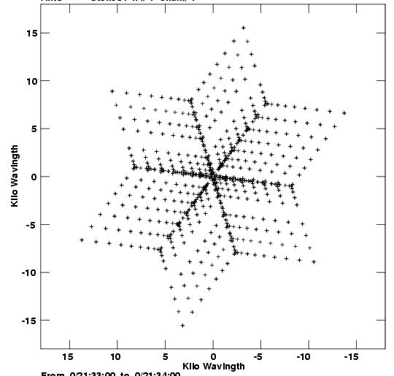
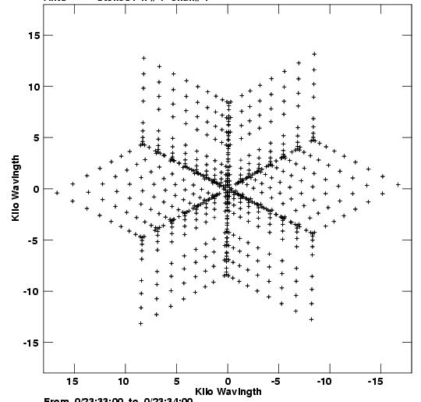
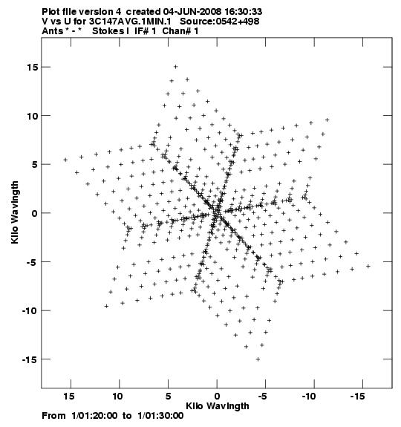
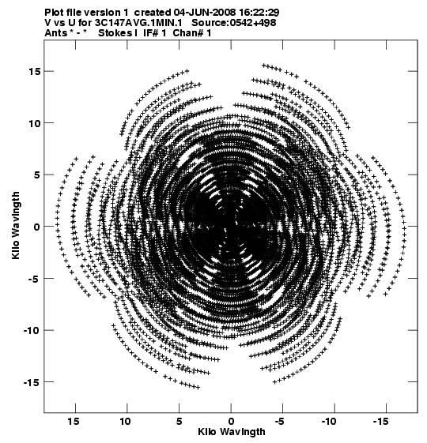
Sample VLA (U,V) plots for 3C147 (δ = 50)
Snapshot (u,v) coverage for HA = -2, 0, +2
HA = -2h
HA = 0h
HA = 2h
Coverage over all four hours.

Slide 59
Summary
In this necessarily shallow overview, we have covered:
  The establishment of the relationship between interferometer visibility measurement and source brightness.
  The situations which permit use of a 2-D F.T.
  The restrictions imposed by finite bandwidth and averaging time.
  How ‘real’ interferometers track delay and phase.
  The standard coordinate frame used to describe the baselines and visibilities
  The coverage of the (u,v) plane.
Later lectures will discuss calibration, editing, inverting, and deconvolving these data.

