Slide 1
Array Configuration
Aaron Cohen
Naval Research Laboratory

Slide 2
Outline of Talk
Quick Review of How Interferometry Works
Overview of Existing Interferometric Arrays
VLA, WSRT, GMRT, VLBA
Parameters of Array Design
min/max baseline lengths, number of elements, etc.
Figures of Merit for Arrays Designs
resolution, angular scale, sidelobe levels, etc.
Optimizing Array Configurations
continuous example
discrete example (LWIA)‏
Large N, Small D concept

Slide 3
Single Baseline Interferometry
A single baseline has a sinusoidal sensitivity pattern across the sky,
oscillating between constructive and destructive interference.

Slide 4
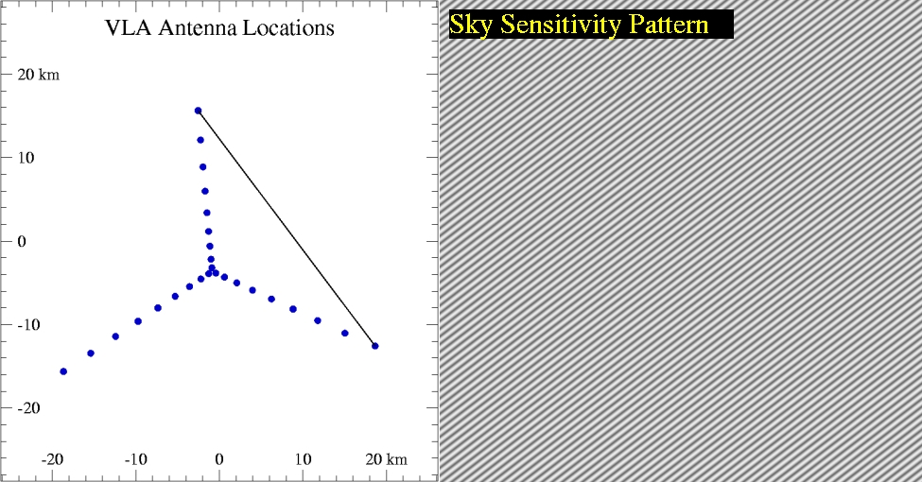
Single Baseline Interferometry
The oscillations in the sensitivity pattern have the same direction as the
baseline, with a period determined by the baseline length in wavelengths

Slide 5
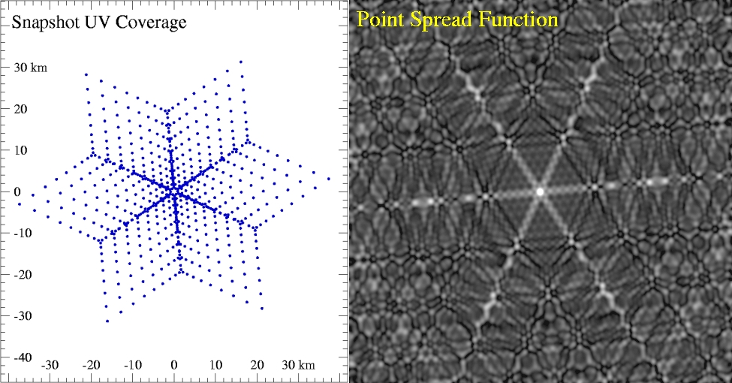
Point Spread Function for the VLA
The uv-coverage is the set of all
baseline vectors.
The synthesized beam (PSF) is the
sensitivity pattern of all baselines.

Slide 6
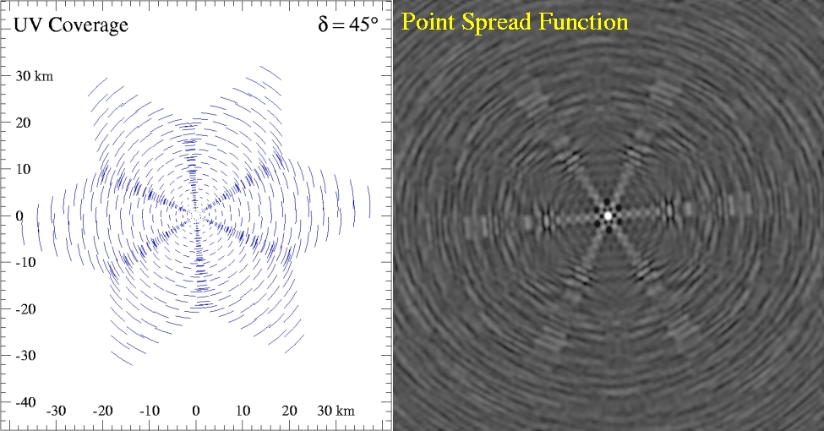
Point Spread Function for the VLA
1 Hour Synthesis Observation

Slide 7
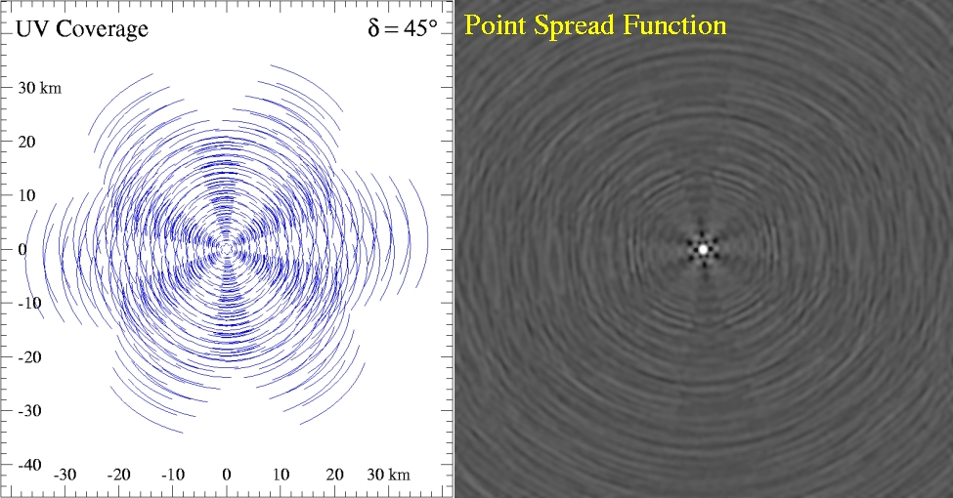
Point Spread Function for the VLA
3 Hour Synthesis Observation

Slide 8
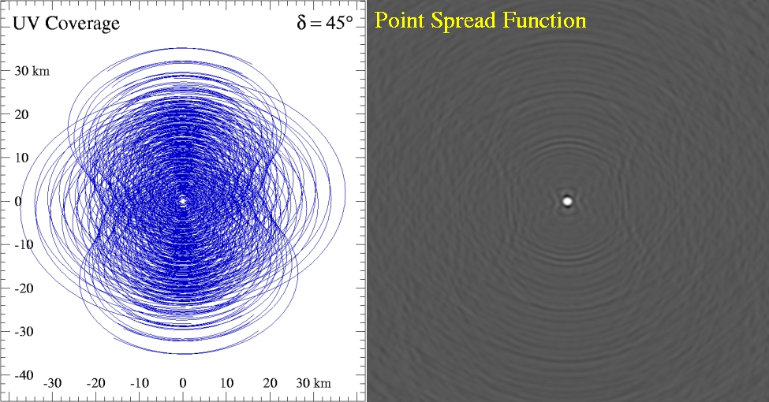
Point Spread Function for the VLA
12 Hour Synthesis Observation

Slide 9
Compensating for Incomplete uv-Coverage
Deconvolution
works well for simple sources
breaks down for large complex sources
Multi-Frequency Synthesis
combine data from a wide range of frequencies in the uv-plane
greatly increases uv-coverage
need to deal with spectral variations

Slide 10
Importance of uv-coverage
Resolution
determined by the longest baselines in the array
Sensitivity to large scale structure
determined by the shortest baselines in the array
Image fidelity
ability to reconstruct complex source structure
gaps in uv-coverage will limit this
Image Dynamic Range
can be limited by side-lobes in the beam

Slide 11
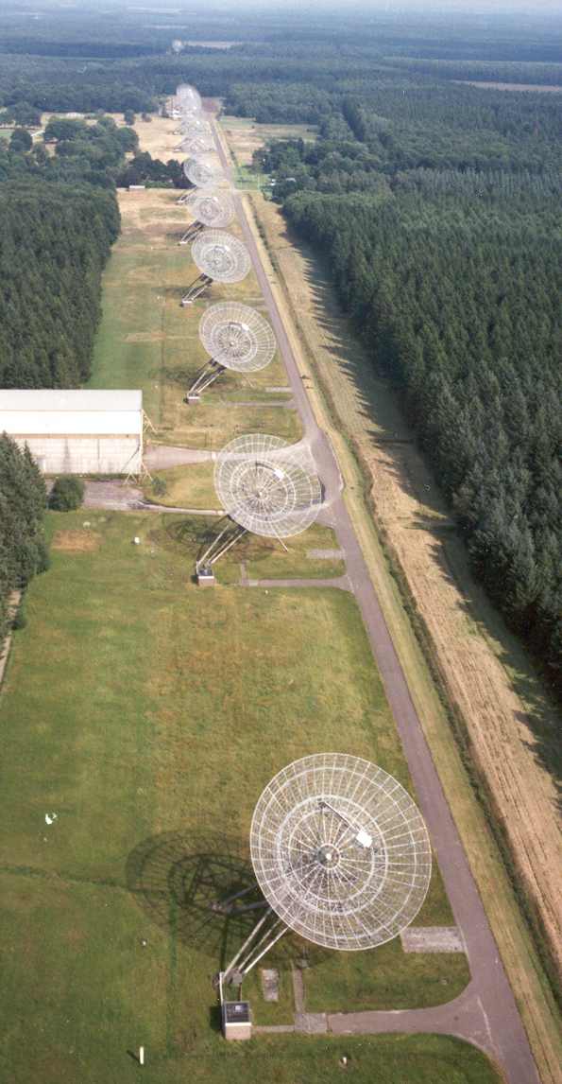
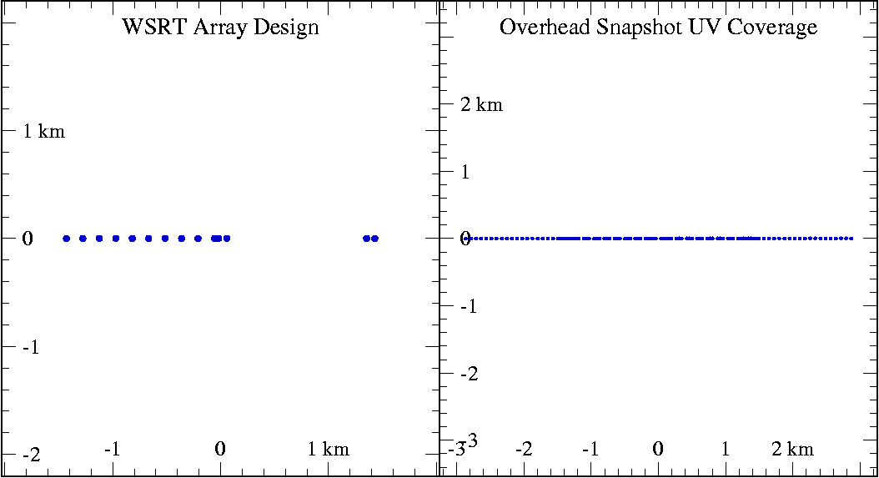
Westerbork Synthesis Radio Telescope
Located in Westerbork, Holland
Has 14 antennas, 25m diameter
East-West Array
Requires Earth Rotation Synthesis for all imaging
Dedicated in 1970: one of the earliest major interferometric arrays

Slide 12
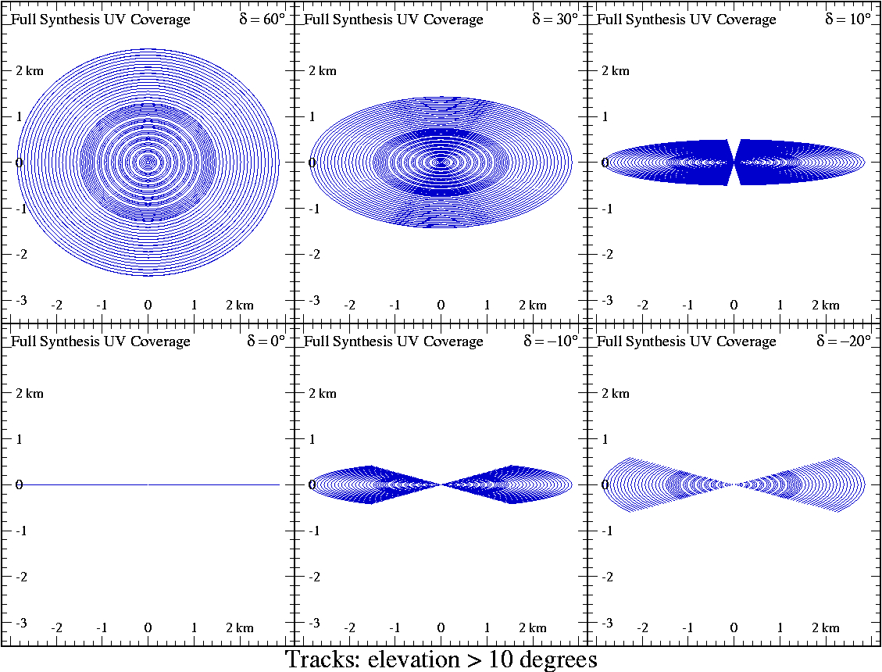
Westerbork Synthesis Radio Telescope
WSRT uv-coverage at various declinations

Slide 13
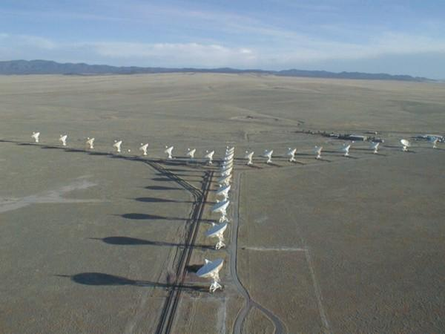
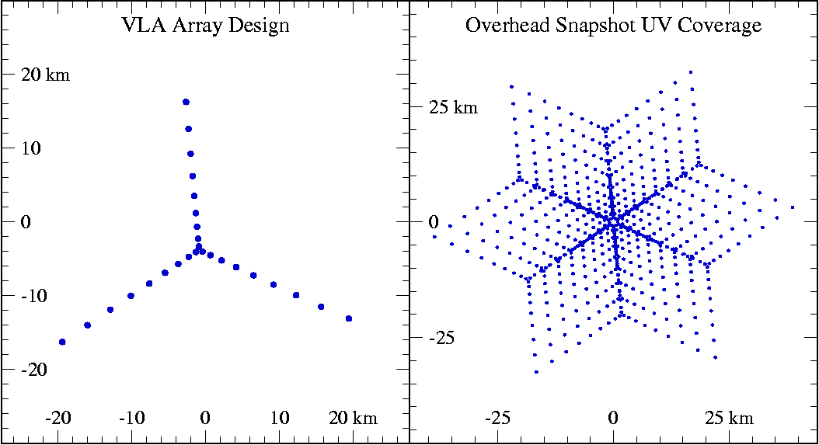
Very Large Array (VLA)‏
Y-shaped Array
Re-configurable
Config. B_{max} (km) B_{min} (km)‏
A 36 0.68
B 11 0.24
C 3.4 0.045
D 1.0 0.035

Slide 14
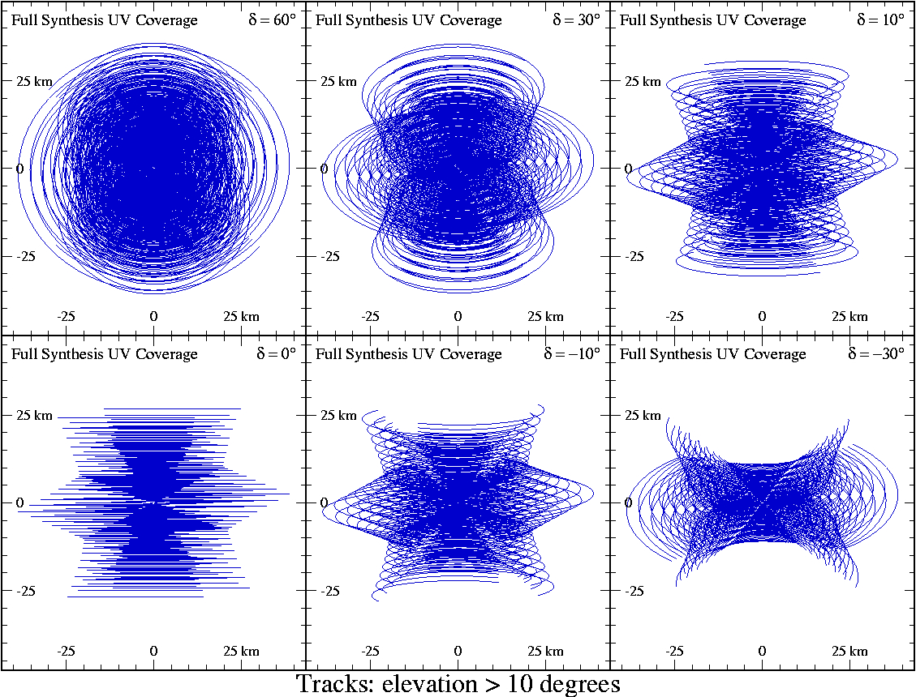
Very Large Array (VLA)‏
VLA uv-coverage at various declinations

Slide 15
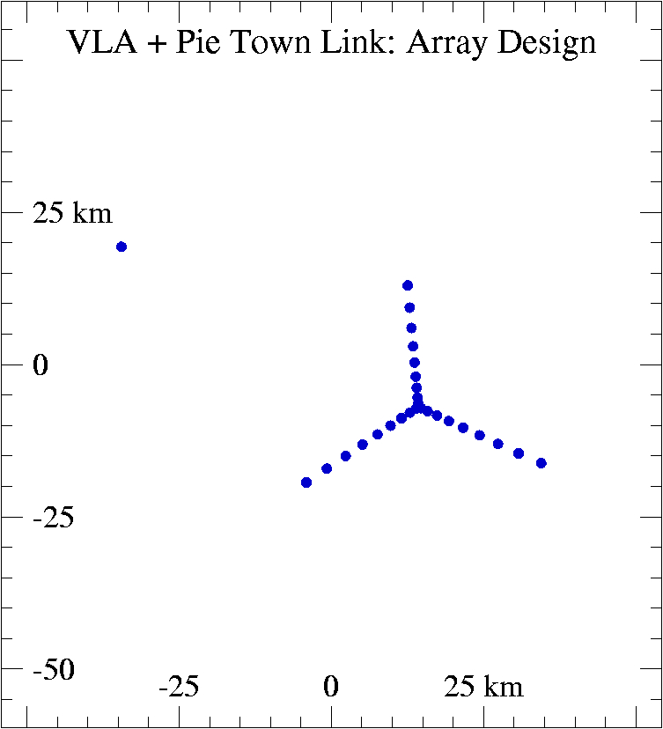
VLA – Pie Town Link
Links (by fiber-optic cable) the VLBA antenna at Pie Town to the VLA
Increases longest baseline from 35 to 73 km
Best at high declinations
Best with long uv-tracks

Slide 16
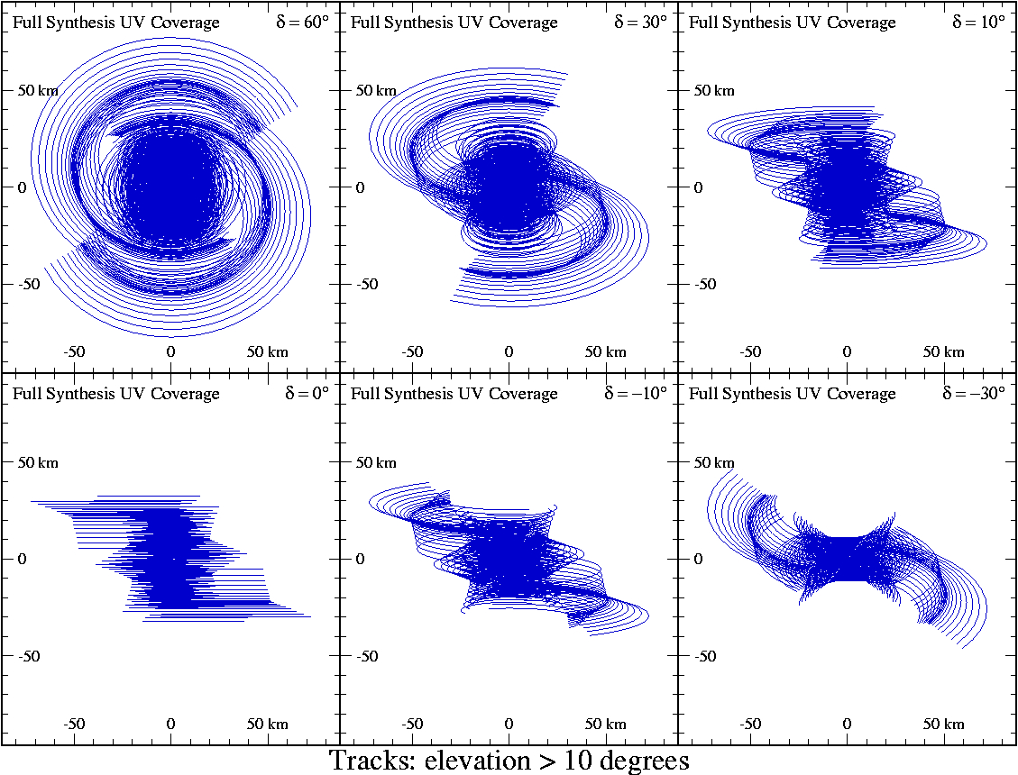
VLA – Pie Town Link
VLA+PT uv-coverage at various declinations

Slide 17
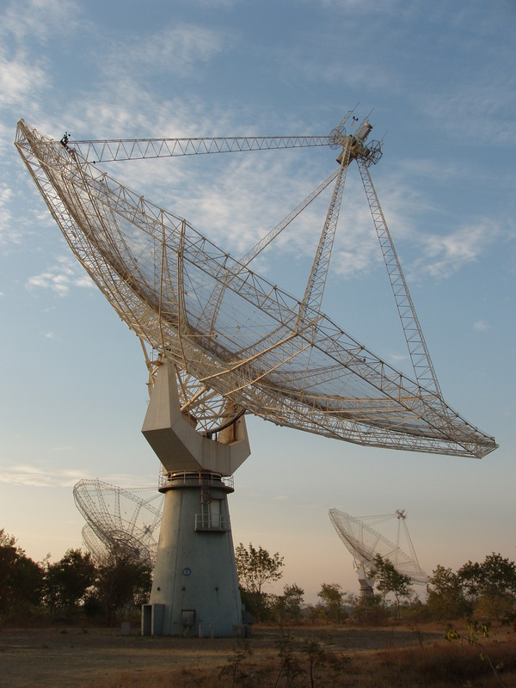
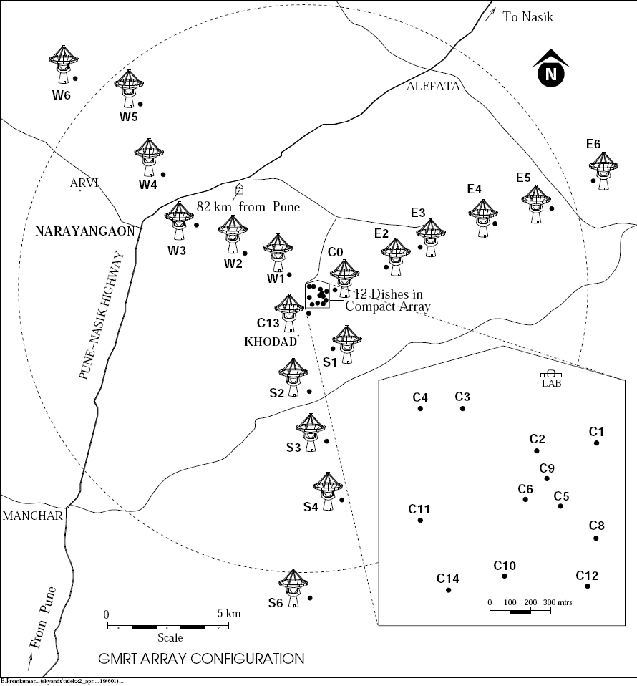
Giant Metrewave Radio Telescope (GMRT)‏
Located near Khodad, India
Contains 30 antennas each with 45m diameter

Slide 18
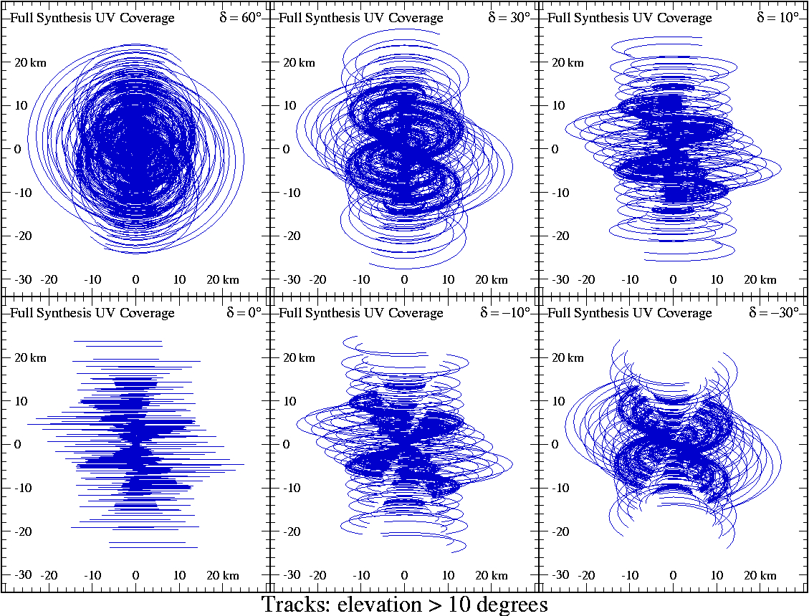
Giant Metrewave Radio Telescope (GMRT)‏
GMRT uv-coverage at various declinations

Slide 19
Very Long Baseline Array (VLBA)‏
Built in 1995
10 VLA-type antennas
Spread throughout continental US plus Hawaii and St. Croix
Maximum baseline over 8,000 km
Elements not electronically connected
must bring recorded data to central correlator
Can achieve resolution of milli-arcseconds

Slide 20
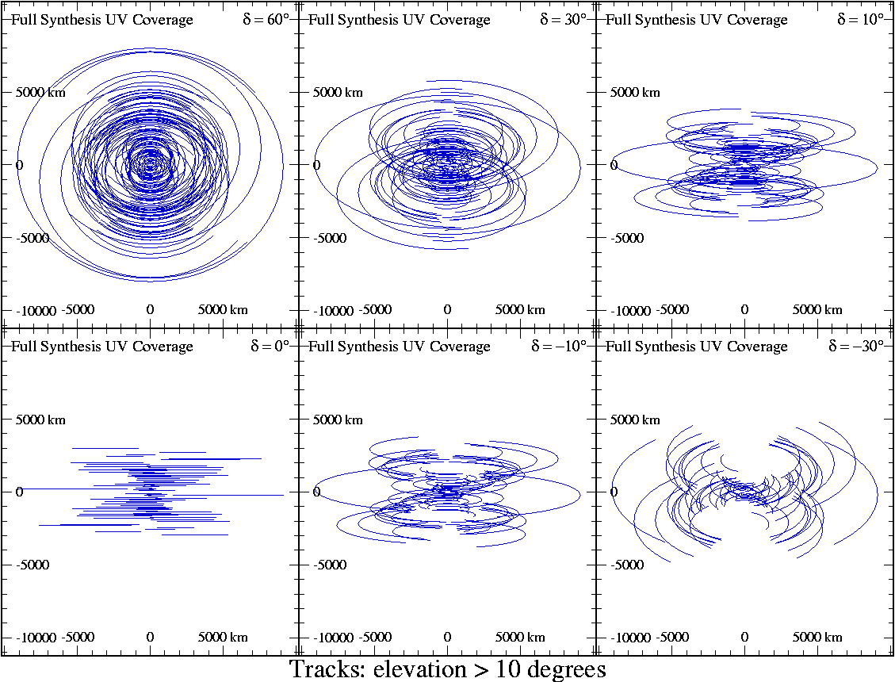
Very Long Baseline Array (VLBA)‏
VLBA uv-coverage at various declinations

Slide 21
Main Parameters of Array Configuration
Maximum Baseline Length
Determines the resolution
Minimum Baseline Length
Determines the sensitivity to large scale features
Number of Elements (N)‏
Limiting factor in how low sidelobes can be
This will affect the ultimate dynamic range achievable
Array shape
This determines uv-coverage and distribution

Slide 22
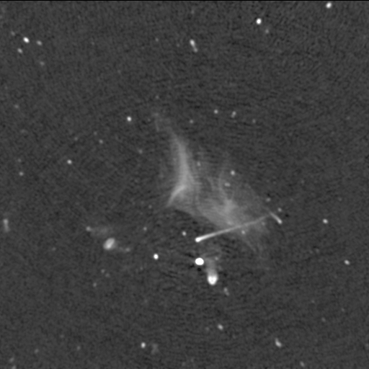
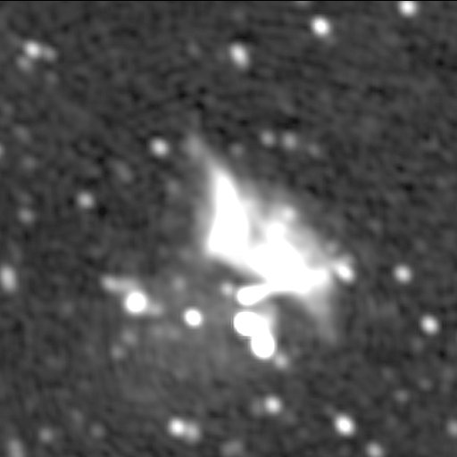
Main Parameters of Array Configuration
Long Baselines: Determine resolution
Short Baselines: Detect large scale features
Abell 2256 at 1369 MHz
VLA C-configuration
VLA D-configuration.
Images from Clarke & Ensslin, 2006

Slide 23
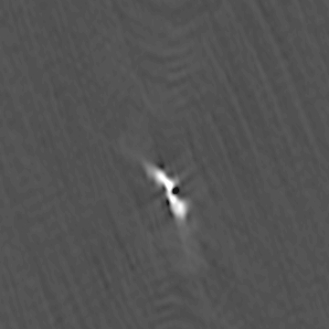
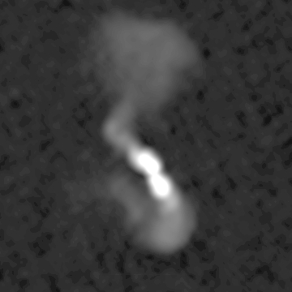
Effect of the range of baseline lengths
The dynamic range between the longest and shortest baselines must be sufficient for the ratio of source size to the desired resolution.
Radio Galaxy Hydra A at 330 MHz
VLA A-configuration
VLA A+B+C-configurations
Images courtesy of W.M. Lane

Slide 24
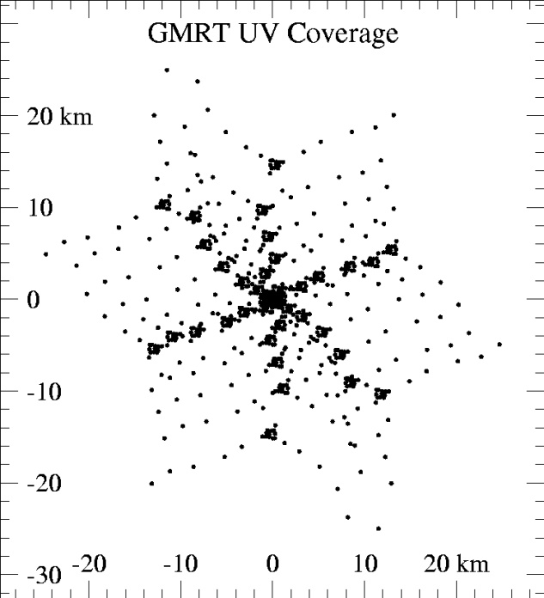
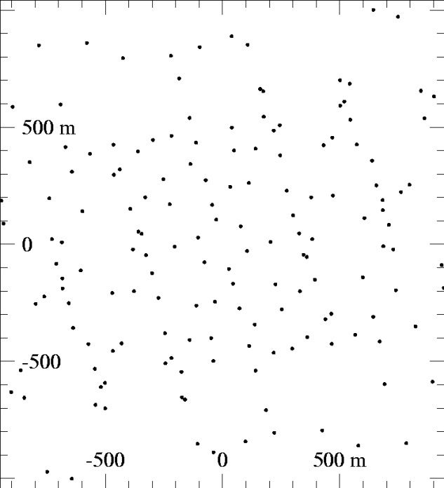
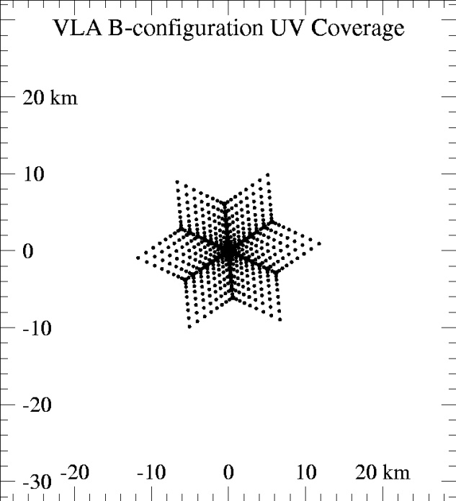
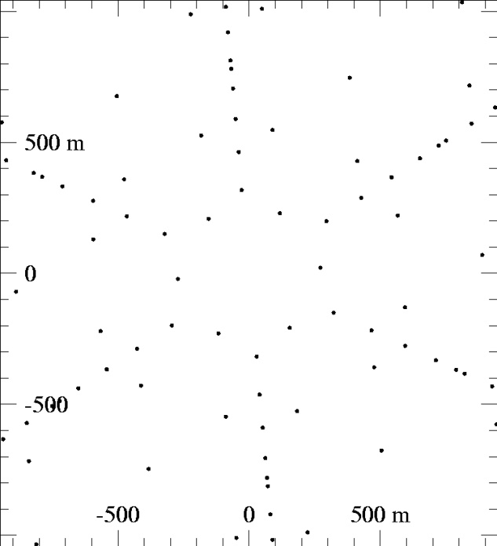
Effect of a central core
Including a compact core can increase the baseline length dynamic range
A core will also introduce non-uniformity in the uv-coverage
This can be corrected with more antennas

Slide 25
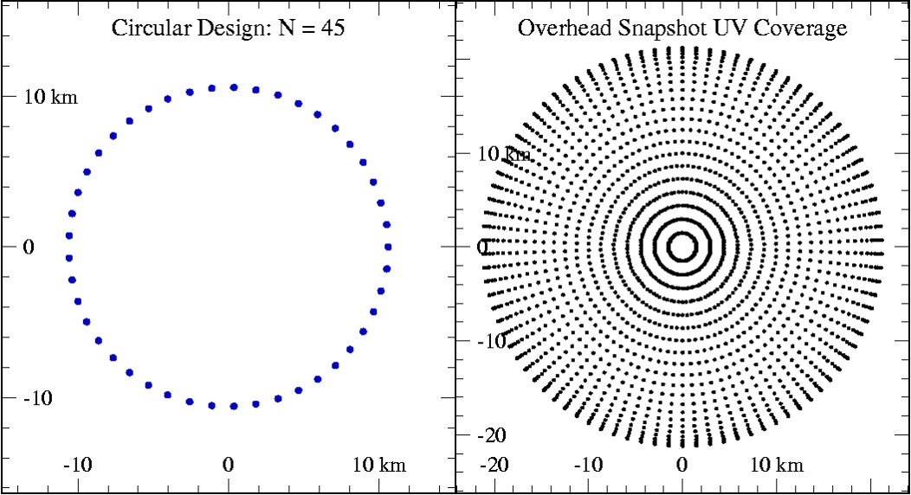
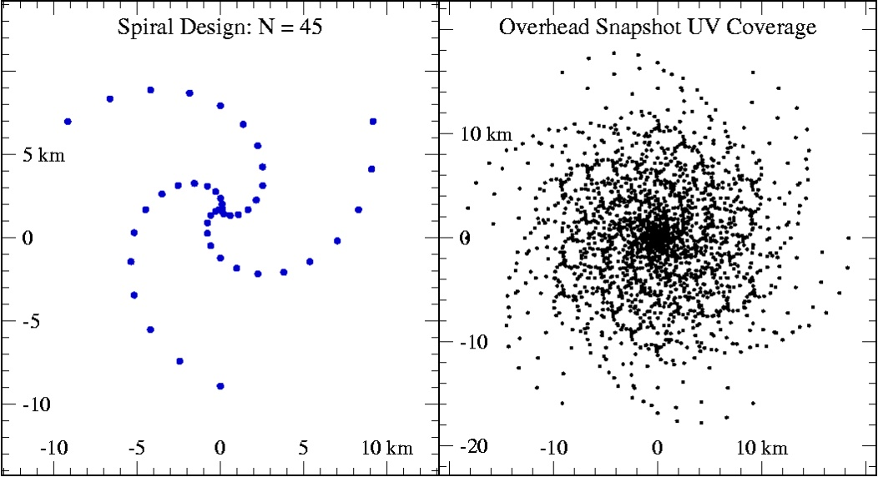
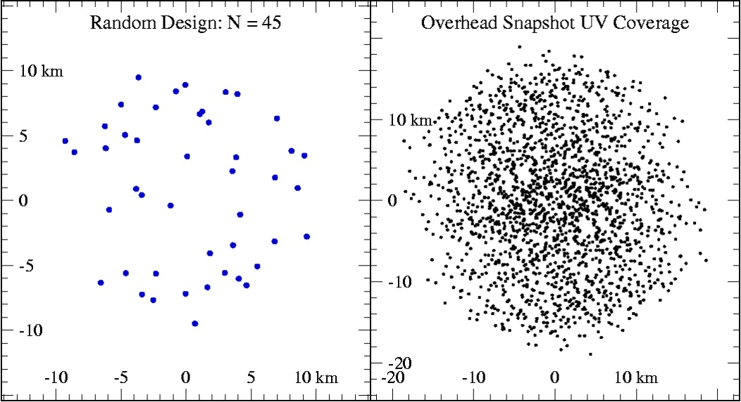
Various Array Designs
Circular
maximizes number of long baselines
Spiral
has more short baselines
Random
has little redundancy or patterns
Circular Design: N = 45
Spiral Design: N = 45
Random Design: N = 45

Slide 26
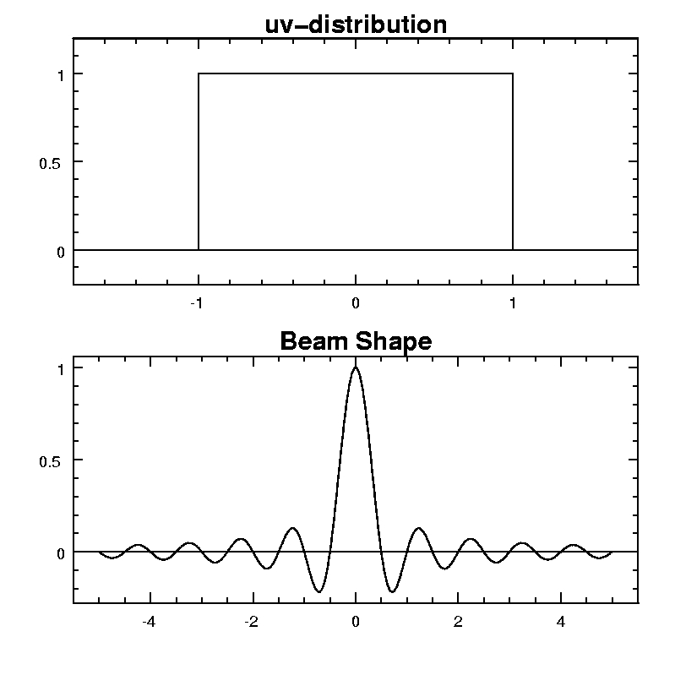
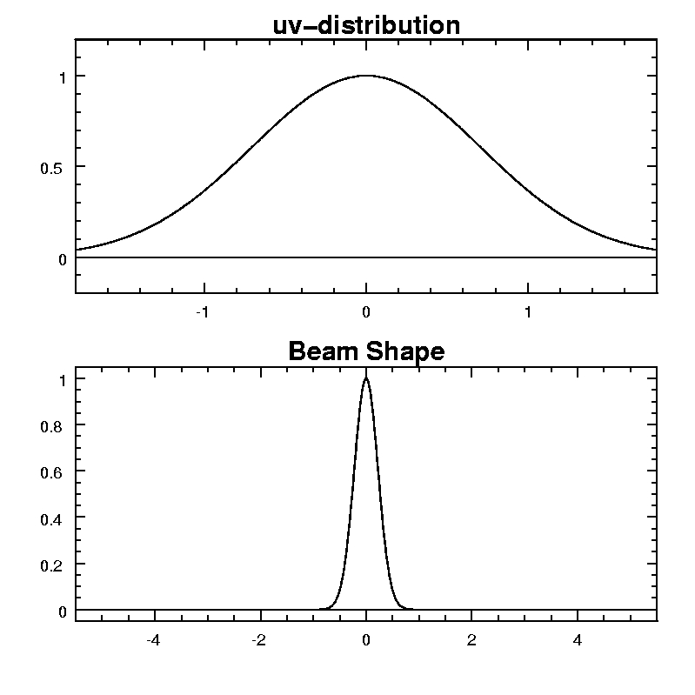
Nearby Side-lobes: dominated by uv-distribution
Even with perfect uv-coverage the distribution or weighting can cause sidelobes:
Uniform distribution
Gaussian Distribution

Slide 27
Distant Side-lobes: Dependence on N
Distant side-lobes are caused by gaps in the uv-coverage.
RMS value of distant side-lobes is proportional to the square root of the number of uv-data points (assuming a random distribution)‏
For a randomly distributed array, this means that the side-lobes will have an RMS value of ~1/N
This can be much higher for non-random distributions
repetitions from patterns will result in much higher side-lobes
Optimization can reduce this somewhat for a small region

Slide 28
Metrics for Optimization
Side-lobe levels
Useful for image dynamic range
Range of baseline lengths
Useful for large complex sources
Largest gaps in uv-coverage
Image fidelity
Baseline length distribution
So that uv-weighting, which reduces sensitivity, is not needed

Slide 29
Array Optimization
Trial and Error
devise configurations and calculate metrics (works OK for small N)‏
Random Distribution
Lack of geometric pattern reduces redundancy
Works surprisingly well for large N
Simulated Annealing (Cornwell)‏
Define uv ‘energy’ function to minimize – log of mean uv distance
UV-Density & pressure (Boone)‏
Steepest descent gradient search to minimize uv density differences with ideal uv density (e.g., Gaussian)‏
Genetic algorithm (e.g., Cohanim et al.,2004)‏
Pick start configurations, breed new generation using crossover and mutation, select, repeat
PSF optimization (L. Kogan)
Minimize biggest sidelobe using derivatives of beam with respect to antenna locations (iterative process)‏

Slide 30
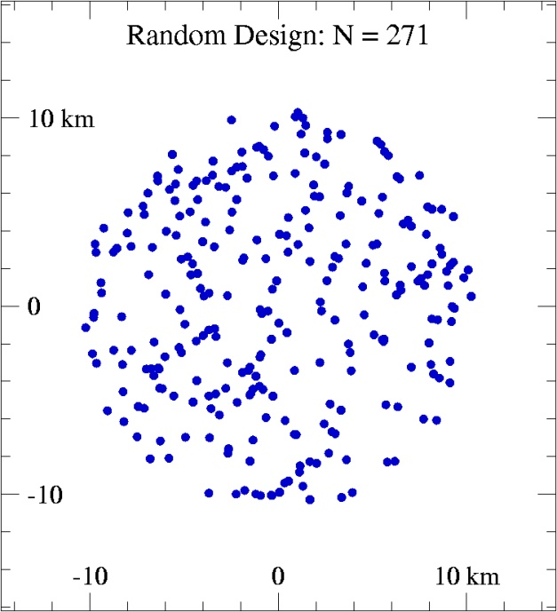
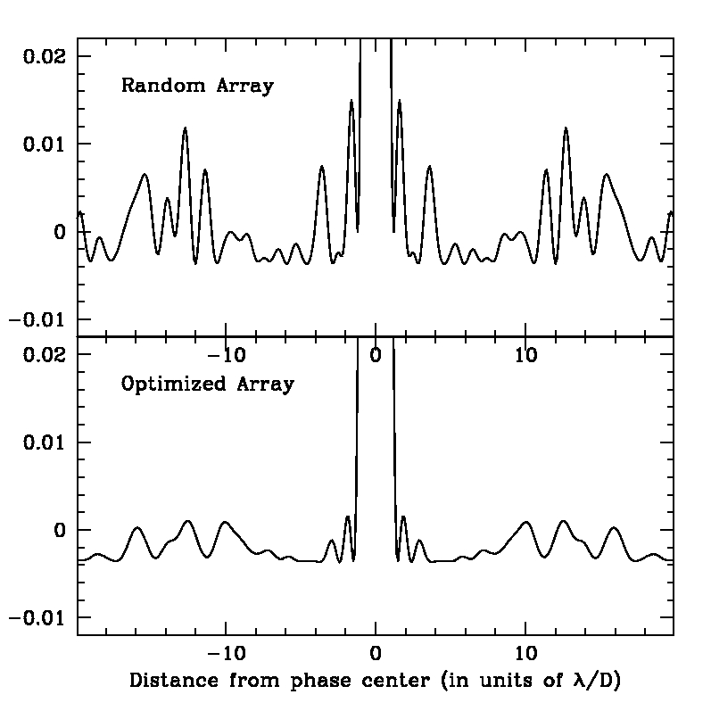
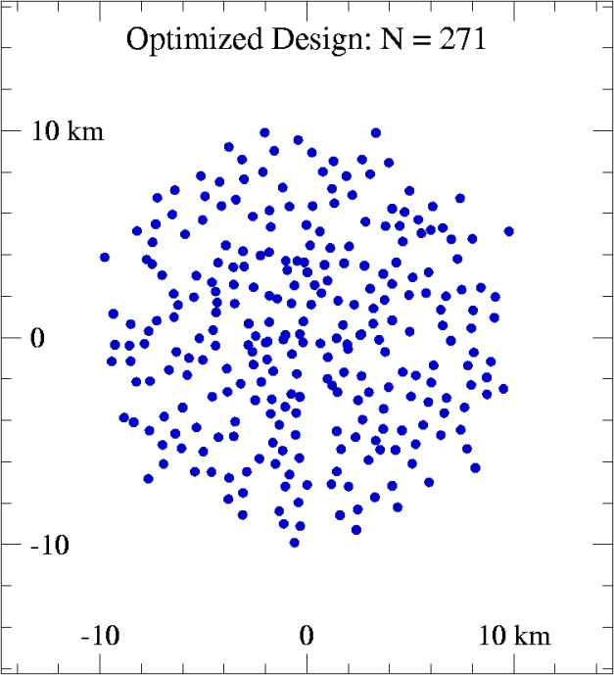
Iterative minimization of sidelobes: Kogan Method
Comparing random versus optimized
arrays for N = 271

Slide 31
Simulations
Simulations are the ultimate test of array design
see how well the uv-coverage performs in practice
Consider likely target objects
Generate realistic models of sky
Simulate data, adding in increasing levels of reality
Atmosphere, pointing errors, dish surface rms etc.
Process simulated data & compare final images for different configurations – relative comparison
Compare final images with input model
Image fidelity – absolute measure of goodness of fit
Compare with specifications for DR and fidelity

Slide 32
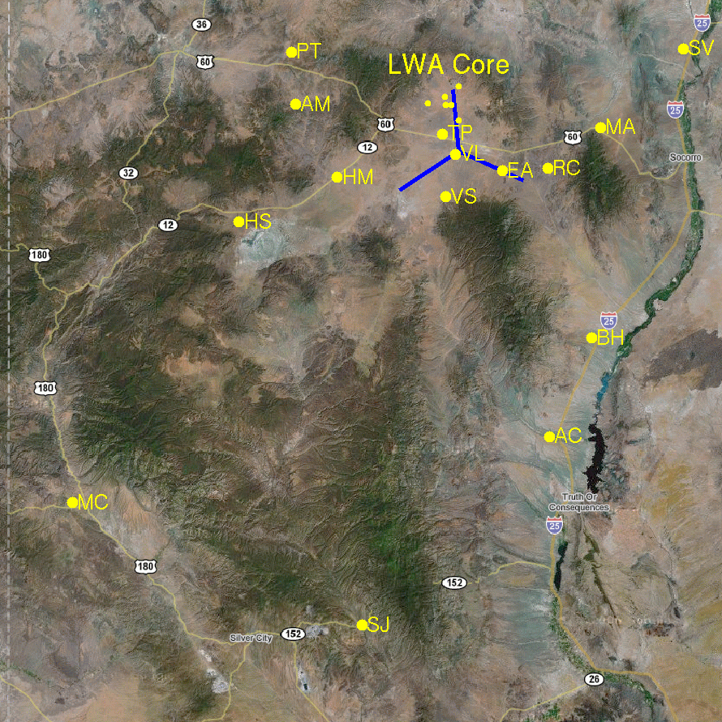
Real World Example: Long Wavelength Array (LWA)‏
Long Wavelength Array (LWA)‏
New low-frequency telescope (10-88 MHz) in New Mexico
52 stations of 256 phased dipoles serve as 'antennas'
Intermediate array will have core plus 10 outlier sites
Need to find best 10 outlier sites

Slide 33
Real World Example: Long Wavelength Array (LWA)‏
Designing the LWIA
10 sites are needed
15 sites found to be suitable based on topography and access to roads, fiber and power lines.
4 sites are “fixed”:
MC, SJ and AC for resolution
VL is already used for prototypes
Need to choose best 6 of remaining 11
462 different options!

Slide 34
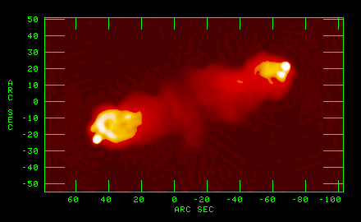
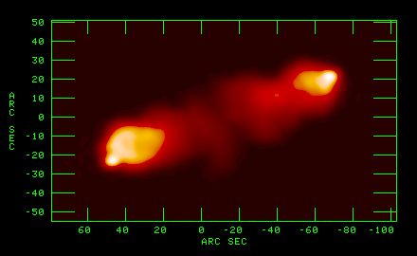
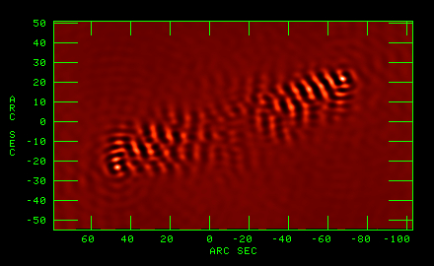
Simulating the Long Wavelength Array (LWA)‏
Cygnus A at 325 MHz with
VLA A-configuration + PT
Simulated LWIA Image (74 MHz)‏
Simulating Image Fidelity
Project model image to simulated uv-coverage and image in normal way
Subtract model to examine residual image errors
Can define: Fidelity Index = (peak intensity)/(residual rms)‏
Residual Map (model subtracted)‏

Slide 35
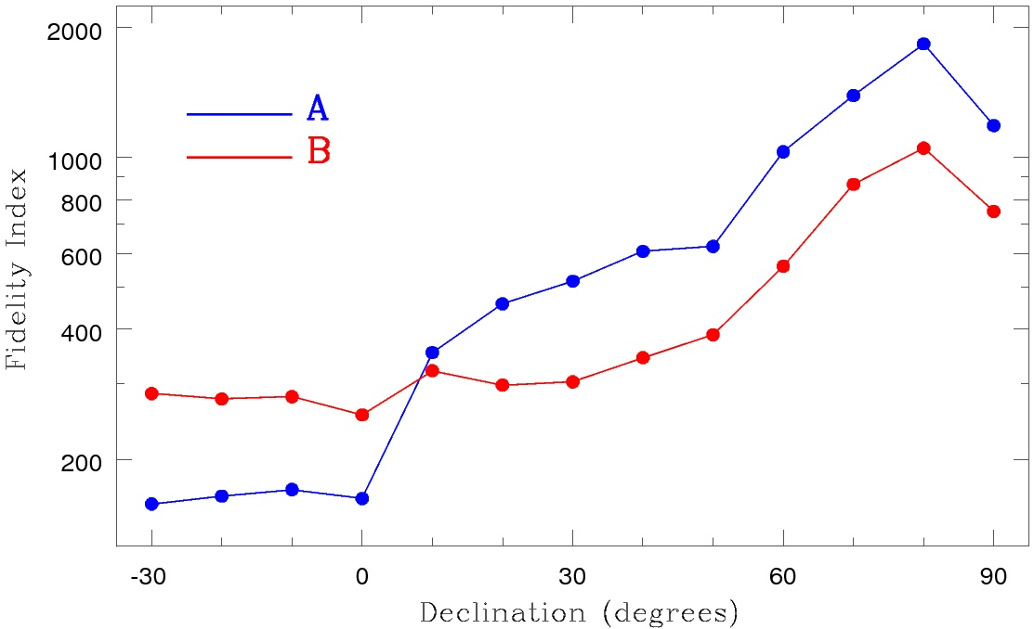
Fidelity Index vs Declination
Fidelity Index for two possible array configurations
Full time synthesis
Various source declinations

Slide 36
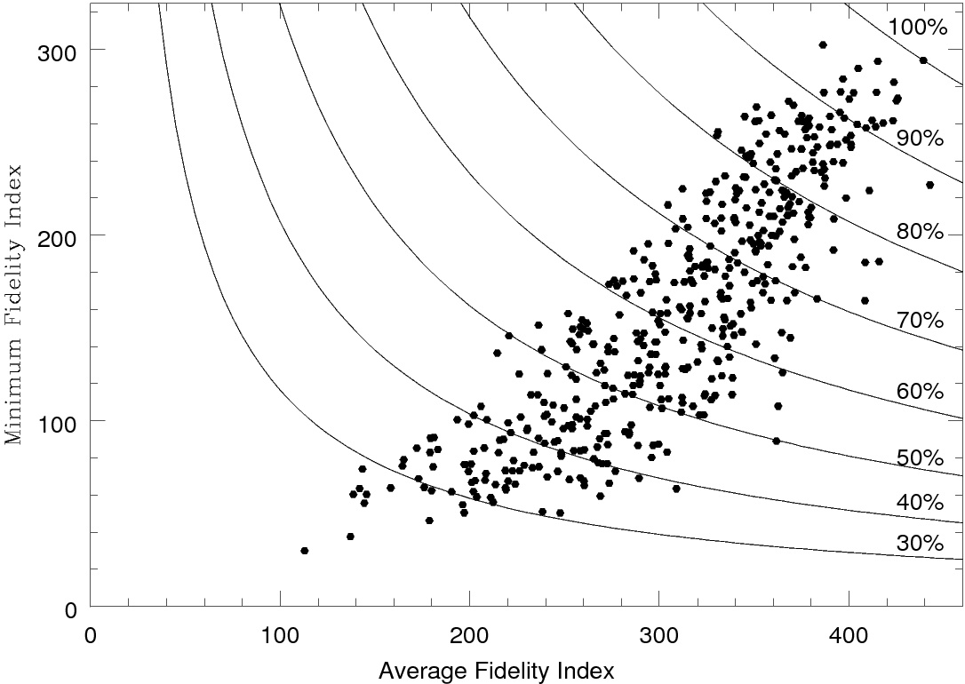
Determining the Relevant Figure of Merit
Fidelity Index based Figures of Merit for all possible array configurations

Slide 37
Rating of Possible Station Sites
Fixed Sites:
VL, MC, SJ, AC
“Optional” Sites Rated by frequency within “top 10” configurations:
HS → 10/10
SV → 9/10
BH → 8/10
HM → 7/10
MA → 7/10
EA → 6/10
PT → 6/10
RC → 4/10
VS → 3/10
AM → 0/10
TP → 0/10

Slide 38
Large-N / Small-D Concept
N = number of antennas in array
D = diameter of antennas in array
Collecting Area (ND²) kept constant
uv-coverage is drastically improved while the point-source sensitivity is unchanged
This can also be the most cost effective way to achieve the desired collecting area

Slide 39
Large-N / Small-D Concept
Advantages of higher N (at constant ND²)‏
Synthesized beam sidelobes decrease as ~1/N
Field of view increases as ~N (for dishes)‏
Redundancy of calibration increases as N
uv-tracks crossings increase as N⁴
Disadvantages of higher N (at constant ND²)‏
Computation times can increase by up to N⁴ !!!
N² times more baselines
N times as many pixels in the FOV
N^{1/2} times as much channel resolution needed
N^{1/2} times as much time resolution needed
Need correlator with more capacity
Higher data rate

Slide 40
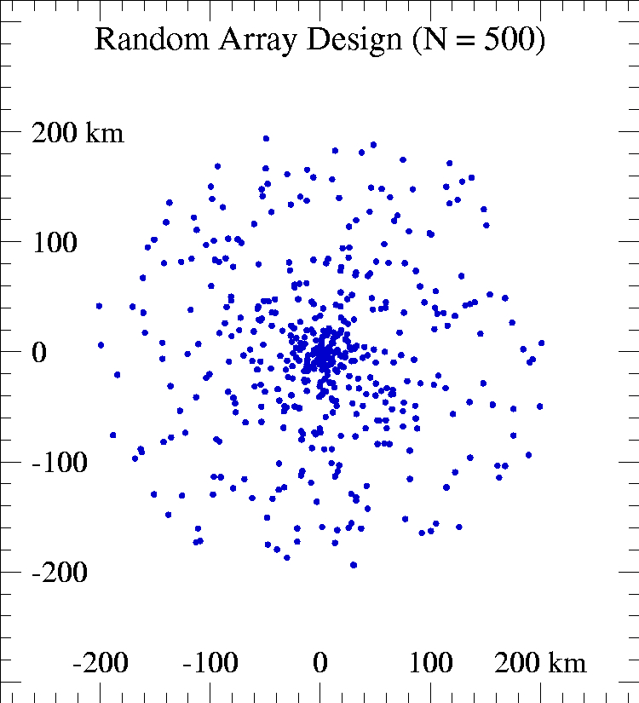
Large-N / Small-D Concept
N = 500 Random Array
N = 500
Elements placed randomly within 200 km radius
Random placement “biased” towards array center for more shorter baselines

Slide 41
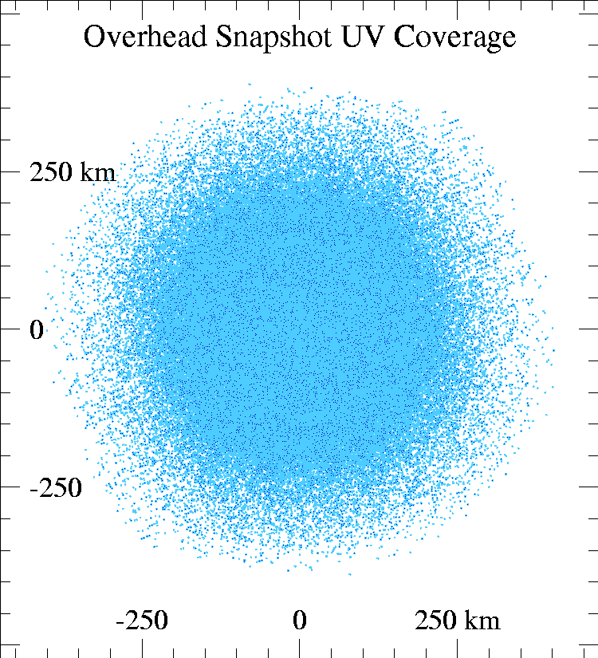
Large-N / Small-D Concept
N = 500 Random Array

Slide 42
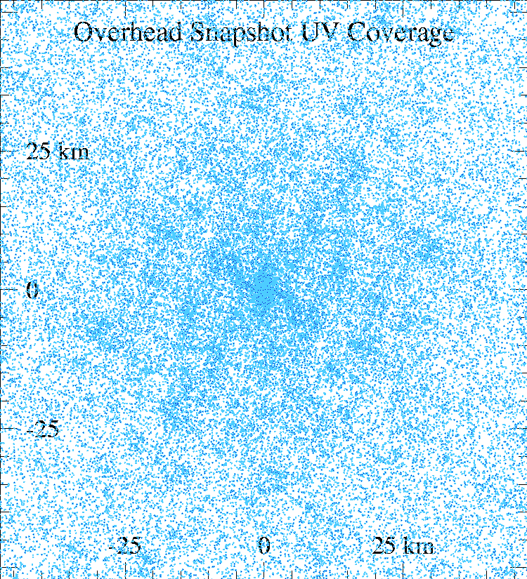
Large-N / Small-D Concept
N = 500 Random Array (magnified 10X)‏

Slide 43
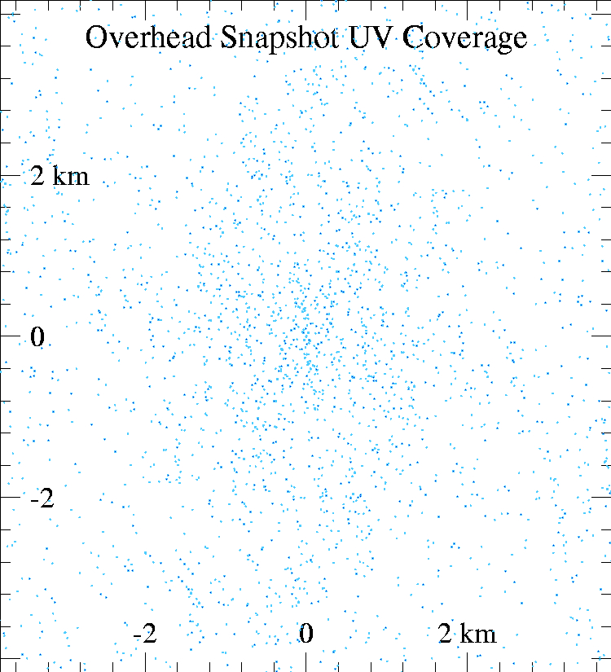
Large-N / Small-D Concept
N = 500 Random Array (magnified 100X)‏

Slide 44
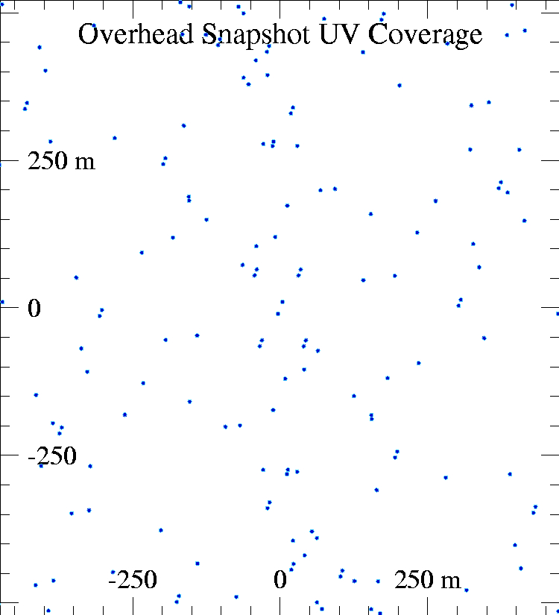
Large-N / Small-D Concept
N = 500 Random Array (magnified 1000X)‏

Slide 45
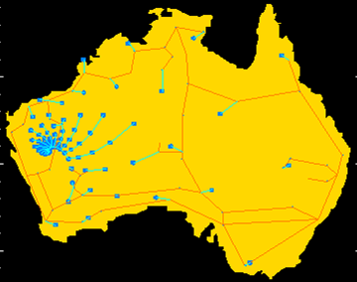
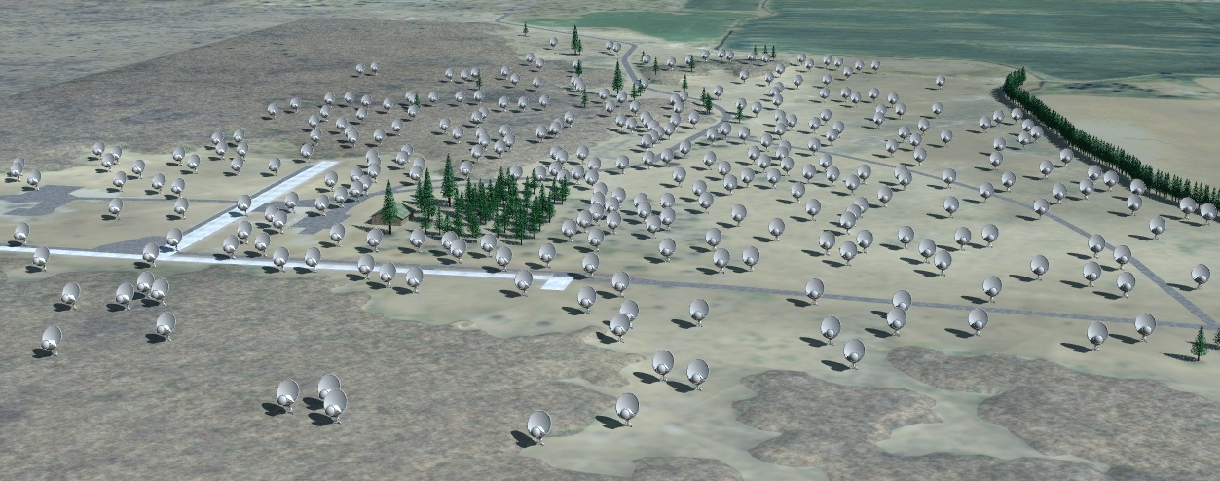
Large-N / Small-D Concept
Possible SKA Design
ALMA: 64 antennas (re-configurable)‏
LOFAR, LWA: >~50 stations
Allen Telescope Array: N = 350
Square Kilometer Array: N ~1000
Allen Telescope Array (Artist Rendition)‏

Slide 46
Conclusion: Determining Array Parameters
Longest Baseline
resolution needed: determined by science requirements, physical constraints
Shortest Baseline
largest angular scale needed: determined by science requirements
Number of Antennas (elements): N
Determined by budget constraints (higher N is nearly always better)‏
Configuration of N elements
Determine figure of merit for the anticipated science goals
Maximize the figure of merit within the given “practical” constraints on element placement.

