Slide 1
Towards Near Real-Time Flare Forecasting
Peter Levens
11/22/24
Notes:
Takeaway:
Background
- Sunspot research in undergrad, graduated in 2023, post bacc at LANL and now back to sunspots.
Transition:
My ‘why’
In my time doing research, the ‘why’ was always space weather, but the flare forecasting tools out there didn’t exist in relation to sunspots, but things like radio flux, solar wind speed etc, so this talk is trying to bridge that gap

Slide 2
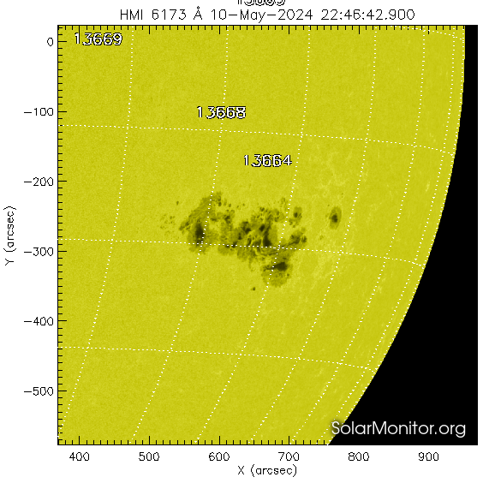
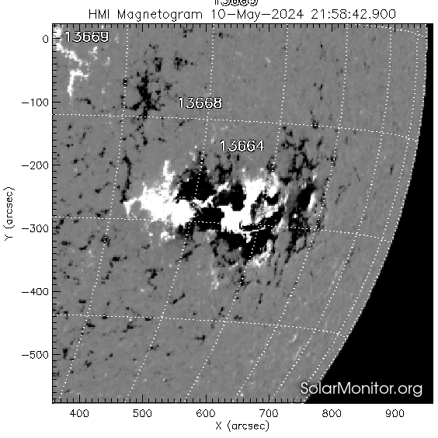
Space weather in history
1859: Carrington Event
Induced current in the Earth’s atmosphere took telegraphs across the country out of commission.
1967: Jammed Radio Communications
Radio and radar communications at US polar surveillance sites became jammed for hours. Air Force prepared aircrafts for war before being informed about a solar storm.
2024: Mass migration of LEO satellites
Thousands of spacecrafts lost altitude and were forced to thrust back to altitude without considering collision avoidance systems.
Notes:
Takeaway:
Longstanding problem
Impact becomes greater given current trajectory
Transition:
What sort of things cause events like these?
https://news.agu.org/press-release/1967-solar-storm-nearly-took-us-to-brink-of-war/
https://www.space.com/may-solar-storm-largest-mass-migration-satellites

Slide 3
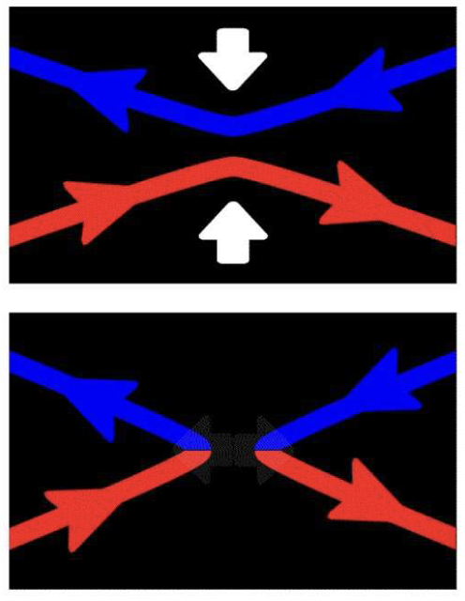
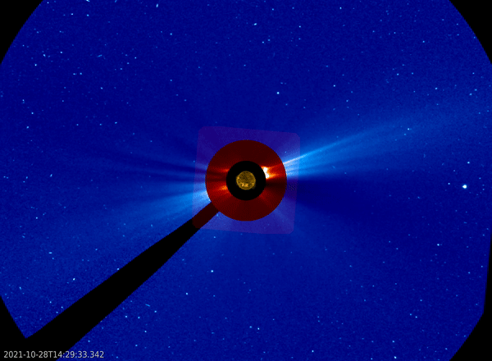
Sunspots and flares 101
NASA & ESA / SOHO
solarmonitor.org
solarmonitor.org
Dense concentrations of magnetic field lines burst through the Sun’s surface.
Magnetic reconnection: release energy across the EM spectrum when opposite polarity field lines connect.
Strongest flares are often linked to coronal mass ejections (CMEs) and solar energetic particles (SEPs).
Notes:
Takeaway:
What is a sunspot, how are flares formed and what comes of them
Transition:
What type of sunspot would be most prone to magnetic reconnection and thus flares?

Slide 4
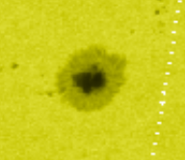
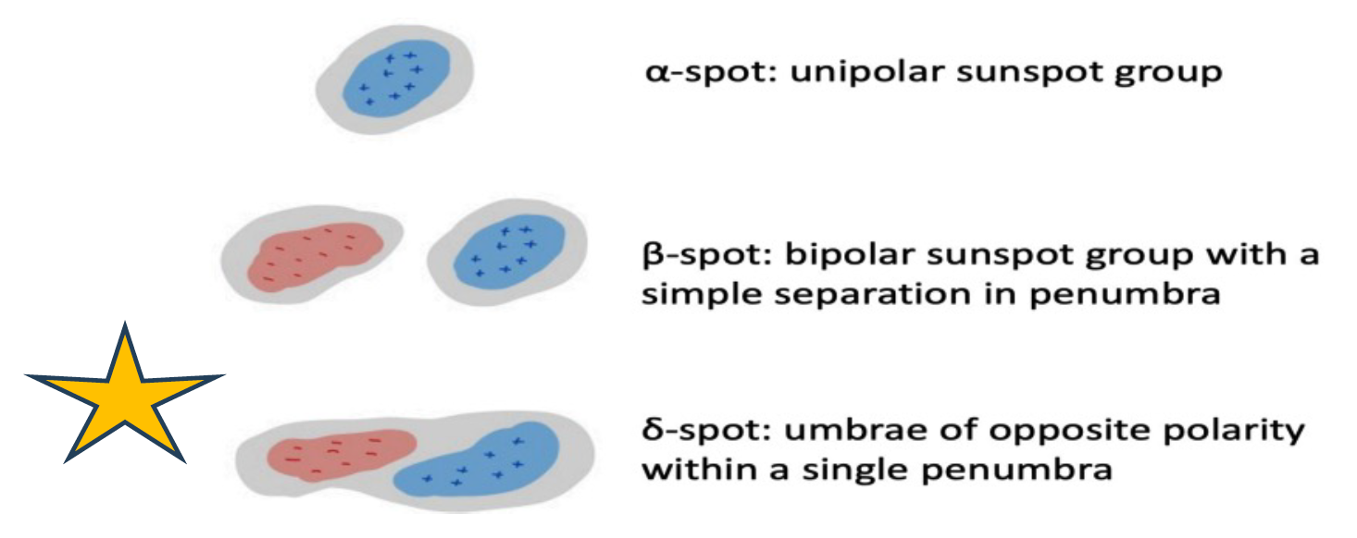
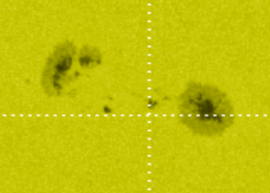
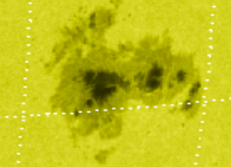
Delta-class sunspots: flare progenitors
>90% of X class flares originate in delta sunspots, despite accounting for fewer than 10% of active regions.
solarmonitor.org
Notes:
Takeaway:
Not all sunspots are equal in space weather impact
This camp of delta-class is in naturally more flare-producing configurations
Transition:
This taxonomy classification is useful, but not the whole picture, it just tells us where to look

Slide 5
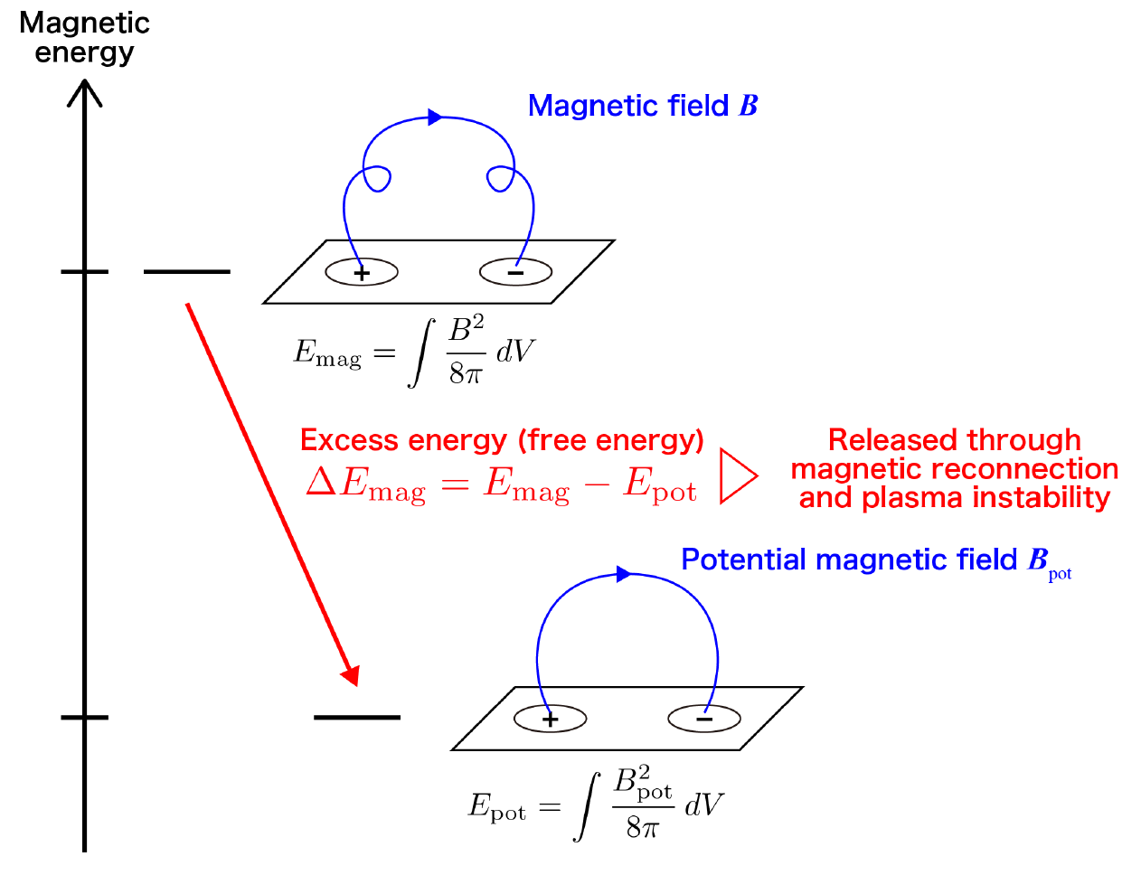
Parameters for flare prediction
Energy budgets: estimate free magnetic energy accumulation.
Magnetic field evolution: assess flux emergence rates, rotation rates, polarity separation.
Field connectivity: Quantify flux imbalance and open field lines.
Toriumi 2024
How can we analyze these physical processes in near real-time?
Notes:
Takeaway:
There are parameters which map energy injection into sunspots which can be converted into impulsive magnetic energy given magnetic reconnection
Transition:
This is thought to be the physics, but nobody is doing this in real time right now. Doing on timescales of hours could give warnings which would be actionable!

Slide 6
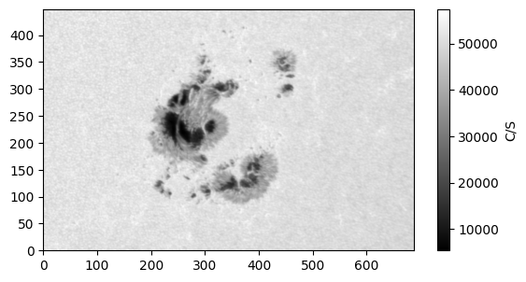
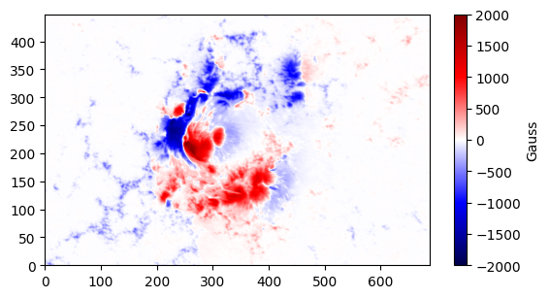
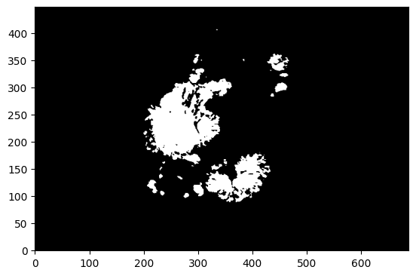
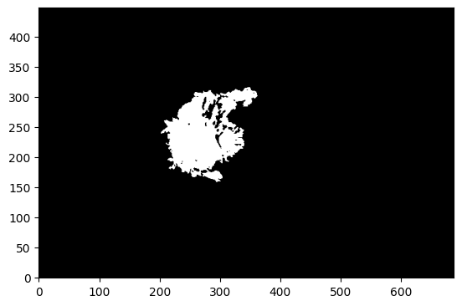
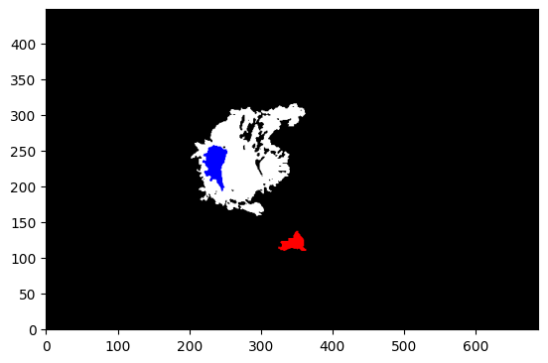
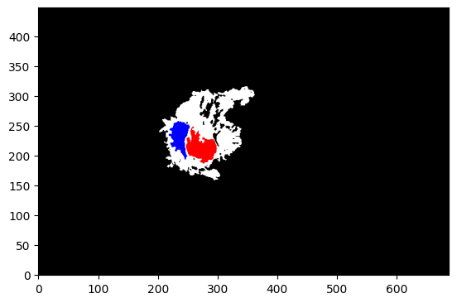
Automated delta-class sunspot detection
HMI
$δ$-class ☐
$δ$-class ☐
$δ$-class ☐
$δ$-class ☒
1. Penumbral map
2. Loop through penumbra
3. Loop through opposite polarity umbra
4. Check as $δ$ when $δ$–criterion is satisfied
Notes:
Takeaway:
The first step to flare forecasting via delta-class sunspot analysis is identifying them as they appear on the disk
Transition:
What does this look like?

Slide 7
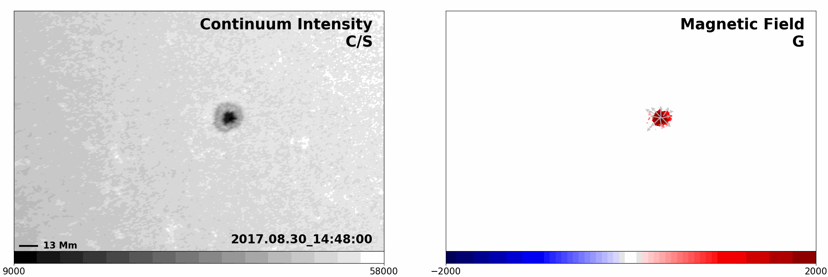
Automated delta-class sunspot detection
Notes:
Takeaway:
The algorithm continually recognizes the shearing regions as they appear on the disk
Transition:
We mentioned physical parameters in real time, what does this look like

Slide 8
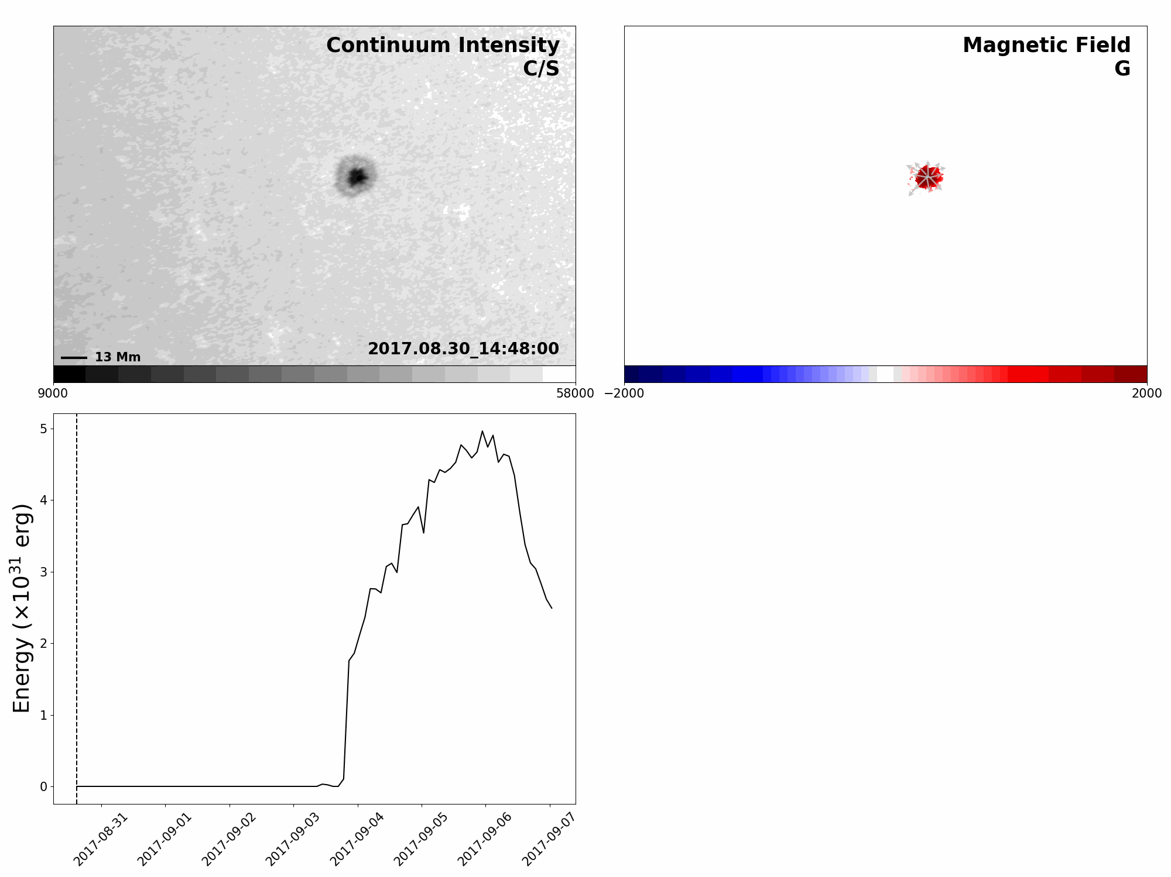
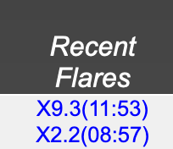
Tracking parameters: free energy budget
Notes:
Takeaway:
You can track parameters within these isolated regions as they evolve on the timescale of hours
They make physical sense, you see the energy release as the dangerous flares are after a high injection, plataeu
Transition:
What I’ve shown up to this point is with highly processed data packages, more of a forensic science, how do I turn this into real time?

Slide 9
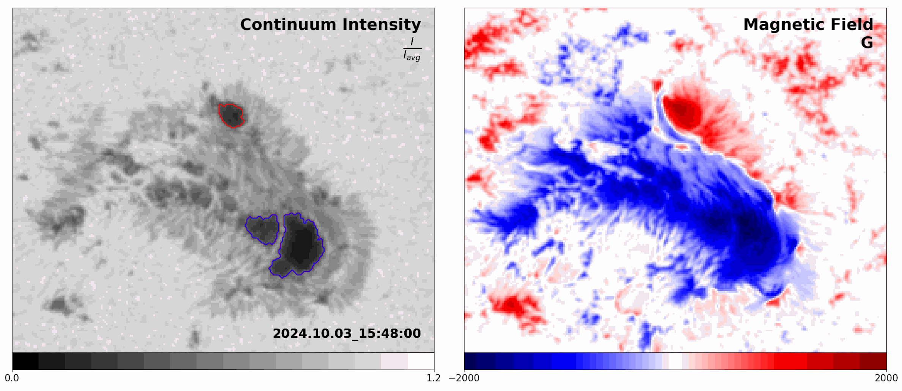
Flare forecasting
HMI Quicklook data enables near real-time harvesting of live observations.
Physical parameters can be analyzed in near real-time as sunspots evolve.
Leverage forensic insights and physical understanding to enhance real-time analysis and forecasting.
Notes:
Takeaway:
HMI has low latency,Quicklook data which you can grab at 12-minute intervals on a 40-minute delay
Recognize these delta sunspots as they appear, applying physical intuition of them while harvesting live data
Transition:

Slide 10
Going forward
Transitioning from processed data to near real-time data analysis shows strong potential.
Identify and monitor physical properties driving energy injection into active regions in near real-time.
Develop a tool to provide spatiotemporal flare warnings.
Notes:
Takeaway:
The science is there even though there’s more to learn, the data products should be enough, and this should be a great break through in space weather.

