Slide 1
Precessing Radio Galaxy Jets: Dynamics and Observable Properties
Chris Nolting^{1,2}
Collaborators:
Jay Ball², Tri Nguyen²
¹Los Alamos National Lab
²College of Charleston
Submitted to ApJ – Archive # 2301.04343

Slide 2
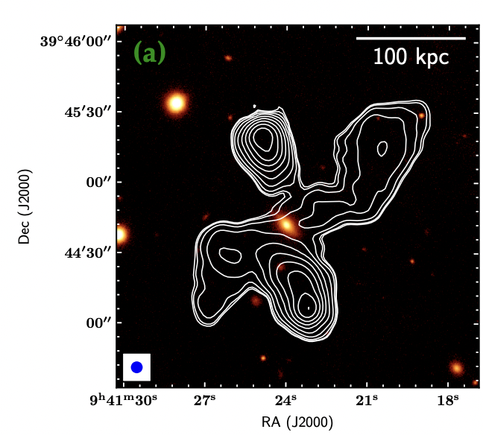
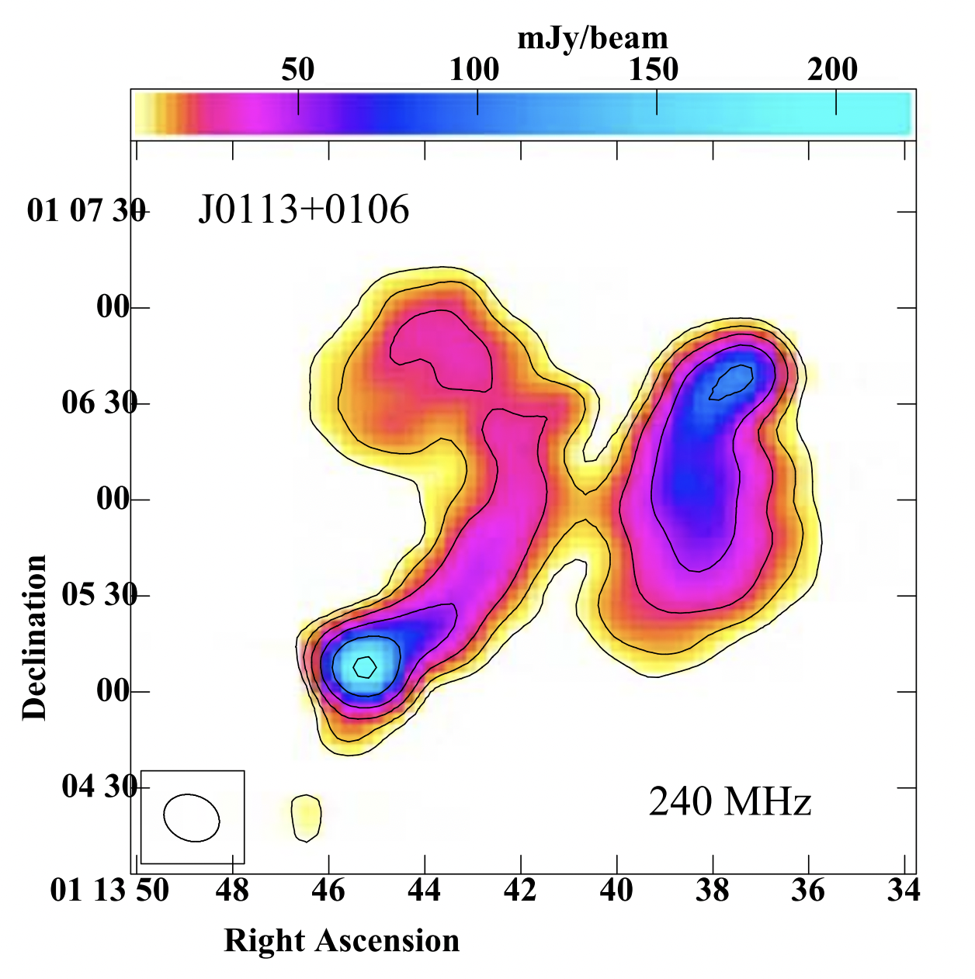
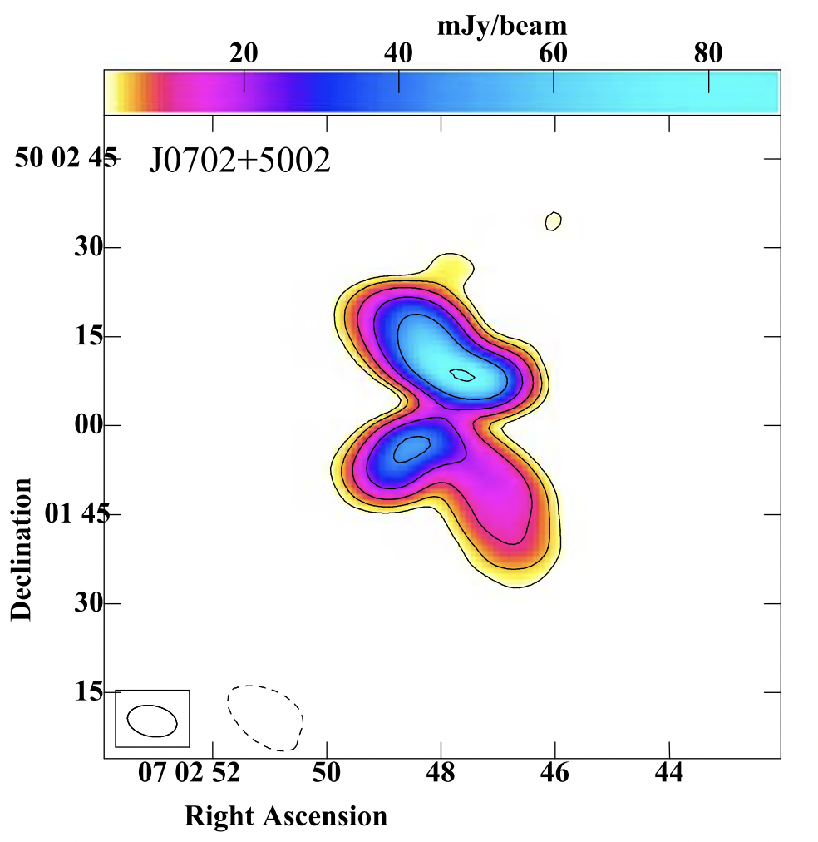
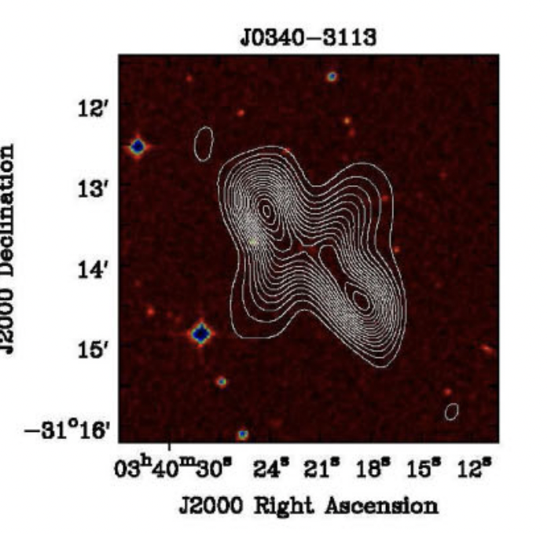
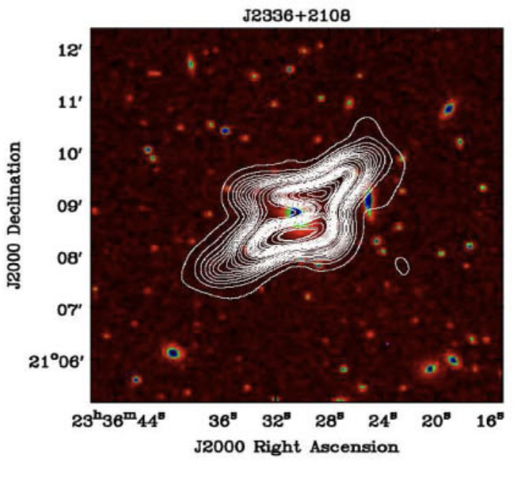
X-shape Radio Galaxies
Also “S-shape” or “Z-shape” depending on morphology
$∼$10% of RGs
Krishna & Dabhade 2022
Lal et al. 2019
Wings / side lobes
Multiple epochs of radio emissions / jets along different axes
Bhukta et al. 2022

Slide 3
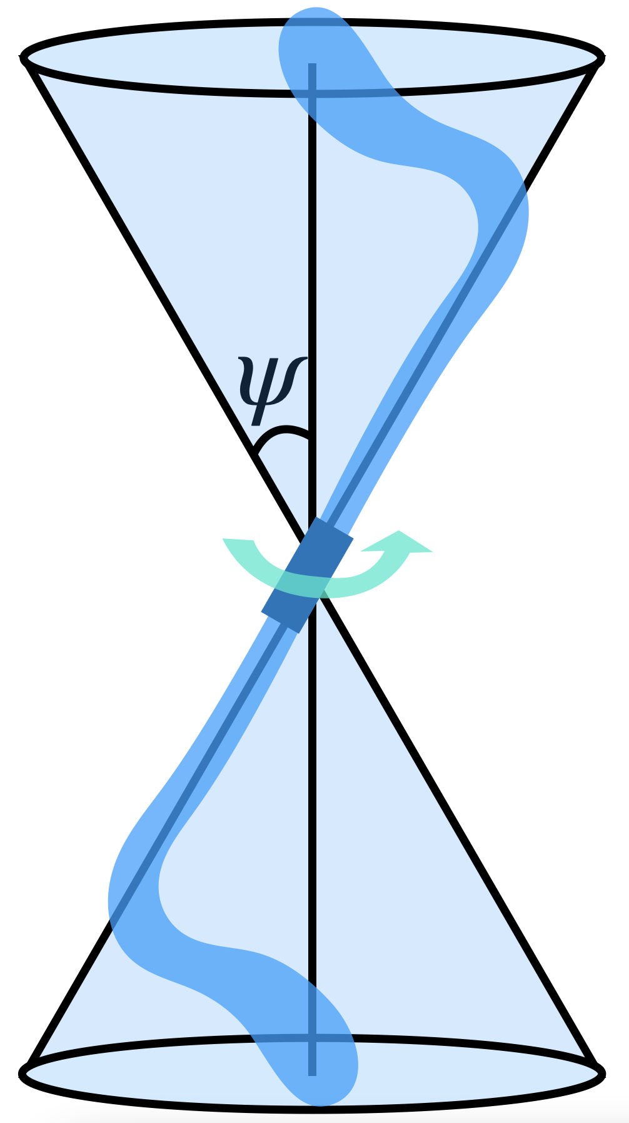
Simulation Setup
3D MHD simulations with Wombat code
Cylindrical jet injection region is rotated every time step
Jet is low density, $β_{p}=75$, in pressure equilibrium, and nonrelativistic
Uniform ambient medium

Slide 4
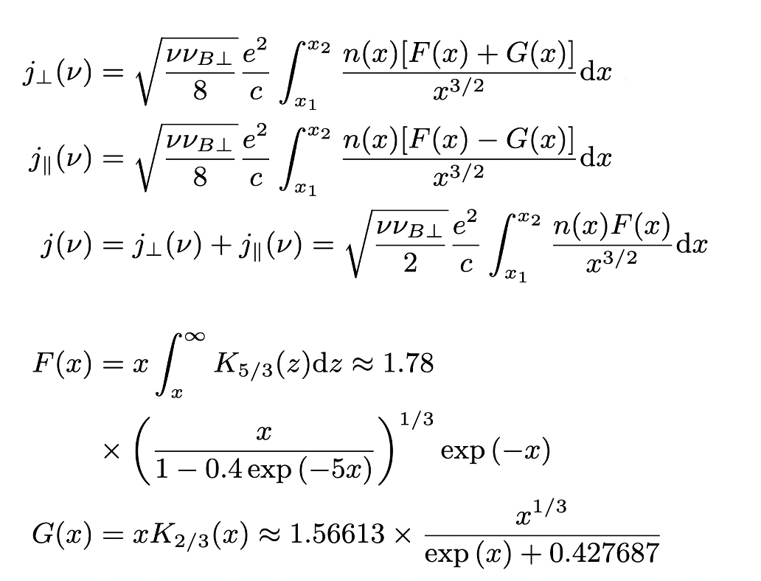
Radio Synchrotron Maps
Population of “cosmic ray” electrons (CRe) injected with jet with a power-law momentum distribution
Radio synchrotron emissivity calculated from the synchrotron kernel functions based on local CRe distribution and magnetic field properties
Multiple frequencies allows for spectral index maps

Slide 5
One example simulation
Precession Angle$ψ=30°$
Precession Period $P=32$ Myr

Slide 6
Effects of Precession Period & Angle
Varied Precession Period (3.2, 32, 96 Myr)
and Precession Angle ($10°$, $20°$, $30°$, $45°$)
Important differences in:
morphology
radio brightness
radio spectrum

Slide 7
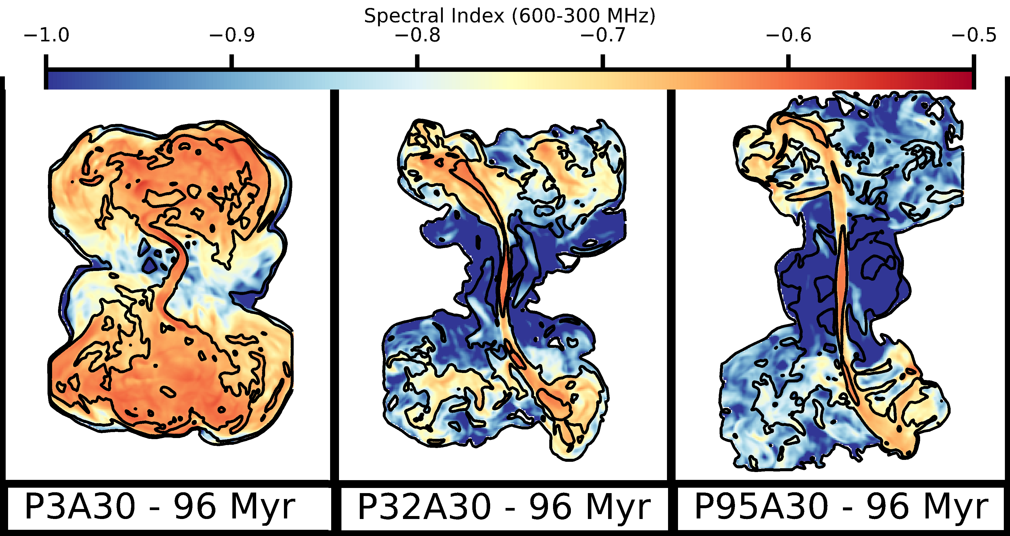
Effects of Precession Period
All with $$ψ=30°$$
Period = 3 Myr 32 Myr 95 Myr

Slide 8
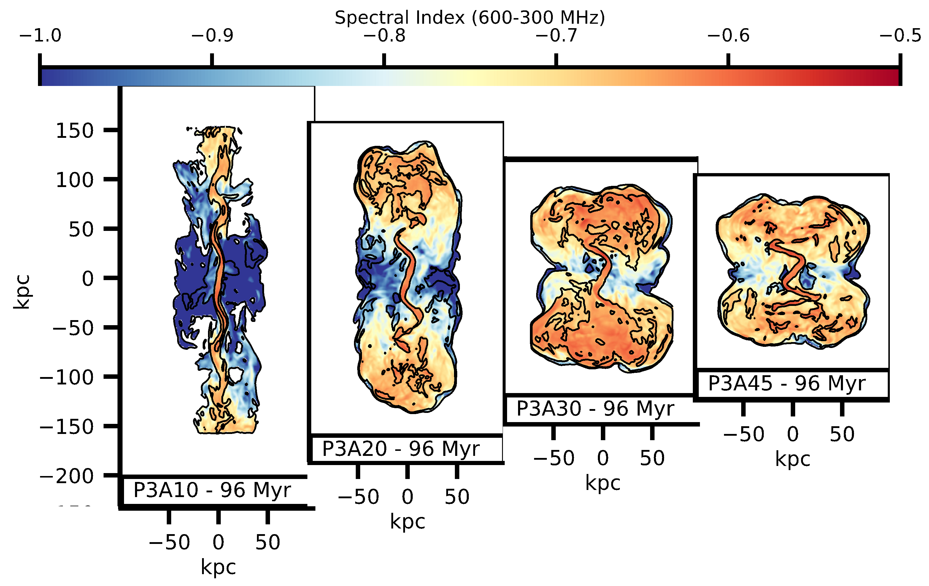
Effects of Precession Angle
45° angle
30° angle
20° angle
10° angle
All with $$P=3Myr$$

Slide 9
Effects of Viewing Angle
Observed morphology greatly depends on viewing angle
For some angles, it may be impossible to determine if the source is precessing

Slide 10
Jet Reorientation Events
Internal precessing jet dynamics can result in strange morphology
After one period, the jet begins to interact with the low density material it left behind previously, greatly reducing the ram pressure the jet feels as it bends through the denser medium
This suddenly increases the bending radius and the jet reorients itself, leading to sharp bends during the restructuring

Slide 11
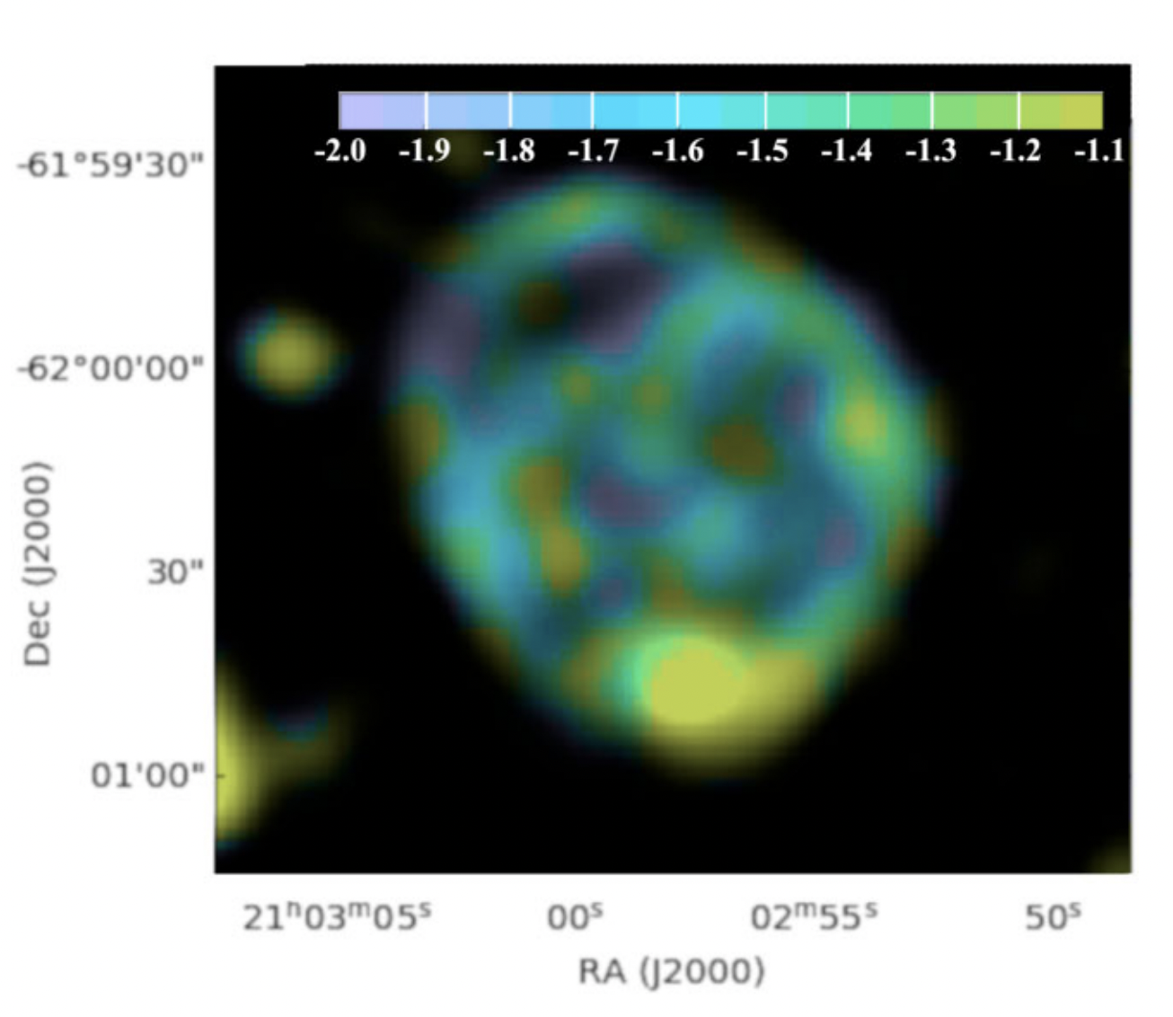
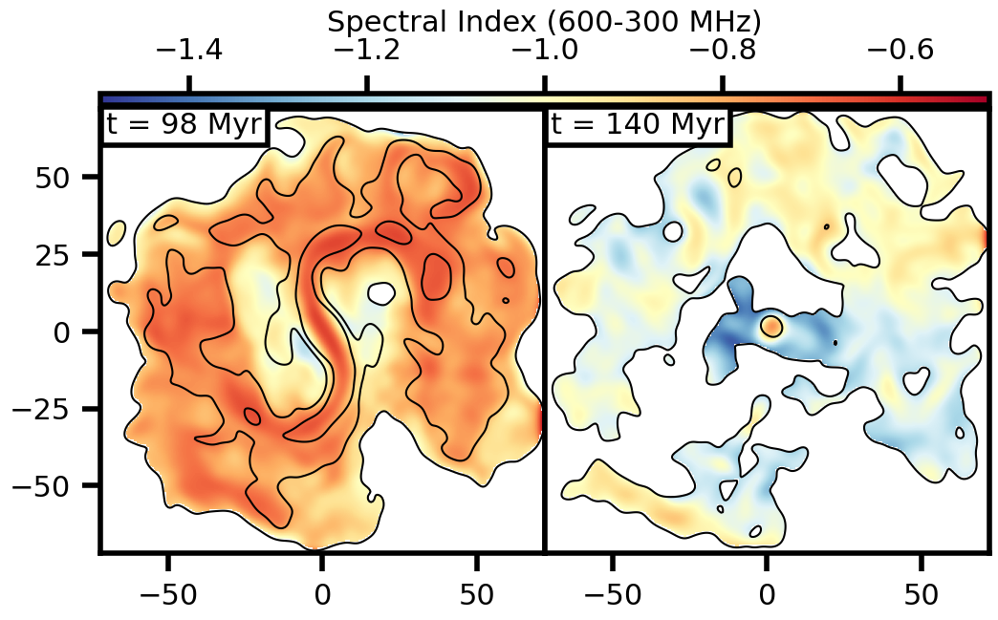
ORC Origins?
Norris et al. 2022

Slide 12
Conclusions
Precessing radio jet morphology changes significantly based on precession properties
Precessing jets with large precession angles are more condensed with flatter spectrum
Precessing jets with shorter precession periods are similarly unable to expand as much as their longer period counterparts
Viewing angle can distort the observed morphology and lead to misunderstanding the dynamics
Internal dynamics can lead to “reorientation events”
From some angles, look similar to ORCs

Slide 13
Appendix: Full Reorientation

