Slide 1
Analysing Mg-II Absorbers from OzDES QSO Spectra
Asif Abbas (NMSU)
Christopher W. Churchill (NMSU)
Glenn G. Kacprzak (Swinburne, Australia)
Susanna Guatelli (University of Wollongong, Australia) Christopher Lidman (ANU, Australia)
Sabine Bellstedt (ICRAR, Australia)

Slide 2
Australian Dark Energy Survey (OzDES)
AAOmega Spectrograph on the Anglo-Australian Telescope
First survey of Mg-II absorbers from the Southern Hemisphere.
QSO spectra wavelength range: 3700Å to 8800Å
Low resolution: 1400 - 1700

Slide 3
Mass Density of Mg-II ($Ω_{{Mg}_{II}}$)
Density of Mg-II relative to the critical density.
Indicator of the mass in Mg-II bearing clouds in galaxy halos.
Never been obtained for z<2.
$Ω_{{Mg}_{II}}=\frac{H_{0}m_{Mg}}{cρ_{c}}\frac{N_{tot}}{ΔX}$
Column Density!!!

Slide 4
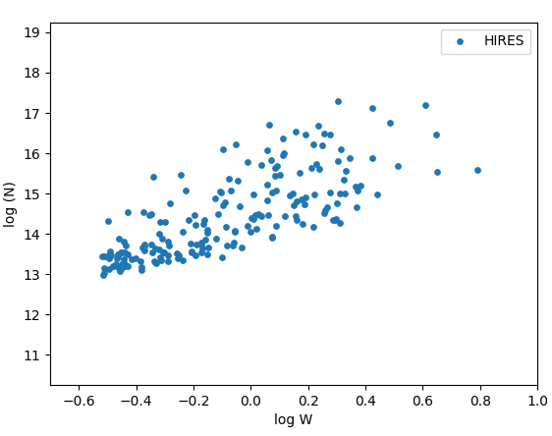
Column densities for a low resolution sample
Step 1. Plot Voigt-Profile column densities (N) against the rest-frame equivalent widths (W) for absorbers from a high-res survey.

Slide 5
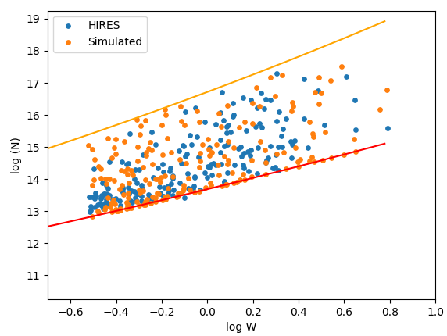
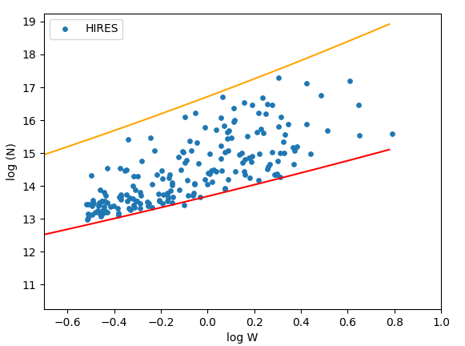
Column densities for a low resolution sample
Step 2. Create a model that describes the N-EW distribution

Slide 6
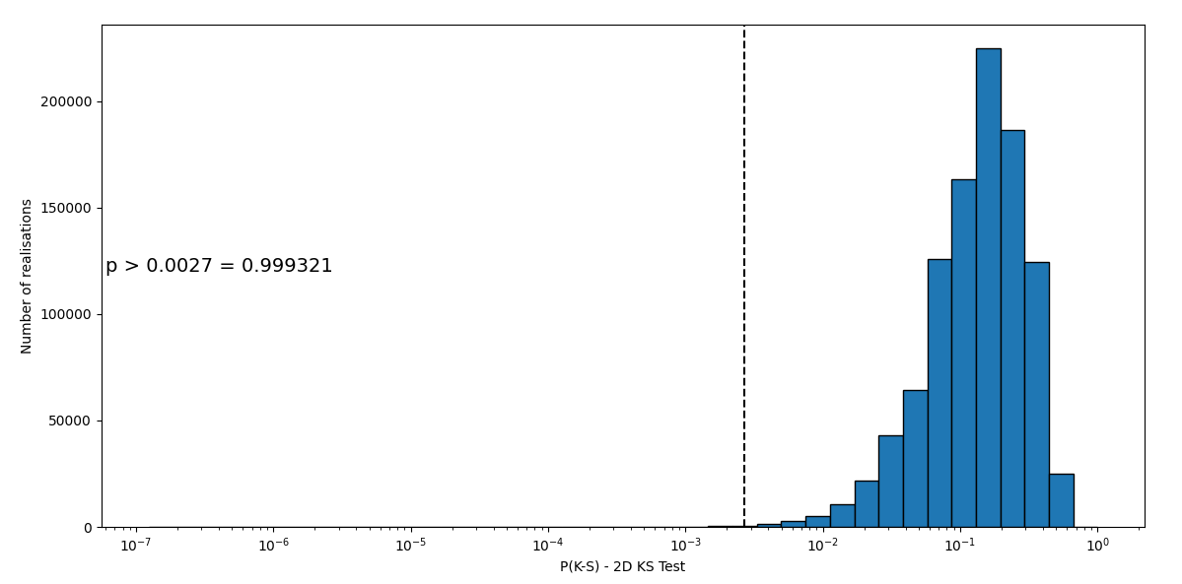
Column densities for a low resolution sample
Step 3. Run a 2D P(K-S) test on a million realisations of the model. This tells us if the model and the data are consistent with being drawn from the same distribution

Slide 7
Column densities for a low resolution sample
Step 4. Input the low res Ws into the model to generate column densities and compute $Ω_{{Mg}_{II}}$, which gives us…..

Slide 8
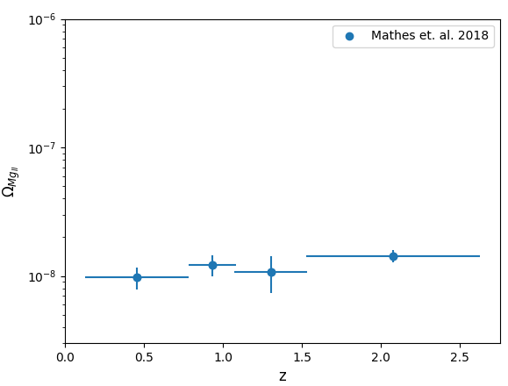
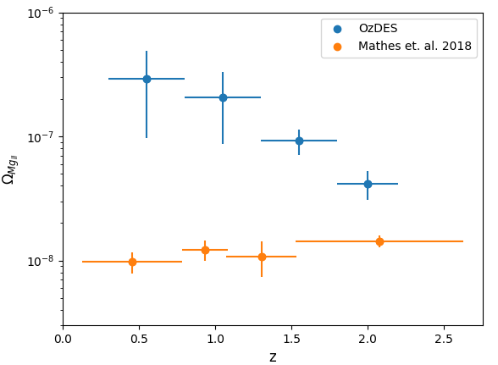
Mass Density of Mg-II ($Ω_{{Mg}_{II}}$)
First measurement of $Ω_{{Mg}_{II}}$ for z < 2.

Slide 9
Conclusions
We develop a new method to measure $Ω_{{Mg}_{II}}$ from low resolution spectra. Can be applied to over a million low res spectra in SDSS to yield tremendous precision for $Ω_{{Mg}_{II}}$ and other ions.
$Ω_{{Mg}_{II}}$ increases by a factor of 10 from z = 2 to z = 0.5, implying the mass of Mg-II bearing clouds in galaxy halos is increasing since cosmic noon.

