Slide 1
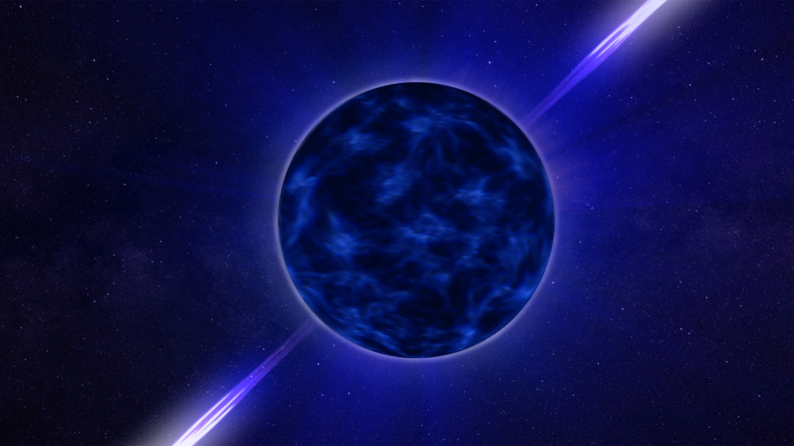
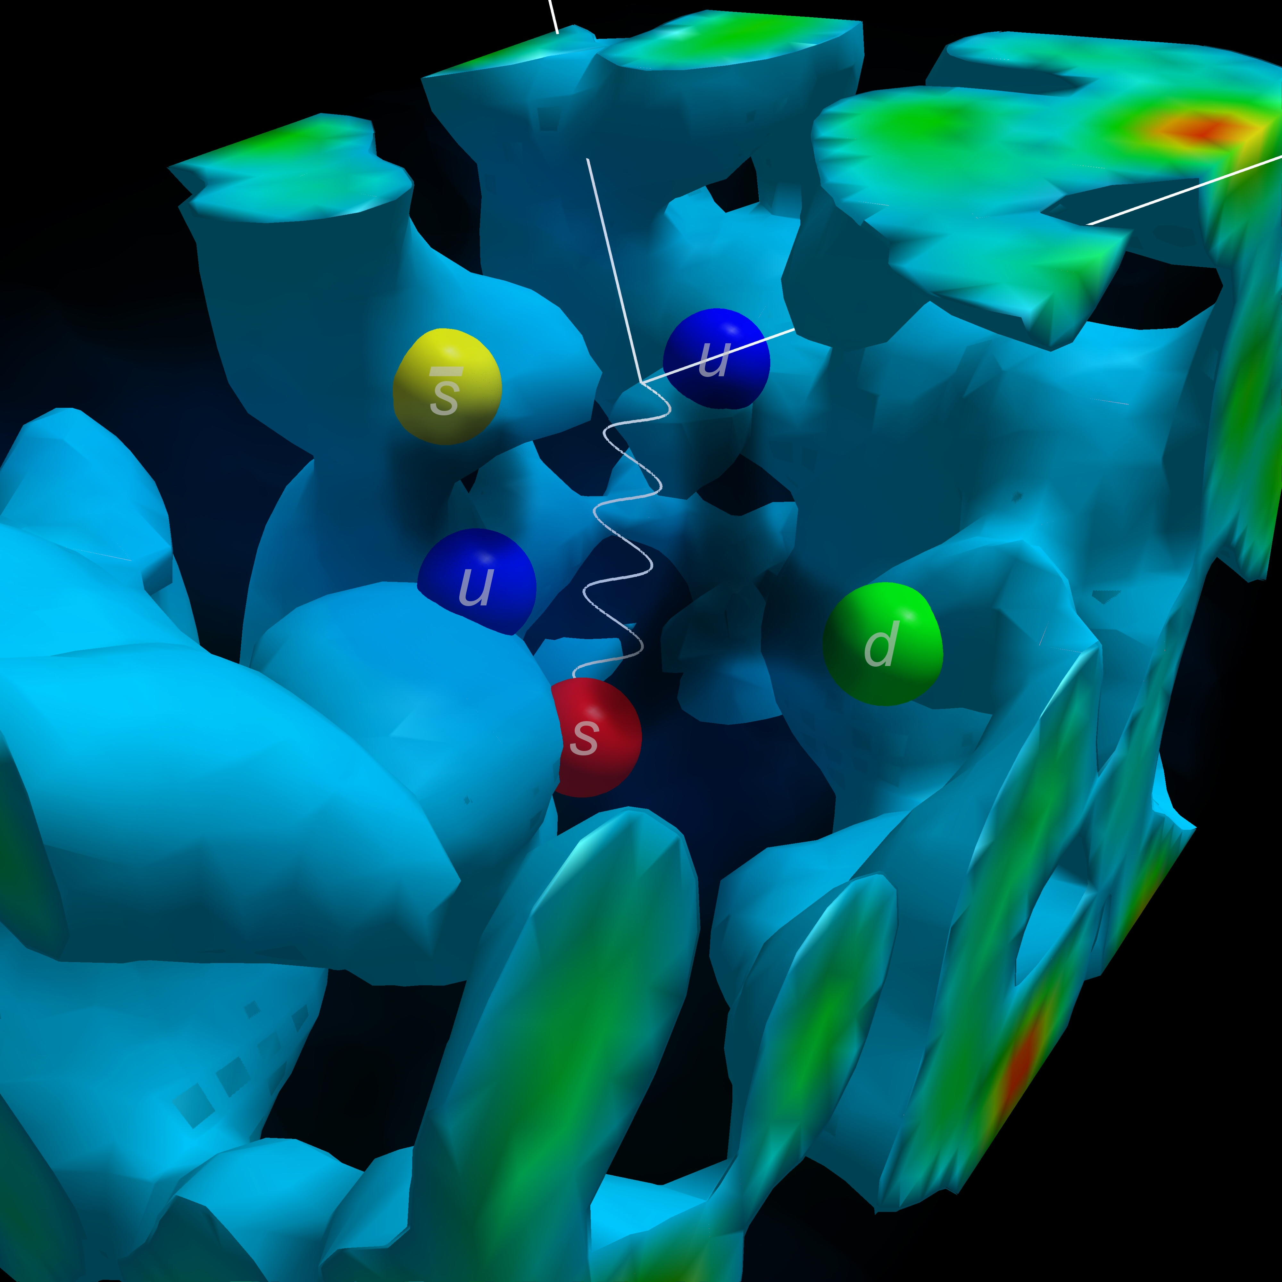
Chiral Condensates in a magnetic field
Image credits:
NASA’s Goddard Space Flight Center Conceptual Image Lab
Derek B. Leinweber
Where astrophysics meets qcd
Will Gyory
37th annual New Mexico symposium, 11/19/21
Phd advisor: V. de la incera (UTRGV)

Slide 2
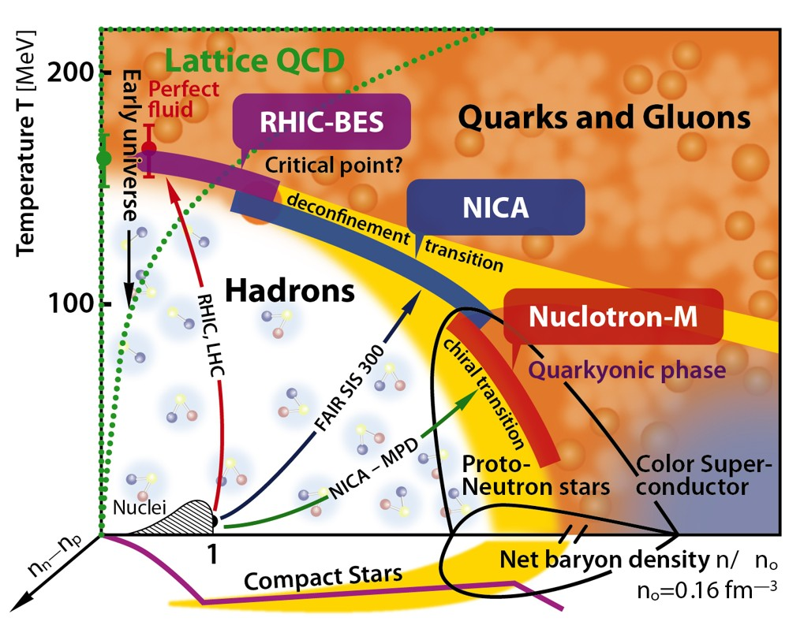
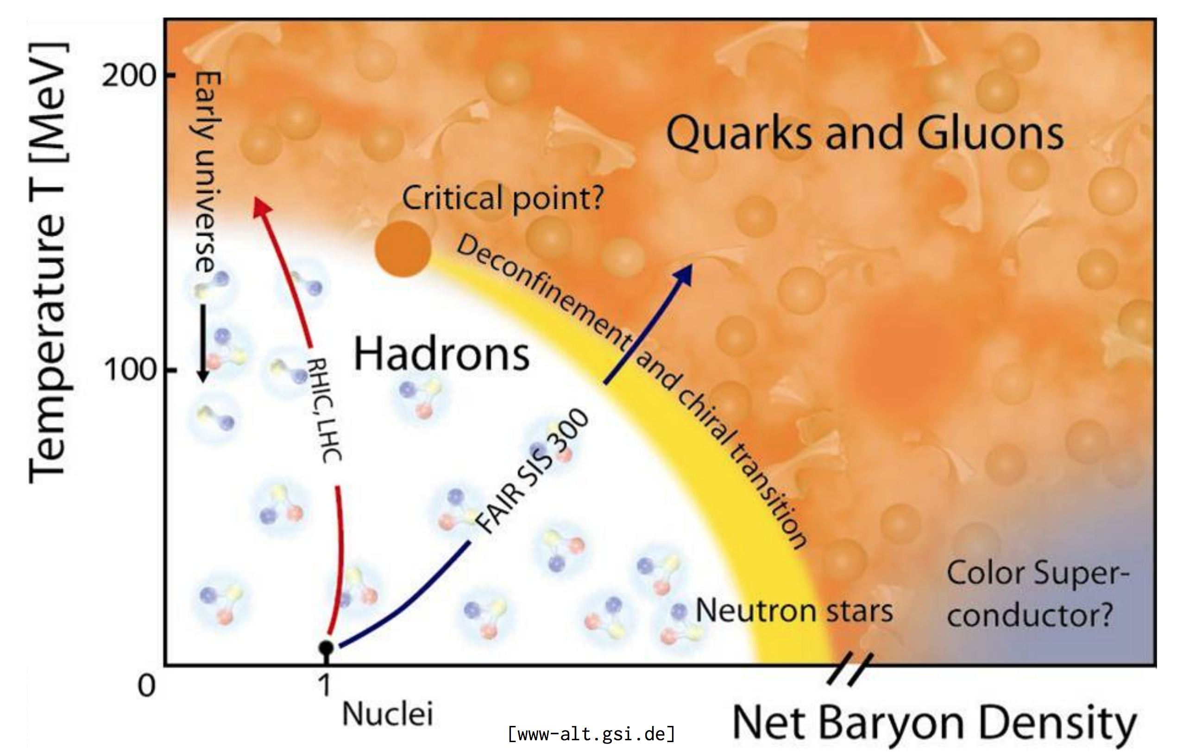
Introduction
Model
Methods
Results
Future Work
QCD Phase Diagram
QCD = Quantum Chromodynamics
  Describes quarks and gluons
Phase diagram attempts to map out states of matter formed by quarks under different conditions
Fundamental and universal
  On this scale, all the matter we encounter on earth is considered the same!
Incomplete experimental and theoretical knowledge
Lattice QCD works for low-µ/high-T; perturbative QCD works for high-T and high-µ regions

Slide 3
Introduction
Model
Methods
Results
Future Work
NJL Model
integrate out gluon degrees of freedom
(preserves all symmetries)

Slide 4
Introduction
Model
Methods
Results
Future Work
Step 2: Use DCDW Ansatz
Next, we propose the following ansatz:
∆ (condensate amplitude) and q (modulation wave number) are order parameters of the theory
First proposed and studied ~30 years ago for a variety of theoretical, historical, and practical reasons
Known as the “(magnetic) dual chiral density wave,” (M)DCDW
  “Dual” because of the two components on the left (scalar and pseudoscalar)
  “Chiral” because chiral symmetry, , is broken (when ∆ > 0)
  “Density wave” because the amplitude of each component varies over space
From here, using mean field theory, one can derive an expression for the free energy, Ω

Slide 5
Introduction
Model
Methods
Results
Future Work
GL Expansion Method
Goal: Minimize the free energy, Ω, with respect to the order parameters (∆, q) ≈ (m, b)
Difficulty: Expression for Ω is somewhat complicated

Slide 6
Introduction
Model
Methods
Results
Future Work
GL Expansion Method
Goal: Minimize the free energy, Ω, with respect to the order parameters (∆, q) ≈ (m, b)
Difficulty: Expression for Ω is somewhat complicated
Strategy: Expand free energy in powers of the order parameters about m = b = 0
To find the coefficient of the term bᵏ mⁿ, take k derivatives of Ω w.r.t b, n derivatives w.r.t m, then let b, m ➝ 0

Slide 7
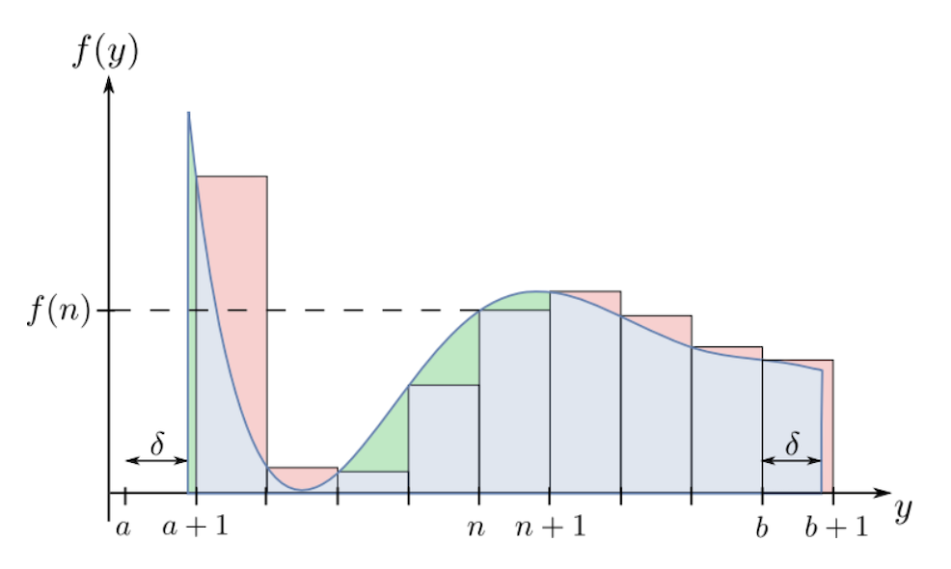
Introduction
Model
Methods
Results
Future Work
Solving for the GL Coefficients
Trick #1: We were able to show that all coefficients with the same total order are identical except for numerical pre-factors, and we found a formula for these pre-factors.
The task is now reduced to finding only the coefficients on terms of the form bᵏ m².
Trick #2: We used the Euler–Maclaurin formula, which approximates sums using an integral, and gives a series of correction terms. After doing so, we were able to derive closed-form expressions for the remaining coefficients.

Slide 8
Introduction
Model
Methods
Results
Future Work
Order Parameter Solutions
These plots show order parameters m and b plotted against chemical potential.
The GL approximations become very good by order 20, which is easy to calculate using the nth-order formulas we derived.
Note that a strong magnetic field (bottom) significantly extends the lower and upper regions of µ over which m is large.
Note also that m doesn’t completely vanish when a magnetic field is present—we call this the “remnant mass.”

Slide 9
Introduction
Model
Methods
Results
Future Work
Critical Temperature
At each chemical potential, there is a critical temperature beyond which m = 0
Strong magnetic fields significantly increase the critical temperature in the region relevant to compact stars
Even for weaker magnetic fields and intermediate chemical potentials, due to the remnant mass effect, the critical temperature can remain significant compared to typical compact-star temperatures

Slide 10
Introduction
Model
Methods
Results
Future Work
Applications and Future Work
Although this work examined the temperatures up to which MDCDW remains energetically preferred, a remaining task is to verify that the condensate is stable against thermal fluctuations.
  It is known that without a magnetic field, DCDW is unstable at all T > 0, an effect called the Landau-Peierls (LP) instability.
  It was recently shown that with a magnetic field, MDCDW does not suffer from this instability. But we do not know the temperature at which thermal fluctuations become significant.
Other key transport properties, like thermal and electrical conductivity can be calculated and compared against astrophysical observations.
Electromagnetic effects & photon interactions—missing pulsar problem?

Slide 11
THANKS!

