Slide 1
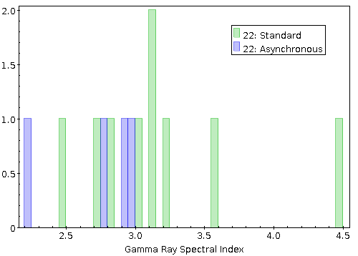
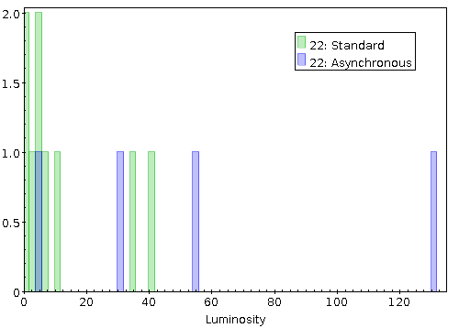
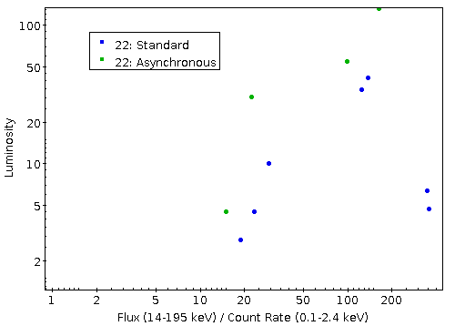
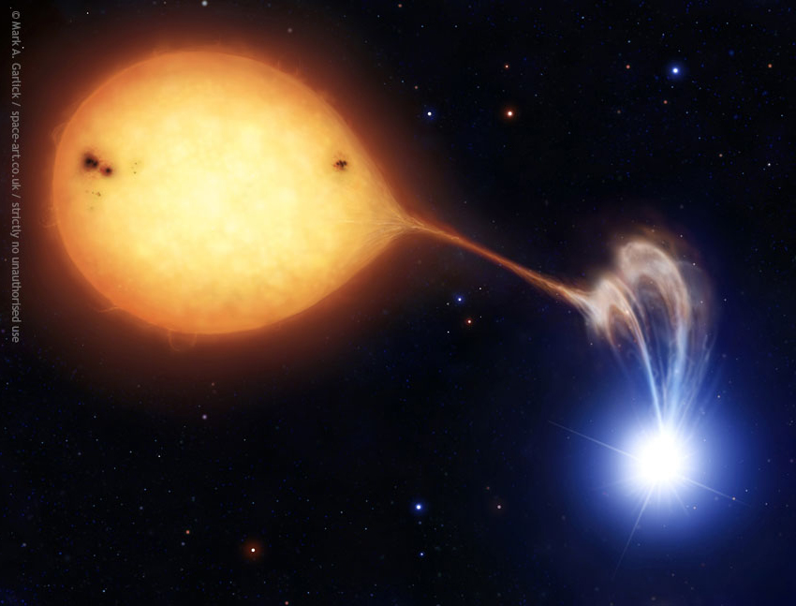
An Analysis of X-Ray Hardness Ratios Between Asynchronous and Standard Polars
Eric Masington¹, Thomas Maccarone¹, Liliana Rivera¹, Craig Heinke², and Arash Bahramian³
¹Texas Tech University
²University of Alberta
³Curtin University
Shown here is Swift’s power law fit to the data from 14 to 195 keV.
Shown here is the distribution of luminosities in the samples of polars.
INTEGRAL showed a disproportionate amount of asynchronous polars, but was this because the x-ray and gamma-ray spectrums are different or because asynchronous polars are more luminous?
Matched data from Ritter and Kolb Catalog of Cataclysmic Variables, Swift-BAT 105-Month All Sky Survey, and the ROSAT All-Sky Survey
Found no evidence of dissimilarity between the two types of polars.
An artist’s rendition of a polar, showing a disrupted accretion flow from a strong magnetic field surrounding the white dwarf.
Notes:
1

