Slide 1
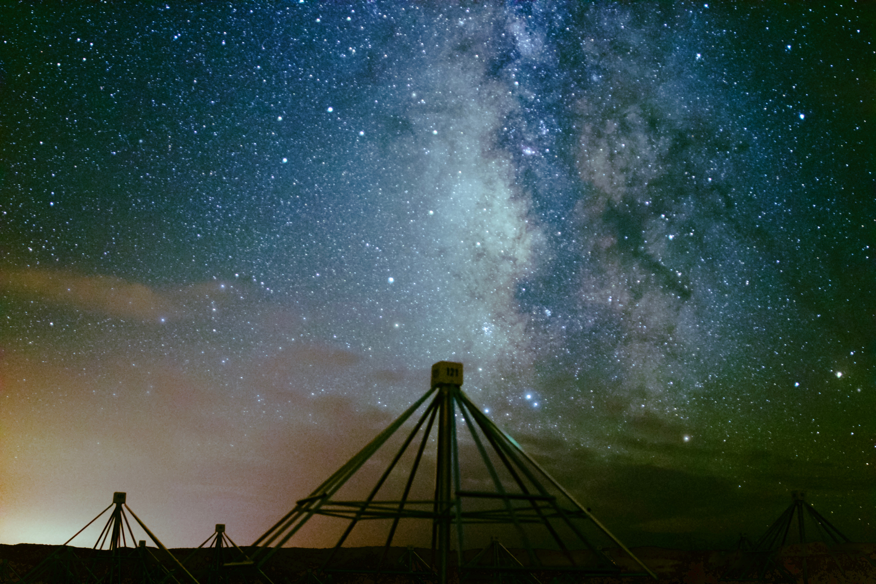





Studying Meteor Radio Afterglows with the Long Wavelength Array and Widefield Persistent Train Camera
${Savin Shynu Varghese}^{1}$, ${\text{Kenneth} \text{Obenberger}}^{2}$, ${\text{Jayce} \text{Dowell}}^{1}, {\text{Greg} \text{Taylor}}^{1}$and ${J. M. Holmes }^{2}$
University of New Mexico
Air Force Research Laboratory
The 35th Annual New Mexico Symposium
Socorro, February 21 , 2020

Slide 2
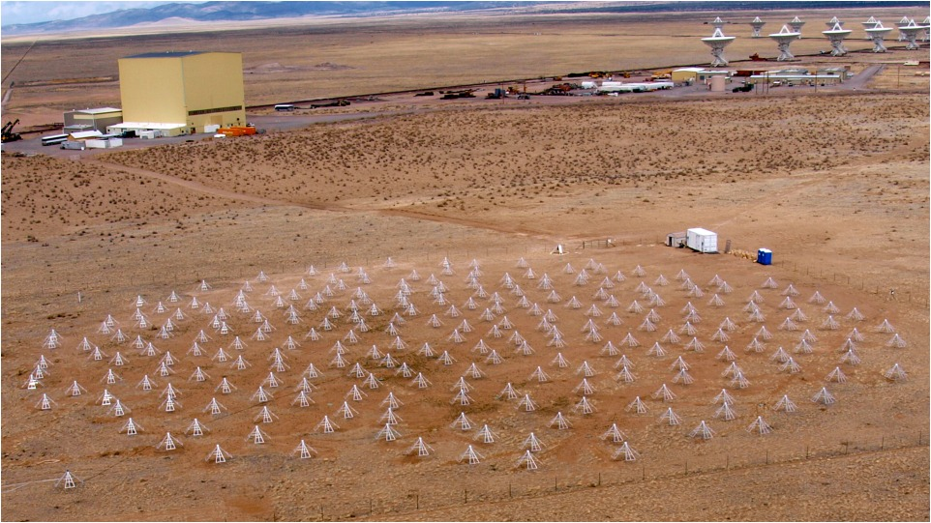
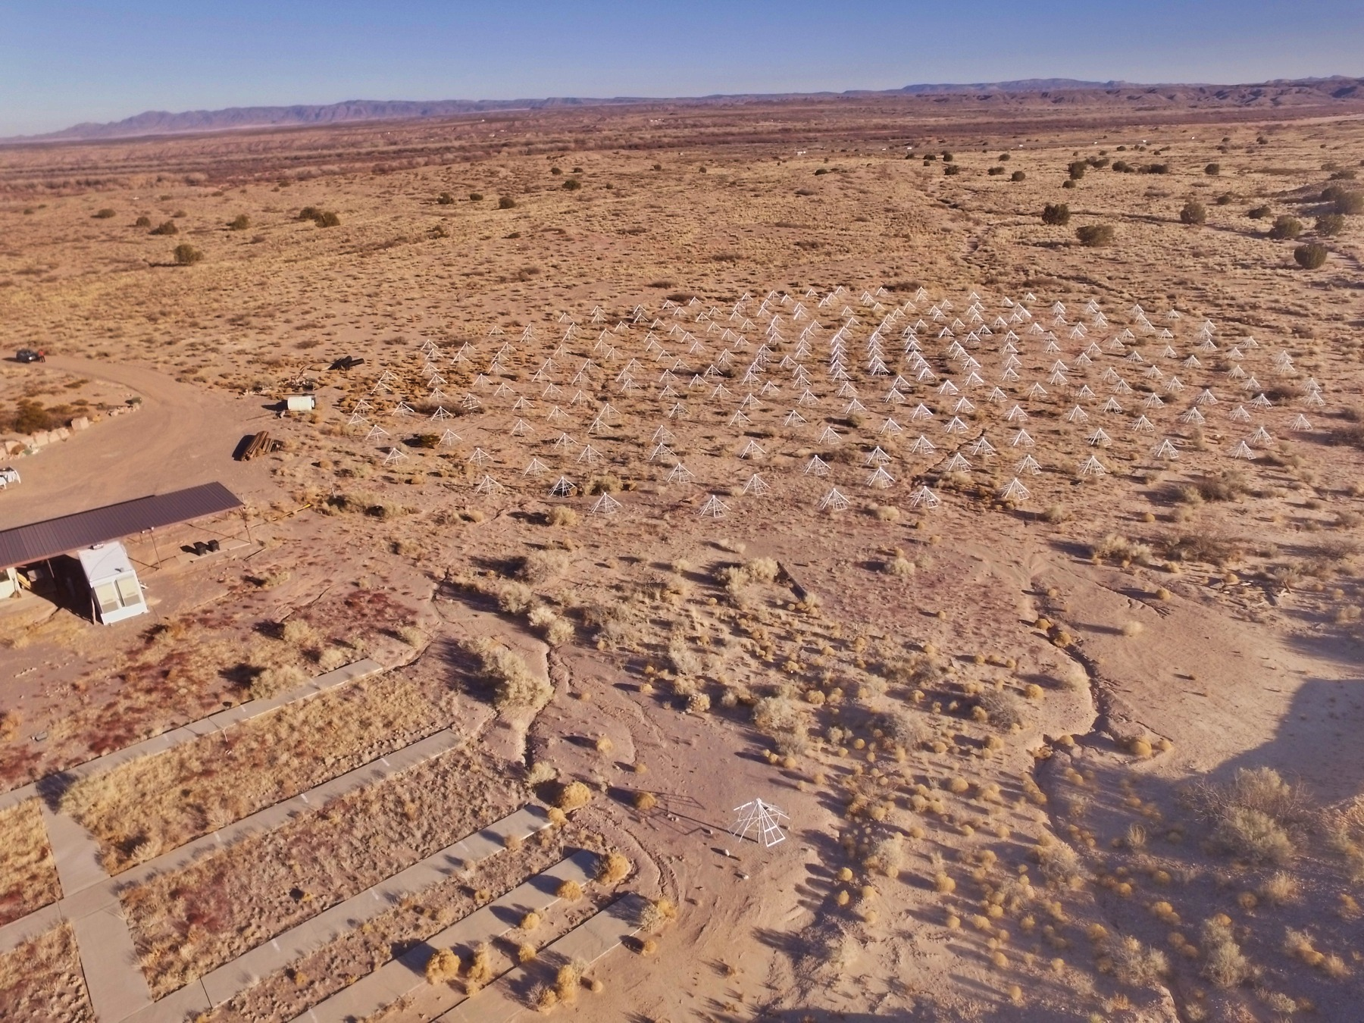
Long Wavelength Array (LWA 1 and LWA-SV)
Operating frequency 10-88 MHz for LWA1 and 3-88 MHz for LWA-SV
256 dual- polarization dipole antennas
Distributed within a 100 × 110 m ellipse
Beamforming and All-sky mode
75 km separation
Notes:
LWA is a radio telescope situated in central new Mexico which currently has two stations. This is the picture of the lwa1. First station operates between 10 -88 MHz frequency range and consists of 256 dipole arrays collecting data in dual polarization mode. The core of the array is distributed in the from of an ellipse 100 * 110 m . LWA1 station is collocated to VLA and second station is situated 75 km ne of lwa1 at the sevilleta national wildlife refuge. Both stations primarily operate in two modes, beam forming mode and all-sky mode

Slide 3
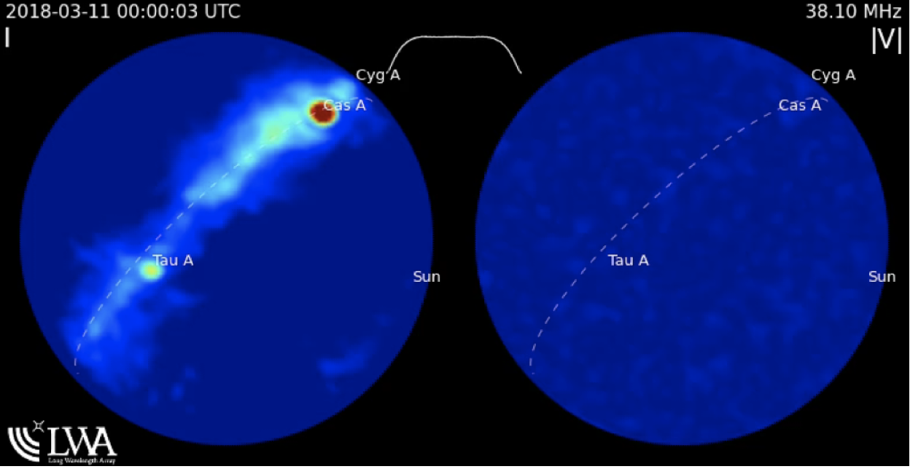
Transient Buffer Narrowband (TBN) & LWA TV
(TBN)- continuous collection of voltage time series data at 100 kHz.
LASI (LWA all-sky imager/correlator) produces all-sky images every 5 s.
Study transient sources.
Notes:
TBN is one of the all sky operating modes of the LWA. In transient buffer narrow band mode we collects the voltage time seris from each dipole continuously at 100 kHz . The TBN data collected is sent to the backend coorelator where signals from each antenna is cross correlated to make images. everything happens in real time and are uploaded to the LWA TV.

Slide 4
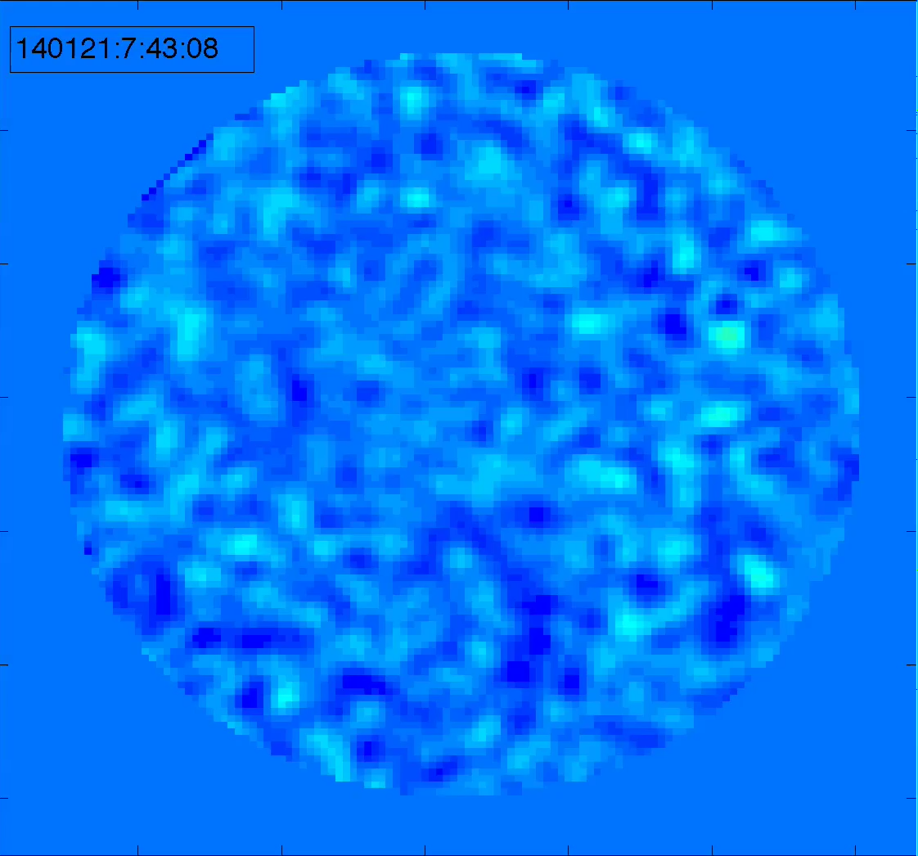
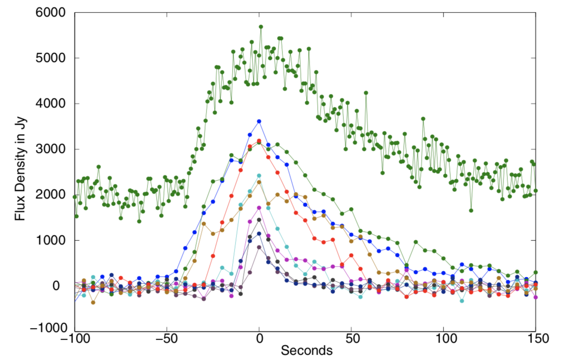
First Detection of Meteor Radio Afterglow (MRA)
Smooth and broadband 20-60 MHz
Isotropic emission
Altitude cutoff ~ 90 km
Radiation mechanism ??
Current hypothesis: electron plasma waves emitting from turbulent ionized trail at plasma frequencies.
Requires energy source of suprathermal electrons
Obenberger et al. 2014, Varghese et al. 2020
Notes:
Earlier we had only LWA1 station and in 2014, ken Obenberger made the first detection MRA . As the meteoroid particle enters the earth's atmosphere at high velocities, they ablates and form a plasma trail. The emission is basically the electro magnetic conversion of plasma oscillations in the turbulent trail.
The image on the right shows the light curves of few such events. All of the events follow a fast rise and n exponential decay which can be from few second to few minutes. This is a movie of the afterglow events which spans 92 degrees in less than 10 seconds and emission recedes to the end point and lasts for few minute.
We have detected may faint point sources events.
We have an average detection 60 mras per year and with a single station it was diffiiculto differentiate between these fore ground sources and cosmic signals.

Slide 5
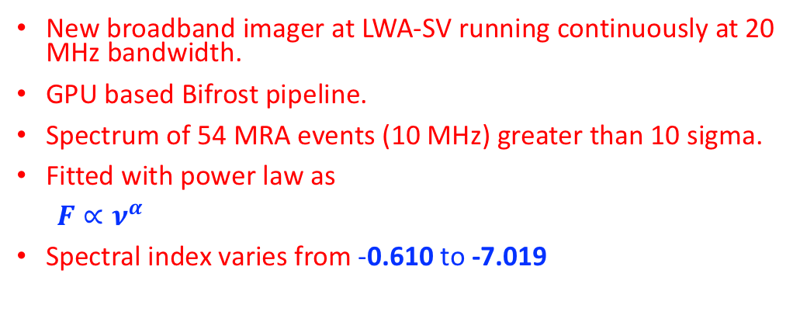
Broadband spectrum of MRAs
New broadband imager at LWA-SV running continuously at 20 MHz bandwidth.
GPU based Bifrost pipeline.
Spectrum of 54 MRA events (10 MHz) greater than 10 sigma.
Fitted with power law as
$F∝ν^{α}$
Spectral index varies from -0.610 to -7.019
Varghese et al. in prep
Notes:
Now we have a wideband imager and whenever a mra happens in all-sky images, I can just grab the wideband data and make spectrums like this. The idea is to get an average spectral index from a sample of measurements. Once I get the response of the mra, they are calibrated with Cygnus a and they are fitted with power law

Slide 6
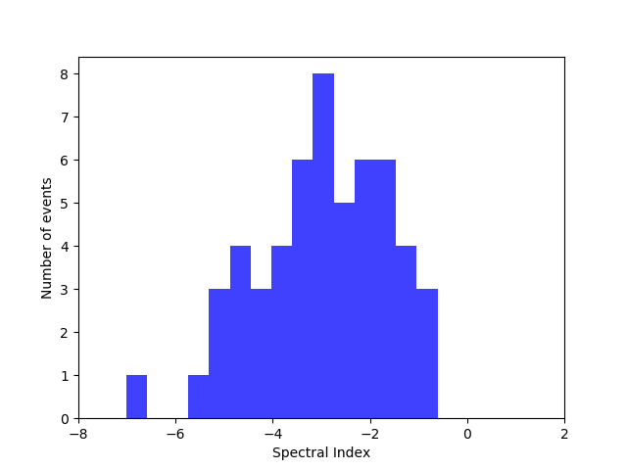
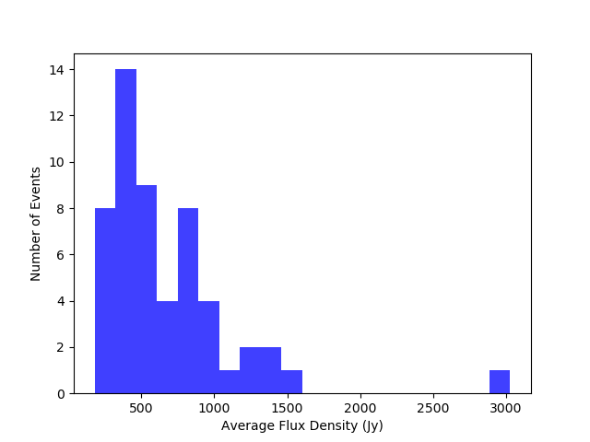
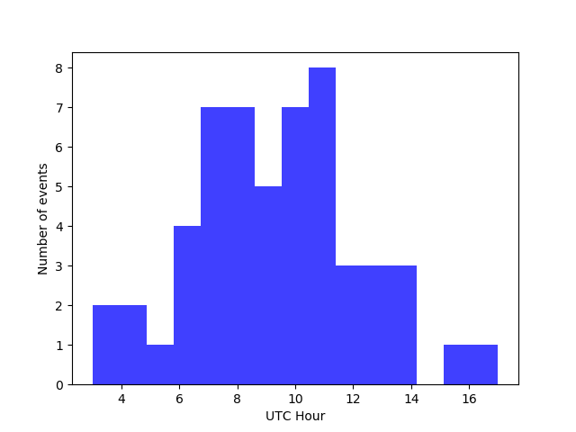
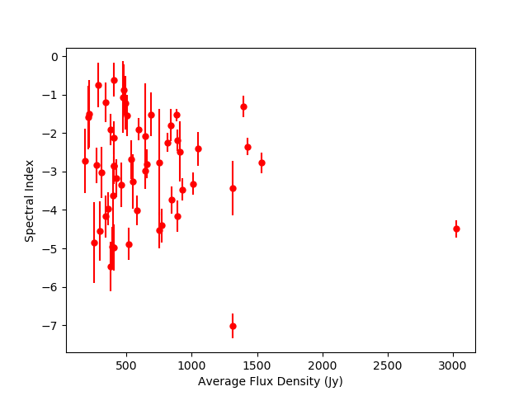
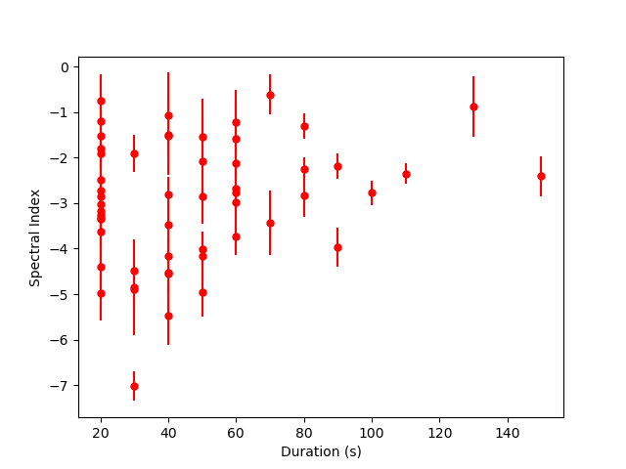
Varghese et al. in prep

Slide 7
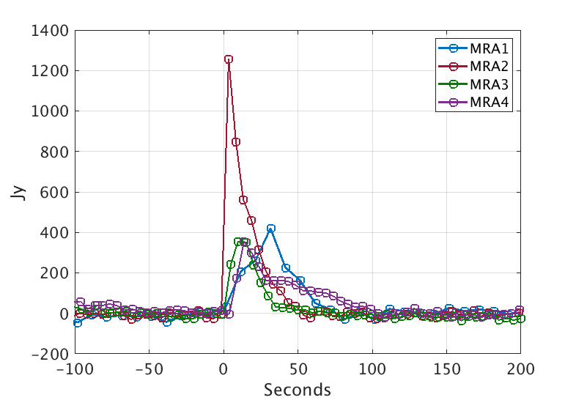
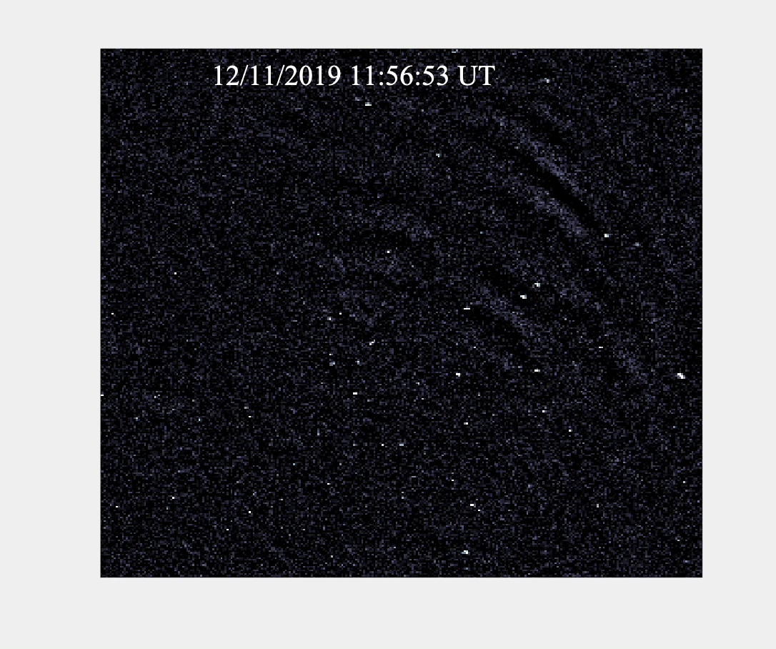
Association between MRAs and Persistent Trains(PT)
Fast and bright meteors produce long lasting emission in optical and NIR
Exothermic reactions between ablated meteoric particles and atmospheric oxygen
Suprathermal electrons to drive MRA emission
Widefield Persistent Train Camera (WiPT) in LWA-SV: CANON 15mm f2.8 Fish-Eye Lens, Apogee Alta F9000 cooled CCD camera and Kodak KAF-09000 sensor
Snapshots of the all-sky every 6.3 sec between 7 pm- 5 am local time when sun and moon below horizon
4 MRAs and associated PTs on clear moonless night
Obenberger et al. in prep

Slide 8
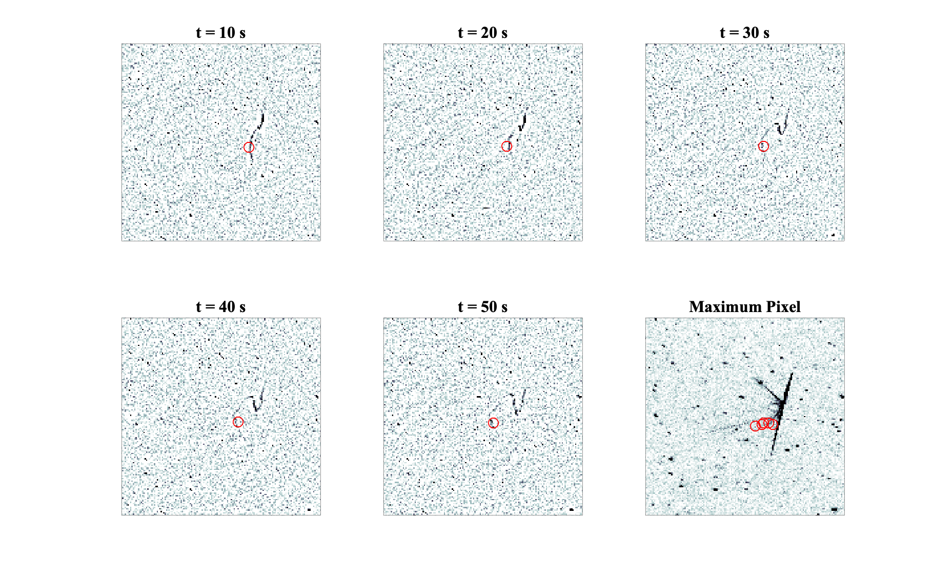
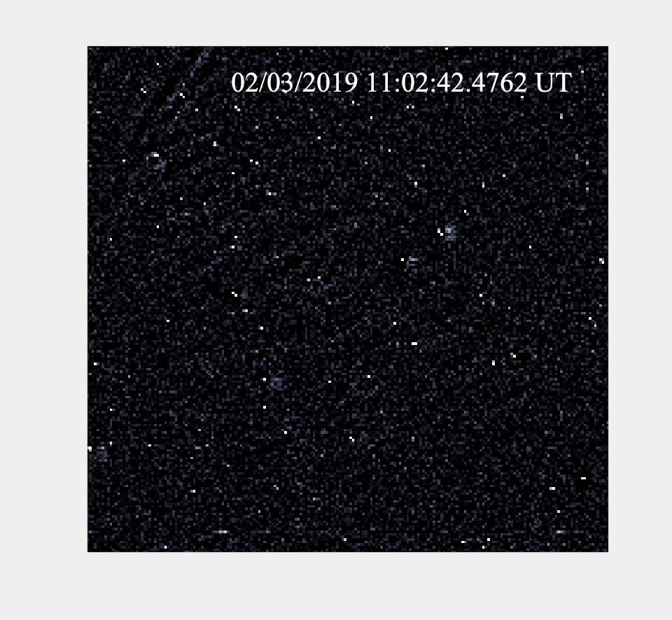
MRA1 & PT1
Obenberger et al. in prep

Slide 9
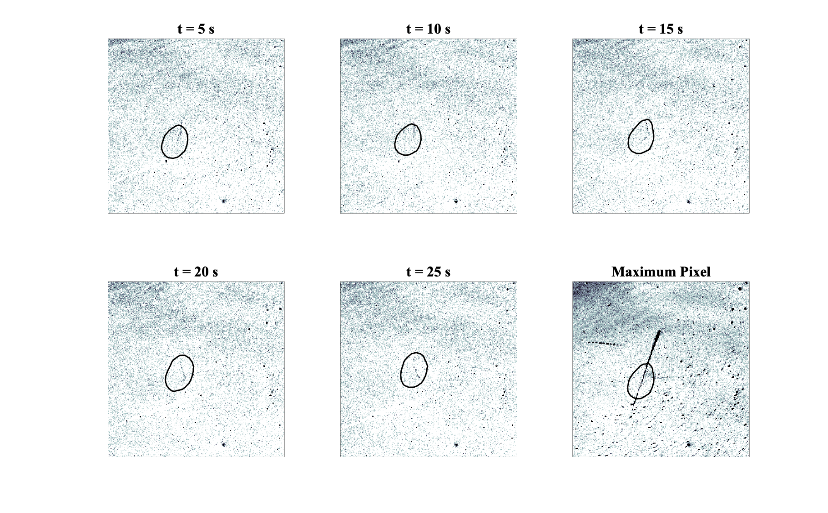
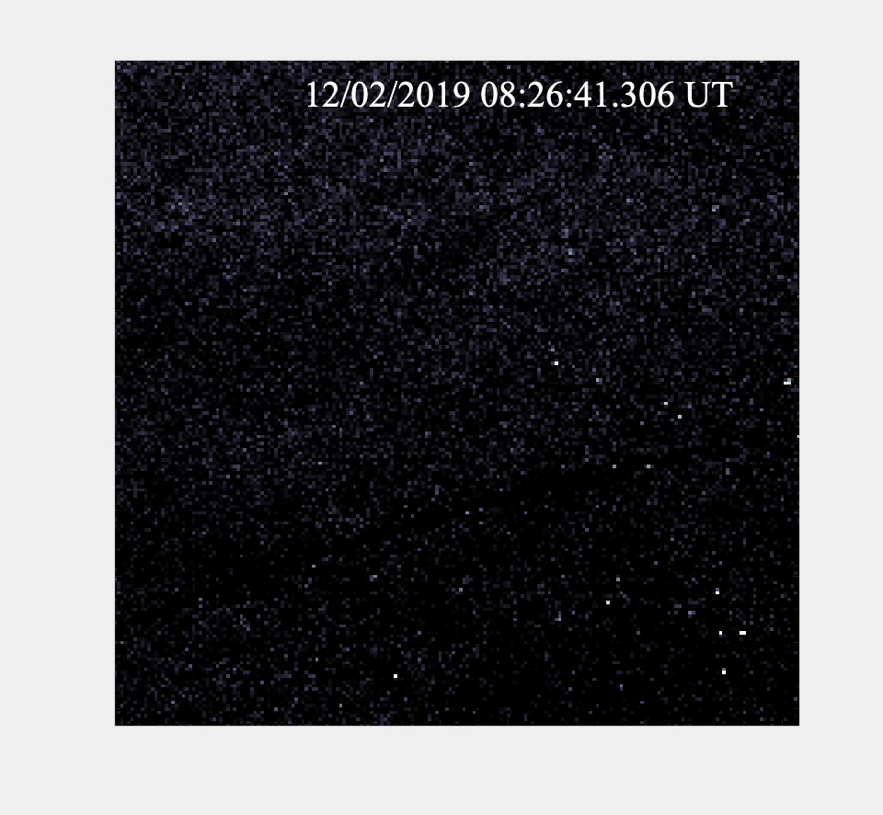
MRA2 & PT2
Obenberger et al. in prep

Slide 10
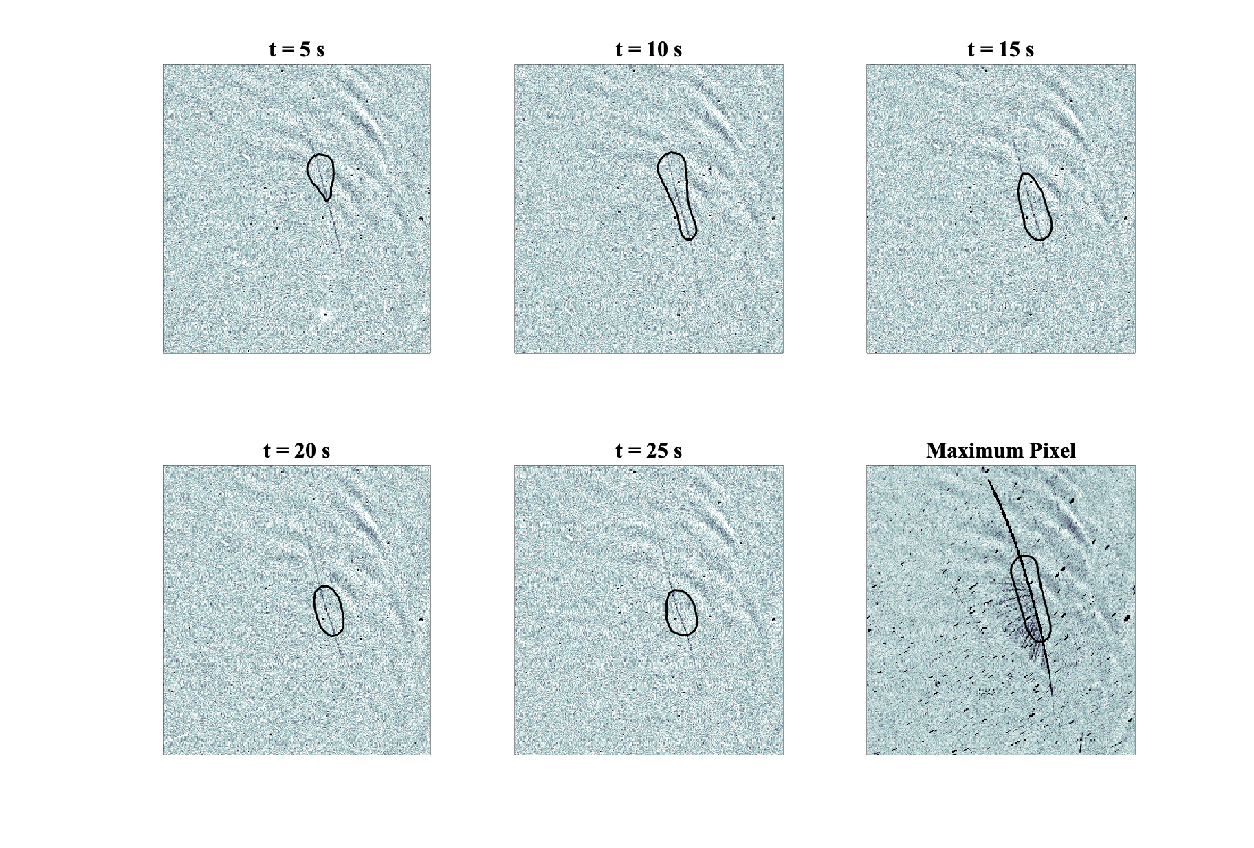
MRA3 & PT3
Obenberger et al. in prep

Slide 11
Summary
Measured spectral index of MRAs peaks near -3.0.
Detection possibility for other low frequency instruments.
Long duration events tends to be flatter and no clear correlation with the other factors.
4 MRAs on clear moonless nights correlate spatially and temporally with PT regions.
Origin of MRAs associated with the region of PT activity.
Exothermic reactions powering PTs could be the source of suprathermal electrons which drives MRAs.

Slide 12


Slide 13
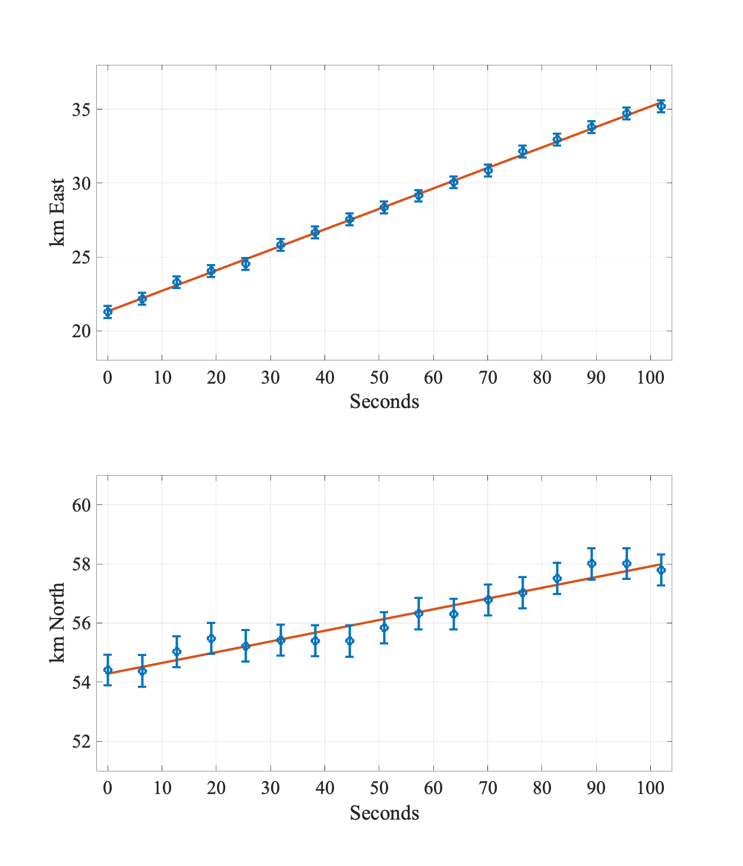
Measured wind Speed of 143 m/s
Horizontal wind model predicts ~ 58 m/s between 90-110 km

Slide 14
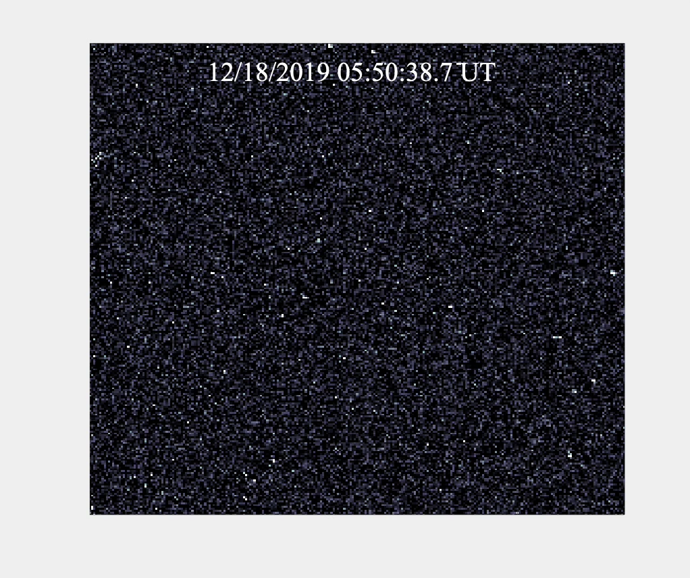
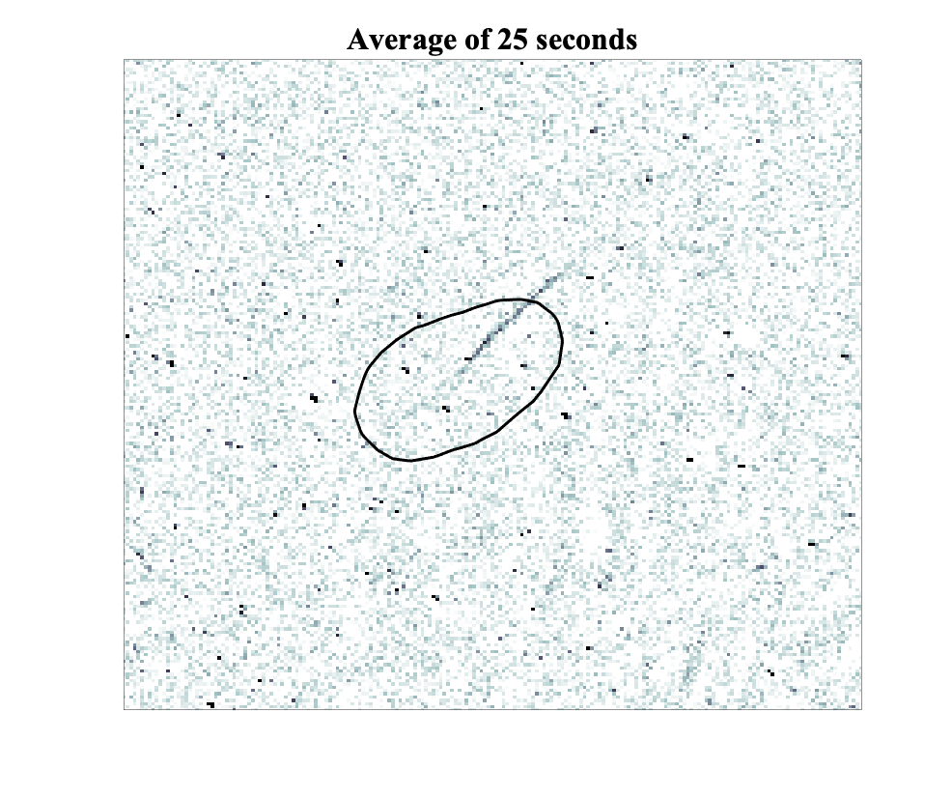
MRA4 & PT4
Obenberger et al.in prep

Slide 15
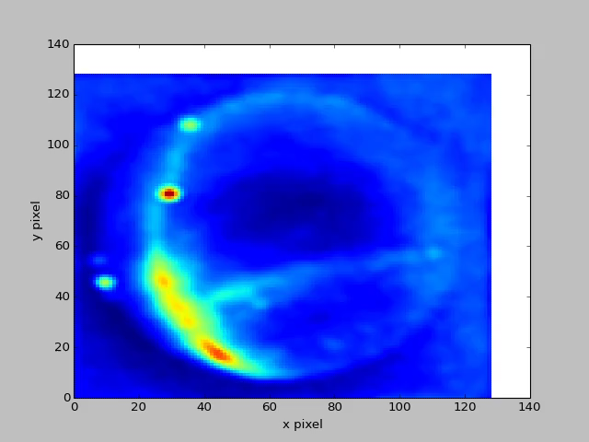
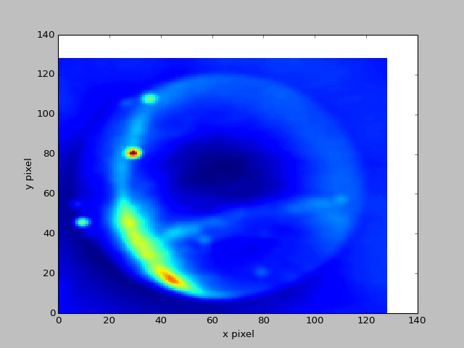
New Broadband Imager
LASI (100 kHz)
Broadband Imager in LWA-SV (10.8 MHz)
Goals:
Collect the broadband spectrum of MRAS
Transient search using broadband data
Imager running continuously at 20 MHz bandwidth
GPU based Bifrost pipeline outputs images
Notes:
This video shows how the images look in LASI operating at 100 kHz and broadband imager operating 10.8 MHz. If you compare both of them, the images from the broadband imager has lesser scintillation and lesser noise

Slide 16
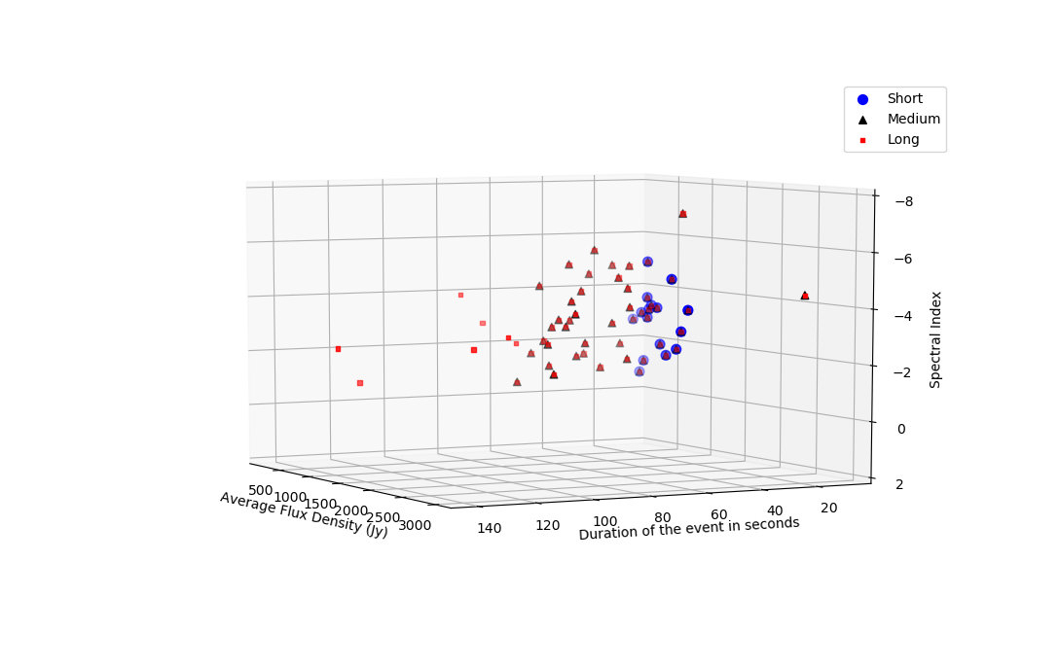

Slide 17
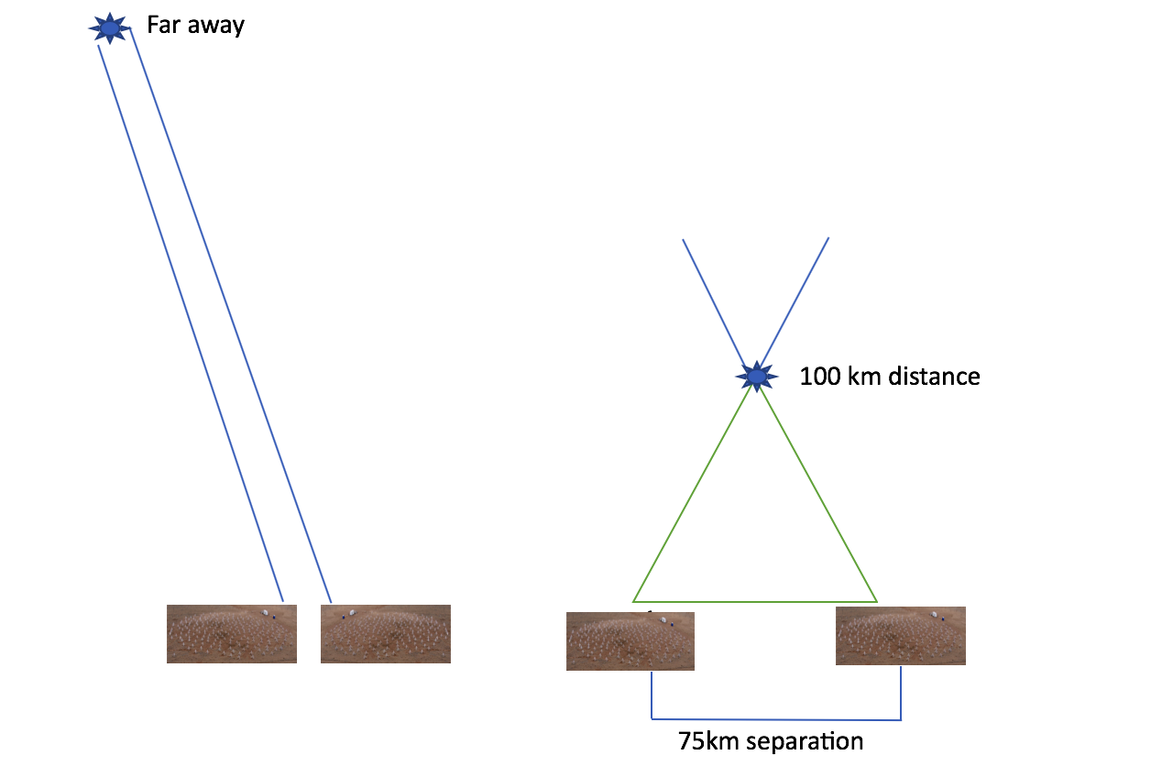
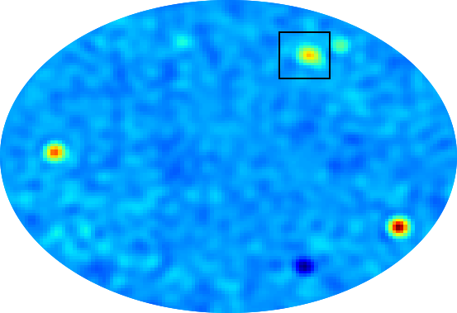
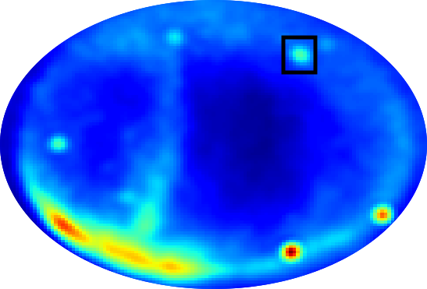
Transient Search Pipeline
Image subtraction algorithm
Average of previous 4-6 images subtracted from a running image
Marks pixels greater than 6σ
Cosmic transient candidate
MRA candidate
Notes:
Transients are class of objects which emits radio waves in the form bursts, flares or pulses from short duration (less than few sec) to long duration(greater than few sec). The location of these sources are associated with explosive or dynamic events. They can be classified into extragalactic, galactic and atmospheric based on the location of their occurrence. Probing such sources will help to understand the physical mechanism of these events
In our pipeline, we use the image subtraction algorithm to find transients. From a running image, an average of 4 images are subtracted to get the subtracted image. This process removes the steady sources in the sky and diffused noise from the galactic plane. But even after doing that, there may be some residuals left due to scintillation of the sources. So we mask the bright sources in the sky. Then pixels greater than 6 sigma are marked as transients. The detection threshold varies near the galactic plane. Currently search is done at 5,15 and 60 s and at stokes I & V.

Slide 18
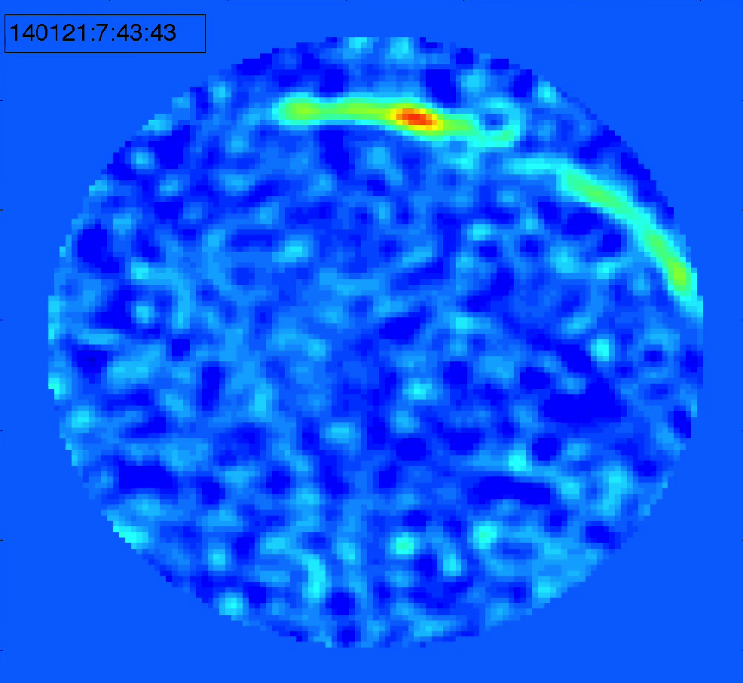
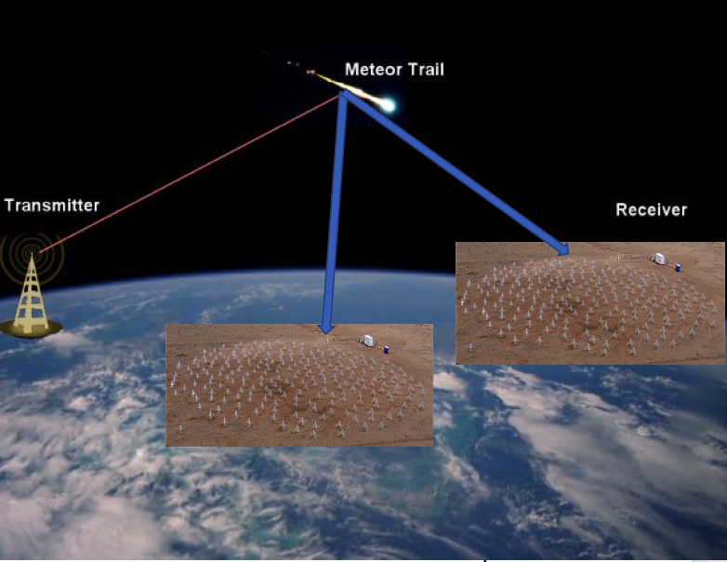
Co-observed MRA & Transmitter Reflections from Meteors (Meteor Scatter Event)
MJD 58243
MJD 58172
MRA-Broadband and unpolarized
Meteor scatter- Narrowband and polarized
Varghese et al. 2019, JGR Space Physics (accepted)
Notes:
.
Now we have two stations to monitor events. This is one of the cases of co-observed mras and rfis in both stations.
The MRA events are identified on the basis of the light curve pattern with fast rise and slow decay and a lack of polarization. At the same time, RFI events are bright, highly linearly or circularly polarized and are short in duration. The event is brighter one lwa1 and fainter in lwa sv. In the next few slides I am going to explain why the differences in fluxes are important and how they can be used to study the nature of mra

Slide 19
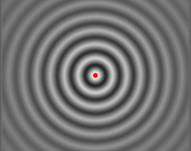
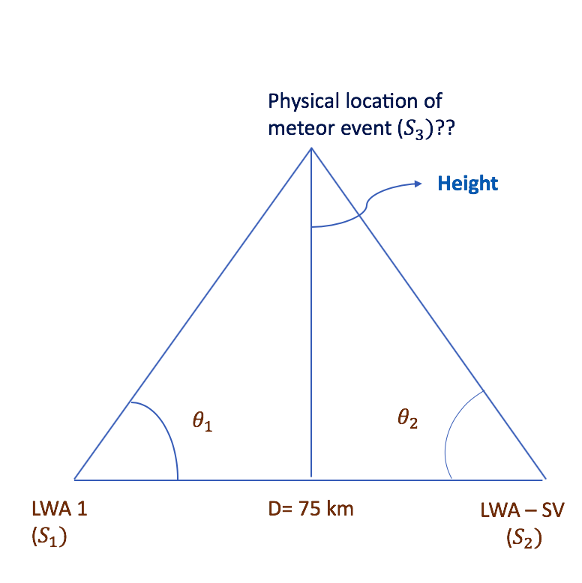
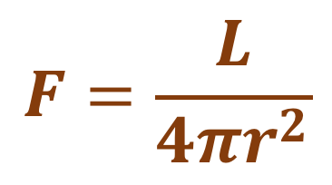
Radiation Pattern for 32 MRAs and 21 Meteor Scatter Events
Flux from images
$$F=\frac{L}{4πr^{2}}$$
Distance from triangulation
Varghese et al. 2019, JGR Space Physics (accepted)
Notes:
The plot shows the luminosity measured in lwa1 and lwasv for 32 mras and 21 rfis. The red point are mras and blue points are rfi ones. Reflection cases are scattered around the fit and has high luminosity values. But mras are localized close to the origin where lumininosity is low . The plot on right is a zoomed version close to the origin. Meteor afterglow follows the fit pretty well except an outlier point marked as mjd 58217. Also if I calculate correlation coefficient, mras has 70% correlation and rfis are uncorrelated. All the points are supposed to fall on this line but there are some deviations from it. We think the reason for such a deviation is projection effect.

Slide 20
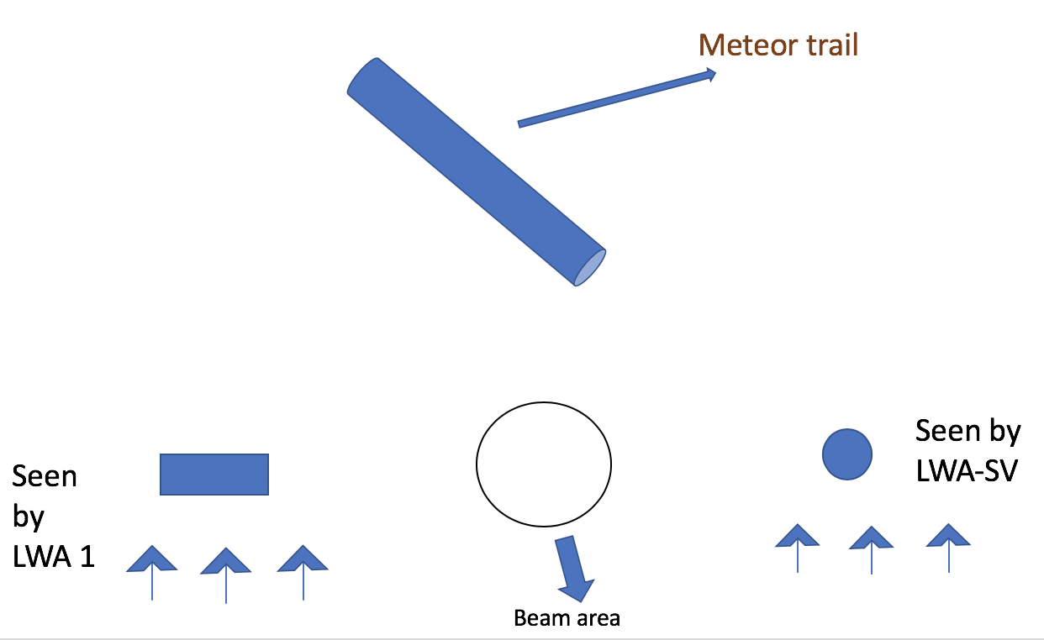
Projection effects
MRA MJD 58217
Varghese et al. 2019, JGR Space Physics (accepted)
Notes:
When we calculated the luminosity we assumed that the source is sphere but in reality meteor trails are cylindrical in shape which is 10 km and 50 m radius. The projection effect arises from the differences in the orientation of meteor trail with respect to the line of sight view from each LWA station. If the meteor trail is thought of as a long cylindrical trail, one station can see the projection of meteor trail as a long rectangle (when trail is perpendicular to line of sight) and the other station will see the projection as a circle (when the trail is along the line of sight). This results in detecting different integrated surface brightness within a beam area.
First plot shows the shows the projection effect of the MRA event on MJD 58217 18:55 UTC in LWA1 and LWA-SV respectively. The image from LWA1 suggest that that it is a point source structure with 4-5 degree radius. At the same time LWA-SV image suggest that it has an elongated source structure spanning across approximately 11-12 degrees in length and 7-8 degrees in width across the sky.
In this figure, the top one is the histogram of log of ratio of luminosities of 32 mra events lwa1 and lwasv. The bottom one is from a monte carlo simulation ken did.
Ken did some carlo simulation to understand the projection effect . If we assume a constant surface brightness and optically thick medium for plasma trails at low frequencies, the angular size of the projected cylinder would be proportional to the estimated luminosity. For this purpose 100,000 cylinders of 10km length and 50 m radius were generated randomly. They were generated in a region =/- 3 degrees from the center of two stations and at a staring height of 100 km and random inclination angle. The measured flux is proportional to the projected area of the trail in each station . So the luminosity would be area times square of distance. The top shows the histogram of ratios of luminosities measured in each station. Simulation actually matches with the observations and there is little difference in the spread of this distribution. It could be due to simpler assumption of constant surface brightness across the trail.
From a randomly generated sample of uniform surface brightness cylinders, we can estimate what luminosity measurements should look like from each station and then compare to the data presented in this paper. To make this estimate we used a Monte Carlo simulation where we generated 100,000 cylinders with lengths of 10 km (approximate resolution of an LWA station at 38 MHz for distances of 100 km) and radii of 50 m. The cylinders are randomly spread over a region ± 3 degrees in latitude and ± 3.6 degrees in longitude from the center of the two arrays. Each meteor has a starting altitude of 100 ± 10 km and has a random inclination angle.

Slide 21
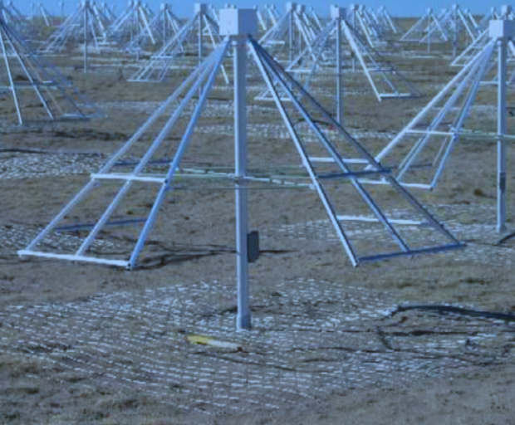
What does Isotropic nature imply?
R
LWA resolution at 100 km ~ 10 km
Two possibilities:
  Completely incoherent at large scales
    Isotropic and unpolarized
  Incoherent addition of coherent emitting regions within the trail
  Fresnel length scale at 100 km ~ 1400m
    Beamed and polarized at small scales
High resolutions observations needed
LWA-OVRO data
D+𝛌/4
D

Slide 22
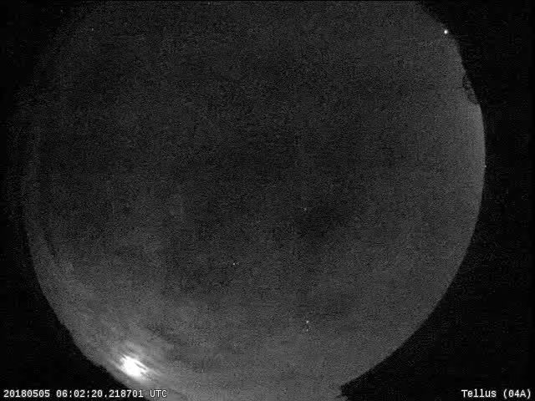
Meteors
Meteors occur when high velocity meteoroid particle collide with earth’s atmosphere and produce light
Heated up due to friction
During ablation temperature rises to 2500 K and starts evaporating
Forms turbulent plasma trail
NASA All-Sky Fireball Network
Notes:
Meteors occur when high velocity solar system particles called meteoroid particle collide with earth’s atmosphere and burn up in the atmosphere due to friction producing light. As these particle enters, they ablates, ionizez the meteoric atom as well as the atmospheric atoms forming a plasma trail. This is a video one of the meteors from nasa fb network
Hypersonic velocity (10 – 80 km/s) impacts enters the dense region and get heated up due to friction
t
Preheating takes place at 300 – 100 km and last for few seconds
Temperature rises rapidly up to 900 K
During ablation temperature rises to 2500 K and starts evaporating
Ablation consumes most of kinetic energy
Dark flight has no light and finally impact

Slide 23
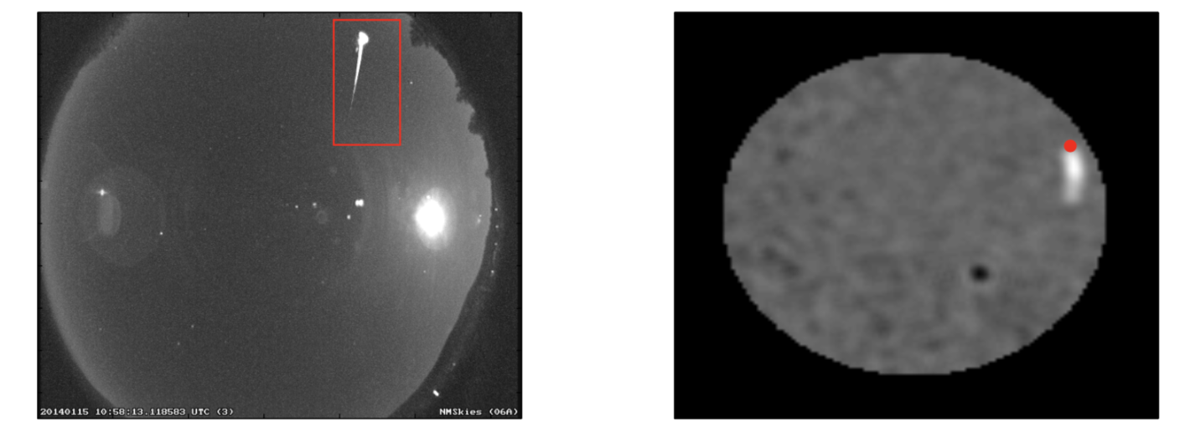
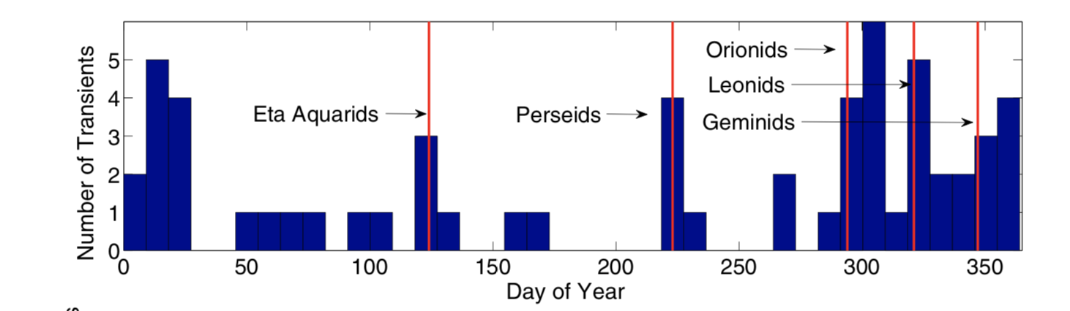
Detected transients are associated with meteor shower
NASA All-Sky Fireball Network station located in Mayhill, NM (left) and LASI (right)
Obenberger et al. 2014
Notes:
The detected radio emission is associated with optical meteors. Figure on left show the image from nasa all-sky fireball network and it’s radio counterpart in lwa1. The red point denotes the head of the trail. Bottom plot shows the number of transients plotted as a function of day in a year. Most of the peak matches with the peak time of meteor shower.

Slide 24
Emission mechanism: Langmuir waves (Plasma oscillations)??
Current hypothesis: electron plasma waves emitting from turbulent ionized trail at plasma frequencies
$$w_{p}=\sqrt{\frac{4πn_{e}e^{2}}{m}}$$
Collision of electrons with neutral atom and ion would suppress plasma oscillations in shorter time scales
But we observe radio afterglow for longer time scales
Some driving mechanism is needed to inject energy into emission process
Notes:
The plasma trail has ions and electrons, as the electrons move away from the ion, it will feel a restoring coulomb focrce resulting oscillation of electrons or Langmuir waves. The Langmuir waves are later converted to em radiation at plasma frequencies. In order to have this emission, the oscillation of electrons should not be damped. But as meteor reaches lower elevation, the collision of electron with neutral and ions will damp the motion faster than the longer time scales of emission. This needed some kind of energy injection and such a mechanism is not clear. This needs better understanding of emisision mechanism

Slide 25
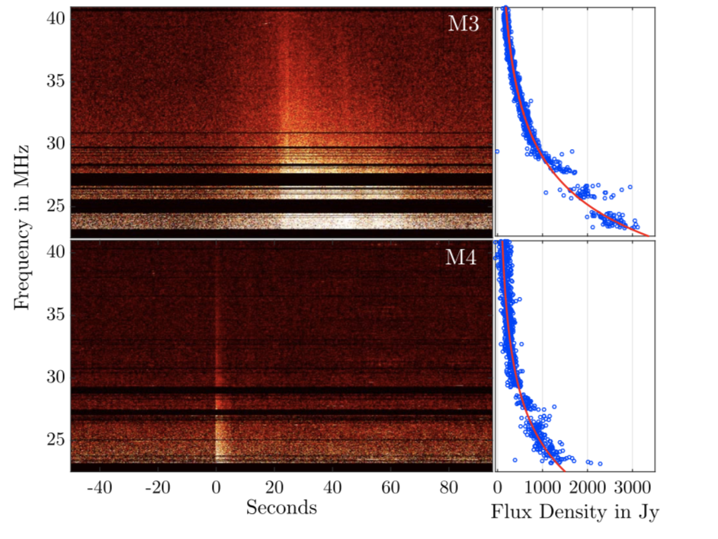
Wideband Spectrum from Beamformed Observations
3 beams around zenith at azimuth angle 60°, 180°, 240° at an elevation of 87°
Emission is broad band
Follows a power law dependence on frequency for 4 cases
$S ∝ ν^{α}$
Spectral index >> -4.8 for M3 and -4.4 for M4
Obenberger et al. 2016
Notes:
This is one of the experiments conducted in past. We find mras in images. But if we use beamformed observation we can get around 40 MHZ bandwidth. But the problem is we don’t where to point the beams in the sky because meteros can happen anywhere. So the idea was to Pointing 3 beams around zenith at azimuth angle 60°, 180°, 240° at an elevation of 87° wait for the mra to happen within the beam. After very long days of observation, a total of 4 mras were captured and this is how the dynamic spectra looks like
Beams allow 32 MHz bandwidth capture
4 fireball have been observed in this mode
Dynamic spectra shows that emission is broad band
This process is spends lots of time and resources yielding nothing

Slide 26
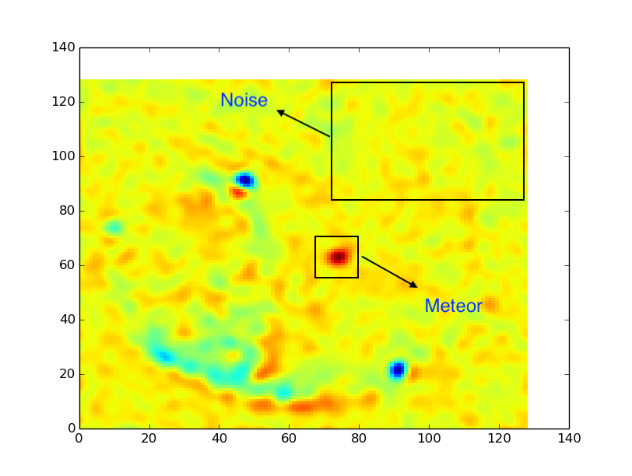
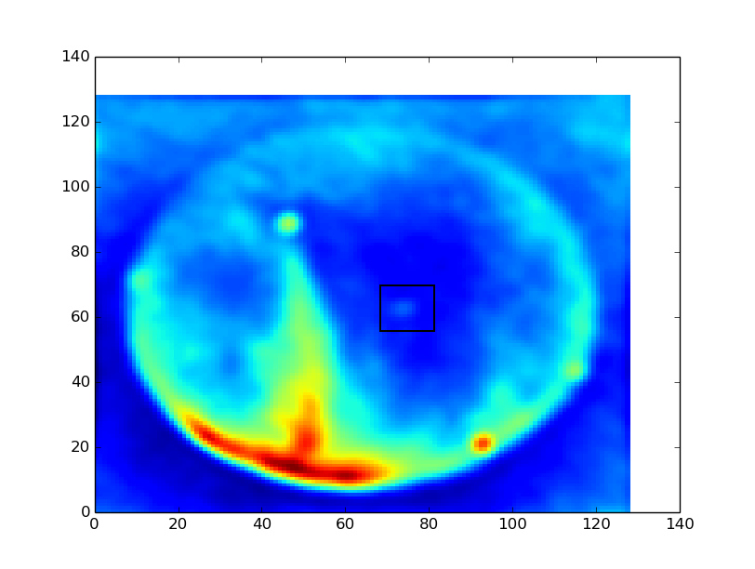
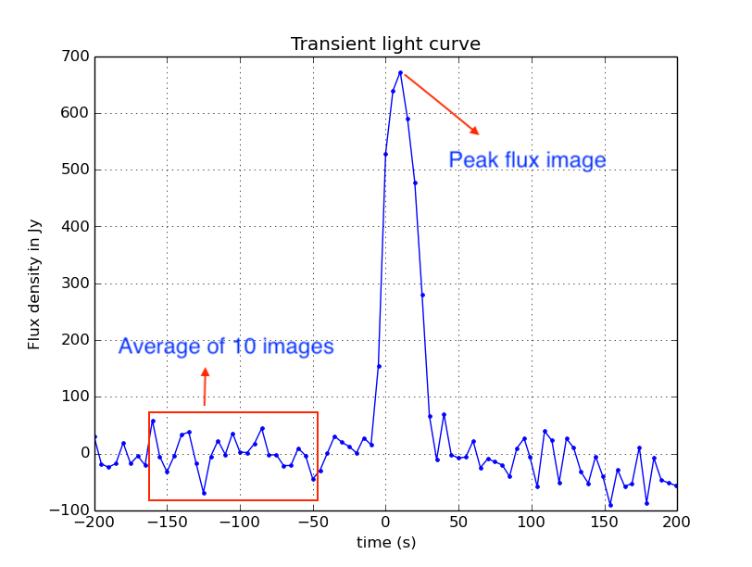

Flux measurement
Light curve gives the peak flux and time of emission.
Average of 10 images is subtracted from the peak flux image.
Look for peak value pixel
Gives flux values in arbitrary values.
Needs flux calibration

Slide 27
Flux Calibration
LASI produces dirty maps.
Cygnus A - good calibrator
Track Cyg A as it transit across sky
Measure the peak value of flux from image
Flux -> function of frequency and elevation
$$\frac{{Flux}_{meteor}\left(elev\right) (Jy)}{{Flux}_{meteor}\left(elev\right) (arbitrary unit)}= \frac{{Flux}_{Cyg A} (Jy)}{{Flux}_{Cyg A}\left(elev\right) (arbitrary unit)}$$
Notes:
LASI produces dirty maps.
Cygnus A - good calibrator
Track Cyg A as it transit across sky
Measure the peak value of flux from image
Flux -> function of frequency and elevation

Slide 28
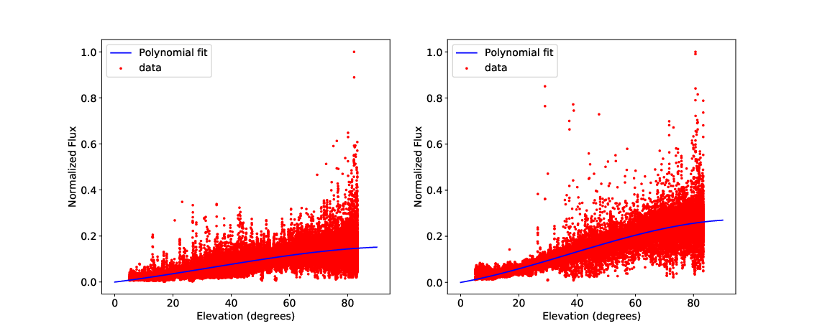
LWA 1 34 & 38 MHz

