Slide 1
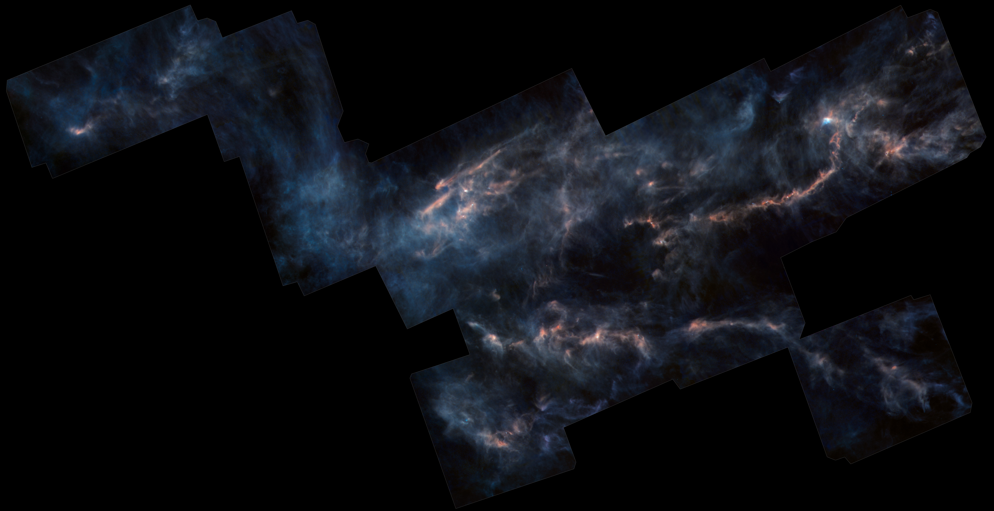
The Virial State of Starless and Prestellar Cores
Yancy Shirley
Univ. of Arizona
Credit: Herschel Gould Belt Team

Slide 2
The starless core is the fundamental “unit” of star formation capable of forming one star or a bound multiple star system
Credit: ESO, Alves

Slide 3
This is NOT a typical starless core…
Credit: ESO, Alves

Slide 4
Taurus Molecular Cloud
Most (~75%) starless cores are coincident with filamentary structure (Andre’ et al. 2010, HGBT papers)
100% of gravitationally bound prestellar cores lie within filaments (Marsh et al. 2016)
Credit: Herschel Gould Belt Team
160 μm, 250/350 μm, 500 μm

Slide 5
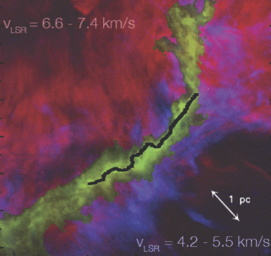
Taurus Molecular Cloud
These core are not evolving in isolation…
CO 1-0
Mass accretion rate
~10s M_{sun}/pc/Myr
Credit: Herschel Gould Belt Team
Palmeirim et al. 2013, Shimajiri et al 2019

Slide 6
Taurus Molecular Cloud
What is the dynamical state of
starless & prestellar cores in
non-isolated environments?
Credit: Herschel Gould Belt Team

Slide 7
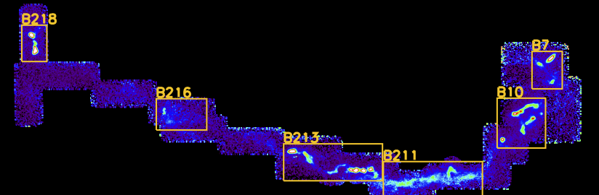
Taurus Molecular Cloud
We will focus on observations of the L1495-B218 region
NH₃ (1,1)
Credit: Herschel Gould Belt Team
NH₃ map Seo et al. 2015

Slide 8
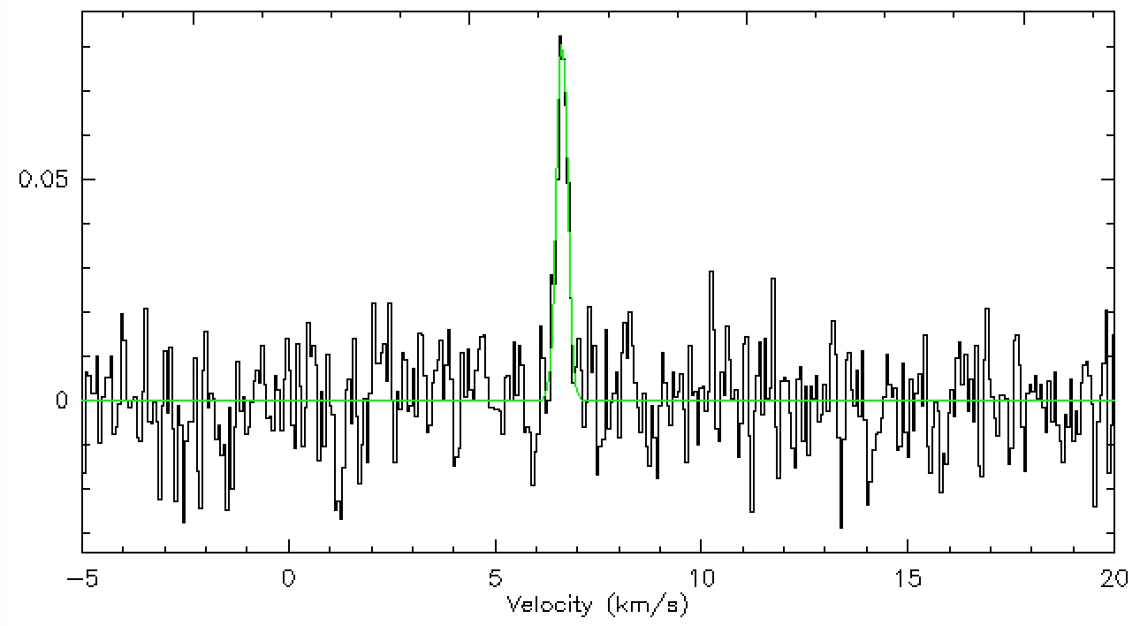
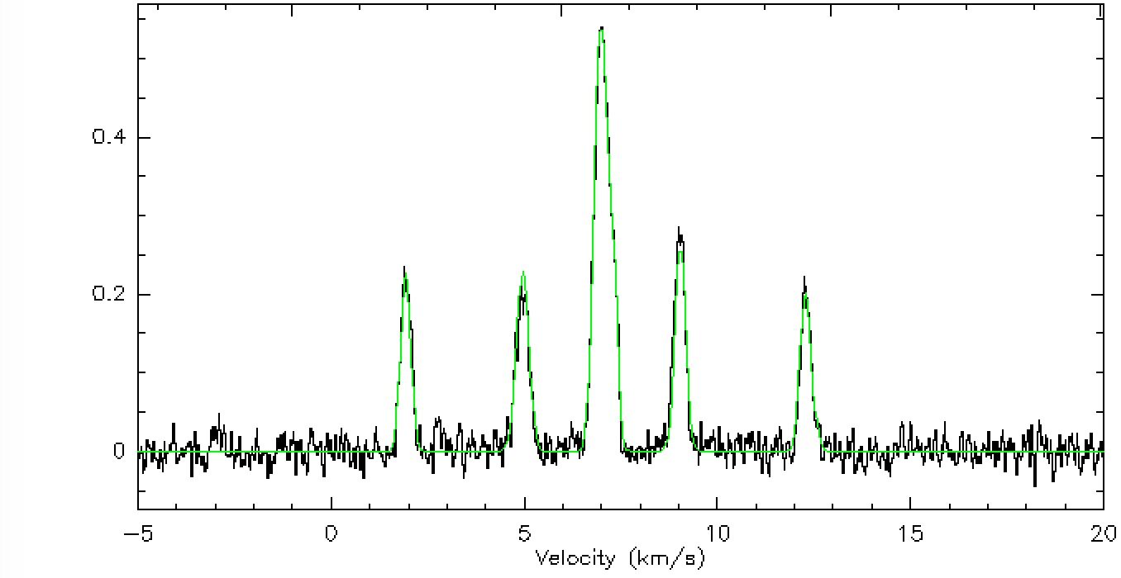
Taurus Molecular Cloud
Also with deuterium fractionation observations
CH₂DOH-e₀
Solid phase deuteration
Gas phase deuteration
Seo39
o-NH₂D
Credit: Herschel Gould Belt Team
Shirley et al. (in prep.)/Ambrose et al. (in prep.)

Slide 9

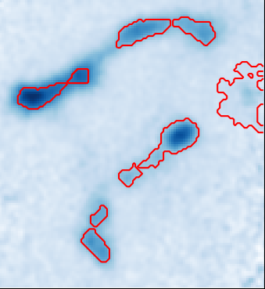
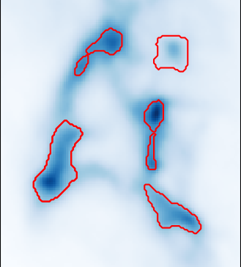
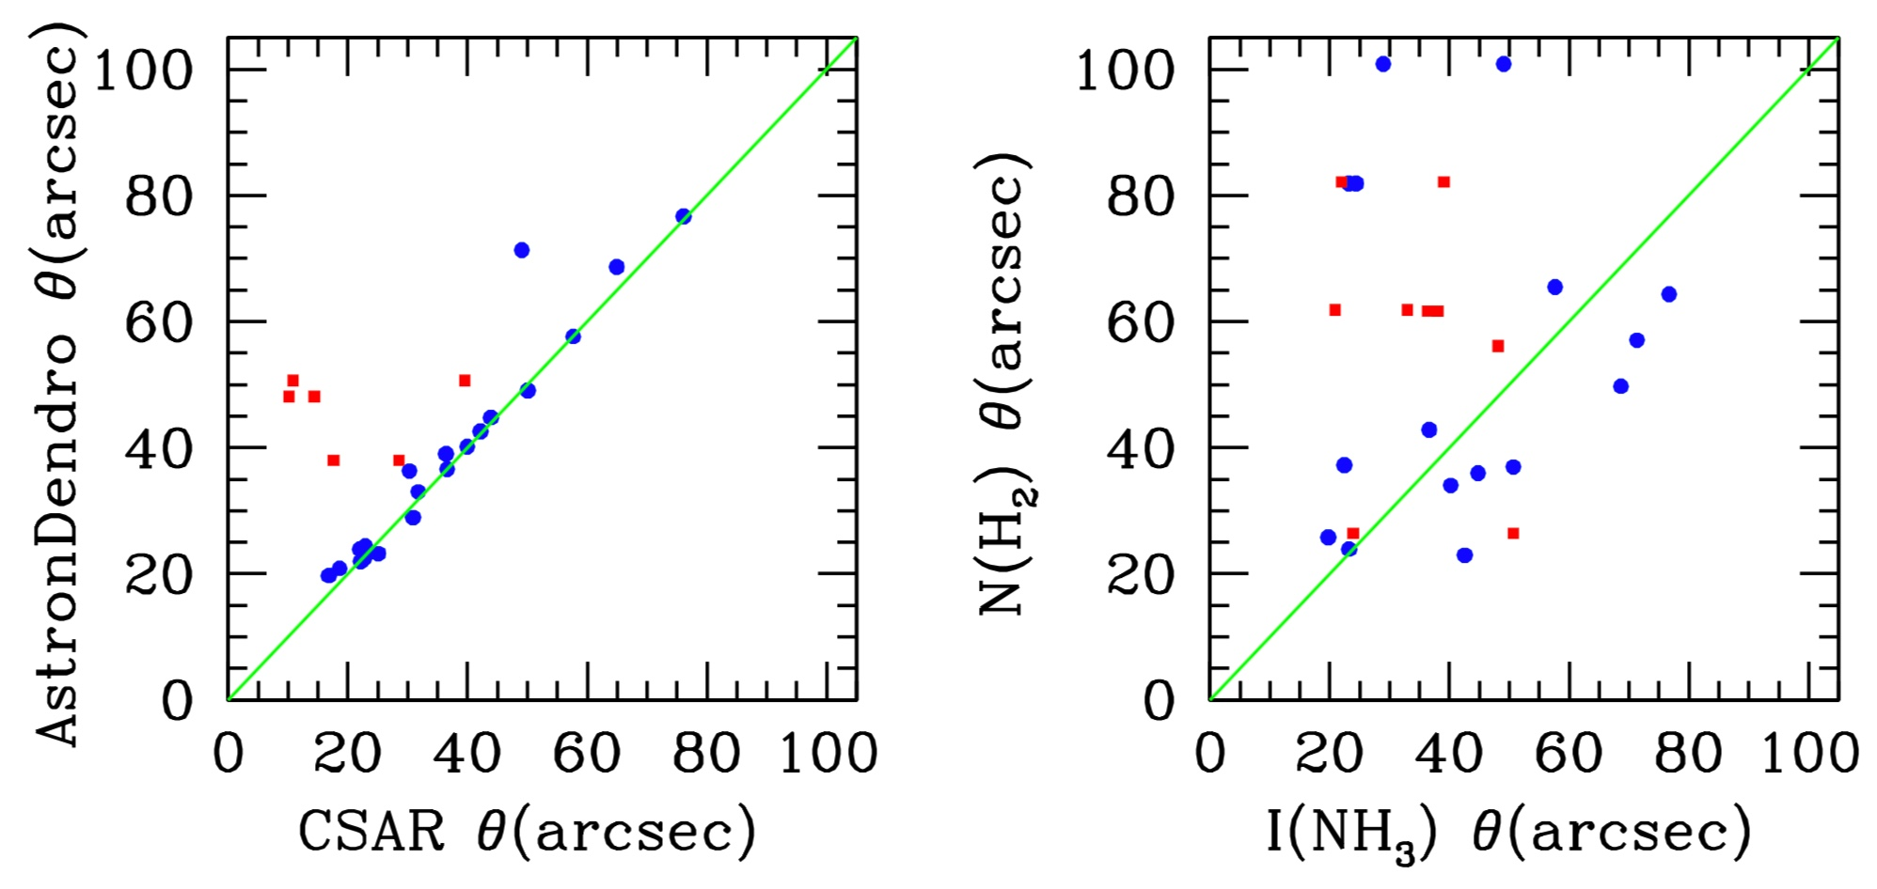
Defining the Starless Core
AstroDendro
NH₃ intensity
AstroDendro
Herschel N(H₂)
500 μm
Jimmy Lilly Honors Thesis

Slide 10
Virial Theorem
½ d²I/dt² = 2Ω_{K} + Ω_{B} – Ω_{G} – 2Ω_{P} – Ω_{ram} – Ω_{Δ} - Ω_{rad}
Ω_{K} = Internal Kinetic Energy = ½ M (σ_{v}²)_{3D}
Ω_{G} = Grav. Potential Energy = ⅗ a GM²/R
P₀ = Weight of filament
P₀ = Turbulent ρ₀ σ_{v}²
Ω_{P} = External Surface Pressure = 4 π R³ P₀
500 μm
simple approx.
Ω_{B} = ∫ x_{i} T_{ij} dS_{j} - ∫ δ_{ij} T_{ij} dV ⅙ (B² – B₀²) R³
If v normal to surface
Ω_{ram} = ∫ ρ₀ x_{i} v_{i} v_{j} dS_{j} 4 π R³ ρ₀ v₀²
simple approx.
Ω_{Δ} = ½ d/dt ∫ ρ₀ r² v_{i} dS_{i} 2 R² d²M/dt²

Slide 11
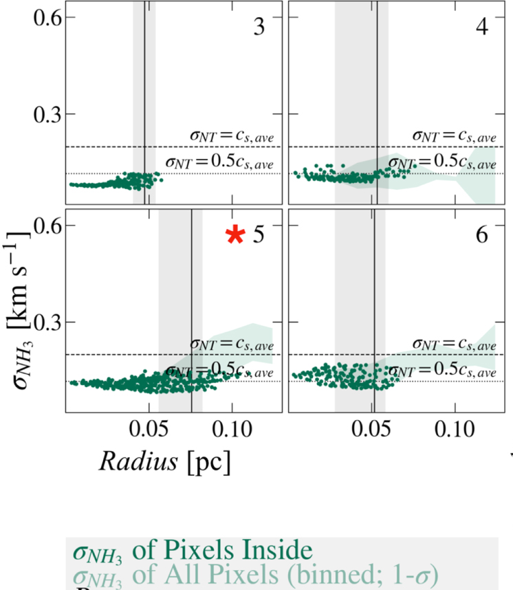
NH₃ Linewidth vs. Radius
NH₃ linewidth
Radius (pc)
H. Chen et al. 2019

Slide 12
B Field Strength?
Optical/NIR Polarization
OH Zeeman
B_{sky} ~ 25 – 75 μG depending on method
B_{los} ~ 11 +/- 2 μG
Line of sight
Chapman et al. 2011
Crutcher & Troland 2000

Slide 13
NH₂D Detections vs. Non-Detections
X Non-detection
Detection
Virial Parameter
Shirley et al. in prep.
Mass

Slide 14

CH₂DOH Deuterium Fraction
Only B10
region observed
non-detections
Virial Parameter
Ambrose et al. in prep.
Deuterium Fraction

Slide 15
Results
Starless cores are the fundamental “unit” of star formation within a turbulent, hierarchical structure.
Their evolution is not isolated from their environment.
There is a correlation between dynamical state (expanded Virial parameter) and the chemical evolution as traced by deuteration
The (preliminary) median fractions for terms in Virial equation are:
    Turb. only +Filament Weight
  2Ω_K 0.57 0.32
  2Ω_P 0.23 0.59
  Ω_G 0.14 0.07
  Ω_B 0.05 0.02

Slide 16
Additional Slides
500 μm

Slide 17
Hydrostatic vs. Hydrodynamic
Collapsing Bonnor-Ebert Sphere similar profile to stable Bonnor-Ebert sphere. Need to probe velocity to differentiate.
hydrostatic
log Density (cm⁻³)
Velocity (km/s)
40%, 60%, 80% of free-fall time
40%, 60%, 80% of free-fall time
log Radius (pc)
Myers 2005

