Slide 1
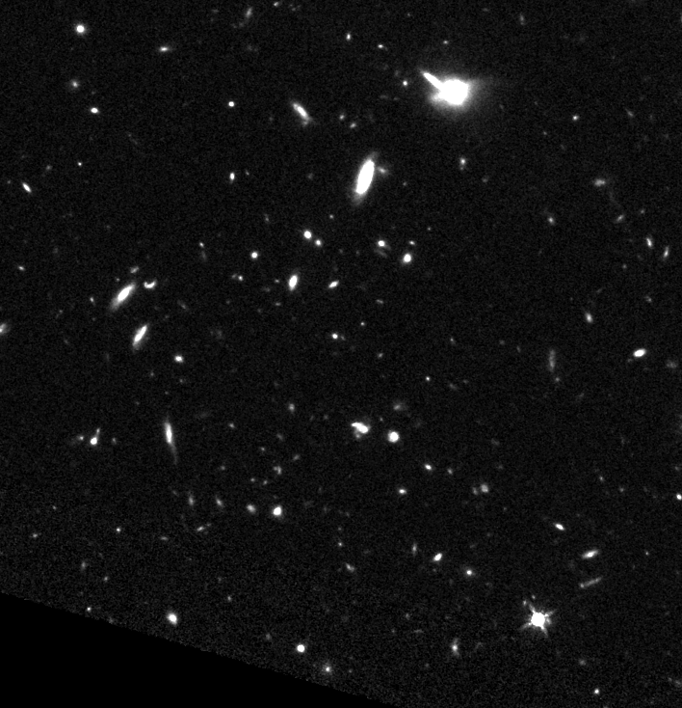
Mapping the Kinematics of the Cosmic Web at z~3.2
Kelly Sanderson¹, Moire Prescott¹, Audrey Dijeau¹, Lise Christensen², Palle Møller³, Johan P. U. Fynbo²
¹Department of Astronomy, New Mexico State University
²Niels Bohr Institute, Denmark
³ESO Headquarters Garching, Germany
Notes:
In order to get at mapping the kinematics of the cosmic web, my group and I look at Lya emitting nebulae.

Slide 2
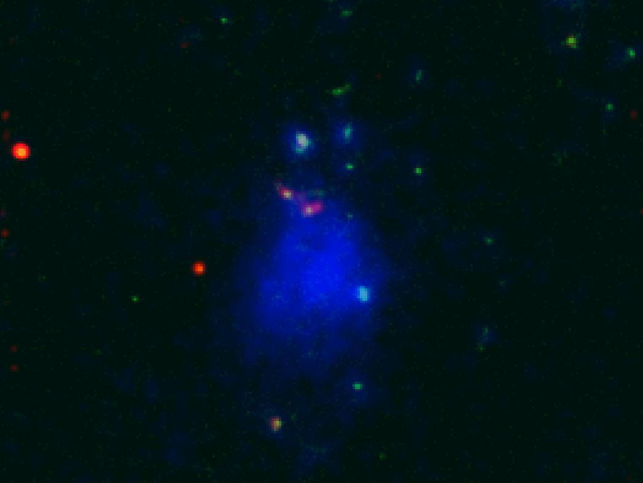
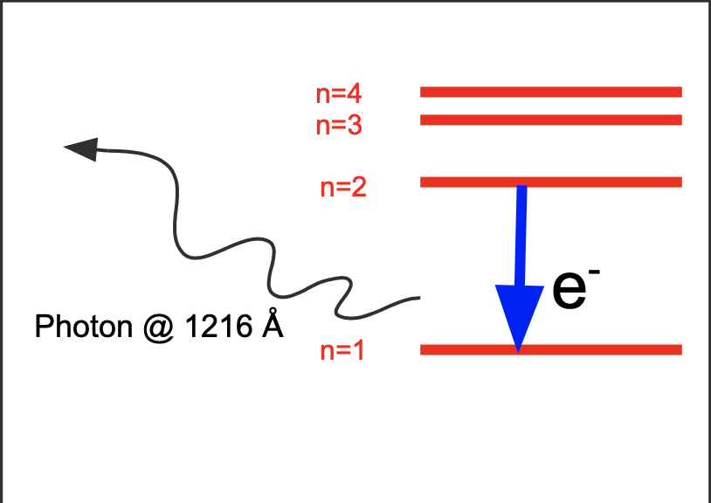
Lyman-𝞪 (Lya) Emitting Nebulae (LAN):
Large concentration of gas emitting the Lya line
Tend to be hosted by group environments
Lya line = Strongest Hydrogen emission line in UV-optical (1216 Å)
Big Questions: What is powering the Lya emission in these objects? What are the kinematics of the illuminated gas?
SCCGE: Moire Prescott & Arjun Dey
Notes:
Lya emitting nebulae are large concentrations of gas that tend to reside in overdense regions of the universe and emit strong Hydrogen Lya radiation
Lya is the strongest Hydrogen emission line produced by electron transitions from the first excited state to the ground state. The photon produced has a wavelength of ~1215.67 angstroms
Some of the big questions surrounding the study of these objects are (1) what is powering the Lya emission? I.e what is causing the electron to excite or ionize so that it can fall back down to the ground state? And (2) what are the kinematics of the extended illuminated gas?
https://ned.ipac.caltech.edu/level5/Sept15/Hayes/Hayes1.html:
“Ultimately the emitted Lyα luminosity (also its EW and departure from intrinsic Lyα / Hα ratio of 8.7) will be a function of Hi distribution, gas kinematics, dust content, and galaxy viewing angle.”
Strongest H emission line in UV optical,
to reclassify source as an AGN, potentially at the redshift of the nebula
HST infrared observations, including newer Herschel data covering the far IR, and
The evidence that the MIR source was an AGN, and not a starburst galaxy, is presented by this bottom figure in which Prescott et al. brought together new MIR observations, of both detections and non detections, from more recently available IR surveys. Mrk231 is an AGN template and Arp220 is a starburst galaxy template.
I do want to note, however, that because the redshift estimate of the obscured AGN was based off of the NIR/MIR SED, which is a power law, it is not very constraining.
This first image is the original NB imaging from the Nilsson et al. discovery paper. The MIR source that Nilsson classified as a high redshift starburst galaxy, due to its MIR colors, is represented by source 6 in this figure.
Herschel=FIR
Spitzer=NIR
Sizes range from ___ to ___ kpc (quote sizes from one of those size comparison plots)
More recent MIR observations of the region
Use colors to reclassify the IR source as an AGN, not a high-z starburst
𝜶𝝰

Slide 3
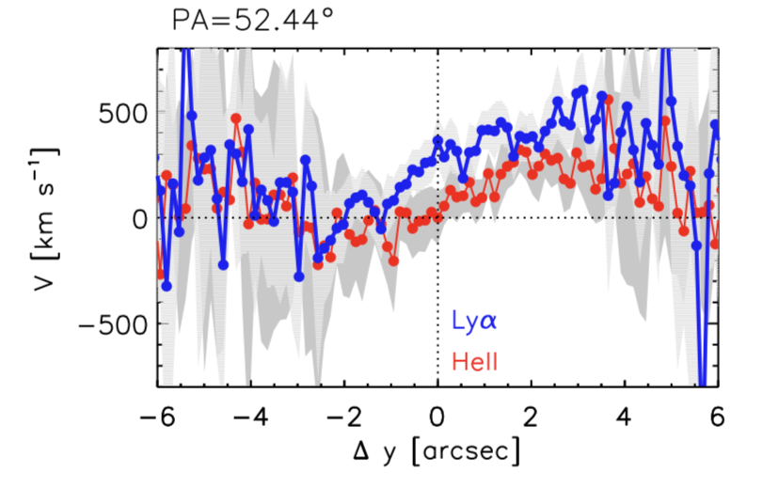
Lyman-𝞪 (Lya) Emitting Nebulae (LAN):
Understanding of these objects limited by:
  Surface brightness dimming (mostly high-z observations)
  Complexity of Lya radiative transfer
    Resonance line
Several studies suggest that kinematic offsets between Lya and non-resonant line tracers are relatively mild on large scales.
Figure 11 from Prescott+2015a
Notes:
Understanding Lya emission in high-redshift objects tends to be limited by surface brightness dimming and the complexity of Lya radiative transfer effects, however, several studies suggest that kinematic offsets between Lya and non-resonant line tracers are relatively mild on large scales such as the ones we are interested in. This figure from Prescott et al.’s 2015 paper shows the rotation curves in Lya and HeII on the large scales of the Lya nebula PRG1.

Slide 4
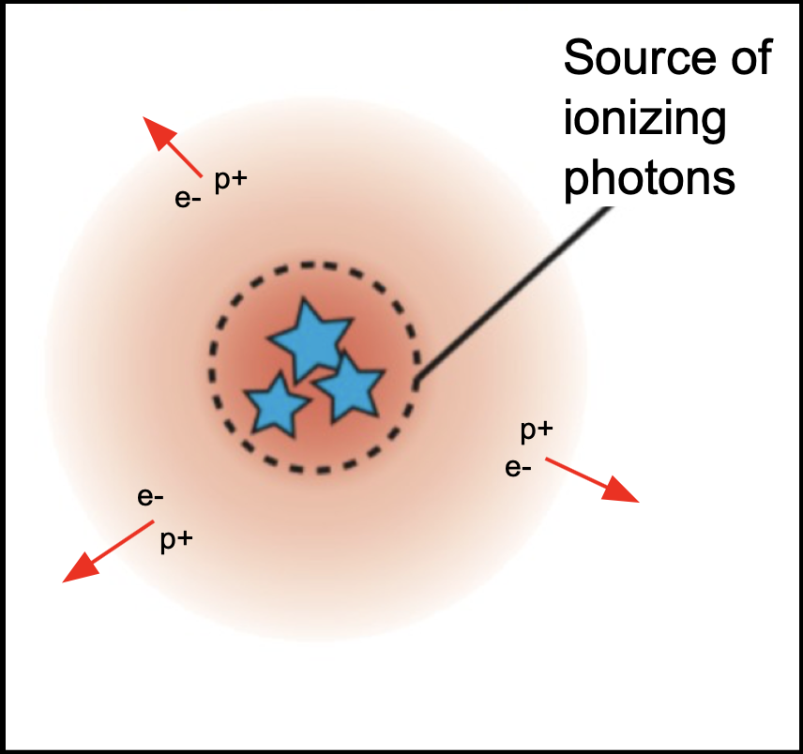
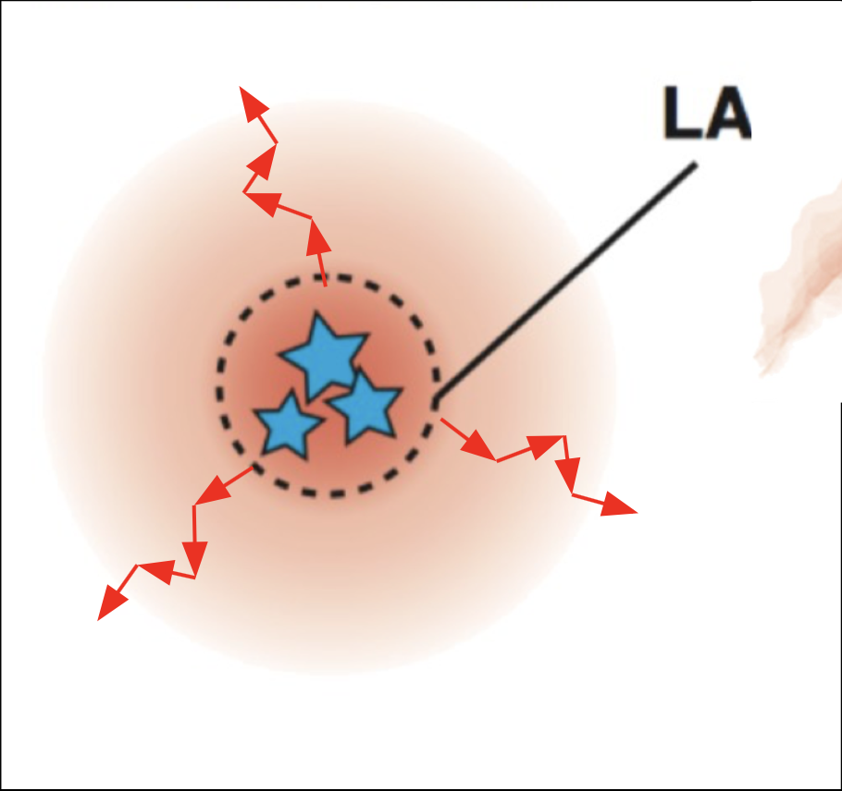
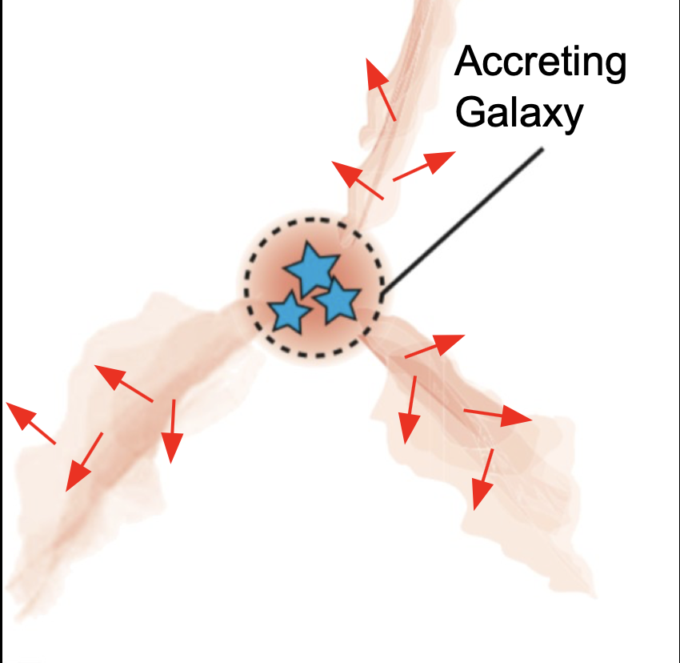
Suggested Powering Mechanisms of LAN:
Shock-heating
Photoionization
Resonant Scattering
Gravitational Cooling Radiation
All have been found to be capable of fully powering the emission of some nebulae.
So the question is: What is the dominant mechanism powering most LAN?
LAE
Photoionization
Resonant Scattering
Gravitational Cooling
Diagrams adapted from Momose+2016
Notes:
Mechanisms that have been suggested as powering sources of the Lya emission include:
Shock-heating caused by powerful galactic winds
Photoionization due to AGN or highly star forming regions
Resonant Scattering caused by centrally produced Lya photons that scatter off the extended nebula (polarization signatures)
Gravitational Cooling Radiation caused by inflowing gas being collisionally heated and then cooling via Lya radiation (occurs at T~10⁴K in regions of ongoing group formation, collisional heating of the gas leads to H and He emission bc of lack of metals)
Depending on who you talk to...all of these mechanisms have been found to be fully capable of powering the emission of some nebulae

Slide 5
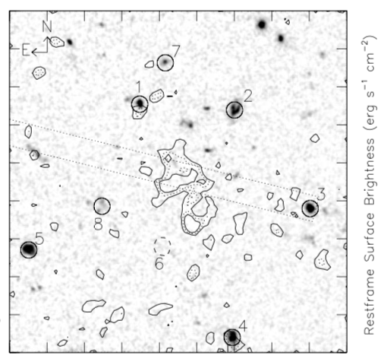
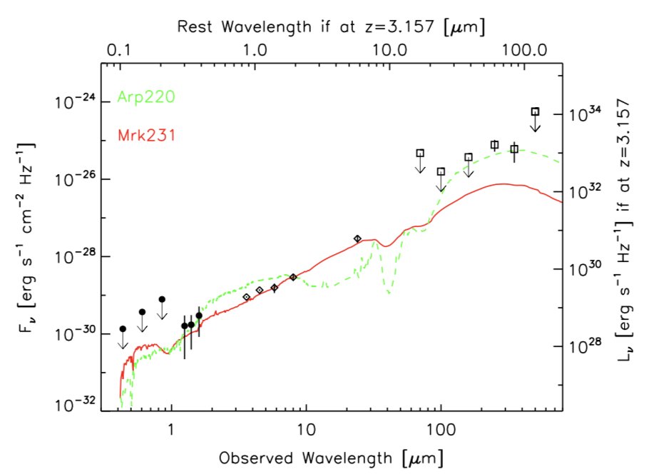
This Work:
z~3.16 LAN discovered by Nilsson+2006
  No associated continuum sources
  1 MIR source, colors implied a high-z starburst galaxy
  Argue that cold accretion (gravitational cooling) is the only plausible powering mechanism
LAN neighborhood revisited by Prescott+2015
  New HST NIR imaging and grism spectroscopy reveal the region of the nebula to be overdense.
  Updated MIR observations and new NIR and FIR observations showed the MIR source is an obscured AGN
  Argues AGN photoionization may in fact be important for this object
Nilsson+2006
Prescott+2015b
Notes:
For this work, we focus in on a Lya Nebula whose powering mechanism has been debated over the last decade. In 2006, Nilsson et al. reported the discovery of LAN that lacked evidence of any associated continuum sources at a redshift of 3.1, shown in the top figure by the contours overlain on the HST V-band imaging of the region. For a while following that discovery, this object was held as the best example of a gravitationally powered LAN until 2015, when Prescott et al. presented more recent observational evidence for a highly obscured AGN potentially buried near the peak of the Lyman alpha emission. The evidence that the MIR source was most likely an AGN, and not a starburst galaxy as previously believed, comes from utilizing improved methods for extracting photometry measurements from Spitzer data covering the mid IR range and including newly available Near IR and Far IR data from HST and Herschel. This can be seen in this bottom figure where the source’s SED containing these measurements has been compared against a starburst galaxy template (green) and an AGN template (red).

Slide 6
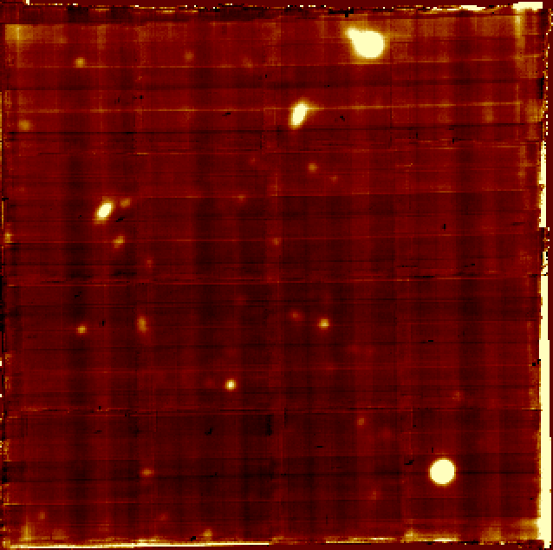
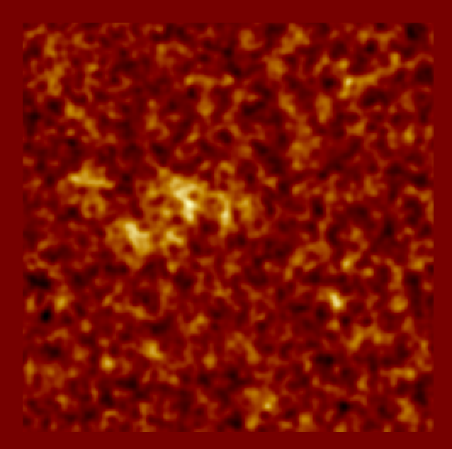
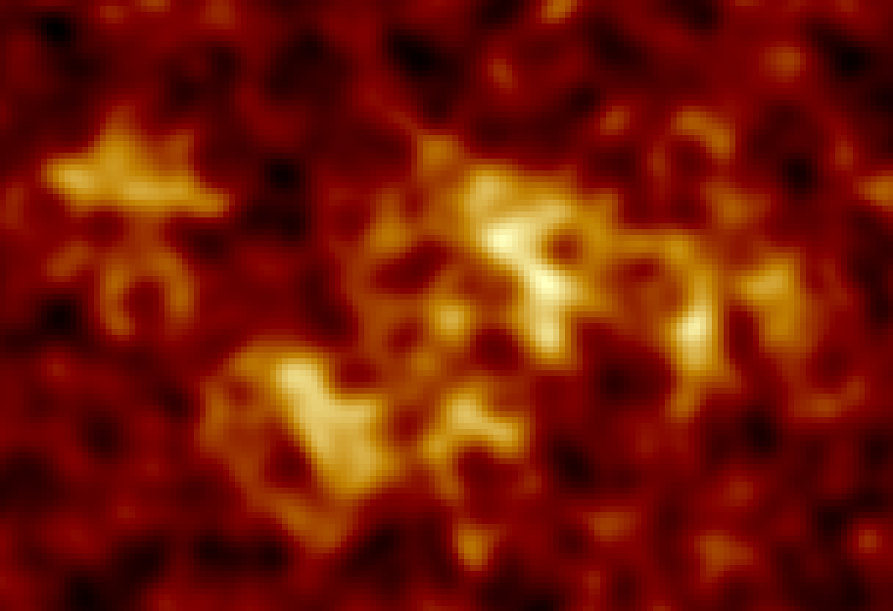
MUSE Data:
MUSE: Integral Field Spectrograph mounted on the VLT in Chile
Total exposure time = 5 hours
Processing:
  Sky subtraction
  Continuum source subtraction
  Spatial and spectral smoothing
Subcube extracted and voxels w/ SNR<2.5 masked
Full white light image of MUSE FOV
NB (~30 Å) image of spatially and spectrally smoothed MUSE FOV
NB (~30 Å) image centered on Nilsson nebula
Notes:
We were interested in learning more about the potential powering mechanism of this lyman alpha nebula by looking at the kinematics of the emitting gas. We obtained 5 hours of exposure time on the Very Large Telescope’s Integral field spectrograph MUSE. The preliminary results of our analysis are presented here today. These figures show pseudo narrow and broad band images from different steps throughout the reduction and analysis process.

Slide 7
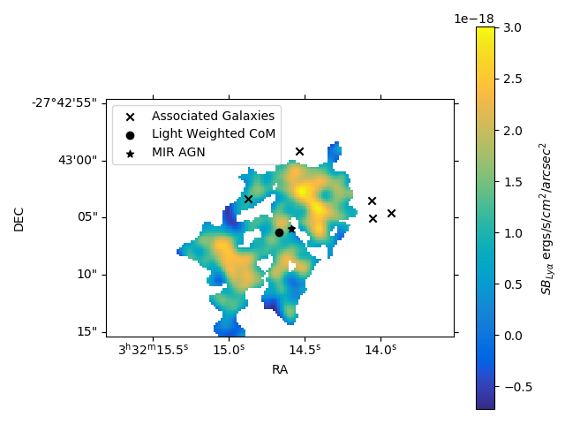
Mapping Out the Ly𝛂 Nebula:
Size ~ 120 kpc across
Clumpy Structures
Nebula offset from most of the neighboring galaxies
AGN close to the light-weighted center; offset spatially by only ~(9.37, -2.31) kpc
Notes:
This figure shows the Surface Brightness map of the nebula with right ascension on the x axis and declination on the y axis. The new data reveals much more extended emission than seen previously along with somewhat clumpy structure throughout the nebula. Interestingly, we found the nebula to be offset from most of the galaxies at the same redshift (including the brightest galaxy in the neighborhood). We also found the position of the obscured AGN, as inferred from its MIR emission, to be close to the light-weighted centroid of the nebula, offset spatially by only ~10kpc

Slide 8
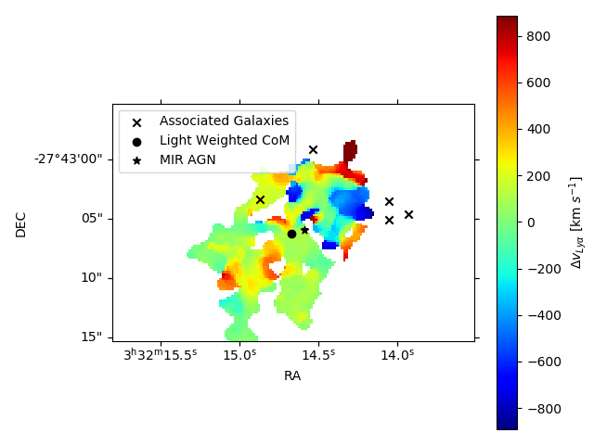
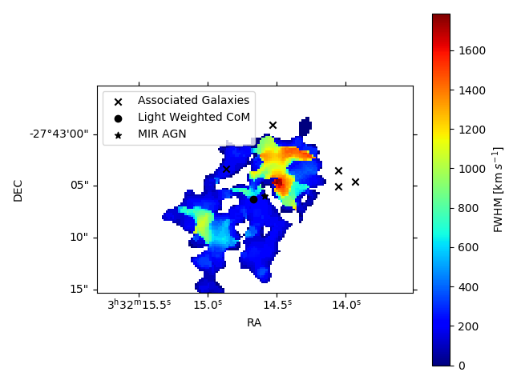
Kinematics of the Ly𝛂 Emitting Gas:
Complex Velocity field
  Minimal coherent kinematic structure
Region around the AGN near kinematic centroid of nebula Δv~200 km/s
AGN near highest 𝞂_{Ly𝛂} region
Notes:
These figures show the light weighted velocity map on top and the FWHM map of the nebula on the bottom, again with RA on the x-axis and DEC on the y axis. Kinematically, the nebula is complex and shows little coherent structure. Within the cube, we find the region around the AGN to be near the kinematic centroid of the nebula, offset spectrally by about 200 km/s. We also find the AGN to be near the region dominated by the highest dispersion within the nebula.

Slide 9
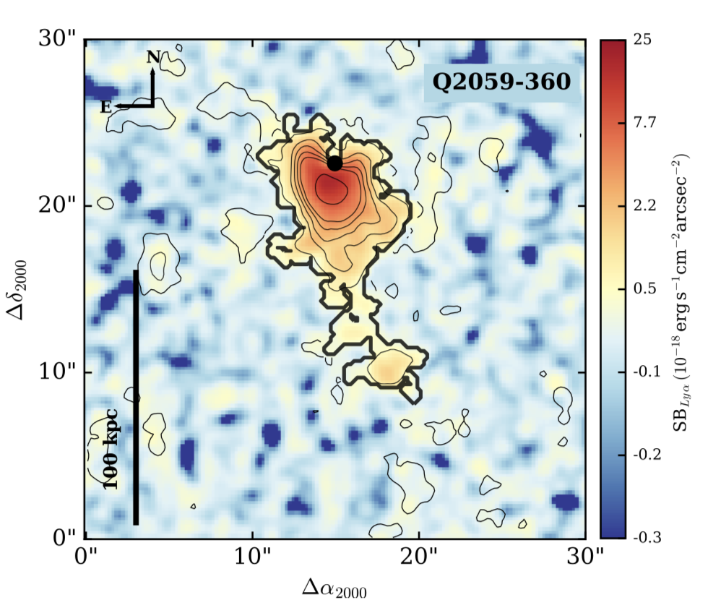
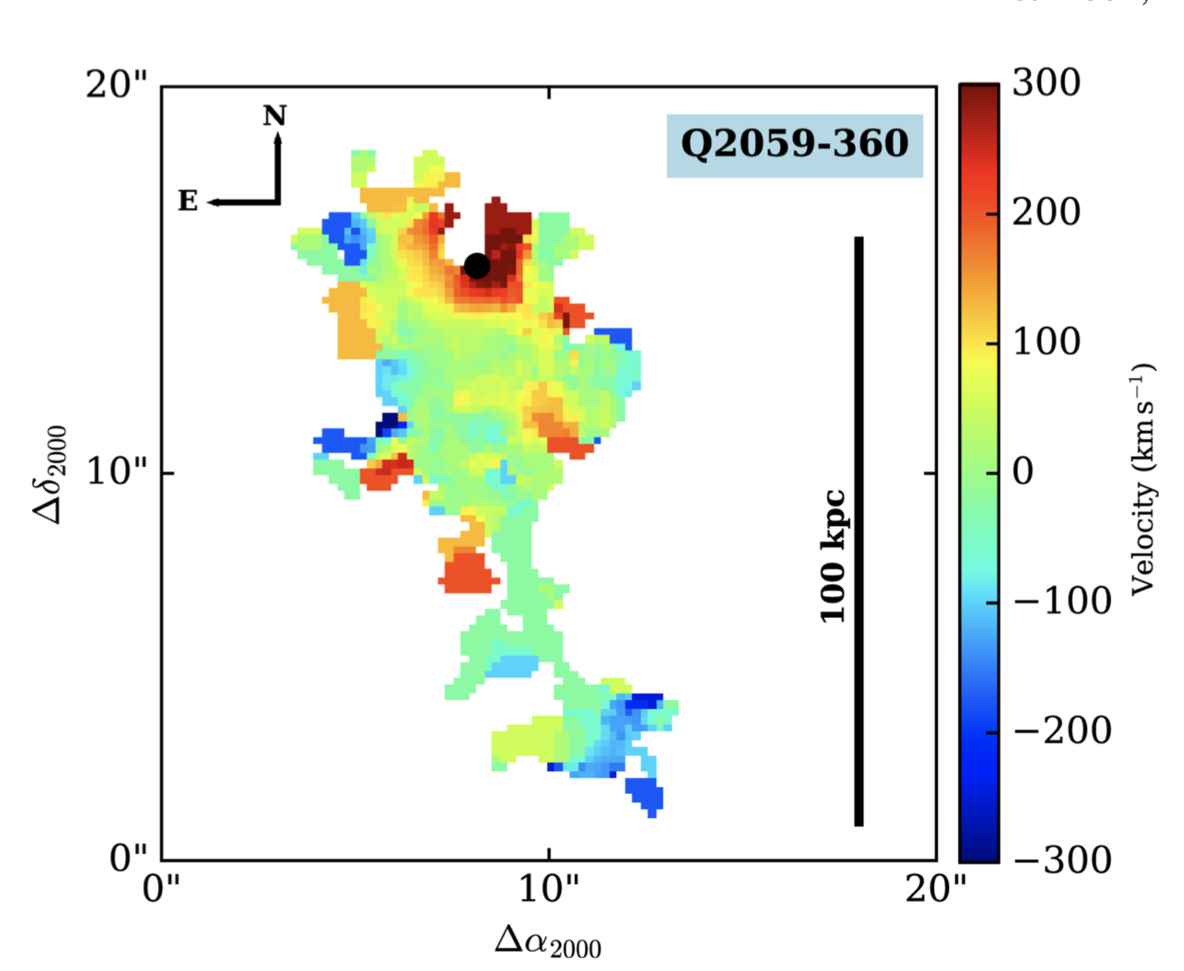
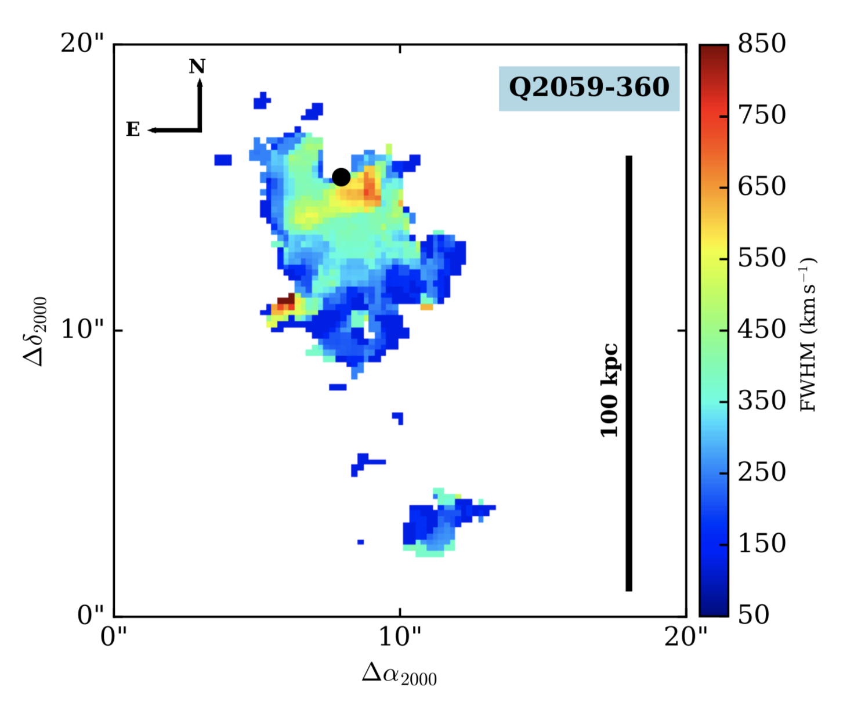
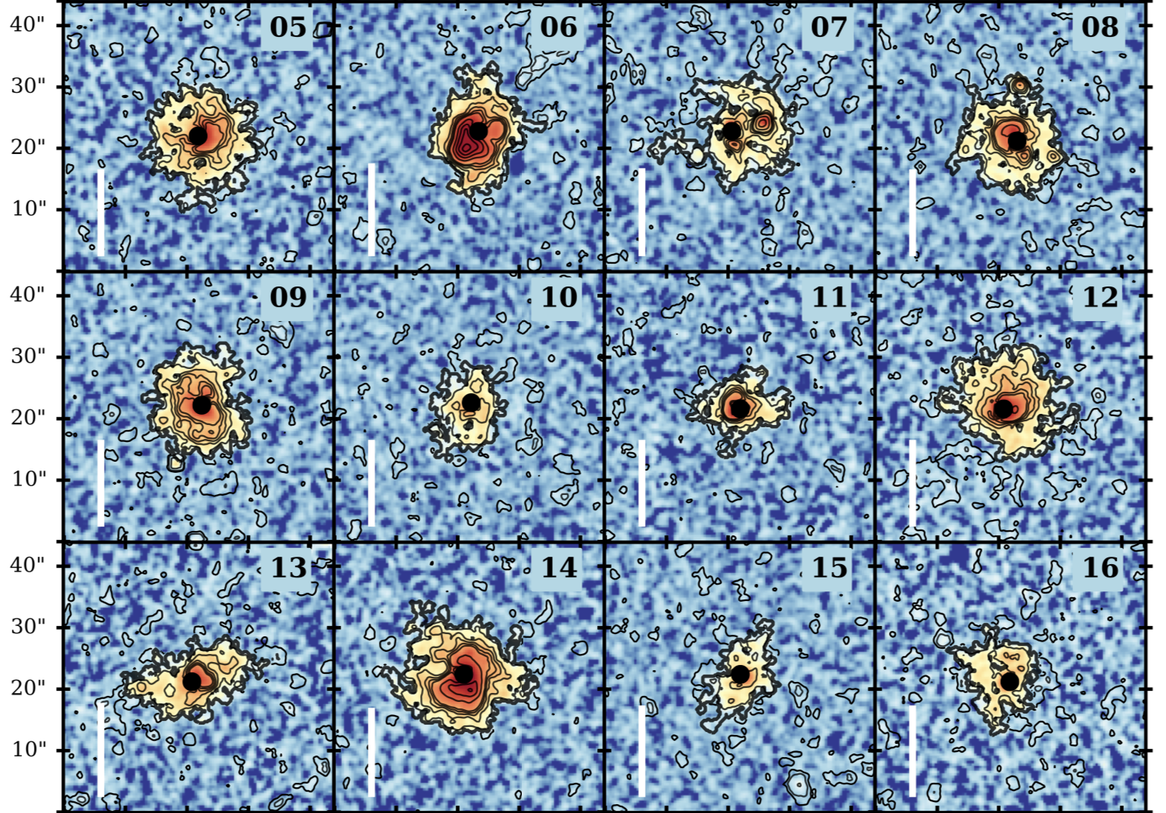
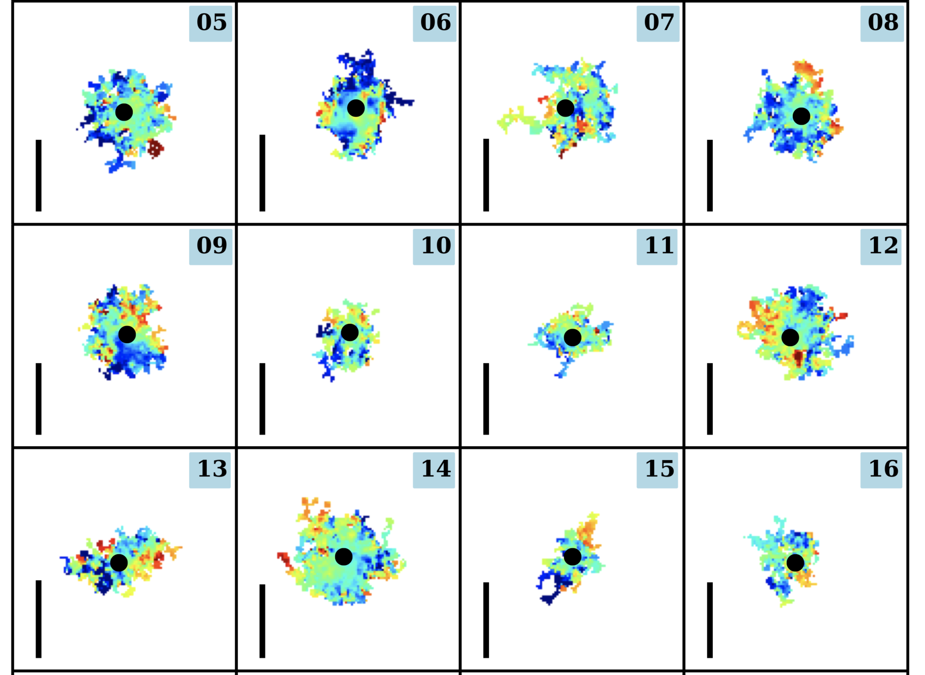
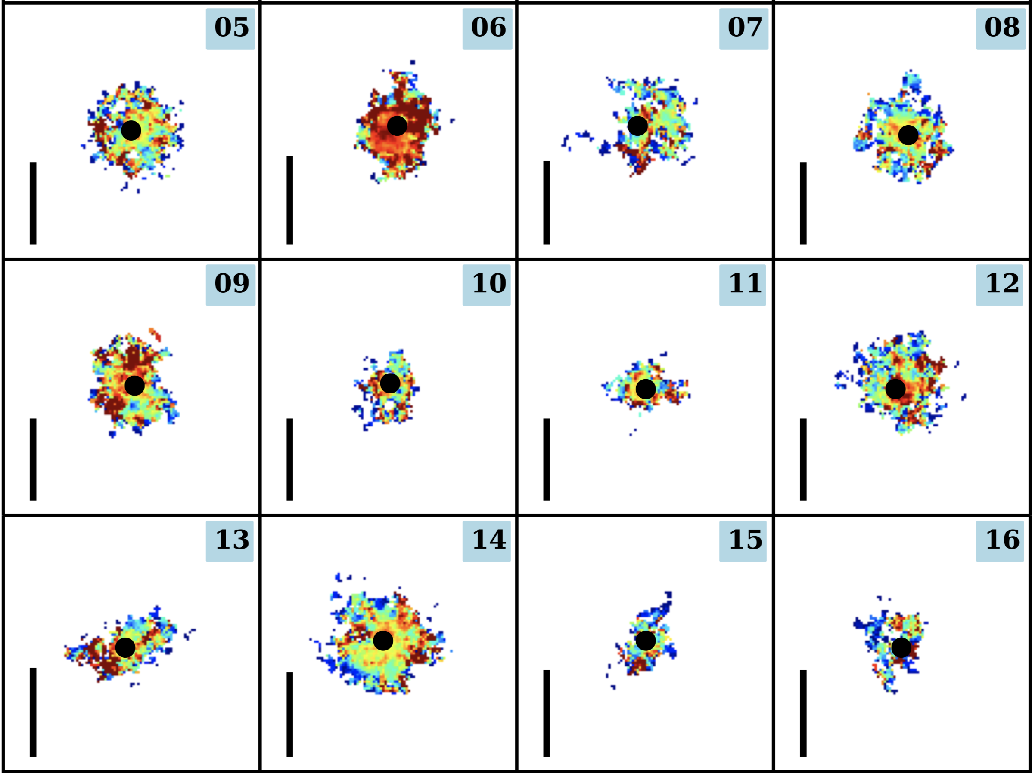
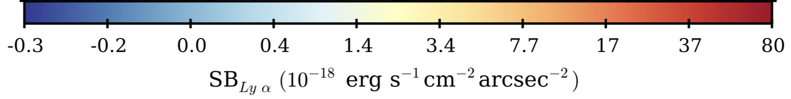
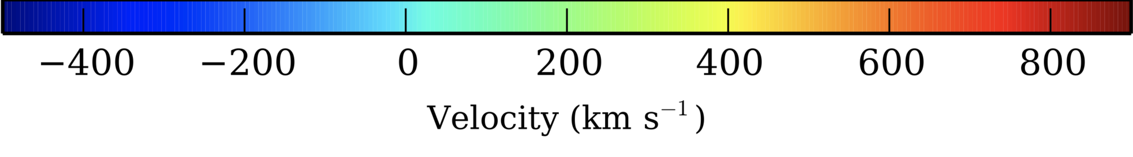
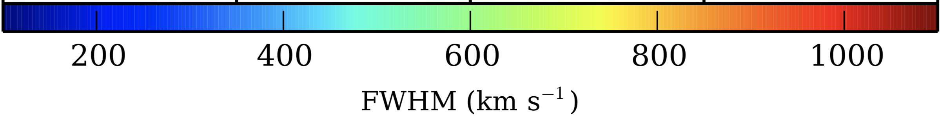
Discussion:
Low Surface Brightness
  SB_{peak}~10⁻¹⁸ ergs/s/cm²/arcsec²
Kinematically similar to other QSO nebulae
Consistent with AGN picture
Need deeper observations
  CIV, HeII, CIII]
North+2017
Borisova+2016
Notes:
These figures are pulled from studies of other QSO powered lyman alpha emitting nebulae in about the same redshift regime as our object. From left to right the figures show the Surface brightness, light weighted velocity, and light weighted FWHM maps for these objects, again with RA on the x axis and DEC on the y axis. In comparison to the other lyman alpha emitting nebulae surrounding AGN at this redshift, we find our object to be less luminous, however, kinematically similar to these other objects. Specifically, very few of the other QSO powered nebulae observed show coherent kinematics and the QSOs, although subtracted from these images, tend to lie near regions of high velocity dispersion. We find that the picture revealed by these MUSE observations are tentatively consistent with an AGN being present in this nebula. We are working to obtain deeper data that will allow us to check for classic AGN emission lines in the region of the MIR source, thus moving closer to determining the dominant powering mechanism of this object.
That is all I have for today, thank you everyone for your time, I can now take any questions.

Slide 10
Summary
Redshift for AGN not highly constrained yet
AGN located near the spatial centroid
Local surroundings of AGN are near kinematic centroid
Peak in velocity dispersion is near AGN location
Overall kinematics of nebula resemble other AGN halos
For further discussion, contact me at ksand017@nmsu.edu
Notes:
So here you are basically summing things up, saying that although we don't have the precise redshift of the AGN, the AGN is located nearly at the spatial centroid, its local surroundings are near the kinematic centroid, the peak dispersion is near the AGN, and the overall kinematics of the nebula resemble other AGN halos.

Slide 11
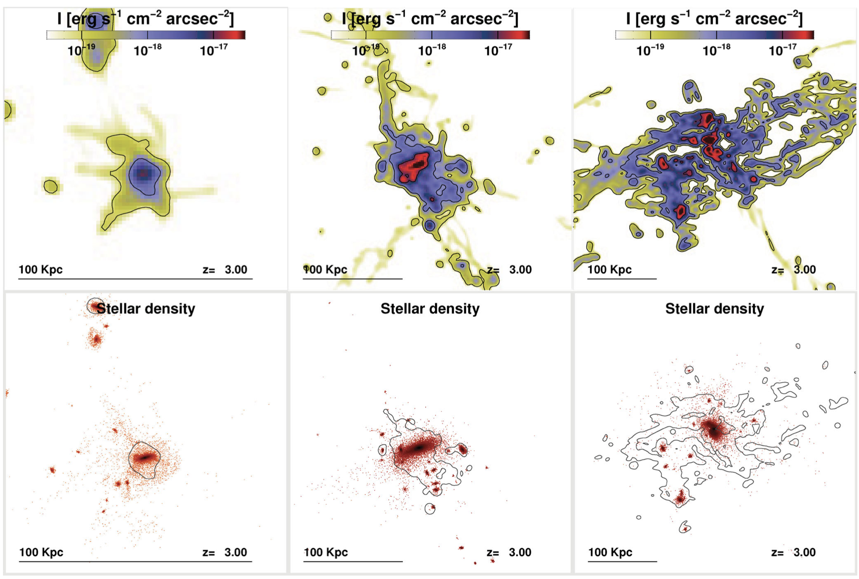
Discrepancies with Gravitational Cooling Models:
BCG is not at the center of the Ly𝛂 emission
  Rosdahl+2012 simulations predict that the BCG should be centralized
Rosdahl+2012
Notes:
Simulations of Rosdahl et al predict that for a gravitationally cooling halo, the brightest spots of the lyman alpha emission are centered on galaxies

Slide 12
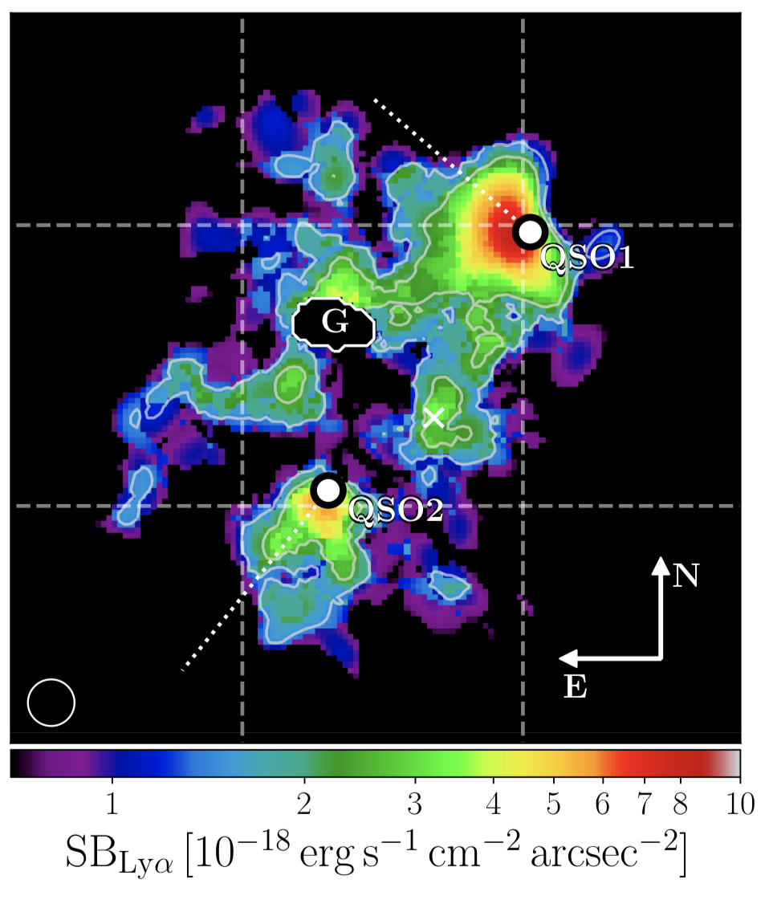
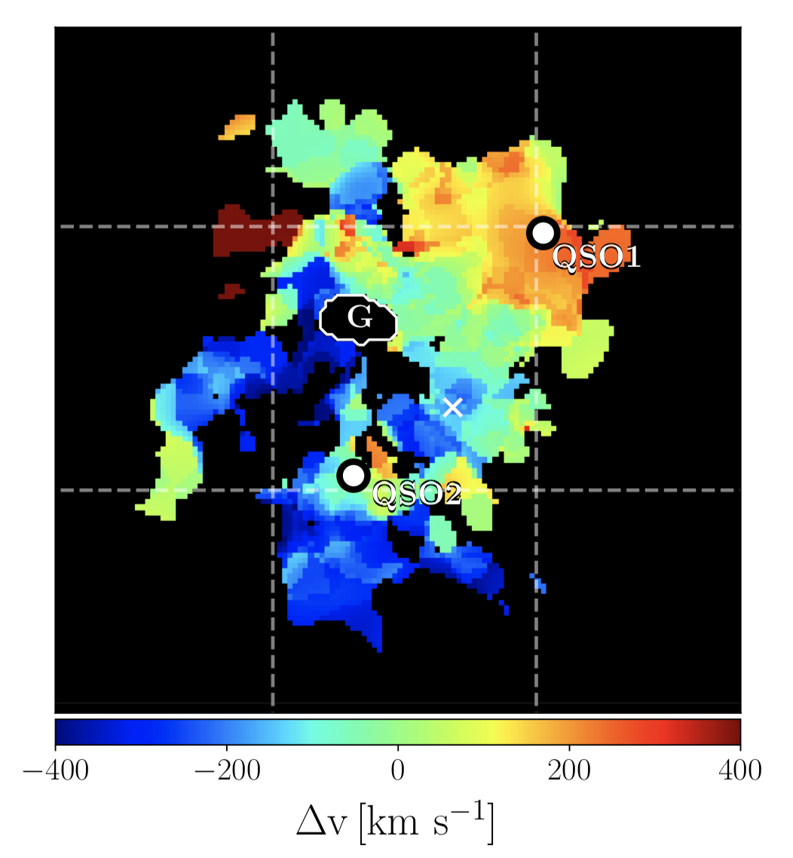
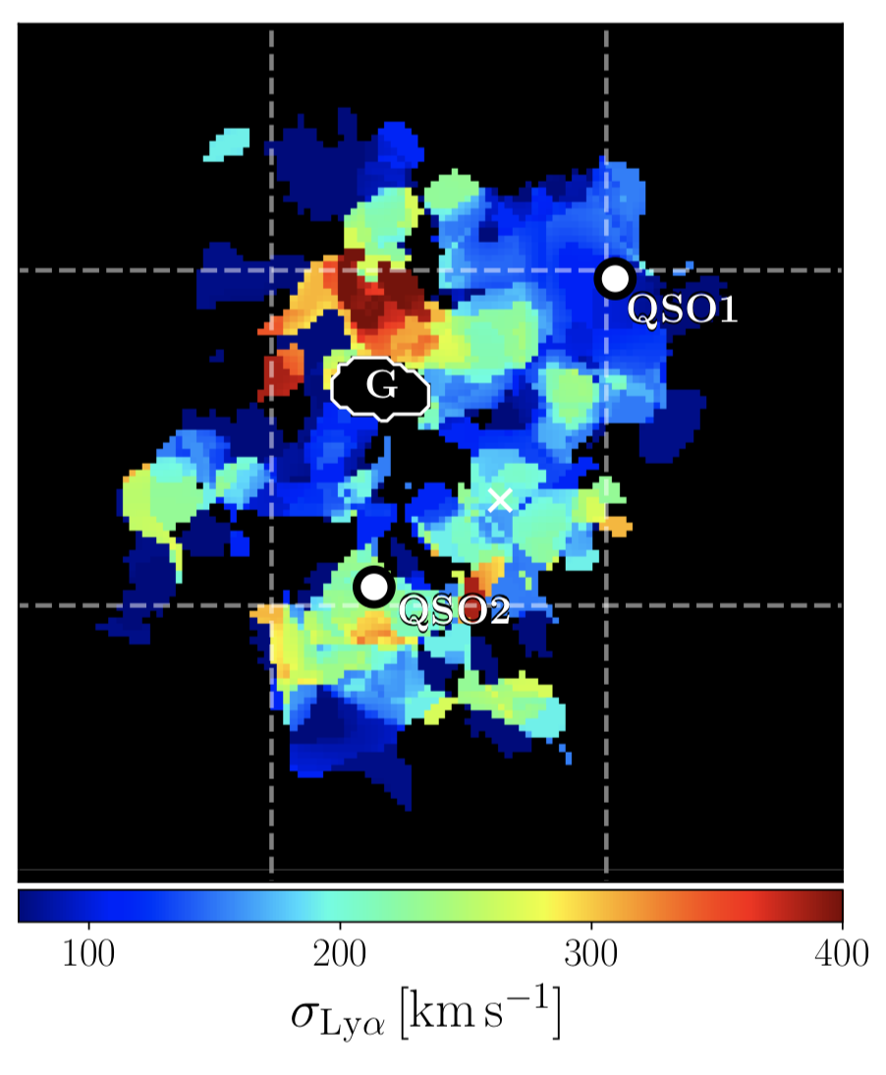
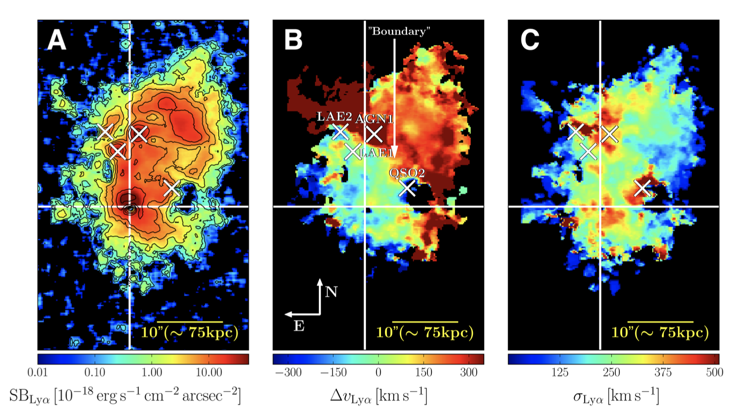
Comparison to QSO Powered LAN with structured Kinematics:
Battaia+2018
Battaia+2019
Notes:
The Nilsson blob shows a lower SB that nebulae that seem to have kinematic gradients across them as well but much still the Nilsson nebula has a higher velocity dispersion overall and especially near the locations of the predicted AGN

Slide 13
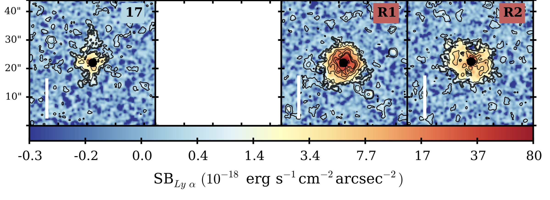
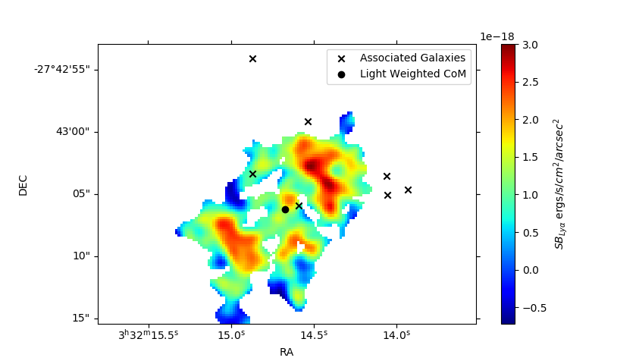
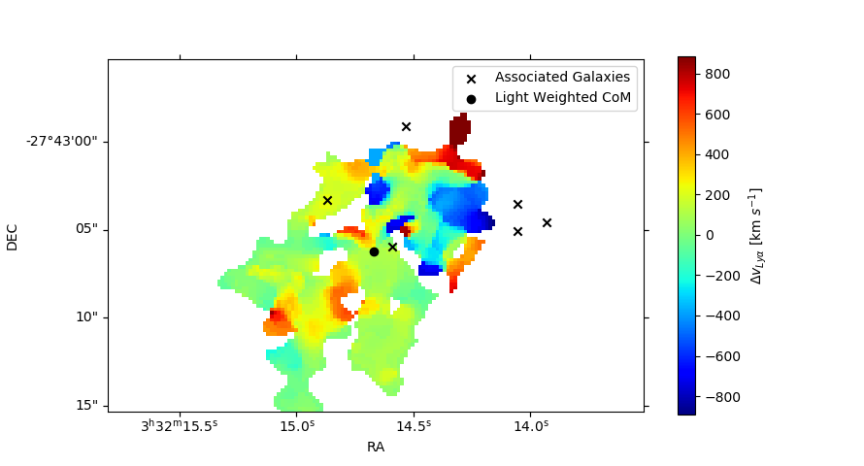
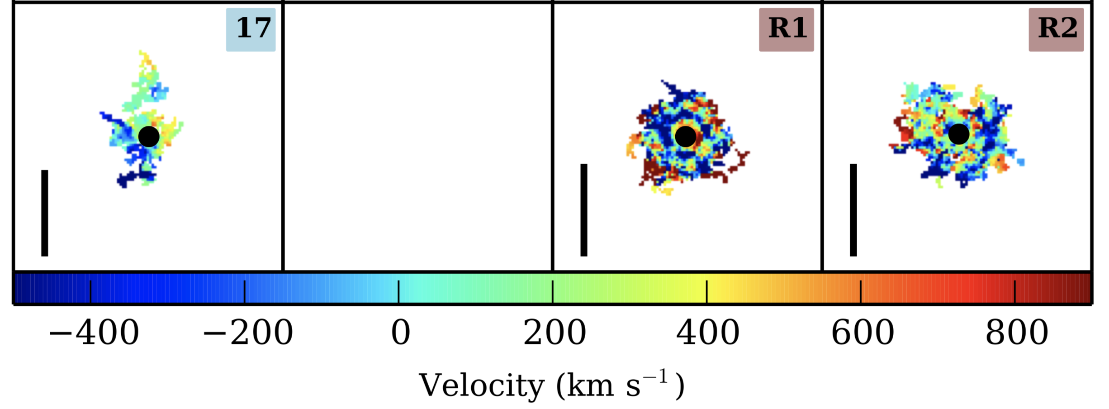
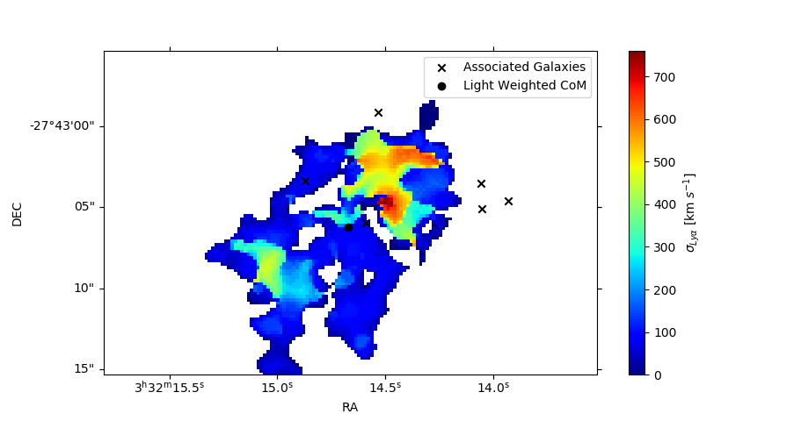
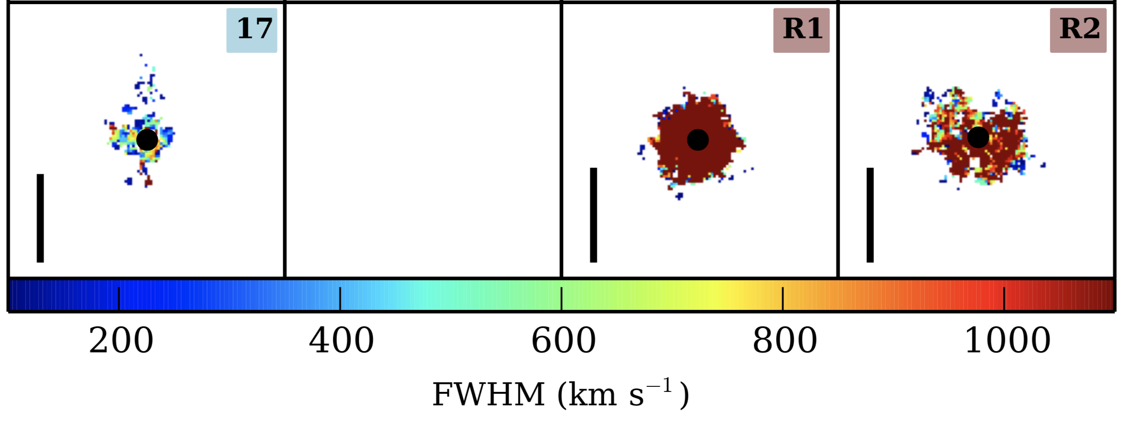
Comparison to Radio-loud QSO powered LAN:
Borisova+2016
Notes:
Nebulae centered on radio-loud QSOs tend to show the most chaotic kinematic profiles. Searches through NRAO VLA Sky Survey (NVSS) and the VLA Sky Survey (VLASS) did not reveal any radio sources at the location of the the nebula.

Slide 14
MUSE Data:
Total Exposure time = 5 hours
  DR with EsoRex Pipeline
    Freudling+2013
Sky Subtracted in ZAP
    Soto+2016
Continuum source subtraction, spatial smoothing, and spectral smoothing with LSDcat
    Herenz & Wisotzki, 2017
  seeing=1.2”, Velocity Window=300 km/s
Subcube extracted and voxels w/ SNR<2.5 masked
Full white light image of MUSE FOV
NB (~30 Å) image of spatially and spectrally smoothed MUSE FOV
NB (~30 Å) image centered on Nilsson nebula
Notes:
We return, again, to this object with new IFU MUSE observations of the Nilsson nebula. 5 hours of exposure time were obtained for this object. On the combined data cube, we performed sky and continuum source subtraction as well as spatial and spectral smoothing in order to take a look at the kinematics of the emitting gas. Regions with SNR less than 2.5 were not included in the final analysis.
With this data, we have performed data reduction using the ESOrex pipeline. On the combined cube, sky subtraction was performed using the Zurich Atmosphere Purge tool as recommended by ESO. We then performed continuum source subtraction as well as spatial and spectral smoothing using the Line Source Detection and Cataloguing Tool, also as recommended by ESO, in order to take a look at the kinematics of the emitting gas. From the post processed cube, we extracted the region of the expected nebular emission.

