Slide 1
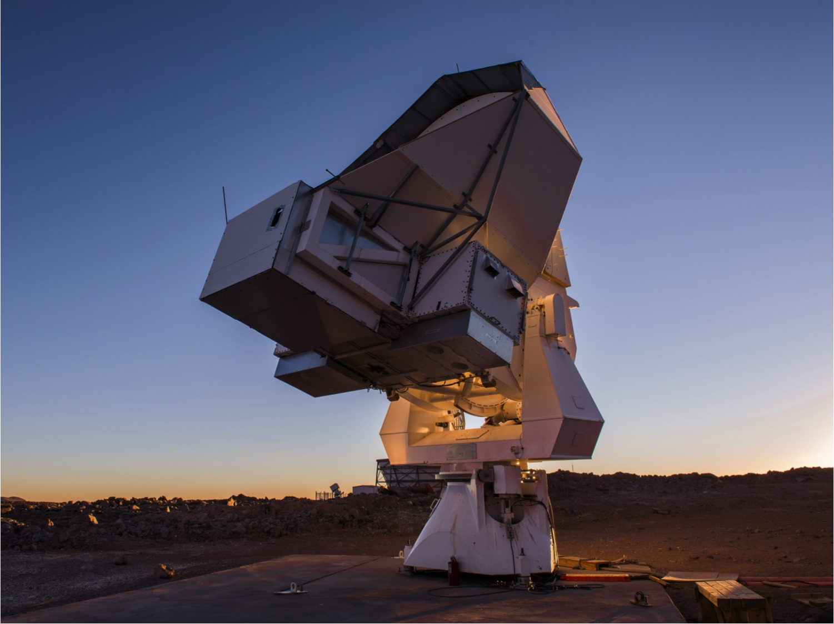
Measuring Cosmic Microwave Background Polarization with POLARBEAR
Kayla Mitchell
NM Symposium
21 February 2020
Notes:
Introduction: Hello, my name is Kayla Mitchell, I’m a grad student at UNM, and today I’m going to be telling you about POLARBEAR, its measurement goals, and how it is trying to achieve those goals. I’ll also give a short overview on the analysis that I have personally been working on for the project.

Slide 2
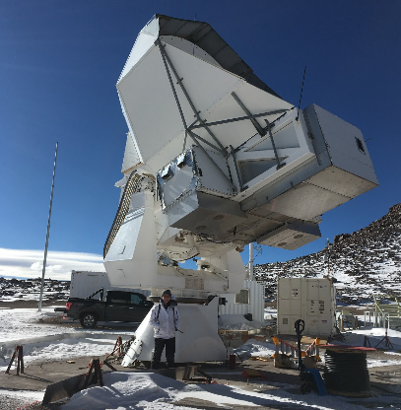
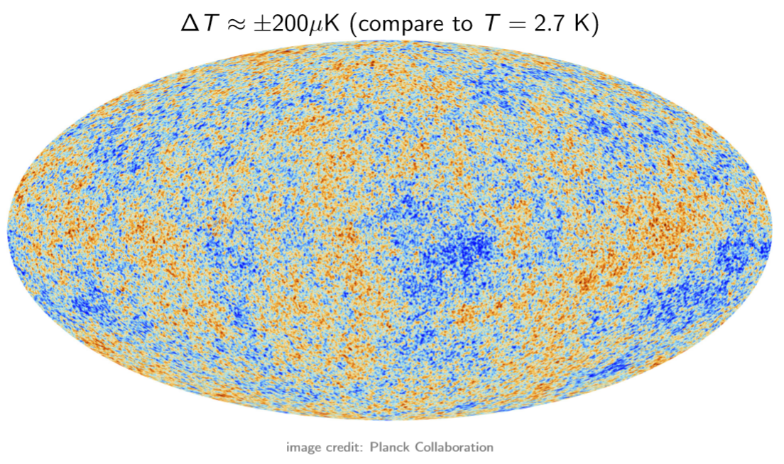
Outline
Background on the CMB
POLARBEAR design
POLARBEAR-2a Commissioning
Future of POLARBEAR
Notes:
Go through outline

Slide 3
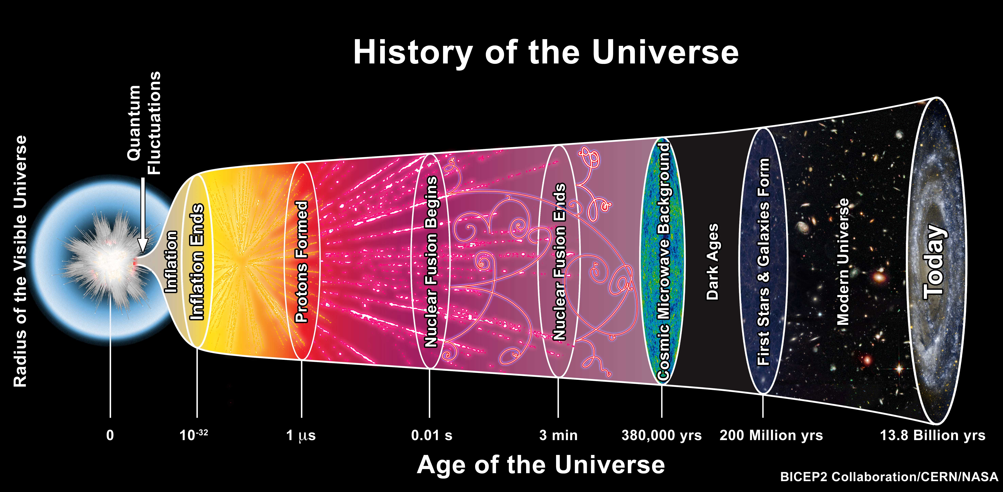
Notes:
-axes
-inflation, exponential expansion after big bang
-slower expansion after, universe cools
-1 eV recombination, neutral hydrogen forming, no more free electrons so photons are free to travel
-observe this surface of last scattering to learn about the early universe

Slide 4
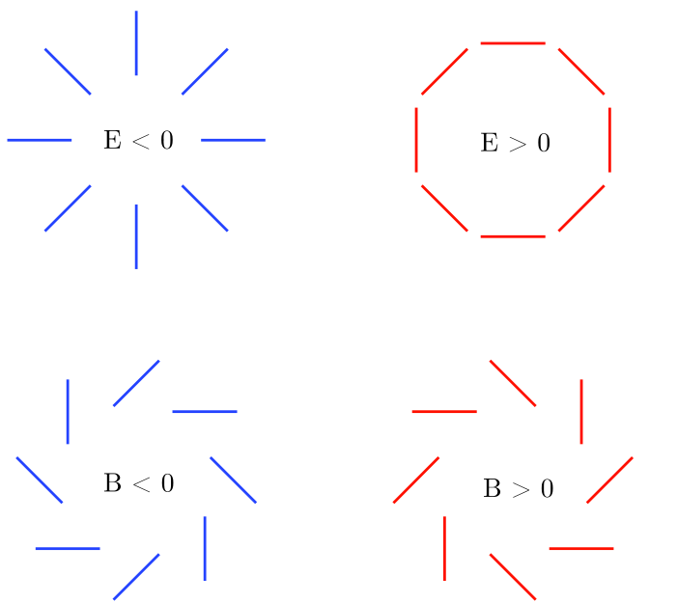
Polarization Modes
E-modes from density fluctuations
B-modes from:
  Primordial gravitational waves
  Gravitational Lensing
  Polarized foregrounds
Notes:
-rather than measuring intensity of the CMB, POLARBEAR is focused on measuring the polarization of the CMB
-We observe 2 patterns of CMB polarization: what are called E and B modes
- As seen here, E modes are curl free and have this symmetric pattern here, while B modes are divergence free and have this swirling pattern
E modes are formed from Thomson scattering in the early universe. In other words, the E modes are produced from density fluctuations of the CMB
These E modes have been measured relatively well, so many experiments are now geared toward investigating B modes
B modes can be created by primordial gravitational waves, lensing around massive galaxy clusters, and foreground objects like dust.
Naturally, we want to remove signals from foregrounds like dust, and get down to the sensitivity needed to detect B modes produced by primordial gravitational waves. This would tell us about inflation and give greater insight into very early times in the universe

Slide 5
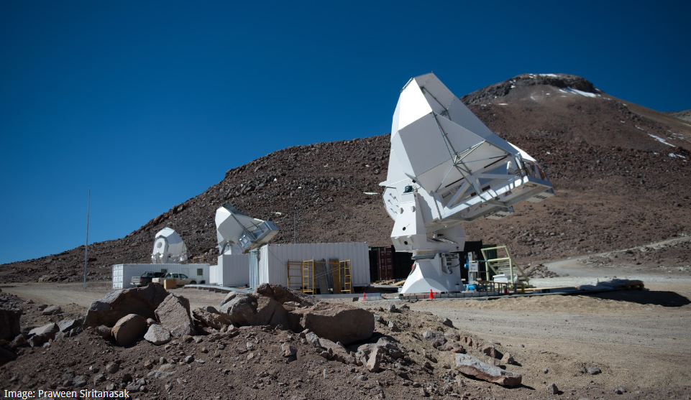
POLARBEAR-2 / Simons Array
Located in the Atacama Desert in Chile at an elevation of 5200m
Observe at 95/150/220/270 GHz
Over 20,000 detectors cooled to 250mK
Notes:
-here is a picture of the site in the Atacama Desert in Chile.
POLARBEAR-1 consisted of only one of these receivers. In upgrading to POLARBEAR-2, or the Simons Array, 3 receivers have been constructed- PB2a,b, and c.
Once all receivers are completed, Simons Array will cover 4 different frequency bands. The additional bands that have been added since PB1 will help remove polarized foregrounds, like dust, to get closer to the sensitivity needed to detect primordial B modes
There will be a total of 22,764 detectors in Simons Array, all cooled to 250 mK
PB2a has already been deployed. Work is continuing on 2b and 2c, aiming to be installed mid 2020

Slide 6
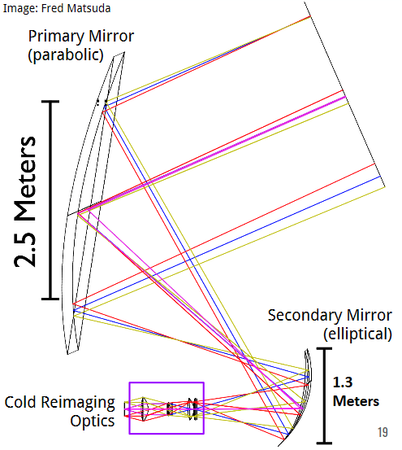
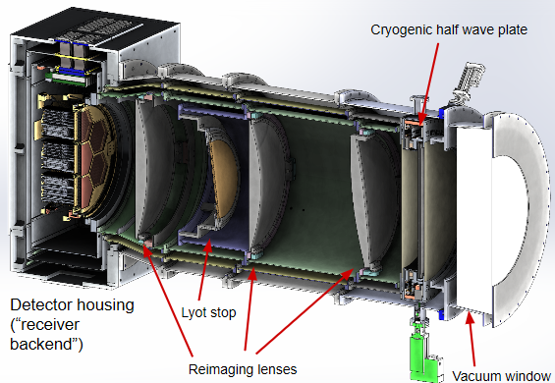
Cryogenic Receiver
Image: Logan Howe
2 m
Notes:
-here is a diagram of one of the receivers.
-the incoming radiation hits the primary mirror, gets reflected off the secondary mirror, and enters the “cold reimaging optics” section where all the cryogenics and detectors are housed.
-in this picture you can see there are further lenses inside the optics tube, which ends at the focal plane here

Slide 7
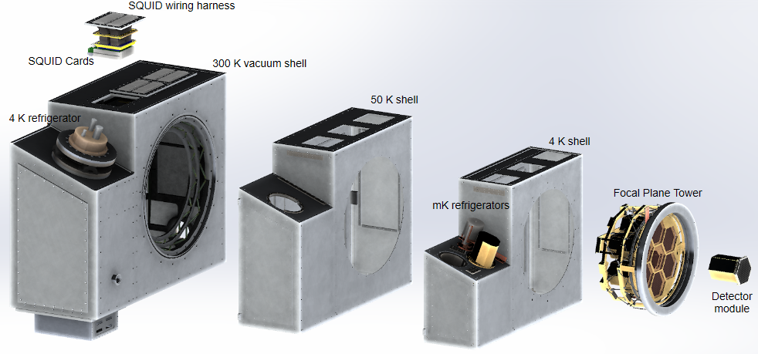
Receiver Backend
300 mK
Image credit: Logan Howe
Notes:
Here is another diagram to give you a better idea of how the cooling happens in the optics tube.
-it is constructed with several different shells held at different temperatures.

Slide 8
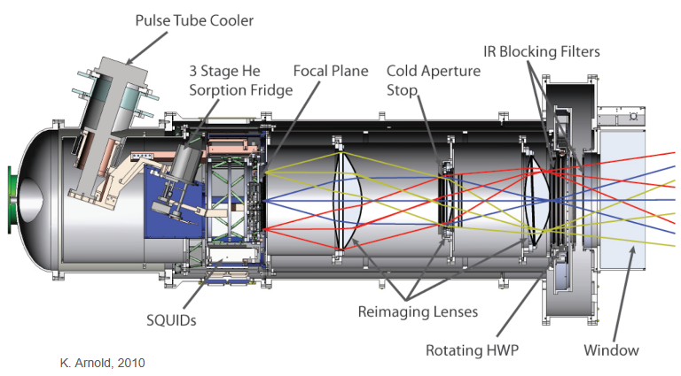
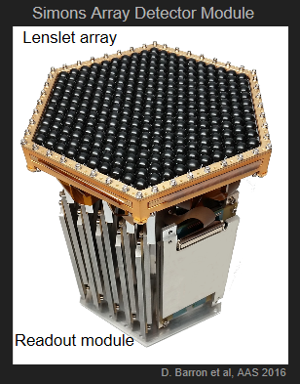
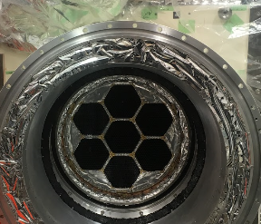
Focal Plane
1084 Transition Edge Sensor (TES) bolometers fabricated on each 6-inch wafer
Coupled to anti-reflection coated lenslets
1897 dual-polarization dichroic pixels in focal plane
Image: Lindsay Lowry
Notes:
This is a close up of where the focal plane tower fits into the backend of the receiver, and one of the readout modules
The top of the module here is covered in anti reflection coated lenslets

Slide 9
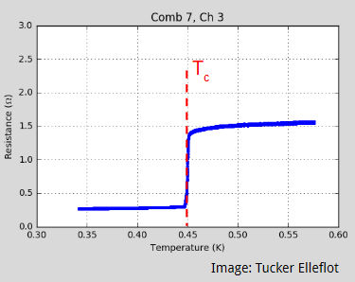
TES Bolometers
Polarization signals much weaker than temperature measurements – need high sensitivity, low noise detectors
Sensitivity of each detector at 150 GHz limited to ~500 µK-sqrt(s) by photon statistics. To improve sensitivity, must add more detectors!
Voltage bias maintains superconducting film at its transition temperature
Small amounts of optical power slightly increase bolometer’s temperature resulting in large changes in bolometer’s resistance
Due to the voltage bias, these resistance changes can be read out as changes in current through the TES
Notes:
The detectors we use are TES bolometers
Since polarization signals are much weaker than temperature measurements (and B modes are even more difficult to detect than E modes), we require high sensitivity, low noise detectors
These detectors are superconducting
TES detectors observing from Chile are limited in sensitivity by the photon statistics of the atmosphere they are observing through.
The sensitivity of one detector at 150 GHz is 500 uK-sqrt(s), which is that in one second of integration, it can resolve a temperature fluctuation of 500 uK on the sky.
You can do 10 times better with one detector by going to space, or you can build 100 more detectors on the ground (which is actually easier)
As can be seen in this plot, it takes only a very small temperature change, that is a very small quantity of optical power, to cause large changes in the bolometer’s resistance
These resistance changes can then be read out as changes in current through the TES

Slide 10
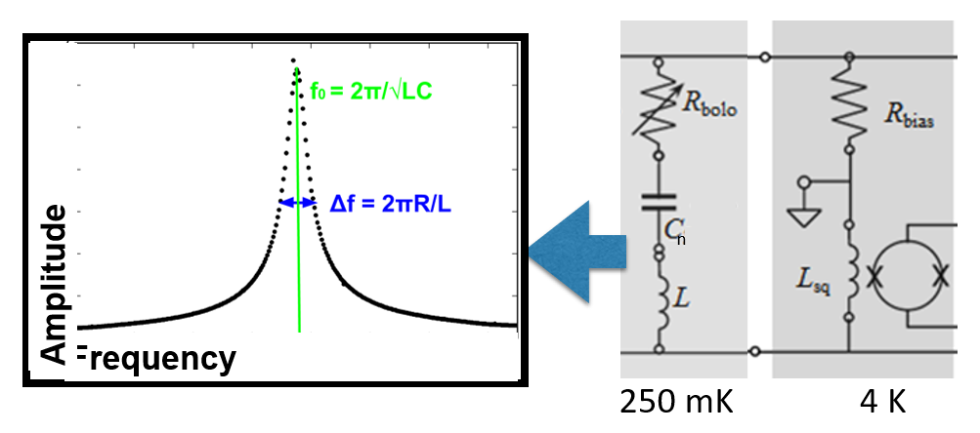
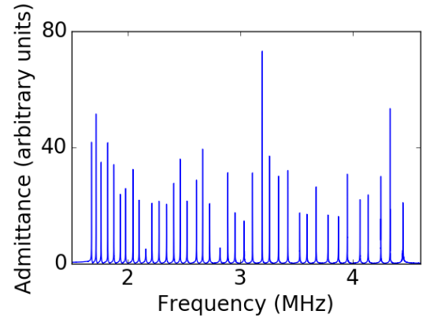
Frequency-multiplexed Readout
Signal from 40 detectors read out on a single pair of wires
Achieved by placing an inductor and capacitor in series with each TES
Signal from optical power shows up as an amplitude modulation
All tones fed through a cold SQUID amplifier
Demodulate signals with room temperature electronics
Notes:
After amplifying the signal, it is passed on to be readout
We use freq mult readout
This allows us to read out the signal from 40 detectors on a single pair of wires, with each signal appearing at a distinct resonant freq
Read bullets
One concern is cross talk, proportional to channel resistance and inversely to freq spacing between the 2 channels and the inductance
Maintaining uniform readout bandwidth requires L constant
Therefore vary C in order to set freq for each channel

Slide 11
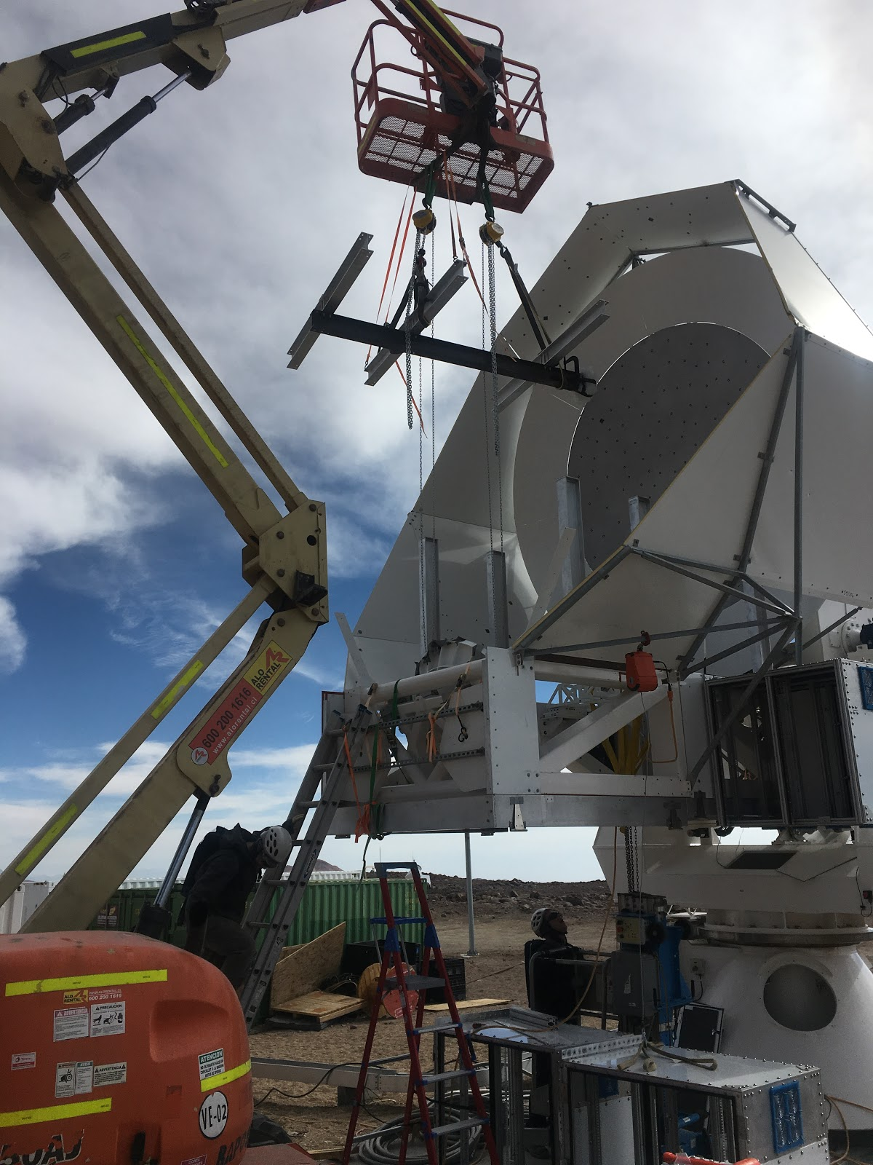
PB-2a
November/December 2018 – receiver placed on telescope, cooled, and calibrated
January 2019 – first planet observations made
Taking network analysis data
First commissioning season austral winter 2019
Image: Lindsay Lowry

Slide 12
Network Analysis Data
Peaks at resonant frequencies

Slide 13
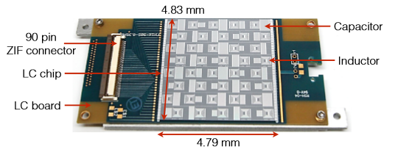
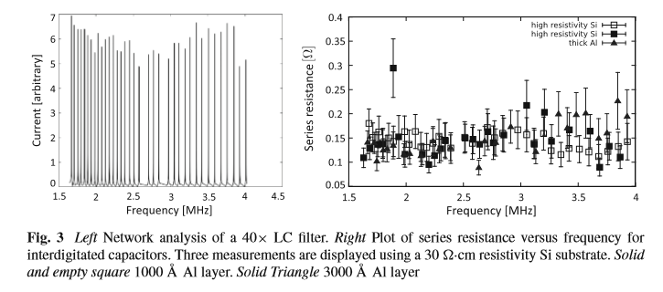
Images: Rotermund et al 2016
Notes:
Low loss!

Slide 14
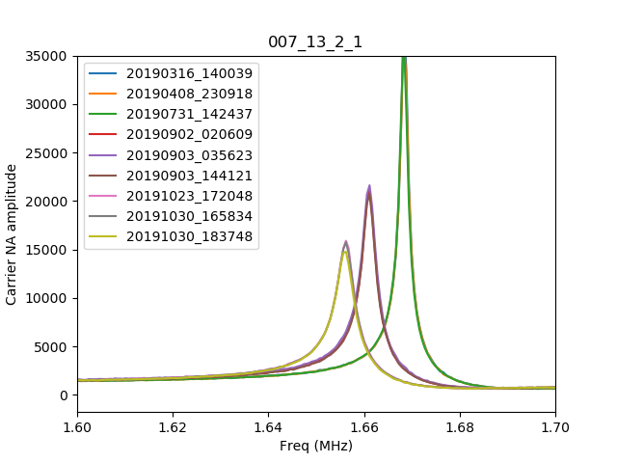
My Work
Notes:
*this is happening to SOME channels, not all

Slide 15
Kinetic Inductance
Expect resonant frequencies to be set by geometry
Changing frequencies could be explained by additional kinetic inductance
Kinetic inductance comes from inertia of charge carriers
In a superconductor with finite temperature, not all electrons are paired up as Cooper pairs
Leads to kinetic inductance effects that depends on temperature and other factors
Effect is exploited to make kinetic inductance detectors, tunable resonators

Slide 16
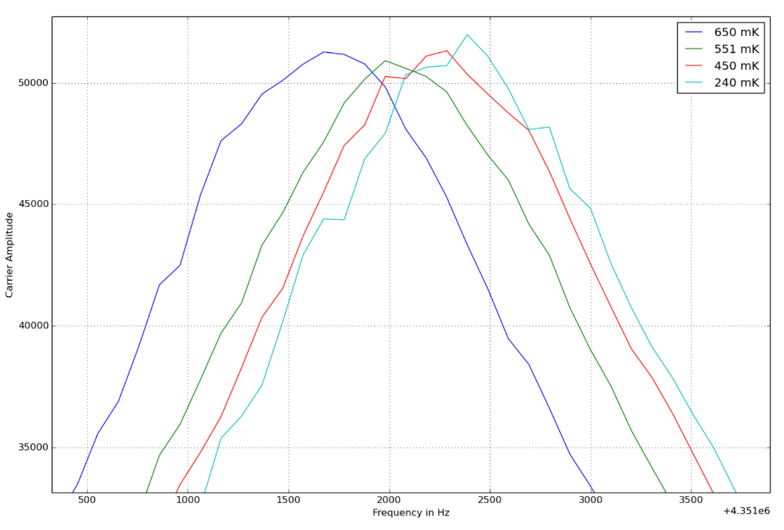
Image credit: Barron, D.
Image credit: Wang, G. 2016.

Slide 17
Current Status
PB2b receiver is on boat to Chile now, commissioning this austral winter
Comparing network analysis data and readout performance from PB2a and PB2b, for submission to Applied Superconductivity Conference this summer
At UNM:
  Will be setting up new cryostat
  Will be used for development/testing of detectors
  Currently working on all-sky IR camera to monitor polarized clouds at site

Slide 18
References
Barron, D. R. Precision measurements of cosmic microwave background polarization to study cosmic inflation and large scale structure. UC San Diego Physics PhD Dissertation. 2015.
Guildemeister, J.M. Voltage-Biased Superconducting Bolometers for Infrared and mm-Waves. UC Berkeley Physics PhD Dissertation. 2000.
Rotermund, K., et al. Planar Lithographed Superconducting LC Resonators for Frequency-Domain Multiplexed Readout Systems. J Low Temp Physics(2016) 184:486-491. 2016.
The POLARBEAR Collaboration. A Measurement of the Cosmic Microwave Background B-mode Polarization Power Spectrum at Sub-degree Scales from 2 Years of POLARBEAR Data. ApJ 848:141. 2017.
The POLARBEAR Collaboration. A Measurement of the Degree Scale CMB B-mode Angular Power Spectrum with POLARBEAR. arXiv:1910:02608. 2019.
The POLARBEAR Collaboration. Internal Delensing of Cosmic Microwave Background Polarization B-modes with the POLARBEAR Experiment. arXiv: 1909.13832. 2019.
Wang, G. Temperature Dependence of the Inductance of Superconductor LC Circuit. Presentation. 2016.
Special thanks to the students at UC San Diego for their help during my visit and with my presentation slides: Lindsay Ng Lowry, Logan Howe, Tucker Elleflot, David Leon

