Slide 1
Understanding dust growth and sub-structures in protoplanetary disks
Yaping Li (LANL)
With Hui Li (LANL), Shengtai Li (LANL)
The 35th New Mexico Symposium

Slide 2
Outline
Observations: sub- structures in protoplanetary disks (PPDs)
Coagulation in gas bump (ring): mm spectral index vs. flux
Coagulation in vortex: vortex lifetime and observational implications
Interpret the ring at the outer disks: eccentric planet
Summary

Slide 3
Observations of Protoplanetary disks
Ringed structures
0.87 mm
1.3 mm
TW Hya (Andrews016)
HD 163296 (Isellar+16)
HL Tau (ALMA +15)
Asymmetry
IRS 48
(van der Marel+2013)
39-47 GHz
Clumpy
LkCa 15
(Isella+2014)
See also many other: AA Tau (Loomis+17), Elias 24 (Cieza+17; Cox+17; Dipierro+18), AS 209 (Fedele+18), GY 91 (Sheehan +18), V1094 Sco (Ansdell+18; van Terwisga+18), MWC 758 (Boehler+18, Dong+18), 16 disks (van der Marel+19), Long et al. (2018) ,DSHARP project (Andrew et al. 2018)

Slide 4
General picture: Dust dynamics
Testi et al. (2014)

Slide 5

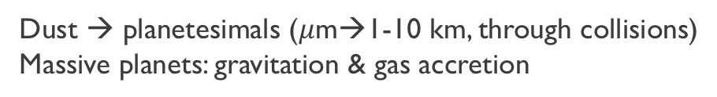




Planet formation: evolutions of solids
ISM dust
sand
pebble
planetesimal
planet
$1 μ$m
$1$mm
$10$cm
$1$km
${10}^{4}$km
Opt/IR
mm obs.:e.g. ALMA
Kepler/TESS
Dust size growth
Dust → planetesimals ($μ$m→1-10 km, through collisions)
Massive planets: gravitation & gas accretion

Slide 6

Radial drift problem for dust: Smooth disk
Gas
Log $Σ_{g}$
Dust drift inward
Log R
Dust experience a head-wind → loss of angular momentum → drift inward (Weidenschilling1977).
Most (~99%) of dust is depleted at ~Myr due to radial drift!
Dust size cannot grow efficiently!
Li et al. 2019a

Slide 7
Viscosity transition model including dust coagulation
Assumption: viscosity gap around 15 au → producing gas bump (ring).
Sources of collision velocity
  Brownian motion, vertical settling, radial drift, turbulence motion (dominant),…
Grains sticking together or fragment , depending on relative velocity.
Dust size evolution governed by Smoluchowski equation:
LA-COMPASS, Li05,09 with coagulation (Birnstiel+10a)
)

Slide 8
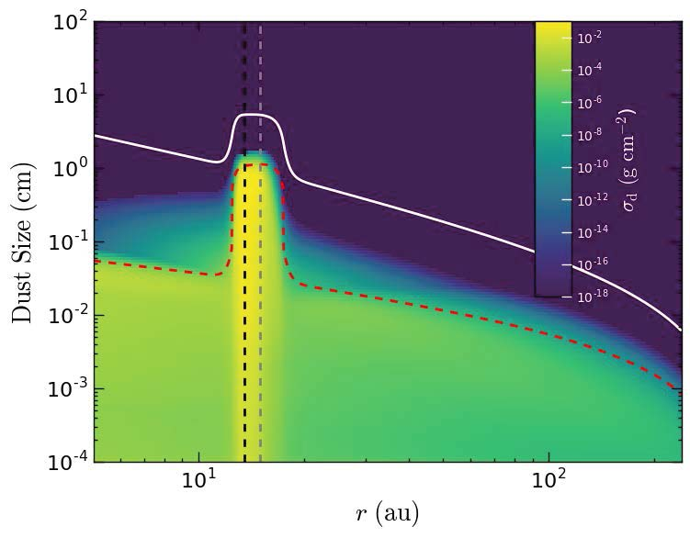
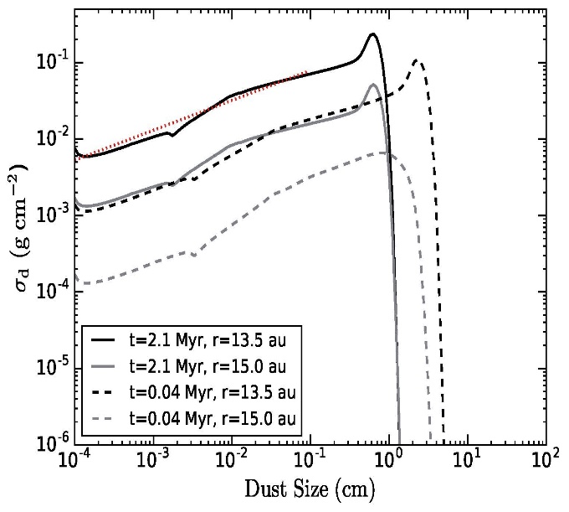
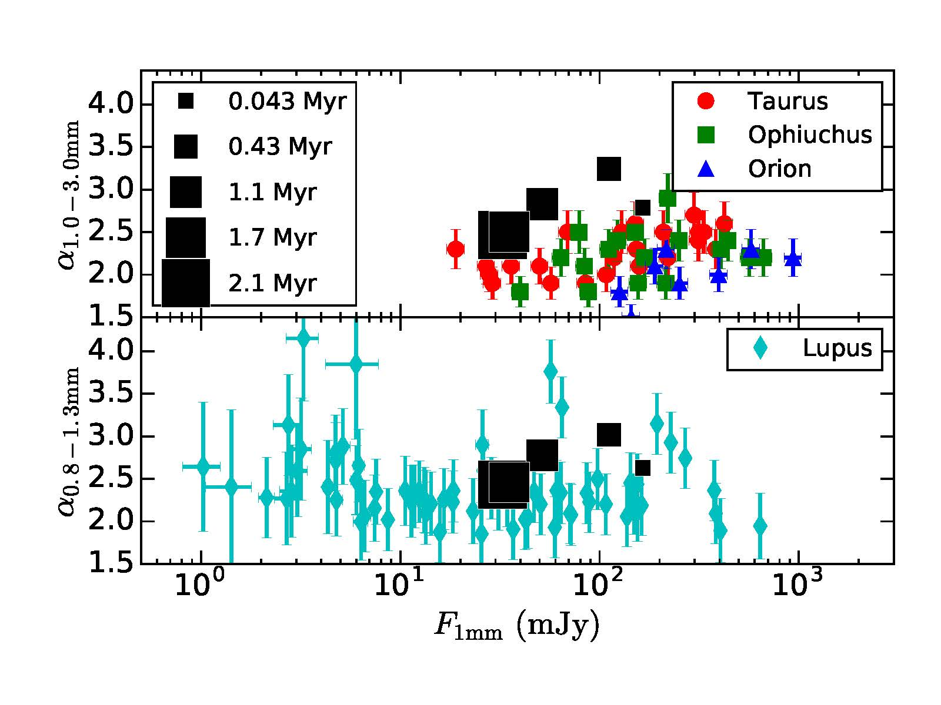
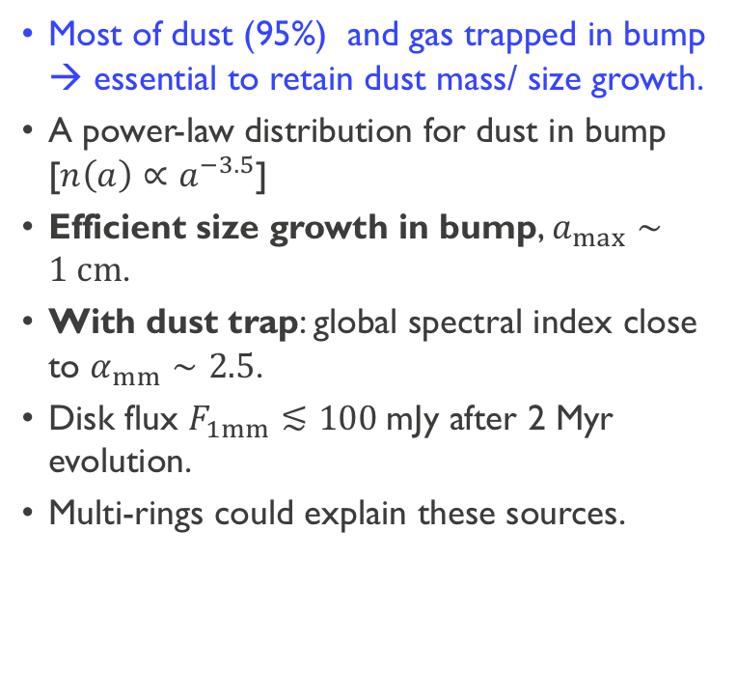
Comparison with observation: global spectral slope vs. mm flux
Most of dust (95%) and gas trapped in bump → essential to retain dust mass/ size growth.
A power-law distribution for dust in bump [${n\left(a\right)∝a}^{−3.5}$]
Efficient size growth in bump, $a_{max}∼1 cm$.
With dust trap: global spectral index close to $α_{mm}∼2.5$.
Disk flux $F_{1mm}≲100$mJy after 2 Myr evolution.
Multi-rings could explain these sources.
Dust size /
Trapping
Dust Mass

Slide 9



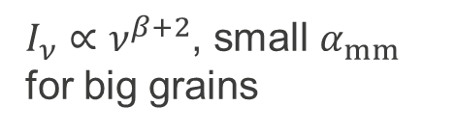

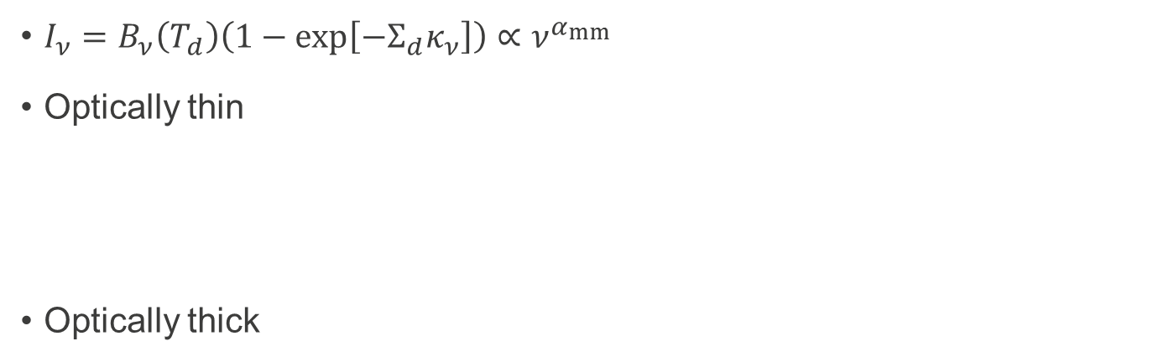
From dust growth and trapping→ Dust mm observations
Dust opacity spectral index $β$
$I_{ν}=B_{ν}\left(T_{d}\right)\left(1−exp\left[−Σ_{d}κ_{ν}\right]\right)∝ν^{α_{mm}}$
Optically thin
Optically thick
$$I_{ν}∝B_{ν}κ_{ν}$$
Rayleigh-Jeans
${I_{ν}∝ν}^{β+2}$, small $α_{mm}$ for big grains
$${I_{ν}∝B}_{ν}$$
Rayleigh-Jeans
${I_{ν}∝ν}^{2}$, $α_{mm}=2$
Spectral index of mm emissions can diagnose dust size and trapping.

Slide 10
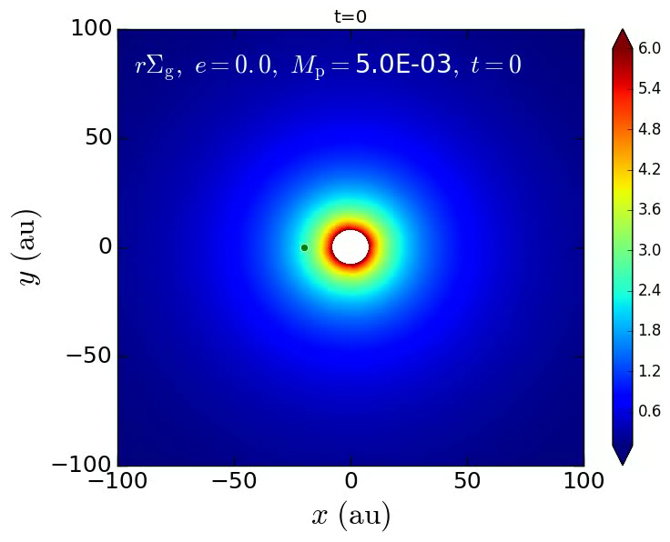
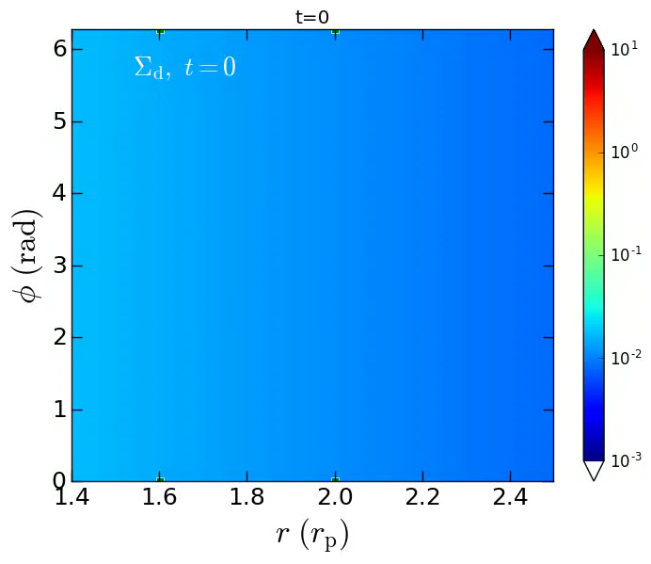
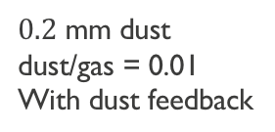

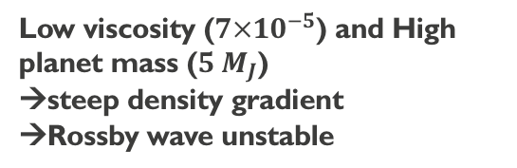
Dust trap by gaseous vortex
2D simulations of dust-gas dynamics
$0.2$ mm dust
dust/gas = 0.01
With dust feedback
Gas Surface Density
${r (r}_{p}$)
A pressure bump at the edge of a planet gap can act as dust trap.
Low viscosity ($7×10^{−5}$) and High planet mass ($5 M_{J}$)
→steep density gradient
→Rossby wave unstable
Dust Surface Density

Slide 11
Vortex evolution with 2D coagulation and dust feedback
Dust size is quite non-uniform within vortex region
Dust size growth facilizes the increase of dust/gas ratio.
Vortex can be significantly impacted by dust feedback when coagulation included.

Slide 12
Dust images
Clumpy at longer wavelength, while rings at (sub)mm band for coagulation models.

Slide 13
Eccentric planet
  Eccentric planet?
  Observations: CI Tau (Duffell +15; Rosotti+2017; Clarke+18), Keppler survey
  Theory: planet-planet scattering (e.g., Rasio+96; Lega+13), planet-disk interaction (e.g.,Papaloizou01;Duffell+15), Kozai-Lidov (Kozai62;Lidov62), secular chaos (Wu+11).
Non-linear evolution of highly eccentric orbit including dust:
  Planet dynamics: circularization process
  Imprints on the dust
CI Tau
e~0.3 (Johns-Krull+16)

Slide 14
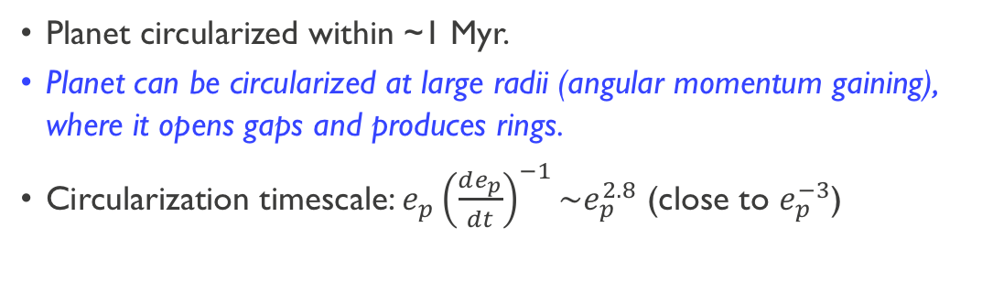
Tidal interaction with eccentric planet in dusty disks
Planet circularized within ~1 Myr.
Planet can be circularized at large radii (angular momentum gaining), where it opens gaps and produces rings.
Circularization timescale: $e_{p}{\left(\frac{de_{p}}{dt}\right)}^{−1}\sim e_{p}^{2.8}$ (close to $e_{p}^{−3}$)

Slide 15
Images: Dust perturbated by an eccentric planet
Before planet circularization
After planet circularization
Observed rings/gaps at outer region of disks after planet circularization

Slide 16

Low disk mass: gap opening before circularization
Gap located the the pericenter and apocenter of the eccentric orbit (even for a fixed orbit: red lines at right panels)!
Low disk mass results in the gap opening more efficient!
Be cautious when using gap location to infer the current planet location!
$$M_{disk}=5×{10}^{−3} M_{⊙},e=0.5$$

Slide 17
Summary
Sub-structures (rings, horseshoe, clumpy, spiral) are quite common in protoplanetary disks. These substructures can effectively trap dust, facilize dust size growth.
A gas and dust ring can produce a lower global spectral index.
Vortex evolution (lifetime, images) can be significantly affected by dust coagulation.
Highly eccentric orbit of planet can produce rings at very large radii of the disk due to angular momentum gaining.
Eccentric planet can open gap before its circularization for a low disk mass.

Slide 18
Transit (5135)
Radial velocity (588)
Microlensing (16)
Imaging (11)
J
“Hot-Jupiters”
S
U
N
“Super-Earths”
V
E
Solar system
M
Me

Slide 19
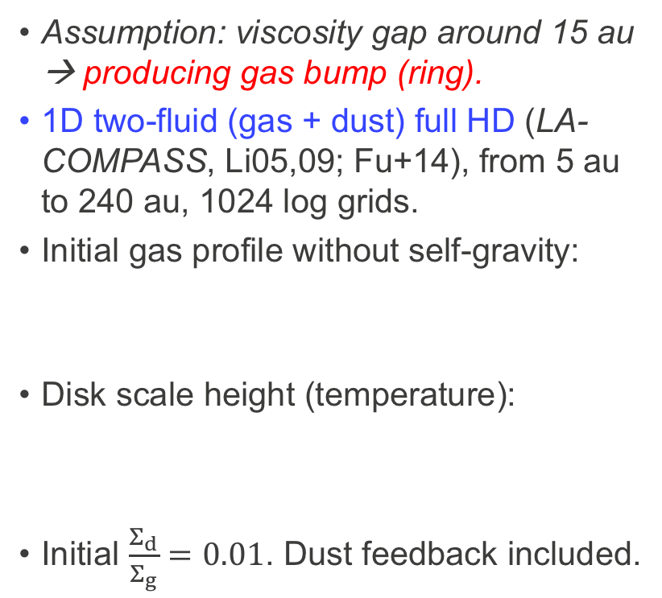
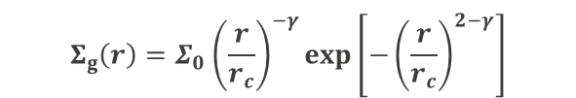
Viscosity transition model
Assumption: viscosity gap around 15 au → producing gas bump (ring).
1D two-fluid (gas + dust) full HD (LA-COMPASS, Li05,09; Fu+14), from 5 au to 240 au, 1024 log grids.
Initial gas profile without self-gravity:
Disk scale height (temperature):
Initial $\frac{Σ_{d}}{Σ_{g}}=0.01$. Dust feedback included.
$$Σ_{g}\left(r\right)=Σ_{0}{\left(\frac{r}{r_{c}}\right)}^{−γ}exp\left[−{\left(\frac{r}{r_{c}}\right)}^{2−γ}\right]$$
Multi-species (151 species) dust with dust coagulation (Birnstiel+10a).

Slide 20
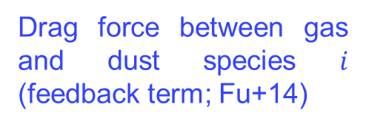
Hydrodynamics for coupled gas and dust
Coupling between dust and gas determined by Stokes number St.
Gas:
Dust for each species (151 in total)
Drag force between gas and dust species $i$ (feedback term; Fu+14)
LA-COMPASS, Li05,09

Slide 21
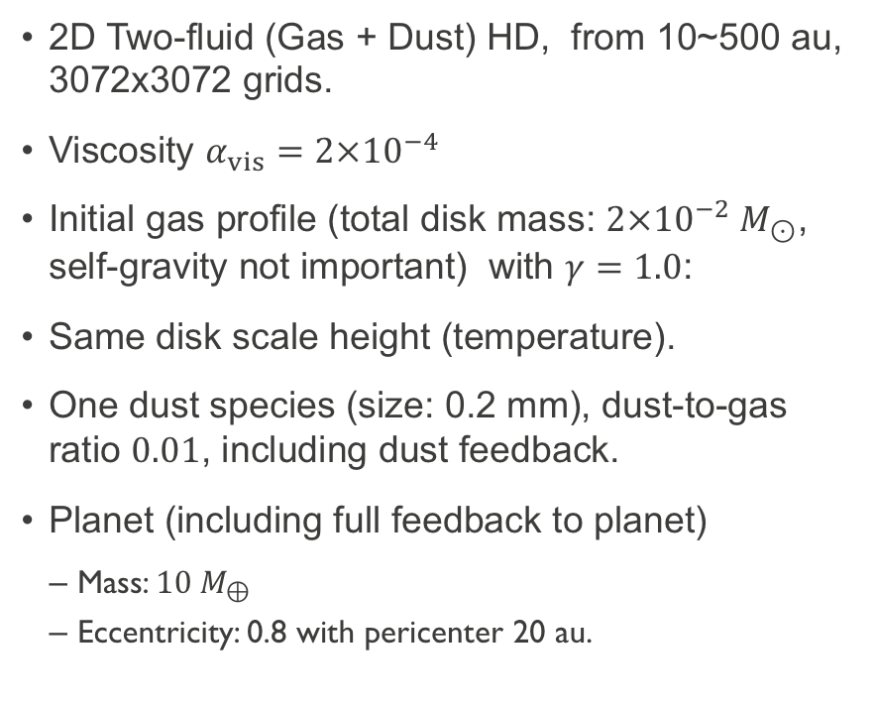
Eccentric Planet: Simulation setup
2D Two-fluid (Gas + Dust) HD, from 10~500 au, 3072x3072 grids.
Viscosity $α_{vis}=2×{10}^{−4}$
Initial gas profile (total disk mass: $2×{10}^{−2} M_{⊙}$, self-gravity not important) with $γ=1.0$:
Same disk scale height (temperature).
One dust species (size: 0.2 mm), dust-to-gas ratio $0.01$, including dust feedback.
Planet (including full feedback to planet)
  Mass: $10 M_{⊕}$
  Eccentricity: 0.8 with pericenter 20 au.

Slide 22
Rings produced via planet-disk interaction
Producing rings and gaps (@~50 au) after planet is circularized.
Gas
No gaps/rings before planet circularization (t=2000, or red lines: fixed orbit)
Dust
Before planet circularization
After planet circularization

