Slide 1
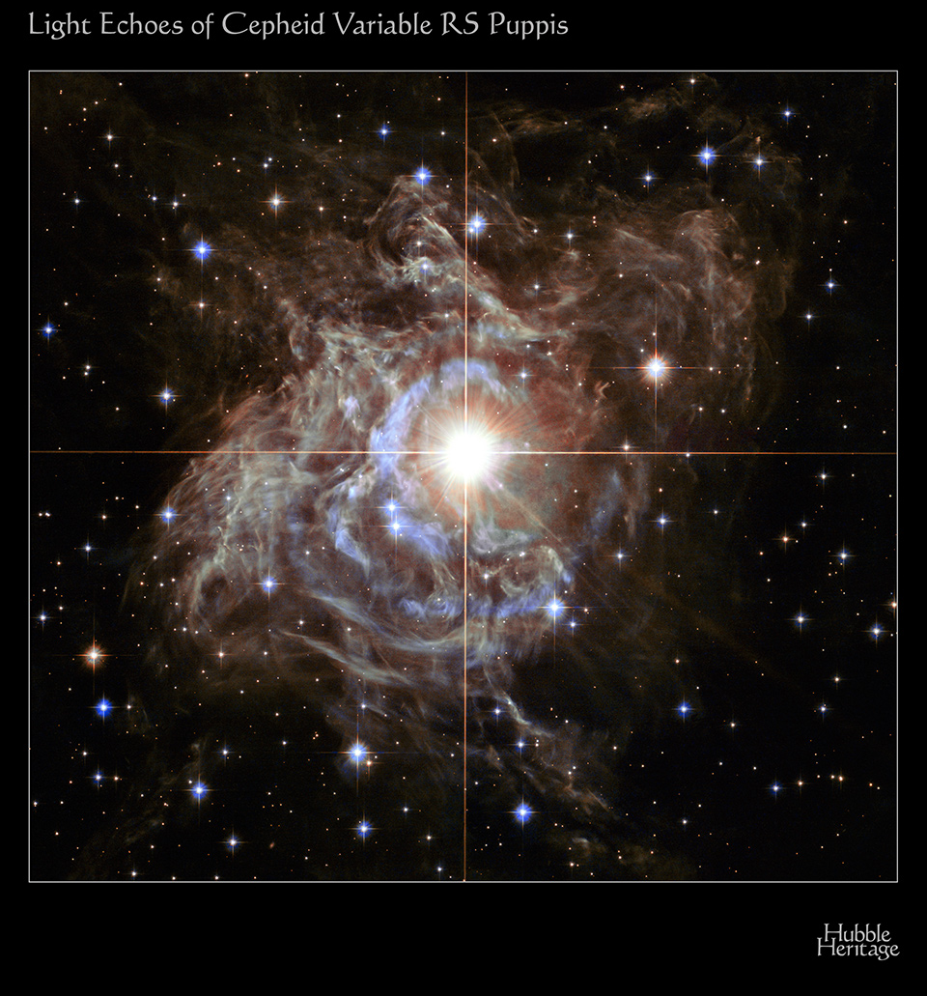
Modeling Pulsations of Cepheid Variables using the Open-Source MESA Code
Joyce Ann Guzik
E. Farag, J. Ostrowski,
N.R. Evans, H. Neilson, S. Moschou, and J.J. Drake
35th Annual New Mexico Symposium
February 21, 2020
NASA, ESA, and the Hubble Heritage Team (STScI/AURA)-Hubble/Europe Collaboration. Acknowledgment: H. Bond (STScI and Penn State University)

Slide 2
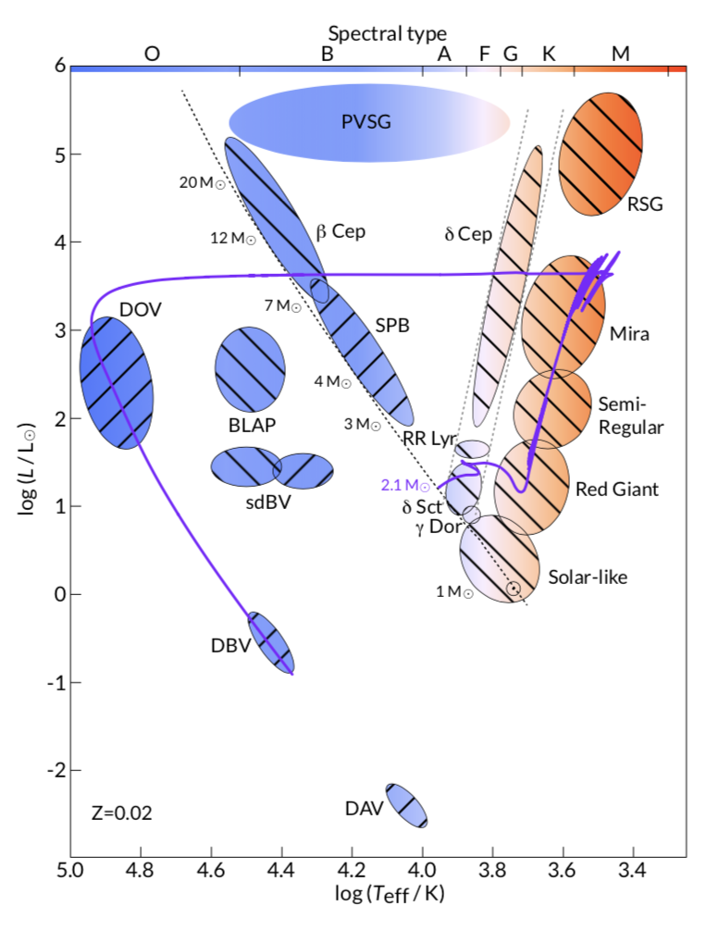
What are (classical) Cepheids?
Pulsating variable stars
Prototype δ Cep discovered 1784 (J. Goodricke)
4 to 15 x mass of Sun
Fusing helium to carbon and oxygen in cores
Pulsation periods 3 to 100 days
Pulsations driven via the ‘kappa' (opacity) mechanism in envelope helium ionization zone ~50,000 K
Radial fundamental, 1st overtone, or 2nd overtone (rare) pulsations
From Paxton et al. 2019
Notes:
`

Slide 3
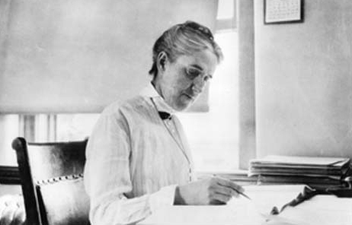
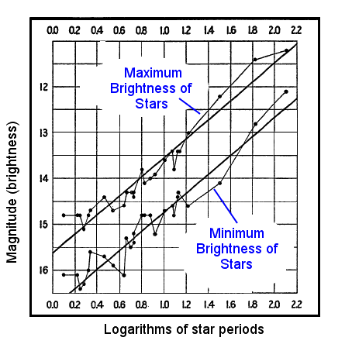
Why are Cepheids important?
Period-luminosity relation (Leavitt 1908) used to calibrate distance scale for universe
  Determine Hubble Constant
“Laboratory” to test stellar physics
  Cepheid mass discrepancy
Caputo et al. 2005

Slide 4
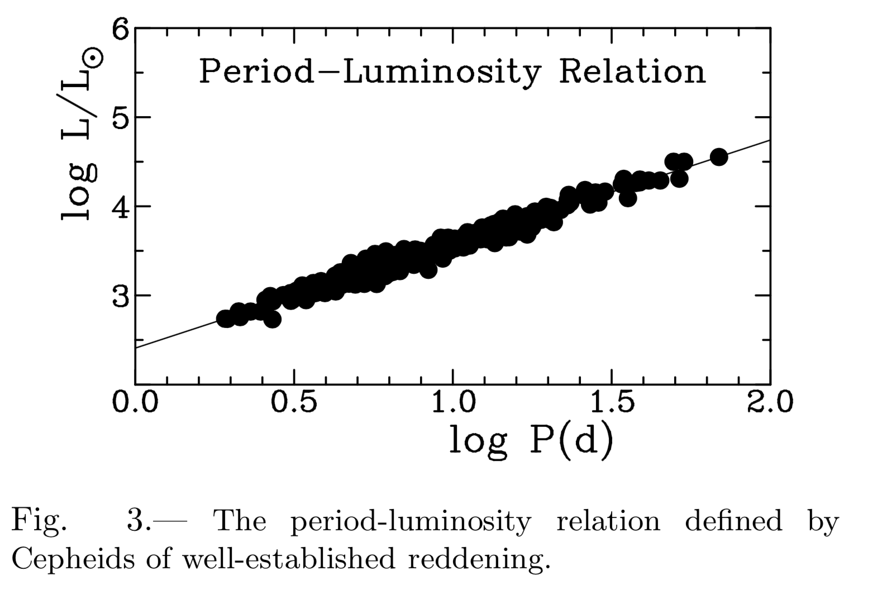
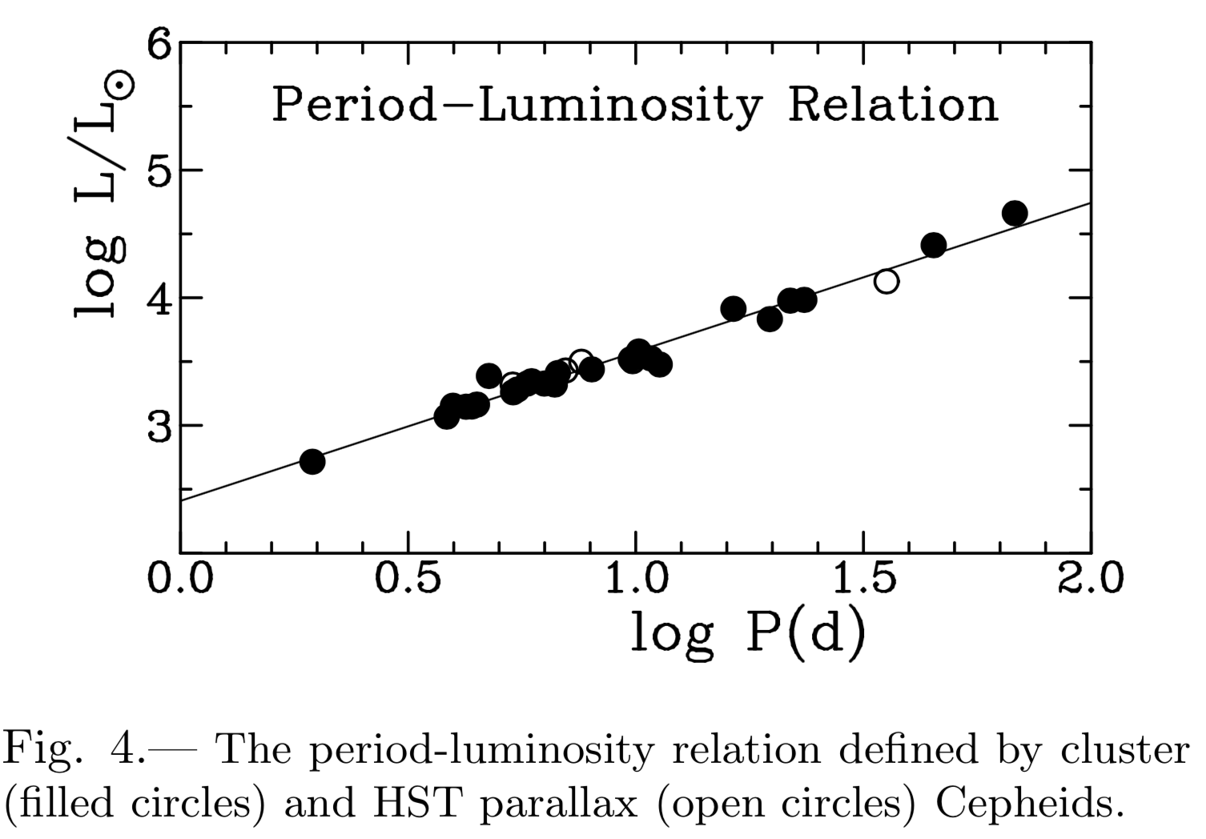
The Cepheid period-luminosity relation must be calibrated by using Cepheids with known distances
Turner et al. 2011
Turner et al. 2011
Caputo et al. 2005
The slope and intercept of the straight-line fit are uncertain

Slide 5
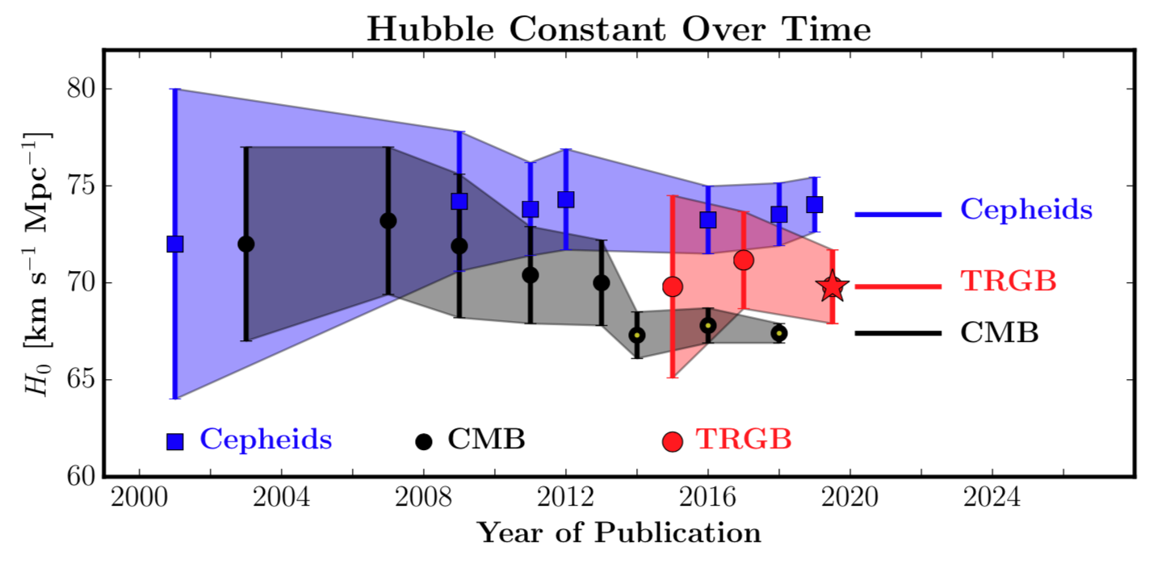
The Hubble Constant derived using Cepheids is higher than that measured using the Cosmic Microwave Background
(Tip of red giant branch)
Freedman et al., ApJ 2019

Slide 6
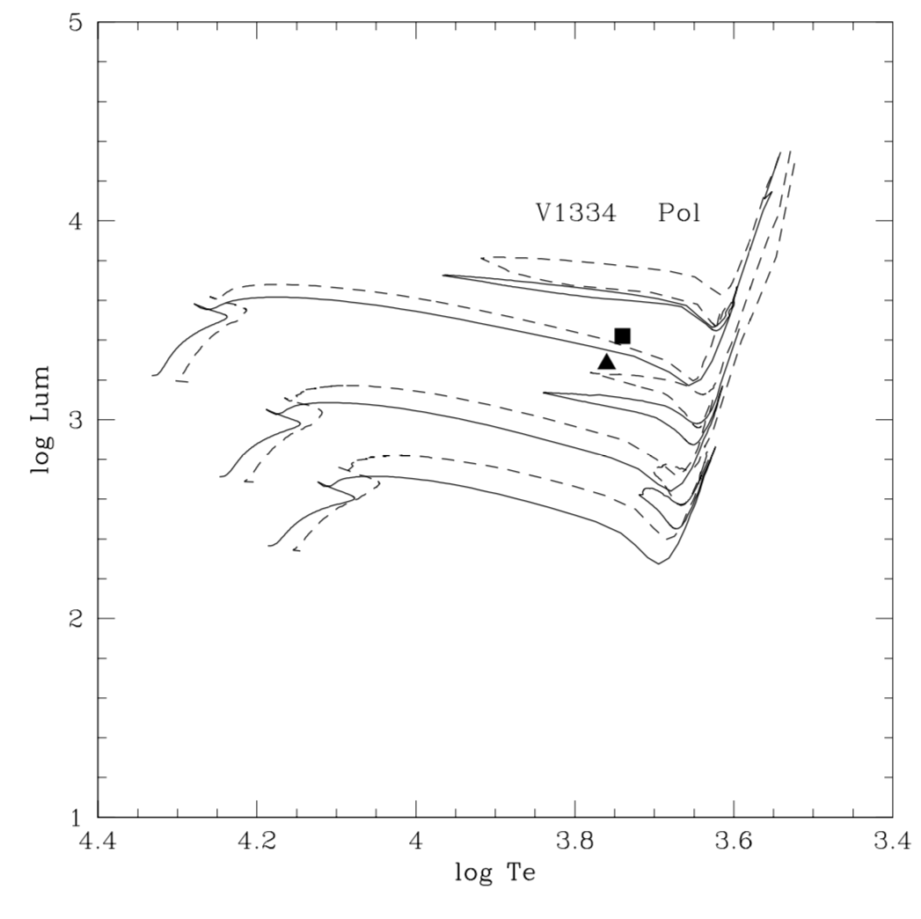
Cepheid masses determined from binary orbit dynamics are lower than evolution model masses
Polaris 3.45 ± 0.75 M_{sun}
(dynamical mass)
7
5
Evolution masses
+/- rotation
4
V1334 Cyg 4.288 ± 0.133 M_{sun}
(dynamical mass)
Evans et al. 2018

Slide 7
The Open Source MESA code was used to model Cepheid evolution and pulsation
MESA = Modules for Experiments in Stellar Astrophysics
Open-source stellar evolution code (Paxton et al. 2011, 2013, 2015, 2018, 2019)
New 2019 capability to calculate radial hydrodynamic pulsations of stellar envelope models (RSP)
Directions and tutorials on mesa.sourceforge.net
Runs on desktops and laptops (e.g., my Mac laptop!)
Used to calculate Cepheid evolution models by following
  ‘getting started’ tutorial and example
star/test_suite/5M_cepheid_blue_loop
Used to calculate Cepheid envelope pulsation models
star/test_suite/rsp_Cepheid

Slide 8
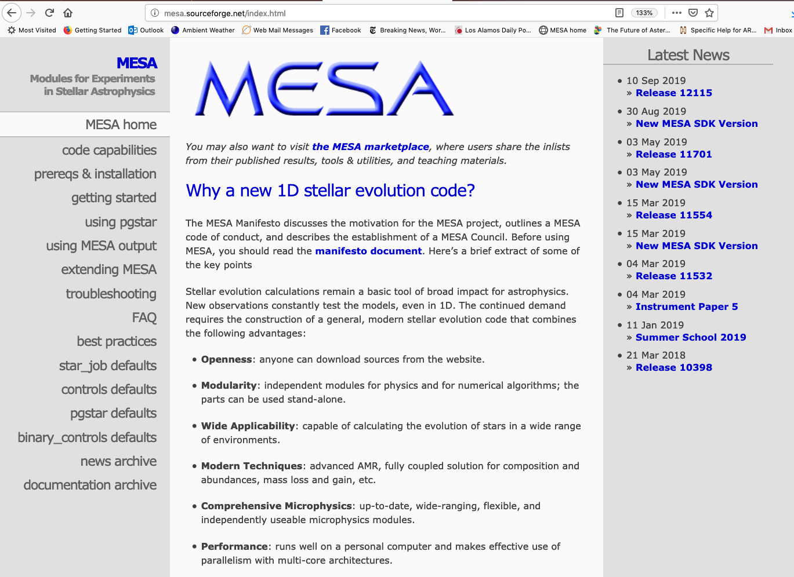
MESA page on mesa.sourceforge.net

Slide 9
MESA Evolution Tracks for Z=0.02, Y=0.28
Cepheid Pulsation Instability Strip
No rotation or mass loss
Z= initial mass fraction of heavy elements
Y= initial mass fraction of helium

Slide 10
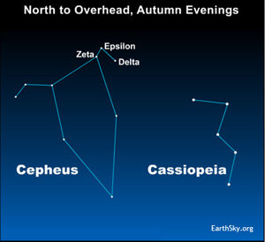
The prototype Cepheid δ Cep varies from V=3.48 to 4.37 mag with period 5.36 days
By Cepheus_constellation_map.png: Torsten Bronger. Cepheus_constellation_map.png, CC BY-SA 3.0, https://commons.wikimedia.org/w/index.php?curid=10827910

Slide 11
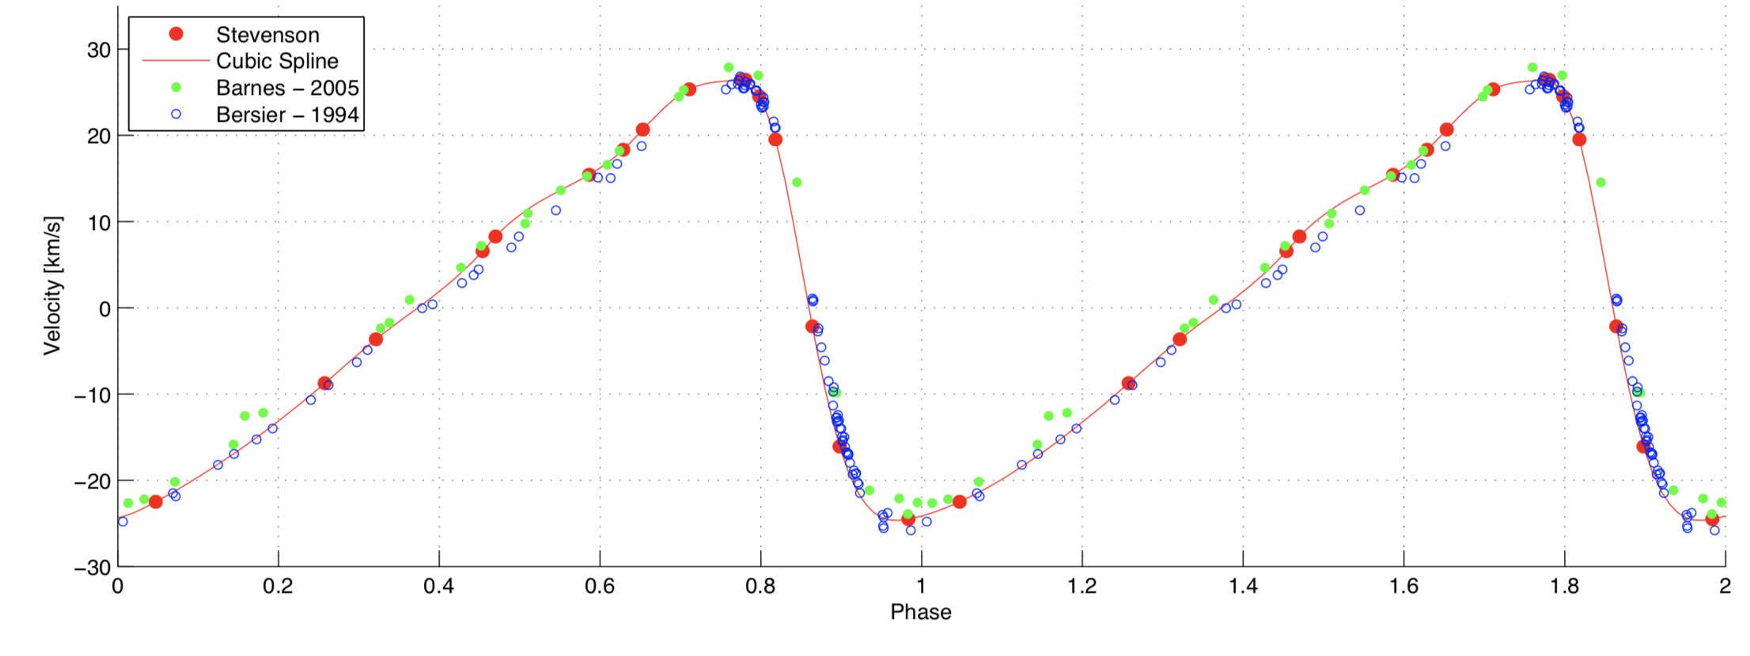
The radial velocity curve of delta Cep has a ‘sawtooth’ shape with amplitude > 20 km/sec (45,000 miles/hour)
Stevenson et al. 2011
Period 5.3662 days, Radial fundamental mode

Slide 12
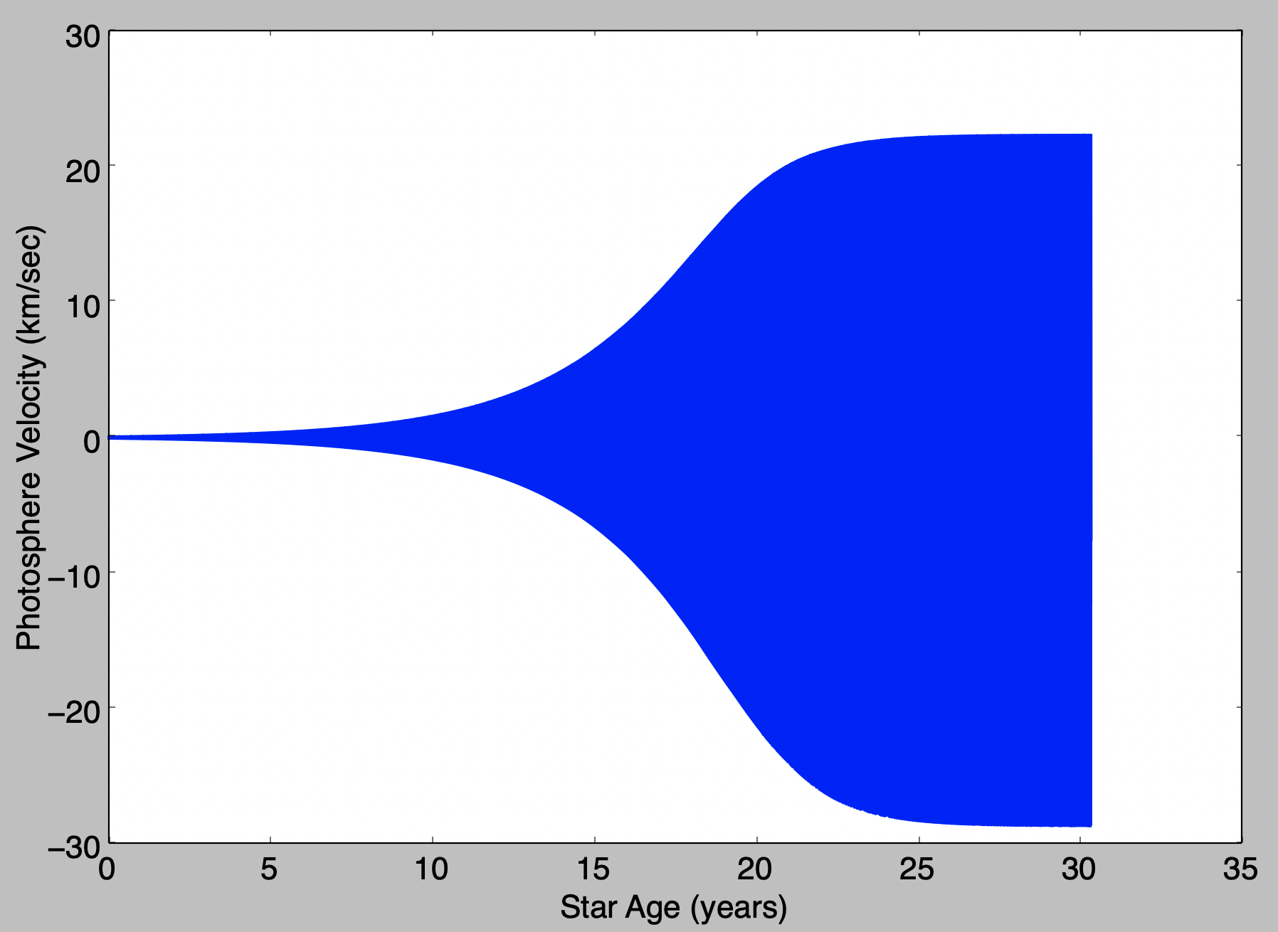
MESA RSP simulations initiated in fundamental mode at 0.1 km/sec grow to > 20 km/sec
Mass 5.3 M_{sun}
Period_initial 5.3676 d
delta Cep model

Slide 13
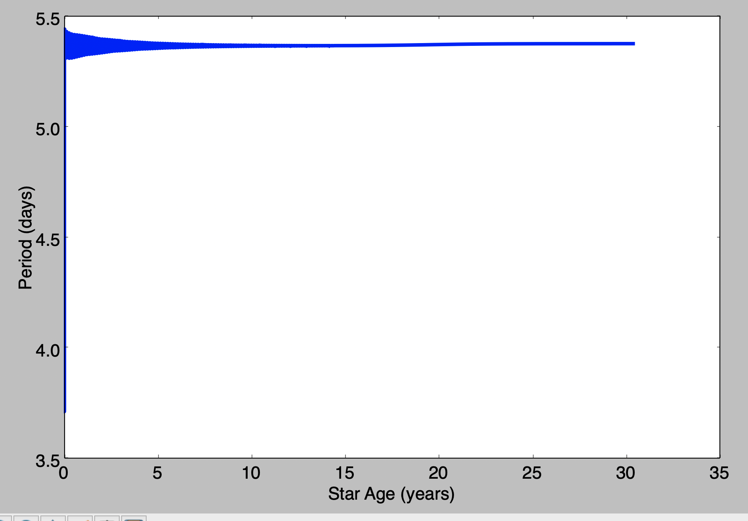
The pulsation period oscillates before reaching a constant value
delta Cep model

Slide 14
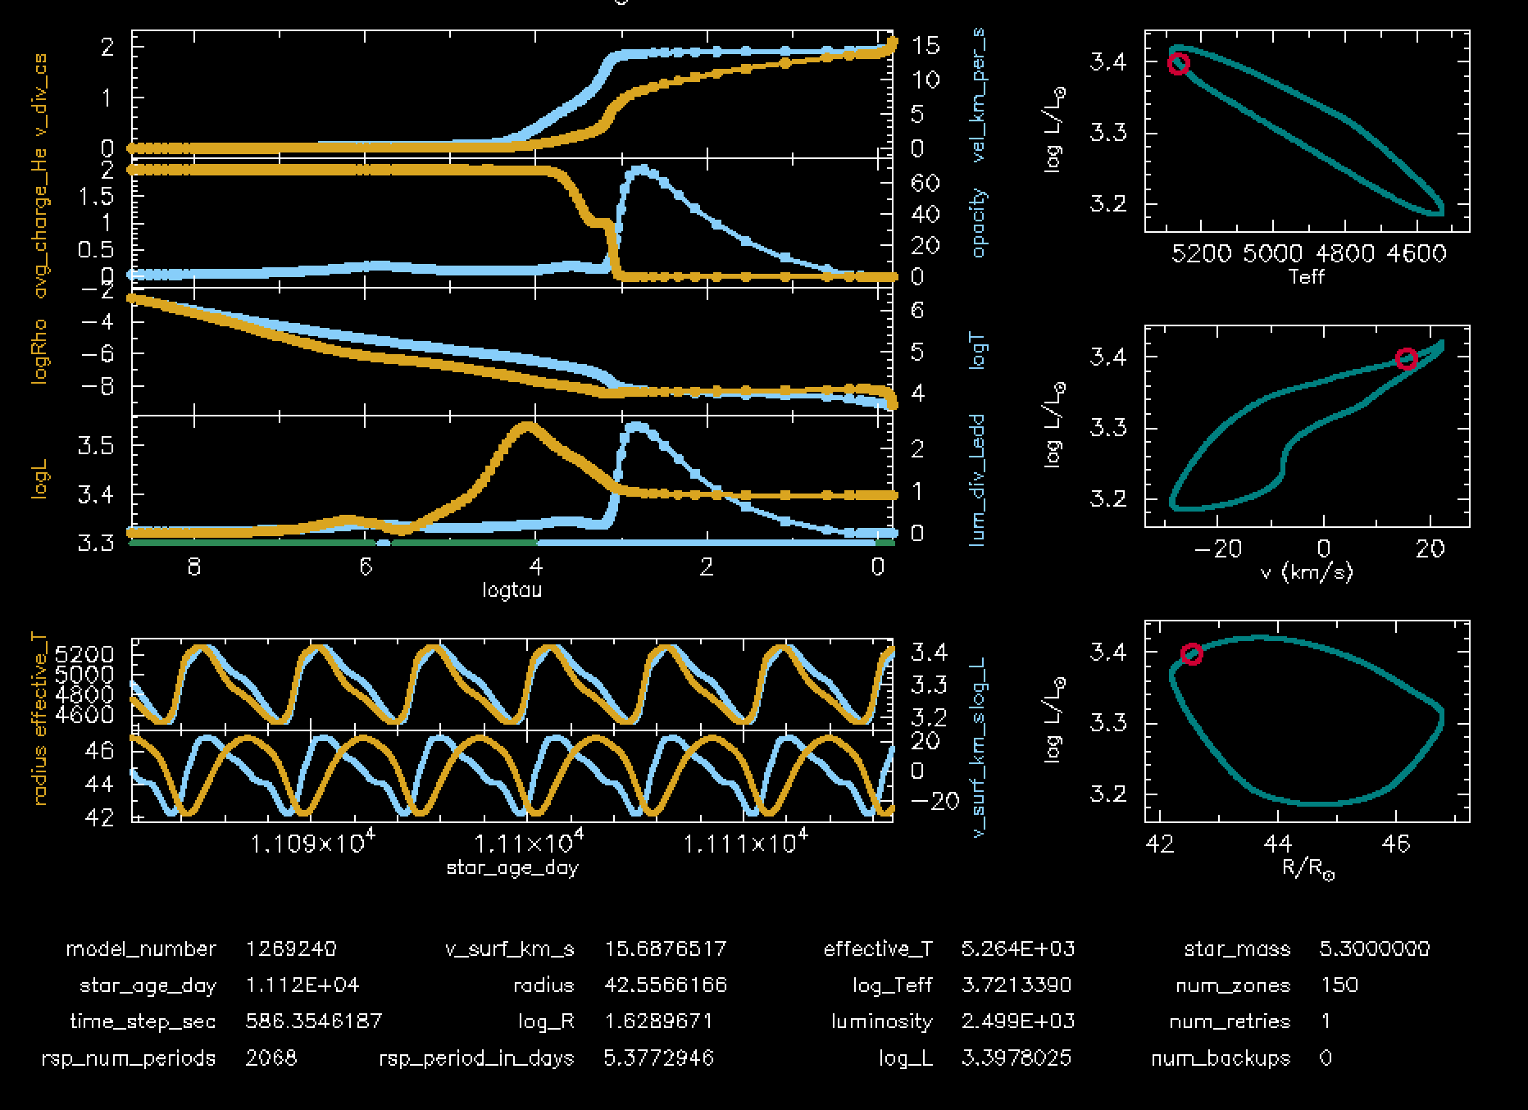
A ‘dashboard’ shows pulsation properties during the simulation
delta Cep model

Slide 15
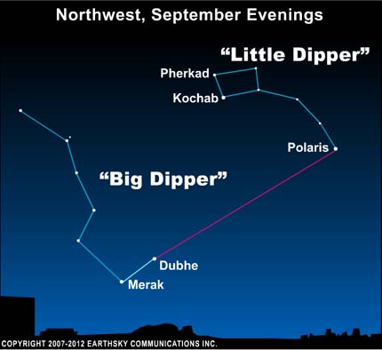
Polaris varies between magnitude V = 1.86 and 2.13 with period 3.972 days

Slide 16
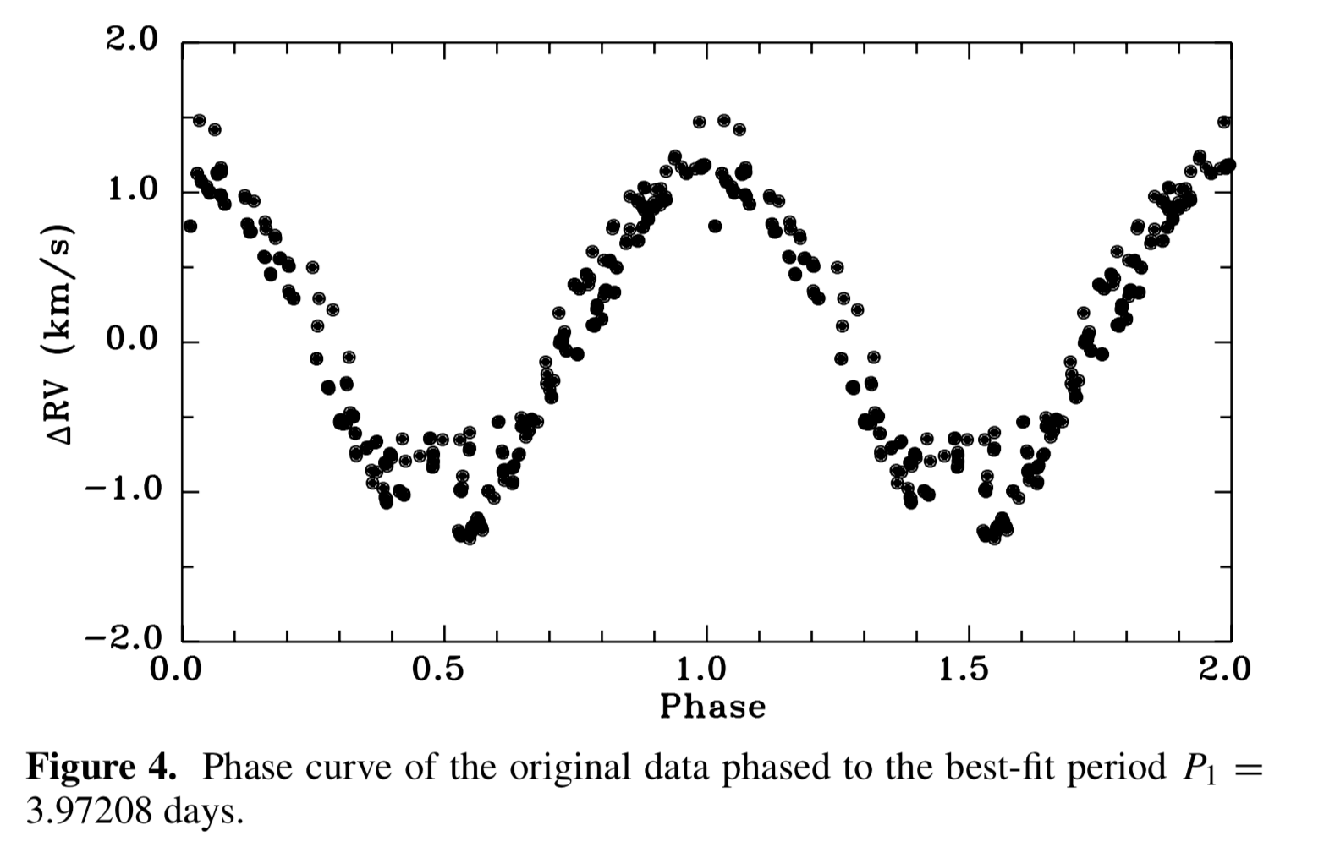
Lee et al., AJ 2008
Polaris has a smaller radial velocity amplitude of only one to a few km/sec
1st Overtone Mode

Slide 17
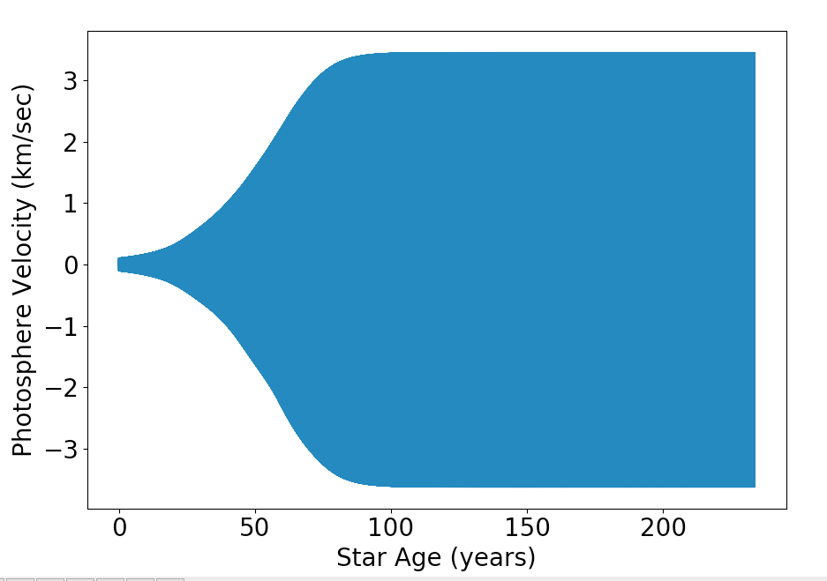
MESA RSP Polaris simulations initiated in 1st Overtone at 0.1 km/sec grow to > 3 km/sec
Mass 5.93 M_{sun}
Period_initial 3.9716 d (1st Overtone)
Note: Mass needed to be increased to 5.93 M_{sun} to find models with unstable 1st OT pulsations with desired period
Polaris model

Slide 18
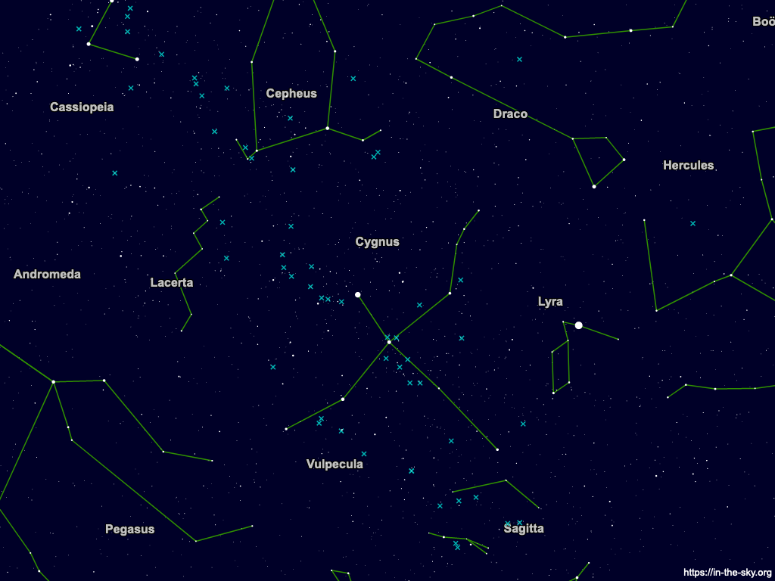
V1334 Cyg (V=5.89 mag) pulsates with period 3.332 days

Slide 19
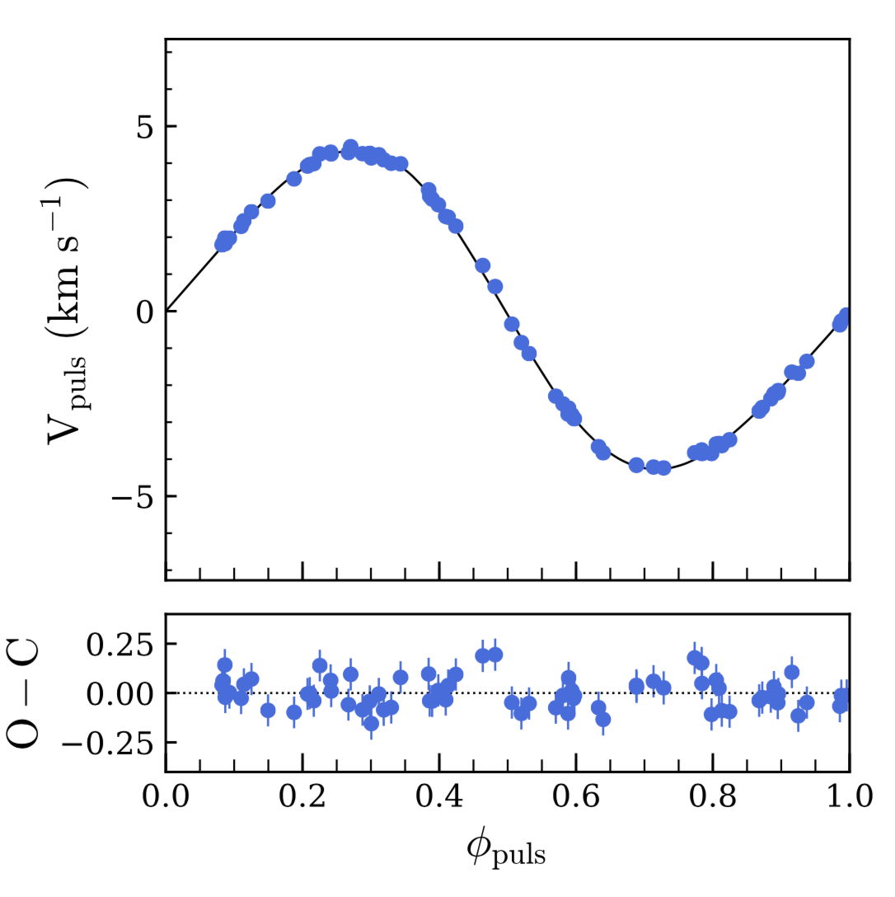
V1334 Cyg has a low radial velocity amplitude of about 5 km/sec (1st OT)
Gallenne et al. 2018

Slide 20
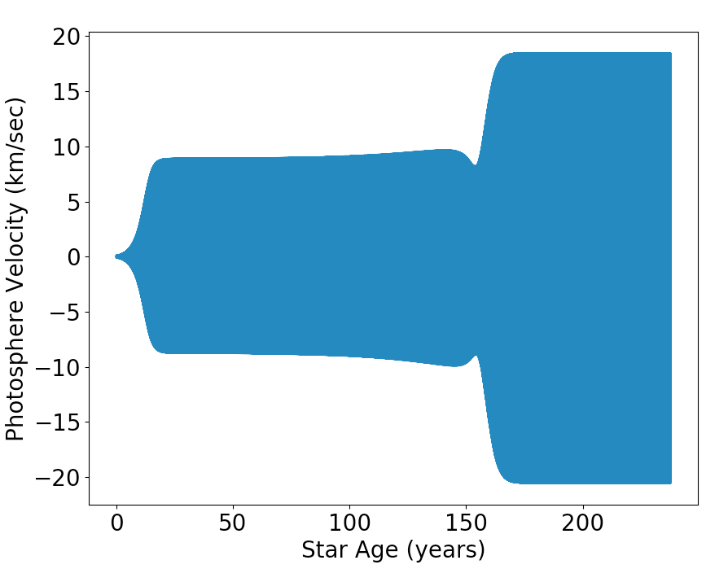
V1334 Cyg radial velocity initiated in 1st OT at 0.1 km/sec grows to nearly 10 km/sec, but then model switches to fundamental mode, with radial velocity amplitude 18 km/sec!
Mass 4.288 M_{sun}
Period_initial 3.3324 d (1st Overtone)
V1334 Cyg model

Slide 21
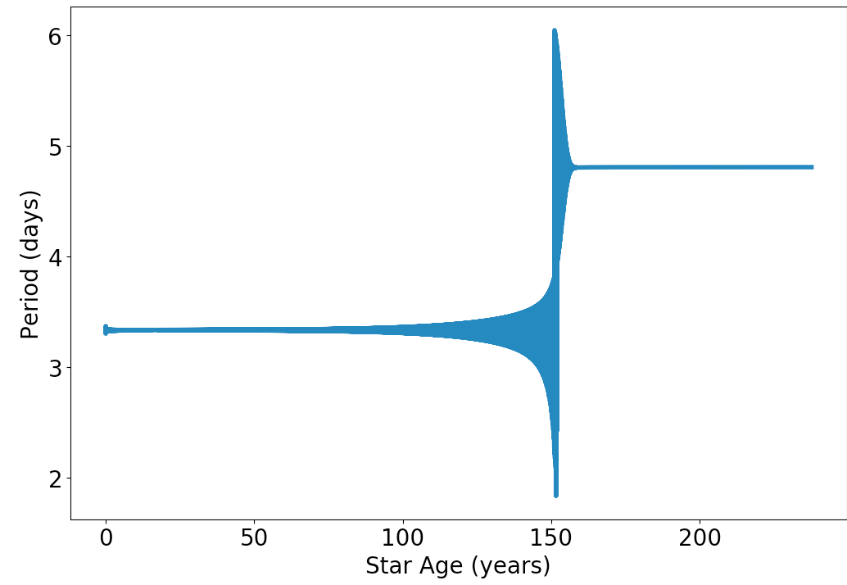
The pulsation period starts to converge to a 1st OT period, but then switches to fundamental mode!
V1334 Cyg model

Slide 22
Models lie above MESA evolution track for 5 M_{sun}
Note: Polaris modeled with mass 5.93 M_{sun}

Slide 23
Conclusions from MESA models of Polaris, δ Cep, and V1334 Cyg
  Limiting radial velocity of RSP models agree well with observed amplitudes
  RSP models that match observed pulsation periods have higher effective temperature and/or lower luminosity than observed values
  The Polaris and V1334 Cyg RSP models with periods matching observations have positions in the H-R diagram above a 5 solar mass evolution track, inconsistent with their dynamical masses

Slide 24
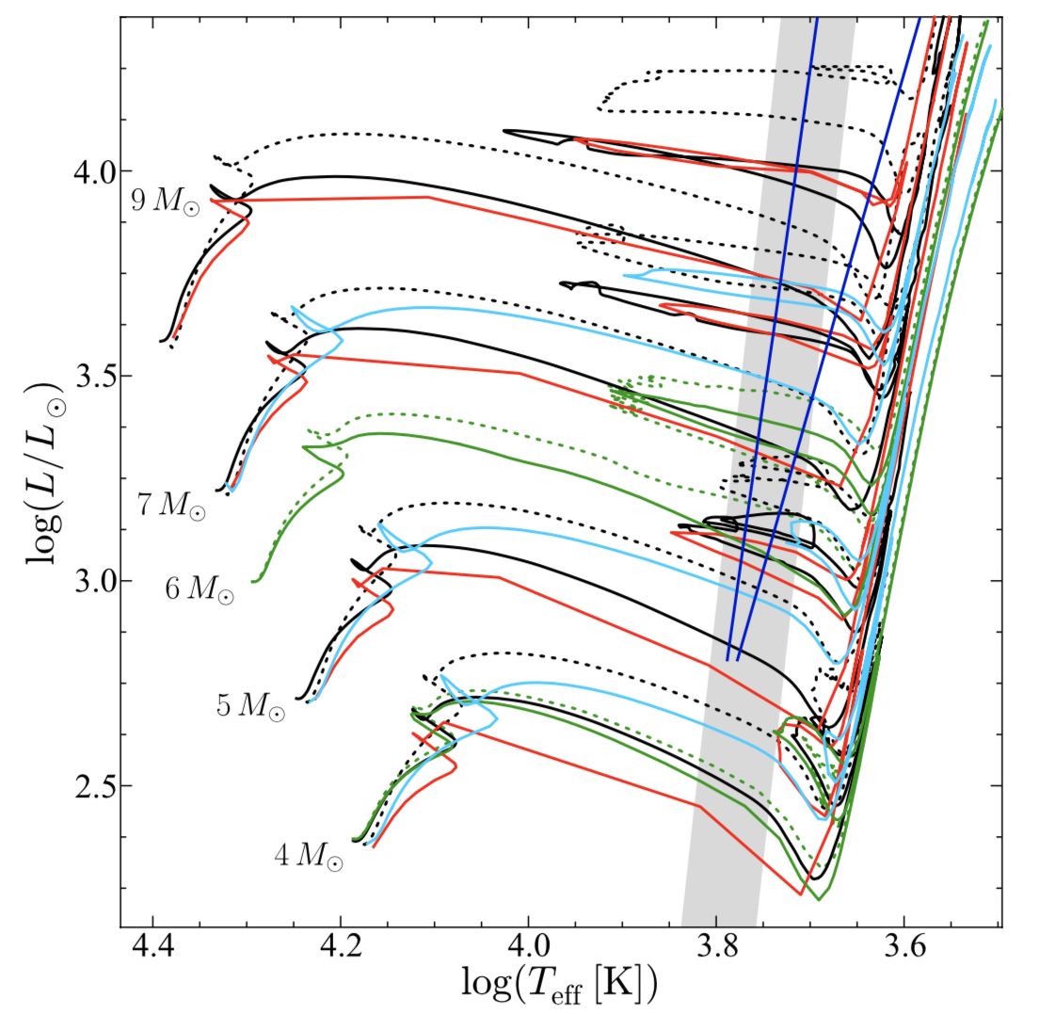
MESA can be used to explore changes in input physics to attempt to resolve this Cepheid mass discrepancy
Helium and metal abundances
Convective overshoot
Mass loss
Rotation
Opacities
Nuclear reaction rates
Anderson et al. 2014

Slide 25
Backup Slides
From Simon 1994

Slide 26
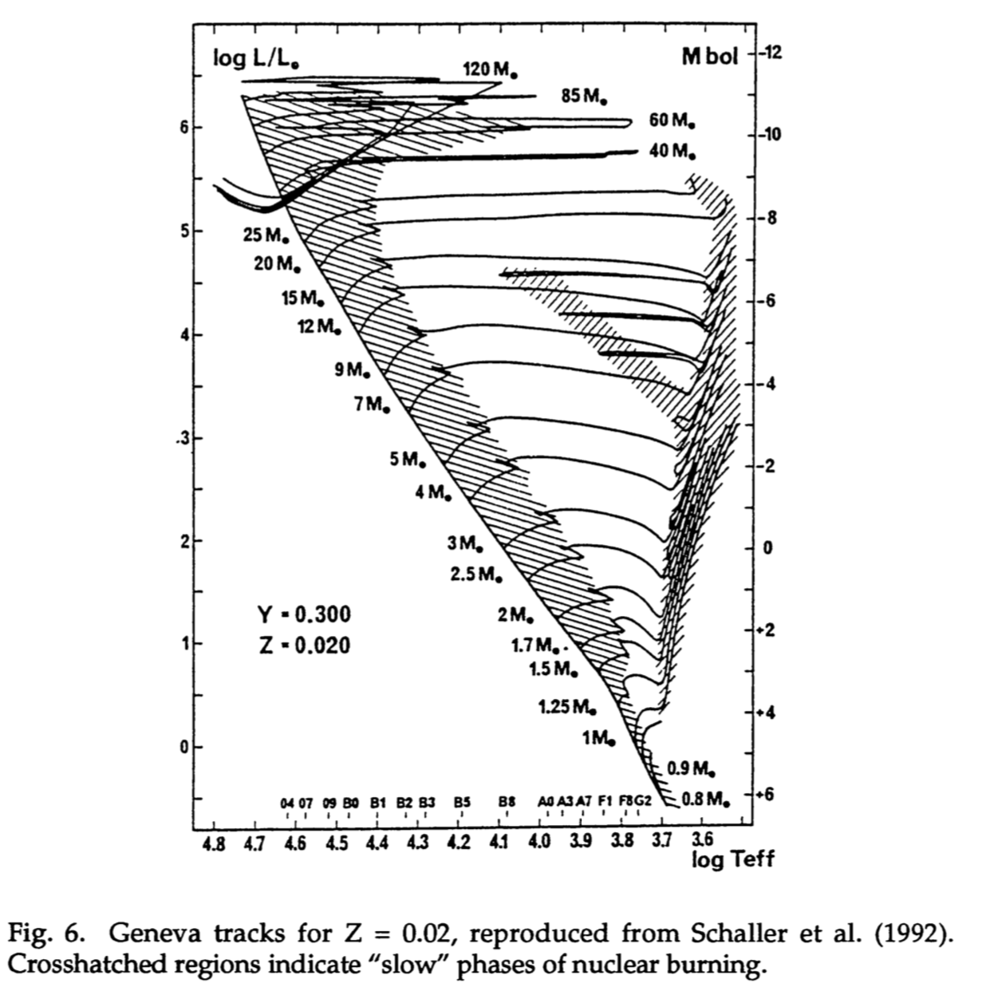
Cepheid Evolution
Stars of 5-15 M_{sun} can ‘blue loop’ to hotter temperatures after crossing to the red giant branch
During the ‘blue loop’ they spend a significant fraction of their lifetime in the core helium burning phase before evolving to the red to become asymptotic giant branch stars
From Simon 1994

Slide 27
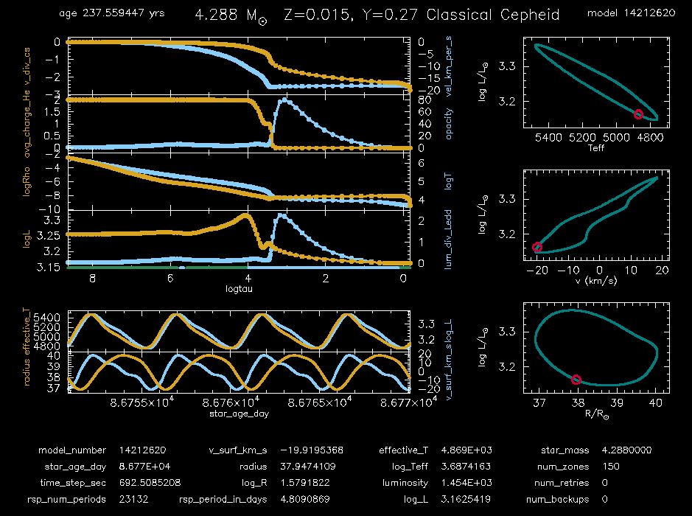
V1334 Cyg ‘dashboard’

Slide 28
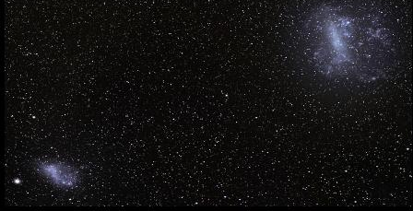
Small and large Magellanic clouds are satellite galaxies to the Milky Way Galaxy
Small Magellanic Cloud
200,000 light years away
Large Magellanic Cloud
163,000 light years away
From Paxton et al. 2019

Slide 29
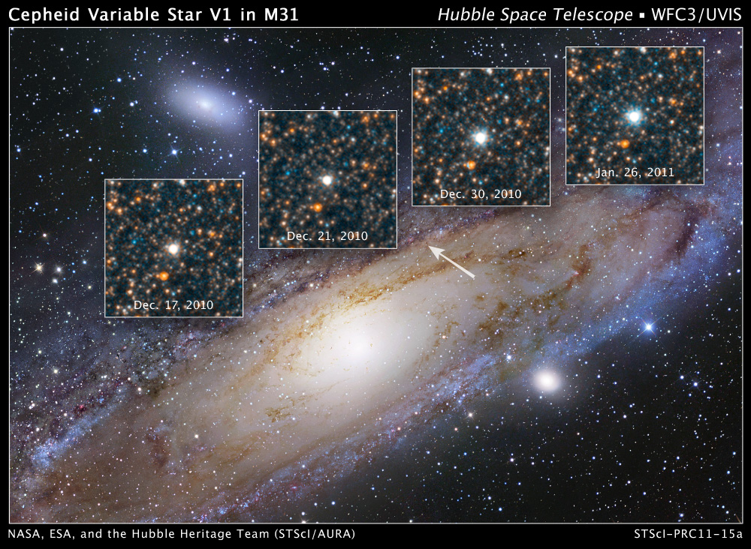
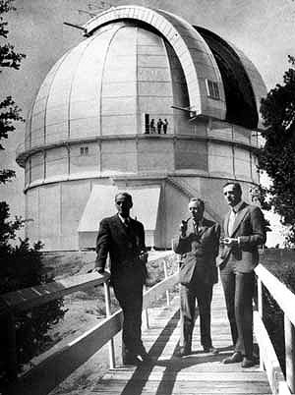
Edwin Hubble in early 1920s found Cepheids in Andromeda Galaxy, showing that galaxies are far outside the Milky Way
From Paxton et al. 2019

Slide 30
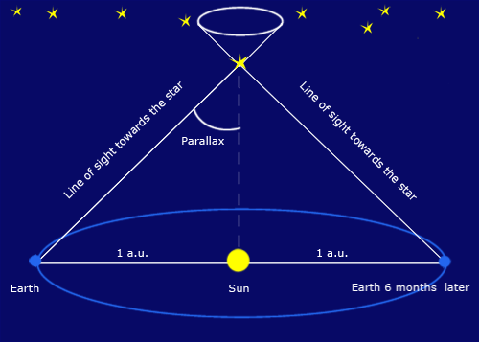
Absolute distances of Cepheids can be measured using ‘parallax’
From Paxton et al. 2019

Slide 31
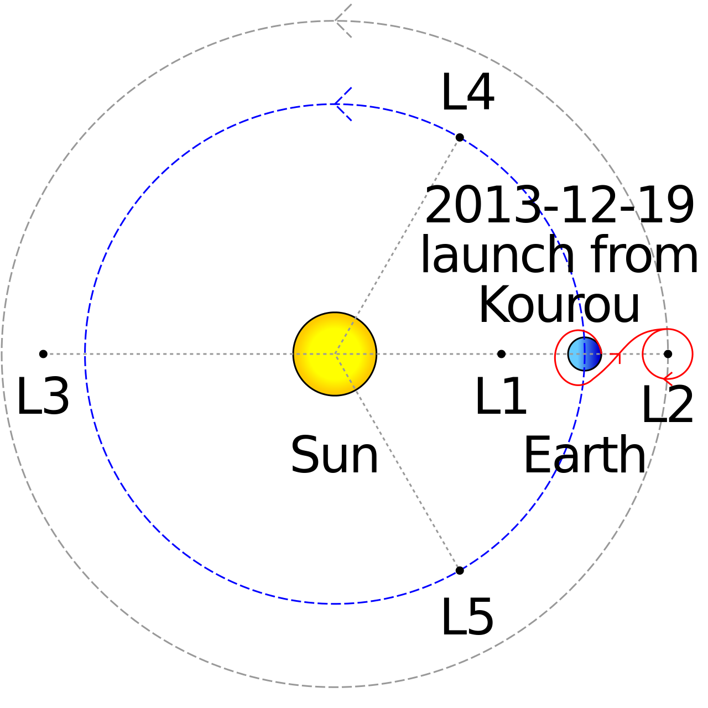
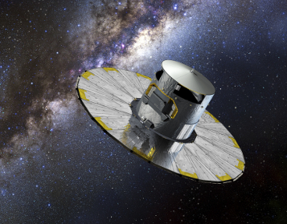
Gaia spacecraft will measure distances of stars in Milky Way, including nearby Cepheids, to higher precision
By Cmglee - Own work, CC BY-SA 3.0, https://commons.wikimedia.org/w/index.php?curid=30257831
By Source (WP:NFCC#4), Fair use, https://en.wikipedia.org/w/index.php?curid=39342811
From Paxton et al. 2019

Slide 32
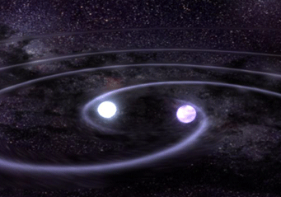
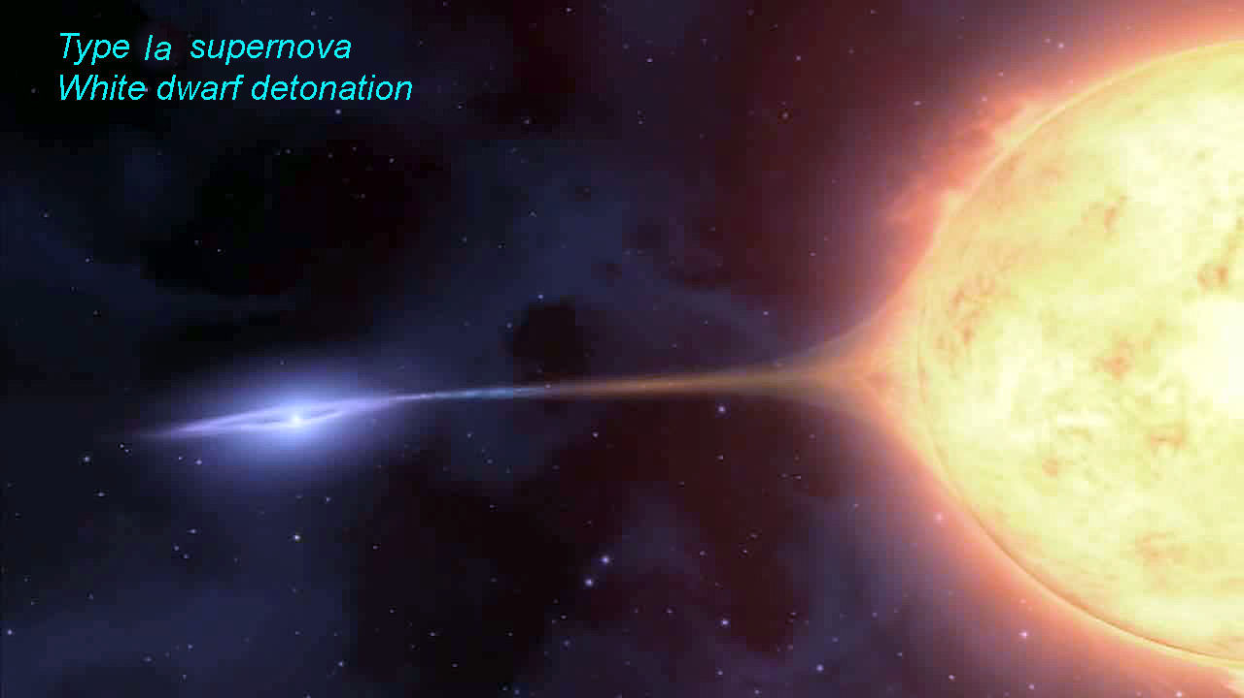
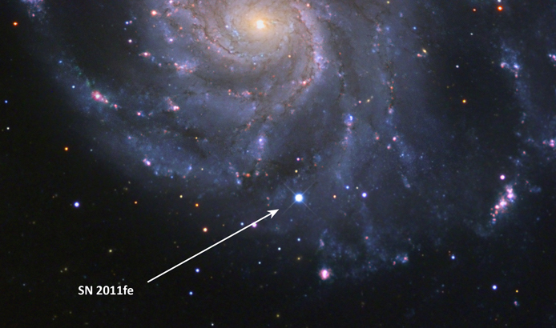
Type Ia supernovae can be seen in the most distant galaxies, and are used to determine universe’s expansion rate (Hubble Constant)
White dwarf merger
Type Ia SN in Pinwheel Galaxy 20 million light years from Earth
This galaxy also contains Cepheids, so distance scale using Type 1a SN could be calibrated
From Paxton et al. 2019

Slide 33
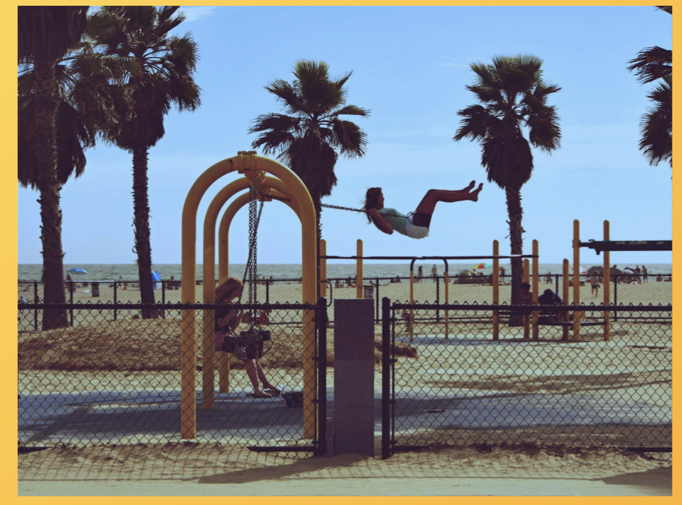
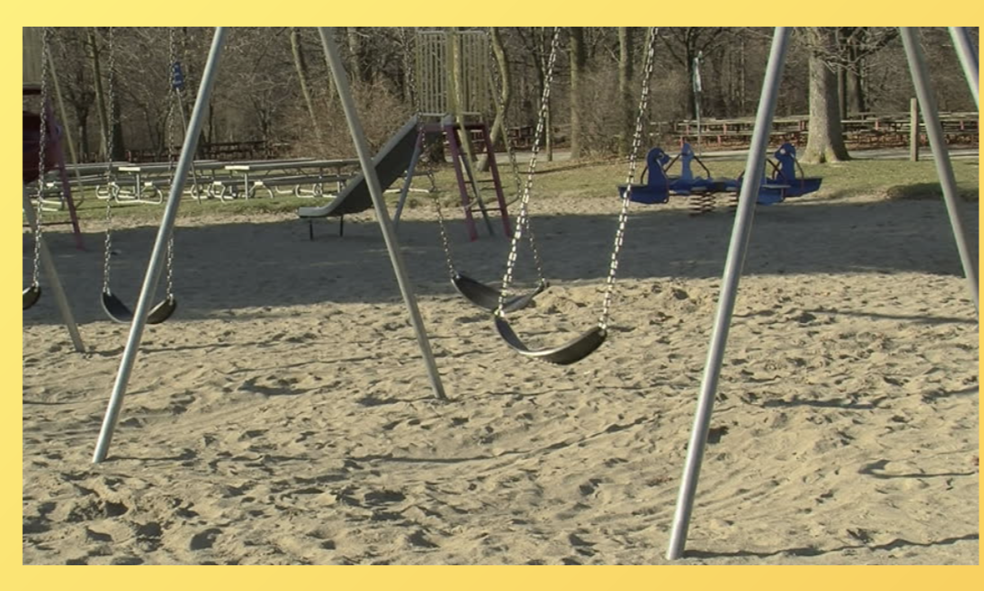

Pulsation driving analogies
From Paxton et al. 2019
From Townsend 2019

Slide 34
Cepheid pulsations are driven in region of helium ionization in stellar envelope
H
Z
He
Opacity and opacity factor for 8 M_{sun} model in Cepheid instability region
From Paxton et al. 2019

Slide 35
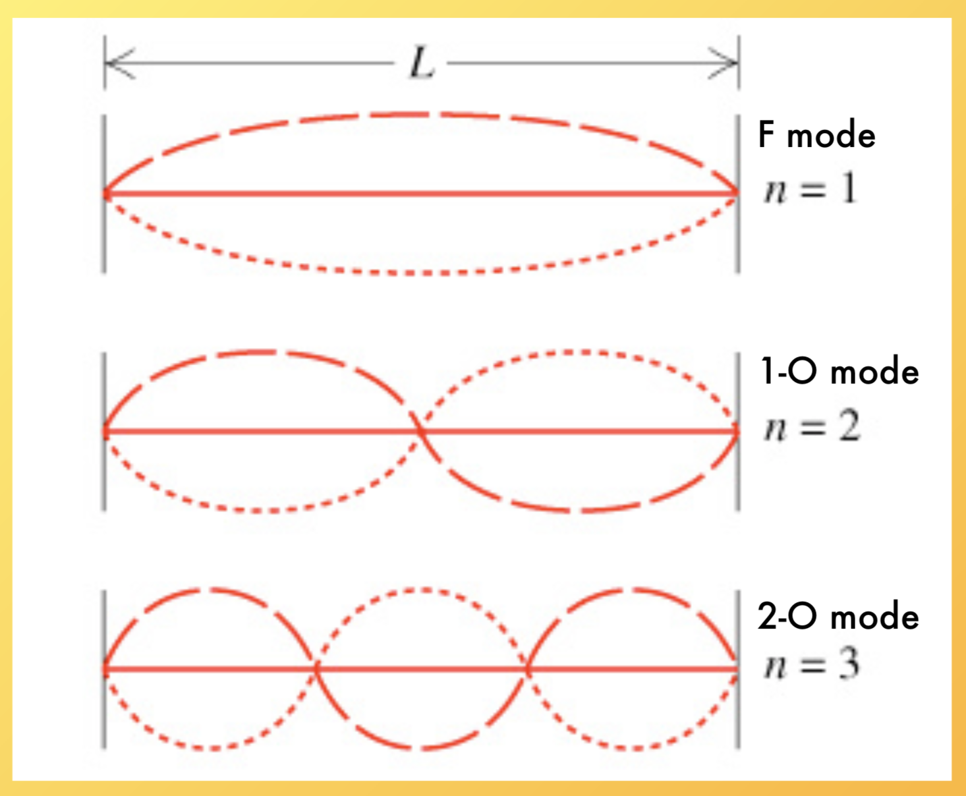
Fundamental, first overtone, and second overtone modes on a string
From Paxton et al. 2019
From Townsend 2019

Slide 36
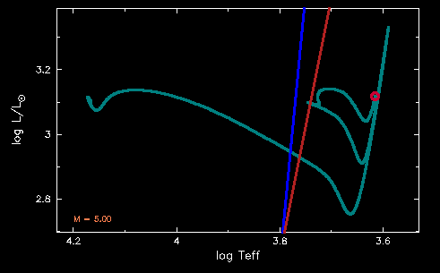
Why do Cepheids pulsate?
5 solar mass Cepheid evolution track
From Paxton et al. 2019

Slide 37
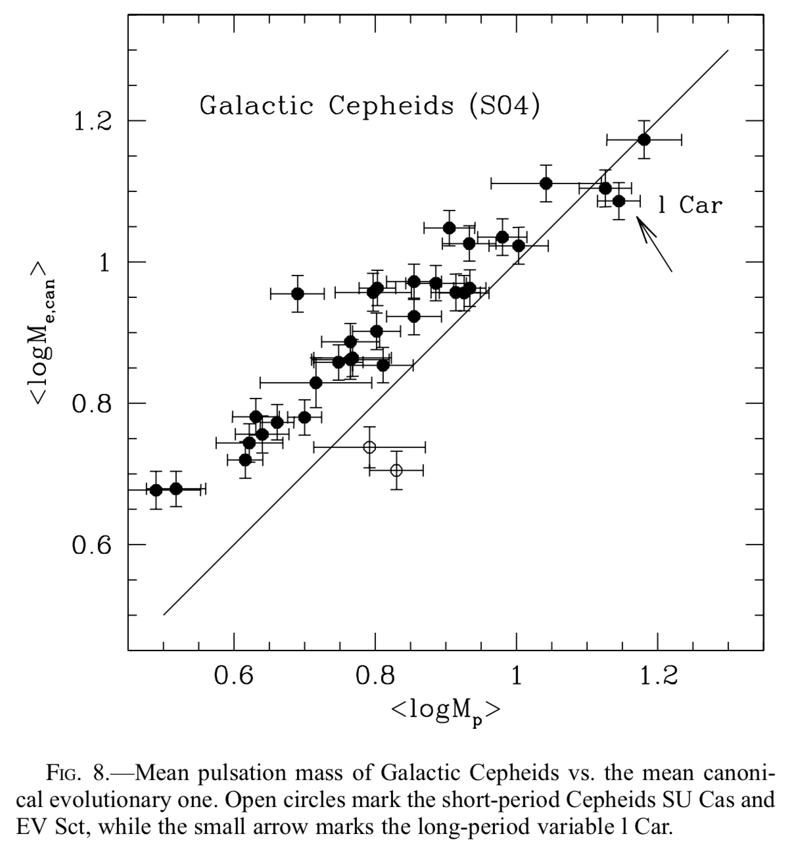
Pulsation masses of Milky Way Galactic Cepheids are lower than evolution masses
Caputo et al. 2005

Slide 38
Abstract
Cepheid variable stars are core helium-burning stars of around 4 to 15 solar masses that show radial pulsations with periods of 3 to 100 days and magnitude variations of a few tenths to up to 2 magnitudes per pulsation cycle.
Cepheids show a period-luminosity relation, discovered by Henrietta Leavitt in 1908, that has been used to determine distances within the Galaxy and to galaxies beyond the Milky Way. Cepheids are also a laboratory to test stellar interior physics, such as nuclear reaction rates for helium burning, turbulence models, and opacities, under conditions not accessible in laboratories on Earth. Current problems in Cepheid research include the discrepancy between the Hubble constant derived from the Cepheid period-luminosity relation, and that derived from cosmic microwave background observations; and the discrepancy between Cepheid masses derived from pulsation periods or binary dynamics and that derived using stellar evolution models.
Here we show how the open-source MESA (Modules for Experiments in Stellar Astrophysics) code (Paxton et al. 2011, 2013, 2015, 2018, 2019, http://mesa.sourceforge.net/) can be used to explore Cepheid evolution. We also show results using the new radial stellar pulsation (RSP) capability in MESA to model the hydrodynamics of Cepheid envelopes during their pulsations, and simulate light curve and radial velocity variations. We will compare models with observations of Cepheids with well-known properties such as delta Cep, Polaris, and V1334 Cyg. These stellar modeling capabilities are accessible to anyone with a laptop computer, following the directions in the MESA tutorial for installation, and starting with the examples in the MESA test suite.

