Slide 1
Evolution of neutral oxygen during the Epoch of Reionization
Caitlin Doughty
Arts & Sciences
Astronomy

Slide 2
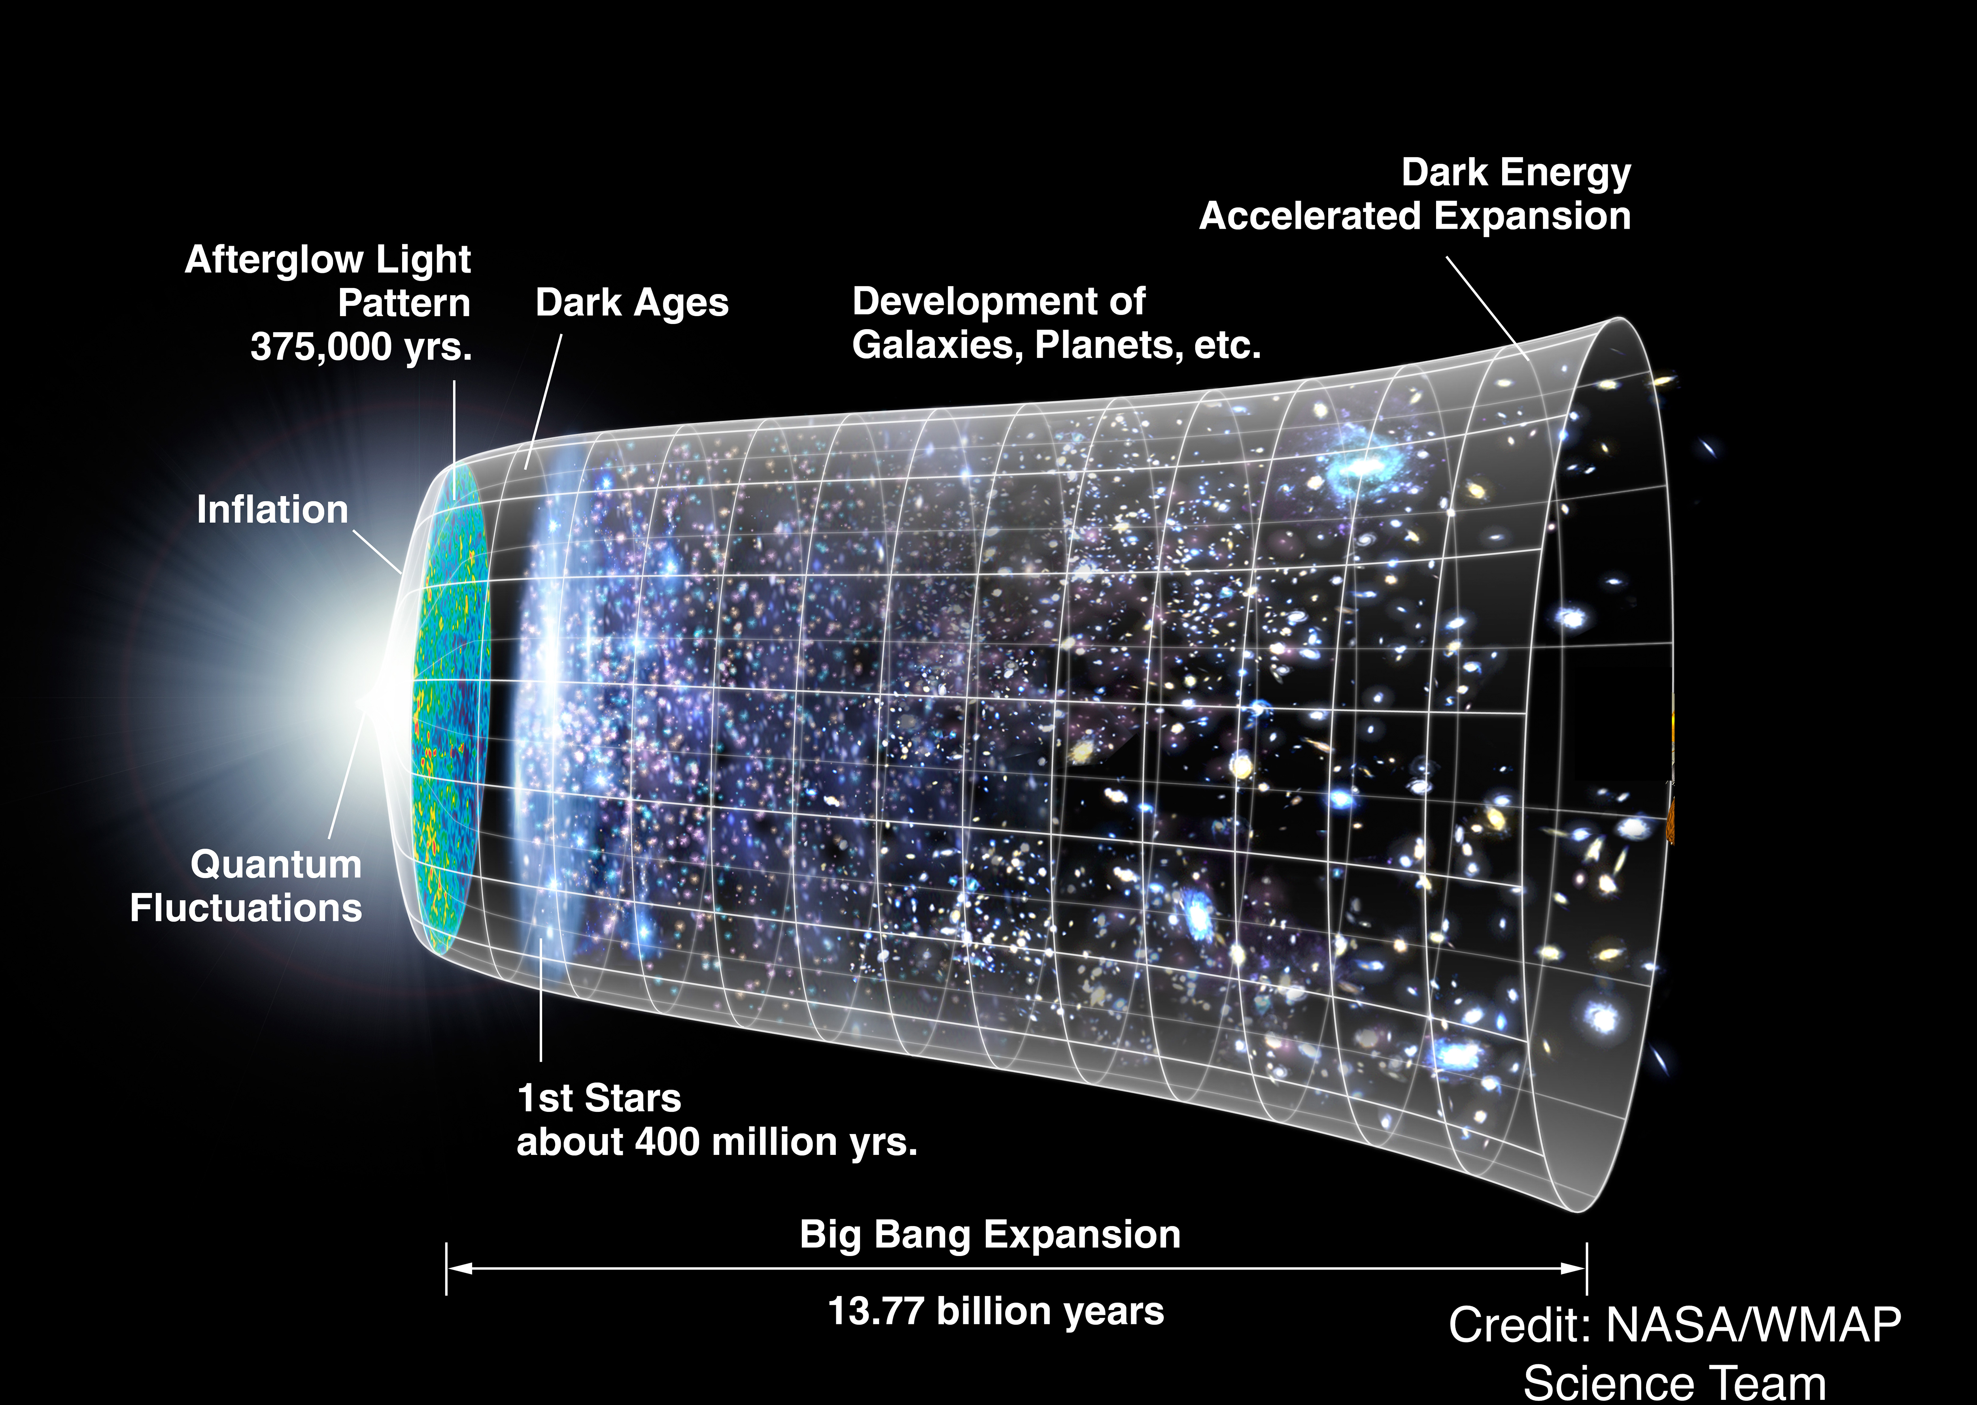
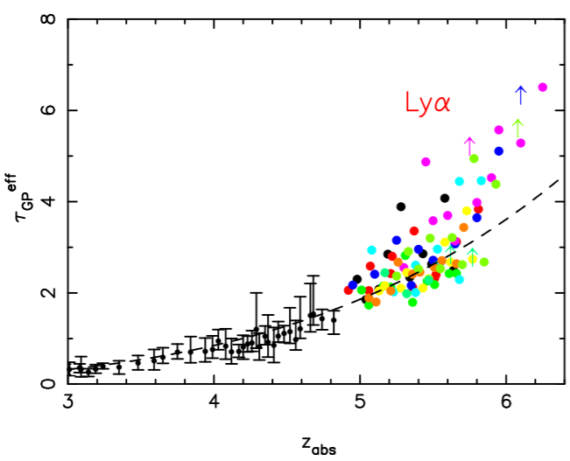
Ionization of hydrogen
Fan et al. 2005
Previously, observations have suggested it ended at z~6

Slide 3
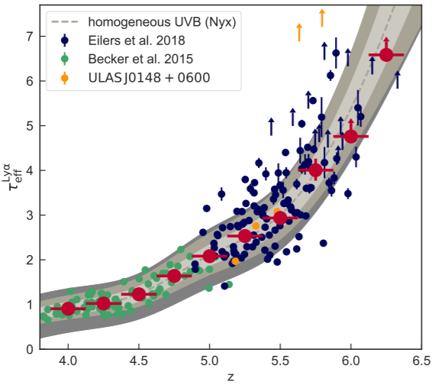
Uncertainty in EoR timeline
Eilers, Davies, & Hennawi (2018)
Becker et al. 2015
“islands” of HI down to z~5.5
Reproduce observations with EoR ending at z=5.3
Kulkarni et al. 18

Slide 4
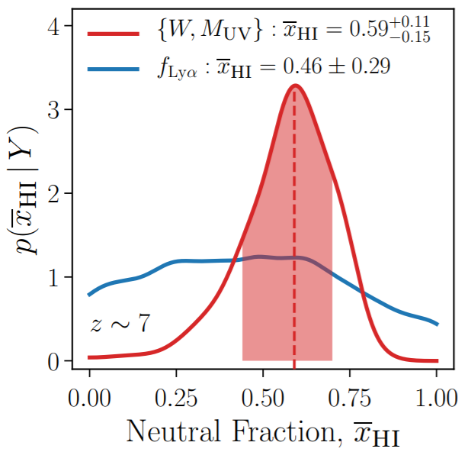
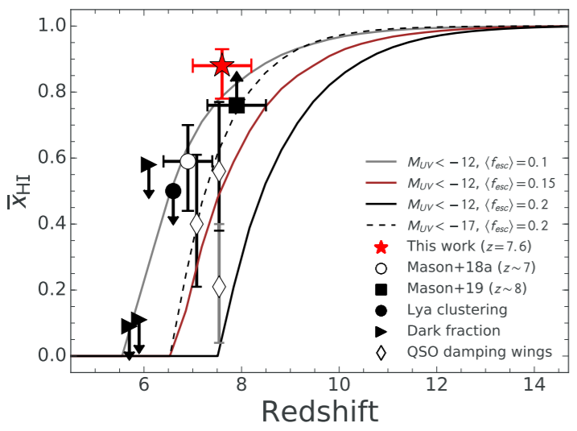
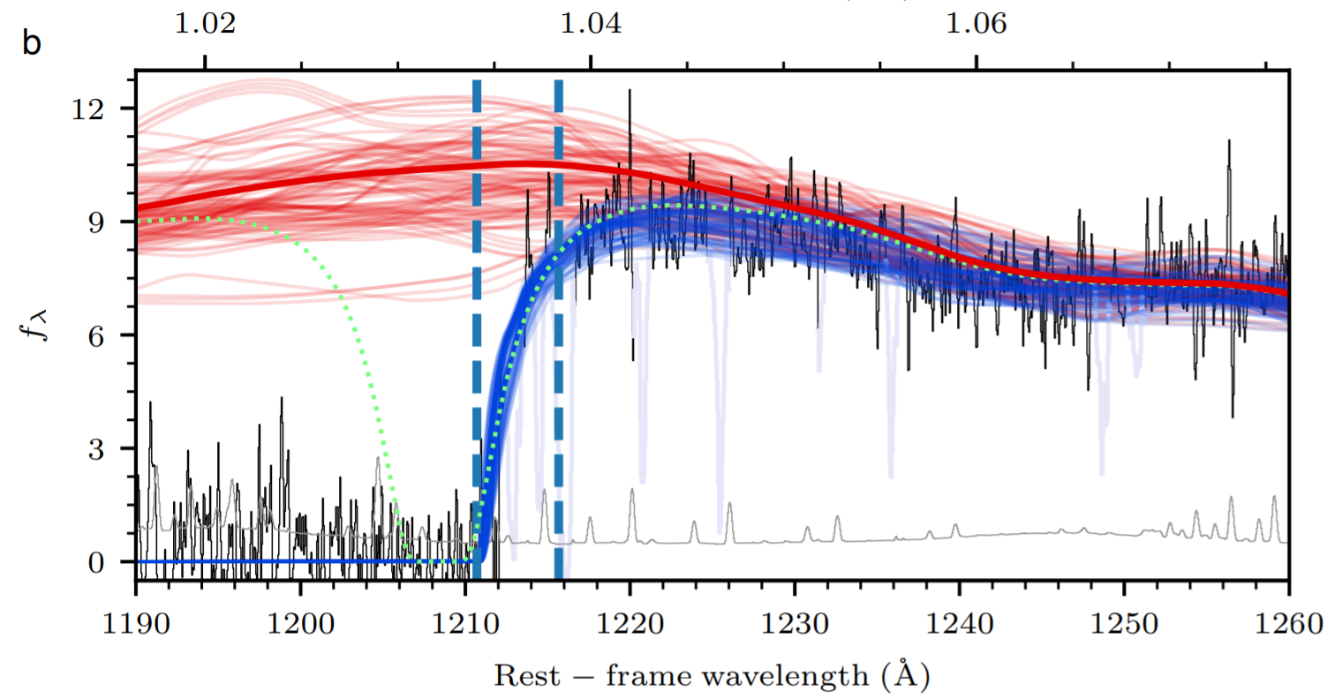
Measurements of x_{HI} constrain EoR directly
Mason et al. 2018a
Hoag et al. 2019
Bañados et al. 2018

Slide 5
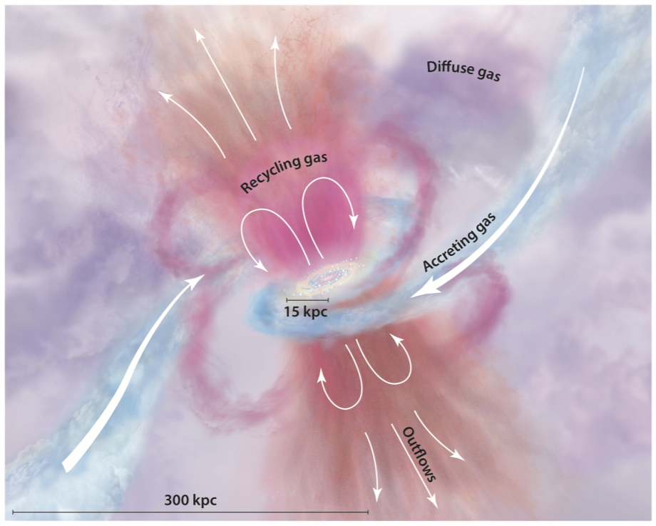
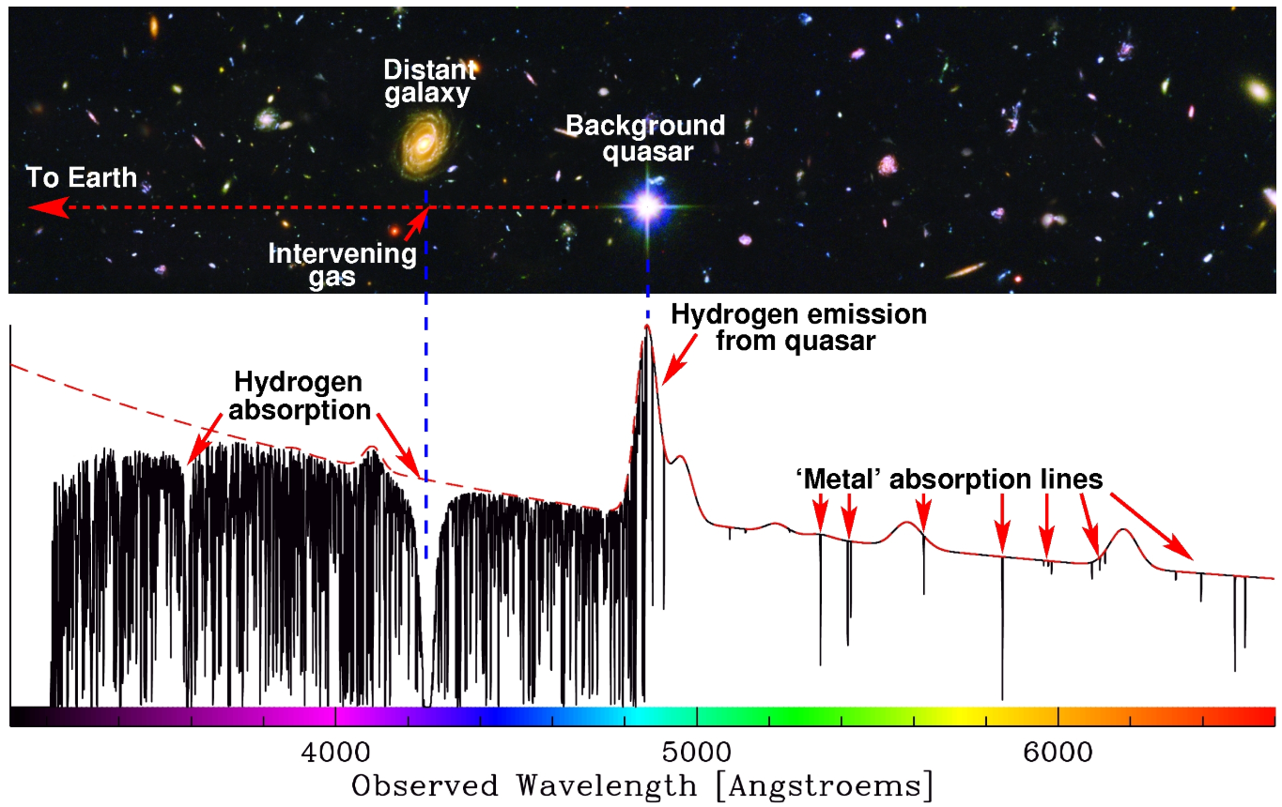
Production of metals in galaxies
Z
Z
(Courtesy Jochen Liske)
Z
Tumlinson, Peeples, & Werk 2017

Slide 6
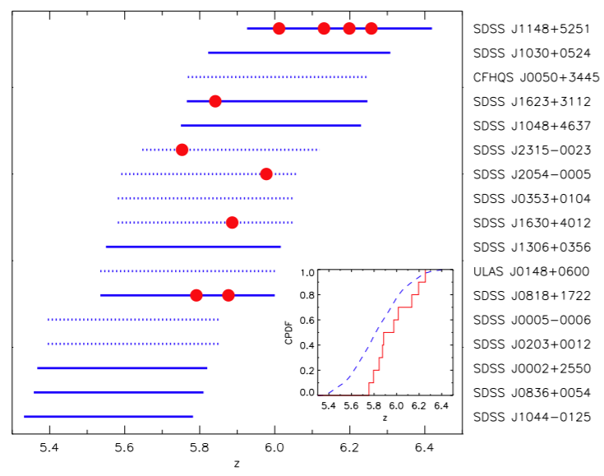
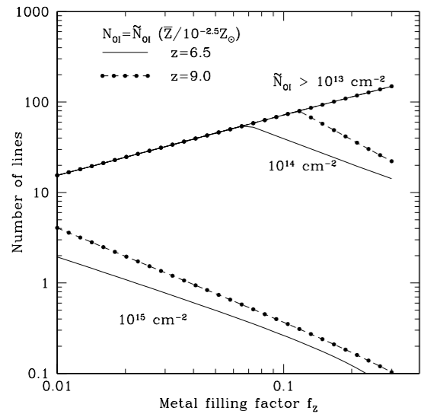
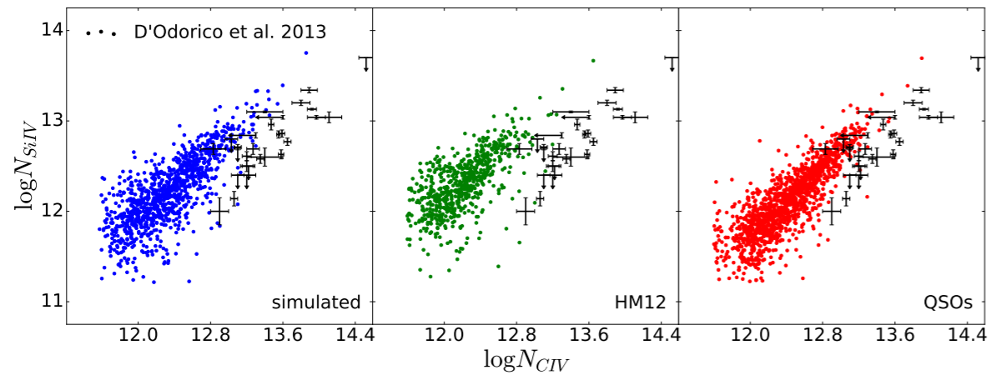
Constraining timeline of EoR using metals?
(z~6)
Becker et al. 2011
Oh (2002)
Doughty et al. 2018

Slide 7
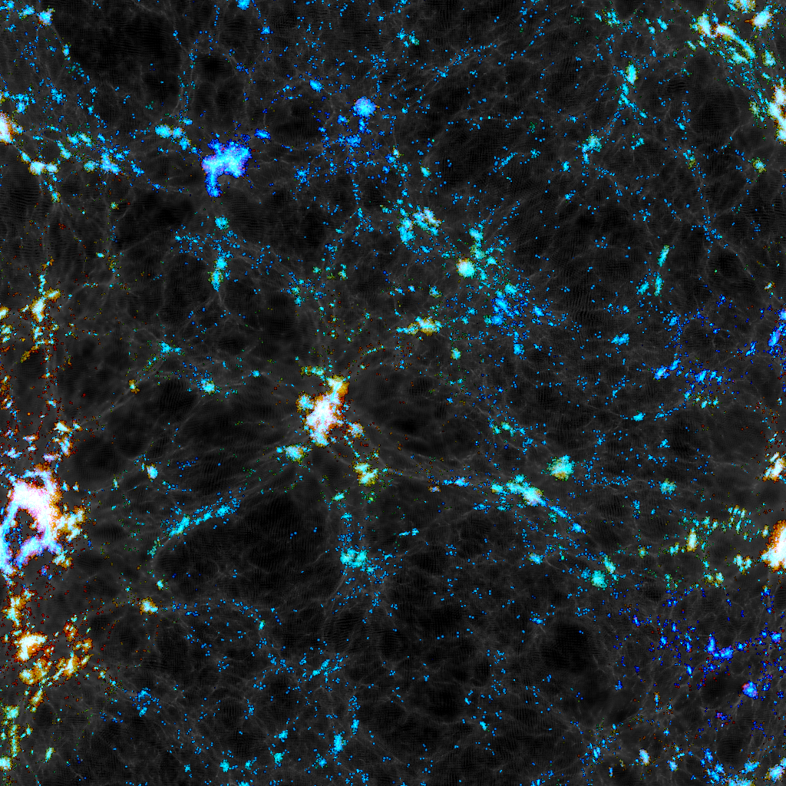
Simulation and procedure
Map of metal column densities in newest iteration of Technicolor Dawn (see Finlator et al. 2020)
Include on-the-fly radiative transfer to account for an inhomogenous UVB during EoR
Examine trends in OI evolution throughout EoR, focusing primarily on z=8→5
Cast sightlines to mimic observations of metal absorption in QSO spectra
Artificial noise is added (S/N=50), and systems detected at >5σ are retained
(Courtesy Kristian Finlator)

Slide 8
Simulation and procedure
Left with information about (1) the intrinsic gas properties in the simulation and (2) catalogues of OI systems representing what observers could see.

Slide 9
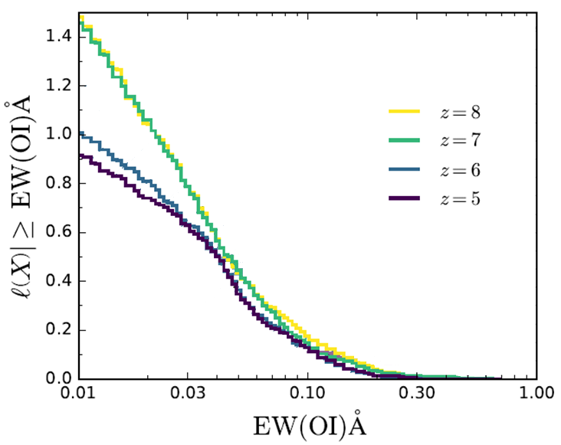
Simulated EW distribution
Steep distribution
Little evolution above z=7, then rapid changes between z=7 and 6
Most significant changes are for EW<0.04 Angstroms
Doughty & Finlator (2019)

Slide 10
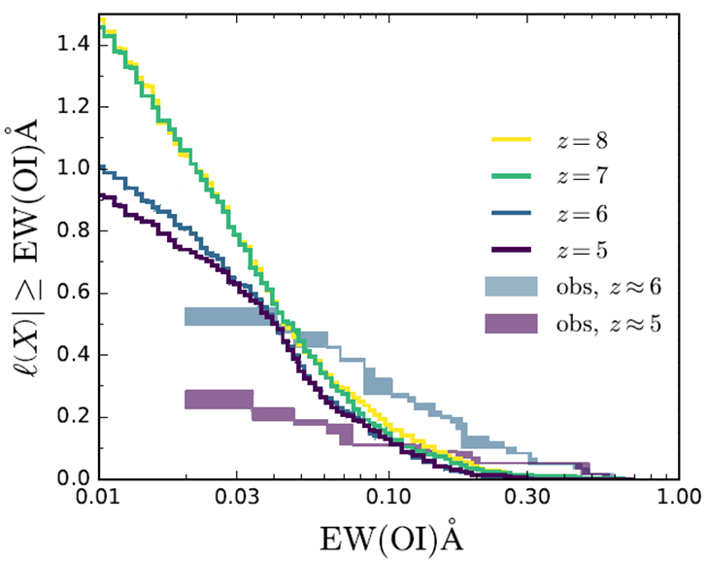
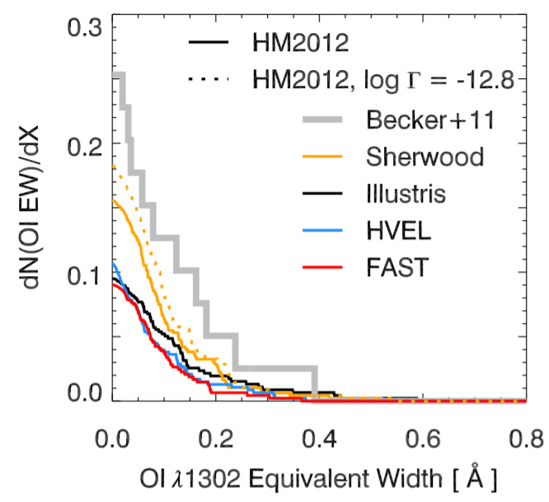
Simulated + Observed EW distribution
Observed distribution is much flatter
Similar discrepancy to other works (e.g. Keating et al. 2016 below)
Doughty & Finlator (2019)

Slide 11
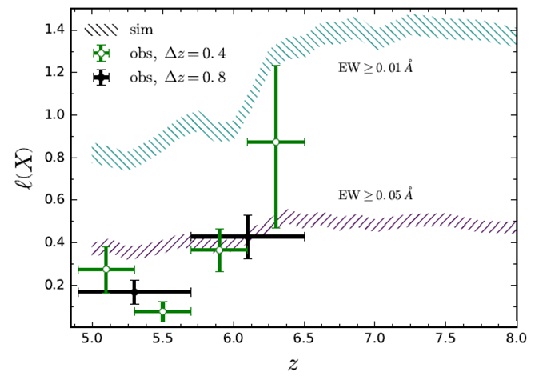
Simulated + Observed incidence rates
Simulated O I systems show evolution at z~6.3
Very weak systems show stronger evolution
Observed systems evolve across z~5.7 (large z bins) or z~6.1 (small z bins)
Simulation doesn’t match the magnitude of the change
Doughty & Finlator (2019)

Slide 12
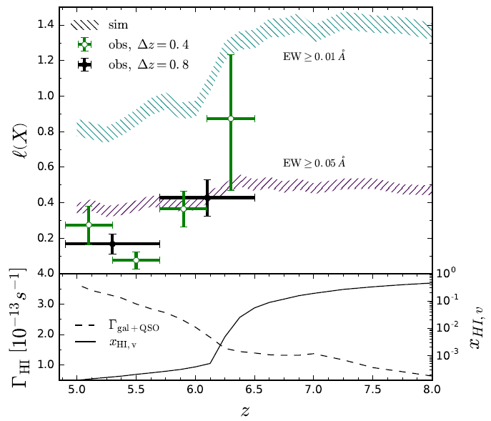
Incidence rates
Evolution in simulation occurs when HI photoionization rate increases, and x_{HI,v} reaches 1%
Corresponds to the “epoch of overlap” of reionized HII regions (e.g. Gnedin (2004))
Doughty & Finlator (2019)

Slide 13
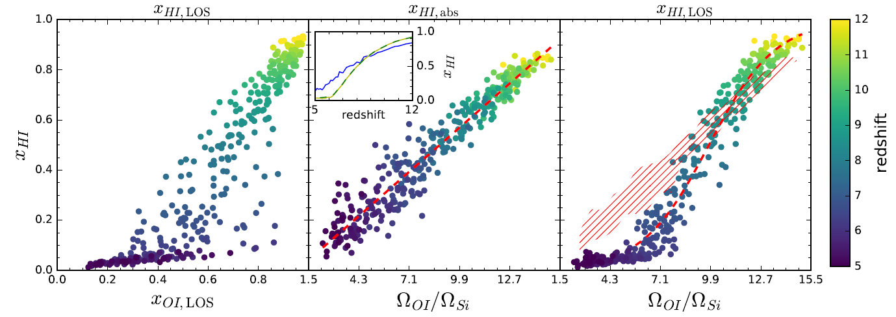
x_{OI} versus x_{HI}: large scatter
Doesn’t seem tremendously useful for inferring the H I neutral fraction.
Doughty & Finlator (2019)

Slide 14
Ω_{OI}/Ω_{Si} from absorbers traces x_{HI,m}
Much more useful!
Doughty & Finlator (2019)

Slide 15
Gas in absorbers deviates from all gas
Doughty & Finlator (2019)

Slide 16
Take-aways
Fun stuff:
O I gas ionizes outside-in and weak O I systems are ionized first
Significant evolution in the number of OI systems occurs when x_{HI,v} reaches 1% in the simulation
Since the observed incidence rate of O I systems drops at z~5.7, this may represent the “epoch of overlap” phase of hydrogen reionization
Appropriate ratios of metal comoving densities (like Ω_{OI}/Ω_{Si}) obtained from observations of absorption systems may trace the HI neutral fraction
Less fun stuff:
Cosmological simulations are still not great at reproducing observations of metal line absorption systems in the CGM. Why?

