Slide 1
Calibrating Polarization For an Array with Linear Feeds

Slide 2
Calibrating Polarization For an Array with Circular Feeds
State of the Practice
First calibrate receiver gains separately for each polarization.
  Gains can have an arbitrary phase
Find leakage terms (leakage from one feed into the oppositely polarized one)
  For instance by observing a point source known to be unpolarized
  Or by observing a range of parallactic angles
Correct for leakage terms
Solve for phase difference between the two polarizations.
  Also known as setting the electric vector position angle (EVPA)
  Done by observing a source with known polarization angle.

Slide 3
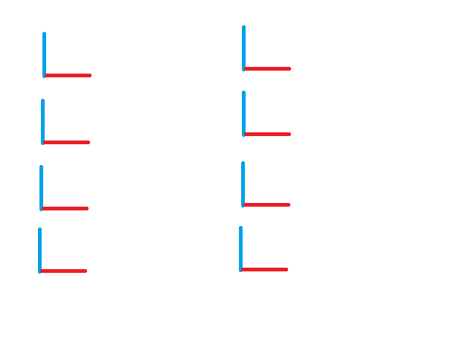
The case of linear polarization
Feeds arranged parallel
Again, one can calibrate the gains in the two polarizations separately.
Leakage terms can again be derived by observing an unpolarized source or by tracking over a range of parallactic angle.
Setting the phase difference between the two polarizations still needs to be done.
  By observing a polarized source.
    But the polarization cannot be parallel to the feeds
  By making, and calibrating, an artificial signal fed to both polarizations and recovered in the product.

Slide 4
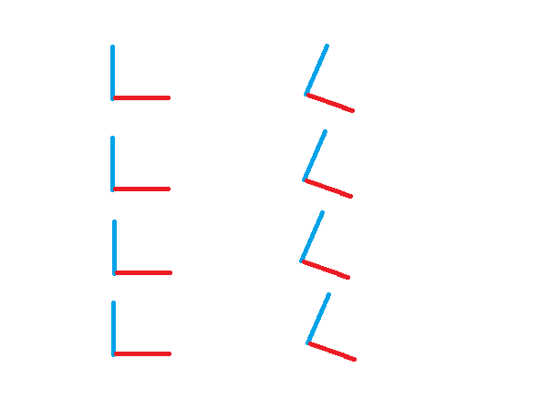
Another Possibility
Some Dipoles Tilted
Again, consider an unpolarized source.
Each collection (vertical and tilted, X and Y dipoles) can be calibrated independently for gain and leakage.
Both the X and Y dipoles of the vertical set correlate with, say, the X dipole of the tilted set.
  This directly give the phase difference between the X and Y dipoles.

Slide 5
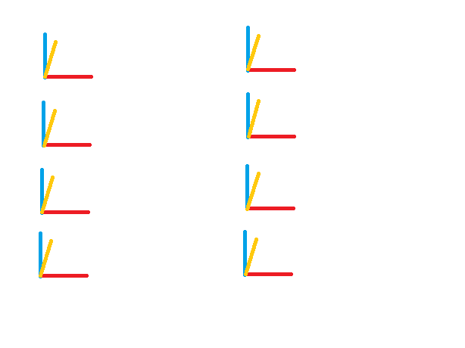
What If Your Calibrator is Polarized?
Case of Parallel Dipoles
The polarization is degenerate with the gains of the two polarizations.
The polarization must be known and removed in order to calibrate the gains.
But, the projection of the polarization on the direction at 45 degrees to the dipoles is known from the X-Y correlations.
So calibration can be done if
  Source polarization is known a priori.
  Tracking over a range of parallactic angles lets polarization be solved for from X-Y correlation.

Slide 6
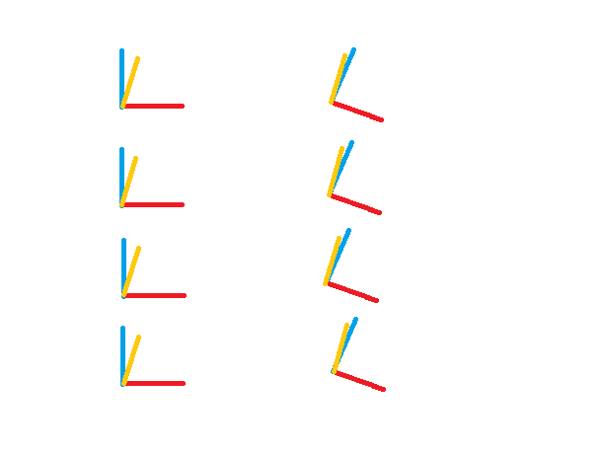
What If Your Calibrator is Polarized?
Case of Mixed Dipole Orientation
Within a set of given orientation, polarization is degenerate with gains, if you consider both orientations, polarization can be solved for.
Rationale: Since, as before, the projection of the polarization onto the 45 degree direction is well determined for the two sets of orientations, the complete polarization vector can be calculated.
When the polarization is known, it can be removed and gain calibration solved.

Slide 7
What About Leakage Terms?
Since we are assuming a point source, polarized power in the X-Y correlators must have the same, zero, phase as the unpolarized part of the source power.
The imaginary part of this correlation is due to leakage.
The real part of leakage is degenerate with gain within any dipole orientation set.
But it is not between sets. Employing both orientations lets you solve for the real part of leakage as well.

Slide 8
The “Twisted Dipole” Option
Advantages are mainly operational:
  No special polarization calibration observations are needed. The concept of polarization calibration observation vanishes.
  All point source observations are polarization calibration observations. The concept of calibrating polarization vanishes.
Disadvantages:
  The calculations of I, q, u for imaging become more complicated
  One cannot easily cut the data output rate by a factor of two by recording only two orthogonal polarization products
  Small subarrays need to be examined to make sure they include both orientations.

