Slide 1
JAGWAR follow up of Gravitational Wave Events
Deven Bhakta 35th New Mexico Symposium

Slide 2
Overview
GW170817A
What is JAGWAR?
LIGO O3
Preliminary Results

Slide 3
Acknowledgements
Dr. Alessandra Corsi (TTU)
Arvind Balasubramanian (TTU)
Dr. Dale Frail (NRAO)
Dr. Kunal Mooley (NRAO, CalTech)
Dr. David Kaplan (UWM)
JAGWAR collaboration

Slide 4
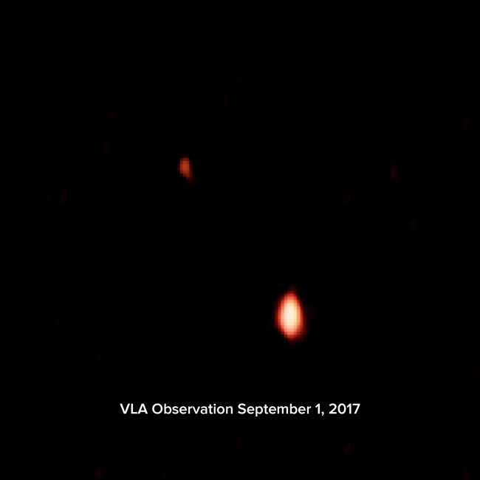
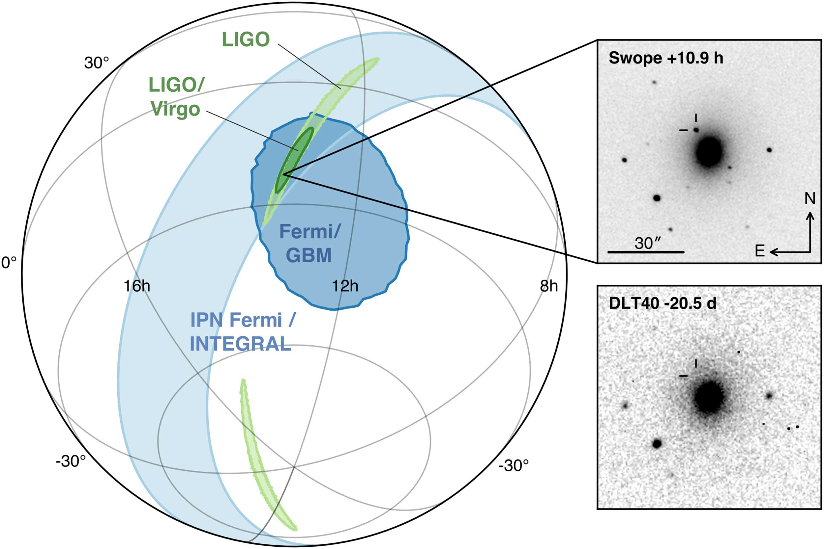
GW170817 sky localization & EM counterpart
Abbott et al. 2017, ApJL, 848 L12
(and refs therein!)
Coulter et al. 2017, Science, 358, 155
Valenti et al. 2017, ApJL, 848, L24
Hallinan, Corsi et al. 2017, Science, 358, 1579

Slide 5
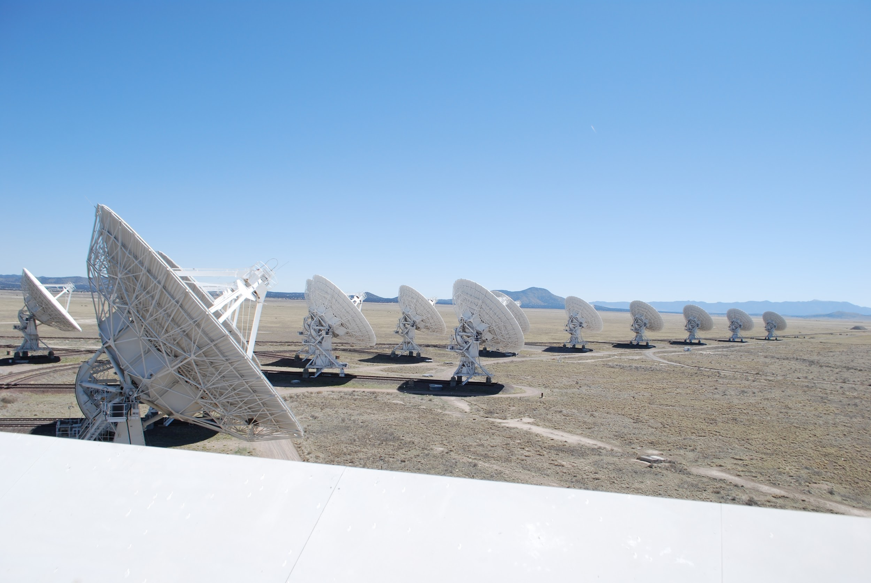
JAGWAR (Jansky VLA mapping of Gravitational Wave events as Afterglows in Radio)
The JAGWAR collaboration has been optimized to maximize the VLA's potential for the discovery of radio counterparts.
Additionally, JAGWAR has partnered with the PIs of leading EM-GW efforts at the world's major radio facilities to optimize the use of observing time

Slide 6
Two Pronged Search Strategy
Single deep pointing
Ideal if an EM counterpart has been discovered and well localized through optical or x-ray observations
Typical C-band: offers max continuum sensitivity and secondary benefit of measuring an accurate in-band spectral index
Radio Only search
Galaxy Targeting via widefield mosaicking to accommodate large localizations from LIGO
Typical S-band
Frequencies will be optimized based on events

Slide 7
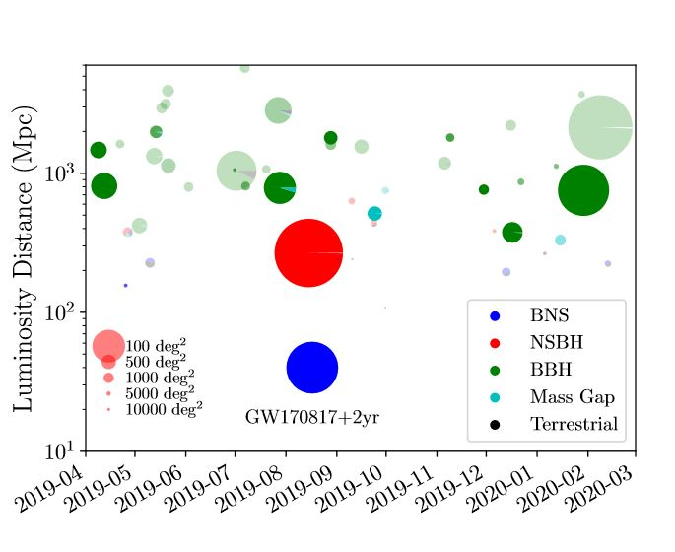
Number of Events in O3
Since the start of LIGO O3 on April 2019, ~50 detections have been made by LIGO/Virgo
We have observed for candidate events S190814bv and S191216ap

Slide 8
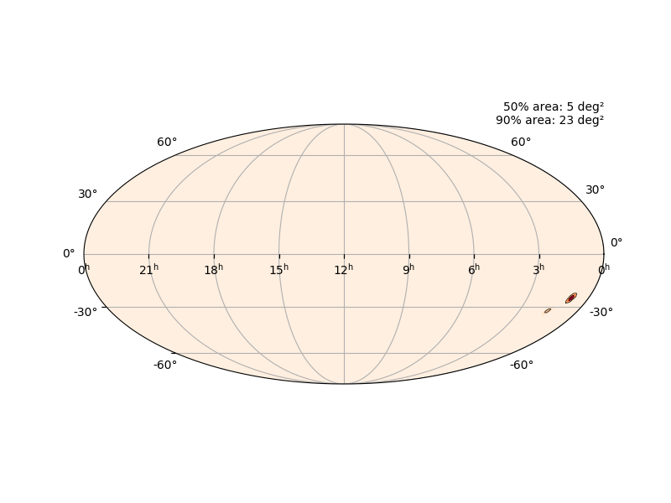
S190814bv
Blind Search in L-band, 27 pointings over 5 sq. deg region (50% containment)
Observed in two epochs
Sept 2019, Nov 2019
We are currently in the process of identifying any transcients
gracedb.ligo.org
Epoch | Average RMS
Epoch 1 | 26 micro Jy
Epoch 2 | 21 micro Jy

Slide 9
S191216ap
Observed 1 epoch in C-band covering 0.3 sq deg
Localization: ~70 sq deg
Distance: 325 Mpc
We are in the process of imaging the data
gracedb.ligo.org

Slide 10
Questions?
P.S. http://chirp.sr.bham.ac.uk/

Slide 11
Backup slides

Slide 12
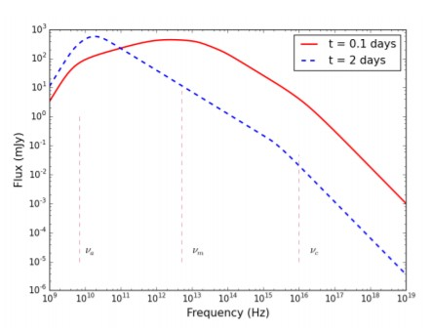
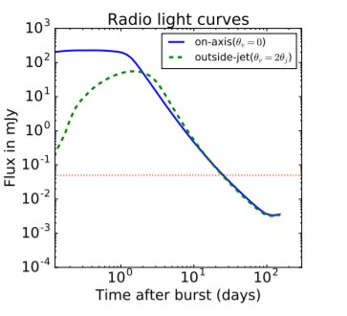
Typical GRB afterglow
Afterglow spectrum for a typical sGRB at 300 Mpc
Radio Light curve for on-axis vs. off-axis sGRB
Saleem, M., Resmi, L., Misra, K., et al. 2018, MNRAS, 474, 5340

Slide 13
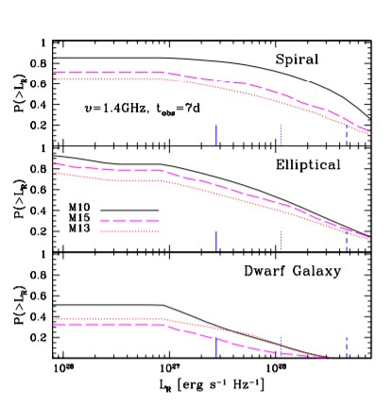
S191216ap
Fermi GBM did have a detection ~0.4 sec after GW150914
The plot shows predicted afterglow at 1.4 GHz at various distances in various galaxies.
Perna, R., Chruslinska, M., Corsi, A., et al. 2018, MNRAS, 477, 4228

