Slide 1
Europa's Observed Surface Water Ice Crystallinity Inconsistent with Thermophysical and Particle Flux Modeling
Jodi Berdis
Murthy Gudipati
Jim Murphy
Nancy Chanover
New Mexico State University
Caltech, Jet Propulsion Laboratory
New Mexico State University
New Mexico State University
Notes:
Recently learned effective method of communicating science, by following the outline of a fairy tale, so the title is going to change just a little bit...

Slide 2
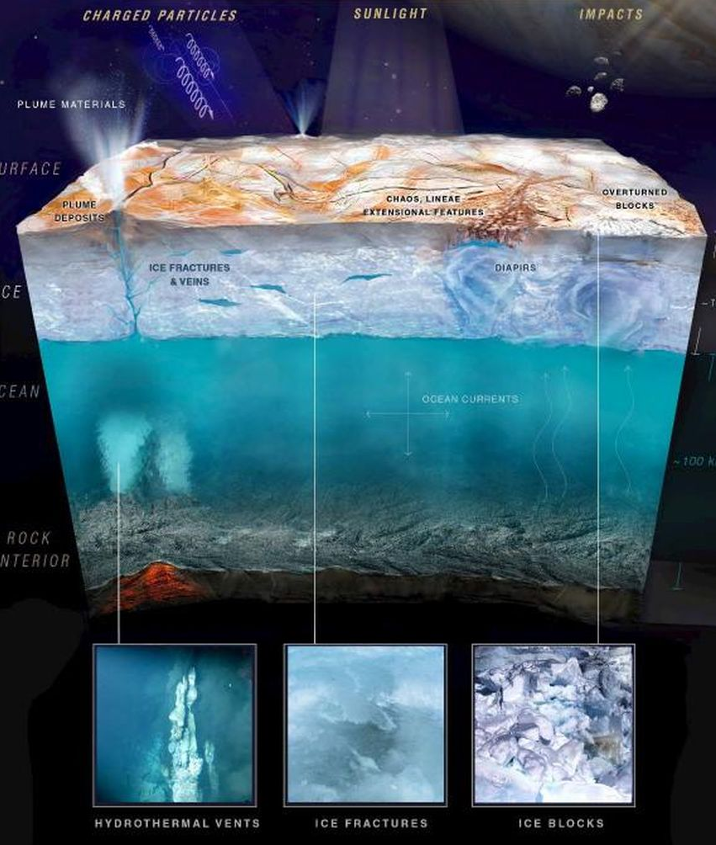

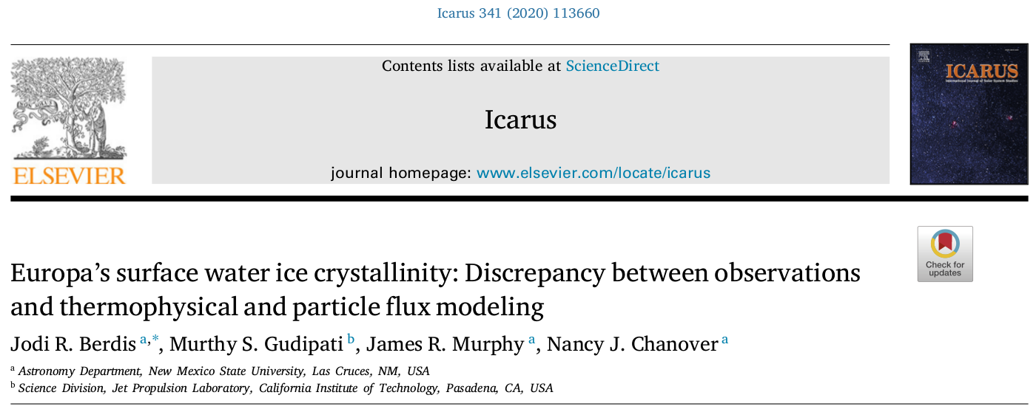
The Tale of the Unusual Water Ice Crystallinity
Jodi Berdis
Murthy Gudipati
Jim Murphy
Nancy Chanover
New Mexico State University
Caltech, Jet Propulsion Laboratory
New Mexico State University
New Mexico State University
Notes:
Based on my paper just accepted to Icarus, about the types of water ice on Europa’s surface.
Cutaway of Europa’s upper interior, liquid water ocean sandwhiched between a silicate rock core and icy shell, and this is a fairy tale after all, so maybe there’s a mermaid or two in that ocean

Slide 3

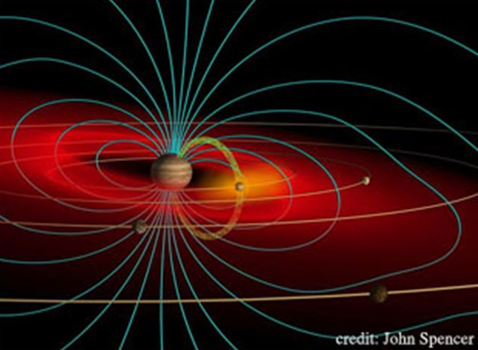
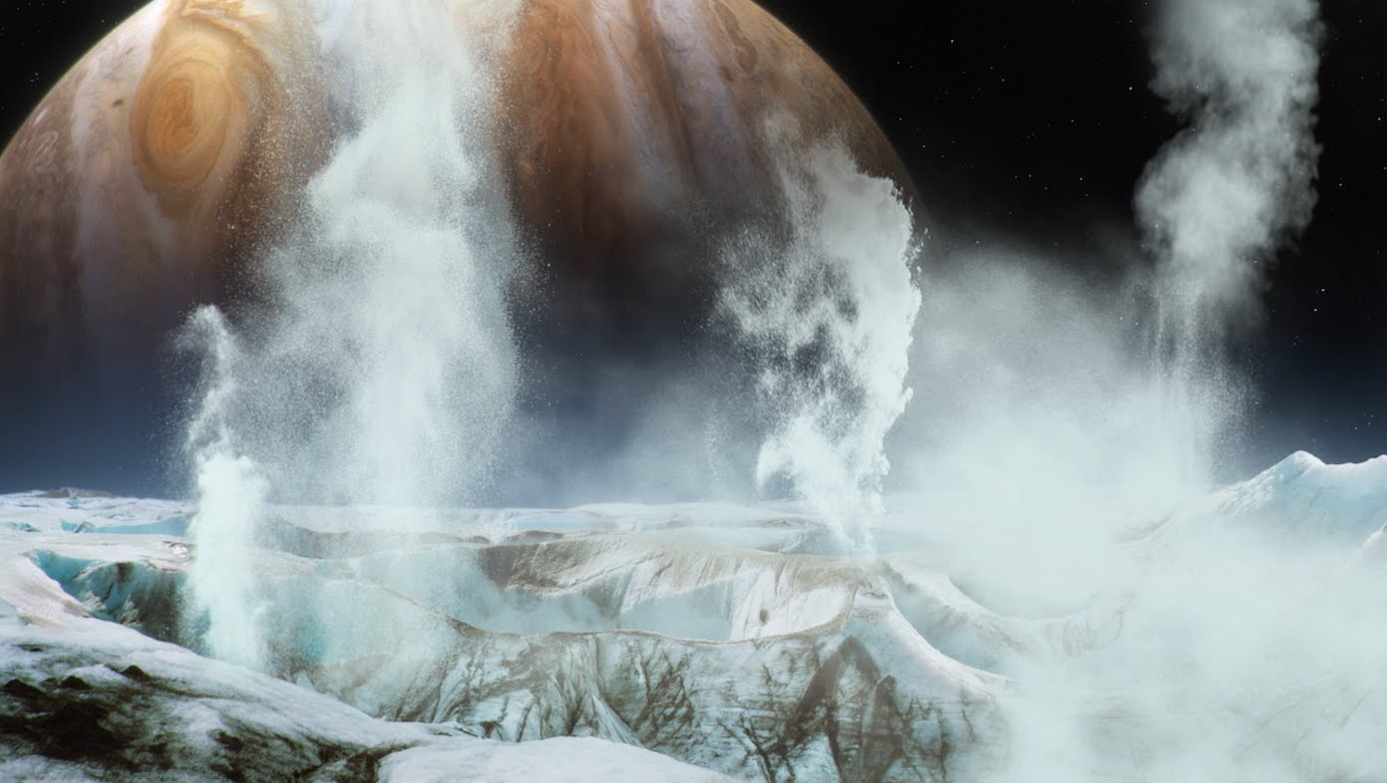

Story Time!
Once upon a time there was…
Every day…
One day…
This led to…
Because of that…
Until finally...
Notes:
Basically this method follows the significant moments in a fairy tale, luckily very similar to the scientific method, but with slightly different prompts
Read these off
So we’ll follow this story line, except instead of dragons that breathe fire, we’ll be having run-ins with Jupiter’s magnetic field that breathes charged particles. And instead of fairies sprinkling fairy dust, we’ll encounter plumes sprinkling water ice particles.

Slide 4
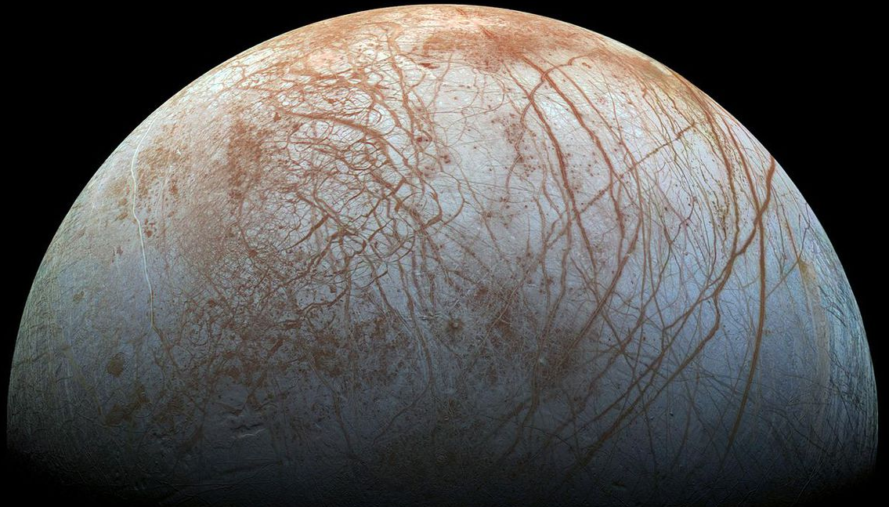

Once upon a time there was...
Europa
Subsurface liquid water ocean (Carr et al. 1998; Pappalardo et al. 1999)
Charged particle bombardment from Jupiter’s magnetic field (e.g., Cooper et al. 2001; Paranicas et al. 2002, etc.)
Unusual surface geomorphology / cryovolcanic processing, e.g., chaos terrain, plume activity (e.g., Pappalardo et al. 1998; Collins & Nimmo 2009; Roth et al. 2014, etc.)
Notes:
Moon of Jupiter named Europa, has an icy shell with a subsurface water ocean, charged particles that bombard the surface due to Jupiter’s magnetic field, and very unusual geomorphology on the surface - plumes erupting material from the ocean and depositing back onto surface, other forms of cryovolcanic activity, such as diapirs (upwellings of warm ice) that cause chaos terrain features on the surface

Slide 5

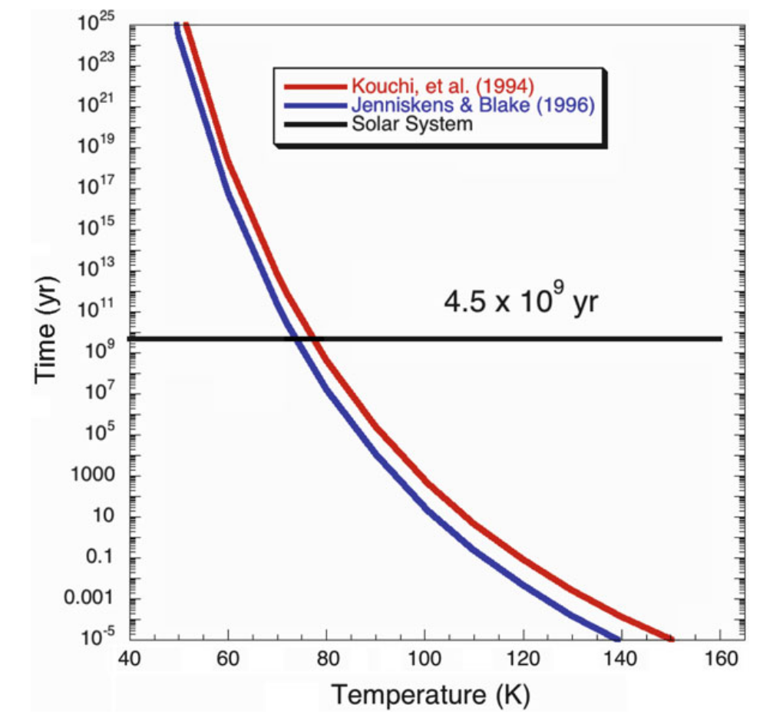
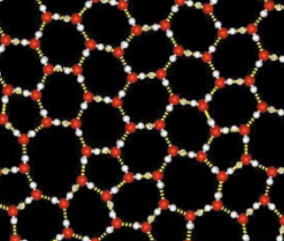
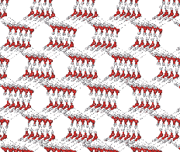
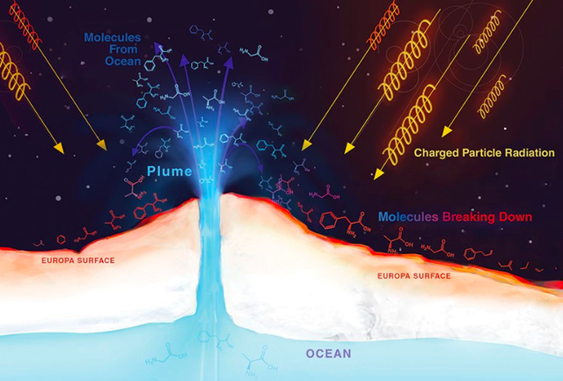
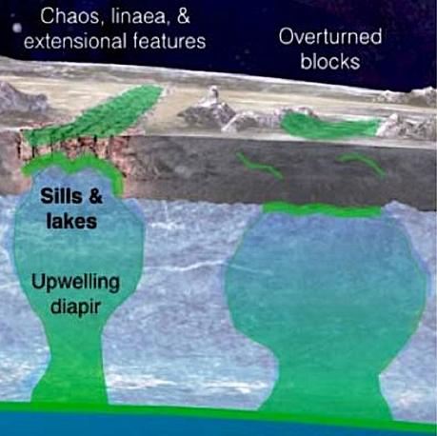
Every day...
Amorphous
Crystalline
Crystalline and amorphous water ice fought to win the Great Europan War
Amorphous water ice
Charged particle bombardment
Vapor-deposition as plume material
Crystalline water ice
Thermal relaxation of amorphous water ice
Cryovolcanic activity
Mastrapa et al. (2013)
Time (yr) to relax into crystalline
Notes:
Two types of water ice, referring to the lattice structure of the water ice molecules.
Amorphous caused by…. And has this molecular structure
Crystalline caused by…. Thermal relaxation, where the warmer the ice is, the quicker it will relax into crystalline. And has this molecular structure
Percentage of water ice that is in crystalline form is called “crystallinity”, so 70% crystallinity means that 70% of the water ice is crystalline, 30% is amorphous
And this percentage is a balance, a constant war between these processes, when amorphous is winning the war the crystallinity is lower, and when crystalline is winning the war the crystallinity is higher.
And for the remainder of the talk, things in red will signify increasing amorphous water ice content, and blue will signify crystalline water ice content

Slide 6
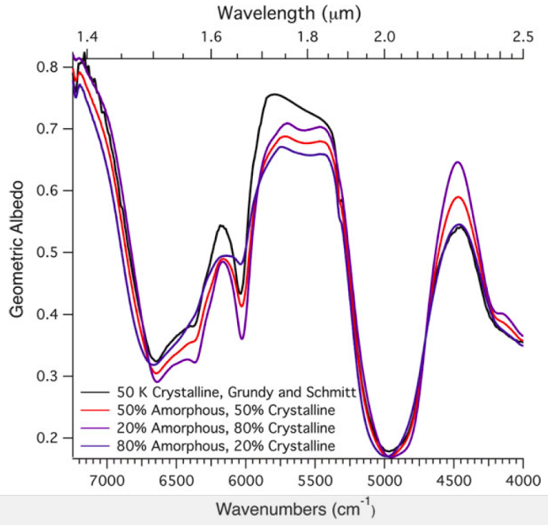
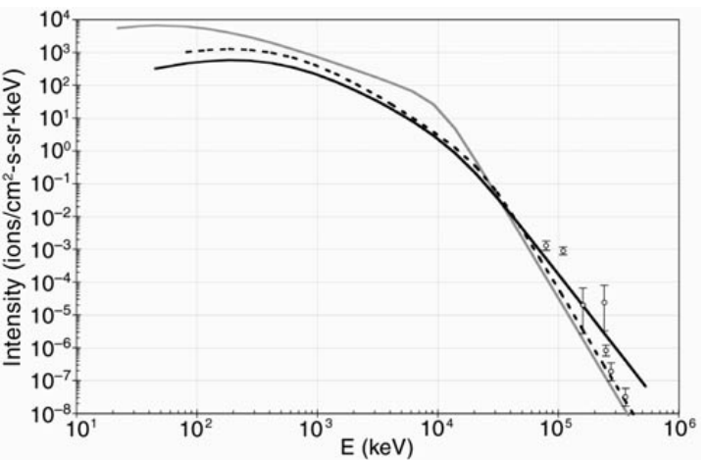
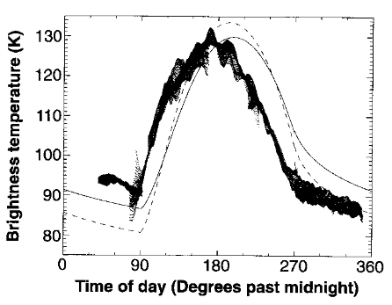
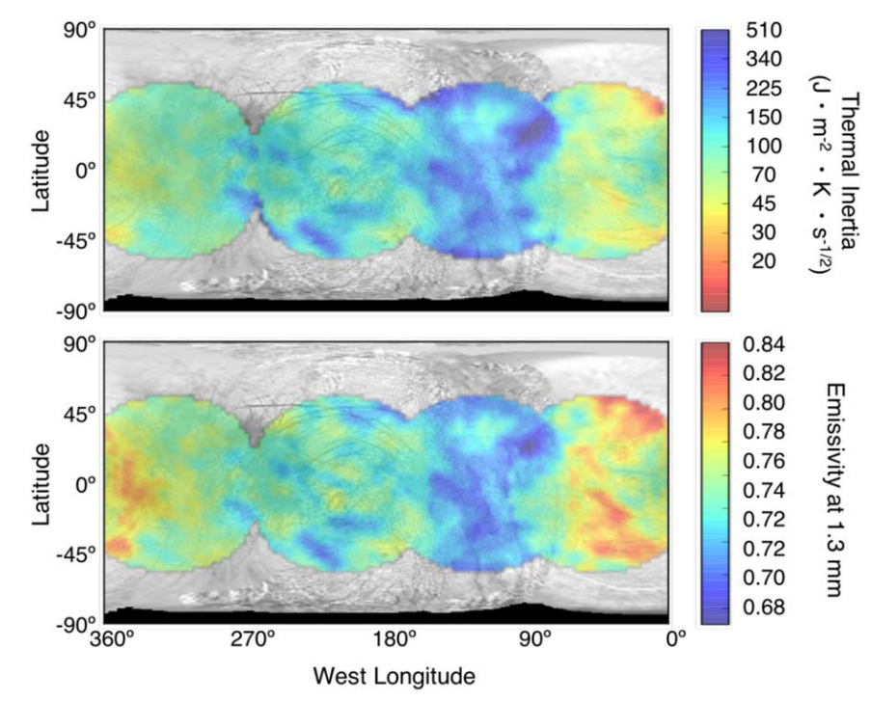
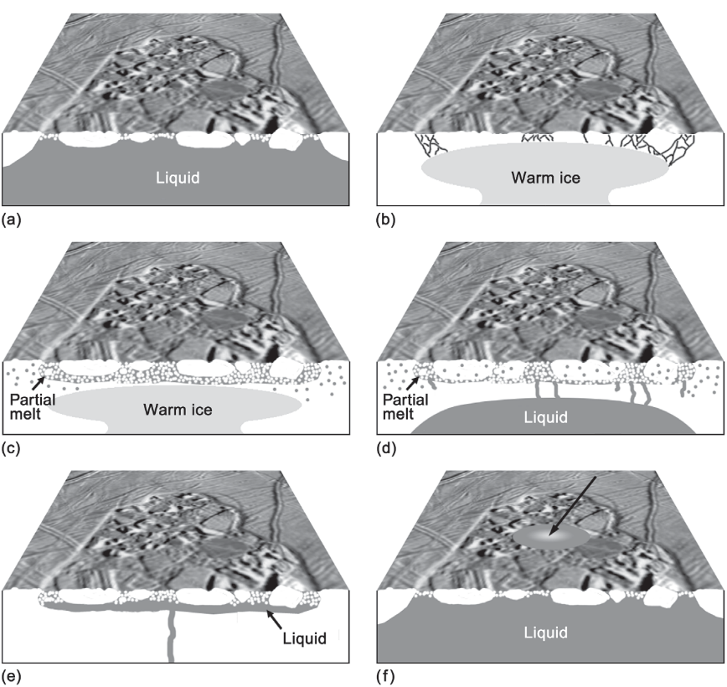
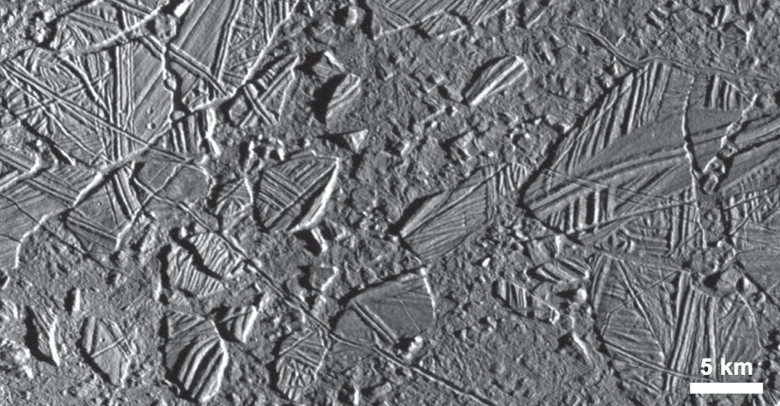
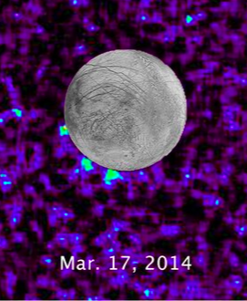
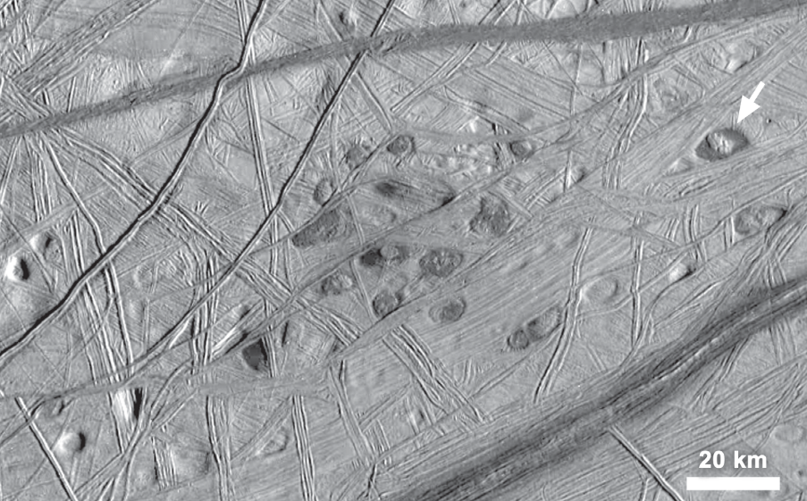
One day...
Amorphous
Crystalline
Spectrally-distinct signatures of crystalline and amorphous water ice (Mastrapa et al. 2008, 2013)
Well, on several days...
Ion bombardment from Galileo PPR (Paranicas et al. 2002)
Thermophysical modeling of airless bodies (Spencer et al. 1999; Trumbo et al. 2017, 2018)
Galileo sees signatures of cryovolcanic activity (Collins & Nimmo 2009)
Hubble detection of plumes (Roth et al. 2014; Sparks et al. 2016)
Notes:
Really on several days, over the past years but let’s just pretend it was all on one day for the sake of our fairy tale…
First, started to realize we could tell the difference between crystalline and amorphous based on NIR spectral bands
Then, we developed thermophysical modeling of the surface
And then the Galileo spacecraft arrived, and gave us charged particle bombardment estimates at the surface, and signatures of cryovolcanic activity.
Finally, Hubble detected plumes
All these incredible things started to happen, and this led to...

Slide 7


This led to...
Amorphous
Crystalline
Our science question:
Can you reproduce the water ice crystallinity (on Europa’s leading hemisphere) using ONLY thermal and particle flux modeling?
If not, this could provide a glimpse into how cryovolcanic and plume processing affect the ice!
But if so, does that mean cryovolcanic and plume processing are equally affecting the crystallinity?
Notes:
This led to our science question, where the hero (why yes, yes I am the hero in my own story) rides in to save the day and investigate this science question.

Slide 8

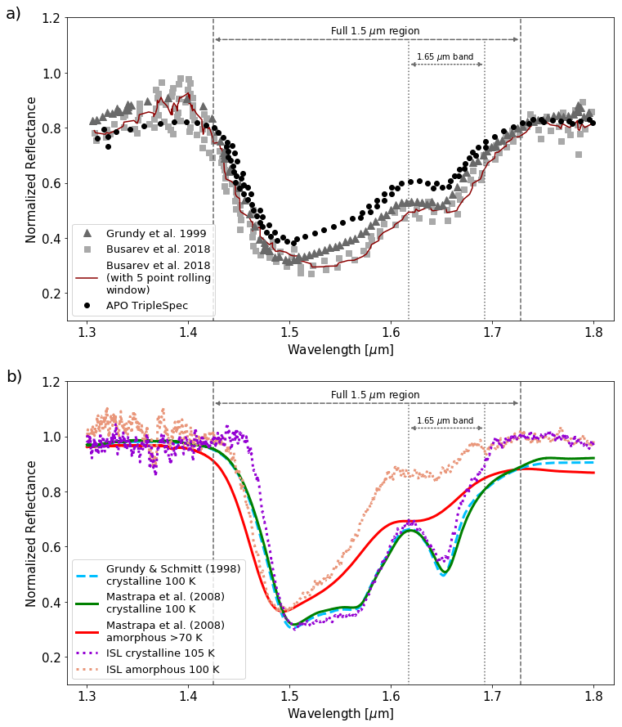
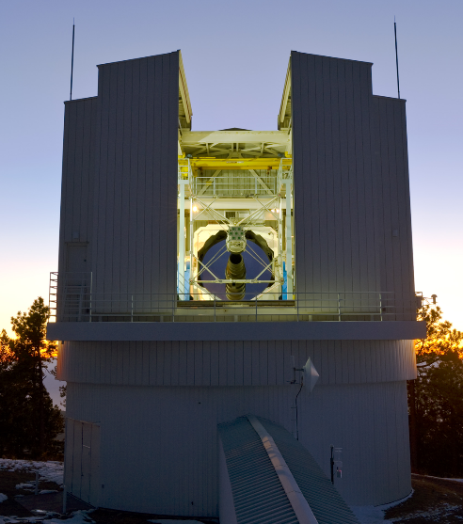
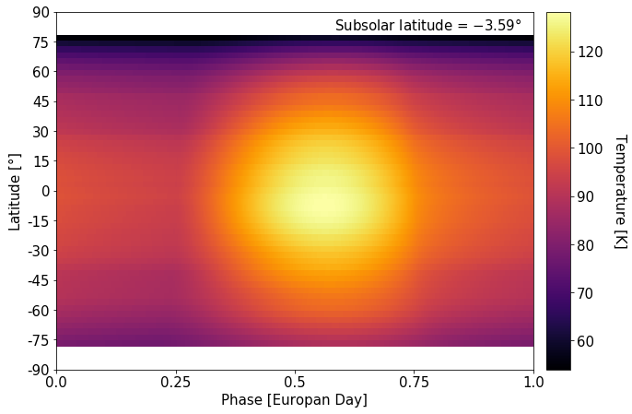

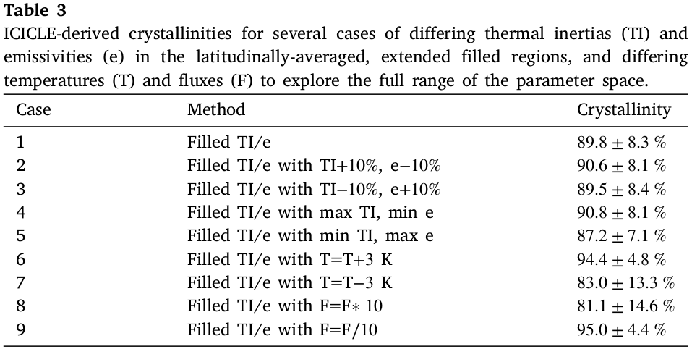
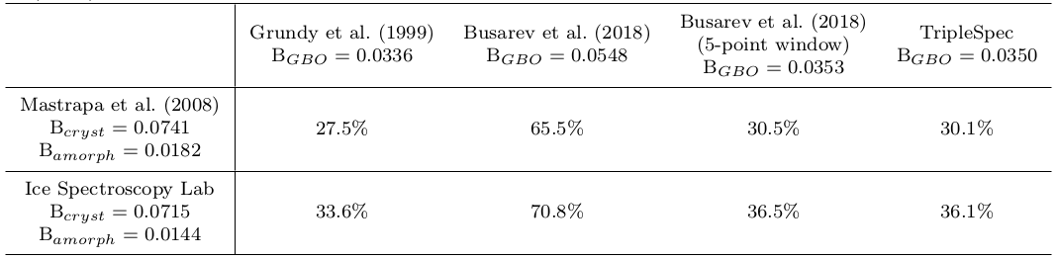
Because of that...
Amorphous
Crystalline
Observed Crystallinity
Modeled Crystallinity
Incipient Code for Investigating the Crystallinity of the Leading-hemisphere of Europa (ICICLE)
Apache Point Observatory, Sunspot, NM
Baragiola et al. (2013); Dalle Ore et al. (2015)
Notes:
So because of that, the hero begins their quest! We calculate crystallinity two different ways: First, telescopically, second, using thermal and particle flux modeling
We use the NIR spectrograph TripleSpec on APO and compare to laboratory spectra of crystalline and amorphous water ice, use this fancy equation here, and get crystallinity percentages which are all around 30% except for <this> one and that’s mainly due to noisy data.
Then, we use a 1D thermophysical model of the surface, combine it with the particle flux contribution, and calculate the crystallinity through some other fancy math that’s all wrapped up in this code that I developed, ICICLE, and get crystallinities ~90%.
30% and 90% are VERY different!
And so finally….

Slide 9
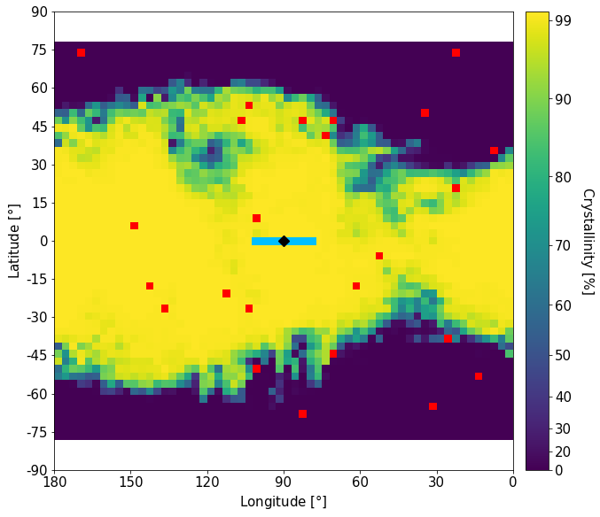
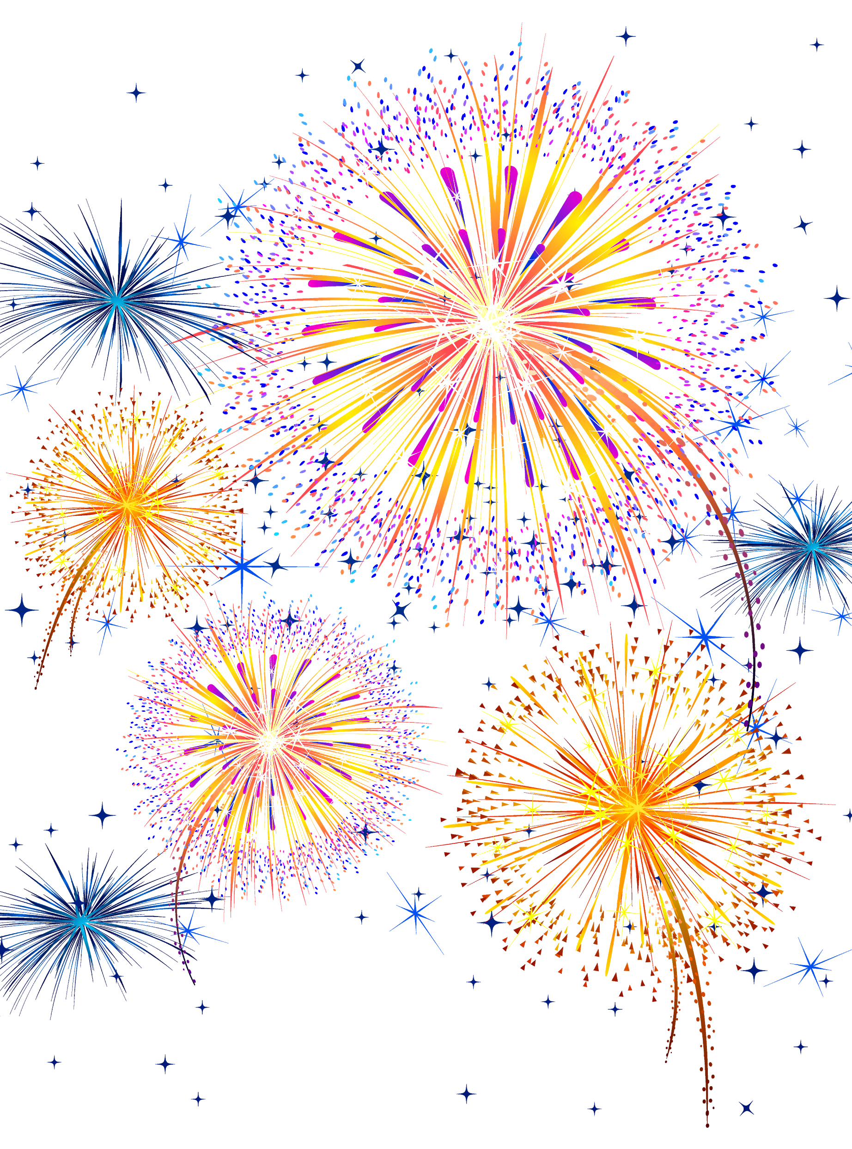

Until finally...
Observed Crystallinity:
Modeled Crystallinity:
So they didn’t live happily ever after?!?
Amorphous
Crystalline
Single circular plume deposition: C ↓ 0.07%
Rectangular plume deposition: C ↓ 0.45%
25 circular plume deposition: C ↓ 1.02%
Notes:
Amorphous water ice wins the battle of the observed crystallinity, and crystalline water ice wins the battle of the modeled crystallinity
So what would it take to get those to match? Well, we can’t alter the observed crystallinity, cuz that’s what we observed! What if we do something to the model?
To attempt to drive down the modeled crystallinity (make more amorphous), I tried artificially placing plumes onto the surface, though their frequency isn’t quite constrained.
Still couldn’t lower it enough, even adding 25 plumes (which is HIGHLY generous) only lowers the modeled crystallinity by ~1%
So, they didn’t live happily ever after?? Have no fear, there will be a sequel to this enchanting tale!

Slide 10
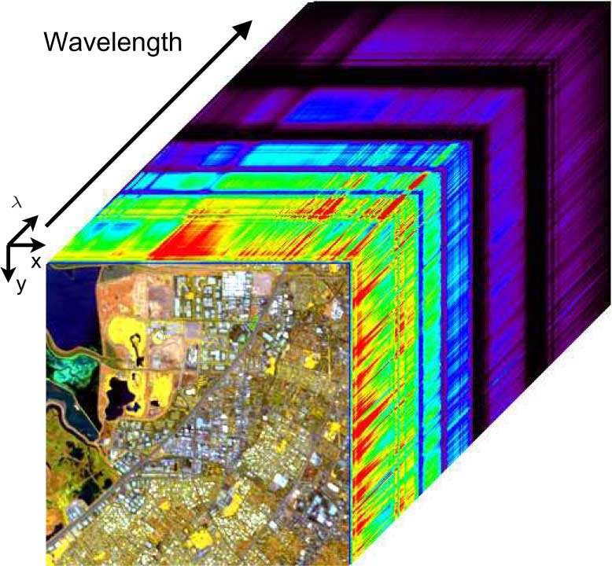
A sequel...?
Thermal and particle flux modeling alone cannot reproduce the observed crystallinity
Diving into hi-res image spectroscopy of the surface to search for plume/cryovolcanic signatures
Notes:
Well now we know we can’t reproduce the observed crystallinity with thermal and particle flux modeling
Our daring hero is back at it again <click>, my next step is to dive into high resolution image spectroscopy (“image cubes”, similar to IFU cubes) to search the surface for fairies and dragons, I mean…<click> plumes and cryovolcanic signatures
So I’ll let you know how it goes! Thanks so much, and I can take any questions :)

