Slide 1
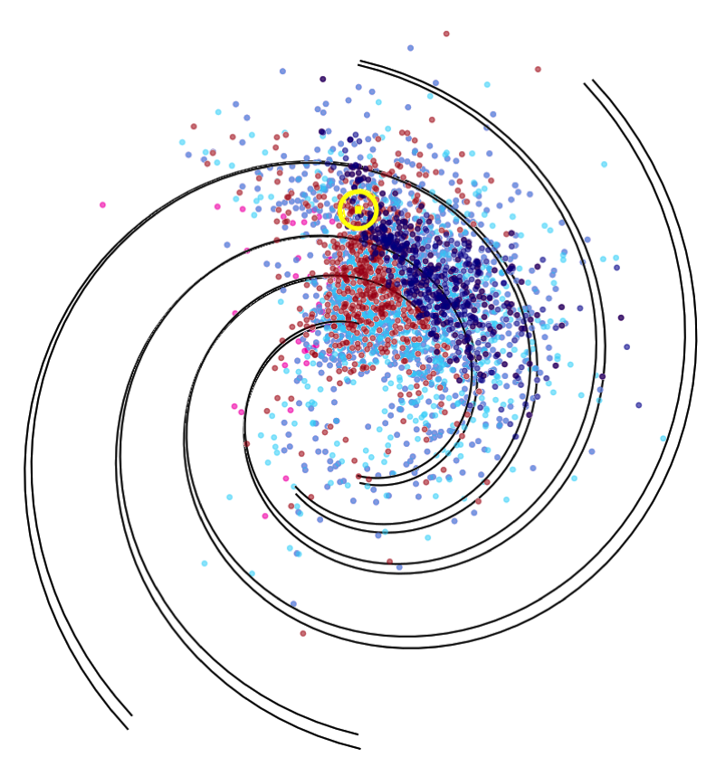
Predicting the Performance of Future Pulsar Timing Arrays
(using population synthesis)
Tyler Cohen¹
Paul Demorest²
¹New Mexico Tech Department of Physics
²National Radio Astronomy Observatory

Slide 2
Gravitational Wave Background Spectrum
Modified from Demorest
Notes:
Gravitational waves are ripples in the fabric of space-time generated by accelerating mass.
SMBH binaries (millions – billions of times Msun) generate gravitational waves at nHz frequencies,
below the LIGO and LISA bands. This gray band is the anticipated spectrum of a stochastic
gravitational wave background produced from the sum of all of the SMBHB. This background
can only be detected using a pulsar timing array. The sensitivity of the NANOGrav pulsar timing
array is shown in blue.

Slide 3
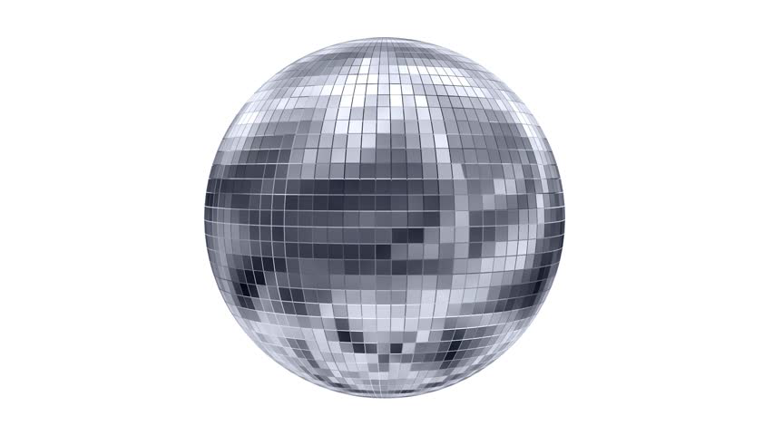

Slide 4
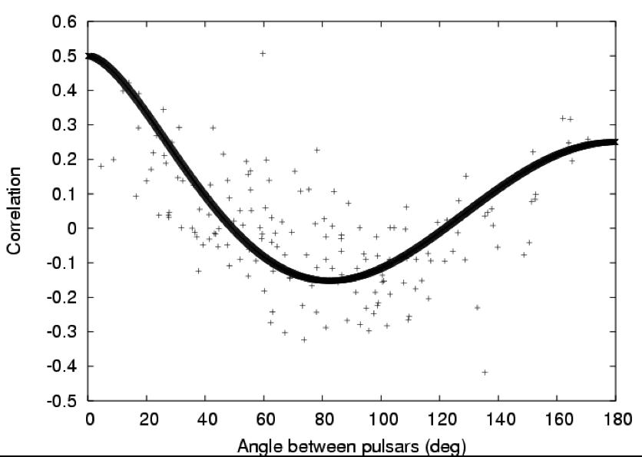
Correlation of Timing Residuals Between Pairs of Pulsars
Hobbs et al. 2008

Slide 5

Notes:
But we can’t just use any pulsars in our pulsar timing array.
This is the entire population of known pulsars on a period-period
derivative diagram. Young pulsars will be born with short periods
but will slow down quickly until they die. If the pulsar can accrete
for long enough off of a binary companion it can be revived and
spun up to very short and very stable periods. These are the MSP
In the lower right and these are what we want to use for pulsar timing
Because we can get more pulses per integration time without a decay
In period.

Slide 6
Sensitivity of Pulsar Timing Array Over Time
Modified from Siemens et al. 2013
Notes:
Our goal is to make predictions about the capabilities of different
pulsar timing arrays and to make recommendations about the best
use of telescope resources to detect a GWB. The way we are doing this
Is by synthesizing a population of MSPs using Monte Carlo methods
and then simulating a timing array of these MSPs.

Slide 7
Simulated Surveys
Survey | Frequency (MHz) | Sky Coverage | # MSPs detected
Parkes Multi-beam | 1230 - 1518 | 50° < l < 260° |b| < 5° | 28
AO Drift | 293 - 362 | -1° < δ < 38° | 33
Swinburne High-lat. | 1230 - 1518 | -100° < l < 50° 15° < |b| < 30° | 12
Swinburne Inter-lat. | 1230 - 1518 | -100° < l < 50° 5° < |b| < 15° | 6
Parkes High-lat. | 1230 - 1518 | 220° < l < 260° |b| < 60° | 5
Parkes Perseus | 1230 - 1581 | 200° < l < 260° |b| < 5° | 1
Parkes Northern Ext. | 1230 - 1518 | 50° < l < 60° |b| < 2° | 2
Parkes 70-cm | 420 - 452 | δ < 0° | 19

Slide 8
Population Synthesis
• survey list
• # real survey detections
• Distributions
• log-normal luminosity
• normal spectral index
• log-normal period
• exponential scale height
• normal radial
• log-normal pulse width
• normal velocity
• NE2001 e⁻⁻-density model
Start
New pulsar
Draw from PDFs
Compute DM from dist. and e⁻⁻-density model
Yes
Run new survey
No
simulated detections <
real detections
End of survey list?
survey detect pulsar?
Stop
No
Yes
No
Yes
detections += 1
Notes:
Input population parameter distributions, optional survey(s) to normalize population, electron density model
PsrPopPy generates a pulsar with properties drawn randomly from input parameter distributions
Checks if pulsar would be detected by survey(s)
Rinse and repeat until number of pulsars detected by survey(s) matches actual number of detections

Slide 9
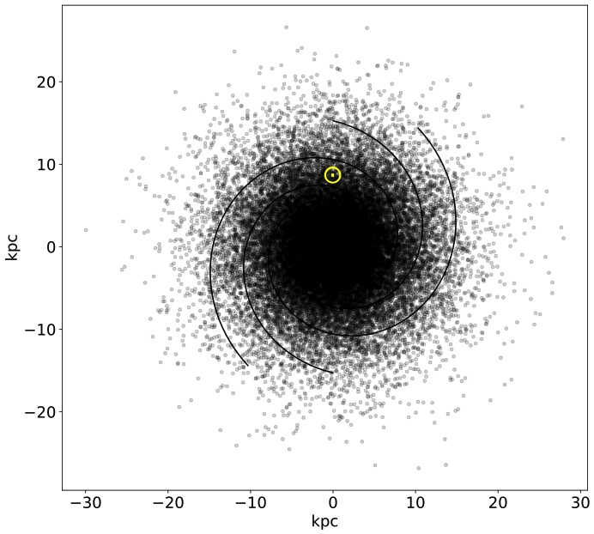
Notes:
So we produce a galaxy of ~30,000 MSPs, most
Of which wont be good for pulsar timing.

Slide 10
Simulating a Timing Campaign
Check if MSP is within the RA and DEC limits of each telescope
Test visible MSPs at Arecibo at L-band for 30 min. Cut MSPs which are too dim or scatter-broadened to be detected.
Compute the timing precision for the MSP (Lam et al., 2018)
Notes:
Radiometer noise can be improved with instrumentation.
The NANOGrav criterion for inclusion in the timing array is σ better than 1μs.
In fact we really want pulsars with TOA uncertainties of 10s or 100s of nanoseconds
Telescope noise includes BW reduction from excised channels for RFI, incorrect gain
Calibration, and summation of polarization profiles.

Slide 11
Notes:
Smaller points are better timing precision
This is consistent with observing ~70 MSPs between Arecibo and Green bank.
We don’t currently include VLA timing in our PTA but are testing 7 MSPs at higher freq.
You’ll notice that pulsars closer to Earth tend to have better timing precision because of
that pesky inverse square law and because they’re less susceptible to scattering and
dispersive effects.

Slide 12
Notes:
Every single one of these pulsars is now under 1 us.
I would submit that given the specs of the future telescopes
and available telescope time there are only about 200 MSPs in
the galaxy which will be useful to PTAs for GWB detection. Finding
them is a different question you can ask me about if you’re interested.
Potential Questions:
• Ones that get worse going from old to new receivers are highly scattered and are noisier in the lower portion of the wider band.
In practice, we would remove part of the bottom of the band until we achieved the optimal timing precision
• At first glance it might appear that we are not seeing as far out into the galaxy, but in fact the top 200 pulsars are now just closer
because of the increased sensitivity

Slide 13
Work in Progress
Keep track of individual survey detections independently. Surveys that detect no MSPs (eg. Parkes 6.5 GHz methanol) can become useful.
Simulate future surveys to predict PTA growth rate
Inclusion of targeted Fermi follow-up searches
    Gamma ray luminosities uncorrelated w/ radio luminosities
MCMC for t_{int} and A_{eff} for all viable MSPs with dish arrays
Notes:
Right now you just give PsrPopPy the sum of all the MSPs found in
your surveys, surveys that don’t detect pulsars are useless. Eg. Parkes 6.5 GHz methanol
Once I get the right statistical description of this optimization problem,
I can optimize for other population parameters besides total number of pulsars detected.
I welcome feedback on the right way to do this.
Is it an average weighted by the total number of pulsars actually detected?
Or a product of poisson probabilities for detecting a number of MSPs in your simulated
Survey given the number the survey actually detects.
We’ve started talking to folks
who are a part of the Green Bank North Celestial Cap survey about incorporating the results of
the ongoing survey

Slide 15
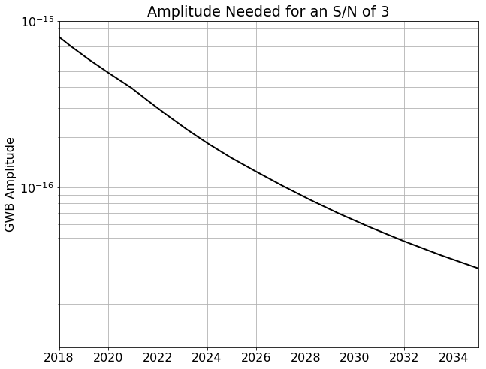
Notes:
Assumes 4 MSPs added per year
DSA2000 comes online in 2026

Slide 16
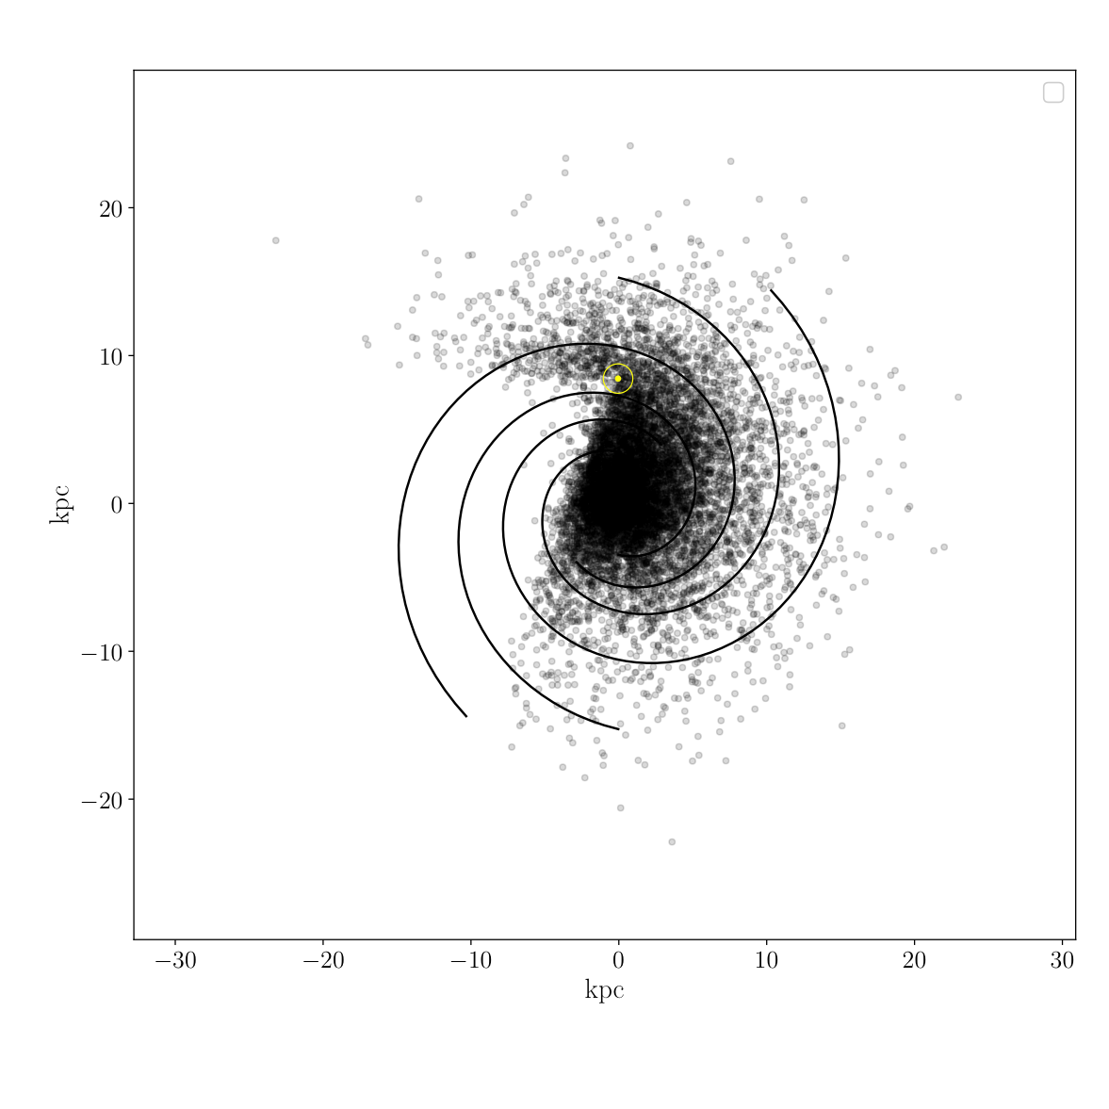

Slide 17
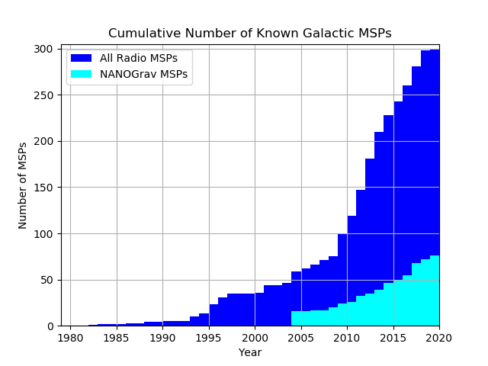
S. Ransom, 2019
Notes:
The first plot with the sensitivity over the next decade assumes 4 MSPs are added to the array each year,
and we’ve hit that mark so far. But is that sustainable? For our Astro2020 white paper we’ve been projecting
200 MSPs by the end of the next decade, but obviously that can’t be reached with 4 per year. So this begs
the question, how do we optimize our current and future telescope plans to find as many well-timed MSPs as
possible? Basically, we want to make more qualitative predictions into the next decade.

Slide 18
How many MSPs will we find?
Simulated PTA | Best σ_{TOA} | Worst σ_{TOA} | Simulated Surveys | # detected
AO + GBT (~Now) | 30 ns | 2.2 μs | • AODrift • PALFA • GBNCC | 115 / 200
AO + GB-UWB + DSA2K (2025+) | 21 ns | 1.0 μs | • AODrift • PALFA • GBNCC • ALPACADrift | 121 / 200
Notes:
GBNCC is about 80% complete and is expected to finish in 2020, dwell times of 120s
AODrift observes narrow strips of the sky at a time and has not evenly sampled the sky
(the galactic center has been particularly neglected since it's hard to get observing time there)
GBNCC and AODrift at 430, PALFA at L-band
ALPACA – L-band phased-array feed for Arecibo

Slide 19
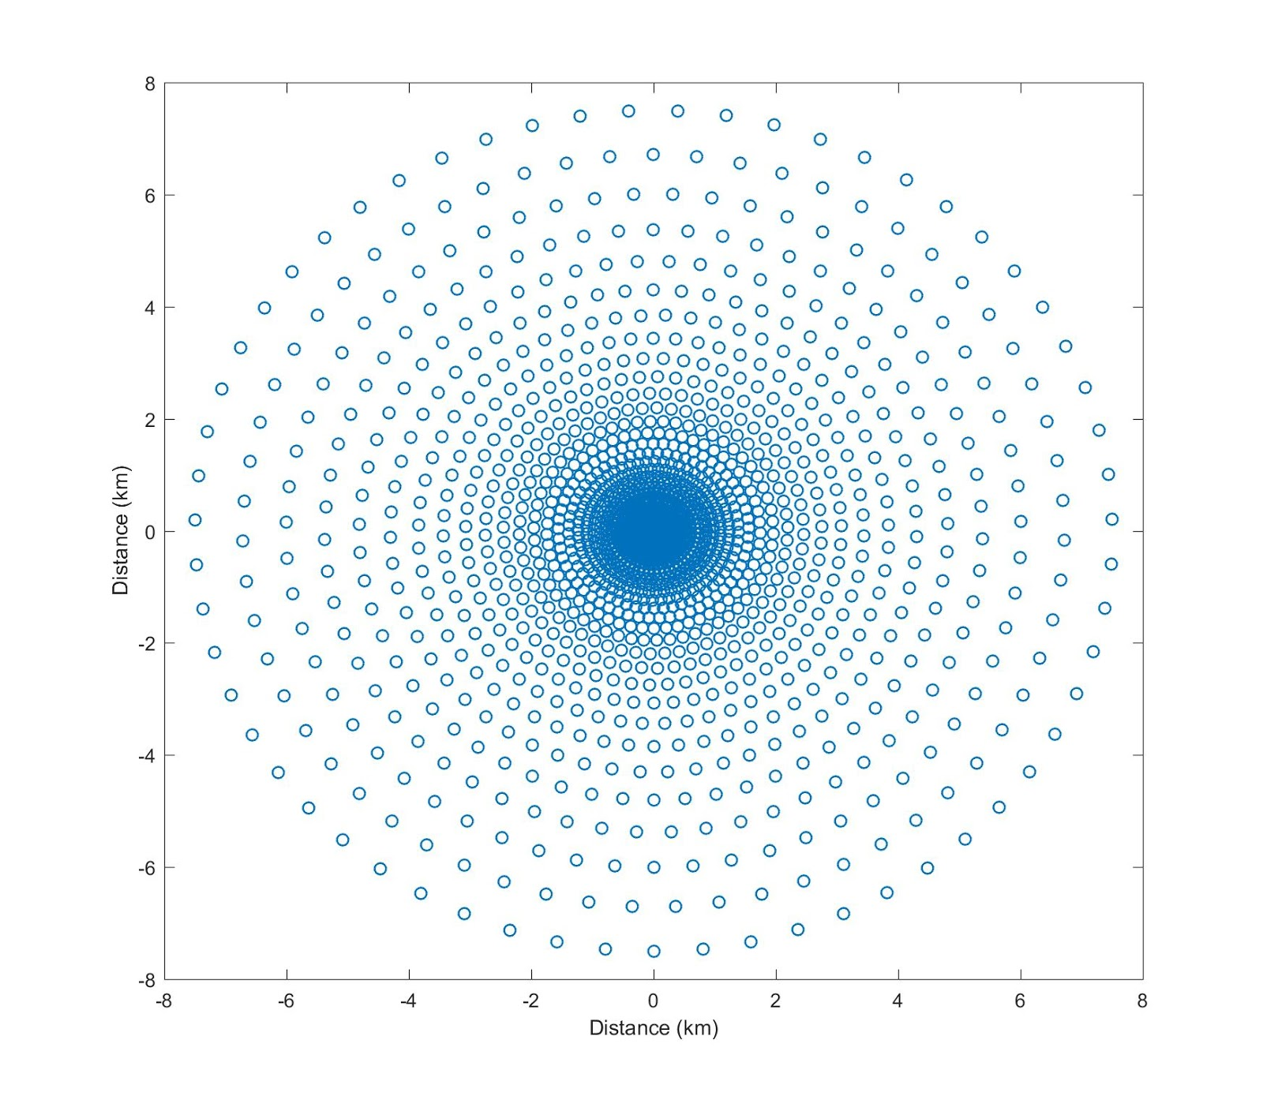
DSA2000
Proposed 2000-dish array at Owens Valley Radio Observatory in CA
T_{sys} ~ 25 K (T_{receiver} ~ 6 K)
Gain ~ 10 K/Jy
Sensitivity comparable to Arecibo and sky coverage comparable to GBT
ν ~ 0.7 - 2 GHz
D. Woody, 2019
Notes:
Ask Scott if he’s going to mention DSA in his NANOGrav overview talk

Slide 20
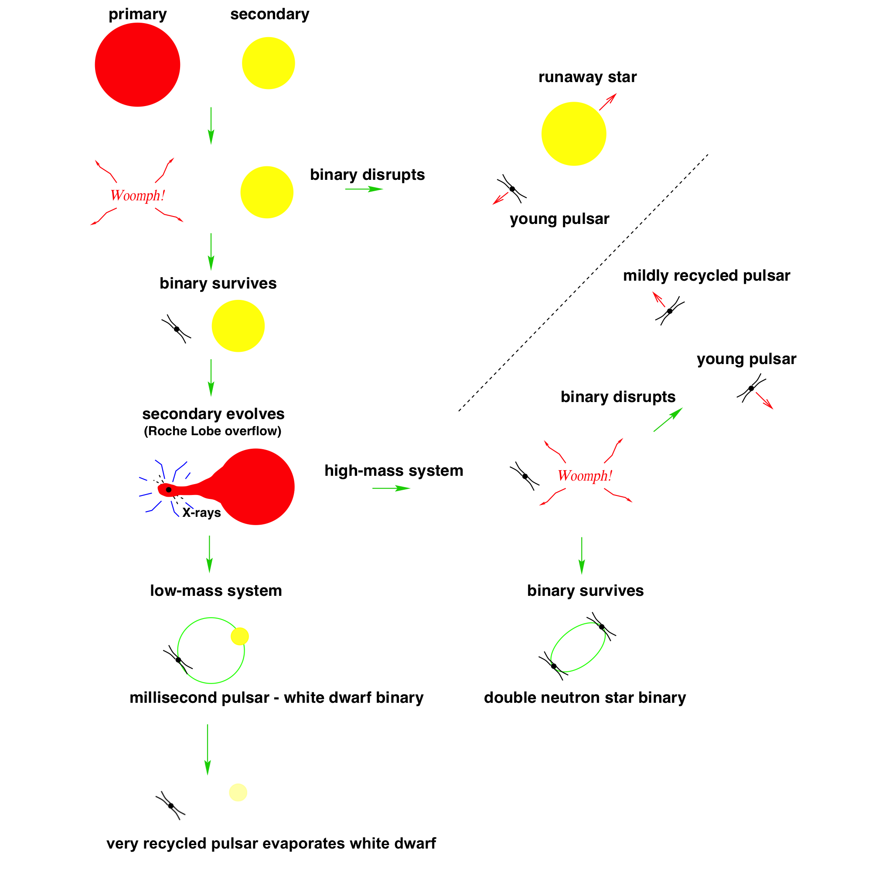
Modified from Lorimer et al. 2008

Slide 21
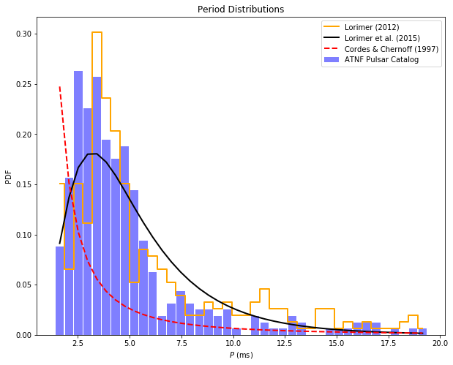

Slide 22
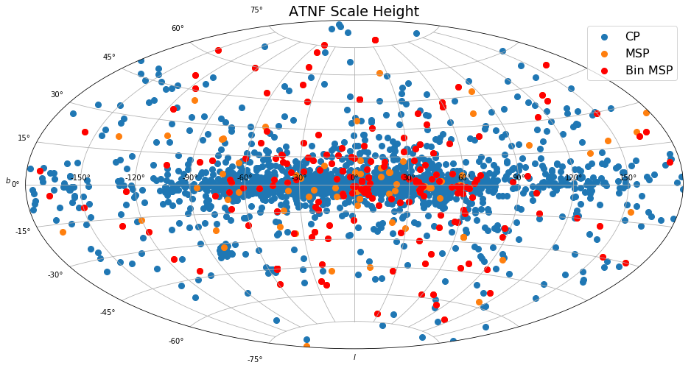

Slide 23
DSA2000 Optimal
Frequency Ranges
Notes:
An MSP which is below the dashed line is better with the bandwidth on the y-axis.
Number of MSPs with sigma TOA better than 1 microsecond:
DSA2000 0.5-2 GHz: 152
DSA2000 0.7-2 GHz: 185
DSA2000 1-4 GHz: 243

Slide 24
