Slide 1
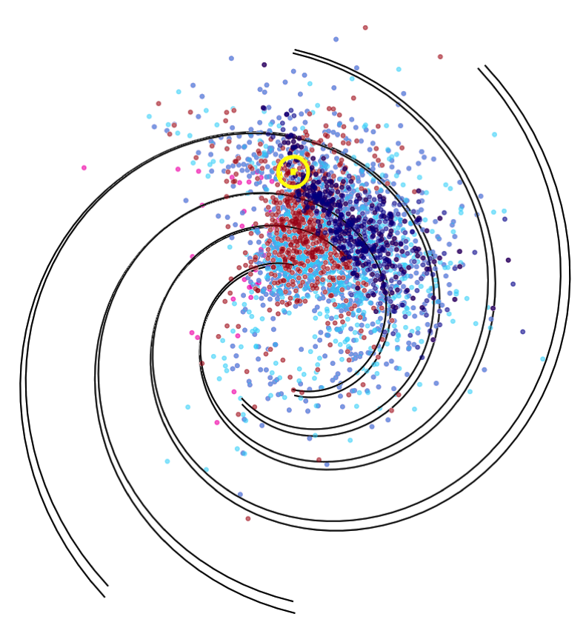
Predicting the Performance of Future Pulsar Timing Arrays:
An analysis of the millisecond-pulsar population
Tyler Cohen
New Mexico Tech Department of Physics,
National Radio Astronomy Observatory

Slide 2
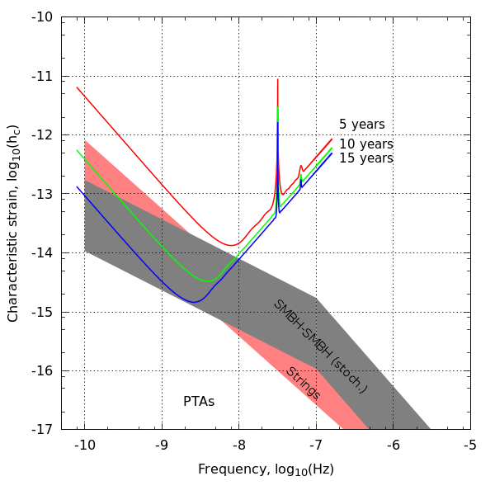
Gravitational Wave Spectrum
Demorest 2016
Notes:
• Gravitational waves are ripples in the fabric of spacetime generated by inspiraling SMBHB at the centers of galaxies
• Superposition of GW from all SMBHB mergers that have taken place throughout the history of the universe forms a stochastic background of gravitational waves.
• North American Nanohertz Observatory for Gravitational Waves

Slide 3


Slide 4
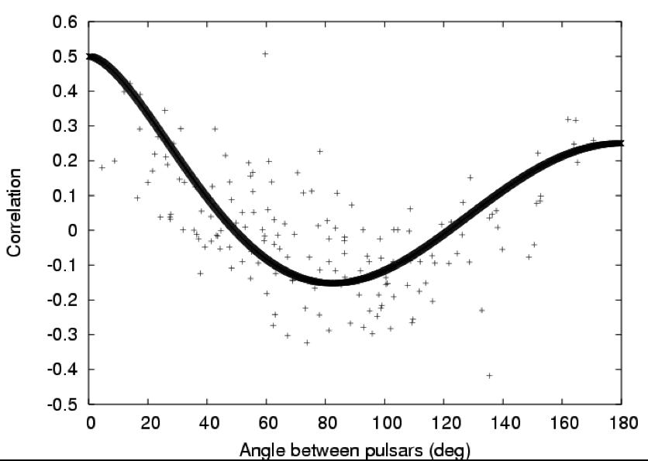
Correlation of Timing Residuals Between Pairs of Pulsars
Hobbs et al. 2008
Notes:
Cross correlated power between each pair of pulsars.
So each one of these gray points is a “baseline”

Slide 5
Objectives
Use multiple pulsar surveys to constrain the parameters of the galactic MSP population
Determine an algorithm for optimizing future PTAs given instrumental and time constraints, and expected MSP population parameters

Slide 6
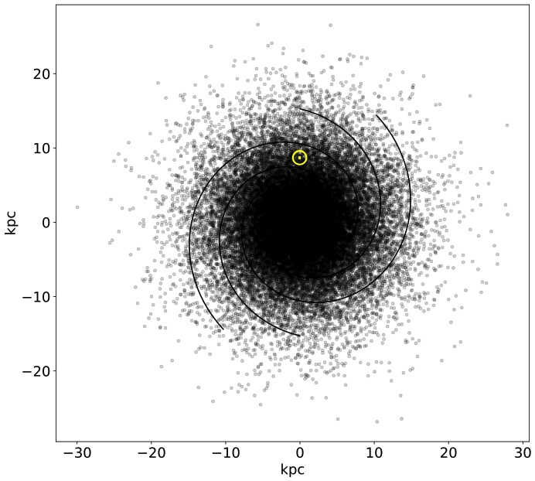
The Population Model
log-normal luminosity distribution
  μ = -1.1 log₁₀(mJy kpc²)
  σ = 0.9 log₁₀(mJy kpc²)
log-normal period distribution
  μ = 1.5 ms, σ = 0.58 ms
an exponential scale height
  μ = 500 pc
Gaussian radial distribution
  μ = 0, σ = 7.5 kpc
log-normal duty % distribution
  μ =15%
Gaussian velocity distribution
Notes:
The full MSP population viewed in the galactic plane is shown at the right.

Slide 7
Simple Time of Arrival (TOA) Uncertainty
Notes:
Radiometer noise can be improved with instrumentation.
The NANOGrav criterion for inclusion in the timing array is σ better than 1μs.
In fact we really want pulsars with TOA uncertainties of 10s or 100s of nanoseconds.

Slide 8
Notes:
Arecibo detects 43 MSPs with σTOA < 1 μs
And Green Bank detects 36.
I am taking into consideration the fact that pulsars visible to both
Arecibo and Green Bank are *usually* timed exclusively with Arecibo.
The uncertainty in the time of arrival due to radiometer noise decreases with bigger telescope
jitter noise stays same
Radiometer noise can be improved with instrumentation

Slide 9
Notes:
FLAT detects 25% more pulsars with σTOA better than 1μs than PTAT
But for bright pulsars, the dedicated PTAT does better
How much time do we spend on ngVLA vs a dedicated PTA telescope
subarray

Slide 10
Notes:
DSA2000 is a planned "large-N, small-D" array with 2000 dishes,
sensitivity comparable to Arecibo at L-band and sky coverage comparable to Green Bank.
Once most of your pulsars become jitter dominated it doesn’t make
sense to make your telescope any bigger, you’re dominated by
noise intrinsic to the pulsar and you can only get better by timing
the pulsars for longer and at this point it makes more sense to start
splitting your array into sub-arrays and trade collecting area for time.
Optimizing the jitter fraction could be used to optimize the
collecting area or number of dishes used by dish arrays for pulsar timing.

Slide 11
Frequency-dependent Timing Precision
Lam et al. 2018 demonstrate optimal frequency and bandwidth that gives lowest σ_{TOA}
FrequencyOptimizer σ_{TOA} calculator includes
  Template-fitting uncertainty
  Frequency-dependent DM
  ISM scattering
  Diffractive ISM scintillation

Slide 12
Constraining Population with Multiple Surveys
The more surveys you add the more degrees of freedom of the population parameters you constrain.
Need to keep track of individual survey detections independently. Surveys that are ongoing (e.g. GBNCC) and that detect no MSPs (e.g. Parkes 6.5 GHz) can become useful.
Notes:
Right now you just give PsrPopPy the sum of all the MSPs found in
your surveys, surveys that don’t detect pulsars are useless. Eg. Parkes 6.5 GHz methanol
Once I get the right statistical description of this optimization problem,
I can optimize for other population parameters besides total number of pulsars detected.
I welcome feedback on the right way to do this.
Is it an average weighted by the total number of pulsars actually detected?
Or a product of poisson probabilities for detecting a number of MSPs in your simulated
Survey given the number the survey actually detects.

Slide 13

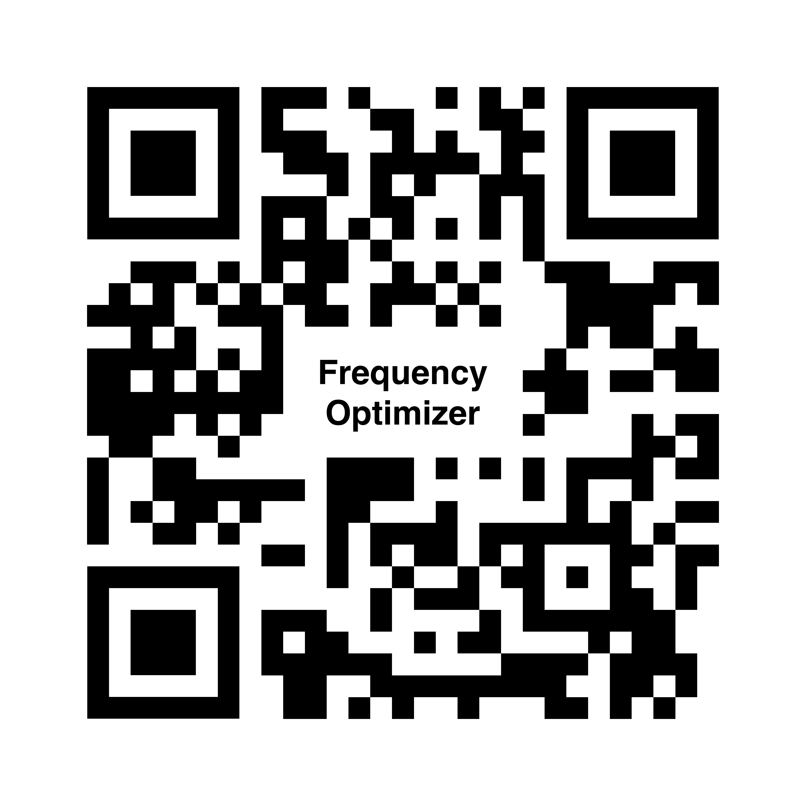
References
Bates, S. D., Lorimer, D. R., Rane, A., & Swiggum, J. 2014, Monthly Notices of the Royal Astronomical Society, 439, 2893, doi: 10.1093/mnras/stu157
Lam, M. T., McLaughlin, M. A., Cordes, J. M., Chatterjee, S., & Lazio, T. J. W. 2018, The Astrophysical Journal, 861, 12

Slide 15
Sensitivity of Pulsar Timing Array Over Time
Modified from Siemens et al. 2013
Notes:
Xavi’s Scaling laws paper
GW SNR vs time
Assuming certain GW amplitude
What happens as you switch non-detections to detections

Slide 16
Notes:
Recall that I said we can reduce the radiometer noise (and to a lesser degree the jitter noise) and improve the timing precision by
Increasing the sensitivity of the telescope and the integration time.

