Slide 1
Next Generation Very Large Array: Concept & Status
M. McKinnon, B. Butler, C. Carilli, S. Durand, W. Grammer, J. Jackson, C. McLaughlin, E. Murphy, R. Selina, S. Srikanth

Slide 2
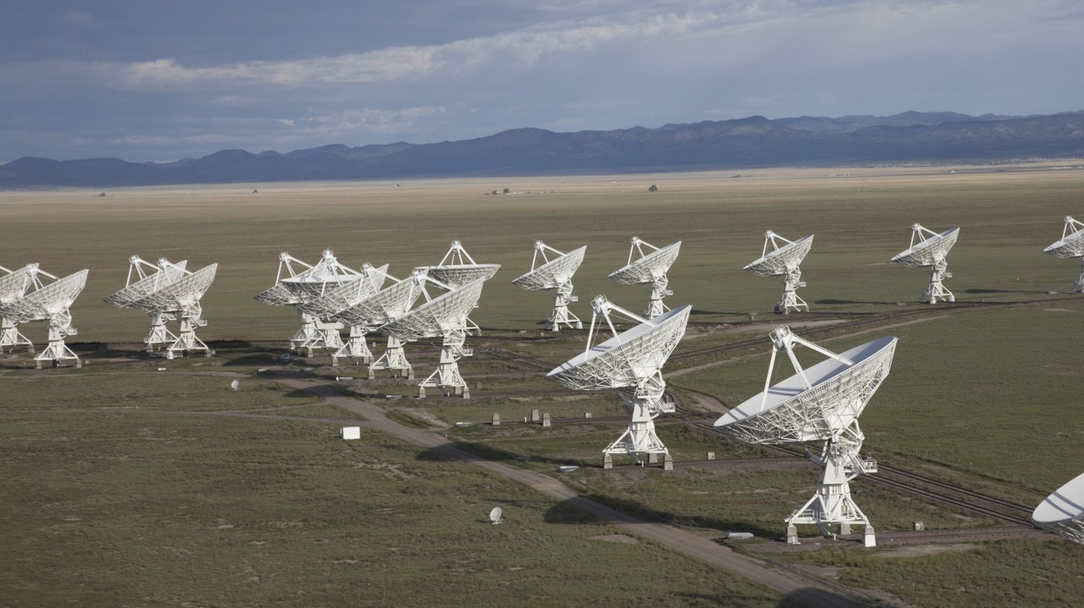
1972 – Approved by US Congress
1975 – First antenna in place
1980 – Full science operations
2001 – Complete electronics upgrade approved by NSF
2011 – Jansky VLA full science ops
The Jansky Very Large Array
~12,000 refereed papers with ~500,000 citations
~500 PhD theses
Among the most productive telescopes ever

Slide 3
A next generation VLA
Scientific Frontier: Thermal imaging at milli-arcsecond scale resolution
Goals: 10x effective collection area & resolution of JVLA at 30GHz - up to ~500km baselines
Frequency range: 1.2 –116GHz
Located in southwest US + MX, centered on present location of JVLA
Baseline design under development
Low technical risk (reasonable step beyond current state of the art)
https://science.nrao.edu/futures/ngvla

Slide 4
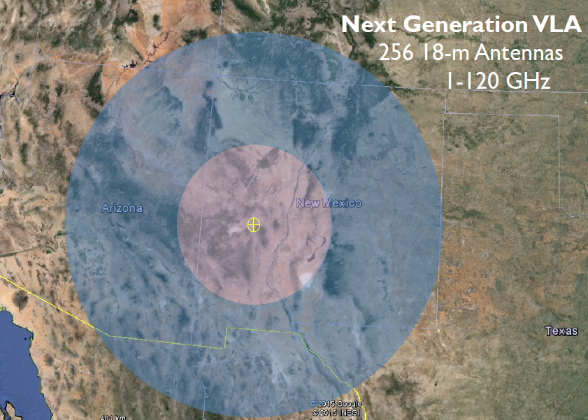
Located in US Southwest, MX
Potential Station Locations
JVLA: Good 3mm site, elev. ~ 2200m
40% in core: b < 1km ~ 1” at 30GHz
70% in mid: b < 30km ~ 0.1”
100% in long: b < 500km ~ 0.01”

Slide 5
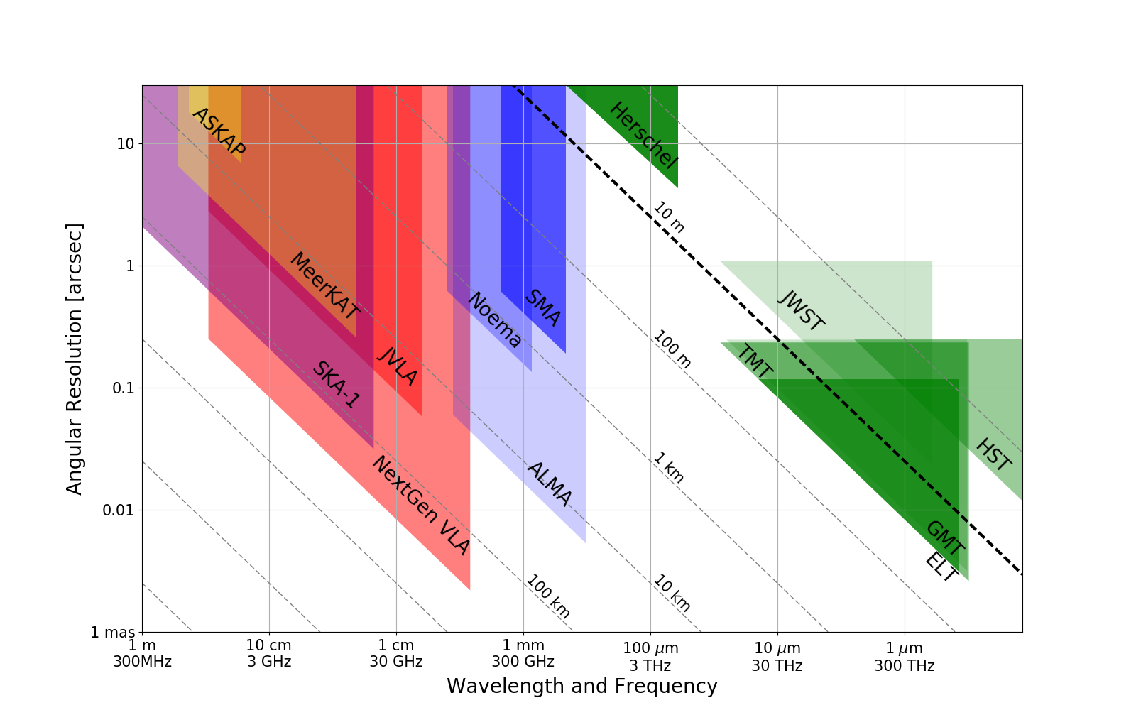
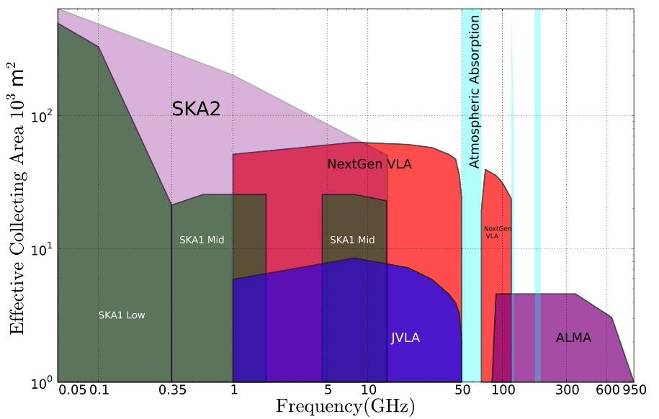
2030s: Bridging ALMA and SKA Scientifically
1AU @ 140pc
Terrestrial zone planet formation
SKA1&2 Baseline Design (2015)
Notes:
< 0.3cm: ALMA 2030 superb for chemistry, dust, fine structure lines
0.3 to 3cm: ngVLA superb for terrestrial planet formation, dense gas history, baryon cycling
> 3cm: SKA superb for pulsars, reionization, HI + continuum surveys
Synergy with ALMA submm, future ELTs
Complement to SKA low frequency capabilities

Slide 6
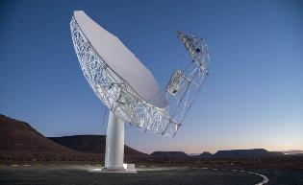
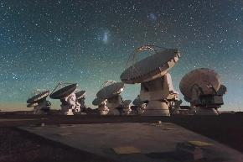
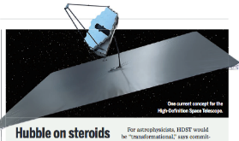
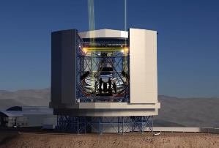
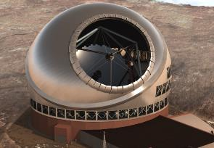
Highly Synergistic with Other Facilities on Similar Timescales
SKA
  Atomic/non-thermal
  Molecular/thermal
ALMA
  Warm/star-forming
  Cold/dense fuel for SF
LUVOIR/HabEx
  Image earth-like planets
  Image terrestrial-zone planets forming
OST (FIR surveyor)
  C/WNM & WIM
  Cold Molecular Medium
TMT/GMT
  Stellar Mass and Unobscured SF
  Dense Gas and Obscured SF
JWST
  Continuing its legacy in many areas of astrophysics

Slide 7
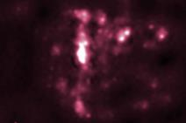
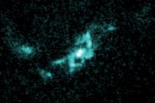
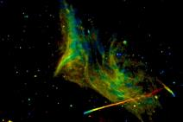
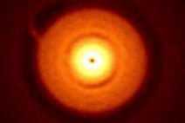
Developing the ngVLA Science Case
Community-Driven, Growing, and Evolving
Development by community-led Science Working Groups (SWGs) covering 4 broad topics. Building on an initial set of community-led white papers (http://library.nrao.edu/ngvla.shtml):
  Cradle of Life: CoL (Brenda Matthews): Terrestrial-zone planet formation, Massive Stars, etc.
  Galaxy Ecosystems: GEco (Danny Dale): wide field, high resolution/sensitive imaging
  Galaxy Formation: GFor (Dominik Riechers): Dense gas history of the Universe
  Time domain, Cosmology, and Physics: TdCP (Joseph Lazio): Plasma physics, Exo-space weather, Strong Lensing
Over 70 Community-Led Science Cases Submitted to SWG Chairs for Design Concept Consideration

Slide 8
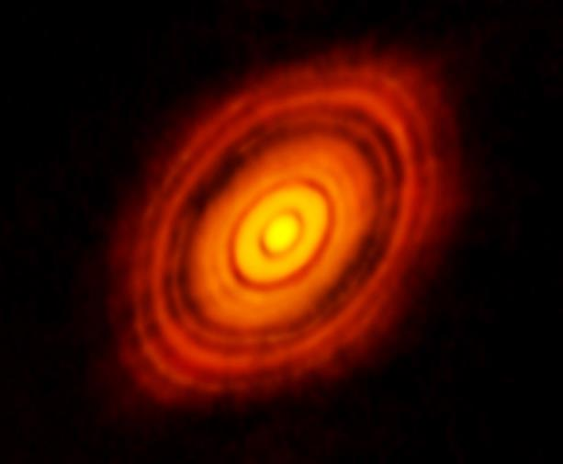
CoL: Terrestrial-Zone Planet Formation
Current State-of-Art in Planet Formation: ALMA Images of HL Tau
Rosetta-stone of planet formation around Solar-mass protostar
  Distance = 140pc
    1Myr old protostar ~ 1 M_{o} + 0.1 M_{o} dusty disk
    Inner few AU disk optically thick in mm/submm
Requirements definition
  Frequency: need low optical depth => 30GHz
  Resolution: need 1AU @ 130pc = distance to nearest star forming regions (e.g.. Taurus, Ophiucus) => 10mas
    Image gaps and annual motions to see accretion onto planets
  Sensitivity: need 1K @ full resolution => 10x VLA, ALMA
ALMA 250GHz Brogan ea.
100AU 0.7” at 140pc
Inner 10AU = ngVLA zone @ 10mas res

Slide 9
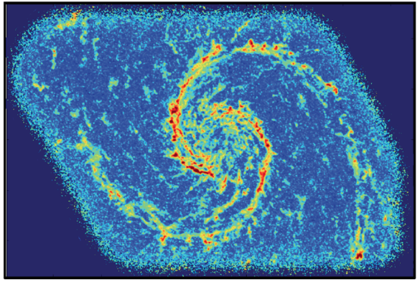
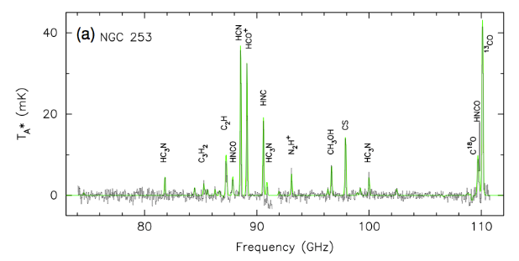
GEco: Spectral Line Mapping
Map cold ISM more than ~10x faster than ALMA
Rich frequency range: 1st order transitions of prime astrochemical + dense gas tracers
CO mapping: tens hours with ALMA
  Other lines are 10-100x fainter
  need ngVLA
Schinnerer+ 2013
CO1-0 Bure 200hr, 1”
Snell+ 2011
State of the Art: M51 in CO (J=1-0) at 1” and ~1 K per km s⁻¹ - Schinnerer et al. (2013) -- 200 hr with PdBI, ~15 hr w/ALMA, ~48 min with ngVLA!

Slide 10
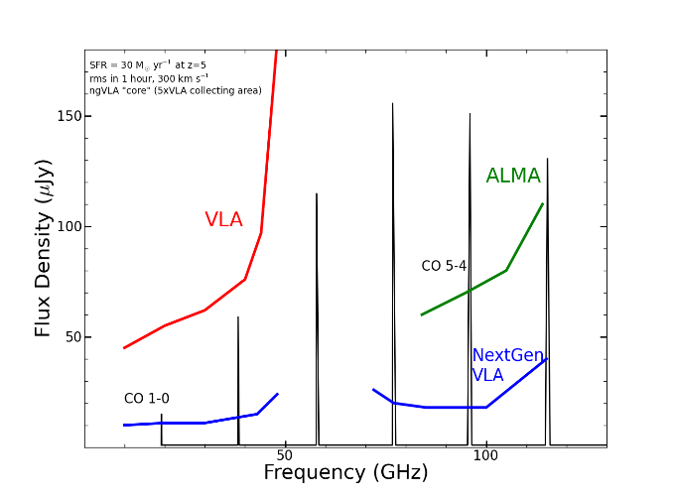
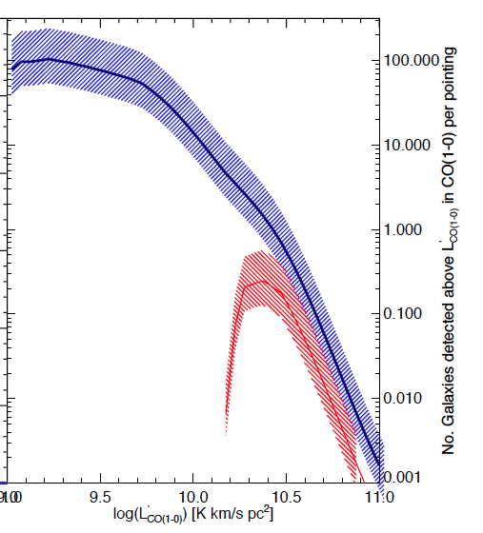
GFor: Revolutionize Molecular Deep Fields
CO emission from ‘main sequence’ galaxies
at high z in 1 hour
z=5, 30 M_{o}/yr,1 hr, 300 km/s
z>1.5 galaxies in CO
ngVLA
50 to 100-fold increase in number of CO galaxies/hr
  JVLA ~ 1, M_{gas} > 10¹⁰ M_{o}
  ngVLA ~ 100, M_{gas} > 2x10⁹ M_{o}
Galaxy counts in CO ~ deepest optical fields, with redshifts!
JVLA, ALMA
Casey et al.

Slide 11
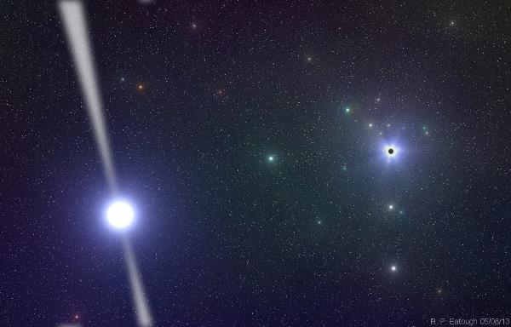

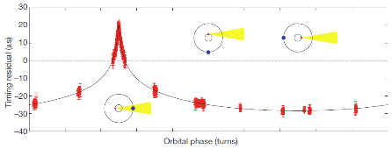
TdCP: Pulsar Science with ngVLA
New window on Galactic Center pulsar science
  ISM likely limits relatively high-precision timing to ν > 10GHz
    Problem: PSRs weak at high frequency
    Frequencies likely not covered by SKA1
  Need to find PSRs around SgrA*
  Strong field tests of GR
Pulsar timing
  Phase most or all of the array
  Science is PTAs (e.g. NANOGrav), NS masses, GR tests, etc.

Slide 12
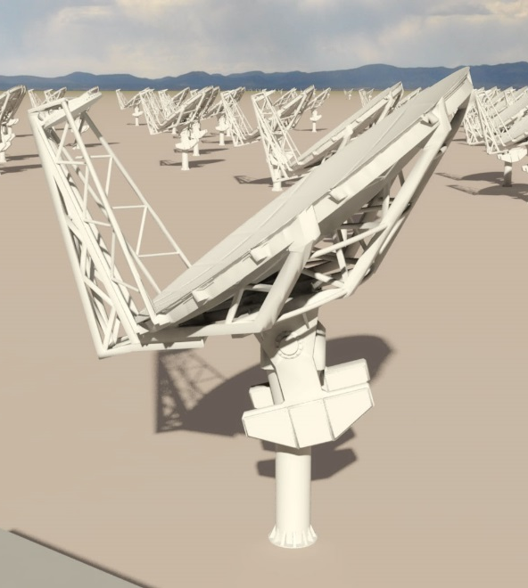
Antenna Concept
18m Aperture: Based on cost and performance modeling.
Offset Gregorian: Off-axis geometry minimizes scattering, spillover, and sidelobe pickup
Feed Low: Performance and maintenance requirements favor a receiver feed arm on the low side of the reflector
Mount concept: TBD.
  Evaluating pedestal mount vs wheel and track.
  Pointing specification is a design driver.
Currently initiating an antenna reference design
Notes:
One key feature is the feed subtended half angle. Concept has wide illumination angle of 55-deg.

Slide 13
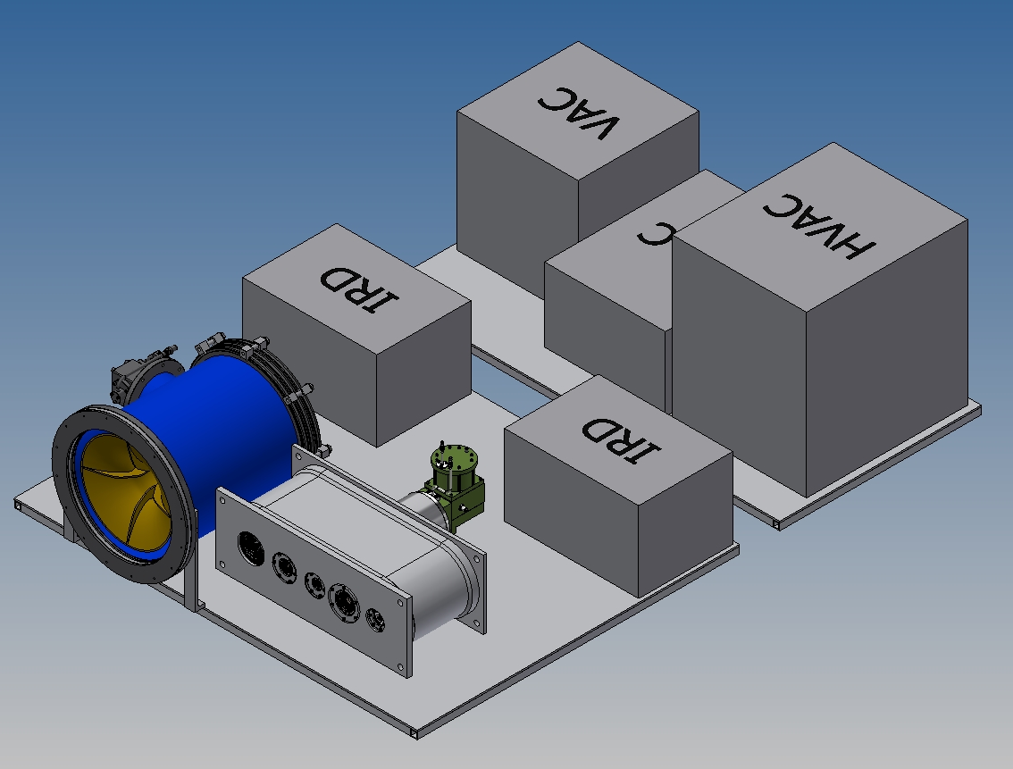
Front-End Configuration Concept
6 Bands in 2 cryogenic dewars
1.2-3.9 GHz and 3.9-12.6 GHz quad-ridge horns, 3.25:1 bandwidth, coaxial LNAs.
12.6-50.5 GHz using three 1.67:1 BW corrugated horns and waveguide LNAs.
70-116 GHz 1.67:1 BW corrugated horn and waveguide LNAs with block down conversion.
Single stage down-conversion to baseband for 5 bands.
Band # | Dewar | f_{L} GHz | f_{M} GHz | f_{H} GHz | f_{H}: f_{L} | BW GHz
1 | A | 1.2 | 2.55 | 3.9 | 3.25 | 2.7
2 | B | 3.9 | 8.25 | 12.6 | 3.23 | 8.7
3 | B | 12.6 | 16.8 | 21.0 | 1.67 | 8.4
4 | B | 21.0 | 28.0 | 35.0 | 1.67 | 14.0
5 | B | 30.5 | 40.5 | 50.5 | 1.66 | 20.0
6 | B | 70.0 | 93.0 | 116 | 1.66 | 46.0
Notes:
Serial data stream off the receiver enclosure at the secondary focus going to a formatter and DTS located at the base of the antenna mount.

Slide 14
Computing Considerations
For most use cases, analysis shows that storing raw visibilities will be tractable when ngVLA becomes operational.
  High time resolution science may not be able to save all visibilities.
  Depends upon continuation of the historic trend in cost of storage.
Computing problem is tractable for most cases, but not simple.
  Computing size requirements are set by lowest frequency band
  Low-frequency, full-beam, will require substantial computing resources – currently omitted from baseline design in order to constrain the cost/complexity of the system.
Current paradigm of reduction at home institution is not supportable
  Data volumes prohibit multiple copies, moving data frequently.
  Resources required for most projects are greater than a single workstation/small cluster.
NRAO’s Science Ready Data Products (SRDP) project on ALMA/VLA is a pathfinder for the techniques and technology needed to support the ngVLA as an SRDP facility.

Slide 15
Recent Highlights
ngVLA Project Office established (Sep 2016)
Formation of Science (Sep 2016) & Technical Advisory Councils (Feb 2017)
Launched ngVLA Community Studies Program (Nov 2016)
  Provides community an opportunity to make contributions to the ngVLA design
ngVLA sessions at AAS and URSI meetings (Jan 2017)
ngVLA Science Case Capture (Dec 2016 – Jun 2017)
Workshop on Developing the ngVLA Science Program, Socorro (Jun 2017)
NSF approved reprofiling of $11M in NRAO development funds for ngVLA development (Sep 2017)
AAS special session: “The VLA Today and Tomorrow: First Molecules to Life on Exoplanets” (Jan 2018)
Notes:
TAC membership was selected to cover a broad range of expertise in relevant technical areas including:
Antennas, low-noise receiver systems, cryogenics, data transmission, correlators, and data processing

Slide 16
Astrophysical Frontiers in the Next Decade:
Planets, Galaxies, Black Holes, & the Transient Universe
Workshop Portland, OR USA June 26-29, 2018
Pre-Registration open: http://go.nrao.edu/ngVLA18
New research facilities and the scientific vision outlined by New Worlds, New Horizons have motivated the exploration of vast new discovery space, and astrophysics has seen extraordinary progress in the past decade, opening new frontiers across many fields. Sponsored by the National Radio Astronomy Observatory, this conference will bring together a substantial cross-section of the astronomical community to discuss how to effectively address the highest priority astrophysical questions of our time. Plenary sessions will feature invited speakers, and three parallel sessions of contributed presentations will address (1) Exoplanet and Protoplanetary Disk Origins, (2) Galaxy Evolution Mechanisms, and (3) Black Holes & Transient Phenomena. Each session will canvas recent observational and theoretical progress, address key unanswered questions, and motivate future research directions in the context of next-generation facilities that would span the electromagnetic spectrum, including a Next Generation Very Large Array, the Large Synoptic Survey Telescope, 30m-class optical-infrared telescopes, the Advanced Laser Interferometer Gravitational-Wave Observatory, and the Square Kilometre Array.
SOC co-Chairs
Brenda Matthews (NRC – Cradle of Life)
Caitlin Casey (UT – Galaxy Evolution)
Laura Chomiuk (MSU – BHs and Transients)
ngVLA
The Next Generation Very Large Array
Notes:
Not an radio-only meeting
really want to have a broad representation of the astronomy community
speaking to interesting science that is achievable with the next generation of facilities
spanning the electromagnetic spectrum
from LIGO/GW to SKA, ngVLA, LSST and the 30m class OIR telescopes.

Slide 17
National, International & Industrial Partnerships
Possible US multi-agency interest
  ICRF – DOD (Navy, Air Force)
  Spacecraft tracking/imaging, `burst-telemetry’ (mission-critical events) – NASA, DOD
  Space situational awareness – DOD
Current international involvement in SAC/TAC/Community Studies:
  Canada, Mexico, Japan, Germany, Netherlands, Taiwan
Current industry involvement through Community Studies:
  REhnu Inc., Minex Engineering Corp, LaserLaB, Quantum Design

Slide 18
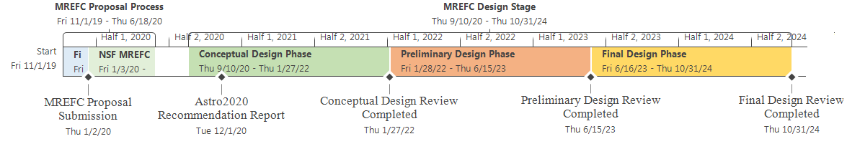
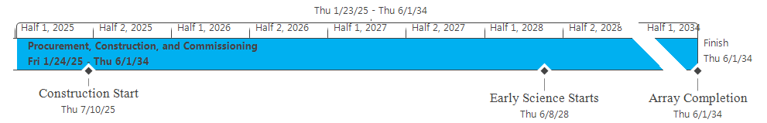
The Road to Astro 2020
Goal: NRAO CoDR-level ‘proposal’ to 2020 Decade Survey
Compelling science program & defensibly costed design of all major elements
2017
Today
2018
2019
Start
Wed 9/14/16
Nov '16
Jan '17
Mar '17
May '17
Jul '17
Sep '17
Nov '17
Jan '18
Mar '18
May '18
Jul '18
Sep '18
Nov '18
Jan '19
Mar '19
May '19
Finish
Mon 7/1/19
Sci Case Capture
Mon 10/31/16 - Wed 5/30/17
Sci Book First Draft
Thu 6/1/17 - Fri 12/1/17
Sci Book Second Draft
Mon 12/4/17 - Fri 6/15/18
Sci Book Final Draft
Mon 6/18/18 - Fri 12/14/18
ngVLA Astro2020 Proposal
Sat 12/15/18 - Mon 7/1/19
Ref. Design First Draft
Mon 10/31/16 - Fri 4/28/17
Rev 1 Design Docs Published (TRL1)
Fri 5/12/17
Ref. Design 1.5 Draft
Mon 5/15/17 - Fri 11/24/17
Reference Design Second Draft
Mon 11/27/17 - Tue 7/31/18
Final Draft
Tue 10/23/18
Community Study Development
Mon 10/31/16 - Tue 8/15/17
Rev 1.5 Design Docs Published (TRL1)
Release 2nd Draft of Sci Book
Fri 6/15/18
Publish Final Draft of Sci Book
Fri 12/14/18
Submit RFIR1
Mon 4/1/19
2020
2023
Design Docs Rev2 Released for Review (TRL2)
Tue 7/31/18
Submit RFIR2
Mon 7/1/19
Release 1st Draft of Sci Book
Fri 12/1/17
Submit NOI
Fri 1/11/19
Final Design Docs Published
Tue 10/23/18
Submit SWPs
Fri 2/15/19
Pre-Proposal Review #1 Complete
US Radio Futures Conference #3
Community Study Final Reports Due
Tue 8/15/17
Pre-Proposal Review #2 Complete
Fri 9/28/18
2025
2034

Slide 19
Summary
ngVLA is being designed to tap into the astronomy community’s intellectual curiosity and to enable a broad range of scientific discovery
Based on community input to date, ngVLA is the next step to build on the VLA’s legacy
Major Challenges: No major technological risks identified, but continually looking to take advantage of major engineering advancements seeking optimization in performance and operations.
Next Steps: Continue to better define the ngVLA science mission and instrument specifications/performance though detailed science book and reference design study.

Slide 20


Slide 21
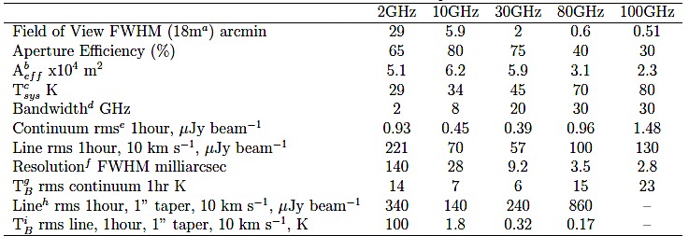
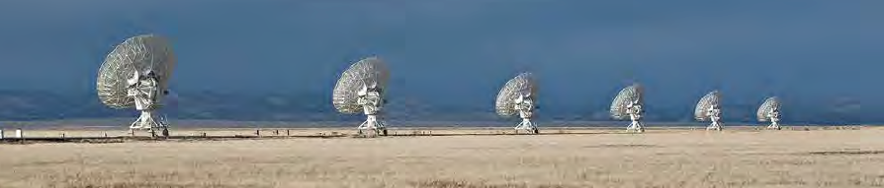
Draft Performance Specifications
Carilli et al. 2015, ngVLA memo #5
Improvements over JVLA
~10x Sensitivity at 30 GHz
~10x Resolution at all bands
1.2 – 116GHz (vs. 1 – 50GHz)

Slide 22
FRB Localization
VLA makes first localization of fast radio burst (FRB 121102)
  VLA appears on cover of Nature for first time
Increasing interest in time domain astronomy
  e.g. FRBs, EM counterparts to ALIGO events

Slide 23
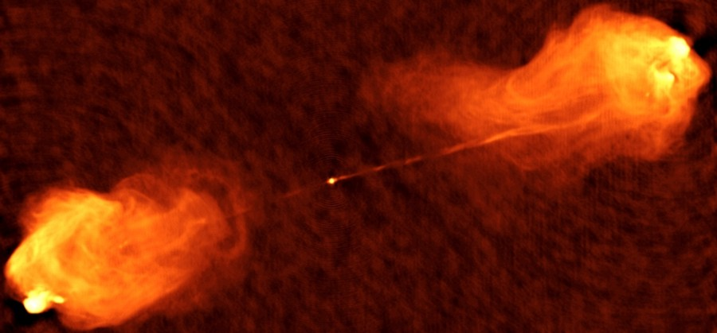
Transient in Cygnus A
Radio transient in Cygnus A
  Object did not appear in observations in 1980s &1996
  Appears with post-EVLA observation in 2015
Possibilities:
  Foreground/background object:
    Probability too low
  Supernova
    Too bright for too long
  Second SMBH in the galaxy
    Caused by rapid increase in accretion rate on an AGN
VLA: 8.5 GHz
Perley, D. A. et al. (2017)
Notes:
Appears at same location at multiple frequencies
VLA & VLBA observations
A-2 also detected with Keck (NIRC2) in May 2002 (Canalizo et al. 2003)
SED is non-thermal over all bands observed
A-2 is clearly separate from the nucleus that powers Cyg-A jets
Could be an AGN TDE, but TDE rate per galaxy is very low and probability to catch by chance is low.

Slide 24
Radio Counterpart to GW17017
IR, Gemini-S
6 GHz, VLA

