Slide 1
Complex Organic Molecules Observed Toward Prestellar Cores
Yancy Shirley
University of Arizona
Taurus Molecular Cloud 460 ly
Credit: John Davis

Slide 2
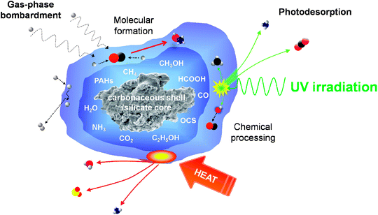
Origin of Complex Organics in ISM
Gas Phase formation: CH₃OH₂⁺ + e⁻ → CH₃OH + H only 3% yield … too SLOW
(Geppert et al. 2006)
~ 1 H
atom/day
i.e. Garrod & Herbst 2006

Slide 3
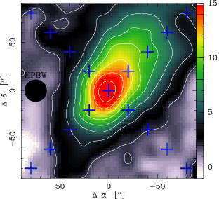
Complex Organic Molecules in Prestellar Cores !
L1544 - a very evolved prestellar core
VLA NH₃ measure ~ 6 K at center (Crapsi+ 2007)
1.2 mm
Methyl Formate
Dimethyl Ether
Methoxy
Methyl Isocyanide
Propynal
Cyclopropenone
Ethynl isocyanide
Vinyl cyanide
Acetaldehyde
Jiminez-Serra et al. 2016

Slide 4
L1521E – A “Young” Prestellar Core
Almost no(?) CO depletion
No indication in kinematics of collapse
“Early-time” molecules (CCS, etc.) peak on core
“Late-time” molecules (NH₃, N₂H⁺) very weak
Weak deuteration (chemically young)
500 μm
500 μm
← CO Depletion
Tafalla et al. 2004, Shirley et al. 2005, Makiwa et al. 2016

Slide 5
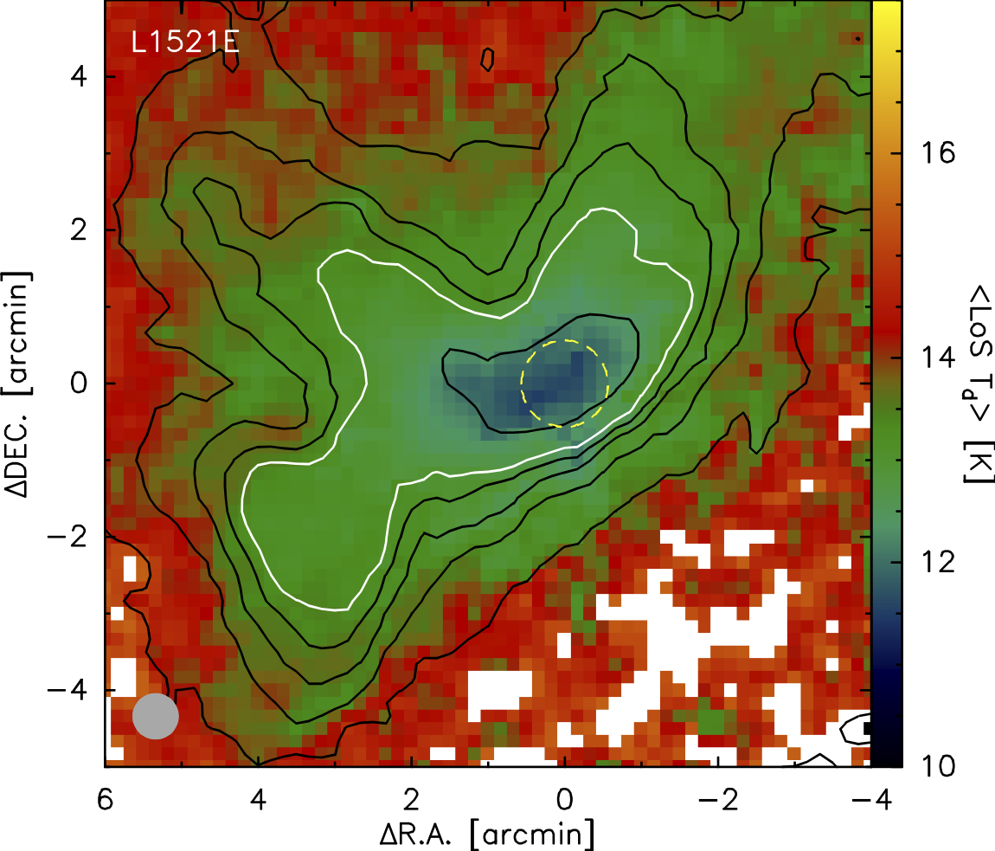
L1521E Physical Structure
A_{V} = 20
Line of sight Dust Temperature (K)
A_{V} = 10
Shirley et al. in prep.

Slide 6
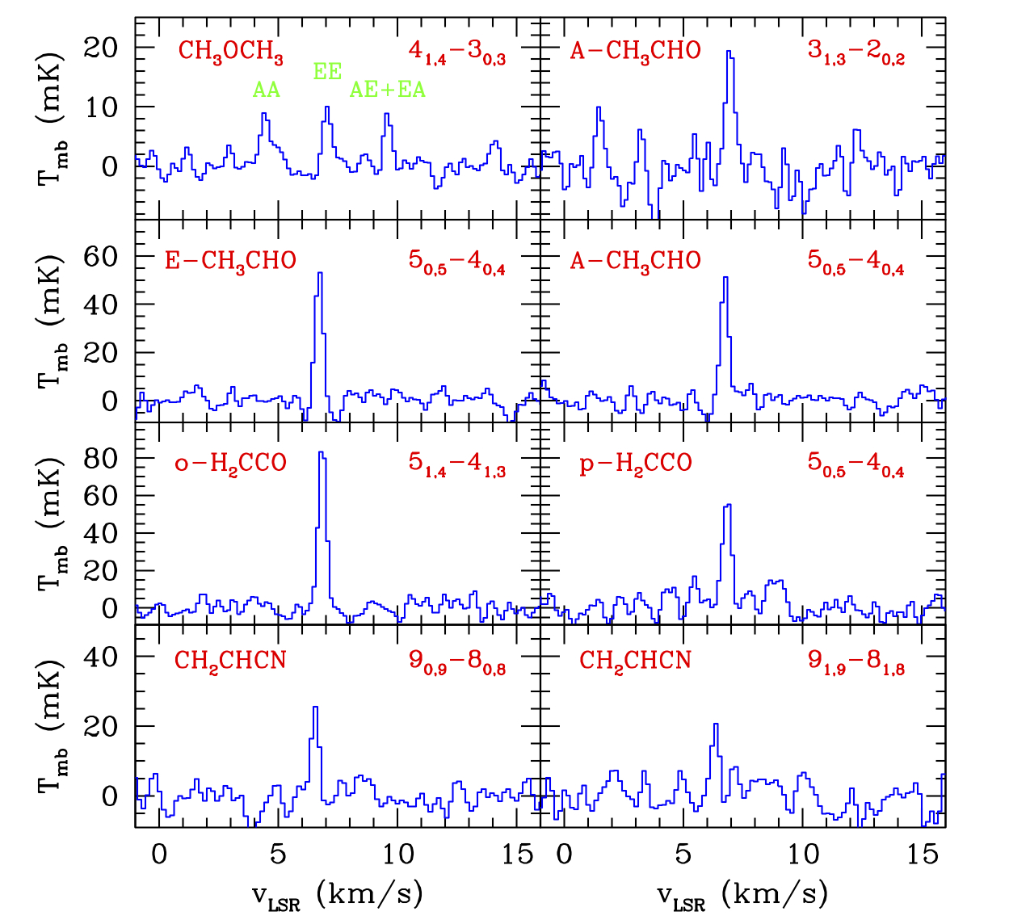
Complex Organics Detected
Shirley et al. in prep.

Slide 7
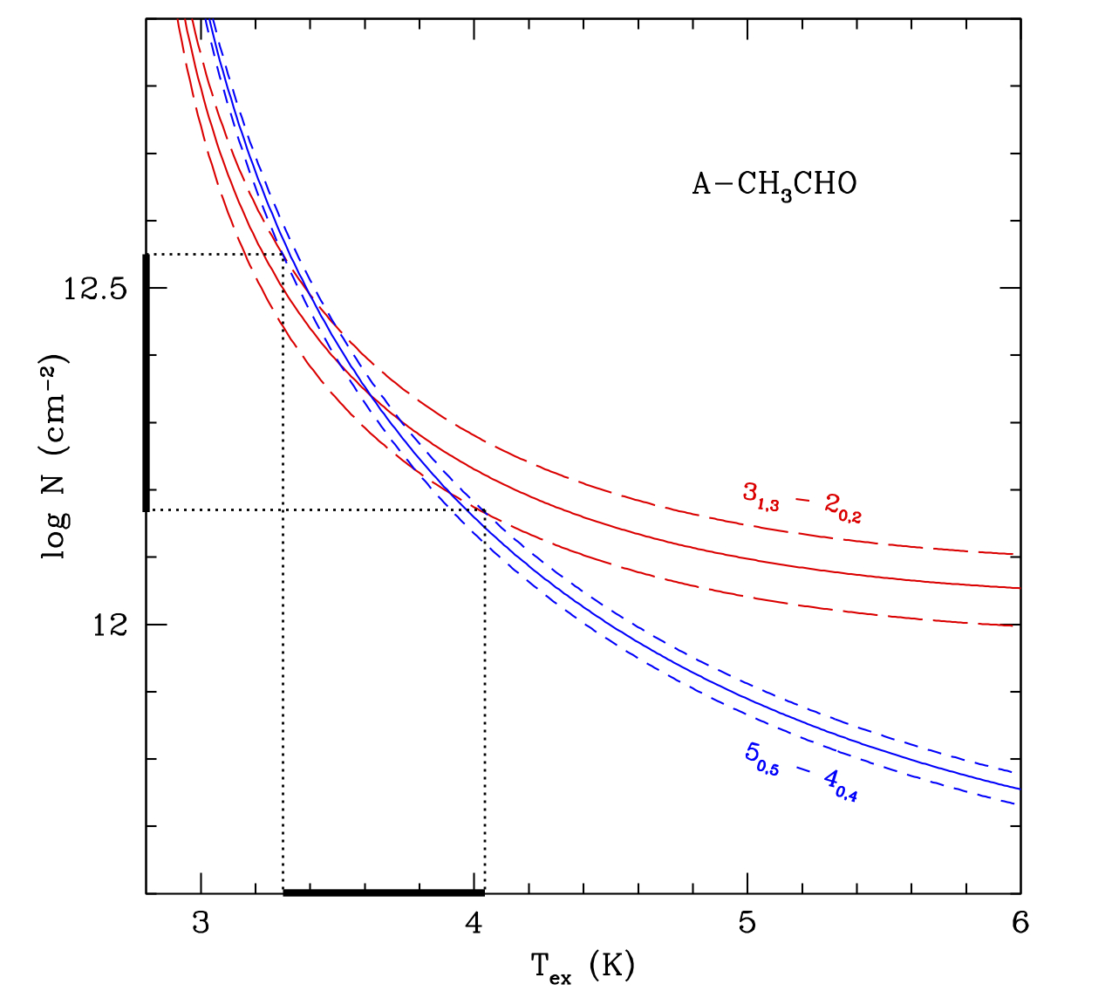
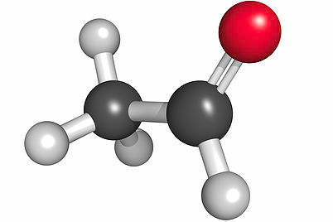
Acetaldehyde
Log Column Density (cm⁻²)
Excitation Temperature (K)

Slide 8
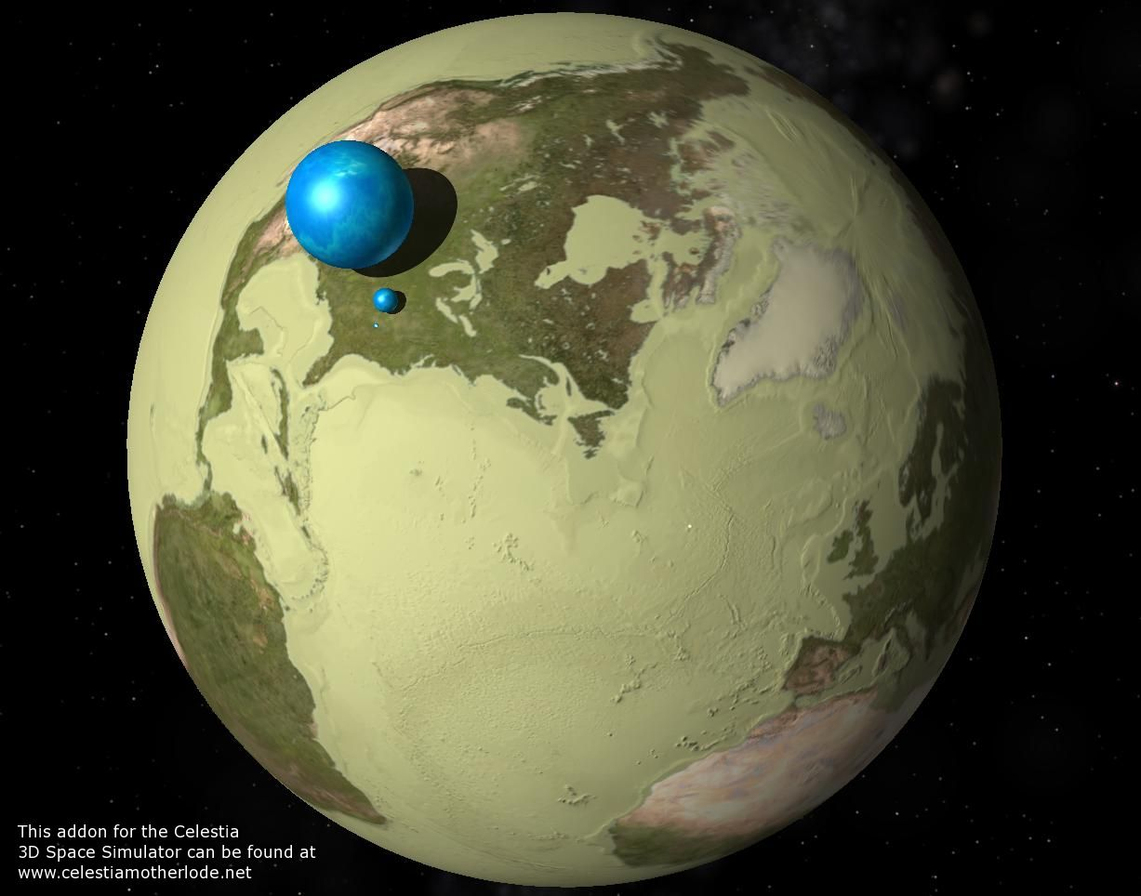
How Much Acetaldehyde?

Slide 9
Comparing L1521E and L1544
Despite being up to 10⁶ yrs younger, comparable COM column densities to L1544 but density is similar to where COM peak in L1544
L1521E
Lifetime (yrs)
L1544
Models have likely underestimated gas phase formation aided by chemical (“reactive”) desorption of precursor molecules from ice
Lifetimes from
Andre et al. 2014 PPVI
Density (cm⁻³)

Slide 10
Reactive Desorption of Radicals
Solid: CO + H → HCO + H → H₂CO + H → CH₃O + H → CH₃OH
Chemical Desorption
~ 1 H
atom/day
Easier to desorb from CO monolayer than H₂O
Minissale et al. 2016 a,b,c

Slide 11
Reactive Desorption Models of L1544
Abundance
Acetaldehyde
Dimethyl Ether
Time (yr)
Vasyunin et al. 2017

Slide 12
Conclusions
Complex organic molecules may form in < 10⁵ yrs at n > 10⁵ cm⁻³ in cold (T < 10 K) prestellar cores
Possible theoretical explanation is that radicals formed in ice are “reactively” desorbed and then gas phase reactions produce COMs (i.e. Vasyunin et al. 2017).
Can test this theory by searching for radicals in gas phase such as HCO, CH₃O, CH₂OH, etc.
New challenge for Astrochemical Models

Slide 13
Reactive Desorption Models of L1544
COM Abundance
- DME - Acetaldehyde
CO
Surface Ice
Radius (pc)
Abundance
Abundance
Time (yr)
CO
Bulk Ice
COM Abundance
Radius (pc)
Vasyunin et al. 2017
Radius (pc)

Slide 14
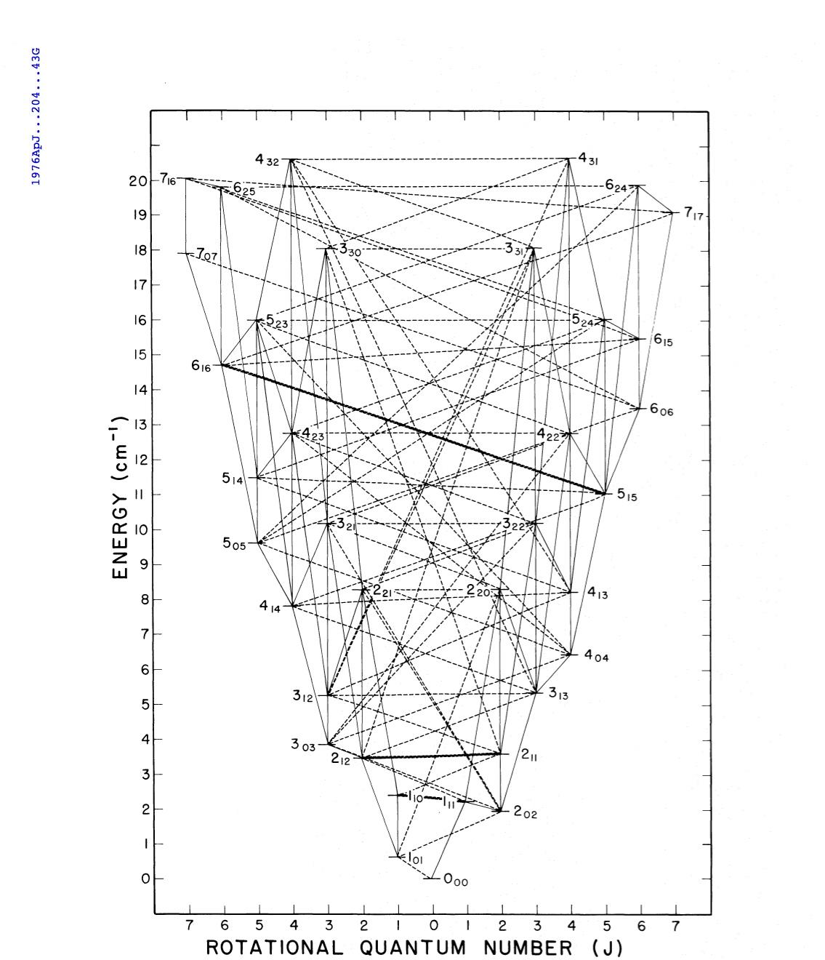
30 K
20 K
10 K
0 K
Gilmore et al. 1976

