Slide 1
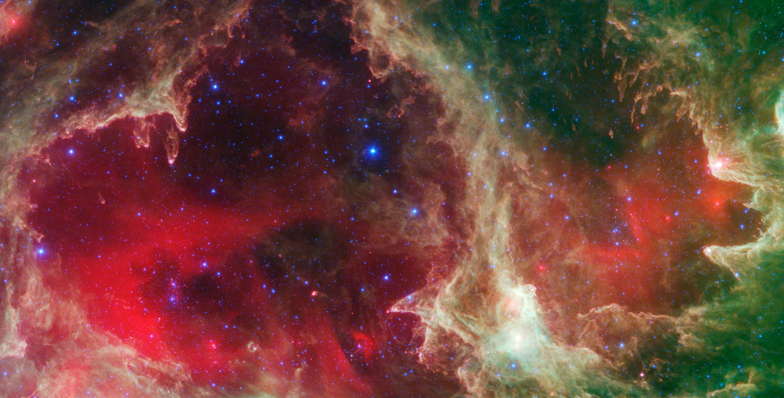


Physical Properties of Free-Floating Evaporating Gas Globules (FrEGGs) in the W5 Star-Forming Region
Samantha Scibelli^{1,2}
Raghvendra Sahai², Mark Morris³, Mark Claussen⁴
¹Steward Observatory, University of Arizona
²Jet Propulsion Laboratory, Caltech
³University of California Los Angeles, UCLA
⁴National Radio Astronomy Observatory, NRAO

Slide 2
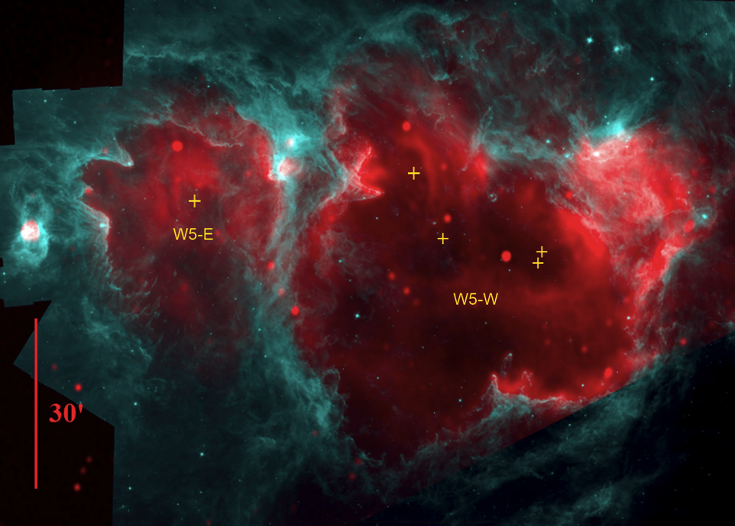
Massive Star-Forming Regions (MSFRs)
Presence of massive stars significantly effects subsequent star formation in HII regions
Within HII bubbles compact objects are formed due to the ionizing radiation
Previous work has discussed two types:
1) Proplyds (Orion, O'Dell,
Wen, and Hu 1993; Ricci, Robberto, and Soderblom 2008)
2) EGGs (M16, Hester et al. 1996)
Radio-continuum emission of the ionized gas at 1.42 GHz
Spitzer-IRAC 8.0micron PAH emission
Exciting Stars
Image: Deharveng et al. 2012
How do the evolutionary details of the star formation process depend on the local environment?
Notes:
The ionizing radiation from bright OB stars can produce photo-evaporating protoplanetary disks or proplyds, the most famous of which lie in the Orion Nebula, imaged with HST and well-studied and modelled.
Additionally, the radiation can progressively ionize dense blobs of nearby molecular material, forming evaporating gaseous globules, or EGGs first reported in M16 by Hester et al. (1996).
- Understanding the impact of external photoevaporation on disks within massive clusters is key to assessing their chances for survival and their planet formation capactiy

Slide 3
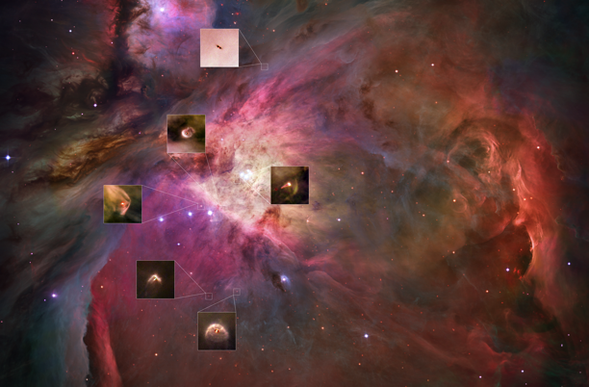
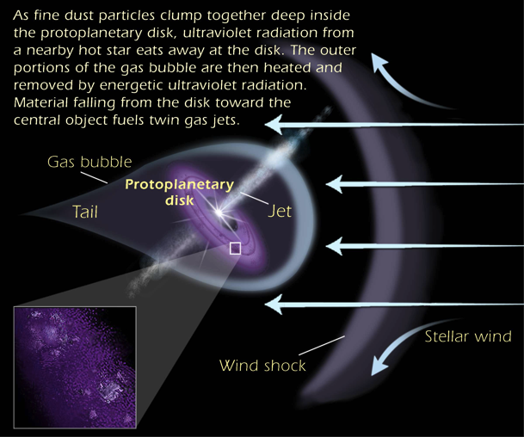
Proplyds vs. EGGs
Proplyds, the most famous cases of which reside in the Orion star- forming region, are homes to evolving protostars
Formed by ionization/ evaporation of gas in circumstellar disks around young, low-mass stars
HST optical images of proplyds (first found in Orion, e.g., O'Dell+1993)
Far-UV (> 912 A) heats the protostellar disk and drives a neutral (atomic) outflow
Extreme-UV (< 912 A) ionizes this flow at a radius several times the disk radius
i.e., at 50-500 AU, 0.1 to 1" at 430 pc)
http://www.spacetelescope.org/static/archives/images/original/opo0113i.jpg
NOTE: Molecular Gas is only expected
to be present in YSO Disk
Size ~ 40-350 AU
Mass ~ (0.7-1.5) 10⁻³ M
Notes:
Proplyds are young stars with disks that are exposed
UV radiation photoevaporates molecular material from the disk
It is important to note that the sizes of these objects are only 40-350 AU in size and around a thousandth of a solar mass
Here is graphical representation of what these protoplanetary disks look like – and how much of an impact UV radiation has on the gas bubble and the environment around the forming protostar
The complexities encountered in studies of the generally crowded and highly structured MSFRs have made it rather difficult to fully understand and characterize the particular influence of radiation and winds on the stellar mass function and star formation efficiency ….

Slide 4
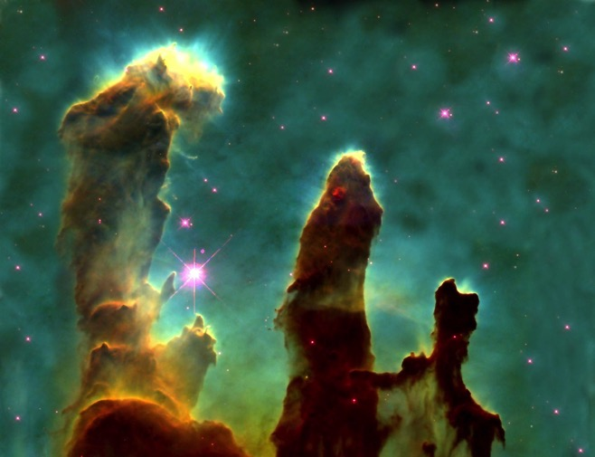
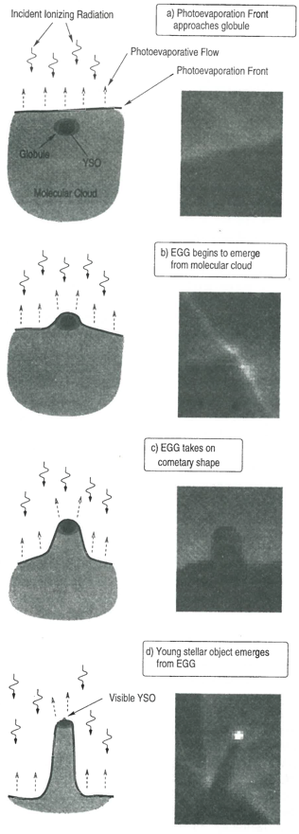
Proplyds vs. EGGs
Evaporating Gaseous Globules (EGGs)
- photoevaporated more slowly than lower density surroundings
- found at the peripheries of the pillars or elephant trunks
"Pillars of Creation", HST optical image of M16, Eagle Nebula
panel is 135" x 174" (134,470 AU x 34,870 AU)
Sizes: 300-2000 AU
EGG Evolutionary Sequence ➔ (Hester+1996)
Notes:
(a) dense globule (may have a YSO) embedded in a GMC (b) dense globule survives against photoevaporation longer than its surroundings (c) this, combined with shadowing by globule, leads to formation of cometary structure, (d) if YSO embedded in globule, it will be firt seen at head of cometary structure

Slide 5
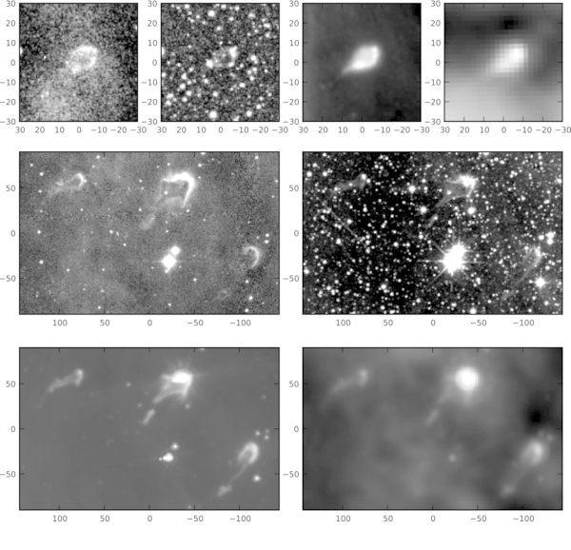
Photoevaporating Proplyd-like Objects in Cygnus
A case of mistaken identity!
Wright et al. 2012: tabulated 10 cometary-shaped clouds in the Cygnus MSFR
High fraction (70%) of these objects appear to have stars, compared to low fraction for EGGs (15%)
concluded that these objects are more proplyd-like, not EGGs
Unlike proplyds, however, in these objects protostellar accretion is still active
Object Sizes:
(top) #1: 24000 x 16000 AU
(middle) #2: 63000 x 22000 AU
(bottom) #3: 113000 x 60000 AU
Notes:
- Objects believed to be proplyds were found in the Cygnus star forming region but there sizes were way to large.
- Makes us ask the question: how many previously classified proplyds are really frEGGS???
-BIG DIFFERENCE: frEGGs are much larger and molecular in composition
- NOW Why does it matter if we’ve found objects that are neither proplyds or EGGs? Which we call frEGGs (the name in the title of this talk)?? These objects

Slide 6
New Objects: FrEGGs
Ongoing study of a class of objects, first identified in the Cygnus MSFR, we’ve named “free-floating EGGS” (frEGGs) (Sahai, Morris, Claussen: Astrophysical Journal, 751, 69 2012)
  Exciting new “clean-cut” probe of the effect of massive stars on subsequent star formation
  Likely progenitors of the pre-solar dense core
  Proplyds may be the end products of frEGGs, in a much later stage of star formation
Carina-frEGG1: one of 12 “proplyd” candidates in Carina MSFR (Sahai et al. 2012)
(a) Spitzer 8 μm (b) HST/ACS F658N (Hα+[NII]) (c) VLT Ks (AO) (panel size 14.6” x 24.4”)
Notes:
Better understand star formation and evolution, specifically in environments of massive star formation
FrEGGs are especially interesting because they are ideal laboratories to study star formation (they are well isolated with well defined boundary conditions), specifically they may be the progenitors of the pre-solar dense core

Slide 7
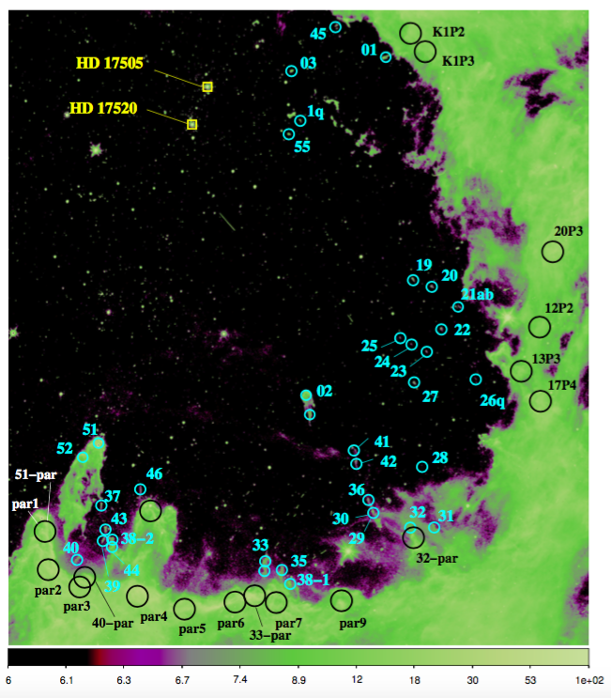
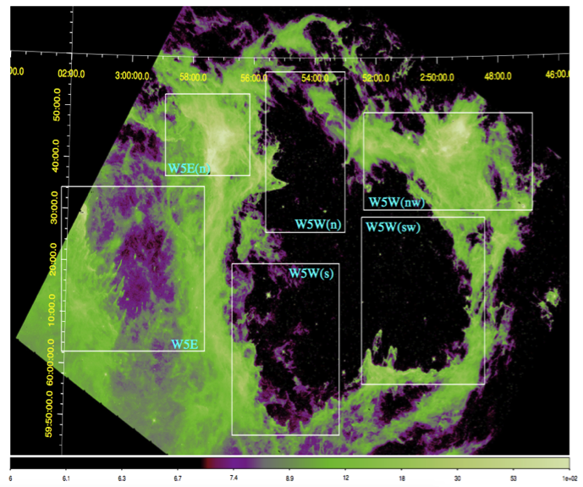
Target Identification: 8 micron Spitzer/IRAC Images
FrEGGs were identified using Spitzer/IRAC channel-4 (8μm) infrared images of the W5 HII star-forming region
W5 is located in the Perseus arm, at a distance of ~2kpc
Notes:
Because of its proximity to the Sun, w5 can teach us about the consequences that feedback from massive stars has on the surrounding material in the context of ongoing star formation
Visual inspection of the archival Spitzer images allowed us to isolated tadpole shaped objects as fregg candidates

Slide 8
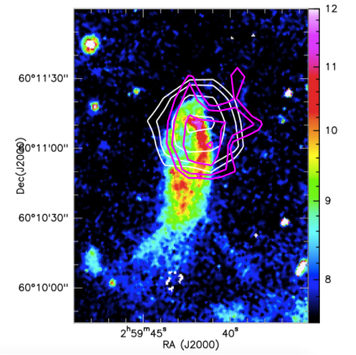
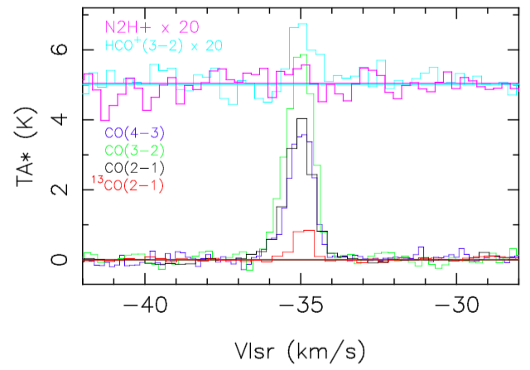
Molecular-Line Observations
Arizona Radio Observatory SMT 10-m ground telescope
¹²CO and ¹³CO J=2-1 molecular maps
On source APS observations of ¹²CO and ¹³CO (additional lines such as N2H+ and HCO+ J=3-2 were observed in some cases)
^{FrEGG W5ETAD1}
¹²CO J=2-1 Map White Contours
¹³CO J=2-1 Map Pink Contours
Notes:
- Additional HCO+ and N2H+ J=3-2 measurements were done for some of the frEGGs, as the better tracers of the measure of high density (∼10⁵-10⁶ cm⁻³) gas.
- The lower resolution of the SMT 10-m telescope meant that molecular line emissions from the frEGGs could be overshadowed by nearby extended clouds. Additionally, frEGG 12 CO emissions may have been too low to detect in the OTF map due to the smaller integration time per pixel for OTF maps compared to APS spectra scans.

Slide 9
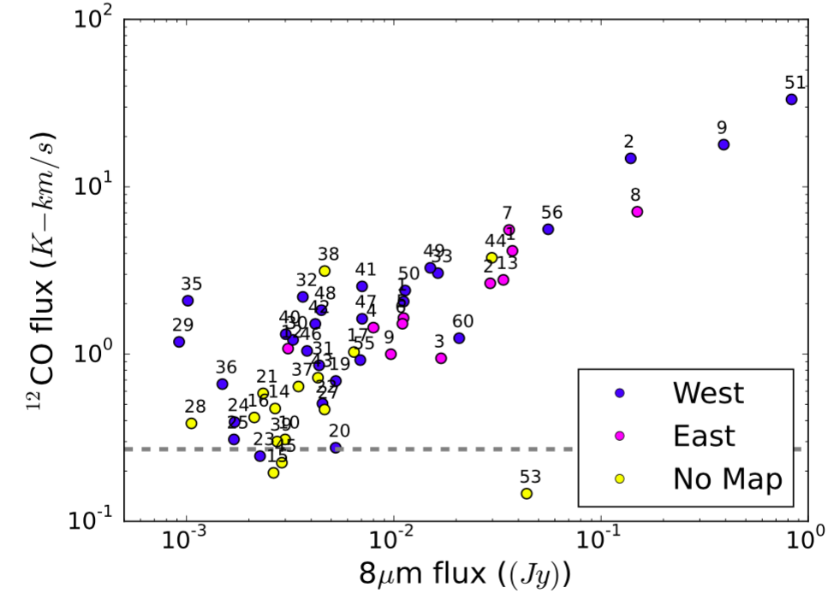
12 CO vs. 8μm: Flux Comparison
57 frEGGs of various quality (Q=0,1,2,3,4) with Q=0 being the best
General trend that the ¹²CO J = 2-1 flux increases as the 8μm flux increases, with scatter towards lower fluxes
  Averaged rms flux values for Q=4 frEGGs
Notes:
Flip back to previous slide and show what you mean by fluxes
- - - Thermalization Assumptions

Slide 10
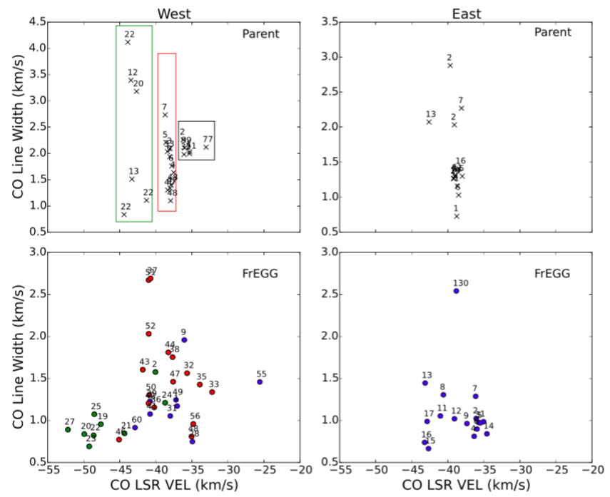
FreGG vs. Parent Cloud Velocities
W5W is more dispersed, i.e. two parent cloud components
W5E only has one parent cloud component and less frEGG scatter
  Black square box: may be frEGGS projected on the parent cloud
The line-of-sight velocities for a sample of parent cloud measurements (top row) and frEGGs (bottom row).
Evidence frEGGs could be dynamically ejected!
Notes:
W5W is more dispersed, i.e. two parent cloud components
Black square box denotes parent cloud meas. believed to actually be frEGGs, due to spatial location
W5E only has one parent cloud component and less frEGG scatter
W5W(sw) South region and all of the W5W(s) region the parent cloud measurements scatter at velocities less than ∼-41 km s−1 (Red box and circled freggs)

Slide 11
FreGG vs. Parent Cloud Velocities
W5W is more dispersed, i.e. two parent cloud components
W5E only has one parent cloud component and less frEGG scatter
  Black square box: may be frEGGS projected on the parent cloud
Red box: southern W5W(sw) region and all of the W5W(s) frEGGs scatter between ~6 km/s of the parent cloud
The line-of-sight velocities for a sample of parent cloud measurements (top row) and frEGGs (bottom row).
Evidence frEGGs could be dynamically ejected!
Notes:
W5W is more dispersed, i.e. two parent cloud components
Black square box denotes parent cloud meas. believed to actually be frEGGs, due to spatial location
W5E only has one parent cloud component and less frEGG scatter
W5W(sw) South region and all of the W5W(s) region the parent cloud measurements scatter at velocities less than ∼-41 km s−1 (Red box and circled freggs)

Slide 12
FreGG vs. Parent Cloud Velocities
W5W is more dispersed, i.e. two parent cloud components
W5E only has one parent cloud component and less frEGG scatter
  Black square box: may be frEGGS projected on the parent cloud
Green box: western W5W(sw) region frEGGs scatter between ~5 km/s of the parent cloud
The line-of-sight velocities for a sample of parent cloud measurements (top row) and frEGGs (bottom row).
Evidence frEGGs could be dynamically ejected!
Notes:
W5W is more dispersed, i.e. two parent cloud components
Black square box denotes parent cloud meas. believed to actually be frEGGs, due to spatial location
W5E only has one parent cloud component and less frEGG scatter

Slide 13
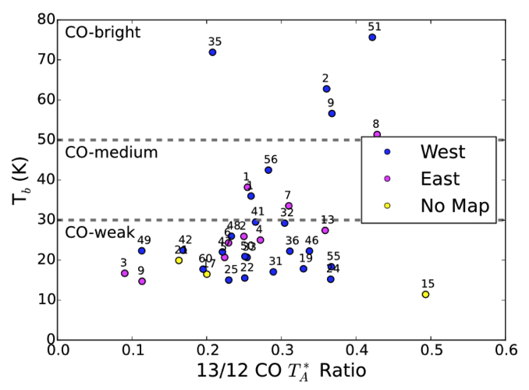
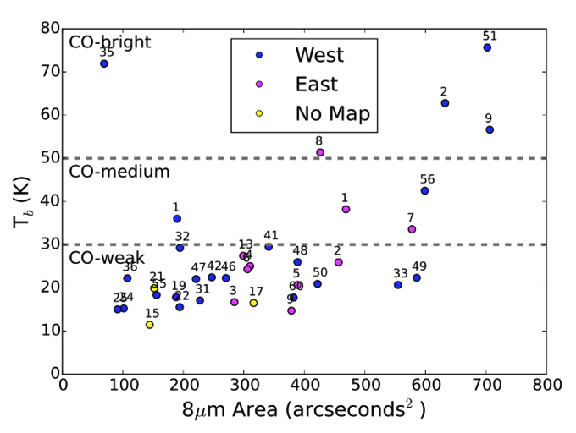
Physical Properties
¹³CO/¹²CO temperature ratios larger than the abundance ratio (~0.02), therefore we can assume the optical depth is thick τ₁₂ >> 1
For given column density and H₂ volume density found the `CO-bright’ frEGGs had brightness temperatures close to their kinetic temperature, whereas `CO-weak’ did NOT, regardless of size (RADEX modeling)
  perhaps frEGGs with low T_{b} values are sub thermally excited in the CO J=2-1 line
Beam-dilution corrected brightness temperatures, ¹³CO flux and 8μm area measurements were used to derive masses and densities
Notes:
36 freggs that have Q=0, 1, or 2 and have 13 CO flux measurements
Note that a line is considered thermalized if its excitation temperatures is equal to its kinetic temperature
Temperatures scaled up by a beam dilution correction factor, since the frEGGs are small compared to the beam diameter
the denser the frEGG the more massive and hotter it is, yet its size cannot be assumed.

Slide 14
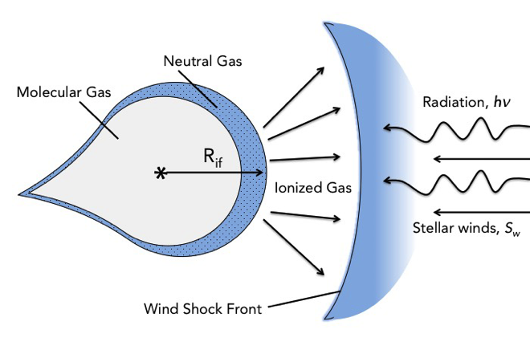
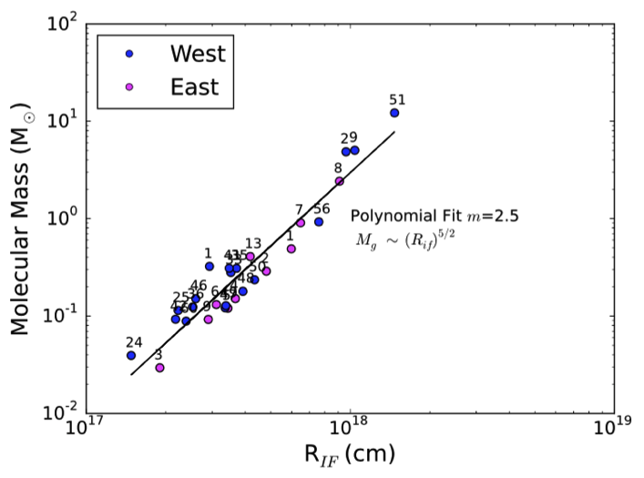
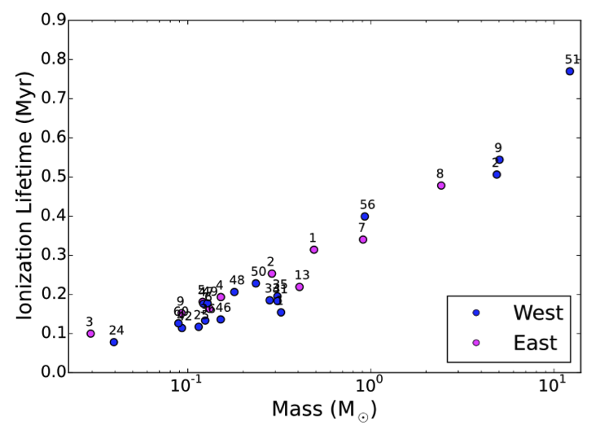
Molecular Mass and Lifetimes
Lifetime found by integrating equation for mass loss due to evaporation (Berne et al. 2010)
Lifetimes between 0.08-0.8 Myrs
Notes:
Only Q=0 freggs so down to 26 freggs
In calculating these number we take into account the ionization stars….
Understanding the impact of external photo evaporation on disks within massive clusters is key to assessing their chances for survival and their planet formation capacity
Higher mass, longer it lives
β_{B} H recombination coefficient (case-B)
C_{II} sound speed ionized gas
N* incident flux of ionizing photons
m_{H} mass of Hydrogen

Slide 15
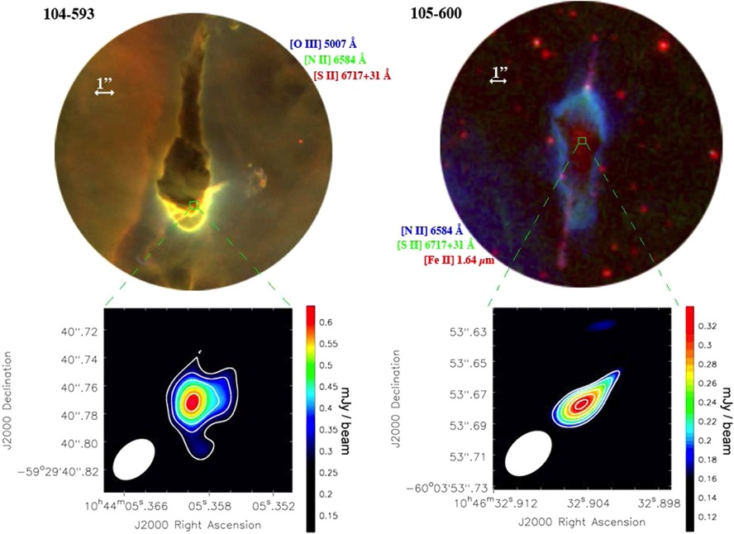
FrEGGs = Early Stage Star Formation?
ALMA images of discs actually forming: shows how frEGGS could be protecting these star-forming disks and allowing for planet formation to occur
Is the formation of stars triggered by the external energetic environment (UV, winds, high-pressure of HII region), or were such stars already in the process of formation in the dense cloud cores?
Figure 2. From Mesa-Delgado et al. 2016, they find the first direct imaging of protoplanetary disks in the star-forming region of Carina, the most distant massive cluster in which disks have been imaged.
Could our lifetimes be long enough to protect the disks forming inside the frEGGs? Will they become proplyds?
Notes:
Our calculation from Berne et al. (2010) predicts larger mass-loss rates and shorter timescales compared to the disk formula used by Mesa-Delgado et al. (2016). In the latter case they only utilze the disk radius, whereas the for- mula for a globule uses the disk mass.
In ground-based narrow-band optical imaging, these objects were seen as dark silhouettes (some with bright rims) against a bright nebular background and were classified as proplyd candidates (Smith, Bally & Morse 2003) (as in the case of the Orion proplyds)
Do proplyds represent the evolutionary endpoint of frEGGs?
Is the formation of stars that may form in frEGGs induced by the surrounding H II regions compression or were such stars already in the process of formation in the relatively dense cloud cores that are susceptible to becoming frEGGs?

Slide 16
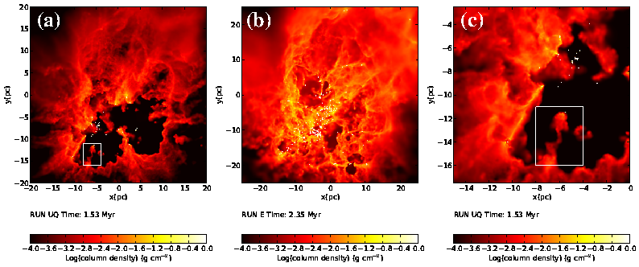
FrEGGs as Probes of Evolutionary Models of MSFRs
Unbound
Bound
Unbound (zoom)
Numerical simulations of turbulent clouds (Dale+2012,2013):
(a) Unbound E_{kin}/E_{grav}=2.3, (c) Zoom-in, showing frEGG like dense compact cloud
(b) Bound E_{kin}/E_{grav}=0.7
Unbound clouds make large bubbles & frEGG-like structures more efficiently
Notes:
Numerical simulations of turbulent clouds with different masses and initial virial ratios. HII bubbles formed in most of the unbound clouds. In these simulations, the HII regions break out of the dense gas where the O-stars form along low-density channels, and surviving dense material is eroded and accelerated by photoevaporation flows. In low-escape-velocity and unbound clouds, this generates large bubbles and frEGG-like objects
16

Slide 17
Summary
Large isolated tadpole-shaped structures are not proplyds, but (free-floating) Evaporating Gas Globules (frEGGs)
Whether other objects are EGGs, FrEGGs, or proplyds has major implications for the star formation rate and the IMF in MSFRs where they are found
Deriving the physical properties of FrEGGs provides precise quantitative constraints for sophisticated studies of irradiated star-forming clouds using hydrodynamical simulations (e.g. Heyer et al. 2006, Henney et al. 2009, Mackey & Lim 2012)
 | EGGs | FrEGGs | Proplyds
Sizes (AU) | 300-2000 | 13000-94000 | 40-350
Masses (M) | -- | 0.03-12 | 0.0007-0.00015
Notes:
- More analysis to be done and a lot of future science on individual objects

Slide 18
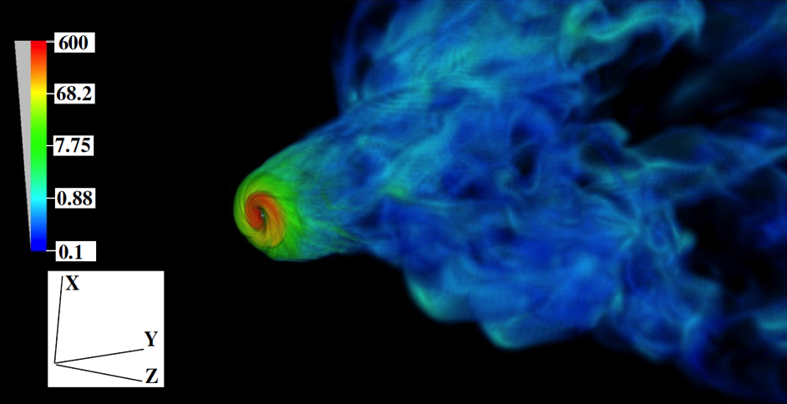
Triggering Star Formation in FrEGGs
Simulation: protostellar disk formed by triggering at 0.6 Myr (colorscale shows density; from Li+2014).
(initial marginally-stable Bonnor-Ebert sphere, M=1 Msun, R=0.058 pc, Temp=10K, with rotation, subjected to compression by external wind)
initial average cloud density = 100
Such simulations provide useful "control" for more realistic frEGG structures from large-scale simulations of GMCs
Large number of studies with models of interaction of magnetised clouds with winds and radiation (McCourt+2015, Arthur+2011, Henney+2009)
Aim to carry out simulations to compare evolution of realistic frEGG-like cloud cores (a) with, and without the pressure of the external HII region, and stellar winds, and (b) compression due to "rocket-effect"
Notes:
initial average cloud density is 100 on this scale
18

