Slide 1
Searching for Neutral Hydrogen in the Early Universe and Progress with Low Frequency Radio Instruments
Nithyanandan Thyagarajan
(NRAO, ASU)
HERA+, MWA+

Slide 2
HERA Collaboration

Slide 3
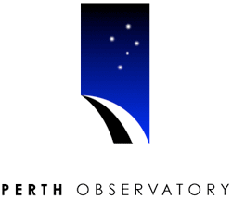
MWA Collaboration

Slide 4
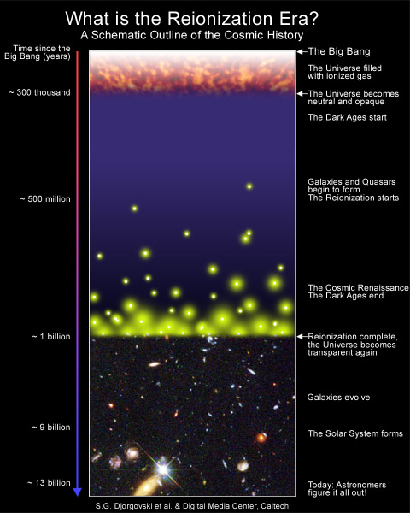
Why study Hydrogen in the Early Universe?
Formation of large scale structures and evolution of astrophysical objects need to be probed
Neutral Hydrogen is a direct probe of the Reionization epoch
Current instruments have enough sensitivity for statistical detection of HI from the EoR (~100-200 MHz)

Slide 5
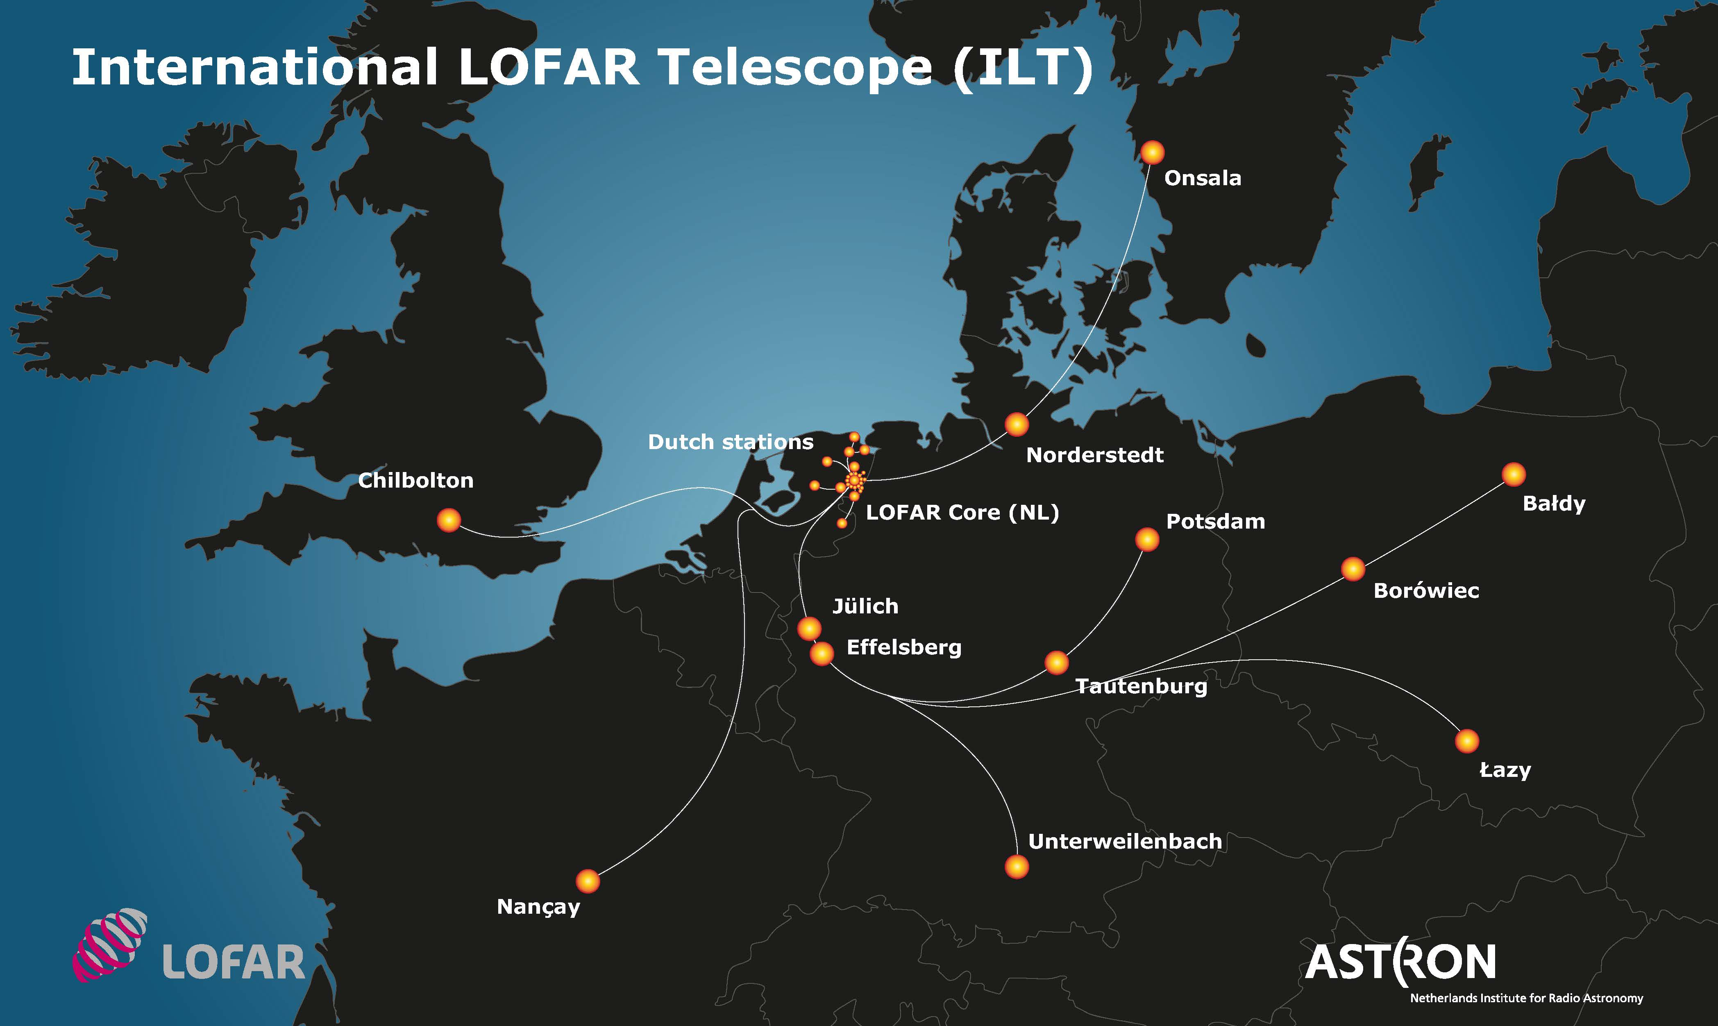
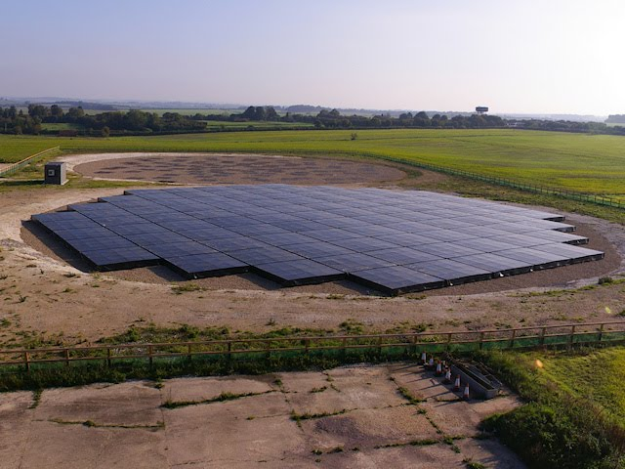
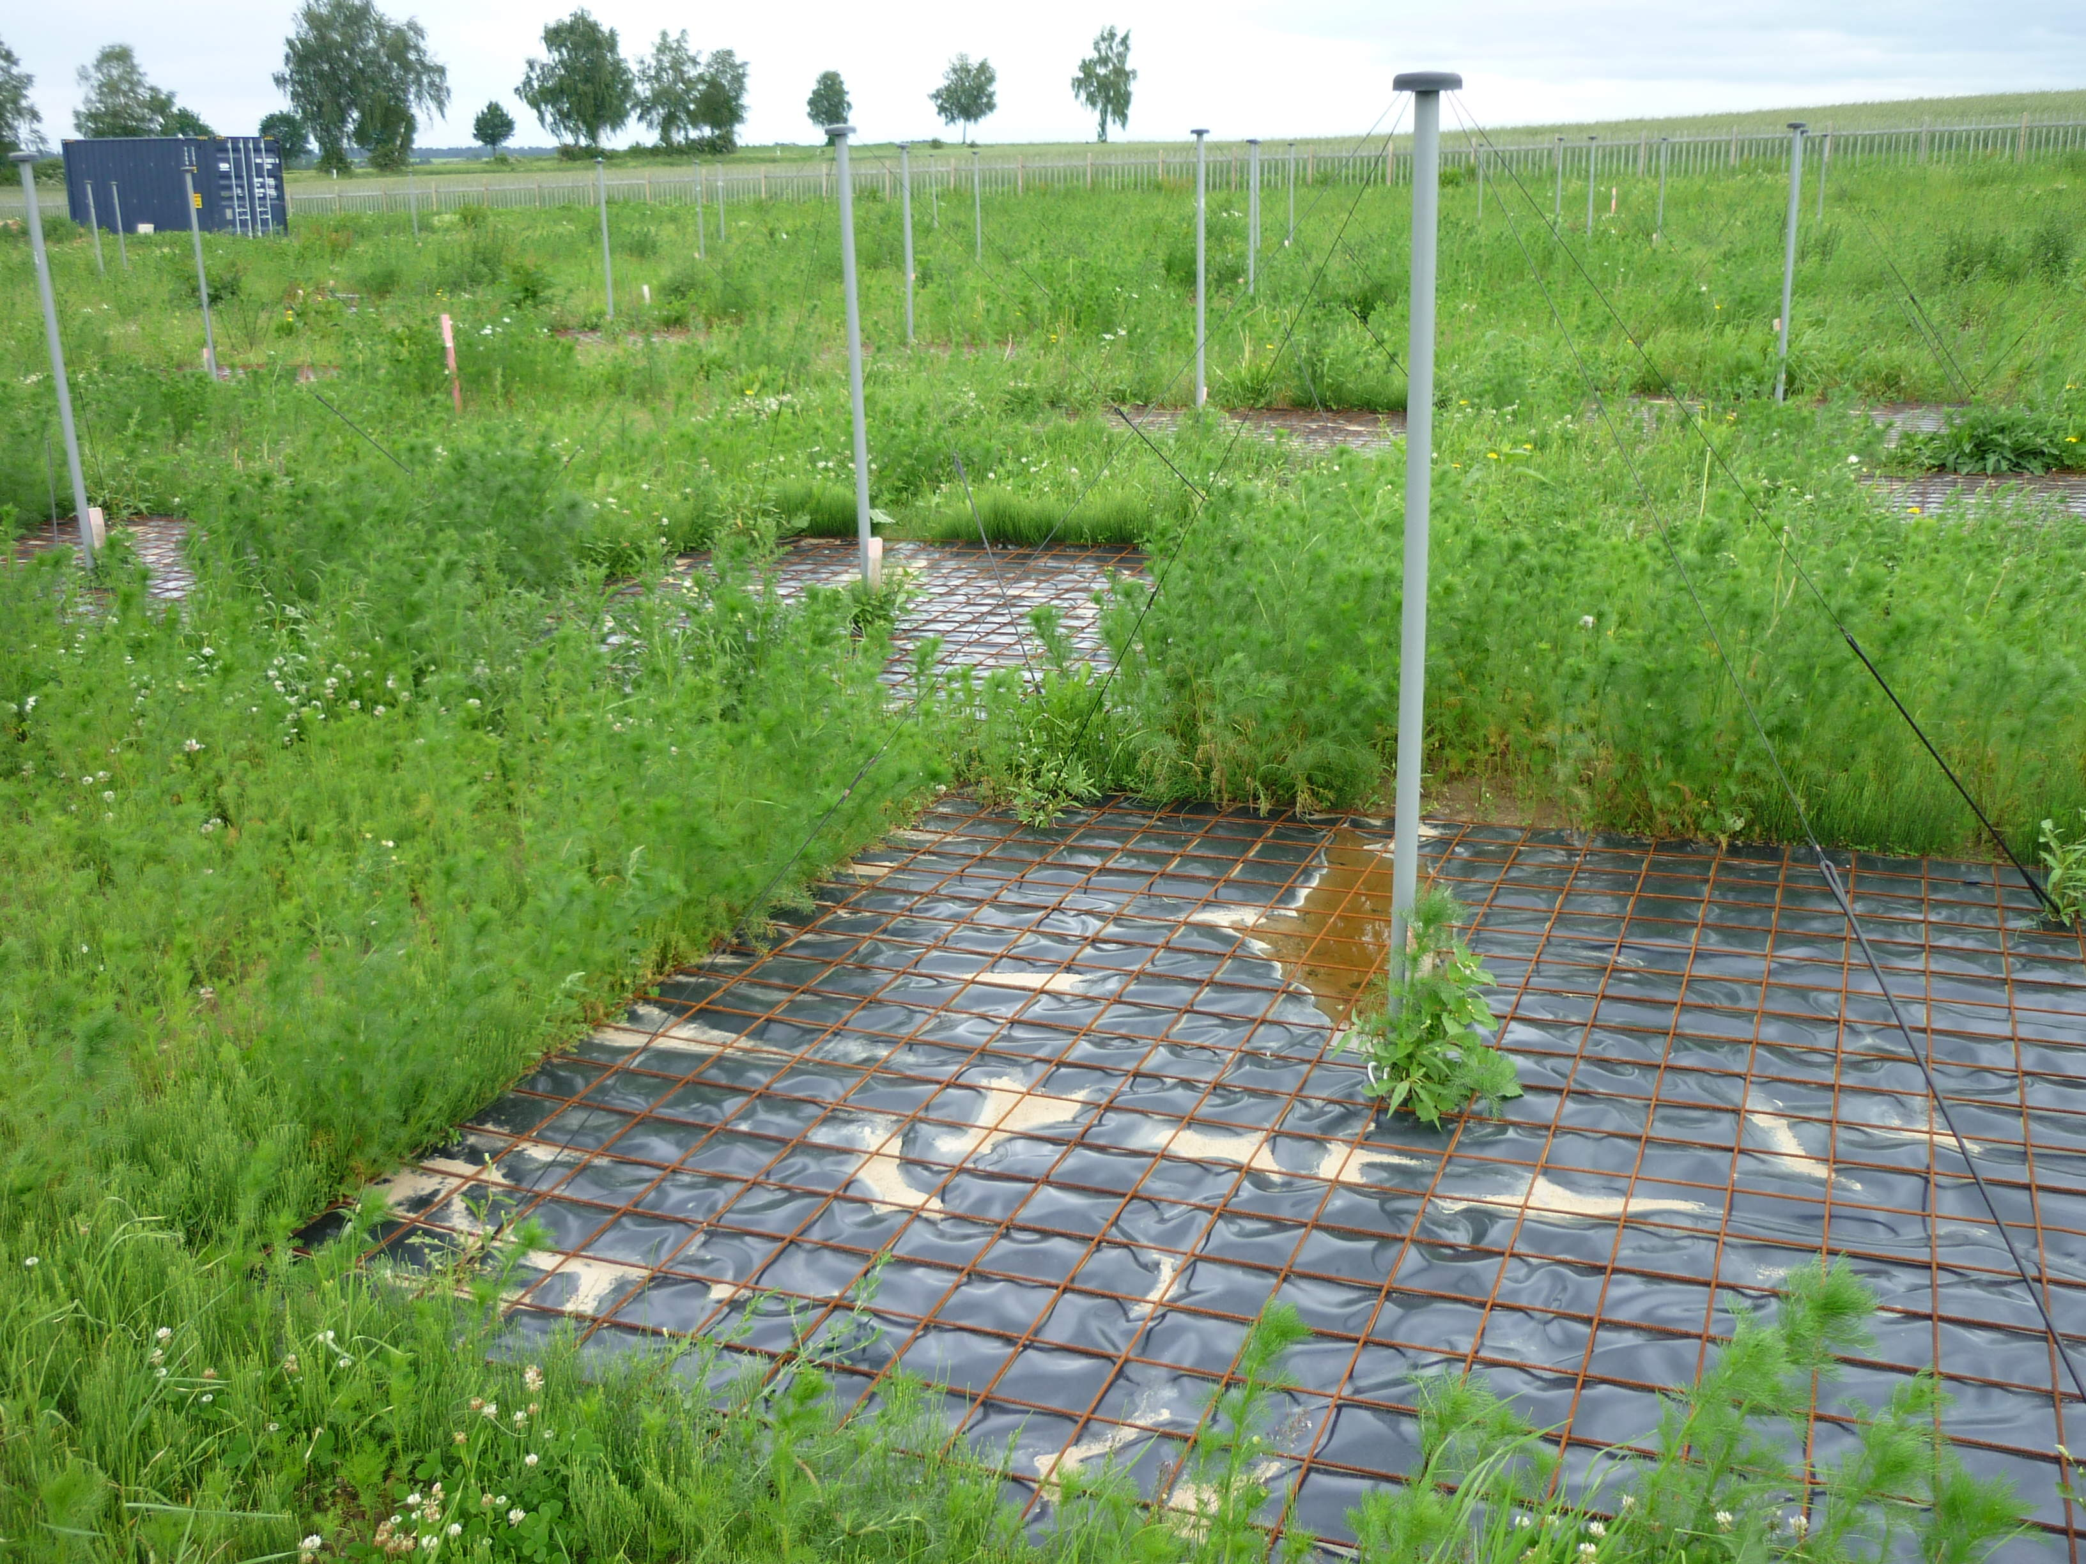
Low Frequency Array (LOFAR)

Slide 6
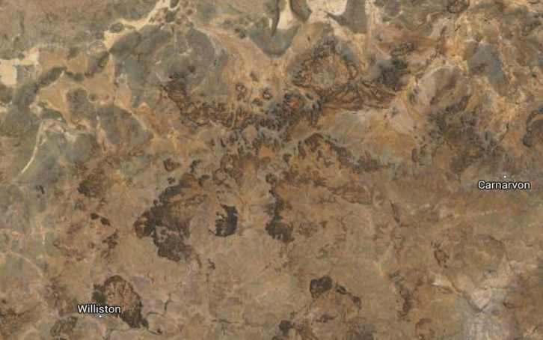
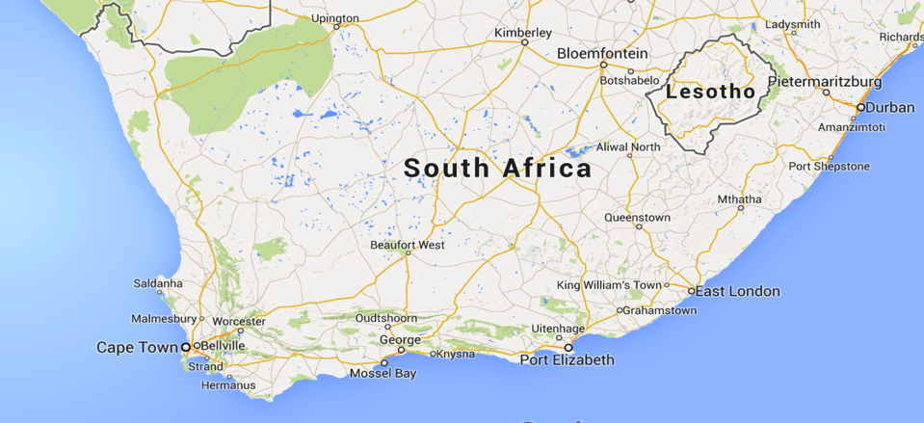
PAPER / HERA

Slide 7
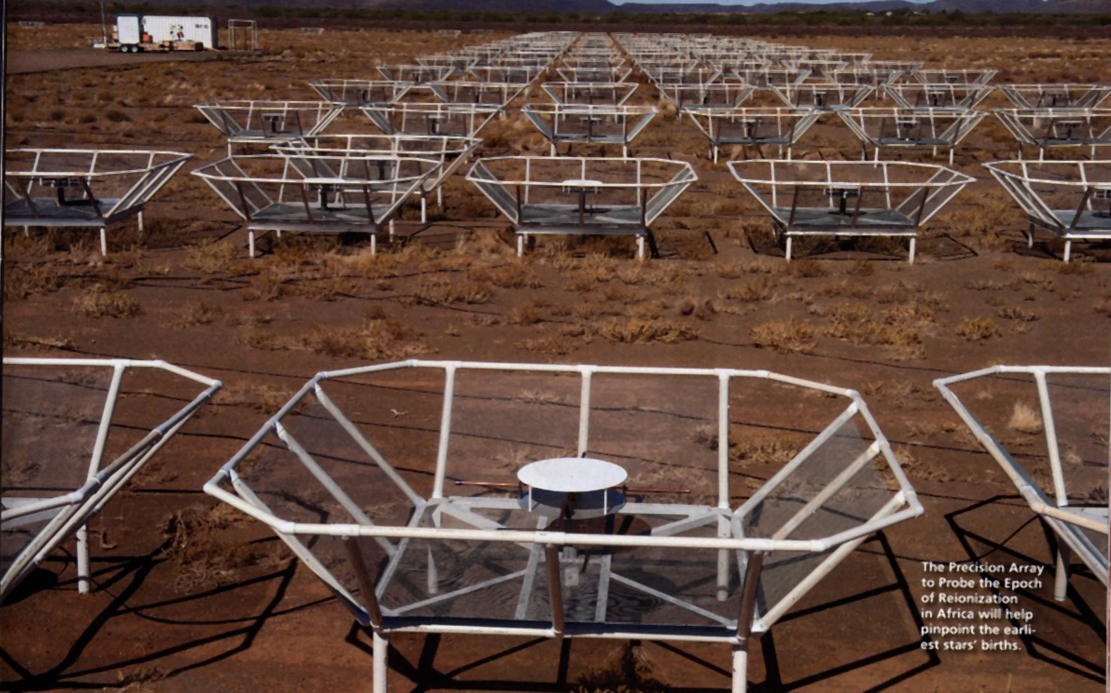

Slide 8
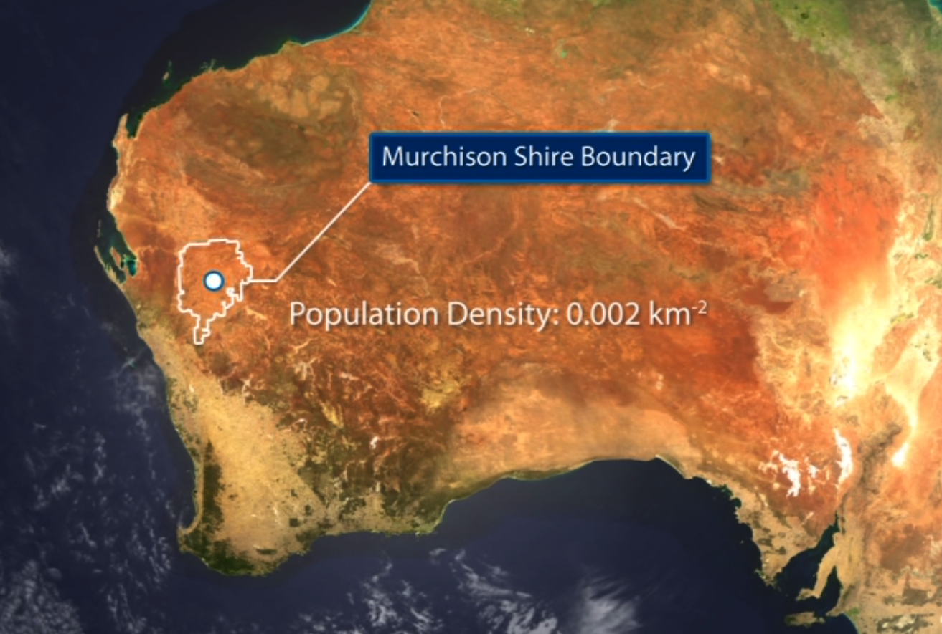
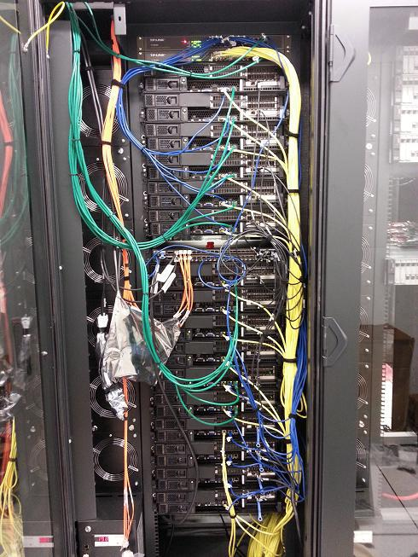
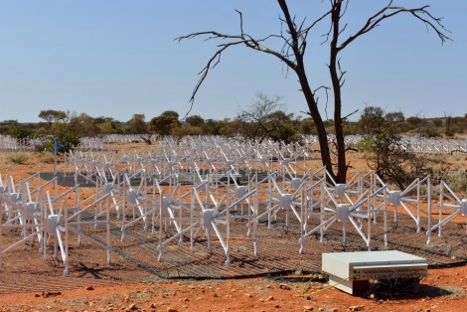
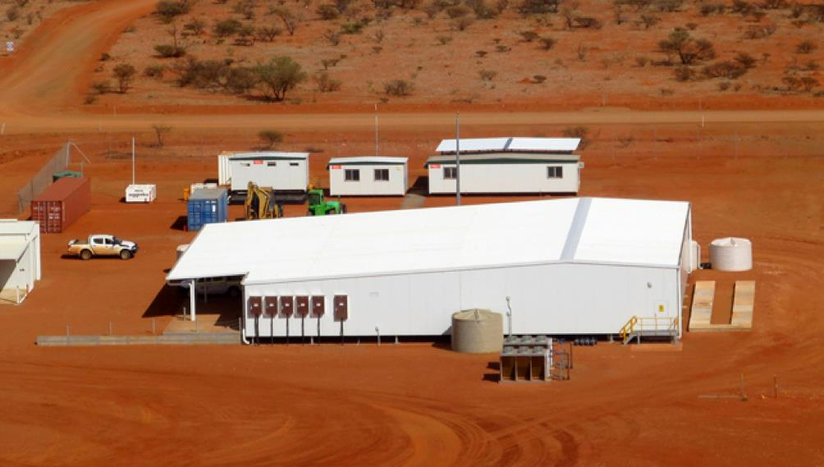
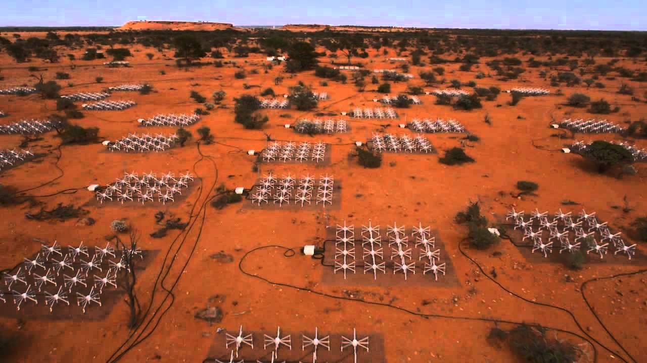
MRO (operated by CSIRO)
On site: data rate into central building ~60 Gbps
41,000 sq. km = The Netherlands
Population density = 0.002 people/sq. km
Geraldton
Off site: data rate into science archive ~3 Gbps
~200 km
Perth
Pawsey Centre 9 PB storage for MWA
Notes:
Best way to describe the MWA (including next 6 slides)

Slide 9
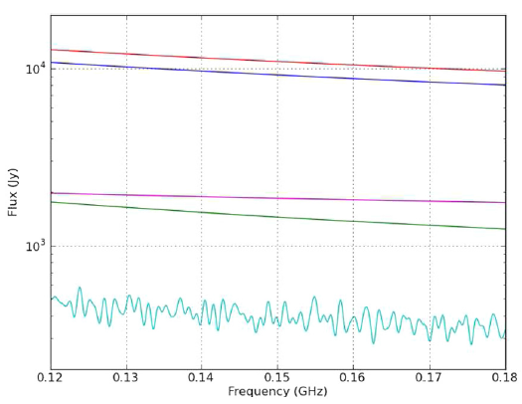
The Foreground Problem
Bright Foregrounds
(but smooth)
HI signal extremely faint
(but not smooth)
Parsons et al. (2012)

Slide 10
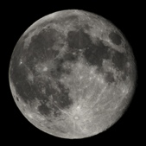
Full moon
20 degs
Offringa et al., 2016.
Notes:
This is the deepest image yet made with the MWA of one of the EoR program’s observation fields . In this image, virtually every dot is an extragalactic radio source at cosmological distance. The field is centred on RA=0, DEC=-27.

Slide 11
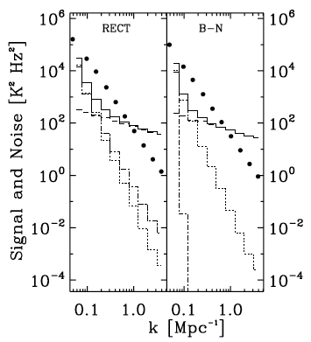
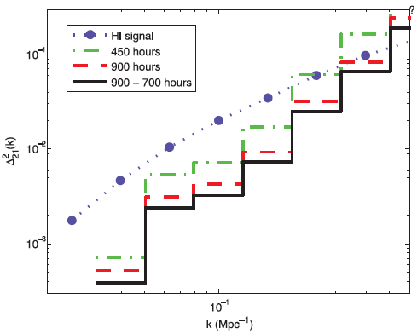
Previous Estimates of Sensitivity
Thyagarajan et al. (2013)
Beardsley et al. (2013)
>10-sigma statistical detection expected with ~1000 hours data

Slide 12
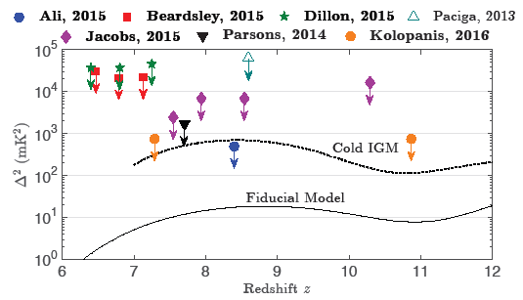
Current EoR Results
LOFAR
Image credit: Matt Kolopanis
Currently limited by foregrounds and instrument systematics (e.g. PAPER64 - Ali et al. 2015, Pober et al. 2015; MWA – Dillon et al. 2013, Beardsley et al. 2016)

Slide 13
Foreground “Wedge” and EoR window

Slide 14
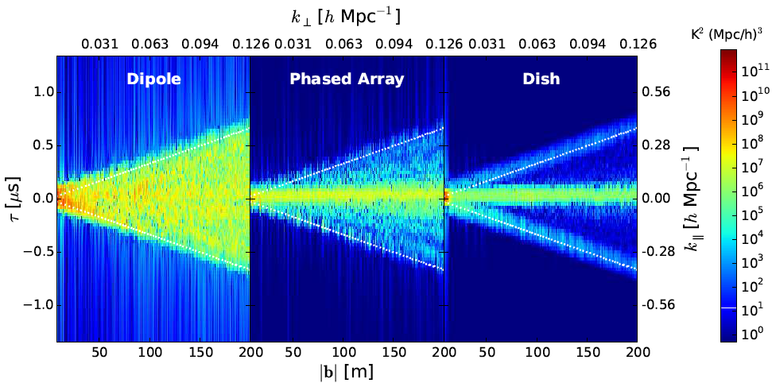
Mitigation of systematics via Antenna Geometry
(e.g. PAPER)
(e.g. MWA)
(e.g. HERA)
Foreground spillover from
Pitchfork drops significantly
Thyagarajan et al. (2015a)

Slide 15
Effects of Beam Chromaticity
Thyagarajan et al. (2016)
Uniform Disk Airy Pattern
Simulated Chromatic HERA beam
Differences seen only due to spectral differences in Antenna beam
Beam chromaticity worsens foreground contamination
HERA aiming for such a robust element design

Slide 16
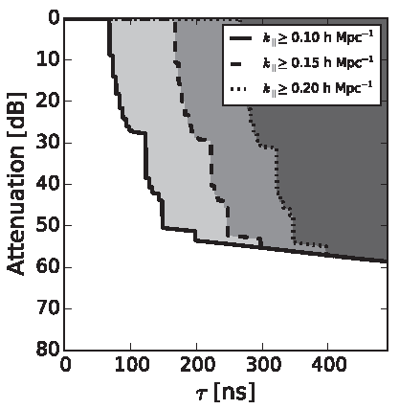
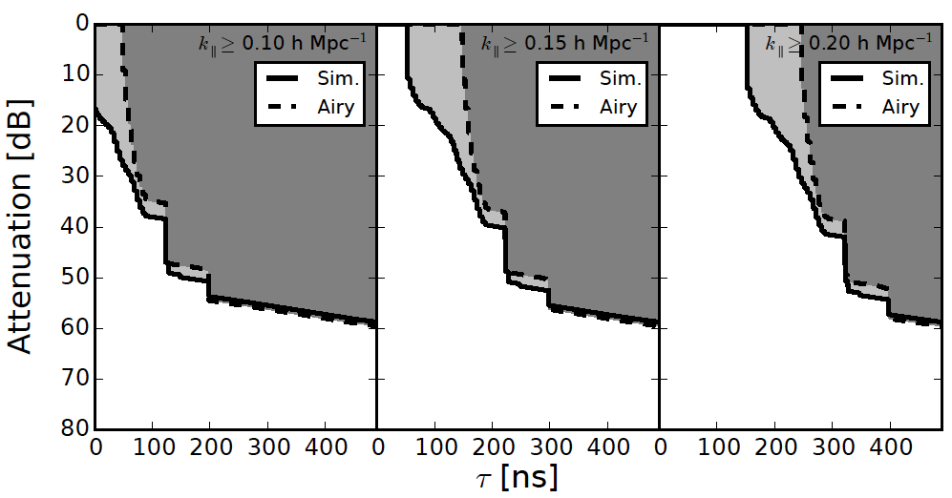
Design Specs on Reflections in Instrument
Dish-Feed Reflections
Antenna-to-Antenna Reflections
Reflections inevitable in electrical systems
Reflections extend foregrounds and contamination in delay spectrum
Require reflected foregrounds to be below HI signal levels
HERA will aim for these specs
Similar study is ongoing for SKA (with de Lera Acedo et al., Cambridge)
Thyagarajan et al. (2016)
Ewall-Wice et al. (2016)
Neben et al. (2016)
Patra et al. (2016)
DeBeor et al. (2016)

Slide 17
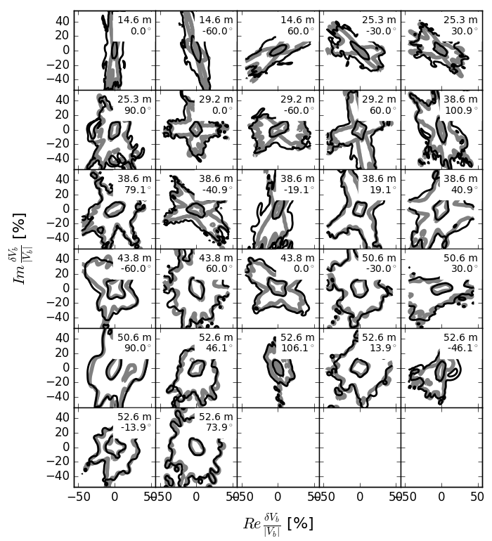
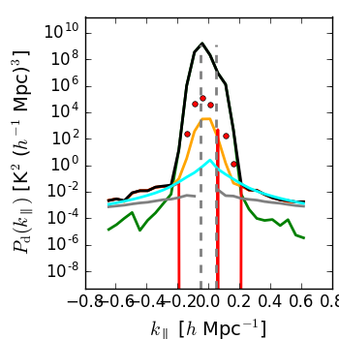
Effects of Antenna Position Errors
Thyagarajan et al. (in prep.)
Deviation from redundancy quickly introduce undesirable levels of spectral structure

Slide 18
Challenges
And more challenges
Knowledge and behaviour of foregrounds – point sources and diffuse emission
Control of wide-field “pitchfork” effects
Careful aperture design
Control of antenna beam chromaticity
Control of reflections in instrument
Control of antenna positions
Careful system design
Calibration Accuracy
Precise Instrument Design & Knowledge
Polarization Leakage compounded with wide-field effects?
Recombination lines taken lightly?
Antenna-to-antenna variations in beam and signal path?
Over-reliance on few analysis techniques?
Cross-correlation with other approaches including at higher frequencies

Slide 19
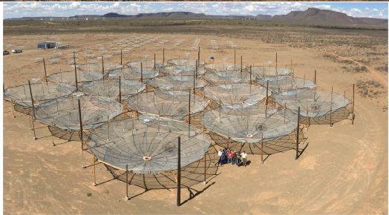
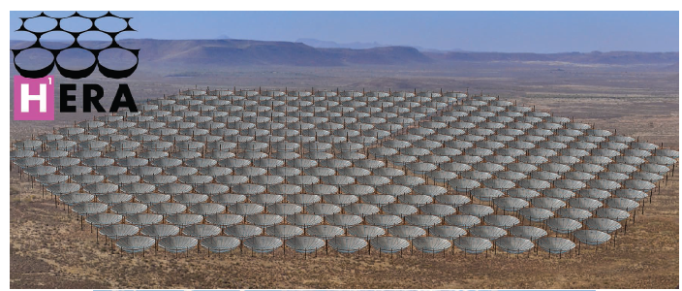
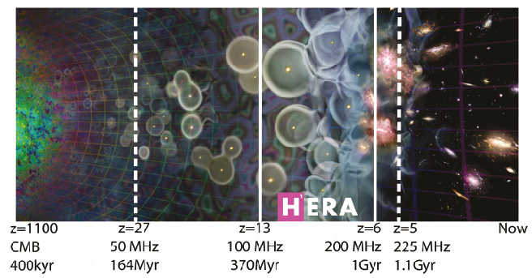
HERA (Hydrogen Epoch of Reionization Array)
Funded by the NSF Mid-Scale Innovations Program and the Moore
Foundation
B = 100MHz
FoV ~ 10 deg. at 150 MHz
350 elements, 14m dishes
Compact hexagonal array
350 dishes

Slide 20
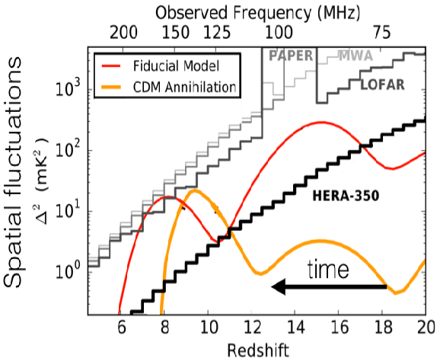
HERA can significantly constrain EoR models
Image Credit: Adrian Liu
Notes:
Increased heating from DM annihilations dampens the fluctuations (orange)

Slide 21
HERA Astrophysical Parameter Constraints
Greig & Mesinger (2015)

Slide 22
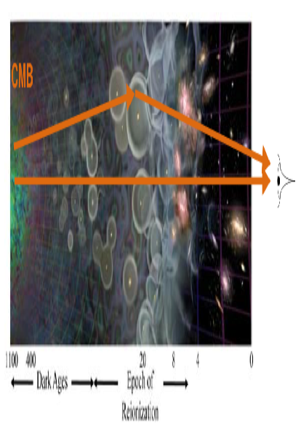
First steps towards constraints on cosmological parameters
Image credit: Adrian Liu
Liu et al. (2015a)
Optical depth is a nuisance parameter for CMB measurements
Scattering reduces amplitude of density fluctuations
Optical depth degenerate with primordial amplitude fluctuations
Notes:
21cm breaks the degeneracy between primordial amplitude fluctuations and optical depth

Slide 23
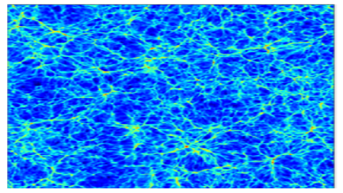
Benefits future neutrino mass experiments
Neutrinos free-stream from over-densities and dampen structure formation
Agarwal & Feldman (2011)
Without neutrinos
With neutrinos

Slide 24
Constraints on neutrino mass?
Allison et al. (2015a)
Liu et al. (2015a)
21cm results can break the degeneracies between
neutrino mass and optical depth

Slide 25
Summary
Systematics are the biggest challenge to EoR and low frequency experiments - HERA, SKA, MWA, PAPER, LOFAR, CHIME
Strategy - best solutions are via robust instrument design, then followed by smart analysis
Exciting times ahead:
Close to significant EoR detection (few years)
21 cm studies will shed light on the dark ages and cosmic dawn when first stars and galaxies formed
Will reveal the astrophysics during the EoR
May help remove degeneracies in cosmological parameters

Slide 26
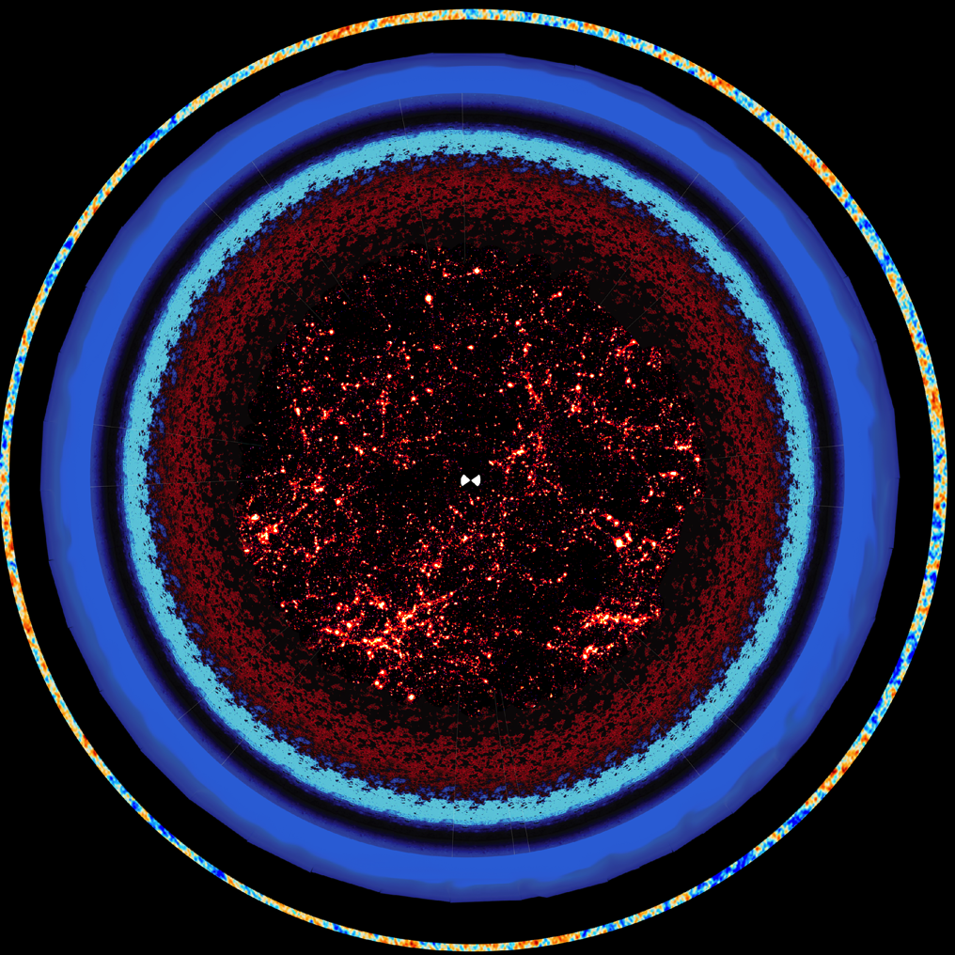
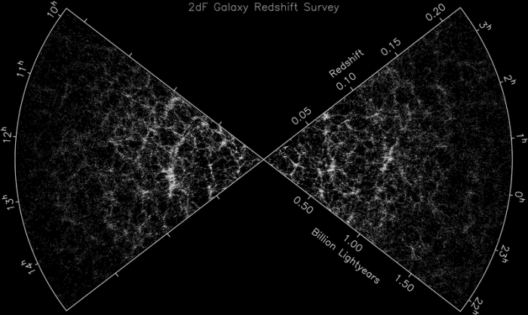
z ~ 6
z ~ 15
z ~ 30
z ~ 40
(Colless et al. 2002)
z ~ 150
z = 1088
(Mao et al. 2008, Zheng et al. 2014)

Slide 27
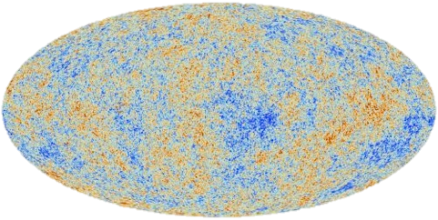
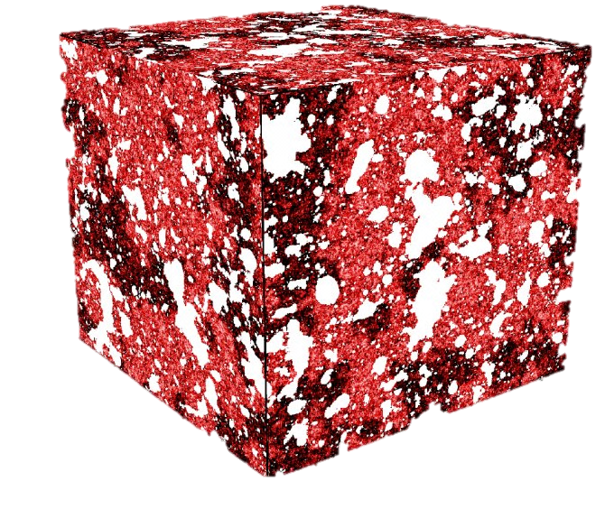
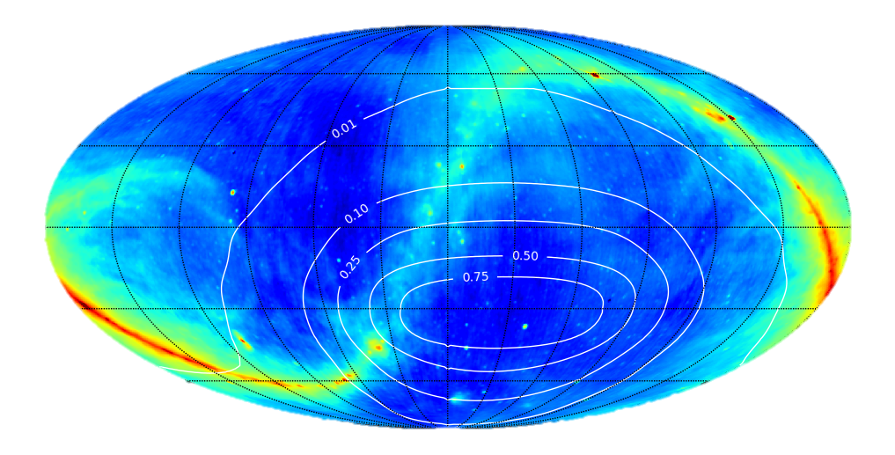
Distinction from CMB studies
CMB
21cm
Measurements vs. frequency
Notes:
The cosmic microwave background is another cosmological probe that requires the extraction of small fluctuations from underneath a large signal. There is a crucial difference between the CMB and 21cm surveys though. Whereas CMB experiments probe a 3D signal, with two spatial dimensions and a frequency axis to get a 2D map of just two spatial dimensions, in 21cm our final product is 3D. This means the CMB has an entire extra axis of redundant information that can help distinguish between foregrounds and signal, whereas this is not the case for 21cm tomography. Every dimension contains unique info for us. As a result, one can show that blind methods don’t work as well for 21cm tomography as they do for the CMB. If we want to fight foregrounds, we have to model them. Returning to the current status of measurements, then, we have two options.

Slide 28
MWA: SKA Low precursor
Notes:
The MWA consists of 128 antenna ‘tiles’. Each tile is a 4x4 grid of dual polarisation dipoles mounted on a 5x5 meter ground mesh. Radio signals from each dipole are combined in an analogue beamformer (white box next to tile) where electronically steers the antenna to point anywhere on the sky. Signals from each tile are send to fielded receiver units where they are filtered and digitised. Each receiver services 8 tiles. A selection of radio frequencies is sent from each receiver for each tile to the central control building for further processing and correlation.

Slide 29
MWA EoR sky coverage
Credit: David Kaplan

Slide 30
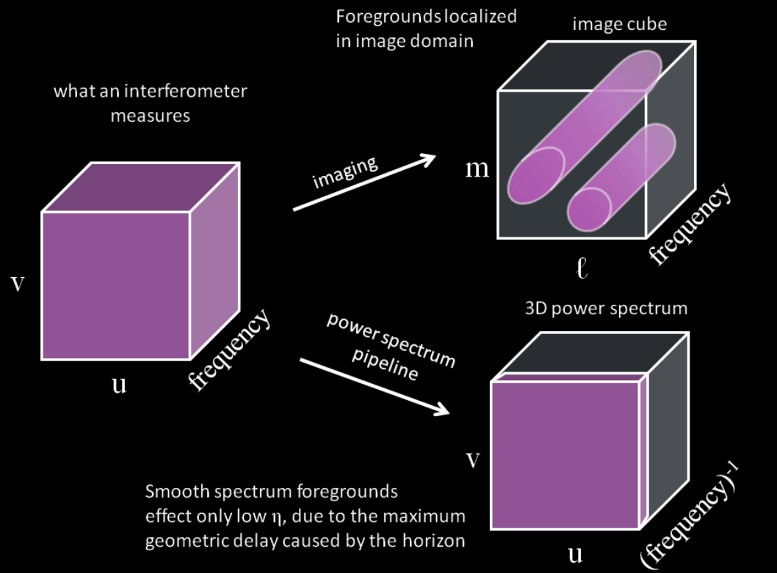
21cm EoR Power Spectrum Analysis Framework
k_{y}
k||
k_{x}

Slide 31
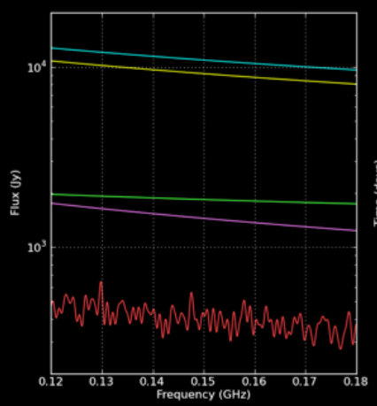
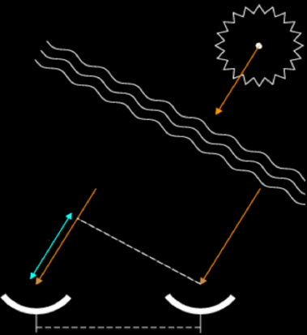
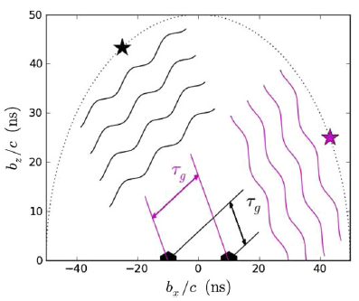
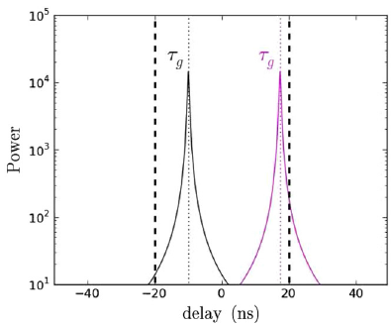
Fourier Space and Delay Spectrum
Parsons et al. (2012)

Slide 33
MWA Past, present, future
Phase 1: 2013-2016
128 antennas, 2.5 km max baseline
Phase 2: 2016-2018
Expand with additional 128 antennas, comprised of
72 closely spaced in 2x hexagonal grids approx 100m size
56 new long baseline antennas to double max baseline to 5km
Only 128 antennas used at any time: reconfigure for
‘EoR array’ (existing core tiles plus new hexes)
‘Long baseline array’ (existing non-core tiles + new long baseline tiles)
Same correlator, receivers: reconfigure by manual re-plugging of tiles into receivers
Phase 3: 2018-
New electronics and receivers

Slide 34
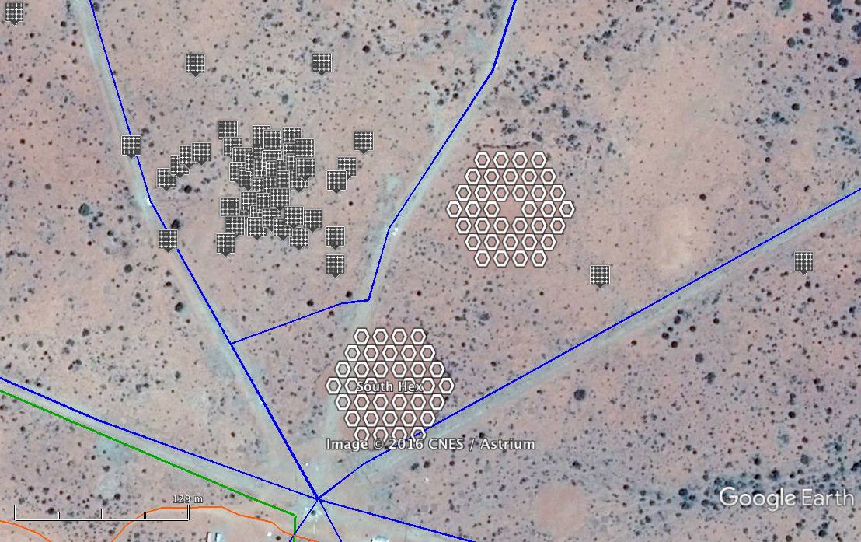
MWA Phase II

Slide 35
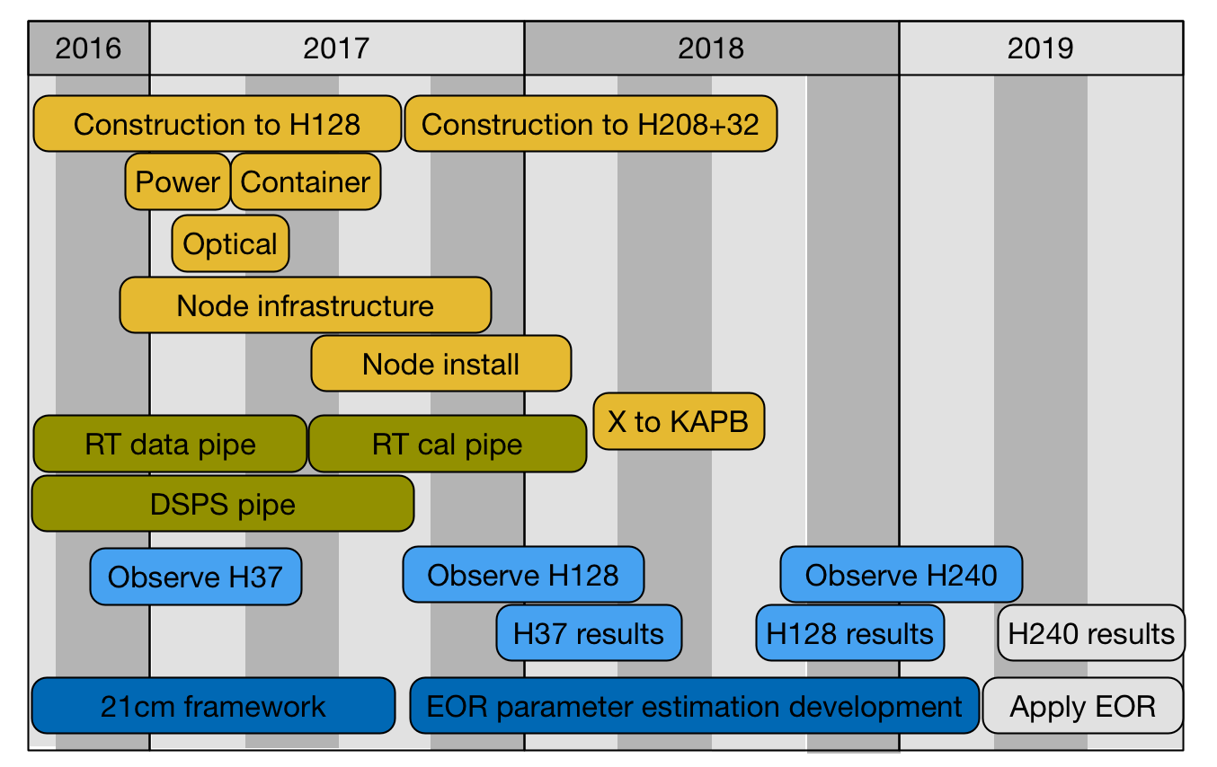
Timeline

Slide 36
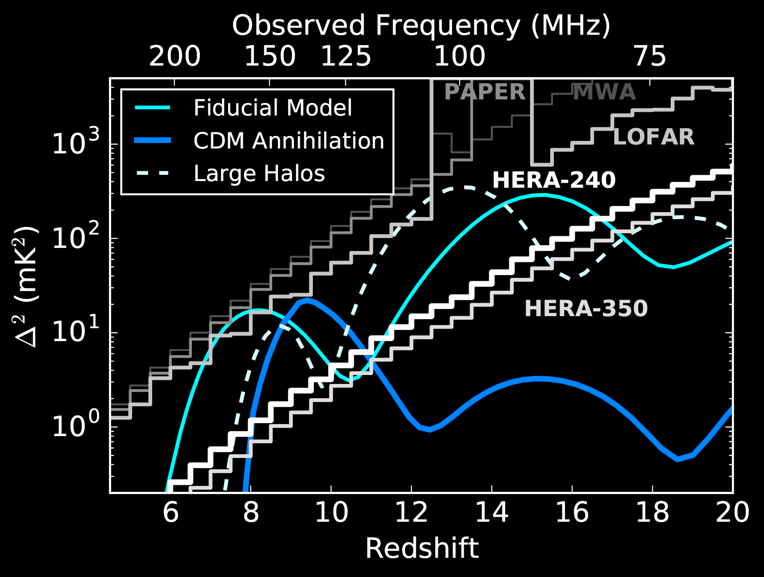
Anticipated performance of EoR experiments
Courtesy Adam Beardsley & anonymous grad student

