Slide 1
Measurements and Models of Ionospheric Faraday Rotation
Joe Malins

Slide 2
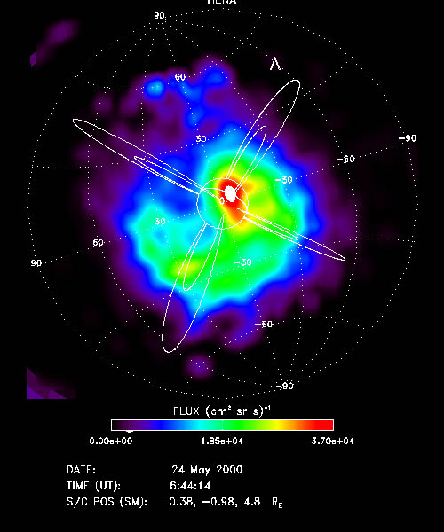
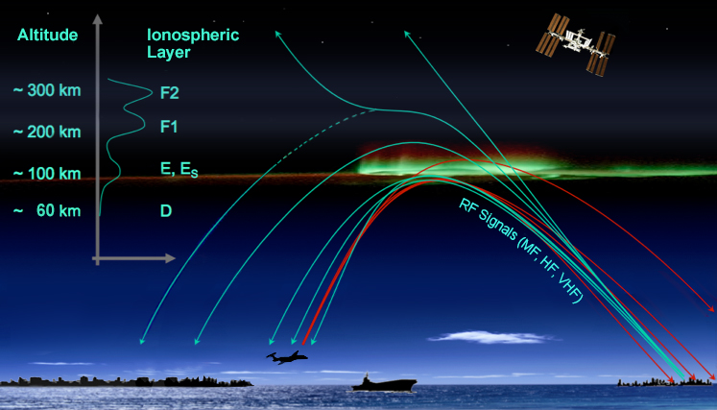
Ionosphere
SEC/NOAA
http://www.astrosurf.com/luxorion/Radio/ionospheric-layers.jpg
NASA/MSFC
http://www.astrosurf.com/luxorion/Images/aurora-energy.jpg

Slide 3
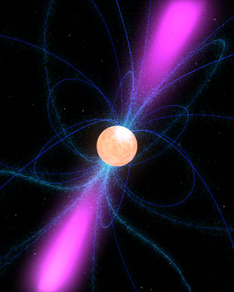
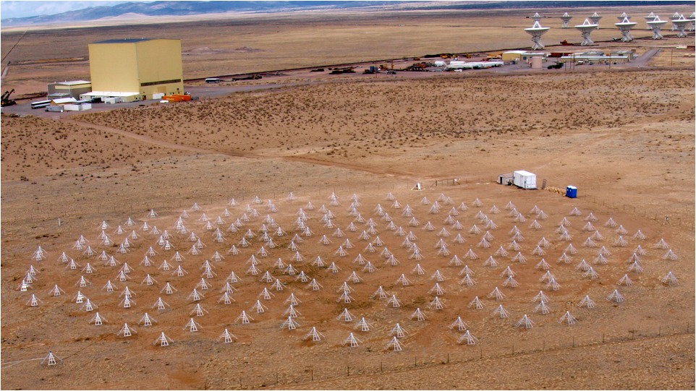
Rotation Measure
Pulsars
LWA
UNM Department of Physics and Astronomy http://www.phys.unm.edu/~lwa/images/lwa1.jpg
NASA https://www.nasa.gov/images/content/230242main_Pulsar2_sm.jpg

Slide 4
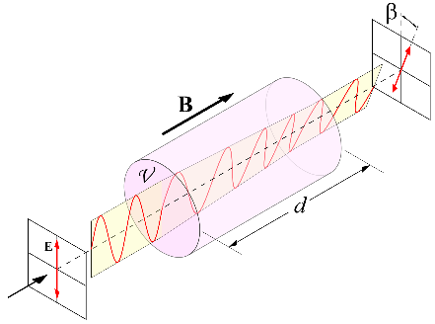
Rotation Measure
Veronica Dike (UNM)

Slide 5
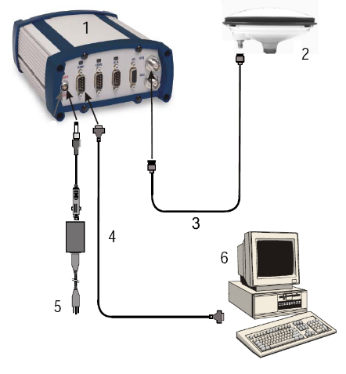
Measuring the Ionosphere
GPS
Ionosphere
NovAtel 4004B Dual Frequency GPS
Receiver

Slide 6
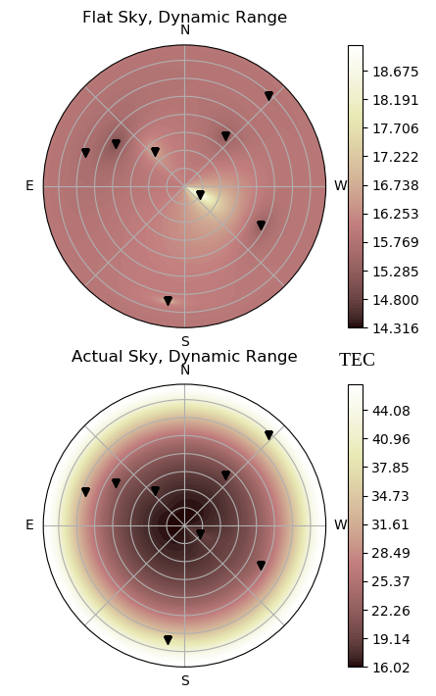
Ionosphere Sky From GPS
2017/10/14 11:00:00 GMT
05:00:00 MDT

Slide 7
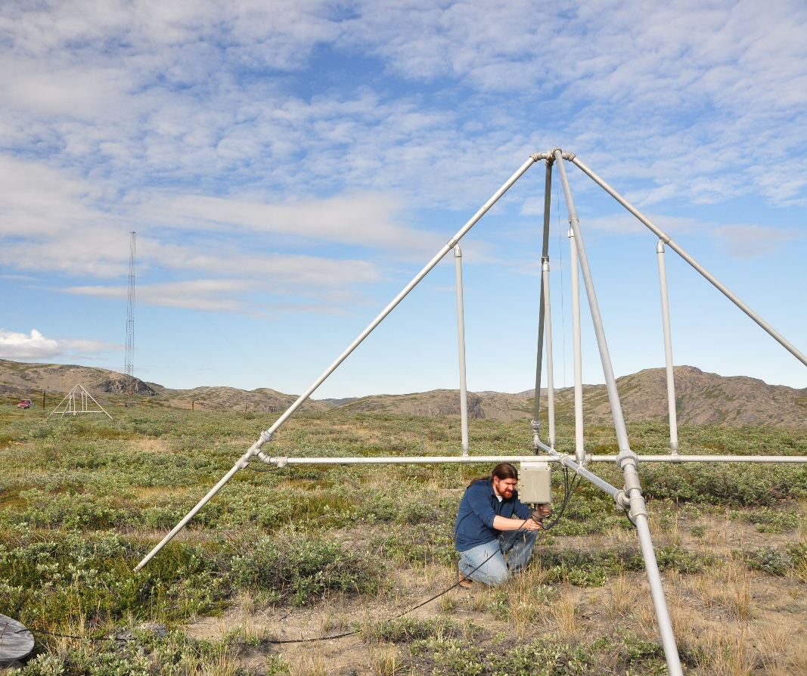
Ionosondes
Ionosphere
Outgoing Pulses
Return Pulses
AFRL Space Vehicles Directorate https://media.defense.gov/2011/Dec/09/2000193124/888/591/0/111209-F-AB000-004.JPG
Ionosonde

Slide 8
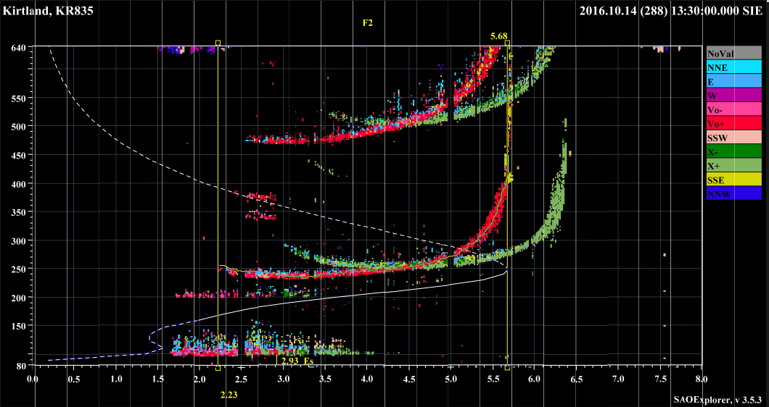
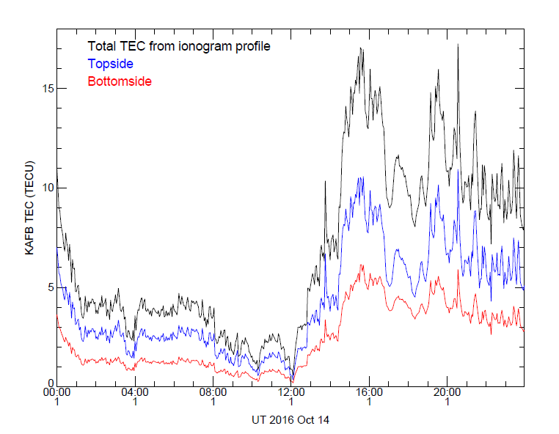
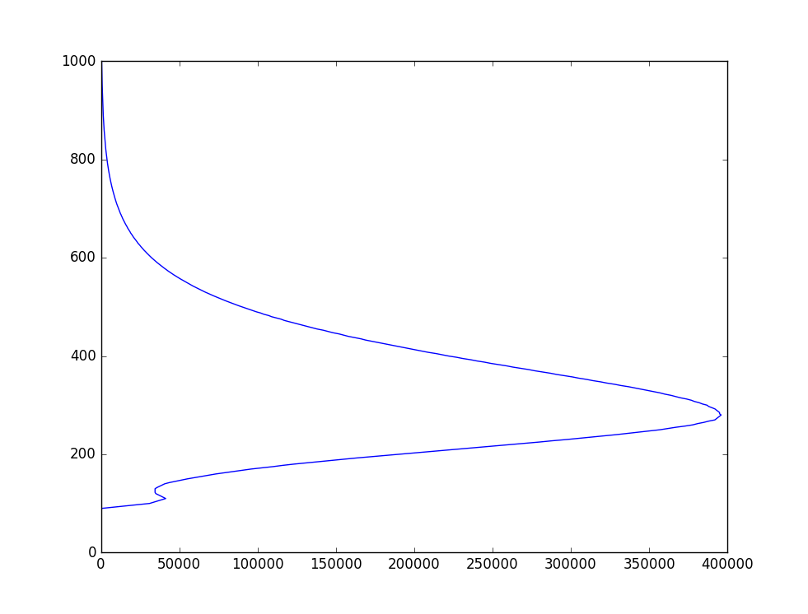
Ionosondes
Profile 2016/10/14 – 00:00:00 GMT
Height, km
n_{e} cm⁻³

Slide 9
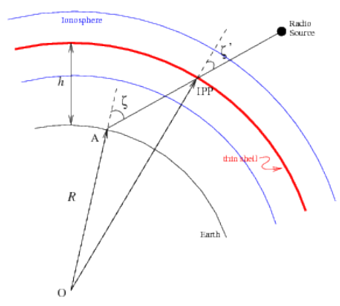
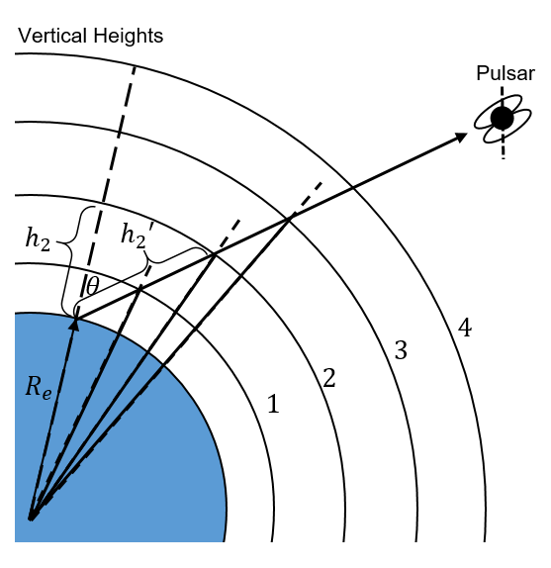
Predicting the RM
GPS Prediction
Digisonde Profile Prediction
Profile 2016/10/14 – 00:00:00 GMT
C. Sotomayor-Beltran et al.: Ionospheric Faraday rotation
$$RM=\frac{e^{2}}{8 π^{2}ε_{0}m_{e}^{2}c^{3}}\int_{0}^{d}{n_{e}\left(s\right)B_{∥}\left(s\right)ds}$$
$$h′=\frac{h+R_{e}\sin\left(φ−\sin^{−1}\left(\frac{R_{e}}{R_{e}+h}φ\right)\right)}{\sin{φ}}$$
$$TEC=\sum_{i}{μf_{a}\frac{TEC_{i}}{d_{i}}}$$
$$μ=\frac{1}{\sum_{i}{\frac{f_{a}}{d_{i}}}}$$
$RM=2.62×{10}^{−13}T^{−1}\int_{0}^{{h′}_{max}}{N_{e}}B_{∥}$
$$f_{a}=\frac{1}{2}\left[1 −\tanh\left(12 \left(φ−65\right)\right)\right]$$
$$RM=2.62×{10}^{−13}T^{−1}\left(TEC×B_{IPP}\right)$$

Slide 10
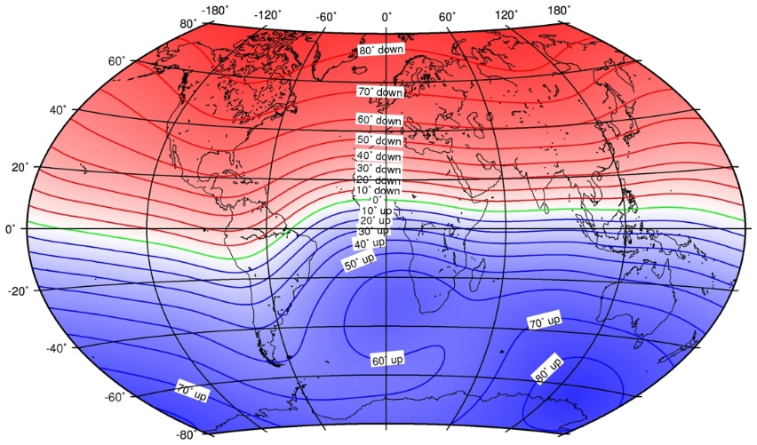
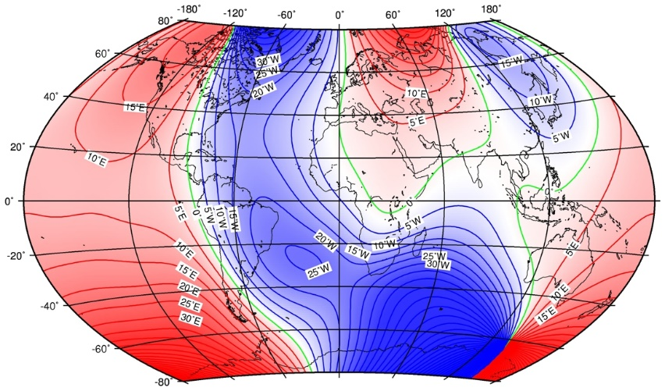
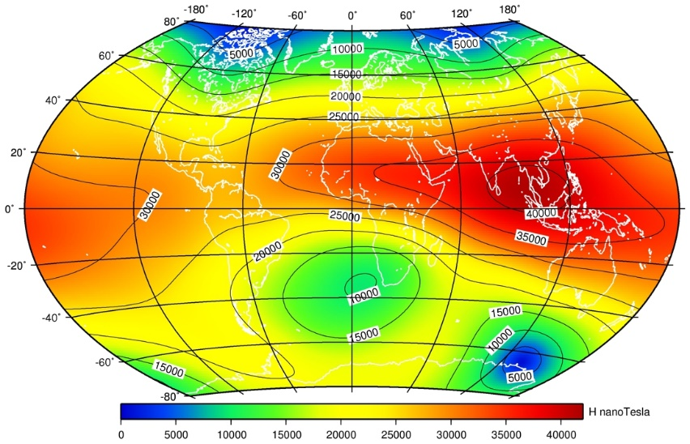
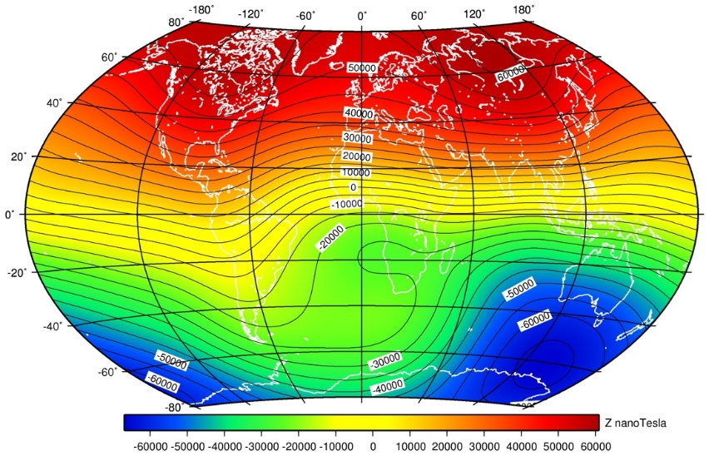
International Geomagnetic Reference Field
https://geomag.bgs.ac.uk/research/modelling/IGRF.html

Slide 11
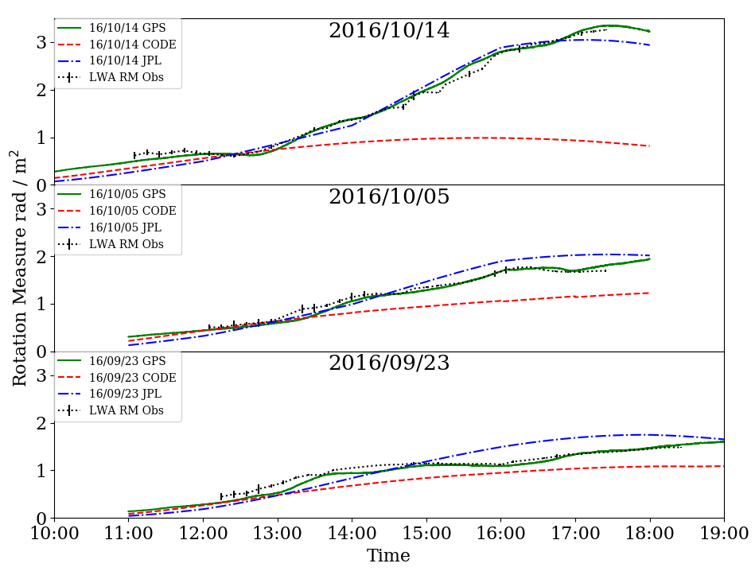
GPS

Slide 12
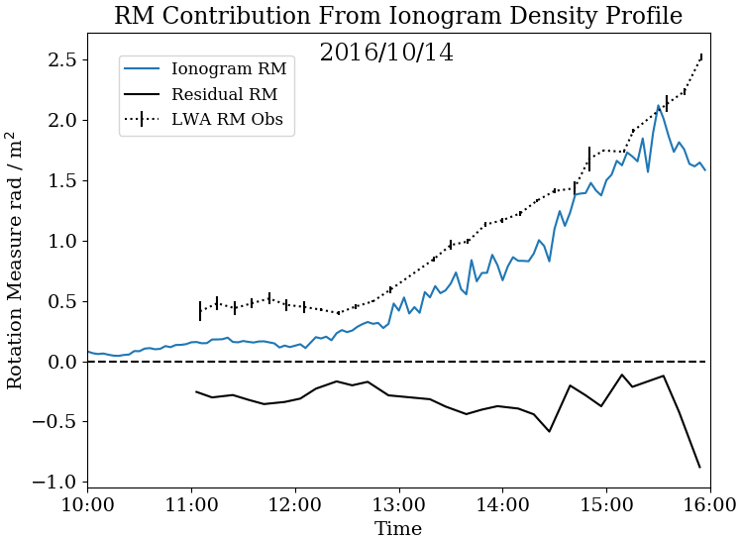

Slide 13
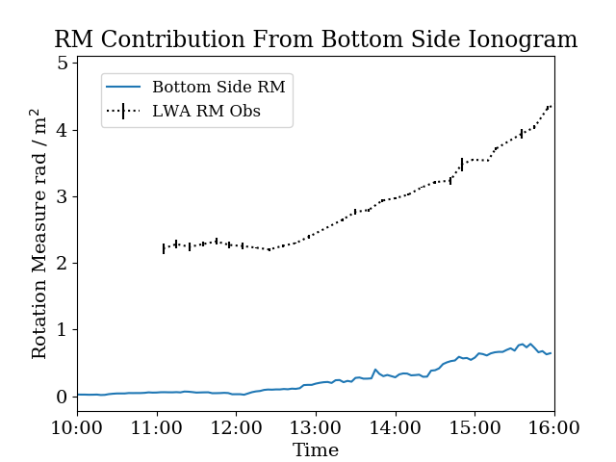

Slide 14
Digisonde Profile Zoom-in
Modified Vary-Chap Profile
Measured Densities

Slide 15
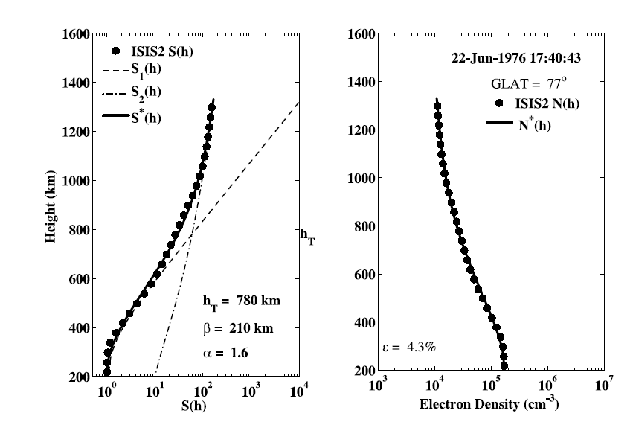
Vary-Chap Profile
NSUMEI ET AL.: NEW VARY-CHAP TOPSIDE PROFILE (2012)

Slide 16
Backup Equations
$$\frac{N(h)}{N_{m}}={\left[S\left(h\right)\right]}^{−1/2} exp⁡\{\frac{1}{2}[1 −Y −\exp{(Y)]\}}$$
$$Y= \frac{1}{h_{m}}\int_{h_{m}}^{h}{\frac{dh}{S\left(h\right)}}$$
$$\frac{1}{S\left(h\right)}=\frac{1}{S_{1}(h)}+\frac{1}{S_{2}(h)}$$
$$S_{1}(h)=c_{1}{\left[{sech}^{2}\left(\frac{h/{h_{m}}−1}{\frac{β}{h_{m}}}\right)\right]}^{−1 }$$
Dr. Stephen White AFRL
$$c_{2}=\frac{h_{T}/h_{m}}{{\left(1+z_{T}^{2}\right)}^{α}} \frac{1}{\left[{sech}^{2}\left(\frac{h_{T}/h_{m}−1}{β/h_{m}}\right)\right]}+ \frac{1}{2^{α}}$$
$$S_{2}(h)=c_{2}\frac{{\left[1+{\left(h/{h_{m}}\right)}^{2}\right]}^{α}}{h/{h_{m}}}$$
$$1=\frac{1}{c_{1}}+ \frac{1}{c_{2}{\left(2\right)}^{α}}$$
NSUMEI ET AL.: NEW VARY-CHAP TOPSIDE PROFILE (2012)

Slide 17
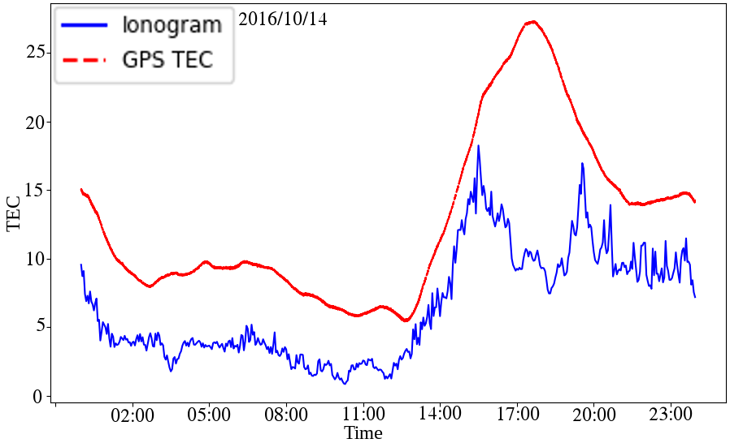
Missing Electrons
Sunrise at 13:12
Unusable Times
Relevant Times

Slide 18
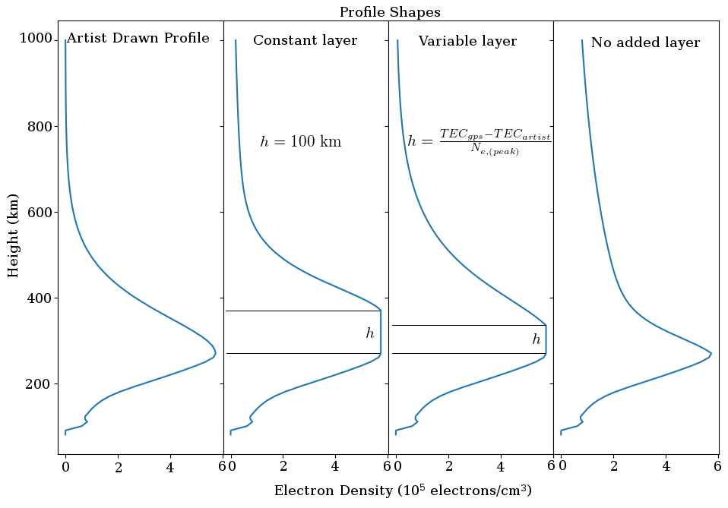
3 methods

Slide 19
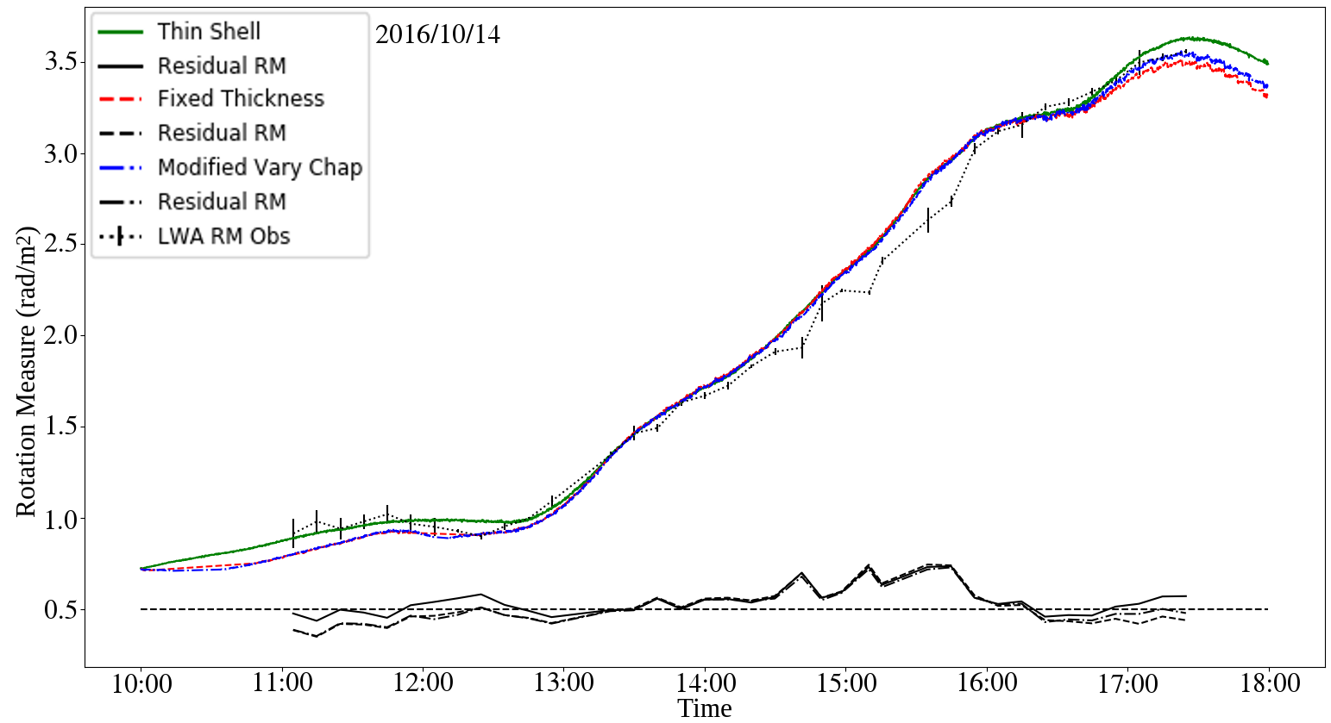
Results
Thin Shell
Thin Shell Residuals
Constant Thickness
Residuals
Variable Thickness
Residuals
LWA RMs

Slide 20
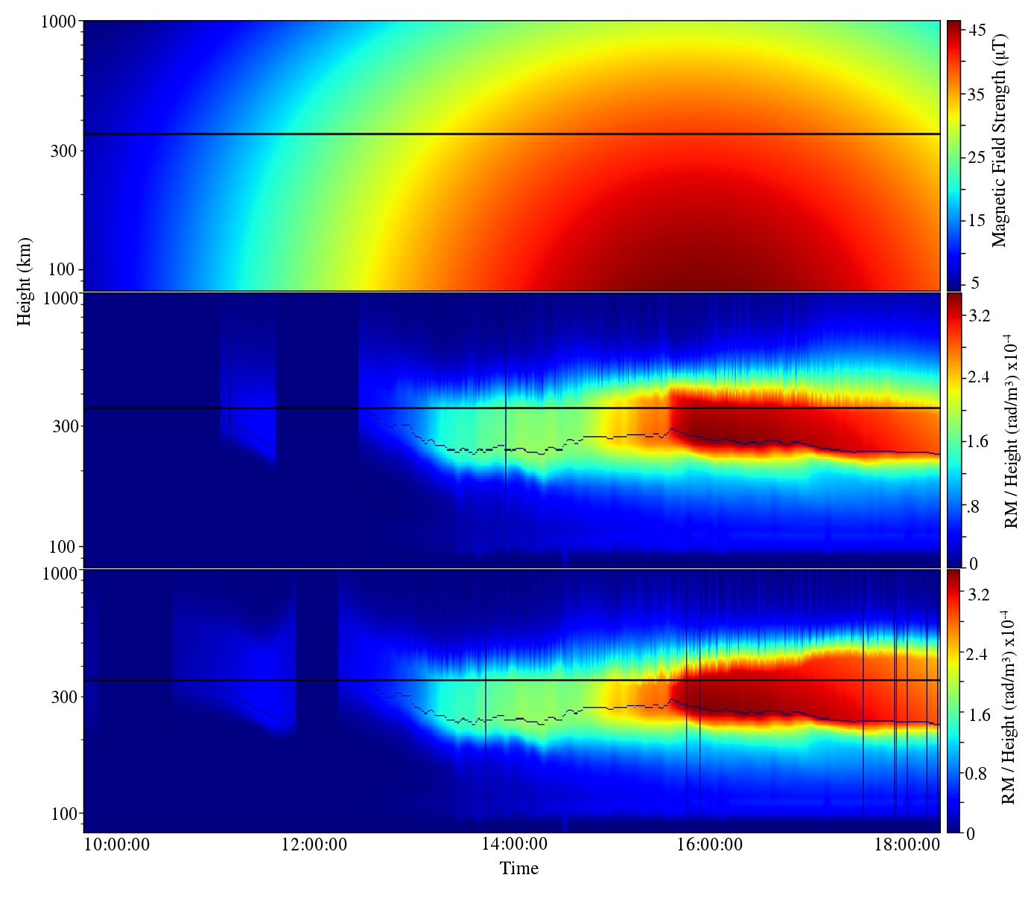

Slide 21
Conclusions
Local GPS outperforms Global GPS Models (JPL, Code, etc.)
Rotation Measures are best predicted by thin shell model
Current Ionogram top-side models under estimate the total electron content
Corrections to Ionogram using GPS Derived TEC bring Ionogram predictions to thin shell model errors
GPS Still largest source of error in RM observations
http://lda10g.alliance.unm.edu/GPS/index.php

