Slide 1
Recent Progress on the Magdalena Ridge Observatory Interferometer
M. J. Creech-Eakman
on behalf of the MROI team
MROI Project Scientist/Physics Prof. NMT
NRAO NM Symposium – Nov 3, 2017

Slide 2
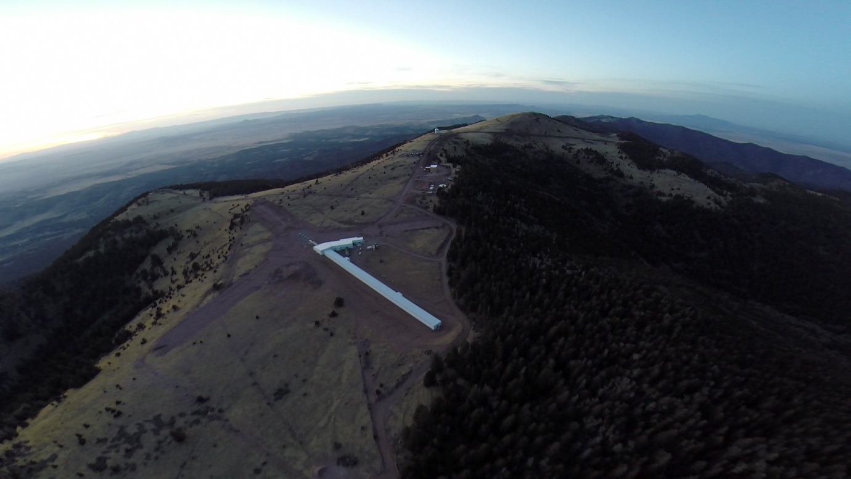
Overview of the Observatory
Magdalena Ridge about 1 hour west of Socorro, NM overlooking VLA
Altitude 10,500 ft
Env. Impact Survey completed in 2003
Two facilities at MRO
Fast-tracking 2.4m
NIR/Optical 10-element interferometer
Third site available
MROI is 10 1.4m movable afocal telescopes in equilateral Y configuration (28 stations)
Optical and near-IR operation, near-IR fringe tracking
Baselines from 7.8 to 347m (58 to 0.3 mas)
Design optimized for imaging mission

Slide 3
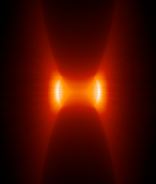
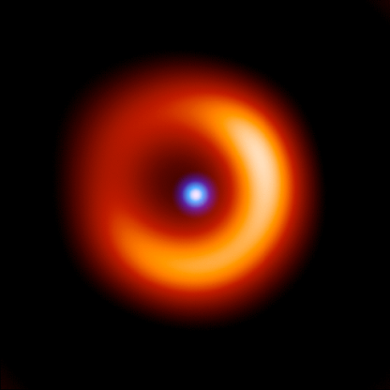
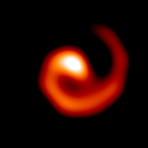
MROI Science Case
AGN:
Verification of the unified model.
Determination of nature of nuclear/extra-nuclear starbursts.
H =14 gives >100 targets.
Star and planet formation:
Protostellar accretion, imaging of dust disks, disk clearing as evidence for planet formation.
Emission line imaging of jets, outflows and magnetically channeled accretion.
Detection of sub-stellar companions.
Stellar accretion and mass loss:
Convection, mass loss and mass transfer in single and multi-star systems.
Bipolarity and collimation of circumstellar material, wind and shock geometries, interacting binary systems
Pulsations in Cepheids, Miras, RV Tauris, etc.
Additional work on Geosynchronous objects demonstrations for AFRL
Direct-TV9 TASAT simulation using 10-telescope MROI in K-band (5 channels) of 8th mag. object with aperture masking on MRO 2.4m

Slide 4
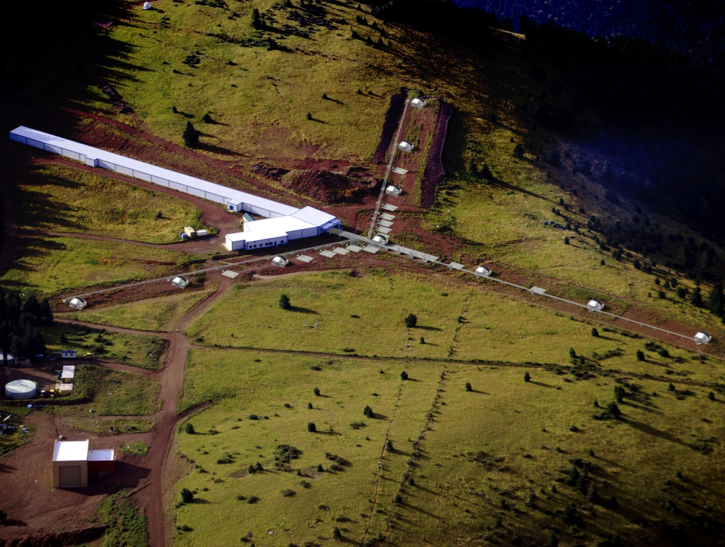
Flow Down for Requirements
Telescope diameter of 1.4 m
H magnitude = 14th for group delay tracking limit
Spatial scales of 0.3 to 58 mas
Baselines from 7.8 to 347 m (for 0.6-2.4 microns)
Moderate-to-high spectral resolutions
Separate fringe tracking and science cameras
High throughput to achieve sensitivity limit
Fifteen reflections from primary to detectors
Optimized coatings for 0.6-2.4 microns
Large number of telescopes rapidly combined
Optimized for model-independent imaging
TAE Photographic
Try to apply lessons learned from other facilities whenever possible.

Slide 5
Quick walk through….
….queue movie

Slide 6
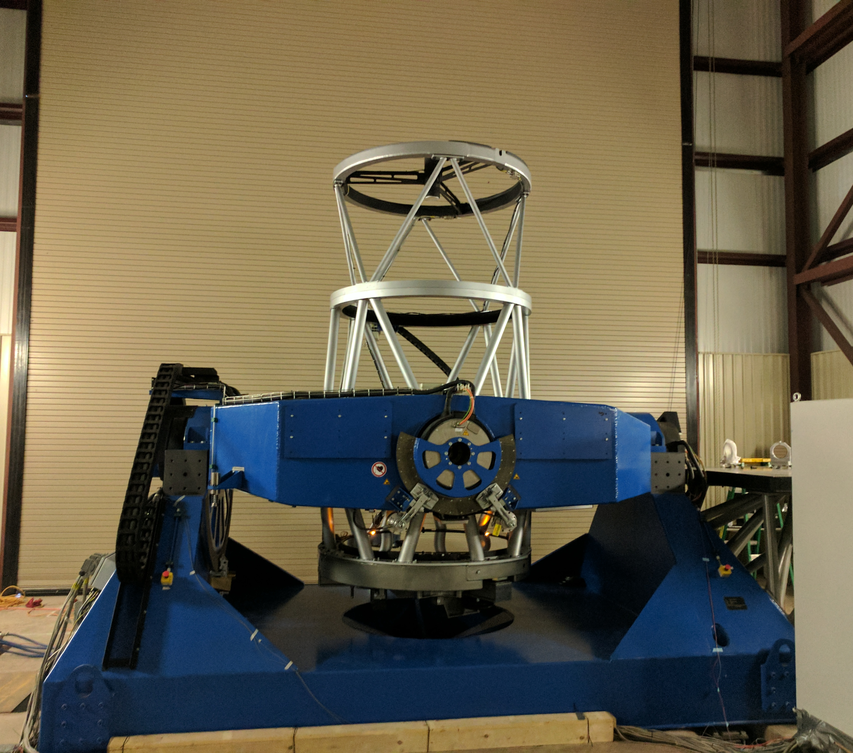
Recent Progress – Telescope #1
Telescope is a 1.4m diameter altitude-altitude mount
Designed/built by AMOS
Light is directed off tertiary across Nasmyth table
Low-order AO: Tip-tilt correction is done using blue light and telescope secondary – preliminary deployment complete
Telescope first light in maintenance facility Nov 29, 2016
Being tested on sky every few weeks

Slide 7
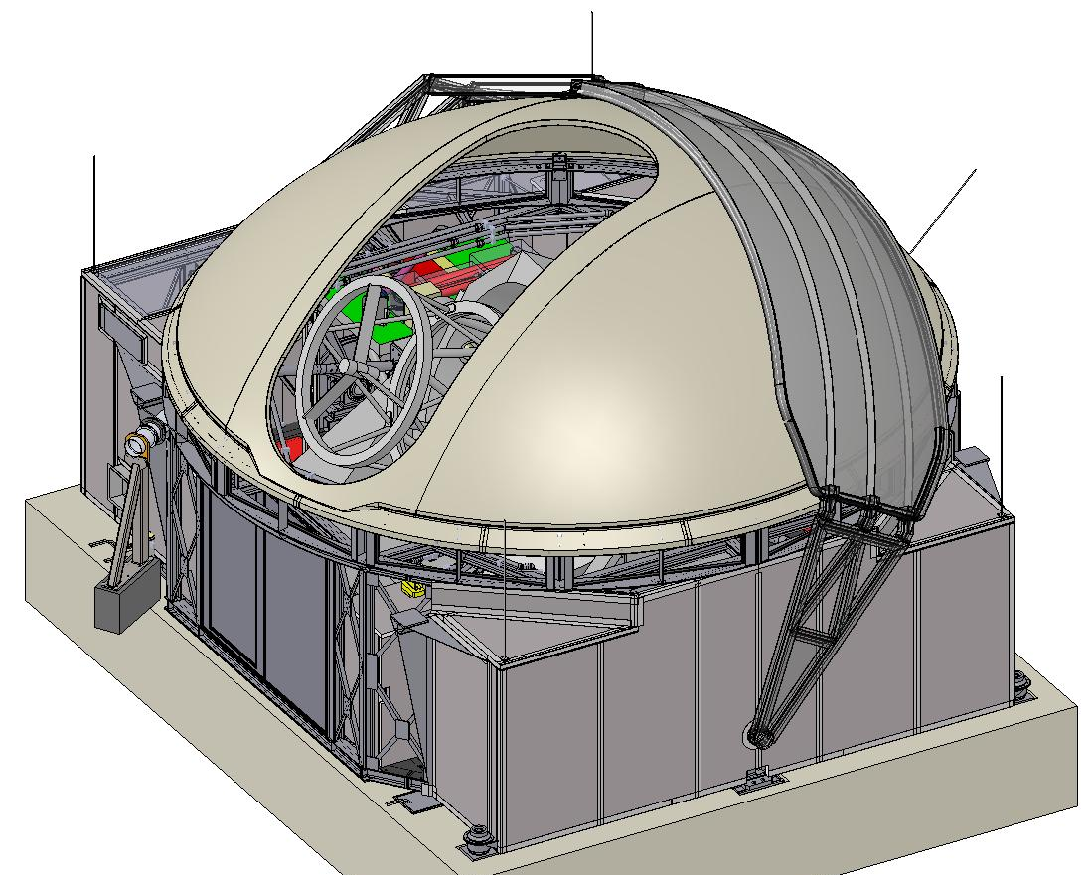
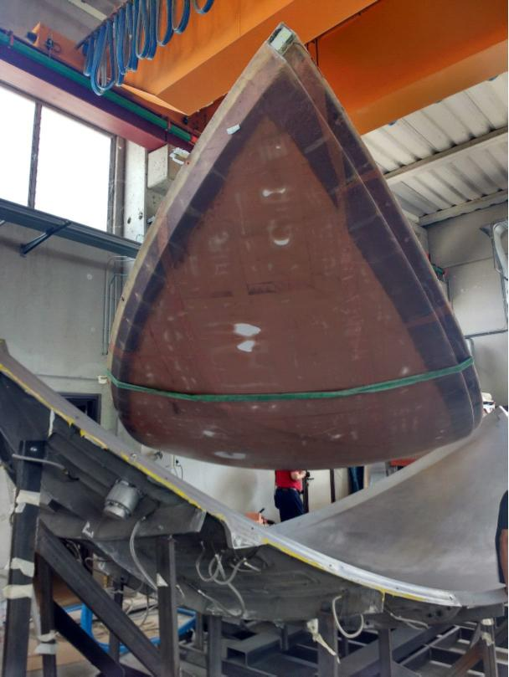
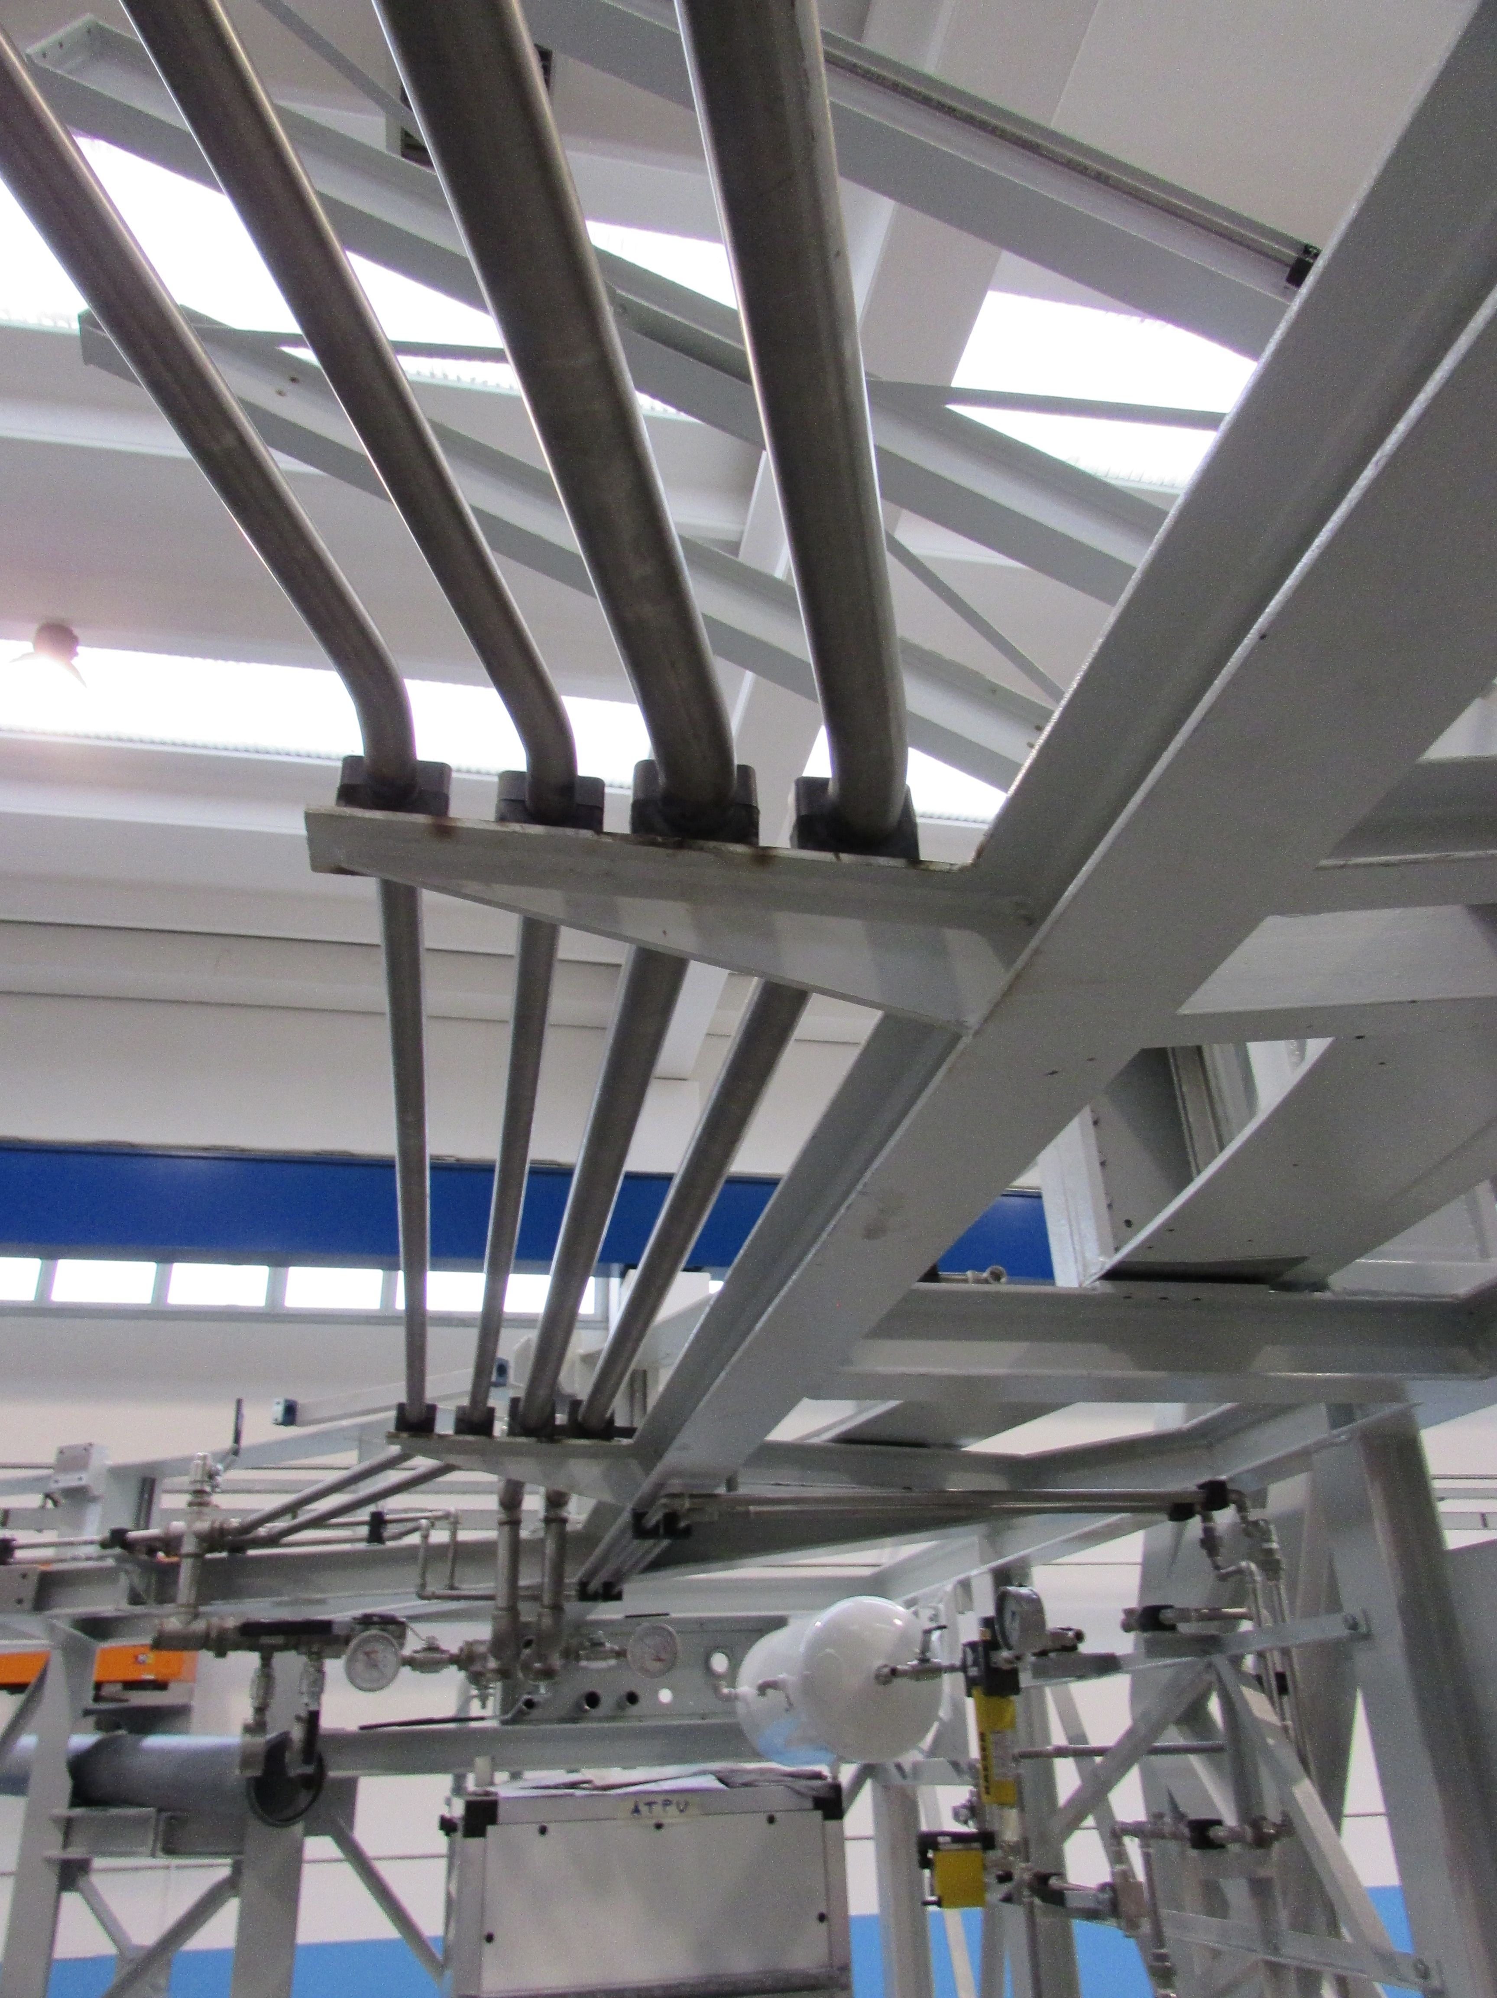
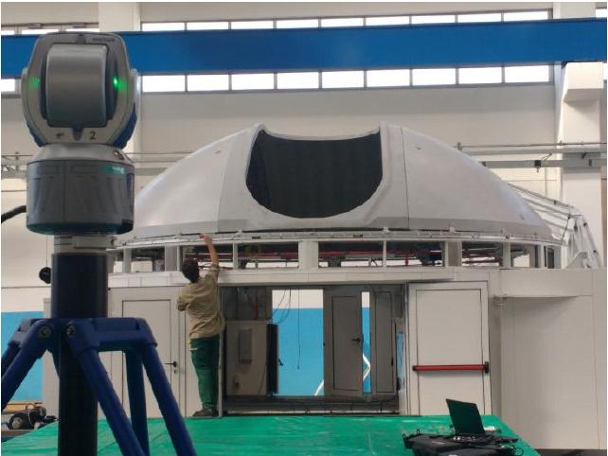
Telescope Enclosure #1
Protects and transports telescopes
Designed/built by EIE
Steel structure, fiberglass dome and carbon fiber shutter
Embedded metal mesh for lightning protection
Louvered for airflow to minimize dome seeing
Relocation specified to take 4 hours per scope
Undergoing FAT now
First dome to be delivered to MROI in early 2018

Slide 8
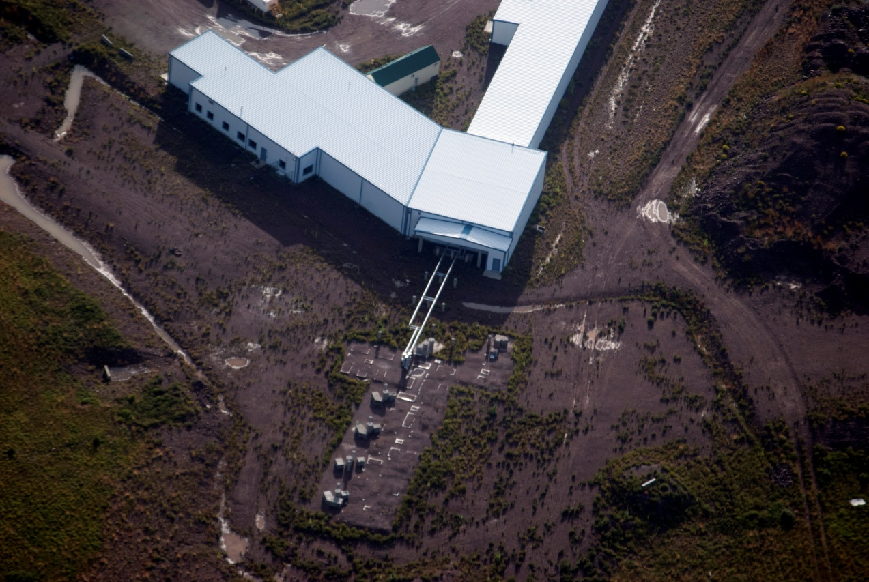
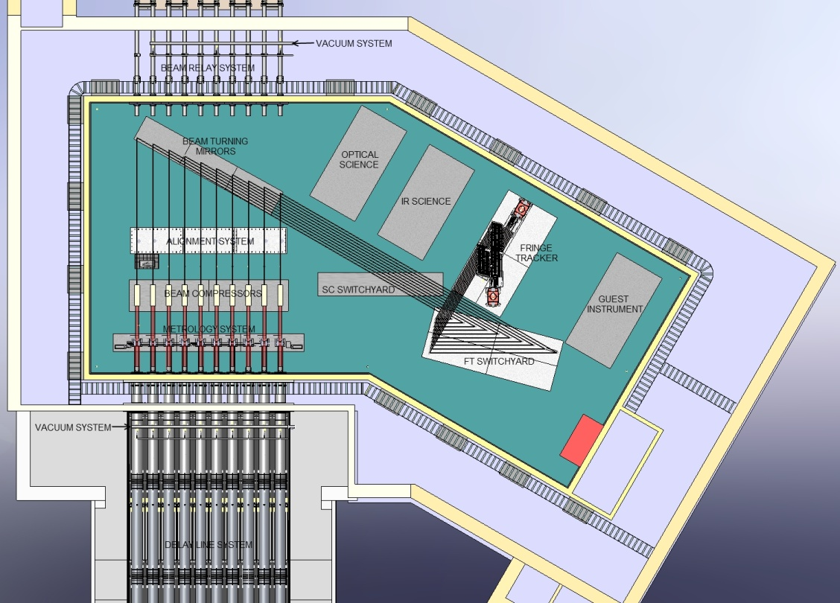
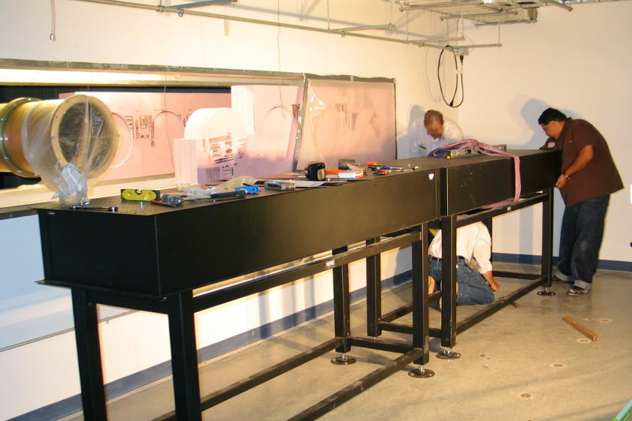
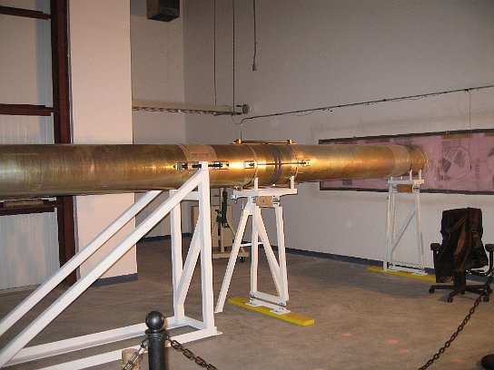
Beam Combining Facility
Completed in 2008
Designed by M3
Vibrational and thermal stability
Supports full 10 telescope array including optical tables for 4 instruments and 10x 190m long delay lines
Includes control rooms, offices and external sleeping quarters
TAE Photographic

Slide 9
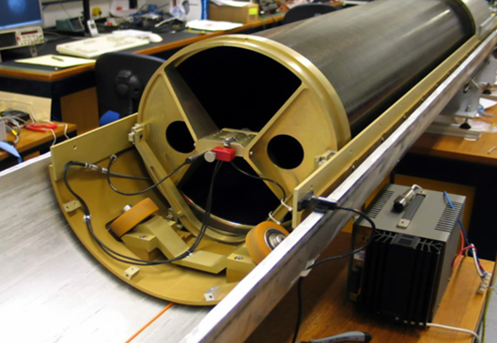
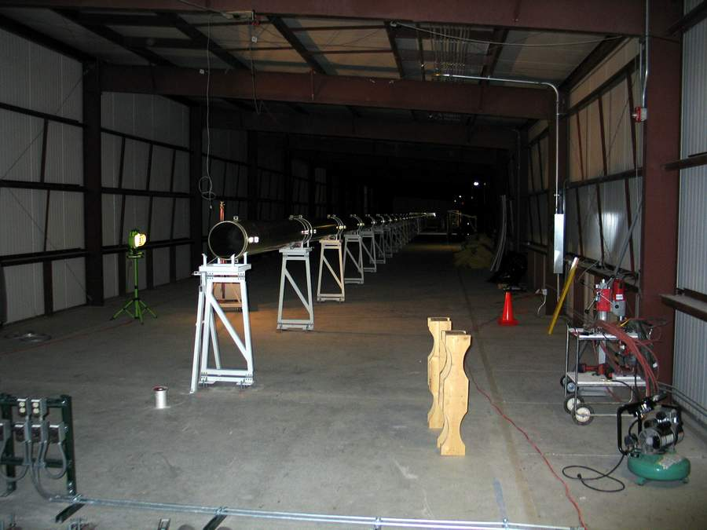
Delay Lines
Innovative design - cart runs on compliant wheels on inside of off-the-shelf vacuum pipe
Designed and built by Cambridge
Sidereal and atmospheric compensation in one-stroke of delay
Inductive pick-up and wireless communication
Pipe install beginning for 2 more beam lines shortly
First cart delivered to MROI
Second cart presently under extended testing at Cambridge

Slide 10
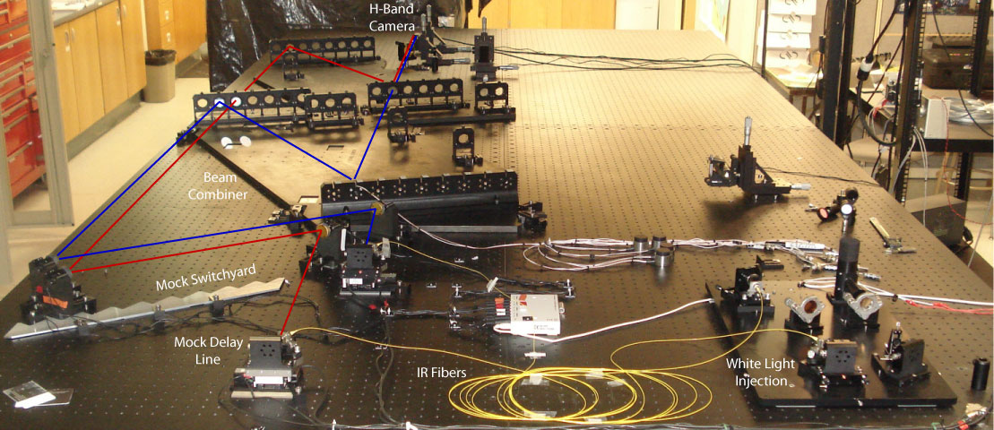
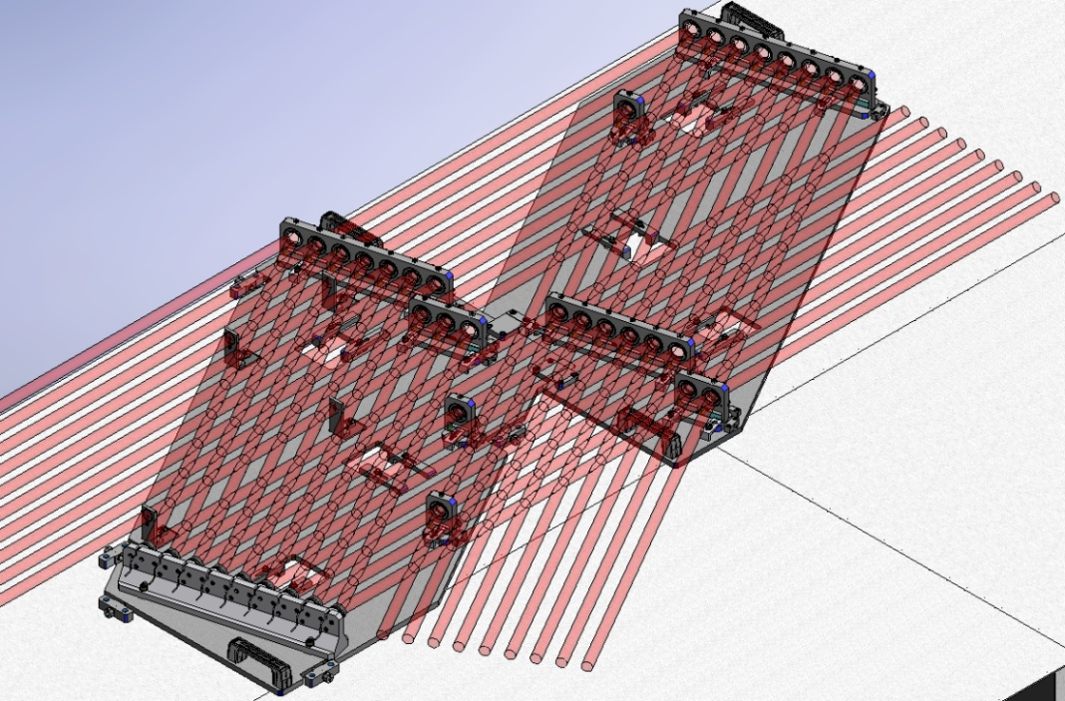
Fringe Tracker -ICoNN
Nearest-neighbors design working at H or K_{s}
Designed and built at NMT/MROI
Dewar accepts 5 combined beams and detects using Selex Saphira detector
Photon counting capability with new detector already under test at Cambridge
Beam combiner mixes all 10 telescopes – inner 6 ports have been tested for fringes in lab

Slide 11
Timeline for Future Development
Funded in $25M cooperative agreement with AFRL which supports deploying first 3 telescopes
First telescope and enclosure deployed on array arms next spring – will characterize light into beam combining facility
Fringes anticipated in 2019 and three-telescope measurements in 2020 – highly funding dependent
More funding needed to complete 10 telescope facility – looking to NSF, alumni, philanthropy
Hardware costs are ~$8M per “beamline” – looking for partners for new beamlines as well as operations
Restarting the SWGs shortly – see me for details

Slide 12
The Team
PI: Van Romero
Director: Ifan Payne
System Architects: David Buscher & Chris Haniff
Project Scientist: Michelle Creech-Eakman
System Engineer: Fernando Santoro
Subcontractors: AMOS, EIE, AOS, Selex, UCryo, several local machine shops
Engineering Team: R. Blasi, C. Dahl, D. Etscorn, A. Farris, M. Fisher, P. Johnston, R. Kelly, D. Klinglesmith, R. Ligon, A. Olivares, J. Pino, C. Salcido, E. Seneta, D. Sun, J. Young
Support Staff: D. Ochoa, C. Gino, C. Pankey
Students: J. Dooley*, E. Garcia, B. Jaynes, L. Jencka, M. LeMaitre, C. McKeen
*- poster 24 upstairs
Thanks for your attention.

