Slide 1
The VLA Sky Survey (VLASS):
A New Generation Radio Sky Survey with the VLA
Amy Kimball (NRAO)
for the VLA Sky Survey team

Slide 2
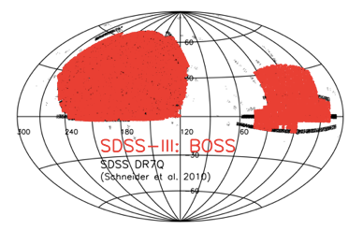
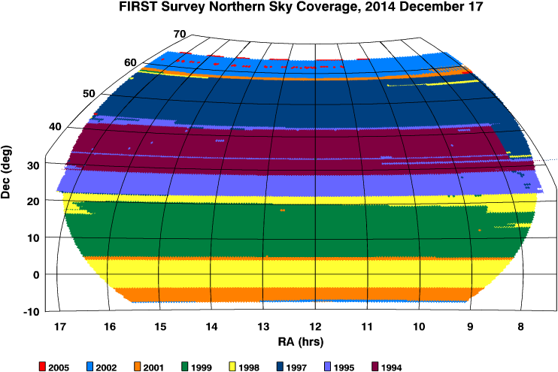
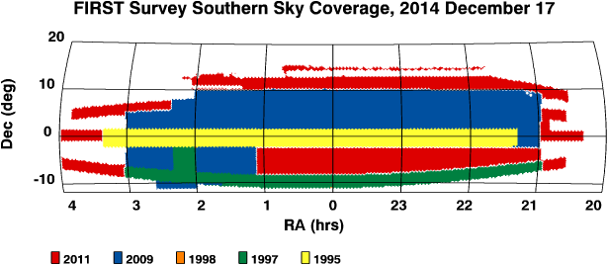
Why a VLA Sky Survey and why now?
Science based on surveys comprise a steadily increasing fraction of VLA publications
20 years since VLA surveys NVSS and FIRST; 5+ years before SKA-1
New scientific opportunities
multi-messenger surveys need radio counterpart with comparable or better resolution
start now to build time series for time domain studies
Community driven survey
Astronomy community proposed a new radio survey taking advantage of VLA’s new capabilities
Reviewed by independent panel, approved by NRAO Director in 2015

Slide 3
VLASS Survey Definition
Highest spatial resolution, all-sky radio survey to date
All-sky (33,885 deg² above declination –40°)
Frequency: 3 GHz (2-4 GHz, less RFI affected regions) “S-band”
64 x 2-MHz channels per spectral window, 16 spectral windows
High angular resolution: 2.5’’ (VLA B-configuration)
Synoptic: 3 epochs separated by 32 months
Observing time: 920 hours per configuration cycle X 6 cycles
Area (deg²) | Resolution (robust) | Rms (μJy/bm) | Density (deg⁻²) | Total Detections
33,885 (δ > -40°) | 2.5” | 120 \ 69 | ~290 | 9,700,000
Full survey, 7 years: September 2017 --- October 2024
Notes:
(<13% science time)

Slide 4
On-The-Fly-Mosaicking observations
Scan telescopes across sky while taking array data (step phase centers)
Efficient when dwell times on-sky are <25s
Correlator dump 0.45s avoids smearing
VLASS survey speed: ~20 deg²/hr with calibration (Moon is ~0.2 deg²)
Scan rate 3.31’/s
1.5’/integration
Row separation 7.2’
Equivalent time-on-source: 5s
×
×
×
×

Slide 5
Key science themes
Imaging galaxies through time and space
AGN feedback, flares, BH merger events; synergies with surveys at other wavelengths (resolution is key!)
Hidden explosions
VLASS will open new parameter space for finding dusty/unbeamed GRBs, SNe, compact object mergers
Faraday tomography of the magnetic sky
Studies of magnetic fields throughout the universe: hot gas in galaxy clusters, magnetic fields within other galaxies, magnetic field in the Milky Way
Peering through our dusty galaxy
Extreme pulsars, cool stars with active coronae, planetary nebulae, HII regions
Missing Physics
Serendipitous discoveries that come from opening up new parts of observational parameter space.
Notes:
Provides a reference radio sky at high angular resolution for multi-wavelength studies

Slide 6
~1PB
Raw data 523 TB
Images 440 TB
VLASS Basic Data Products (public)
Product | Timescale for production | Notes
Raw visibility data | Immediate | In standard archive
Calibrated data | 1 week | From standard archive
Quick Look Images | 2 days | Stokes I wide-band continuum only
Single Epoch Images | 6 months | Stokes I wide-band continuum
Single Epoch Images | 12 months | Polarization and cubes
Single Epoch Catalogs | w/Single Epoch Images | By product
Cumulative Images | 12 months | Stokes I wide-band continuum
Cumulative Images | 12 months | Polarization and cubes
Cumulative Catalogs | w/Cumulative Images | By product
CASA ALMA/VLA data calibration pipeline (VLASS “recipe”)
New imaging pipeline
NRAO → Science-Ready Data Products

Slide 7
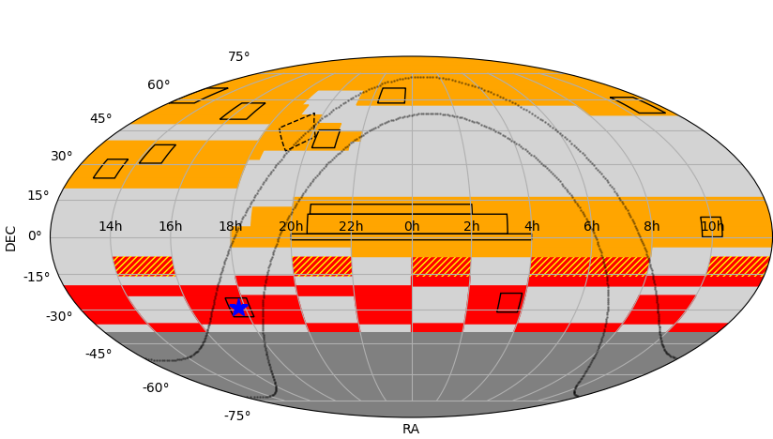
Sky Coverage: cadence and LST pressure
Requirement: 16-month config cycle ⇒ 32-month cadence, same 1st/2nd half division per epoch
Goal: re-observe Pilot tiles (and Kepler field) in 1st-half
Requirement: constant RA pressure per half-epoch (easiest to match LST pressure that varies on16-month configuration cadence)
1st-half
B config
BnA
“hybrid”

Slide 8
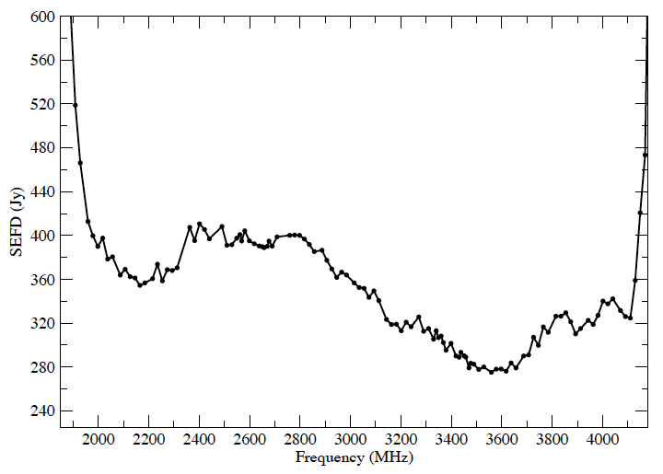
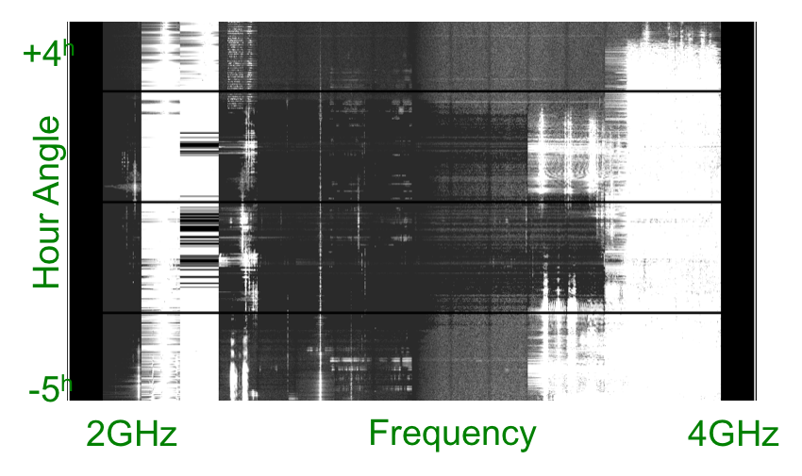
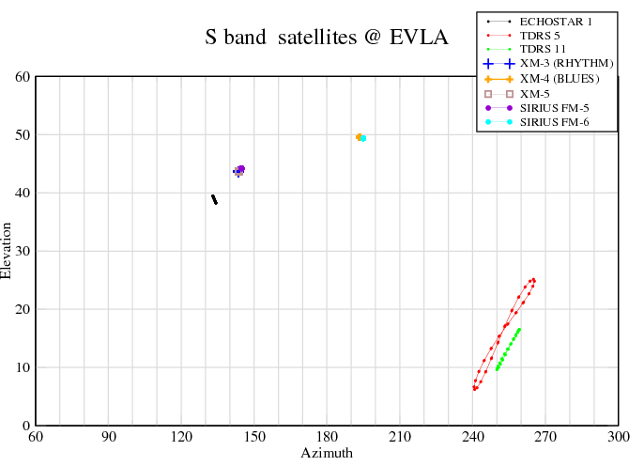
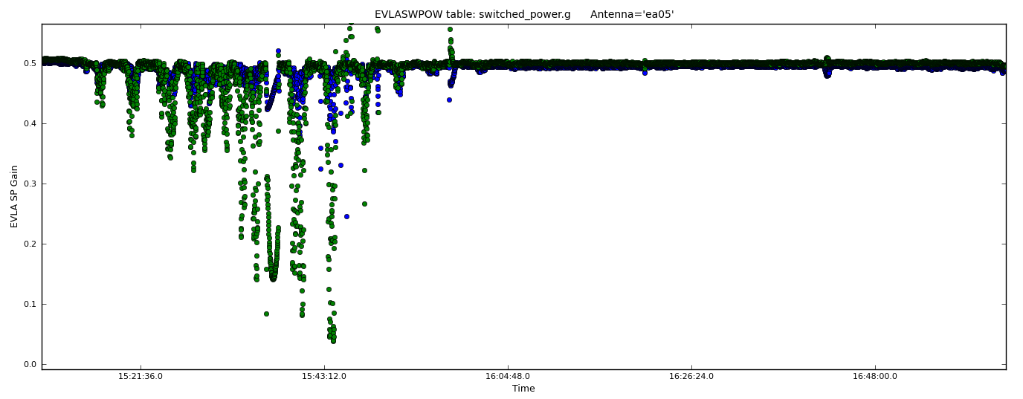
Challenges: RFI / satellite avoidance
Results of RFI sweep
VLASS: 1965-4013 MHz
lower IF
upper IF
SEFD (Jy)
Satellite downlinks + SiriusXM
Satellite downlinks
Frequency (MHz)
Clarke Belt is at δ ~ −5° from the VLA; test shows compression when encountering a geostationary satellite
2-4 Ghz satellites from VLA
Sirius/XM
Switched power gain
Elevation
Switched power data shows compression
Time
Azimuth

Slide 9
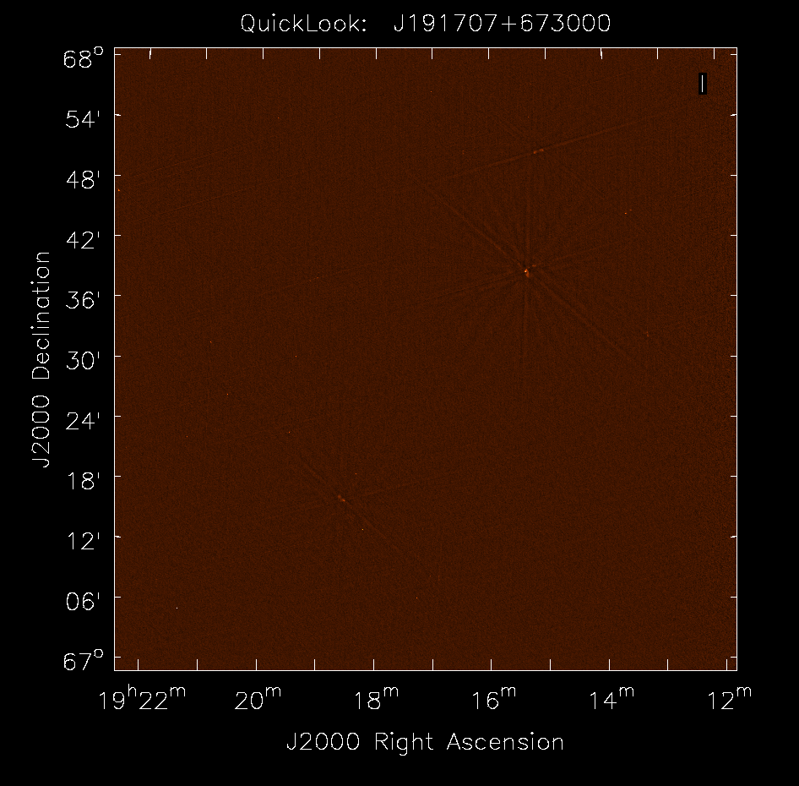
Current imaging: “Quick-Look” Images
First VLASS observation: Sept 2017, 1°x1° sub-mosaic
Instantaneous field-of-view
1°x1° subimage (full 2°x2°)
1” pixel size (13Mpix)
416 phase-centers (2 x 0.45s integ.)
~10GB visibility data
multi -term, -frequency image
𝞂_{I} = 120𝞵Jy/beam
Beam size
Notes:
Image location: file:///lustre/aoc/cluster/pipeline/vlass_auto/cache/quicklook/VLASS1.1/T27t13/VLASS1.1.ql.T27t13.J191707+673000.10.2048.v2/

Slide 10
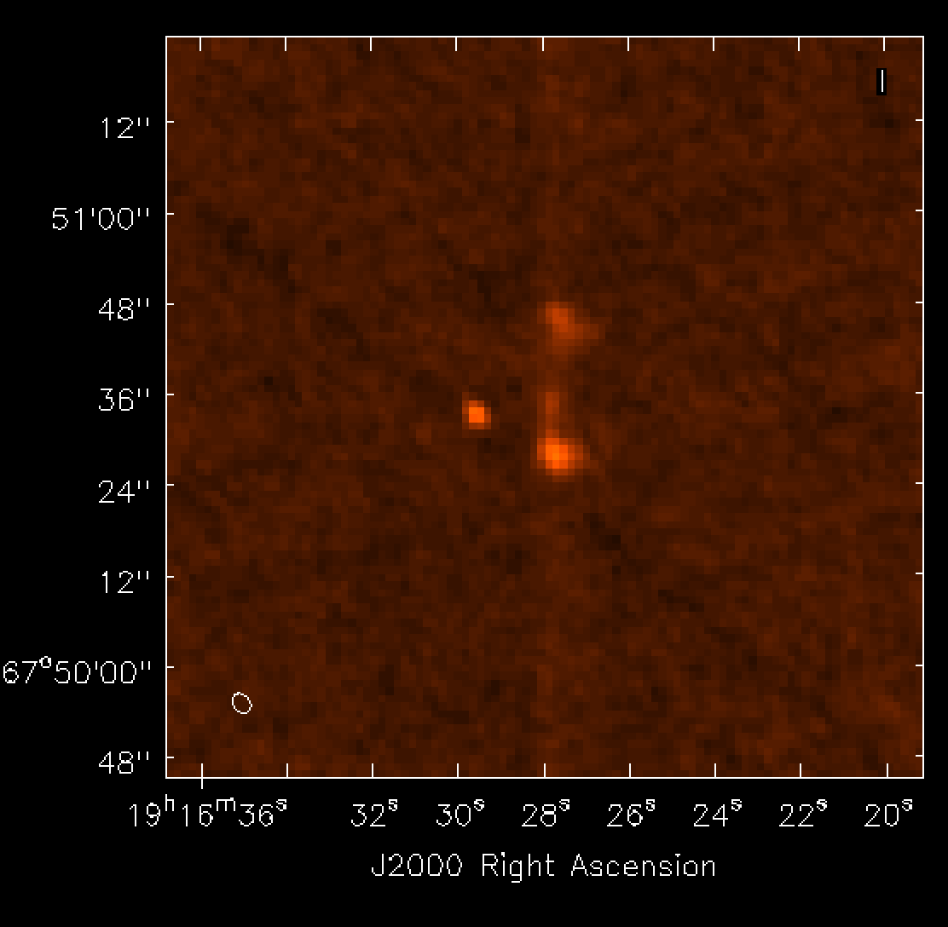
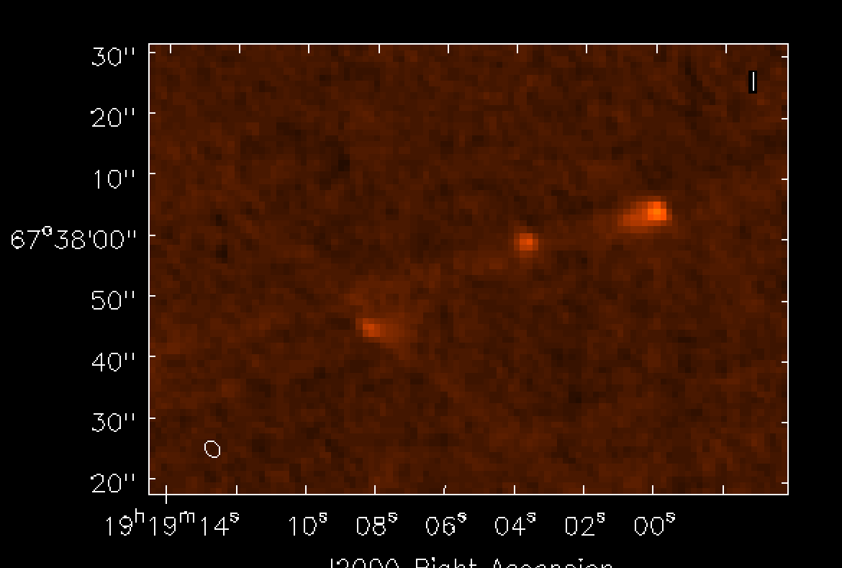
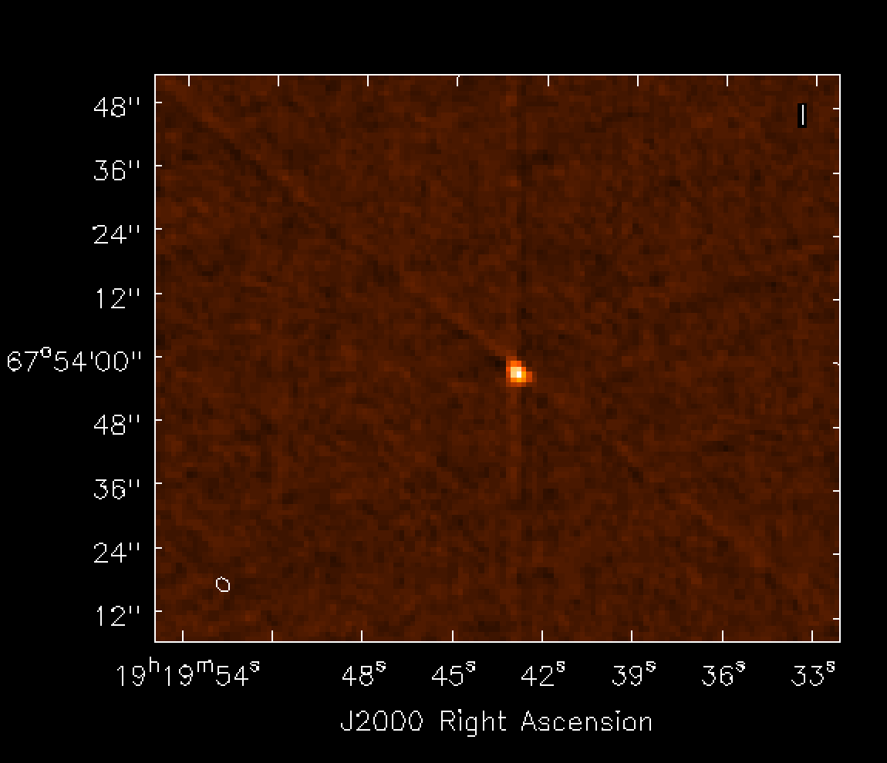
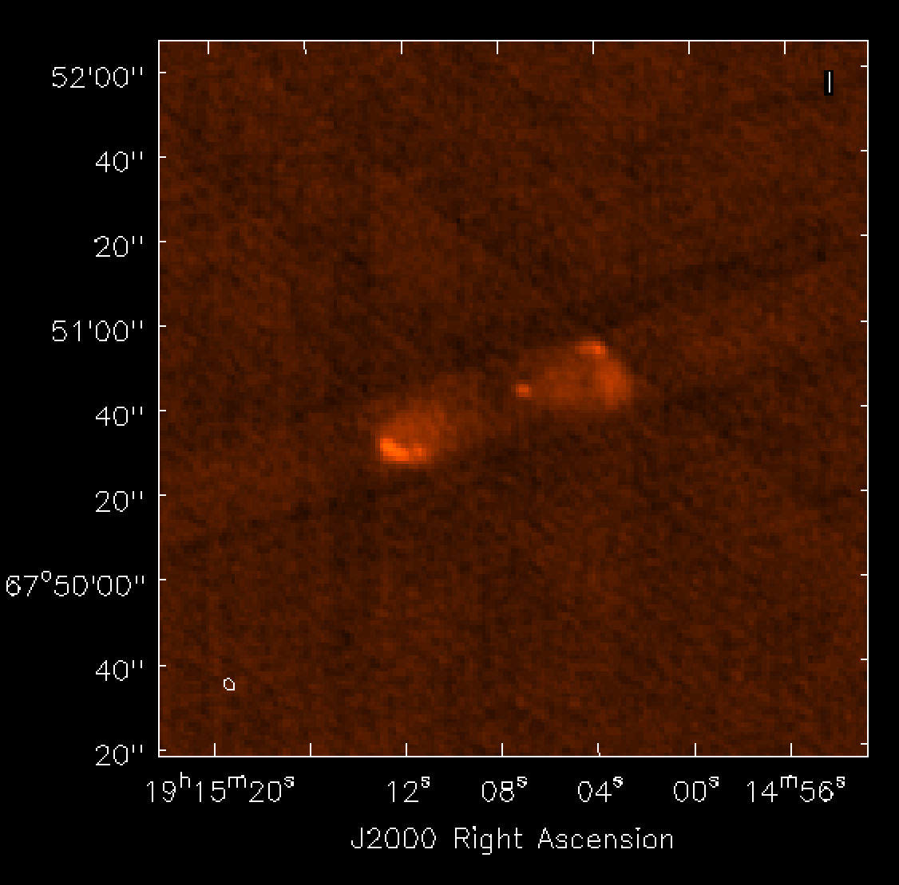
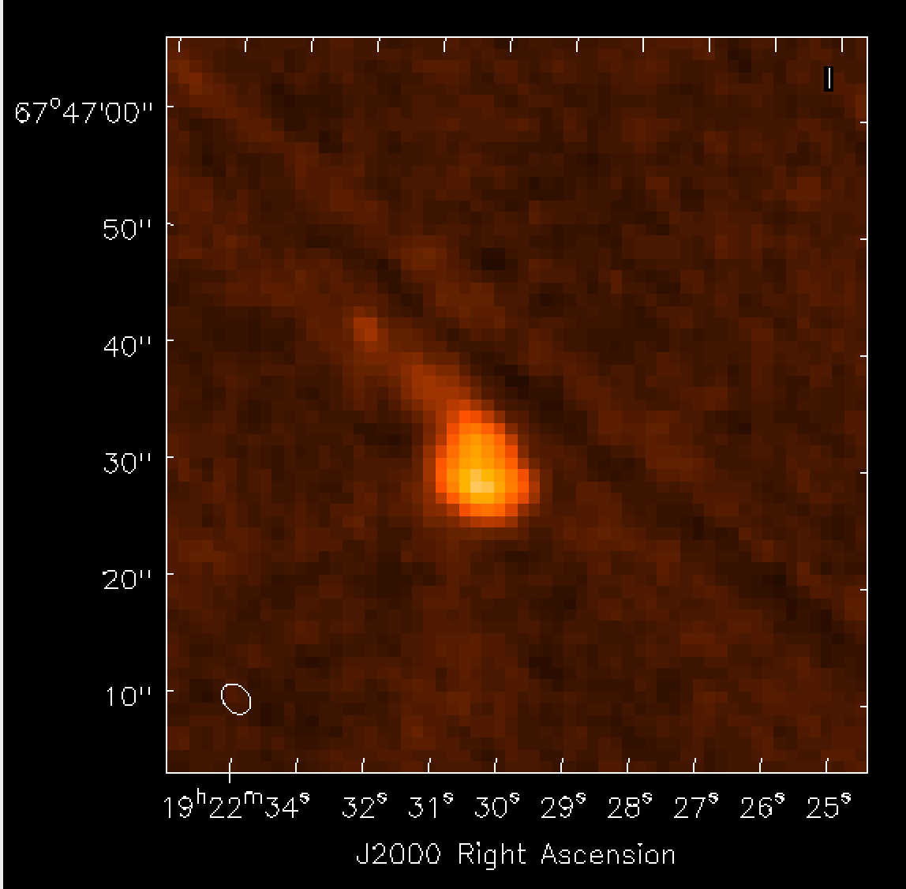
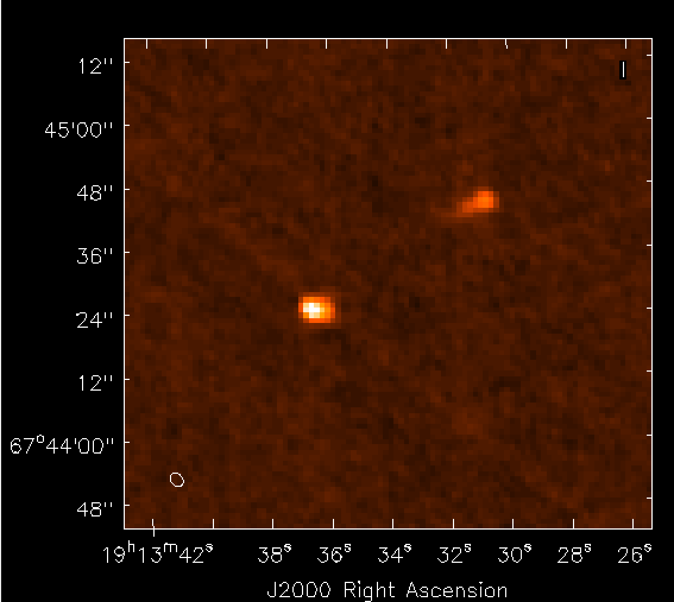
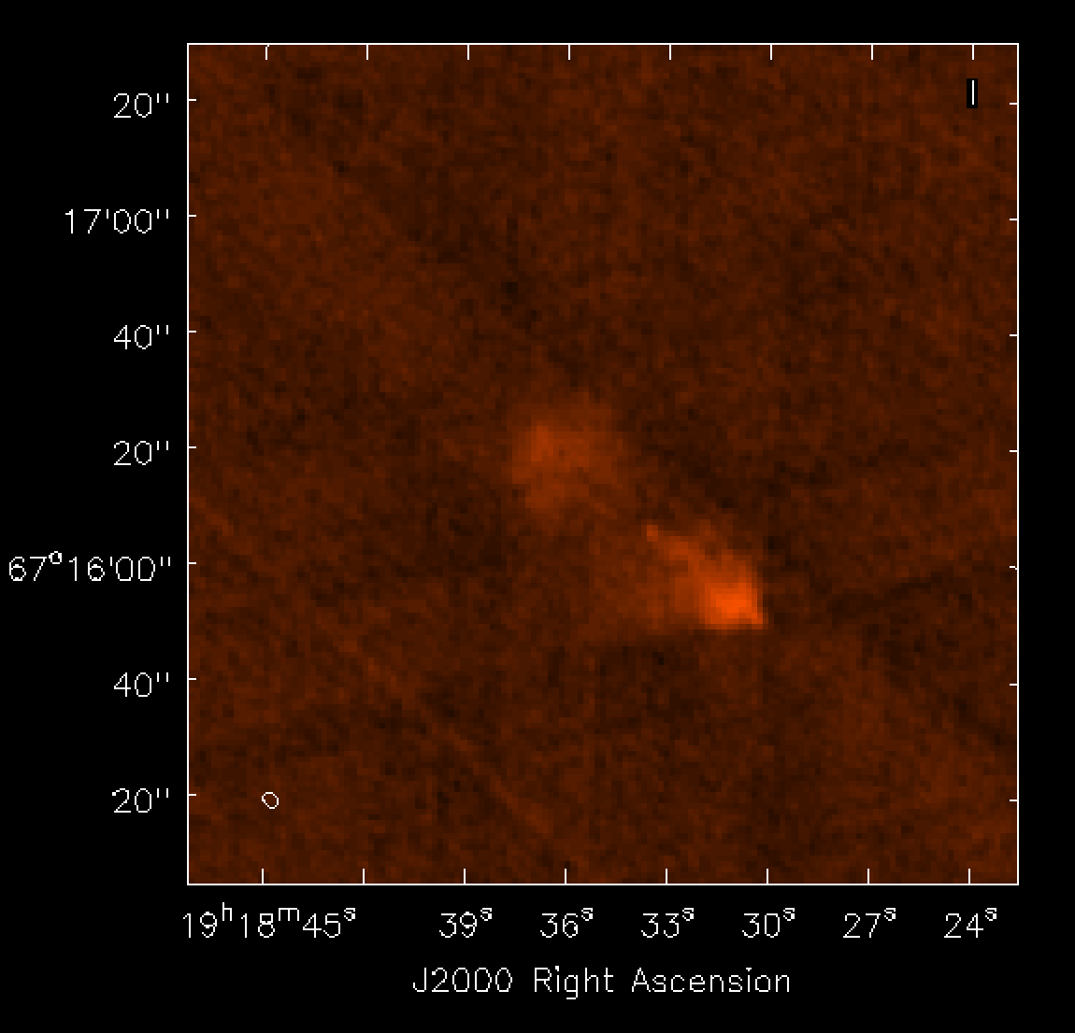
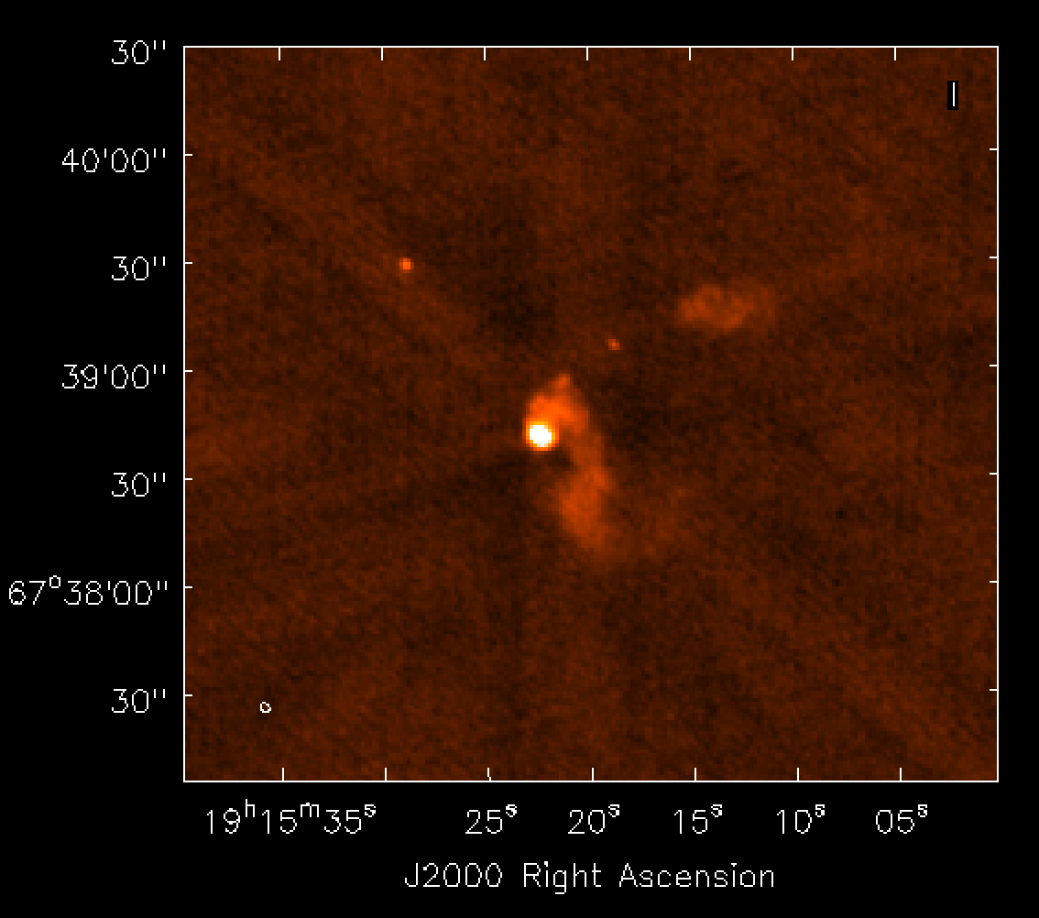

Slide 11
Advantage of VLASS resolution!
Enabling accurate associations with optical galaxies
NVSS
FIRST
VLASS
L. Rudnick (UMinn.)
NVSS J210051-002249
overlaid on SDSS grayscale/colorscale

Slide 12
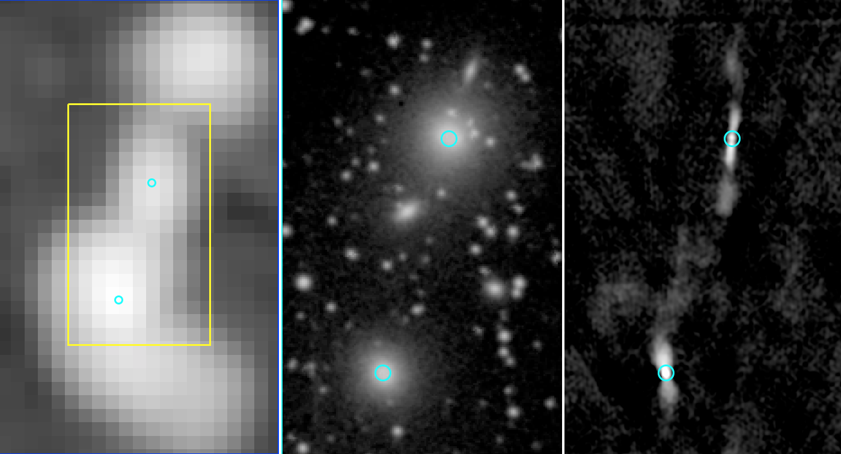
Radio “Galaxy” 3C402
NVSS
DSS
VLASS
Notes:
NVSS: looks like distorted very large triple.
VLASS: two sources

Slide 13
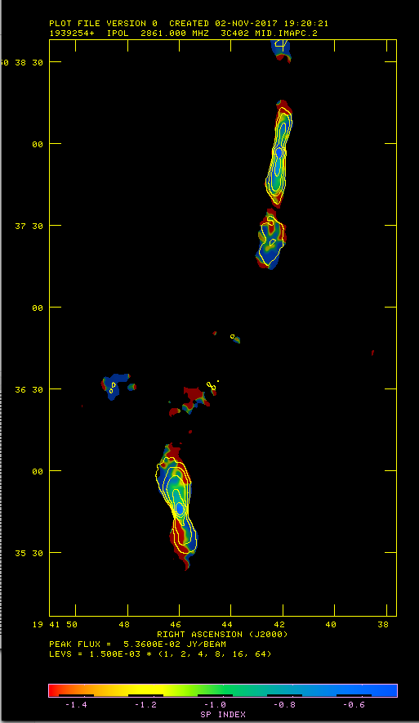
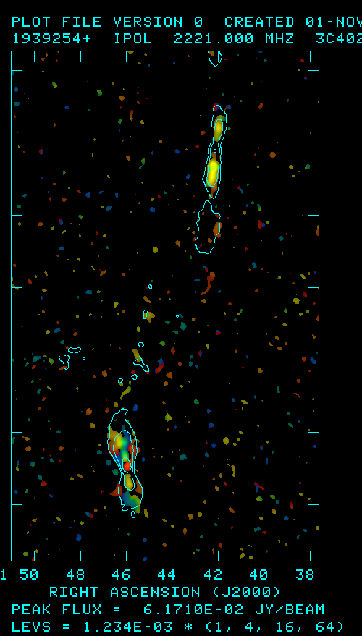
3C402 Galaxies: spectral index and polarization
(preliminary results, L. Rudnick, UMinn.)
spectral index
polarization
Stokes I
Notes:
Total intensity (contours)
Spectral index between 2.2 GHz and 3.5 GHz.
Polarization angle color, polarized intensity
There is an embedded "jet” in the northern plume of the southern source as seen in polarization, although it all blends together in total intensity.
A perfect example of why we need this resolution!

Slide 14
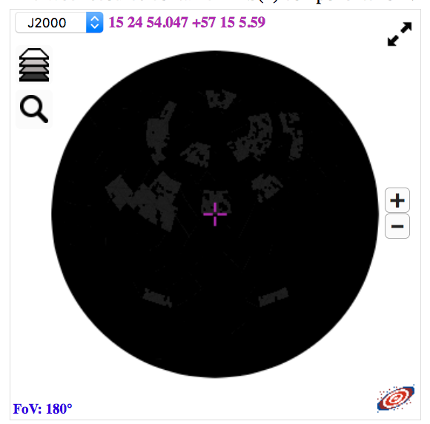
VLASS QuickLook Image Mosaic
http://www.aoc.nrao.edu/~smyers/vlass/VLASS1.1/pubimages/ALLPNG/
HiPS (HEALPix) image displayed by Aladin
Upstairs in the poster room!

Slide 15
VLA Sky Survey Team
VLASS Team (NRAO):
Claire Chandler (Project Director), Steve Myers (Technical Lead)
Rafael Hiriart (Architect), Drew Medlin (Lead DA: Ops/Pipeline/QA)
Chris McLaughlin (Project Management)
Amy Kimball, Frank Schinzel, Josh Marvil, Lorant Sjouwerman (Scientists)
Survey Science Group Board
Stefi Baum (Manitoba), Shami Chatterjee (Cornell) (co-chairs)
Gordon Richards (Drexel), Amy Kimball (NRAO), Rachel Osten (STScI), Joe Lazio (JPL), Gregg Hallinan (Caltech), Gregg Sivakoff (Alberta), Susana Deustua (STScI), Jayanne English (Manitoba), Larry Rudnick (Minnesota), Bryan Gaensler (Toronto), Casey Law (Berkeley), Kunal Mooley (Oxford), Tracy Clarke (NRL), Jim Condon (NRAO), Jim Cordes (Cornell), Nicole Gugliucci (Anselm), Russ Taylor (Cape Town), Rick White (STScI), Ashley Zauderer (NYU)

Slide 16
VLASS references and more information
Survey science website:
https://science.nrao.edu/science/surveys/vlass
Public wiki with technical information, VLASS memo series:
https://safe.nrao.edu/wiki/bin/view/JVLA/VLASS
Access VLASS calibration results and QuickLook images:
https://archive-new.nrao.edu/vlass/
Technical & Pilot results publications in preparation (Lacy et al.)

