Slide 1
VLBA Sensitivity Upgrade: Science and Status
J.D. Romney, J.S. Ulvestad, W.F. Brisken, A.T. Deller, R.C. Walker, & S.J. Durand
NRAO
25th New Mexico Symposium
Socorro, New Mexico
2009 / 1 / 15

Slide 2
The VLBA Sensitivity Upgrade
First Major, Overall Upgrade of the Instrument
… since it was inaugurated in 1993.
Previous, Limited Upgrades
Some receivers upgraded to state-of-the-art.
22-GHz receiver upgrade, funded by MPIfR, completed January 2008.
Two-fold overall expansion of data path bandwidths.
Peak data rate increased from initial 32 to 64 MHz/polarization.
Sustained rate increased from initial 16 to 32 MHz/polarization.
Current Upgrade Goal
Apply modern technology to expand data path to 512 MHz / polarization bandwidth [ → 10 μJy/beam in 6^{h} at λλ 4-21 cm ].
Fourfold increase in continuum sensitivity.
Fainter scientific targets observable.
Fainter, denser calibrators usable for phase referencing and differential astrometry.
Notes:
Pie Town

Slide 3
Science Drivers
AGN jet launching regions.
Blazars with gamma-ray flares.
Location and velocity of gamma-ray burst blast waves.
Mapping ionized gas in AGN cores.
Galactic microquasars.
Line absorption against compact continuum sources.
Astrometry, parallax, proper motion of galactic objects.
Cosmological distance scale.
Extragalactic astrometry.
Notes:
Kitt Peak

Slide 4
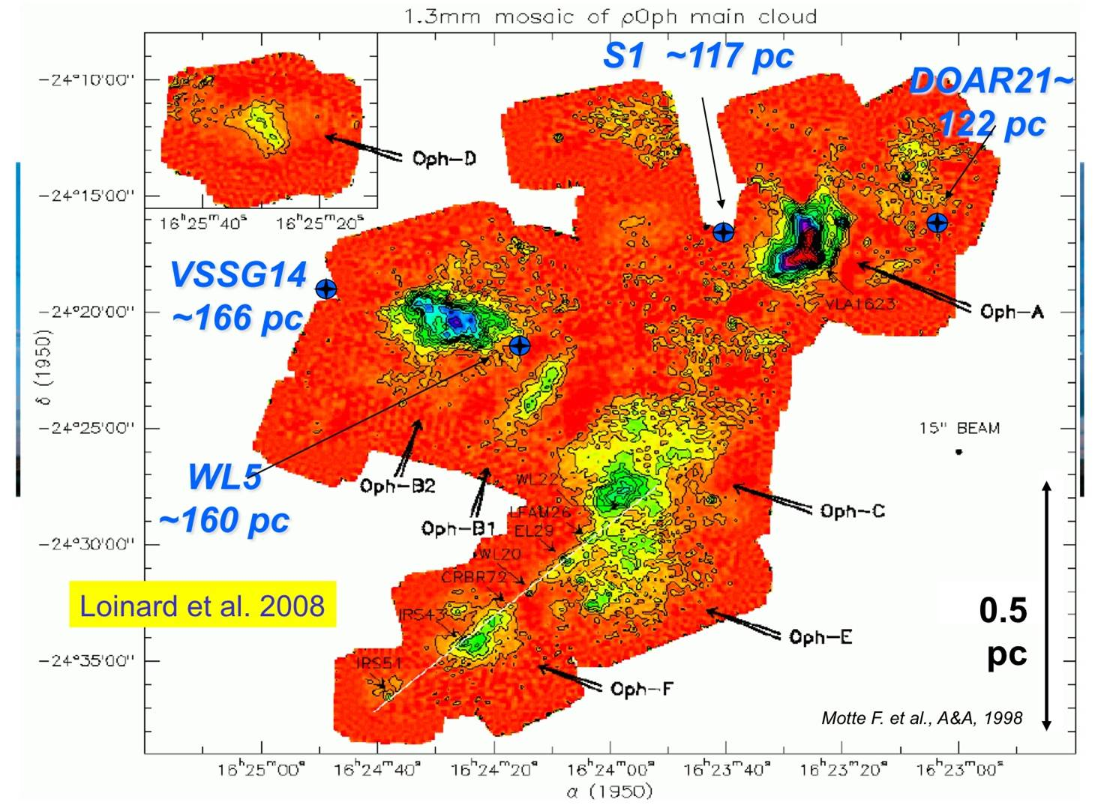
3D Views of the Milky Way
Distances of four young stars in Ophiuchus, with geometric parallaxes measured by the VLBA with 5% accuracy (Loinard et al. 2008).
Similar measurements of water and methanol masers (e.g., Reid et al. 2009) are expected to yield a complete “plan” of the Milky Way galaxy by mid-decade.
Notes:
Los Alamos

Slide 5
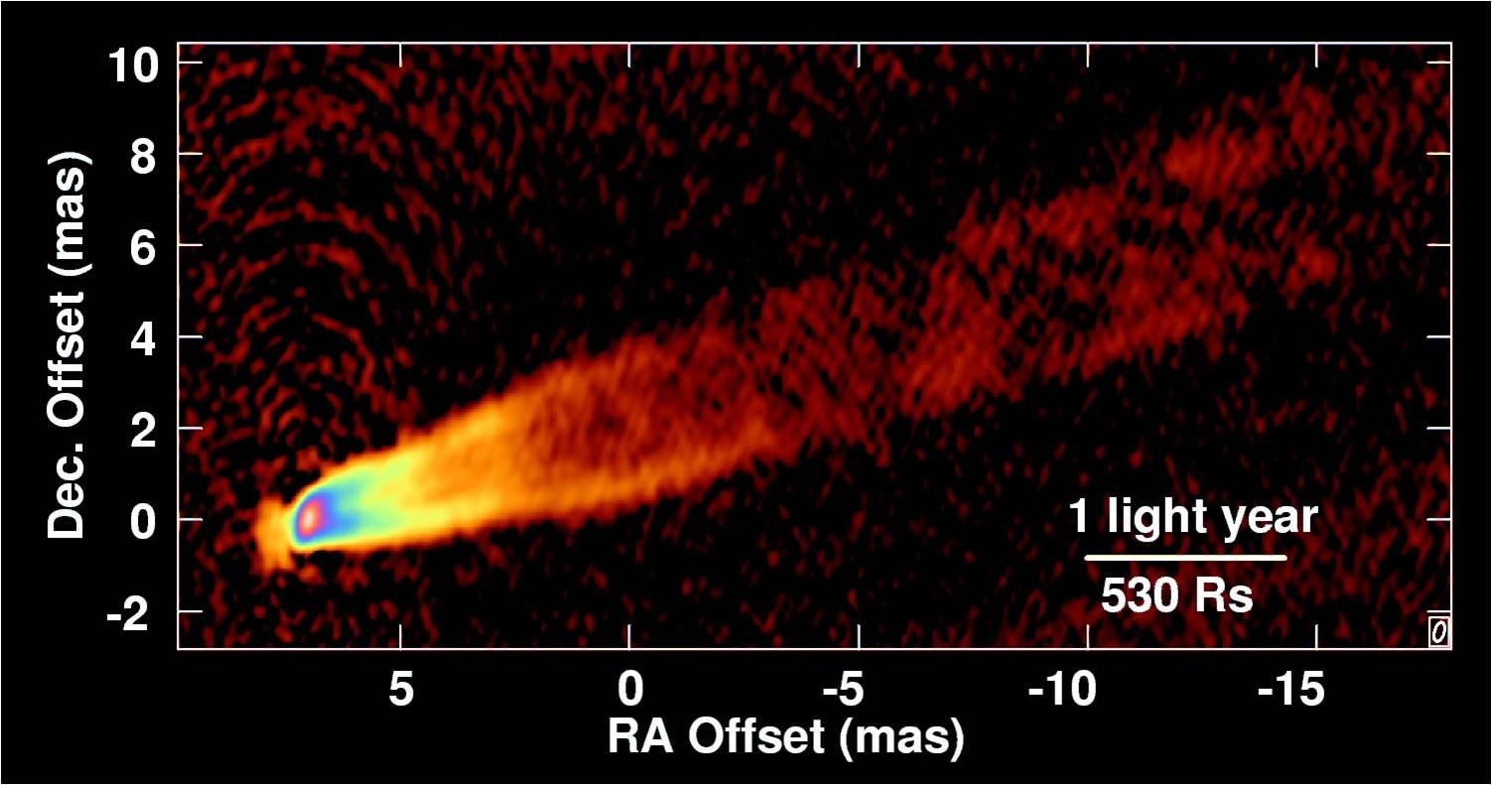
Source of TeV Gamma Rays
VLBA image of the active galaxy M87 with resolution of 30x60 Schwarzschild radii of the central massive black hole (MBH). Multi-epoch imaging has revealed that the TeV source is within tens of gravitational radii of the MBH (Acciari et al. 2009).
See paper by Walker et al. in session 4 this afternoon.
Notes:
Fort Davis

Slide 6
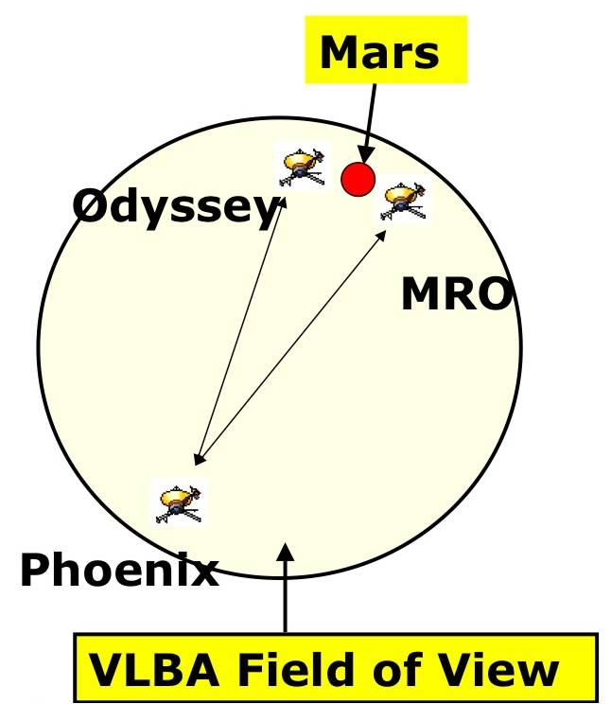
Precision Spacecraft Navigation
The sketch shows the location of NASA spacecraft near the end of a series of VLBA demonstration observations, as the Phoenix space-
craft approached Mars in May 2008 (Martin-Mur & Highsmith 2009). Relative spacecraft positions were determined to better than 100 m.
The VLBA sensitivity upgrade will enable improved troposphere cali- bration by use of weaker reference sources closer to the spacecraft, and thus improve position accuracy.
Notes:
North Liberty

Slide 7
VLBA Sensitivity Upgrade Implementation
Target Completion: 2011
4-Gbps capability, with sustained operation requiring only additional recording and processing resources.
High-priority science, at up to 2 Gbps, could be supported in 2010.
Memo Series
http://www.vlba.nrao.edu/memos/sensi/
Three Sub-Projects
Digital Backend (RDBE) sub-band processor.
Mark 5C recording system.
DiFX software correlator.
Notes:
Owens Valley

Slide 8
Digital Backend Sub-Band Processor
Sample Directly in 512-1024 MHz IF
All subsequent processing digital.
Filter Personalities
Digital down-converter (DDC).
4 independently tunable sub-bands per IF.
Bandwidths 0.5 – 256 MHz; Output sample precision: 1-8 bits.
Polyphase filterbank (PFB).
≥ 32 sub-bands spanning entire 512-MHz IF bandwidth.
Firmware development in collaboration with Haystack Observatory.
Output
10-Gigabit Ethernet; individual sub-band packet streams.
Maximum output rate 8 Gbps.
Notes:
Brewster

Slide 9
Digital Backend (RDBE)
Hardware Platform: “ROACH”
“Reconfigurable Open Architecture Computing Hardware”
Upgrade of UCB CASPER group’s successful iBOB.
Developed by CASPER / KAT / NRAO collaboration.
Two ROACH-based “RDBE” units required for full VLBA station capability.
Status
ROACH boards in hand; 3 prototype RDBE units assembled.
PFB personality firmware largely implemented; Haystack/NRAO collaboration converging.
DDC personality and control software under development.
Notes:
Hancock

Slide 10
Mark 5C Recording System
Successor to Mark 5A/B/B+ Disk-Based Recorders
Joint development by NRAO / Haystack / Conduant Corp.
Requirements
Sustained recording at ≥ 4 Gbps.
Conduant’s “Amazon” disk array controller supports these data rates.
10G Ethernet input interface, in sub-band packet streams.
Mezzanine board for this interface was only new design required.
Output optimized for direct access from a software correlator.
Status
3 complete Mark 5C units
… received as part of development contract with Conduant Corp.
8 Mark 5A → 5C upgrade kits
… purchased by UNAM (L. Loinard) with funding from CONACyT.
Control software under development.
Notes:
St. Croix

Slide 11
DiFX Software Correlator
NRAO Implementation
Software written by Adam Deller at Swinburne University.
Deller now a Jansky Fellow at NRAO/Socorro.
Variety of peripheral software required to interface to VLBA.
Developed by Walter Brisken and software team.
Includes Operator GUI to retain “look & feel” of original system.
Now Operational !
… in routine use for all VLBA observations.
See Poster #29 by Deller et al.
Notes:
Mauna Kea

Slide 12
For further details and references,
see Poster #30 by Ulvestad et al.
Thank you
Notes:
Thank you

Slide 13
Note on the Immediate Future of the VLBA
The 2006 Senior Review carried out by NSF’s Division of Astronomical Sciences included a recommendation that one half of the VLBA’s operating funds (approximately $3M per year) should be found from external sources. A major partnership agreement has been forged, although not yet fully concluded, under which several non-NSF organizations will provide VLBA operating funds beginning in FY 2011, in return for VLBA access. Past partnerships with the Max-Planck-Institut für Radioastronomie (Germany) and the Universidad Nacional Autónoma de México have funded improvement of the critical 22-GHz observing system and deployment of the wideband Mark 5C recording system, enhancing VLBA sensitivity for all astronomers.

