Slide 1
EVLA Observations of the Orion Hot Core: a Taste of the Future
Claire Chandler
on behalf of NRAO-NM staff

Slide 2
The EVLA
The Expanded Very Large Array is a $90M upgrade of the Very Large Array; project began in 2001, will be completed in 2012, on time, on spec, on budget
The EVLA will multiply by orders of magnitude the observational capabilities of the VLA. Key goals are:
Full frequency coverage from 1 to 50 GHz.
Up to 8 GHz instantaneous bandwidth.
New correlator with unprecedented capabilities
~3 μJy (1-σ, 1-hr) point-source continuum sensitivity at most bands.
~1 mJy (1-σ, 1 km/s, 1-hr) line sensitivity at most bands.
New receivers; new data transmission system; new correlator. See http://science.nrao.edu/evla/publications/meetandpresent.shtml for presentations with more technical detail

Slide 3
Milestones and current status
26 of 28 antennas now converted to EVLA standards; antenna conversion complete by July 2010
VLA correlator was shut down on Jan 11
New EVLA correlator made by HIA/DRAO, Canada, awakens early February
EVLA Early Science begins in March 2010
OSRO and RSRO programs begin March 2010 and continue through end of 2012
2 GHz bandwidth initially, full bandwidth (8 GHz) implemented on all antennas mid-2011
Receiver implementation completed end of 2012

Slide 4
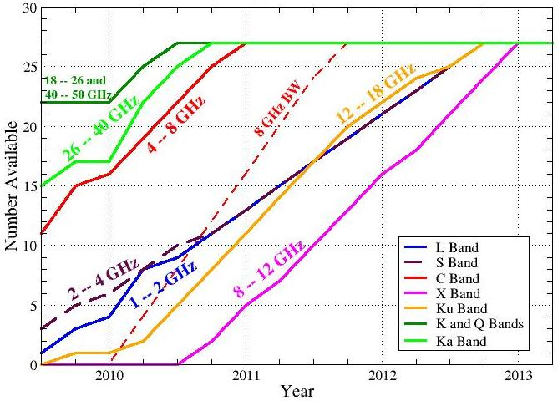
Availability of EVLA receivers/bandwidth
VLA or “interim” receivers will continue to be available at L, C, and X-band in addition to those shown below
EVLA
Correlator
Array Shutdown

Slide 5
EVLA correlator capabilities
Major capabilities:
8 GHz maximum instantaneous bandwidth, with full polarization
From 16384 (min) to 4.2 million (max) frequency channels
64 independently tunable full polarization sub-bands, each of which is effectively an independent ‘sub-correlator’
Extensive special modes: pulsar gating/binning, phased array, VLBI, burst modes, and more
Fundamental capabilities will be developed first, with specialty modes later

Slide 6
Demonstration Science
A 12-antenna sub-array has been used to test a subset of the final correlator
The test configuration provides:
8192 channels
Full polarization
Eight adjacent sub-bands
To illustrate the capabilities of the correlator we have observed the Orion Hot Core at λ ~ 1.2 cm:
3 x 1 GHz coverage
24,000 channels with 1.5 km/s spectral resolution
θ ~ 3 arcsec

Slide 7
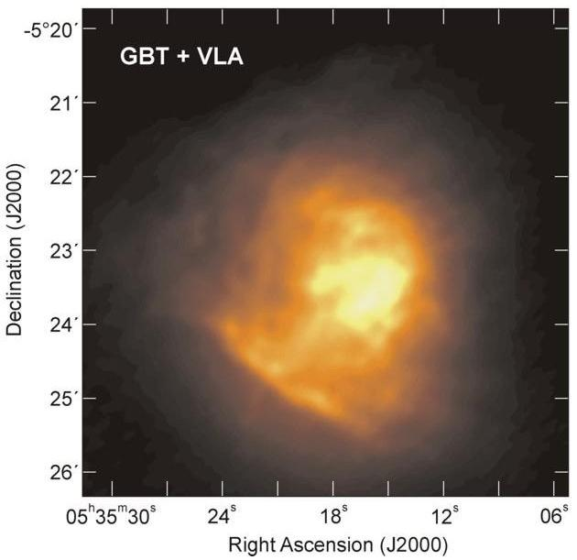
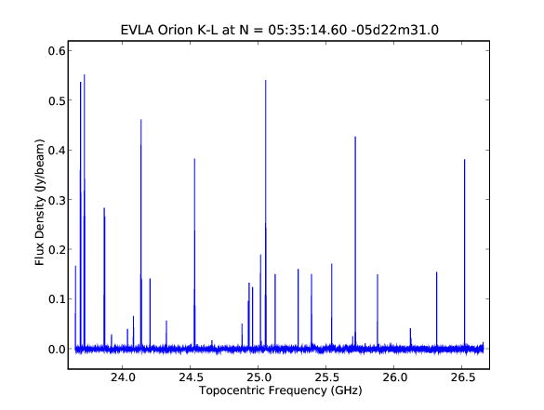
Orion Hot Core
The hot core lies in the molecular cloud behind the nebula
Hot cores are thought to be signposts of the earliest phase of massive star formation; rich chemistry, high densities and temperatures
8 GHz image from GBT+VLA

Slide 8
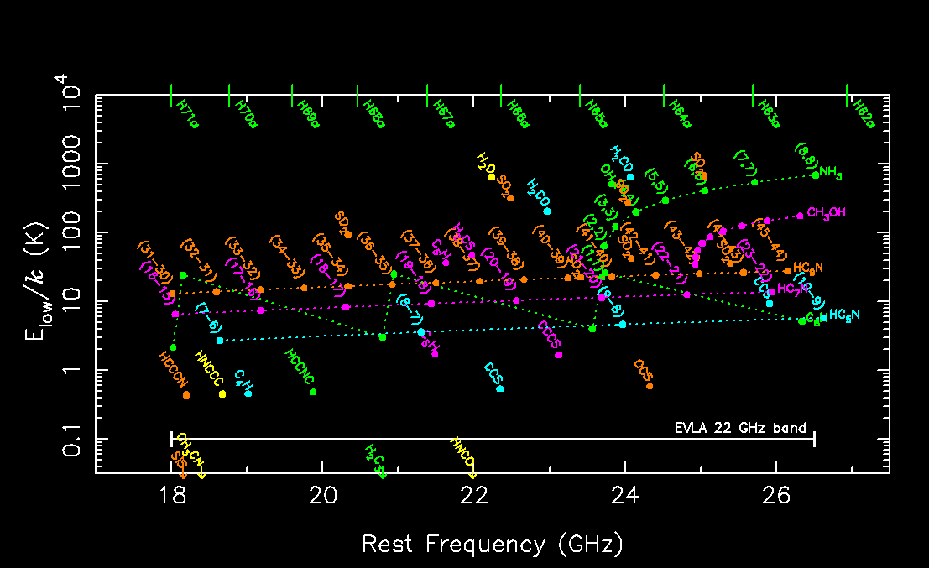
Transitions in K-band 18-26.5 GHz window

Slide 9
Orion Hot Core line IDs
Ammonia, NH₃
8 lowest meta-stable inversion transitions (J,K) = (1,1) to (8,8)
(6,6) line from ¹⁵NH₃ isotopologue
the 4(1,4)-4(0,4) line from NH₂D
meta-stable (9,8) & (10,9) lines
Methyl formate, CH₃CHO
two E/A doublets
Carbonyl sulphide, OCS
J=2→1 rotational transition
Sulphur dioxide, SO₂
Three transitions
Methanol, CH₃OH
Ten maser lines from J=2—10 series, E-type
Various unidentified and weak lines

Slide 10
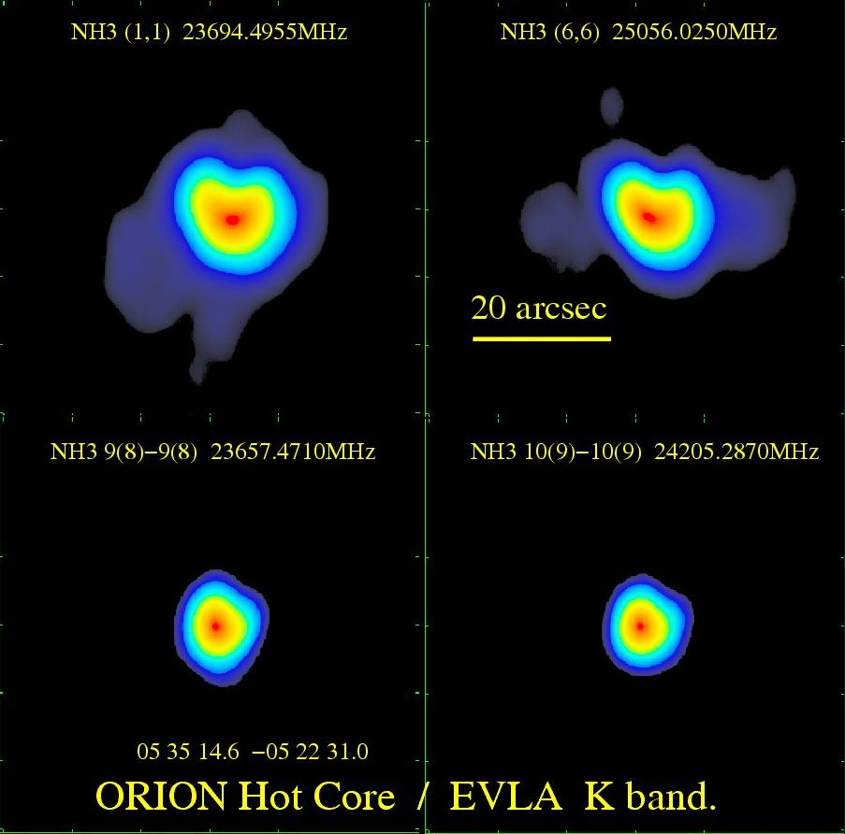
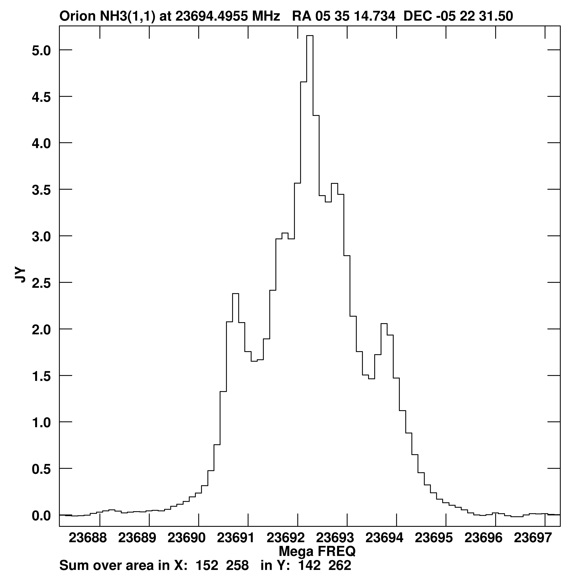

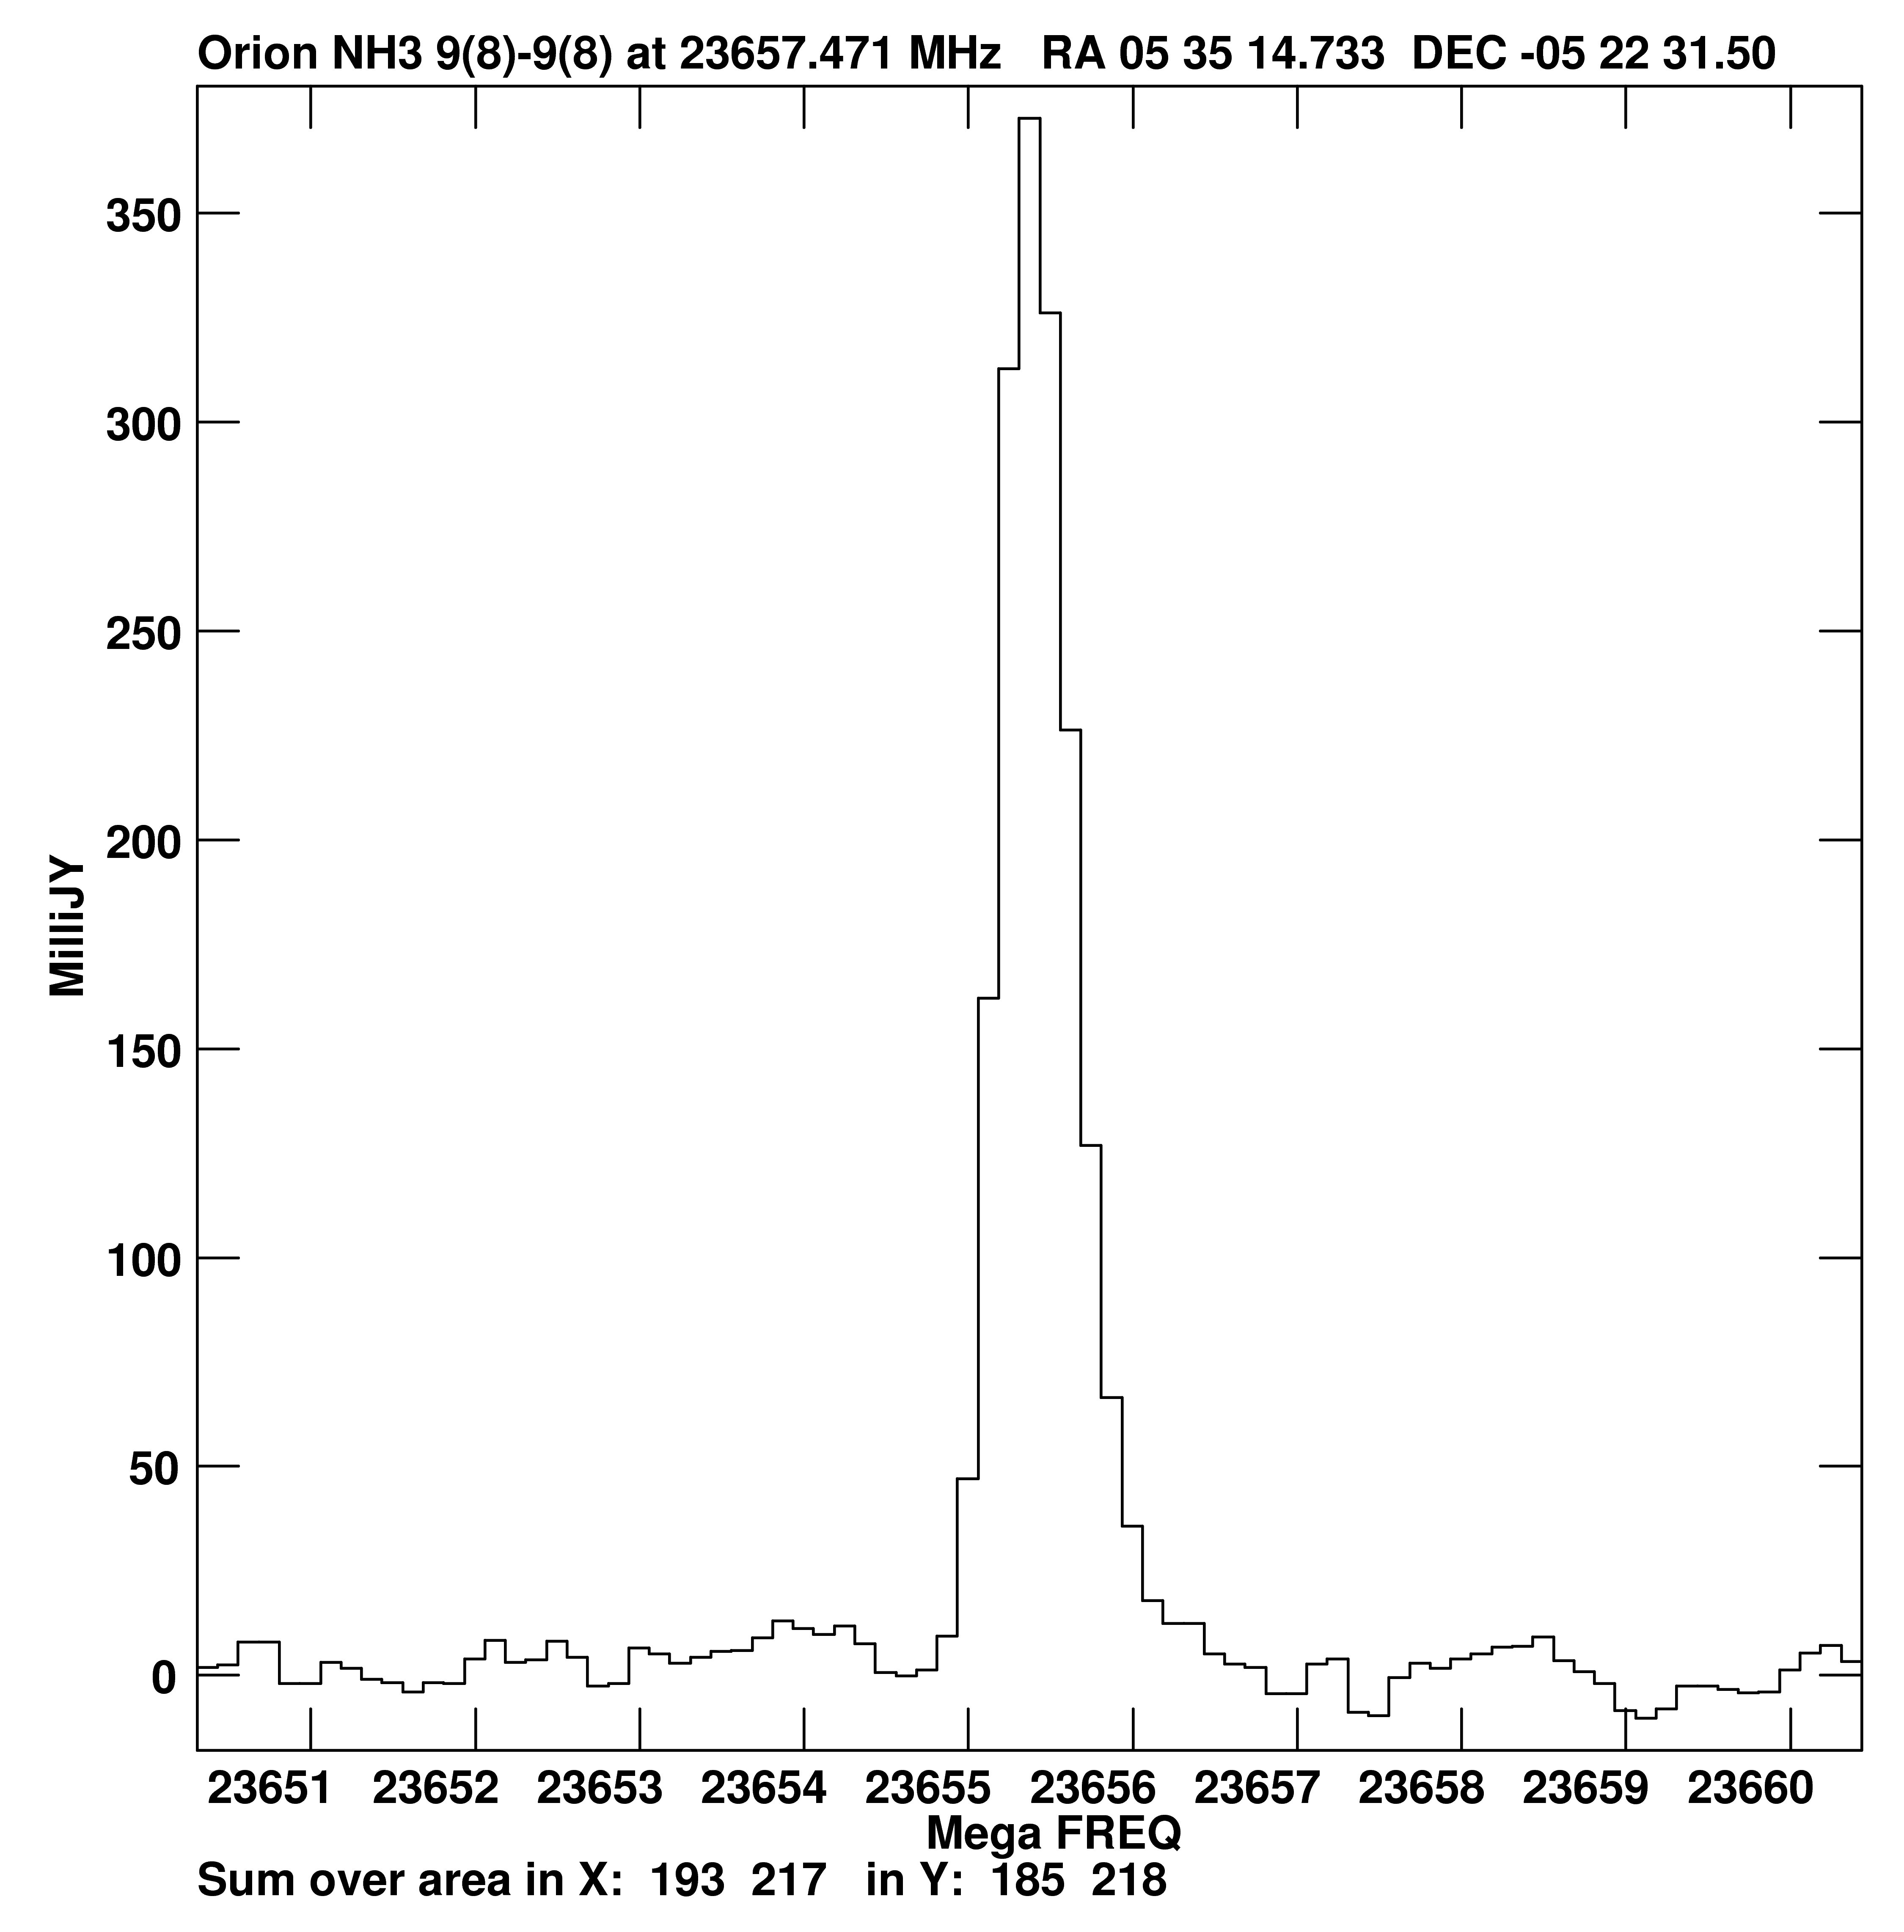
Spatial distribution: NH₃
NH₃ (1,1): E_{low}=23 K
NH₃ (6,6): E_{low}=408 K
Low-energy NH₃ transitions trace cooler, extended molecular gas in the surrounding cloud
High-energy NH₃ transitions pinpoint location of a central heating source in the hot core
NH₃ 9(8)-9(8), 10(9)-10(9):
E_{low}~ 940 to 1140 K

Slide 11
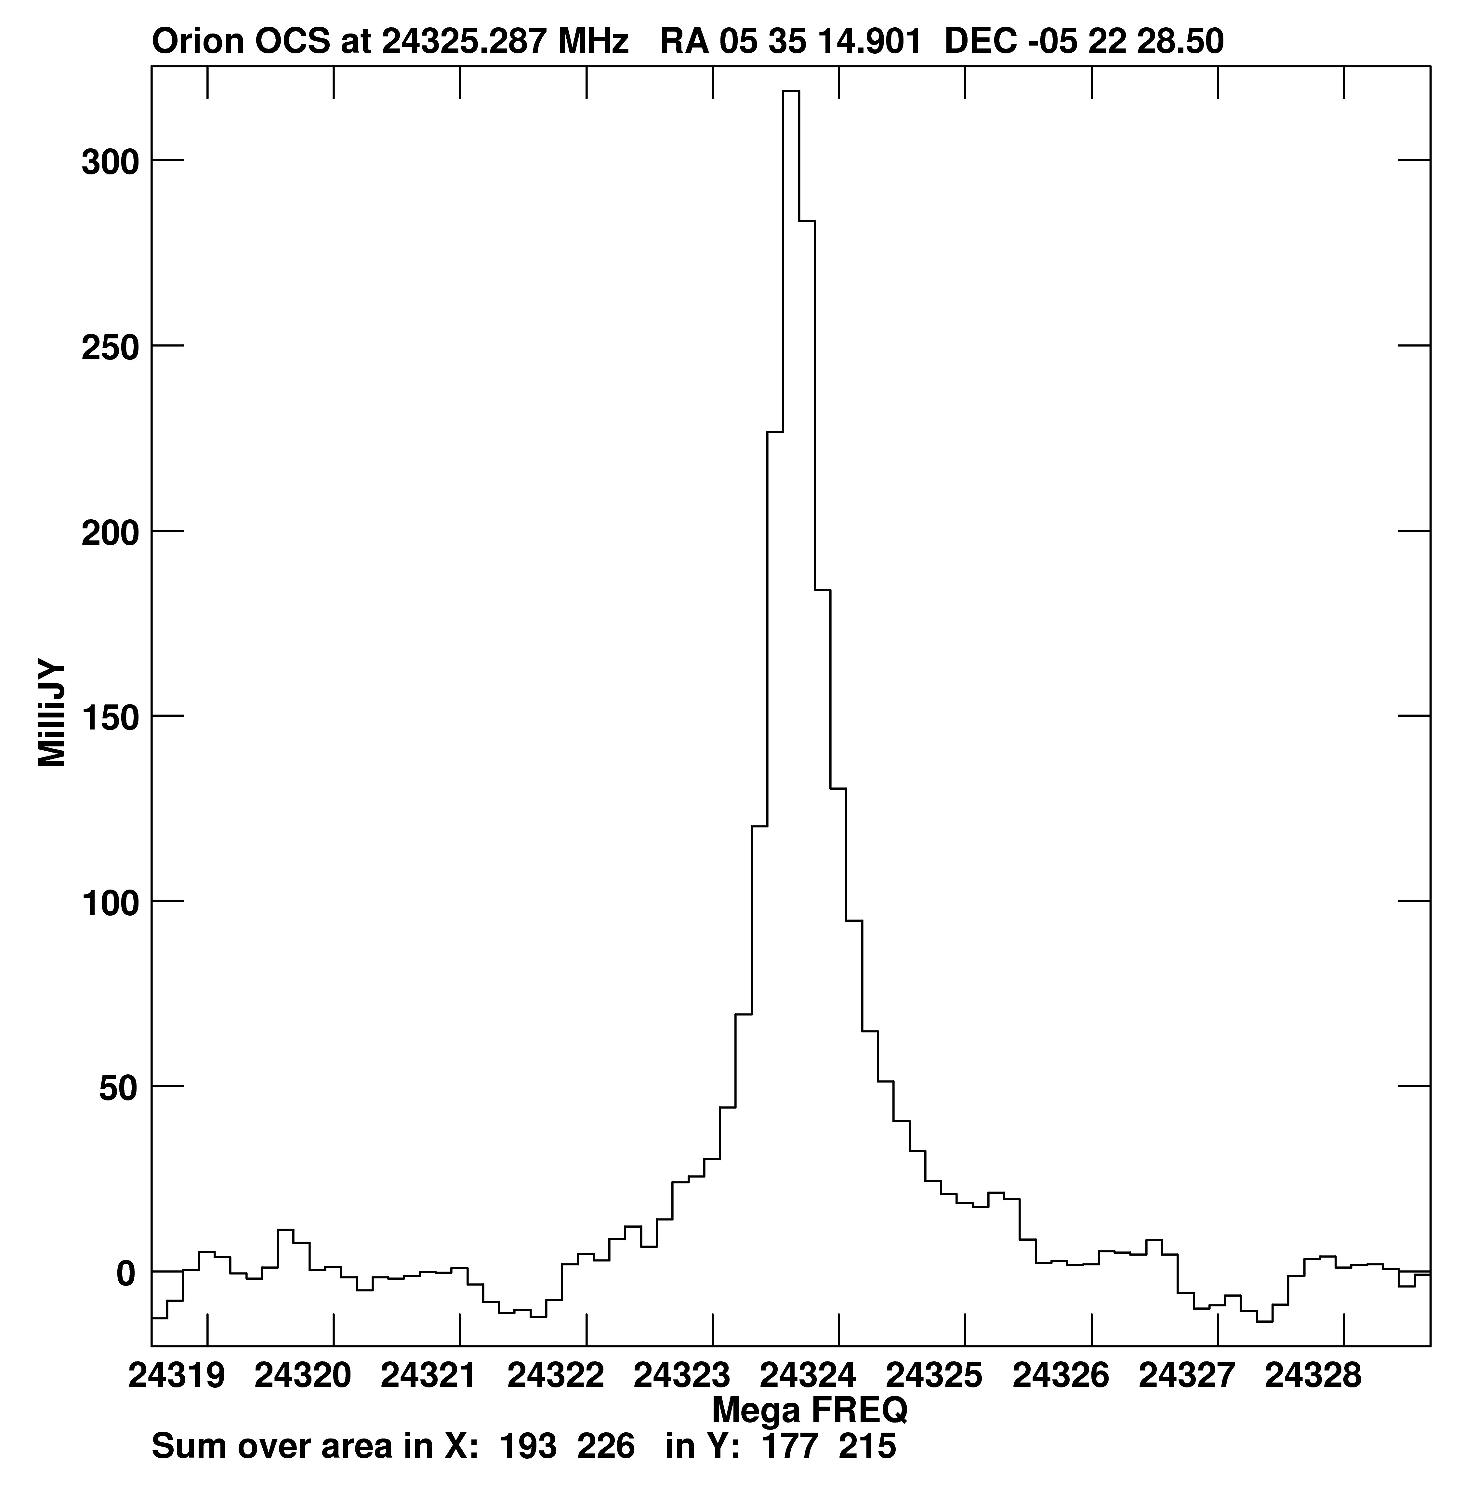
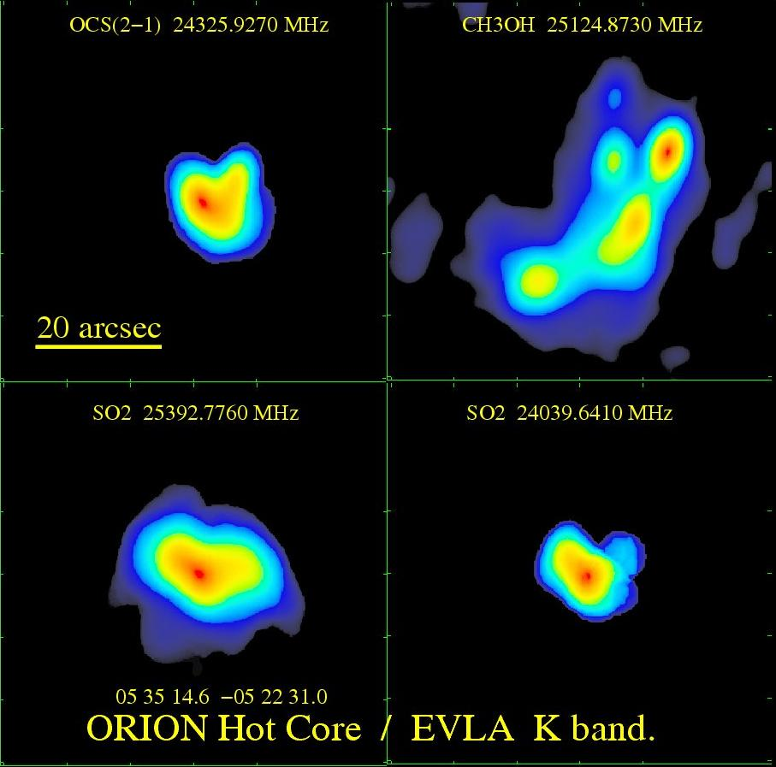
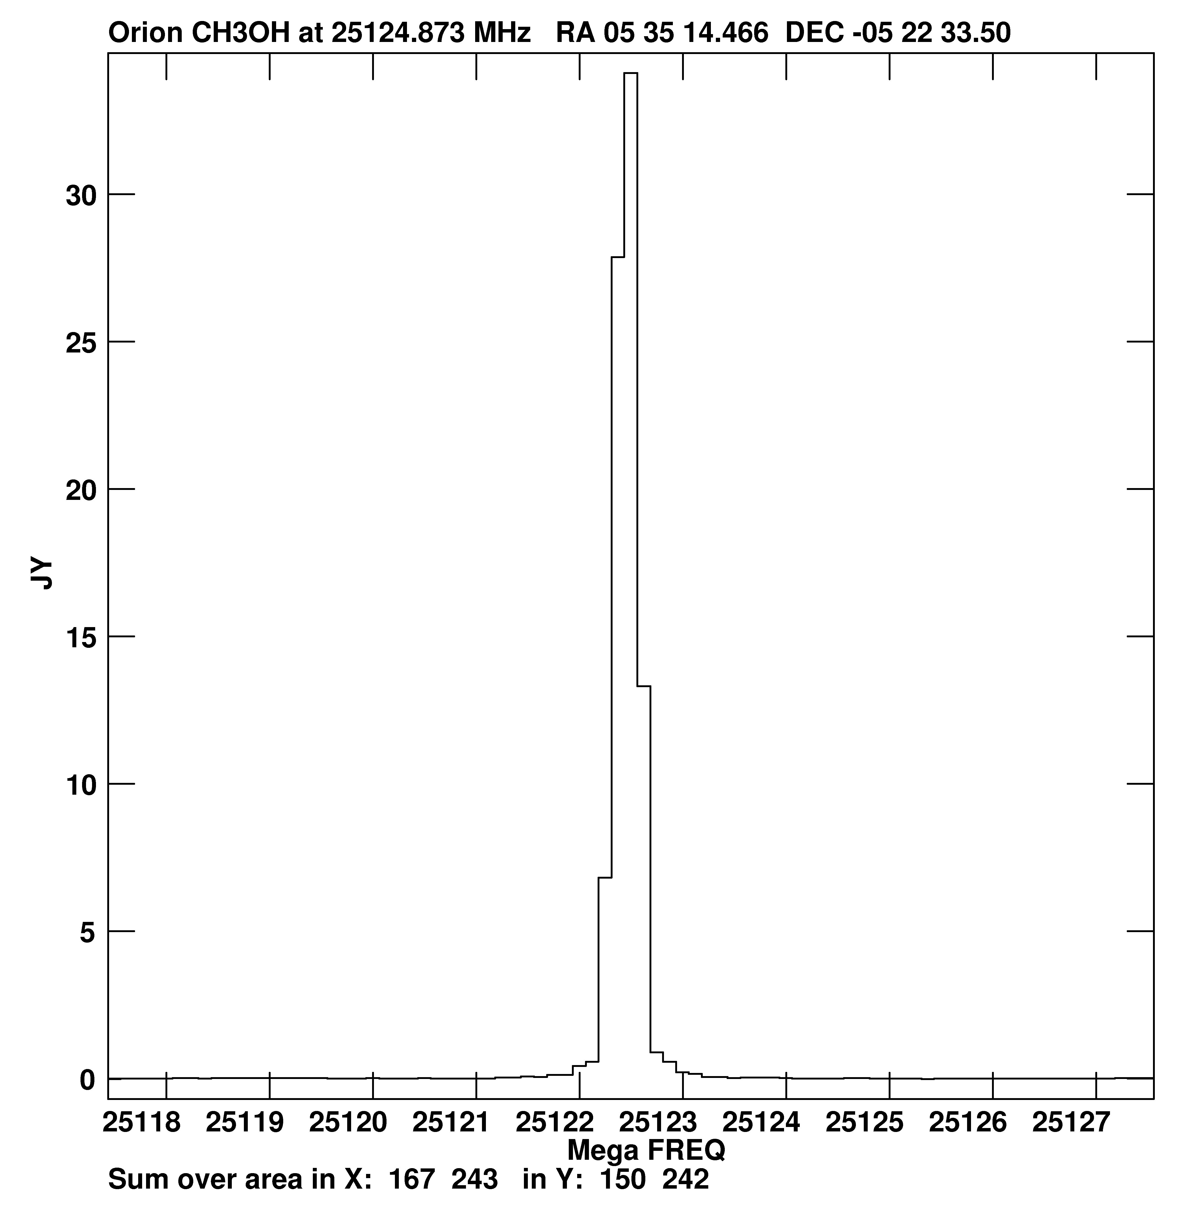
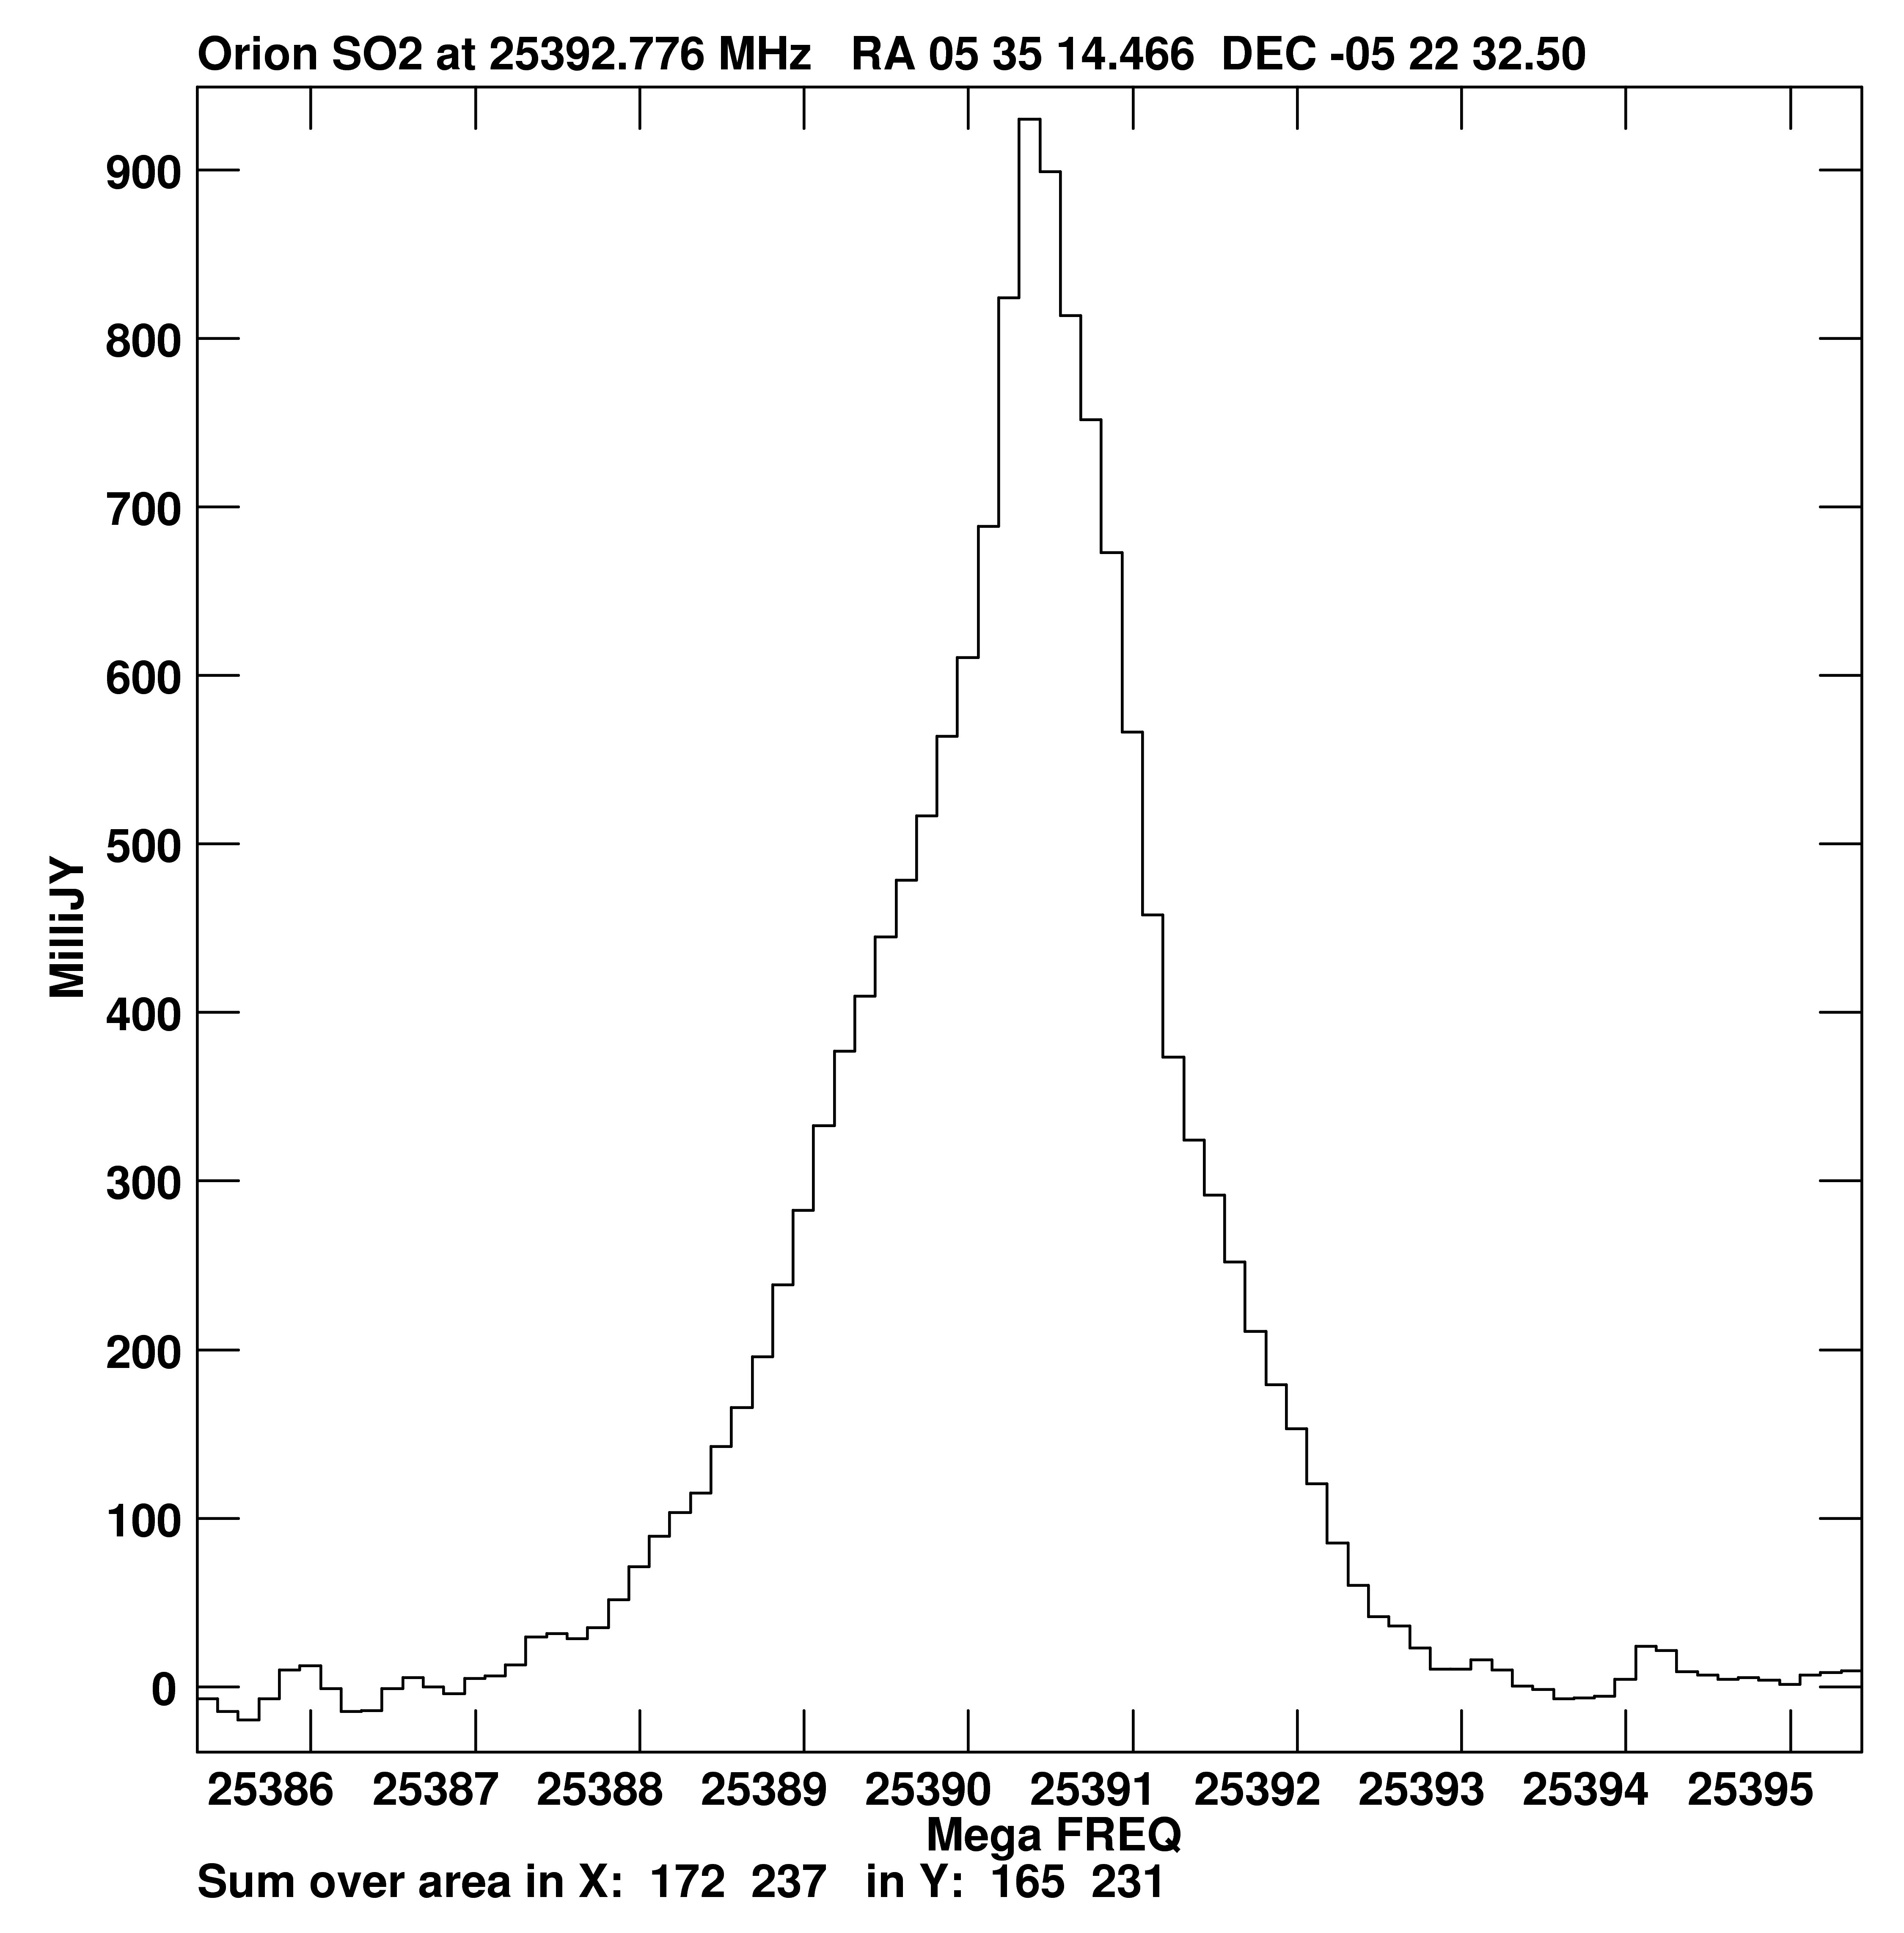
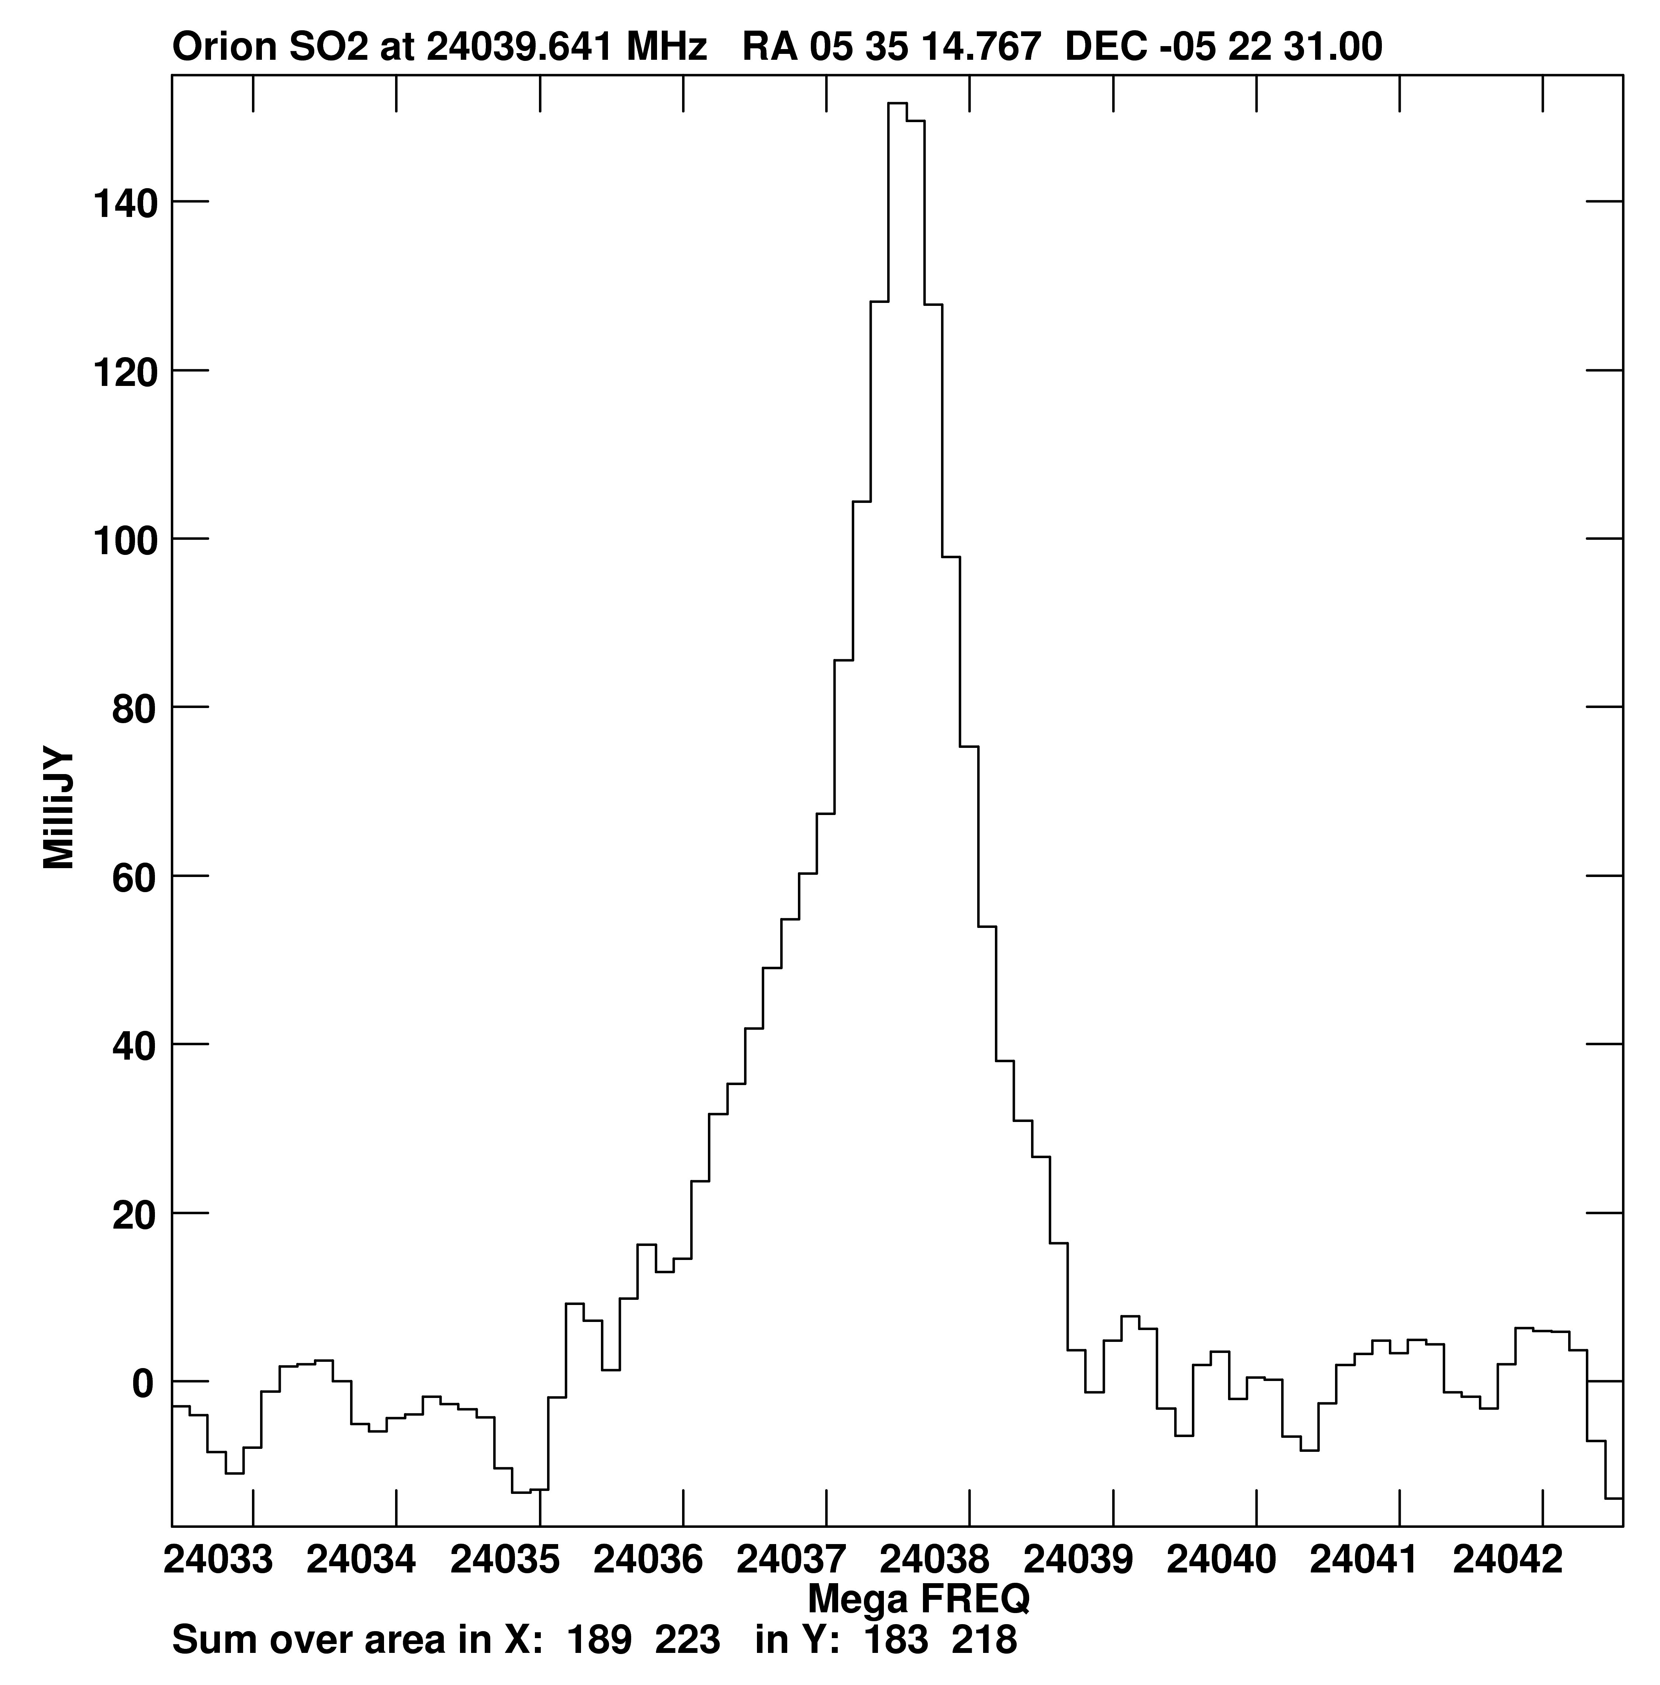
Spatial distribution: S/O-bearing molecules
OCS: E_{low}=0.6 K
CH₃OH: E_{low}=86K
SO₂: E_{low}=36K
SO₂: E_{low}=273K
Credits: Eric Greisen, Vivek Dhawan, Steve Myers
See also: full spectrum and images in poster upstairs

Slide 12
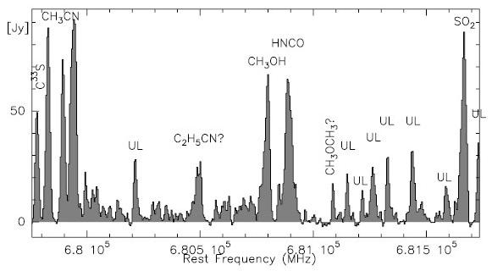
Compare with what ALMA can expect:
2 GHz of spectrum at 690 GHz from the Submillimeter Array (Beuther et al. 2006):
No line-free continuum, many line blends!
Play with the EVLA Demo Science data cube yourself: http://science.nrao.edu/evla/projectstatus/

Slide 13
How you can be part of the EVLA future
Open Shared Risk Observing (OSRO):
Observers will access EVLA in the same way as for the VLA
Initial configuration provides 512 spectral channels with one or two sub-bands of 128 MHz (maximum) each, dual or full polarization; see the EVLA Observational Status Summary for full details: http://science.nrao.edu/evla/proposing/obsstatsum.shtml
Observing begins March 2010
Resident Shared Risk Observing (RSRO):
Must be resident in Socorro for at least 3 months
Participants will assist NRAO staff in expanding capabilities
Participants will have access to more extensive observing capabilities
Observing time proportional to length of residency
27 proposals received on first call, 13 have been accepted
For details, see: http://science.nrao.edu/evla/earlyscience/

