Slide 1
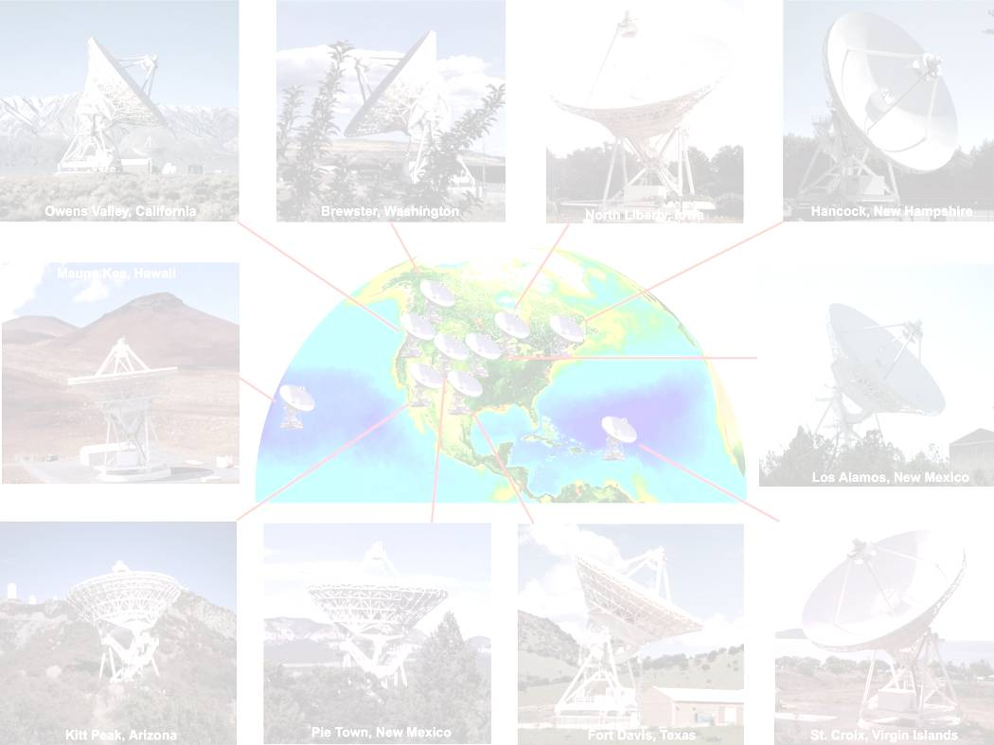
The VLBA Sensitivity Upgrade Project
New Science Enabled by Microarcsecond Astrometry
Workshop held 2009 July 21–23
Socorro, New Mexico
Jon Romney -- NRAO, Socorro
for the Sensitivity Upgrade team:
Walter Brisken, Adam Deller, Steven Durand,
Miguel Guerra, Craig Walker

Slide 2
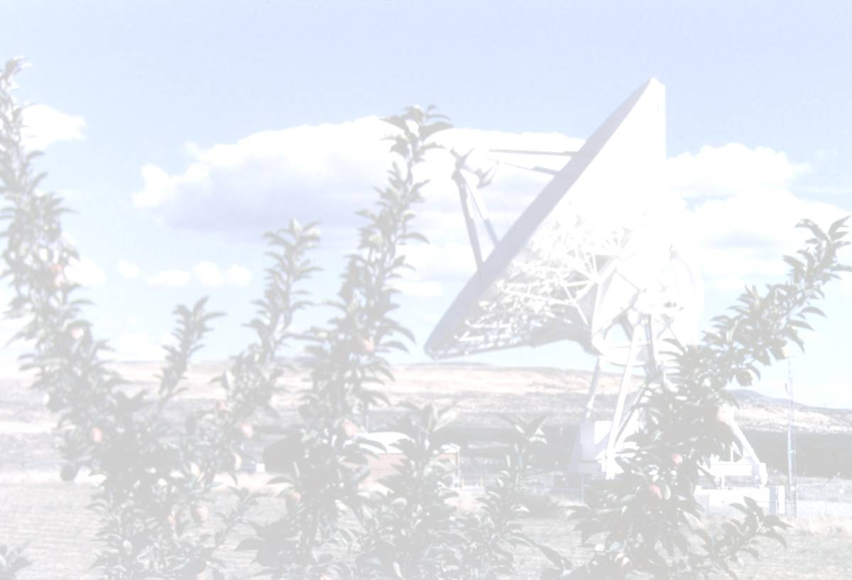
The VLBA Sensitivity Upgrade
First Major, Overall Upgrade of the Instrument
  … since it was inaugurated in 1993.
Previous, Limited Upgrades
  Some receivers upgraded to state-of-the-art.
    22-GHz receiver upgrade, funded by MPIfR, completed January 2008.
  Two-fold overall expansion of data path bandwidth .
    Peak data rate increased from initial 256 Mbps to 512 Mbps.
    Sustained rate increased from initial 128 Mbps to 256 Mbps.
Current Upgrade
  Apply modern technology to expand data path, downstream from IFs, to 4 Gbps bandwidth.

Slide 3
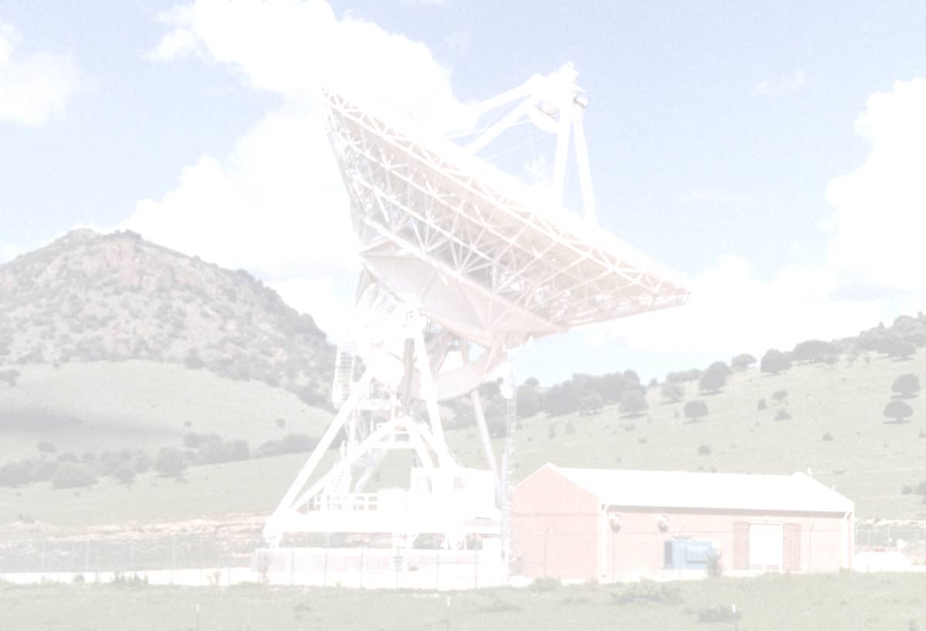
VLBA 4-Gbps Data Path Upgrade
3- to 6-Fold Increase in Continuum Sensitivity
  … [depending on “current”], in most frequency bands.
  Fainter scientific targets observable.
  Fainter, denser calibrators usable for phase referencing and differential astrometry.
    Advantageous for all observations, including spectral line sources.
Matched to Existing LO/IF System
  2 IFs @ 500 MHz BW @ 2-bit Nyquist samples.

Slide 4
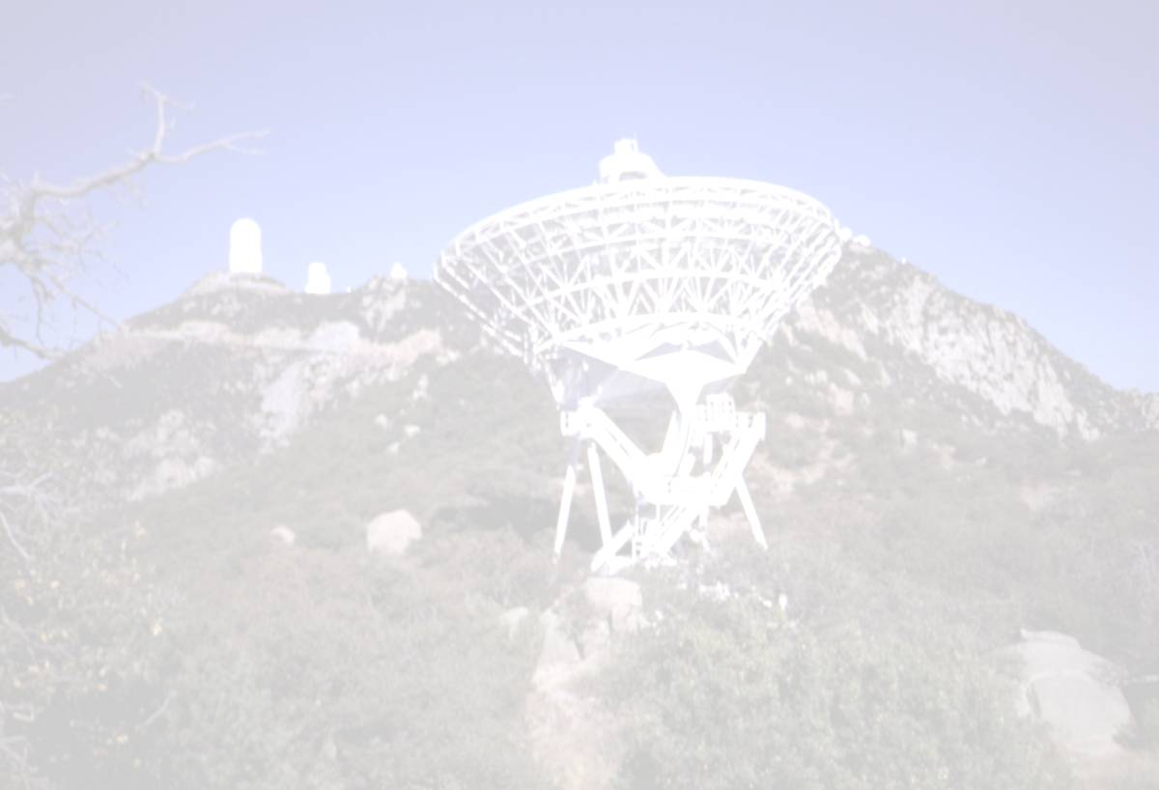
Science Drivers
  AGN jet launching regions.
  Blazars with gamma-ray flares.
  Location and velocity of gamma-ray burst blast waves.
  Mapping ionized gas in AGN cores.
  Galactic microquasars.
  Line absorption against compact continuum sources.
  Astrometry, parallax, proper motion of galactic objects.
  Cosmological distance scale.
  Extragalactic astrometry.

Slide 5
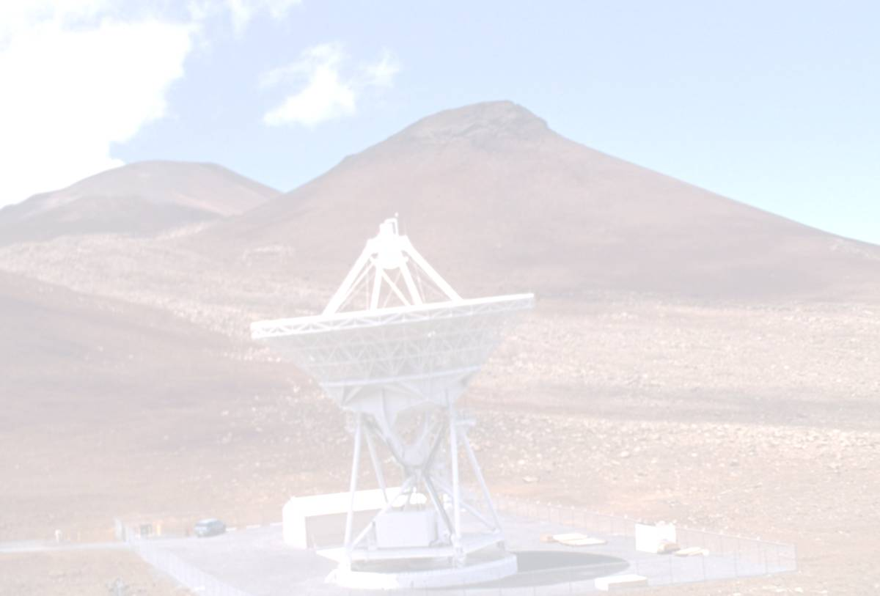
VLBA Upgrade Overview
Target Completion: 2011
  4-Gbps capability, with sustained operation requiring only additional recording and processing resources.
  High-priority science, at up to 2 Gbps, could be supported in 2010.
Funding
  Primary funding from Lockheed-Martin GBT arbitration settlement.
Memo Series
  http://www.vlba.nrao.edu/memos/sensi/
Three Sub-Projects.
  Digital Backend (RDBE) sub-band processor.
  Mark 5C recording system.
  DiFX software correlator.

Slide 6
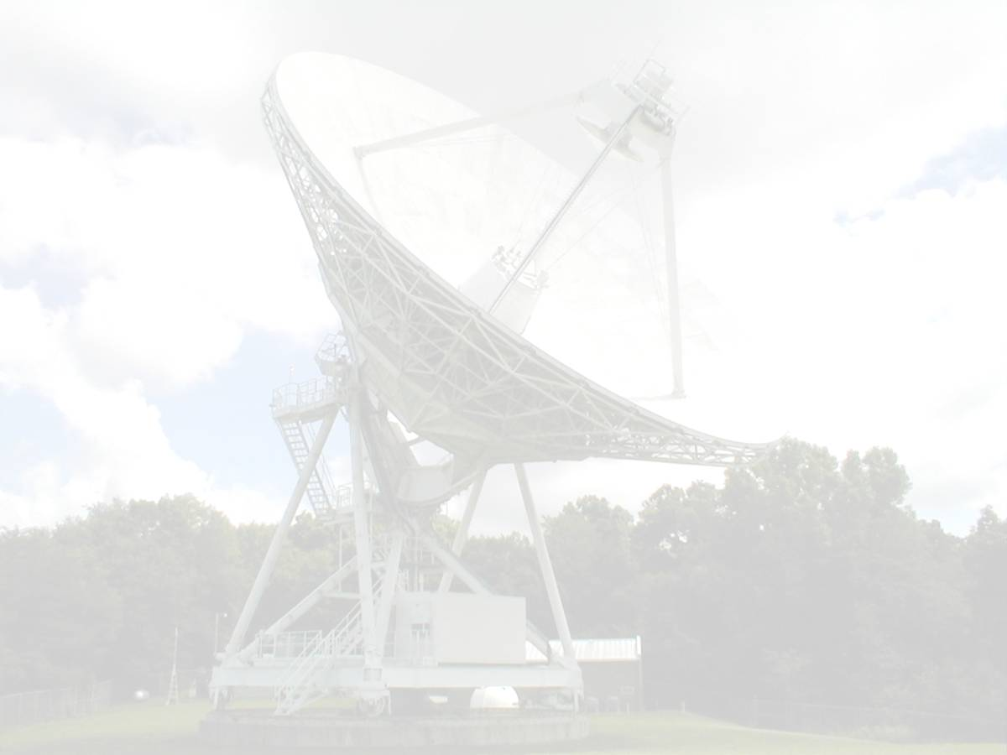
Digital Backend (RDBE)
Sub-Band Processor
Sample Directly in 500-1000 MHz IF.
  All subsequent processing digital.
Filter Personalities
  Digital down-converter (DDC).
    4 independently tunable sub-bands per IF.
    Bandwidths 0.5 – 256 MHz; Output sample precision: 1-8 bits.
  Polyphase filterbank (PFB).
    ≥ 32 sub-bands spanning entire 500-MHz IF.
  Firmware development collaboration with Haystack Observatory.
Output
  10-Gigabit Ethernet; individual sub-band packet streams.
    Maximum output rate 8 Gbps.

Slide 7
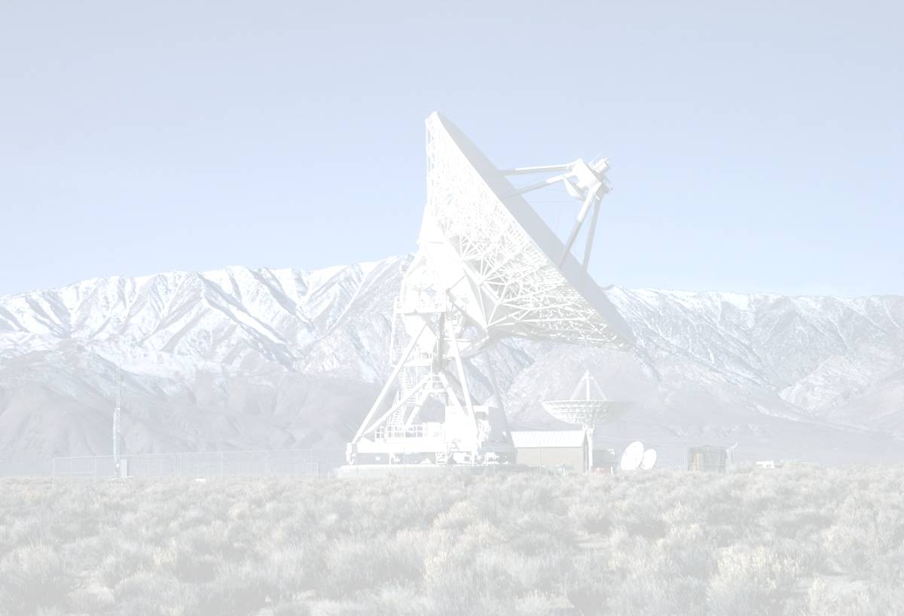
RDBE Hardware Platform
“ROACH” (formerly iBOB-2)
  “Reconfigurable Open Architecture Computing Hardware”
  Upgrade of UCB CASPER group’s successful iBOB.
  CASPER / KAT / NRAO collaboration.
  New, higher-capacity Xilinx Virtex-5 FPGA.
  10-Gigibit Ethernet output interface.
  Two ROACH-based units required for full VLBA station capability.
Status
  Initial order of 6 production boards received; order pending for additional 20 boards.
  PFB personality firmware largely implemented; DDC personality under development.
  Control software under development.

Slide 8
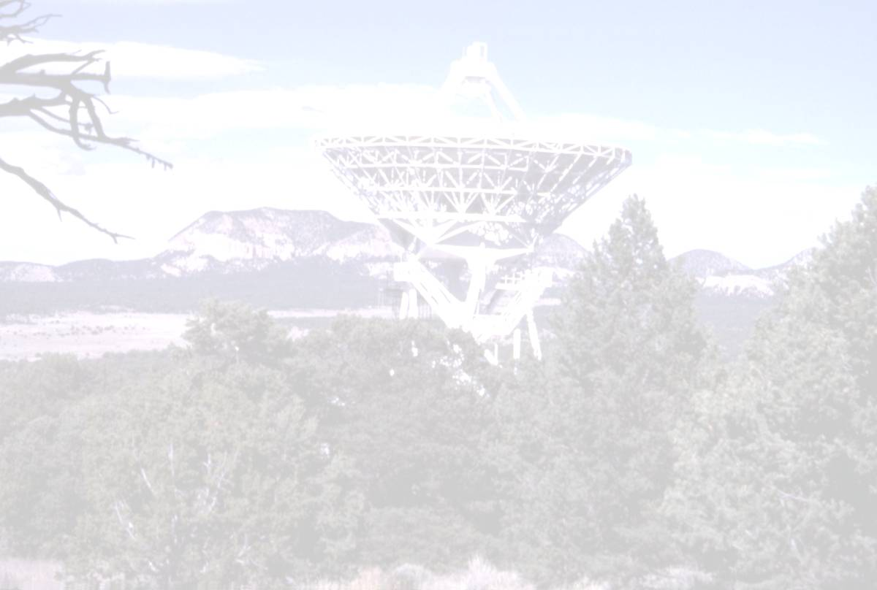
Mark 5C Recording System
Successor to Current Mark 5A/B/B+ Recorders
  Joint development by NRAO / Haystack / Conduant Corp.
Requirements
  Sustained recording at ≥ 4 Gbps.
    Conduant’s “Amazon” disk array controller already supports such data rates.
  10G Ethernet input interface, in sub-band packet streams.
    Mezzanine board for this interface was only new design required.
  Output optimized for direct access from a software correlator.
Status
  3 complete Mark 5C units
    … received as part of development contract with Conduant Corp.
  8 Mark 5A → 5C upgrade kits
    … purchased by UNAM (L. Loinard) with funding from CONACyT.
  Control software under development.

Slide 9
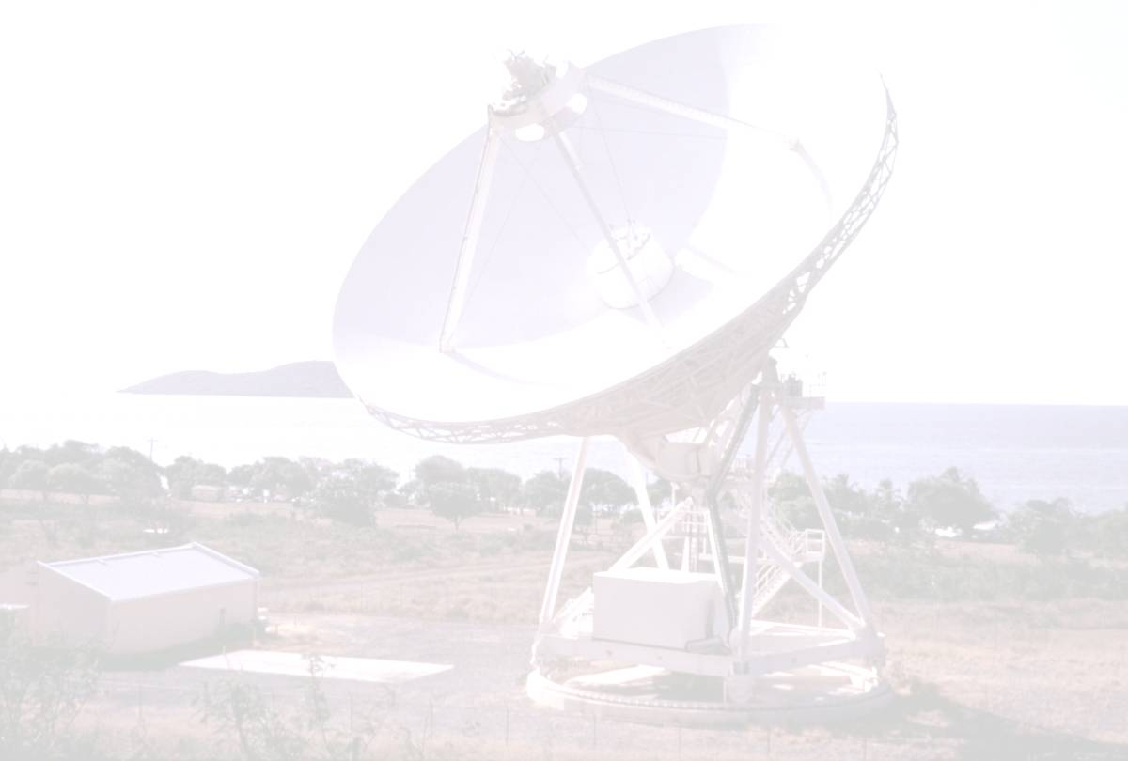
DiFX Software Correlator
NRAO Implementation
  Software written by Adam Deller at Swinburne University.
    Deller now a Jansky Fellow here at NRAO/Socorro.
  Variety of peripheral software required to interface to VLBA.
    Developed by Walter Brisken, almost all now complete.
    Operator GUI recently declared operational.
  “Intermediate cluster” procured and installed.
    20 Intel Xeon quad-core processors.
    Expected to match or exceed throughput of existing correlator, for similar mix of observing modes.
Status
  Formal comparison to original VLBA correlator currently in progress.
  Availability to users expected to be announced in the near future.

Slide 10
Thank you

