Slide 1
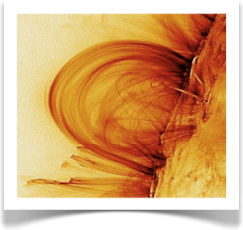
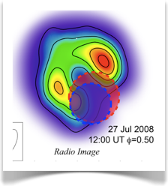
Sub-Milliarcsecond Astrometry of the Algol System
William Peterson & Robert Mutel
University of Iowa
Miller Goss
NRAO
M. Gudel
ETH, Zurich
1

Slide 2
Central science questions
What is the morphology [shape, orientation, timescale] of the radio corona of Algol?
Need high fidelity, high angular resolution images (i.e. HSA, 15+ GHz)
How do the radio images connect to the actual positions of the stars?
Requires precise (sub-mas) astrometry and accurate orbital/astrometric parameters
2
Notes:
`

Slide 3
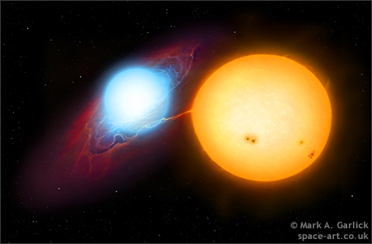
Algol System
Distance: 28.8 pc (93 ly)
Low Proper Motion
Algol C
A-type
1.86 yr orbit
Algol A/B
Radio Active
2.86 day period
Mass Ratio 4.5:1
Separation 3.6 mas
Eclipsing!
Algol A
m = 3.6 M_{sol}
r = 2.9 R_{sol}, 0.5 mas
Algol B
m = 0.8 M_{sol}
r = 3.5 R_{sol}, 0.6 mas
3

Slide 4
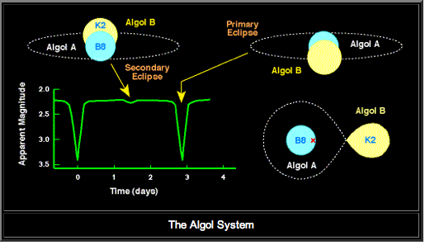
Algol Inner Binary Eclipses
3.6 mas

Slide 5
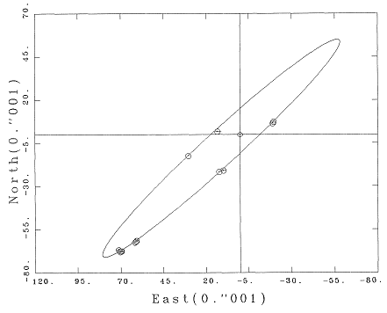
Algol Orbital Orientation
Lestrade et al. 1993
Pan et al. 1993

Slide 6
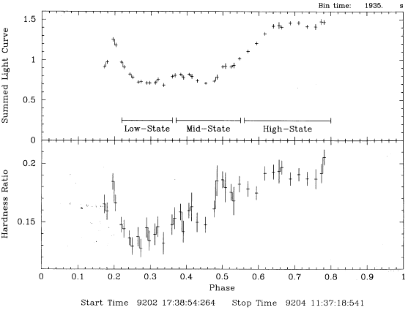
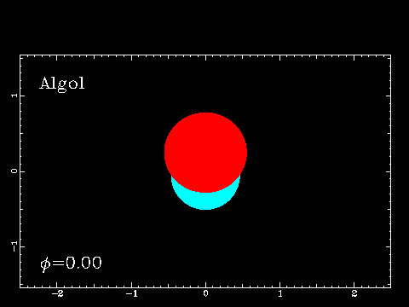
Quiescent X-Ray Emission
Antunes et al. (1994)
Quiescent emission only reduced by ≈15% during secondary eclipse
X-ray emitting region R >> RK, confined largely to polar caps of star?
6

Slide 7
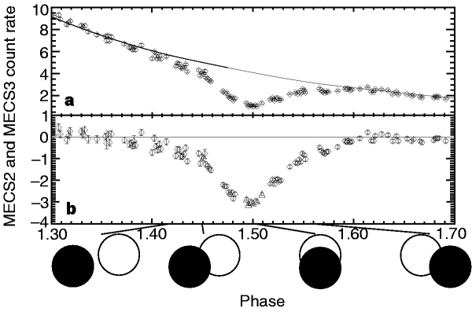
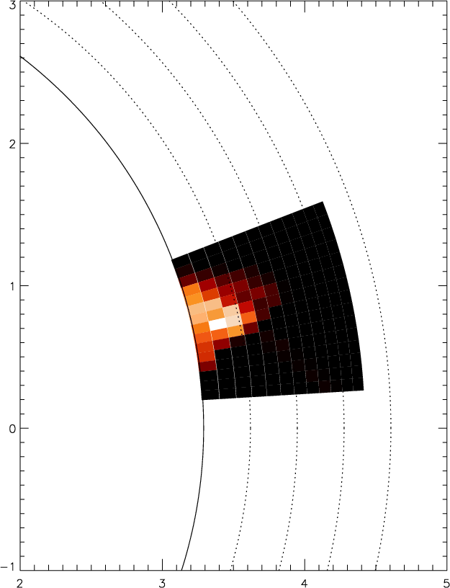
Flaring X-Ray Emission
Flares are entirely occulted during primary eclipse
Sustained heating provides more realistic sizes for flaring regions than free decay
Flaring regions are compact (H ≅ 0.6 R∗) and (in general) confined to the polar regions
Flare modeled on disk
0.1RK
Schmitt & Favata (1999)
7

Slide 8
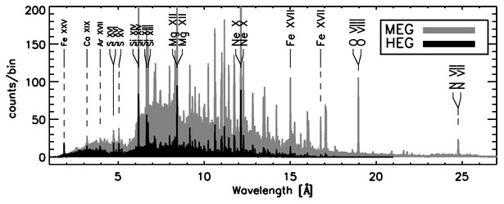
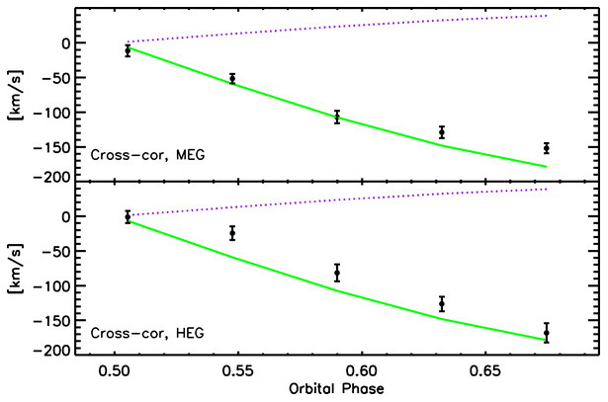
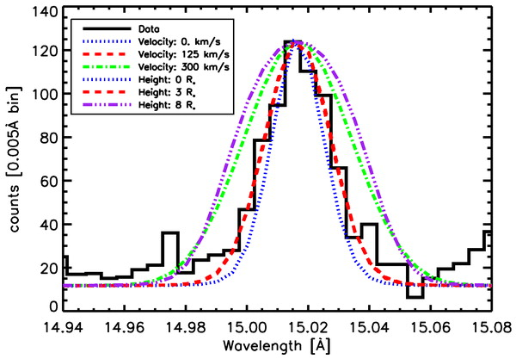
X-ray spectroscopy
Chung et al. 2004 (Chandra)
X-Ray line spectrum
Doppler shift vs. Orbital phase
Best fit at height R~ 3Rsun

Slide 9
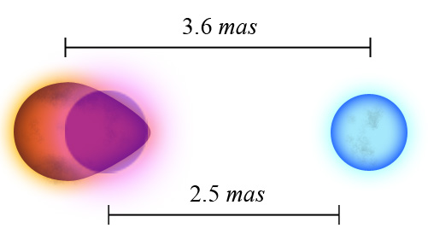
Spectral line widths - Rotational broadening?
Spectral line velocities → Orbit Radius of X-ray source is only ~70% of Algol A-B separation
X-ray emission from K sub-giant is offset toward B star

Slide 10
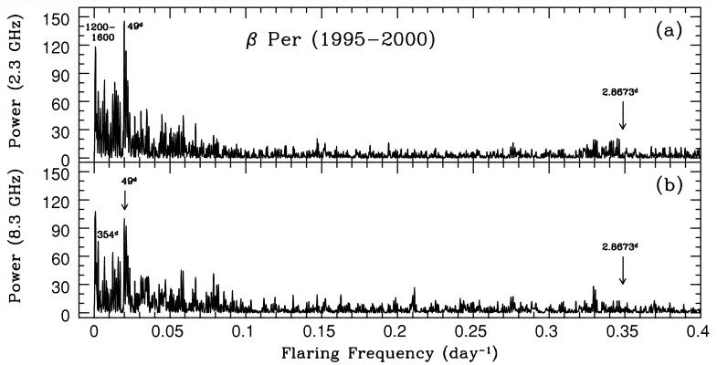
Companion Influence Reconnection at Accretion Disk?
Superhumps in lightcurves (Vogt et al. 1982)
Interaction of accretion disk with B star magnetic field
Flaring Statistical Analysis (Richards et al. 2003)
Accretion Model
(Richards et al. 1993)
10

Slide 11
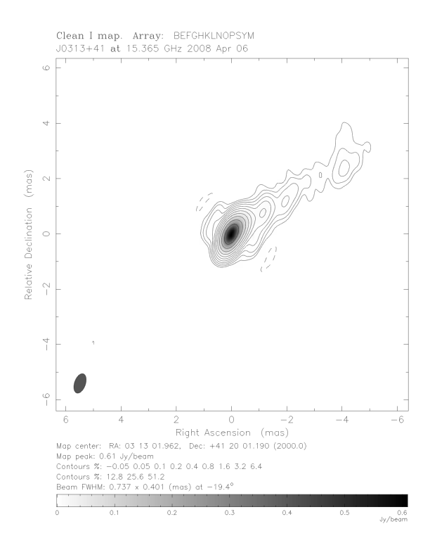
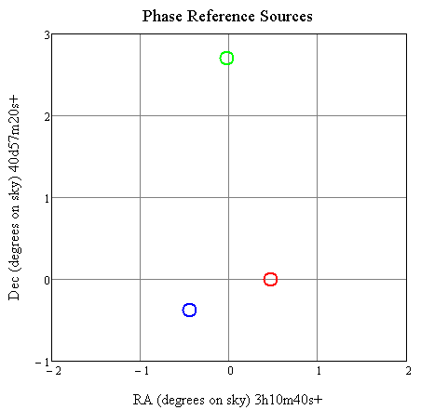
BM267: 6-epoch HSA Imaging of Algol
15 GHz VLBA + Bonn + GBT + VLA April - August 2008
3 x 12hr observations at secondary eclipse
2 x 12hr observations at 0.25 quadrature
1 x 12hr observation at 0.75 quadrature
Phase reference switching time ~90s
J0310+381
2.7º
Primary phase calibrator
J0313+412
S15≈700 mJy
Algol
0.9º
11

Slide 12
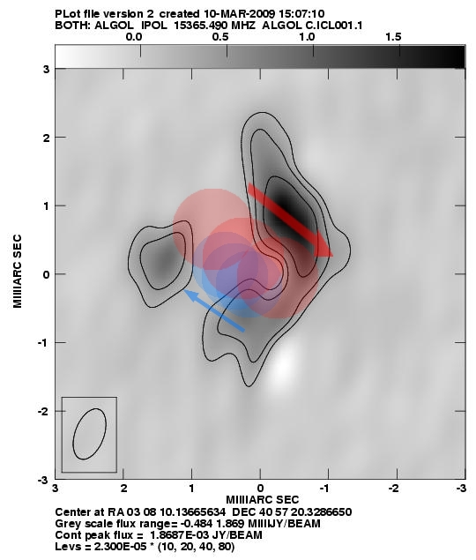
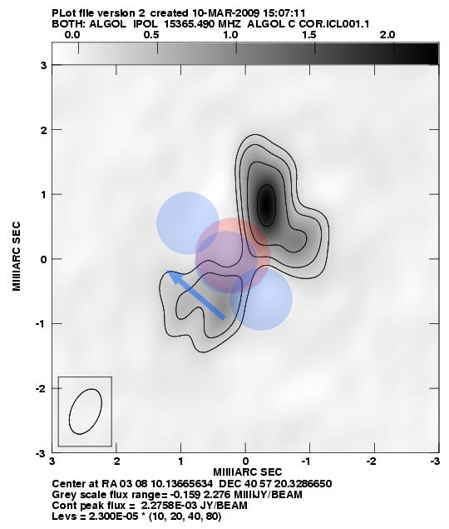
AIPS Correction for moving target
No correction
With correction
K star moves ~ 1 mas (2.5 beams) in 12 hr during secondary eclipse
Motion corrected to center of observation using CLCOR (thanks to Leonid Kogan!)
12

Slide 13
Motion of Algol on Sky
13

Slide 14
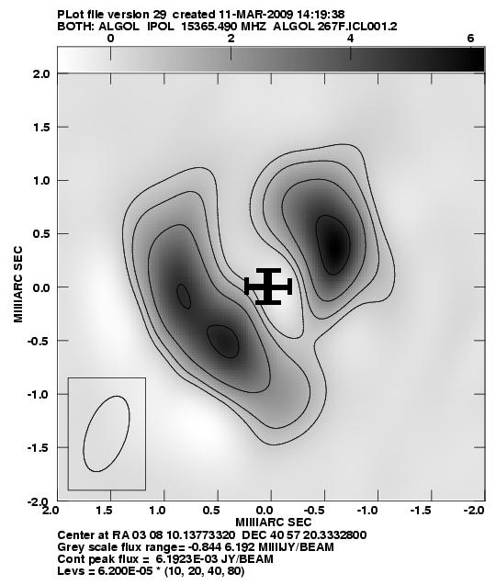
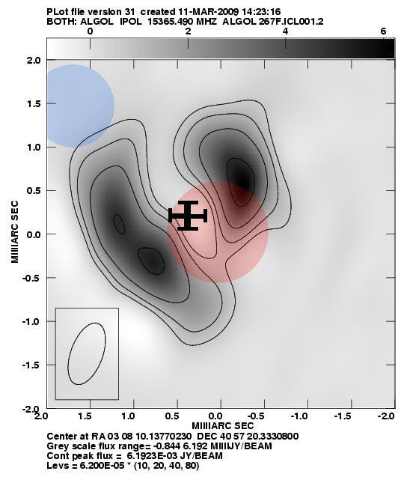
Global Astrometric solution
18 epochs
BM267 (2008)
Fey et al. (2000)
BM109 (1999)
BM74 (1997)
Mutel (1998)
Lestrade at al. (1993)
For each epoch assign radio centroid position
Vary 5 astrometric parameters and minimize chi-squared value
Proper motion (R.A., Dec.), Annual Parallax, J2000.0 position of Algol Barycenter (R.A. Dec. [heliocentric])
6th parameter needed – radio offset toward B8 star!
Arguably the most accurate proper motion ever determined (±10 μas/yr vs. HIPPARCOS, typically ±100 μas/yr)
14

Slide 15
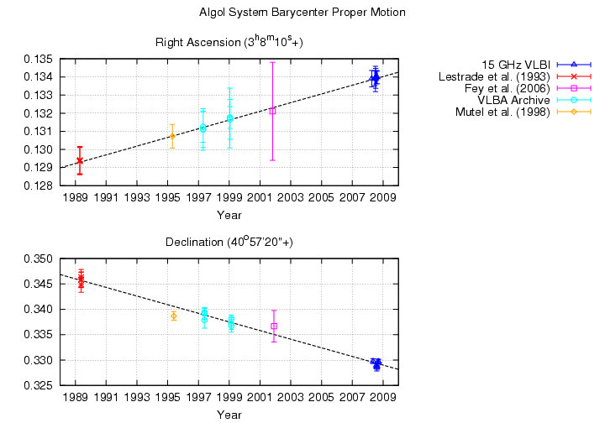
Proper Motion
μ_{αcosδ} = 2.69 ± 0.014 mas yr ⁻¹
μ_{δ} = -0.86 ± 0.007 mas yr ⁻¹
15

Slide 16
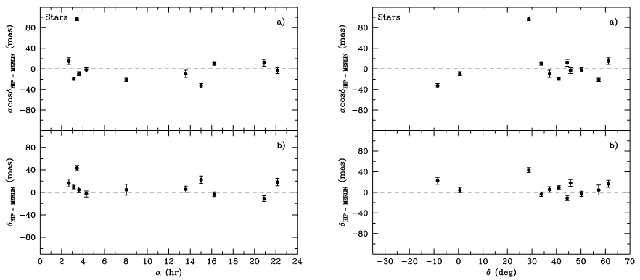
Comparison with HIPPARCOS
 | Parallax (mas) | μ_{αcosδ} (mas yr⁻¹) | μ_{δ} (mas yr⁻¹)
BM267 | 35.14 ± 0.22 | 2.692 ± 0.015 | -0.860 ± 0.0007
HIPPARCOS | 35.14 ± 0.90 | 2.39 ± 0.77 | -1.44 ± 0.88
Fey et al. (2006) | N/A | 3.30 ± 0.74 | -2.87 ± 0.76
Compare to HIPPARCOS Center-of-Luminosity Position (observation epoch 1991.25)
R.A. (error in mas) | Dec. (error in mas) | α₀-α_{hip} | δ₀-δ_{hip}
3:08:10.129718 ±0.71 | 40:57:20.34432 ±0.58 | -16.1 | 10.0
Compare to Fey et al. (2006) MERLIN position of radio emission (epoch 2001.8276)
R.A. (error in mas) | Dec. (error in mas) | α₀-α_{fey} | δ₀-δ_{fey}
3:08:10.1343± 2.7 | 40:57:20.335 ± 3.1 | 0.83 | -2.9
16

Slide 17
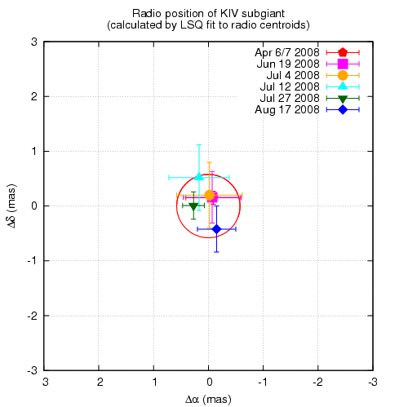
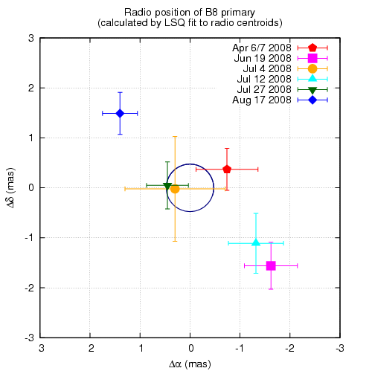
Is K star really at centroid of radio?
Test Fit to Algol B vs. Algol A
χ² = 0.7
χ² = 3.25 (reject 10⁻¹⁴)
17

Slide 18
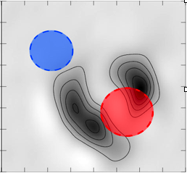
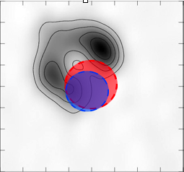
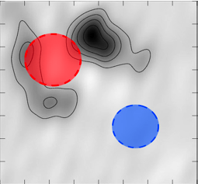
Precision astrometry allows sub-mas Radio-Optical Image Registration
18

Slide 19
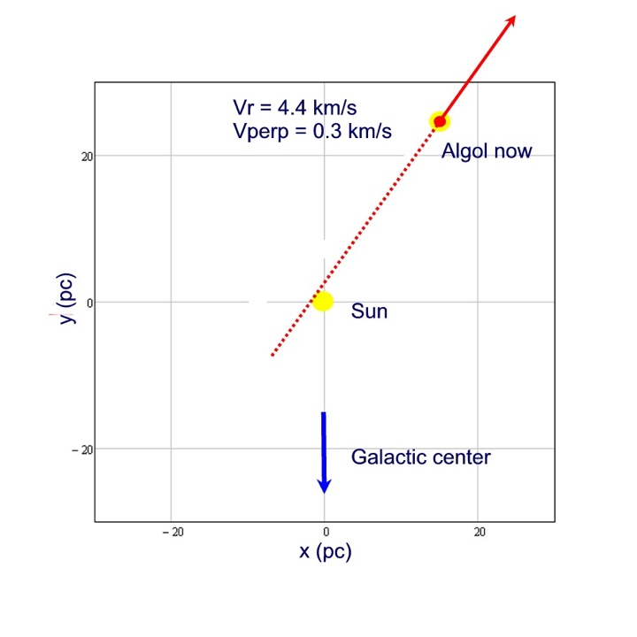
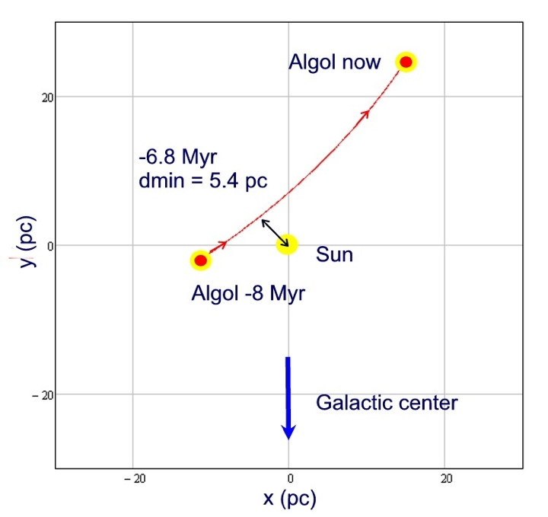
Was Algol a Death star??
19

Slide 20
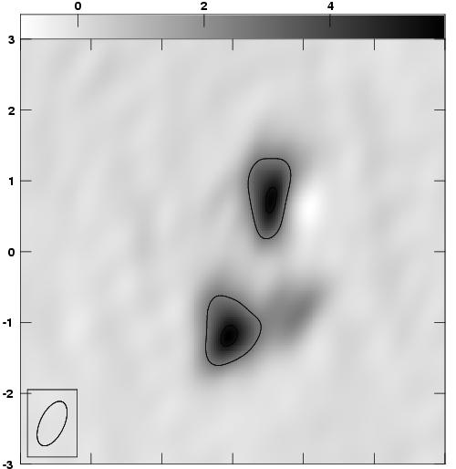
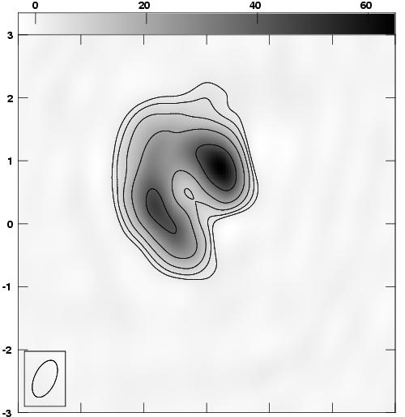
Morphology depends on activity level
April 6, 2008 1400-0200 UT
Phase = 0.50 S = 29.7 mJy
July 27, 2008 0600-1800 UT
Phase = 0.50 S = 436.9 mJy
20

Slide 21
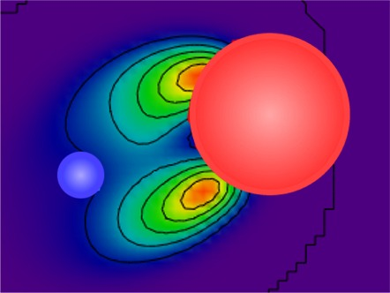
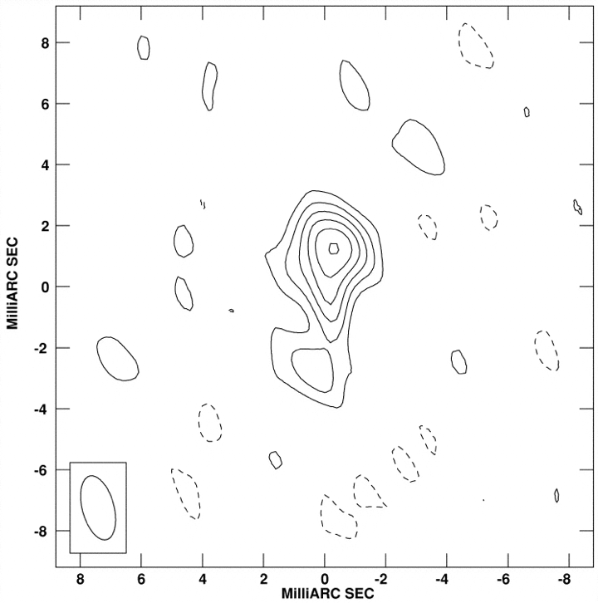
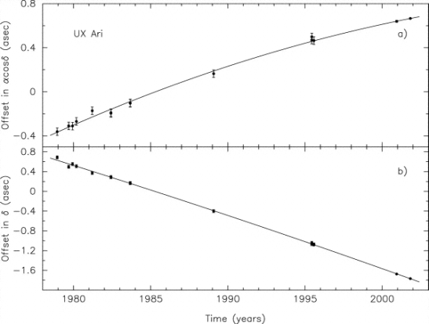
Are Algol’s coronal loop structures common to active binaries?
Test second active binary system: UX Ari
Larger distance (50.2 pc) but longer period (6.44 days) gives a=1.67 mas (resolvable by VLBA-HSA)
Similar flux density range
Past phase-referenced VLBI observations (helps astrometric solution)
Acceleration=> Possible third companion
UX Ari HSA simulation 23 GHz
21

Slide 22
Summary
First VLBI maps of coronal loops on another star
First sub-milliarcsecond registration of a radio position to the optical star position
The dominant feature of Algol’s magnetosphere is a large loop, oriented (in general) toward the B-type primary
Loop is anchored near the poles of the K subgiant
Consistent with X-ray observations
Gyrosynchrotron loop model fits radio morphology
Quiescent - τ=1 at feet of loop (δ≈3)
Flaring - τ=1 fills loop (δ≈1.8)
Is this feature common to active stars?
22

