Slide 1

Global Astrometry with the VLBA
Dave Boboltz (USNO)
Outline
VLBI astrometry/geodesy overview
Applications of global VLBI astrometry
Contributions of the VLBA
Future astrometric science at the VLBA

Slide 2
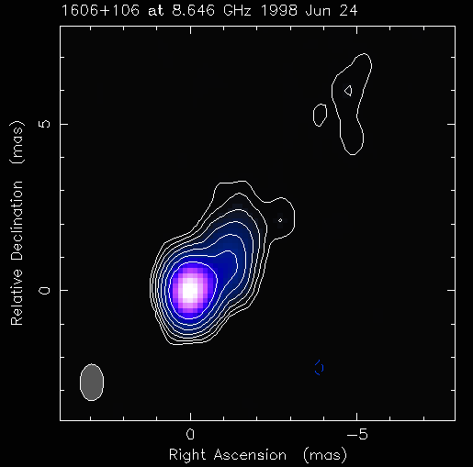
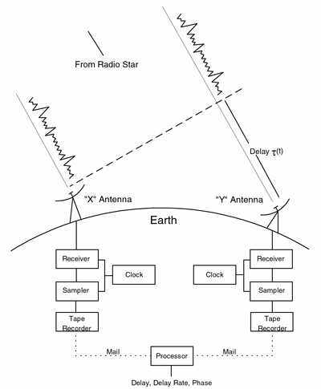
Global (Wide-angle) VLBI Astrometry
Observations of compact extragalactic radio sources
  Negligible proper motions
  Distributed over the celestial sphere
  Dual frequency S (2.3 GHz) / X (8.6 GHz) observations to remove ionospheric effects
Basic VLBI observables
  Group delay, delay rate, phase delay, amplitude of coherence function
Group delay traditionally used in VLBI astrometry/geodesy
Overview Applications Contributions Future Work

Slide 3
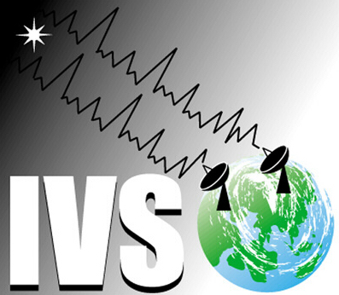
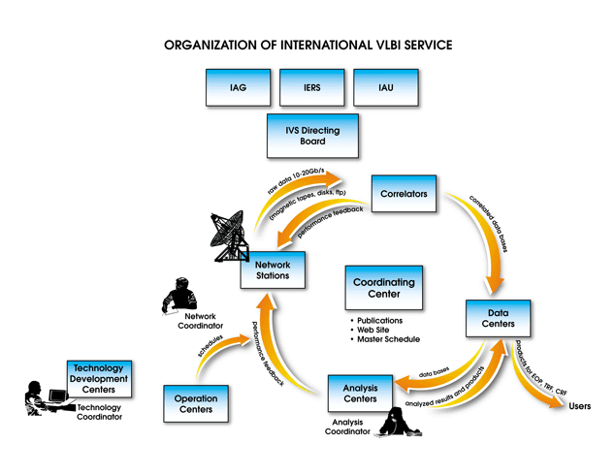
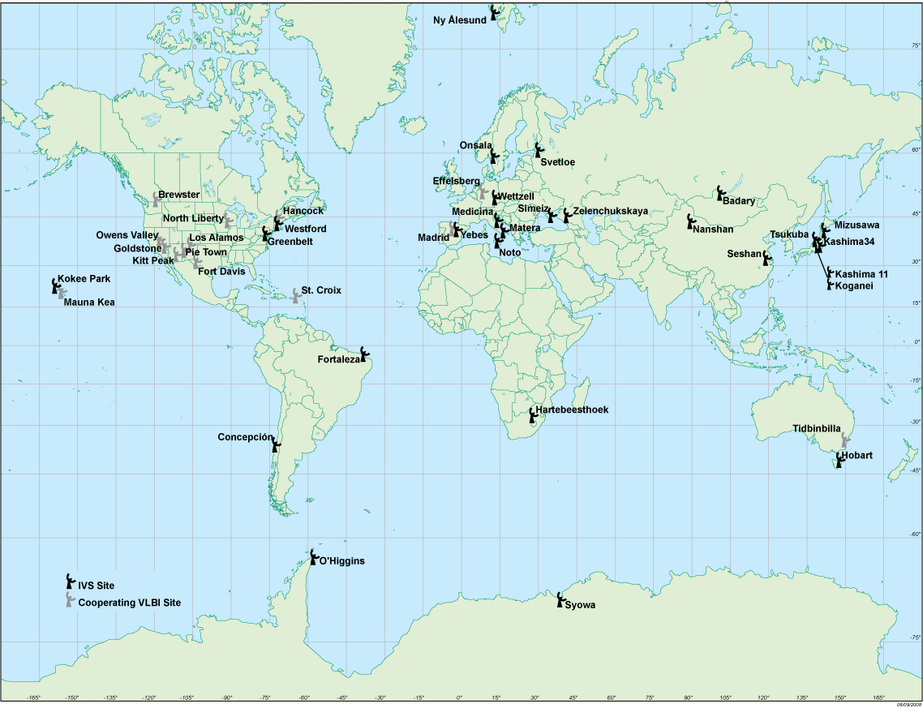
Astrometry/Geodesy and the IVS
Astrometric/geodetic VLBI is coordinated through the International VLBI Service for Geodesy and Astrometry (IVS).
http://ivscc.gsfc.nasa.gov/
Overview Applications Contributions Future Work

Slide 4
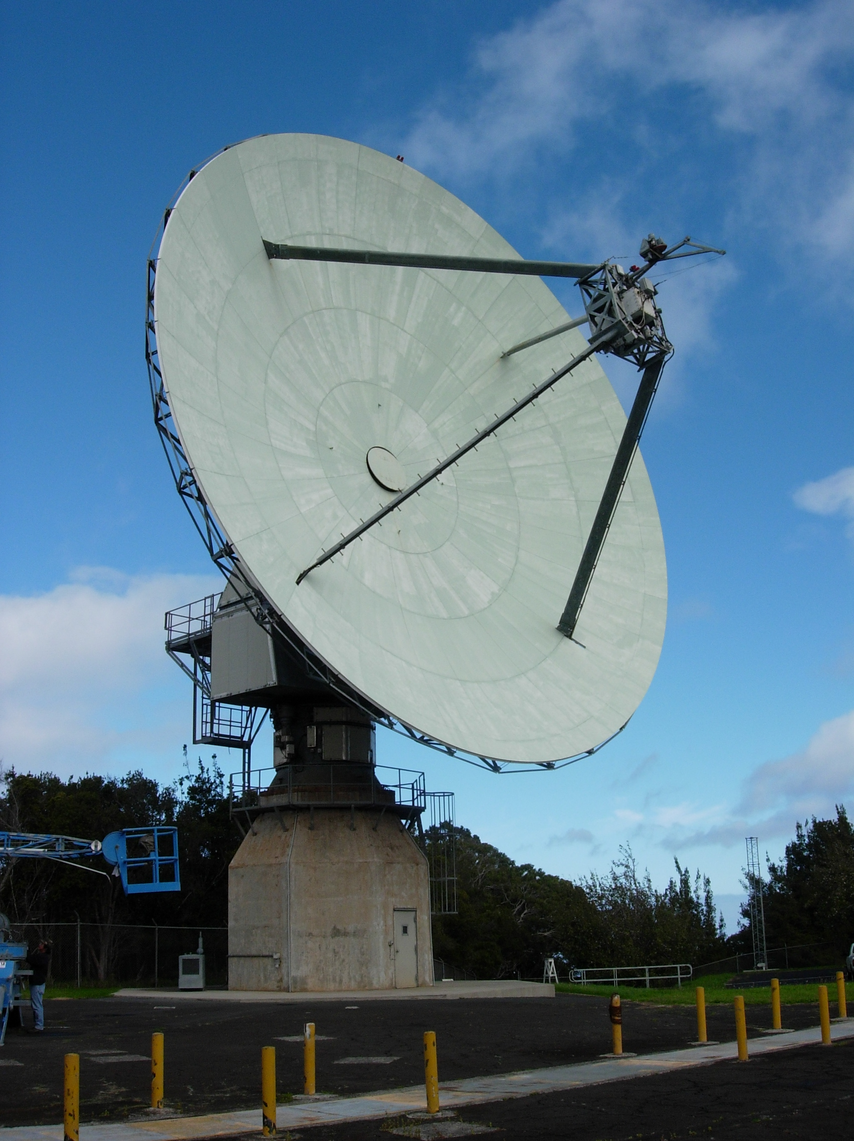
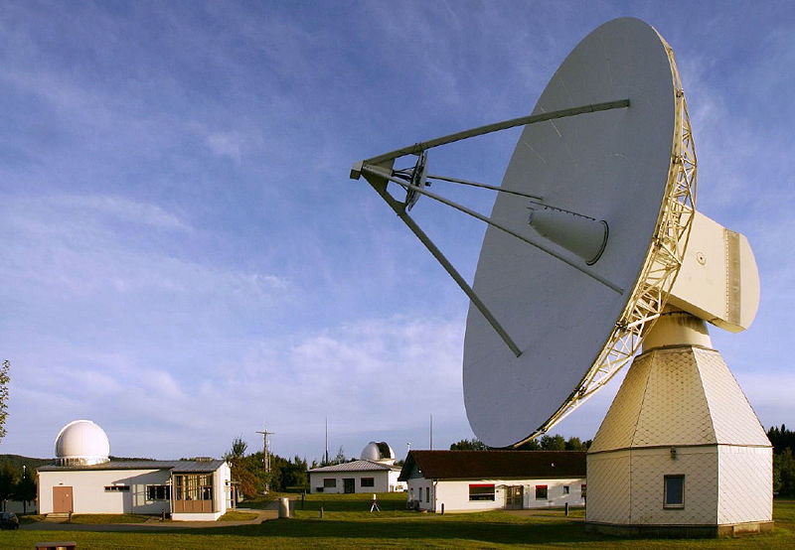
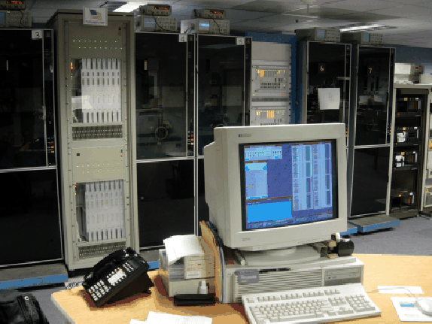
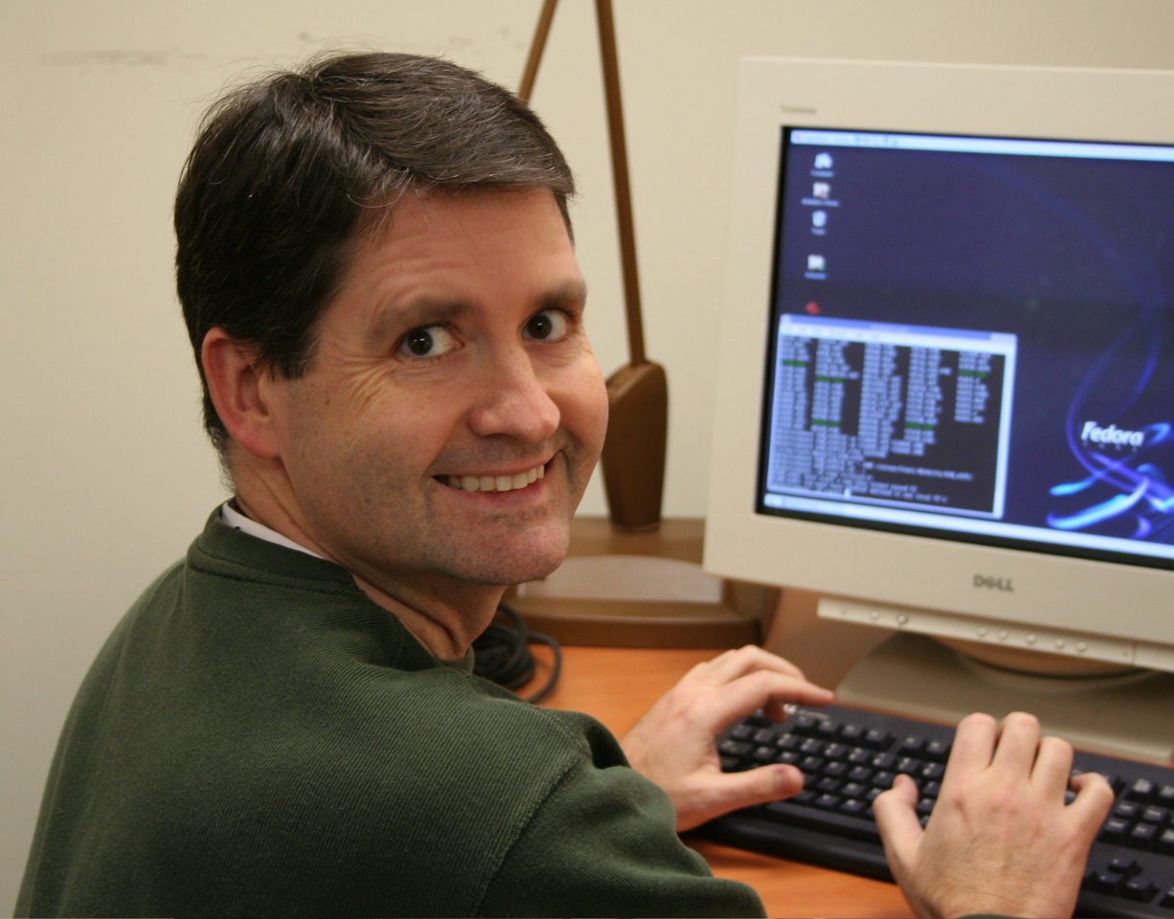
VLBI Astrometry/Geodesy Data Path
Observations
  24-hr sessions 2+ times per week
  1-hr “intensive” sessions daily
  Mark 5 recording and shipping
Correlation
  Mark 4 VLBI geodetic correlators
  VLBA correlator
Post-processing
  Calibration
  Fringe-fitting
Data analysis
  Daily session analysis
  Periodic multi-session solutions
Overview Applications Contributions Future Work

Slide 5
Software Packages
Scheduling
  SKED (GSFC VLBI group) geodetic network
  SCHED (NRAO) VLBA
Correlation
  CALC/SOLVE (GSFC VLBI group)
    CALC used by most of the world’s correlators
    Computes theoretical delay/delay rate for observations
    Computes partial derivatives of delay/delay rate w.r.t. various parameters (i.e. earth orientation, site positions, source coords.)
Post-correlation processing – fringe-fitting
  FOURFIT (MIT Haystack) output of Mark 4 geodetic correlators
  AIPS (Greisen 2003) output of VLBA correlator
Overview Applications Contributions Future Work

Slide 6
Software Packages
  Data Analysis – CALC/SOLVE (GSFC VLBI group)
  SOLVE performs least-squares fit and parameter adjustments using:
    CALC derived theoretical delays and partial derivatives
    Observed group delays
    Additional models and partial derivatives
  Interactive SOLVE
    Single session data
    Ambiguity resolution, ionsphere calibration, clocks, atmosphere parameterization, editing, etc.
    Database production & submission to IVS
  Non-interactive SOLVE
    Multi-session (global) analysis (performed periodically as needed)
    Uses arc-parameter elimination method (Ma et al. 1990)
Other analysis packages – OCCAM, Steel Breeze, QUASAR
Overview Applications Contributions Future Work

Slide 7
Models Included in the Theoretical Delay
A priori geophysical effects modeled following IERS Conventions 2003 (McCarthy and Petit 2004):
  Solid Earth tides
  Pole tide
  Ocean loading
  High-frequency EOP
Additional modeled effects include:
  Troposphere – hydrostatic mapping function
    Neill Mapping Function NMF (Neill 1996)
    Vienna Mapping Function VMF (Boehm et al. 2006)
  Azimuthal atmopheric gradients
  Atmospheric pressure loading (e.g. Petrov & Boy 2004)
  Antenna thermal deformation (e.g. Nothnagel 2008)
Overview Applications Contributions Future Work

Slide 8
Applications: The Celestial Reference Frame
ICRF: quasi-inertial reference frame defined by VLBI estimates of the coordinates of 212 extragalactic radio sources
  Realization of International Celestial Reference System (ICRS)
  608 total sources (defining, candidate, other)
  Adopted by IAU January 1, 1998
  Data span 26 years (1979 – 1995)
  250 micro-arcsec noise floor
  Axes maintained to ~20 micro-arcsec
Two Extensions (ICRF Ext. 1 and Ext. 2)
  Fey et al. (2004)
  Added 109 new sources
ICRF enables narrow-angle astrometric science and precise spacecraft navigation
Overview Applications Contributions Future Work

Slide 9
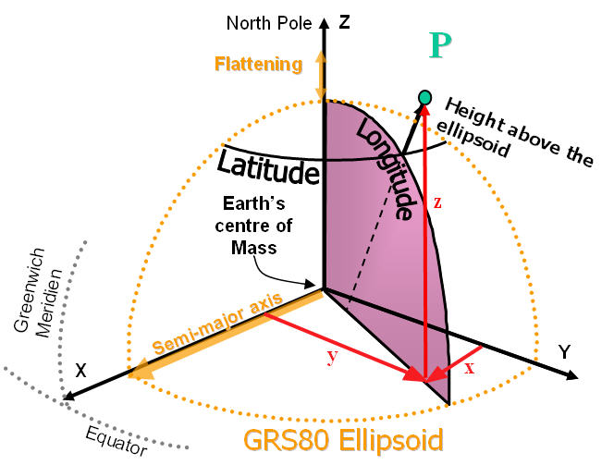
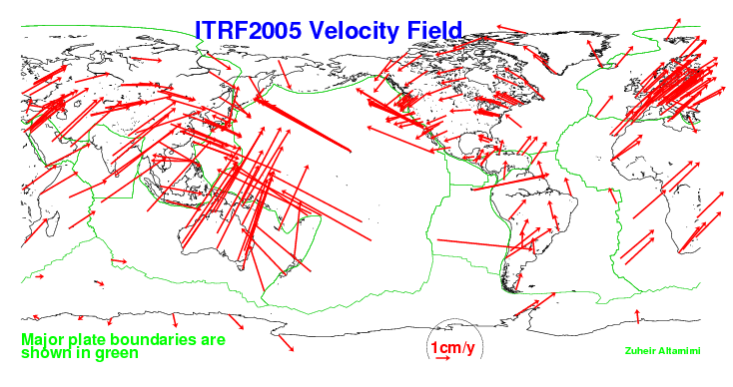
Applications: The Terrestrial Reference Frame
ITRF: reference frame defined by estimates of the coordinates and velocities of a set of stations as determined by VLBI, LLR, GPS, SLR, and DORIS.
ITRF dynamic
  Current version ITRF 2005
  ITRF 2008 in production
Enables a wide range of geophysical science
  Structure and deformations of Earth’s crust, mantel & core
  Sea level change, earthquakes
Overview Applications Contributions Future Work

Slide 10
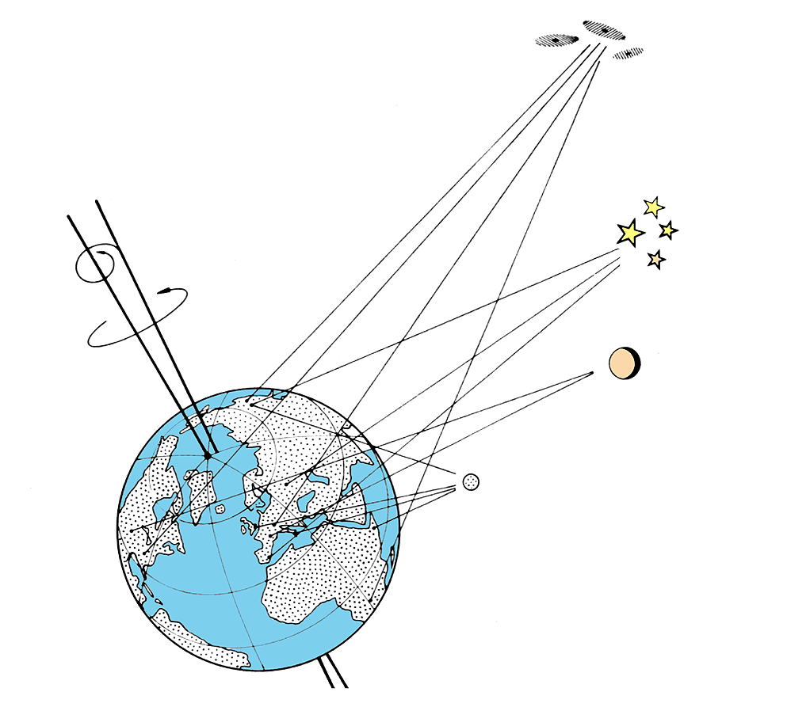
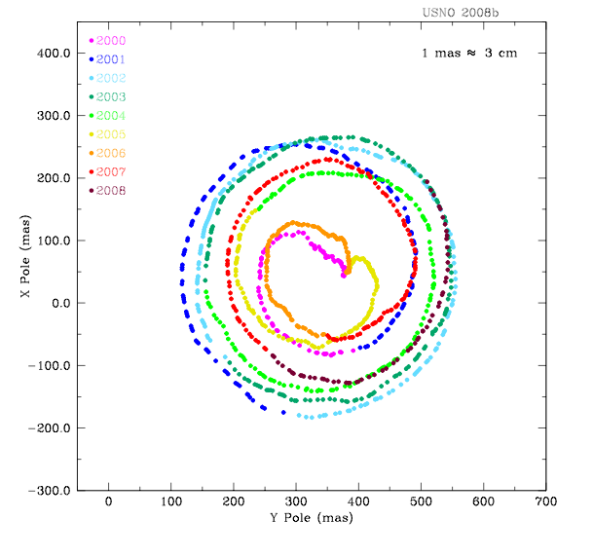
Applications: Earth Orientation Parameters (EOP)
Polar Motion, Earth rotation rate (UT1-UTC), Nutation offsets
Transformation between CRF and TRF
Updated daily with by new VLBI experiments
  VLBI results combined with results from other techniques (ie. GPS, SLR, LLR, DORIS)
Used to predict future EOP
  e.g. USNO Bulletin A
Useful in a variety of applications
  Transportation, geo-location, communications, navigation
  package delivery
Nutation
Polar Motion
Rotation Rate
(UT1-UTC)
Overview Applications Contributions Future Work

Slide 11
Second Realization of the ICRF – (ICRF2)
Work began in earnest in 2008 (IVS and IAU working groups)
IAU resolution has been submitted (late Spring)
  August meeting in Rio de Janeiro
113 page IERS technical note recently completed
30 years of data (1979 – 2009)
Improved geophysical models & analysis techniques
Catalog contains positions for 3414 sources
Scaling (inflation) factor of source position formal errors = 1.5
Noise floor of ~40 micro-arcsec
  Factor of 5 - 6 better than ICRF1
Axis stability of ~10 micro-arcsec
  Factor of 2 better than ICRF1
Overview Applications Contributions Future Work

Slide 12
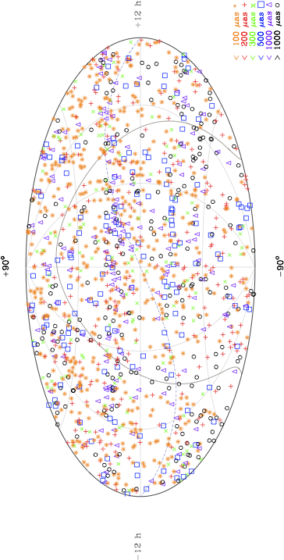
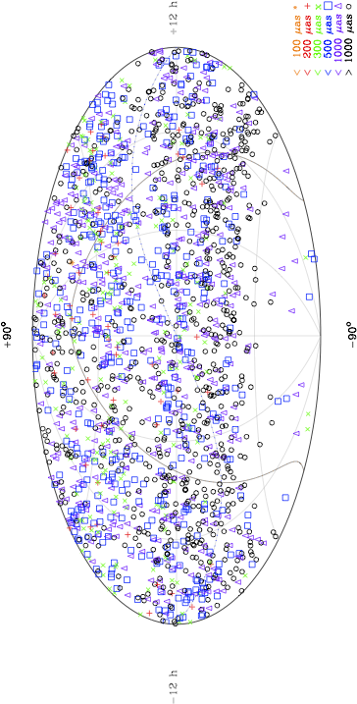
ICRF2 Distribution of All Sources
1448 multi-session
sources
1966 single-session
sources
Many are from VCS
Overview Applications Contributions Future Work

Slide 13
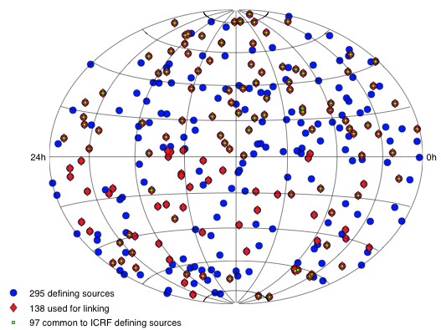
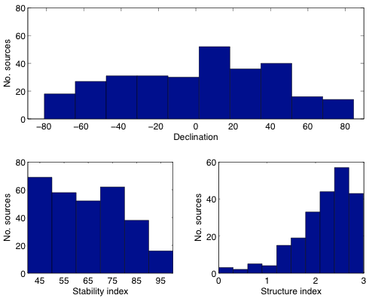
ICRF2 Defining Sources
Defining source ranking:
  Formal errors of the catalog position estimates
  Positional stability from source time series
  Source structure index
    From VLIB imaging
295 Defining sources
  Only 97 are ICRF1 defining sources
138 sources to link to ICRF1
Uniform distribution
  Mean declination 0.7 deg.
Overview Applications Contributions Future Work

Slide 14

Contributions of the VLBA
Why use the VLBA?
  Homogeneous array of 10 antennas
  Among the most sensitive and phase stable VLBI systems
  Dual S/X-band capable
Astrometric/Geodetic session history
  Pietown (1988), Los Alamos (1991)
  All 10 stations of VLBA (1994)
  To date ~170 observing sessions
  Only ~3% of all VLBI sessions since 1979
However …
  More than 1.7 Million S/X group delay pairs
  ~28% of all VLBI measurements
Overview Applications Contributions Future Work

Slide 15
VLBA Astrometric/Geodetic Contributions
Gordon (2004) study showed that
  Including regular (non-VCS) VLBA observations
  Improved TRF accuracy at non-VLBA sites by 10-40%
  Reduced CRF source formal errors by 54% RA and 62% dec.
    for sources greater than −30 deg. declination
Petrov et al. (2009)
  Detailed study of precise geodesy with VLBA
  14 year data span (1994 – 2007)
  Station positions accurate to
    2 - 3 mm vertical displacement
    0.4 – 0.6 mm horizontal displacement
  In terms of formal errors and observed scatter VLBA sessions among the very best VLBI experiments
Overview Applications Contributions Future Work

Slide 16
VLBA RDV Program
Research & Development VLBI (RDV) program started in 1997
  GSFC, NRAO, USNO
VLBA + up to 10 geodetic stations
73 sessions processed to date (<2% of all geodetic VLBI)
Astrometry/Geodesy:
  ~1.2 Million S/X group delay pairs
  ~20% of total number of group delays for all geodetic VLBI
Imaging:
  Determination of source structure
  6747 S/X-band images of 711 sources and growing
  Radio Reference Frame Image Database
  http://rorf.usno.navy.mil/rrifd/
Overview Applications Contributions Future Work

Slide 17
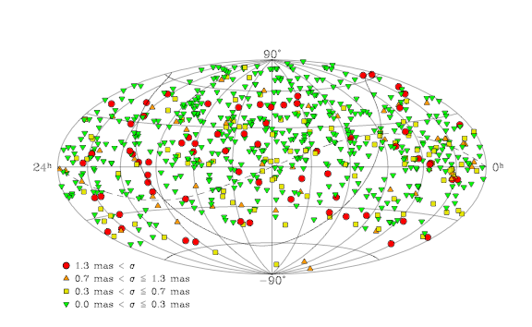
VLBA RDV Reference Frame
RDV data set significant on its own
Study (Fey et al. 2009 in prep)
  65 RDV sessions 1997 – 2007
  wrms position differences RDV catalog – ICRF Ext. 2
    <300 micro-arcseconds
Overview Applications Contributions Future Work

Slide 18
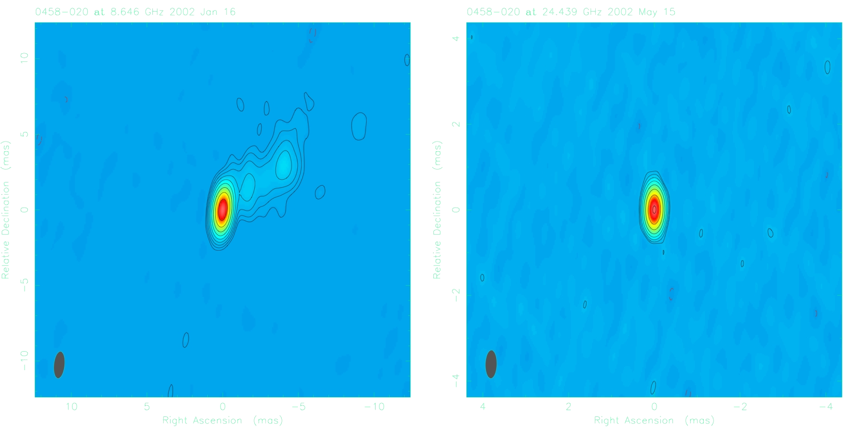
High-Frequency VLBI Astrometry
Why go to higher radio frequencies?
  Expect decreased RFI at higher frequencies
  Expect reduced ionospheric effects
  Expect reduced source structure effects
  NASA moving to Ka-band (32 GHz) for spacecraft communications
  Phase-referencing to nearby quasars very useful for spacecraft navigation
X-band (8.4 GHz)
K-band (24 GHz)
Overview Applications Contributions Future Work

Slide 19
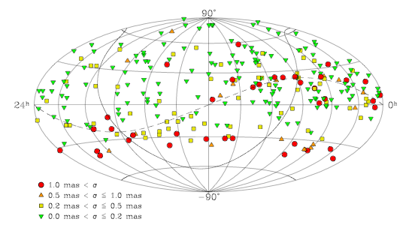
High-Frequency Reference Frame
Joint program: Bordeaux Obs., NASA-GSFC, NASA-HQ, NASA-JPL, NRAO, USNO
Goals of the K (24 GHz) / Q (43 GHz) Program:
  Develop a high-freq. CRF for spacecraft navigation
  Investigate the frequency dependence of source structure
  Develop astrometric and image databases for use by the community
VLBA the most capable tool
Twelve 24-hr VLBA sessions
  2002 to 2009
  Lanyi et al. 2009 – astrometry
  Charlot et al. 2009 – imaging
Talk this meeting (Chris Jacobs)
Overview Applications Contributions Future Work

Slide 20
e-VLBI at the VLBA
Goal: Stream VLBI data over high-speed internet connections to reduce latency due to recording and shipping disk-packs
Two important applications of near-real-time VLBI
  Variable rotation rate of the Earth (UT1-UTC)
    UT1-UTC observations performed 1-hr each day
    Important component for GPS accuracy
  Spacecraft navigation
    Phase-referencing of spacecraft to nearby quasar
    Requires CRF
NASA and USNO interested in e-VLBI at VLBA
Overview Applications Contributions Future Work

Slide 21
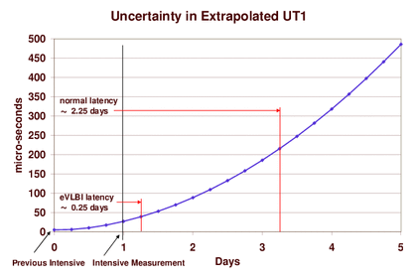
Why Use e-VLBI for UT1-UTC?
Reducing data latency from 2.25 days to 6 hours results in:
  Factor of 5 reduction in UT1-UTC uncertainty
  40% reduction UT1-UTC prediction errors 7 days out
Overview Applications Contributions Future Work

Slide 22
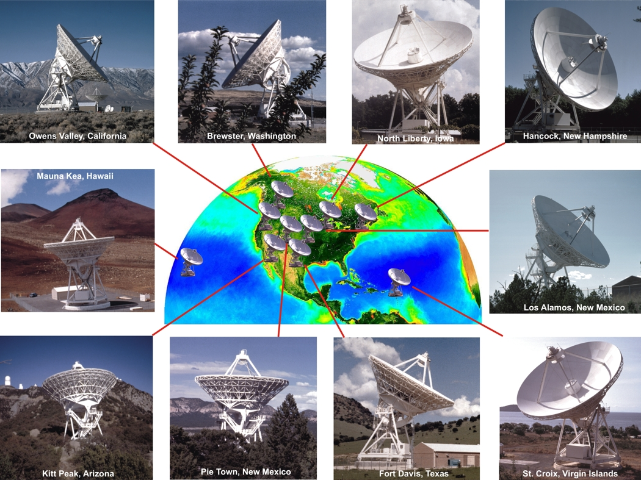
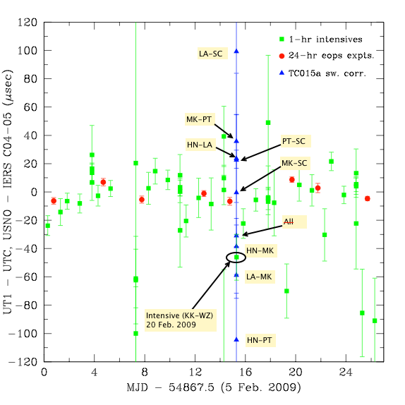
UT1-UTC using the VLBA
VLBA experiment TC015a
  5 stations (HN, LA, MK, PT, SC)
Goal: Simulate 1-hr geodetic intensive experiment to measure UT1-UTC
Shown are the residuals after subtracting the IERS C04 time series for UT1-UTC from our USNO time series
The two longest east-west VLBA baselines in very good agreement
10 additional sessions underway
Poster this meeting (Ojha et al.)
Overview Applications Contributions Future Work

Slide 23
Ties to Frames at Other Wavelengths
Current ICRF defined in the radio using VLBI
  The Hipparcos Frame (HCRF) is the optical realization
The future ICRF will likely be defined at optical wavelengths by astrometric satellite missions (i.e. J-MAPS, Gaia, SIM Lite)
The radio frame will need to be tied to new ICRF
Gaia
  Will observe ~500,000 quasars
  Accuracy <100 micro-arcseconds
  Talk this meeting (Patrick Charlot)
SIM Lite
  Will observe ~100 quasars
  Accuracy <10 micro-arcseconds wide-angle
  Talks this meeting (Steve Unwin, Anne Wehrle, Ken Johnston)
Overview Applications Contributions Future Work

Slide 24
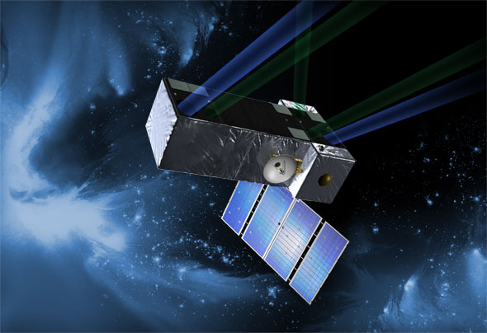
SIM Lite Key Science Project
Astrophysics of Reference Frame Tie Objects
  P.I. - K. J. Johnston (USNO)
Investigate Astrophysics of Reference Tie Sources
  Extragalactic
  Stars: non-thermal radio continuum and maser emission
Determine Stability of Reference Frame Tie Objects
  Pre-launch: radio and optical observations
    Determine quasar variability
    Positional stability
Select Reference Tie Objects (50 - 100)
  Reduce grid zonal errors
  Take rotation out of SIM Lite frame
  Tie to current VLBI-based ICRF
Overview Applications Contributions Future Work

Slide 25
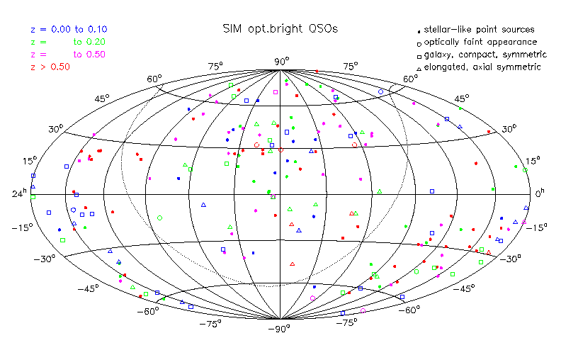
Photometry of SIM Lite Frame-Tie Quasars
Goal: To derive accurate magnitudes of potential reference frame targets to allow optimization of SIM Lite time.
Targets selected from list of ~240 bright quasars.
Results for 235 bright quasars (Ojha et al. 2009, AJ, in press)
Overview Applications Contributions Future Work

Slide 26
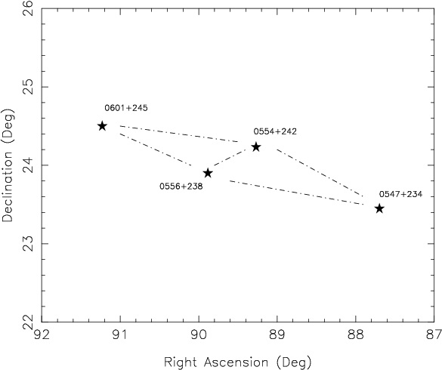
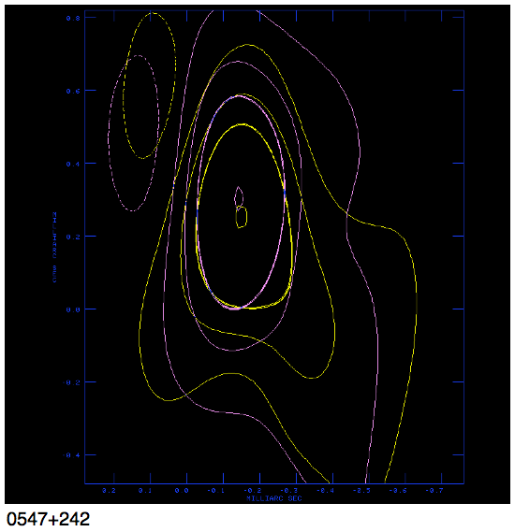
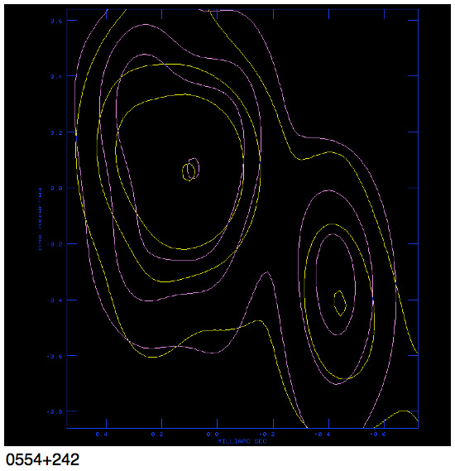
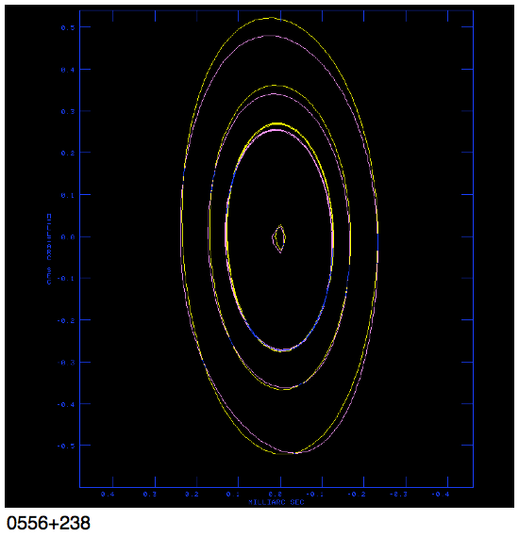
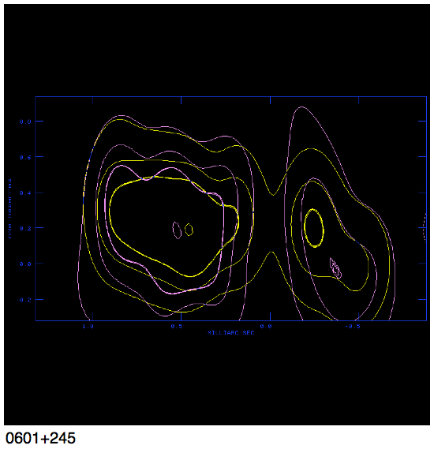
Core Stability of Frame-Tie Quasars
Goal: Investigate the core stability of potential SIM Lite quasars
Collaboration with Ed Fomalont
Narrow-angle astrometry on 4 wide-angle ICRF sources
VERA and VLBA observations
  23 and 43 GHz phase-referencing
  All sources within 3 deg. of each other
  Variable session cadence
Overlay of sessions separated by 2 days
  15 micro-arcsec e/w
  30 micro-arcsec n/s
0556+238
0547+234
0554+242
0601+245
Overview Applications Contributions Future Work

Slide 27
Summary
For Astrometric/Geodetic work the VLBA provides:
  Homogeneous, frequency agile, phase stable, VLBI system
  Many observations (group delay pairs) per session
In turn, Astrometric/Geodetic work provides:
  Correlator model inputs (TRF and EOP)
    Station coordinates and velocities
    Earth Orientation Parameters
  Source positions (CRF)
    Vital to narrow-angle, phase referencing observations
  Observing techniques
    DELZN type observations used in phase referencing
Overview Applications Contributions Future Work

Slide 28
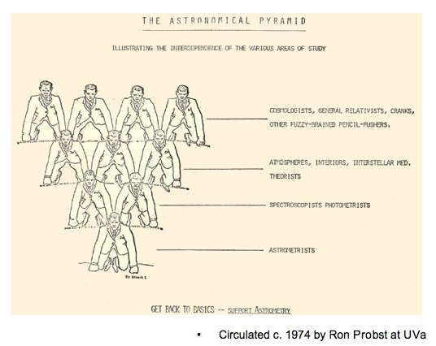
Thanks for Listening

Slide 30
Solution Parameterization - Arc
Arc (or local) parameters – those parameters adjusted for each observing session or more frequently
UT1 and polar motion offsets & rates (once per session)
Nutation offset angles (once per session)
Station clock functions
  Long-term – quadratic polynomials (once per session)
  Short-term – piecewise linear (60 minutes)
Wet troposphere zenith delays
  Piecewise linear (20 minutes)
Azimuthal atmospheric gradients
  Adjustments to a priori model (6 hour intervals)
Sometimes if time series is desired:
  Station positions
  Source positions

Slide 31
Solution Parameterization - Global
Global parameters – those parameters estimated once for entire data set
Station Positions and Velocities at reference epoch
  Form the basis for a TRF
  Can impose constraints to be aligned to established TRF
Source Coordinates
  Form the basis for a CRF
  Can impose constraints to be aligned to established CRF
Harmonic station motions
Non-linear anharmonic station motions
Antenna axis offsets

