Slide 1
Status and future plan of VERA project
H.Kobayashi
Mizusawa VLBI observatory
National Astronomical Observatory of Japan
2009.July.21
VLBA Astrometry workshop@Socorro,NM

Slide 2
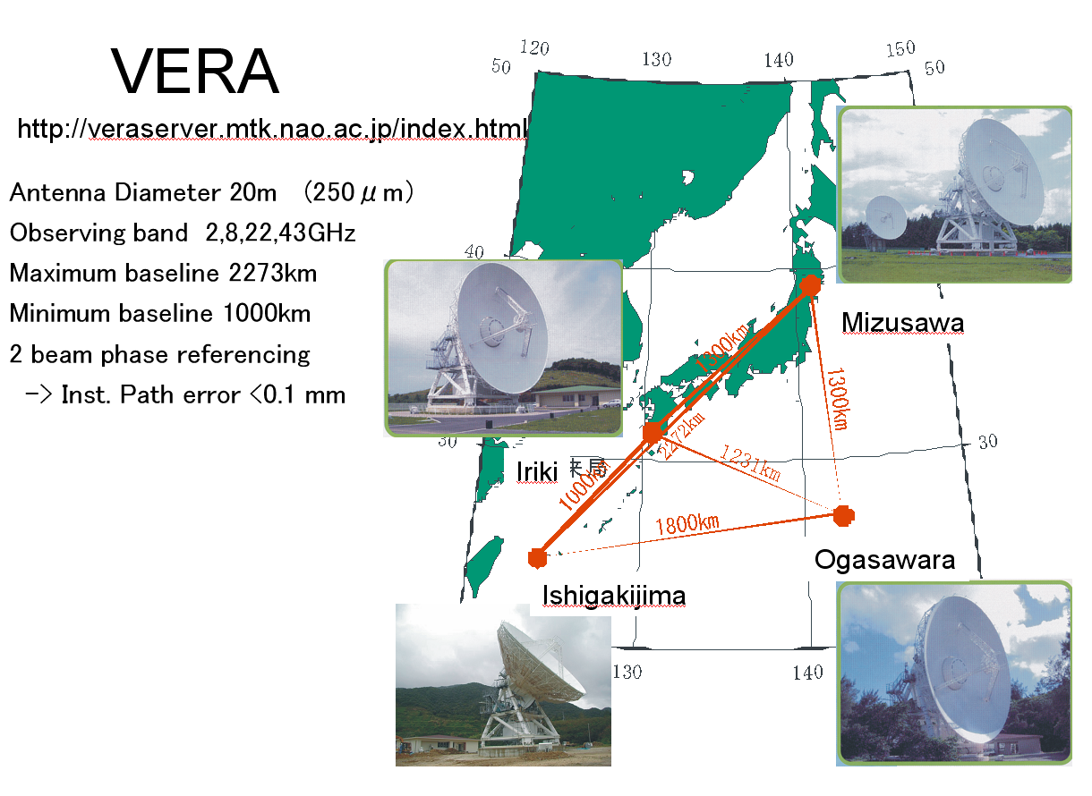
11 researchers
5 post-doc.
7 students
technicians, operators, etc.

Slide 3
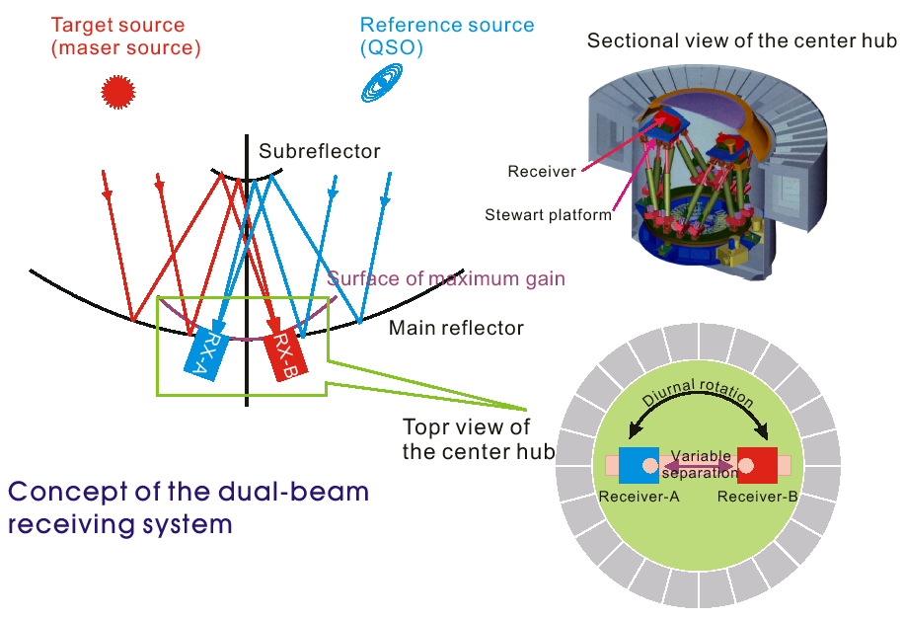

Slide 4
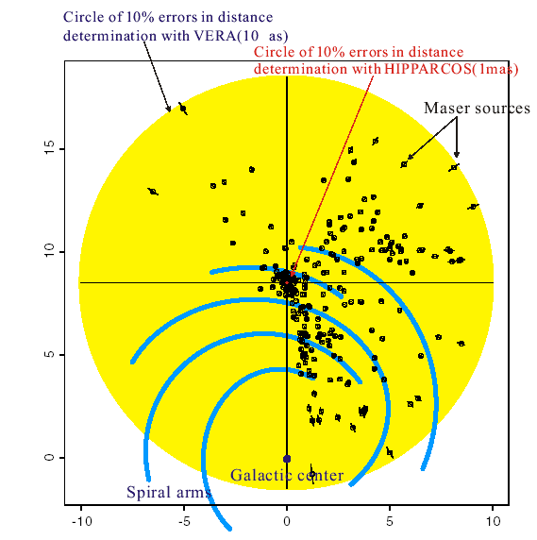
VERA scientific goal
Measurements of distance and proper motions of galactic maser objects (H₂O,SiO)
Dynamics of the Galaxy Maser object:
luminous point-like objects
-> triangulation point of the Galaxy !

Slide 5
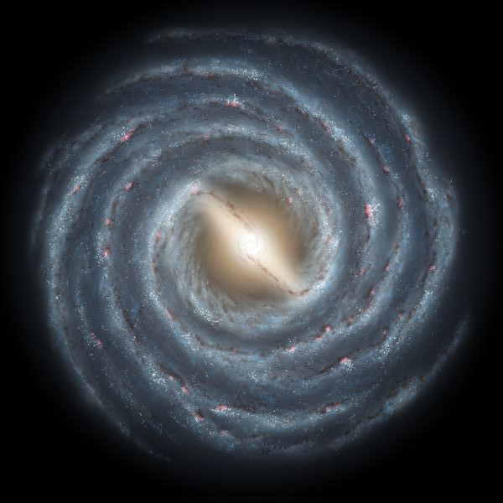
Results of VERA measurements
Milky way galaxy
Sun neighborhood
W49N
ON2
NGC 281
OH43
IRAS1921+1723
AFGL2789
NGC 281
Sun
NGC 1333
Sgr A
S269
IRAS08058+2138
ρ oph
Orion
S Crt
VY CMa
Illustration courtesy:
NASA/JPL-Caltech/R. Hurt (SSC/Caltech)
Parallax + Proper motion
Proper motion

Slide 6
Period-Luminosity relation of Mira variables
Preliminary results !
VERA results on Whitelock et al. 2008
Mk = -3.62 LogP +1.57
Mk = -3.09 LogP +0.18
Mk = -3.51 LogP +1.10

Slide 7
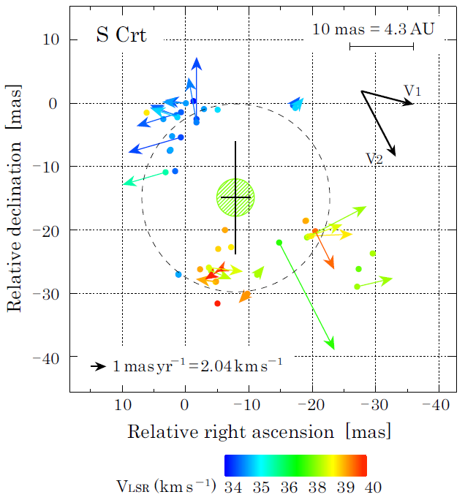
S Crt results
Maser flow with bipolarity
Flow inclination to line of sight ; 43°
Trigonometric parallax
VERA
Pi = 2.33 mas err 0.3
mu_a -3.17 mas/yr err 0.22
mu_d -5.41 mas/yr err 0.22
HIPPARCOS
Pi = 1.27 mas err 0.92
mu_a -3.37 mas/yr err 1.00
mu_d -4.67 mas/yr err 0.75

Slide 8
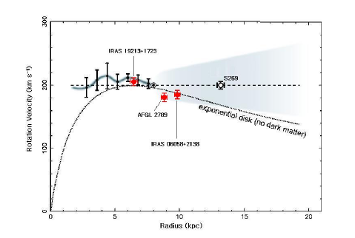
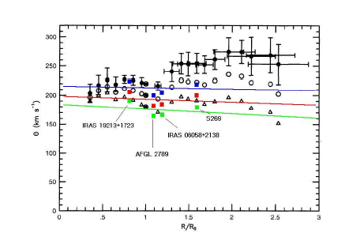
Galactic rotation curve
Massive ring at 11 kpc causes the dip ? Sofue 2009
Honma, et.al, 2007, Oh, PhD thesis, 2009
HI observations Honma and Sofue, 1997

Slide 9
Distance measurementｓ of OrionKL
H2O maser （Hirota et.al, 2007) VERA
  437±19 pc
Nonthermal star GMR A VLBA (Sandstrom et.al, 2007) VLBA
  389±22 pc
Nonthermal stars (Menten et.al, 2007) VLBA
  414±7 pc
SiO maser （Kim et.al, 2008) VERA
  418±6 pc
Coincide with 1% accuracy between VERA and VLBA !

Slide 10
Current astrometry accuracy
(10～30μarc sec.）
Δθ ＝ ΔL/D ΔL：２B phase referencing error
D: baseline length
-> 0.1 mm => １０μarc sec.
Short time variations
  instrument ： < 0.1mm
  Atmosphere ： < 0.1mm
Long time variations
  Baseline error ： 5mm -> 0．3mm @2 deg. separation
  -> 15 μarc sec.
  Excess path by atmosphere ： 30mm -> 0.3mm ＠2deg. Separation -> 30 μarc sec.
→ 10～３０μarc sec. accuracy for trigonometric parallax

Slide 11
See other results
Kinematics of the CSE in VY CM; Choi, et.al, Thursday morning session
Astrometric Observations of Methanol Masers toward W3(OH) with JVN ; Matumoto et.al, Poster #5
The Outflows Traced by Water Masers in Orion-KL; Kim, et.al, Poster #6
Water Vapor Masers in the NGC7538 Region; Kameya, et.al, Poster #8
The Astrometric Feasibility and Accuracy of VERA; Oyama, et.al, Poster #9

Slide 12
Open Use of VERA
Usual open use observations
  400 hours
  VERA + Kashima(34m) + Nobeyama(45m)
  22GHz and 43GHz
  Proposal deadline : 1st of December
  Acceptance ratio of whole proposals is around 50%
  Needs of extensions more

Slide 13
New observation scheme
List up VERA catalog candidates
  Around 300 objects at first, finally more than 500
  Systematic observations
    Quality guaranteed observation with dynamic scheduling
    Fringe check and intensity monitor periodically
    Analyzed data (map data) and visibility data are supplied.
  First list will be announced within a month.
Open use of these cataloged data
  Structure and dynamics of the galaxy
  Internal proper motions and distance etc.
  Some extension observations can be proposed.

Slide 14
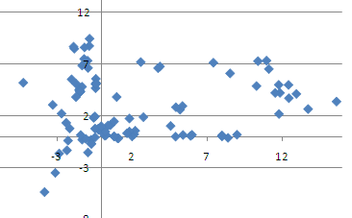
VERA candidate objects
Milky way galaxy
Arm structure
Far side rotation
W49N
ON2
OH43
NGC 281
Sun
Sgr A
Inner rotation curve
S269
Outer rotation
Local structure
Sun
G.C.
Sun
Illustration courtesy:
NASA/JPL-Caltech/R. Hurt (SSC/Caltech)
Mira Period-luminosity relations
Nearby GMC 3-D structure

Slide 15
Future plan of VERA
Combination with KVN
  20m x 7 station array ; 1500 hours/yr
    VERA only; 2500 hours/yr
  2 times improvement of astrometry accuracy
  Short baseline (ex. SgrA*)
Recording bandwidth
  1 Gbps -> 8 Gbps ; VDB2000
  2～３ times sensitivity improvement for calibrators
New receivers
  6.7GHｚ ; room temperature receivers have been installed already.
  22GHｚ dual polarization

Slide 16
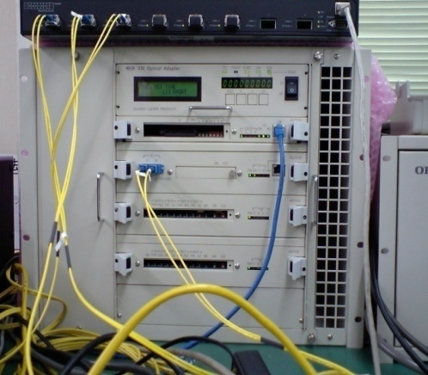
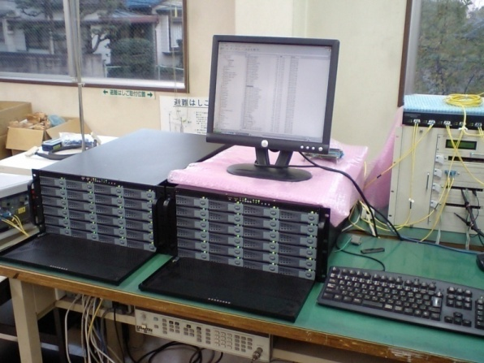
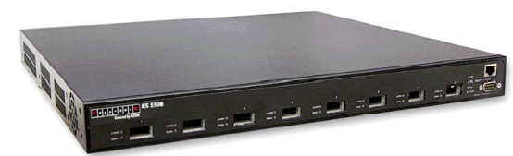
VDB-2000
(8Gbps Disc recorder)
2Gbps x 4
VSI-H－
10 GbE
Converter
（VOA200）
10 GbE
Hub
1 or 2
Gbps
×４
I/O
Disk Server （DDB）
Disk Server （DDB）
10 GbE
Disk Server （DDB）
VSI-H
Disk Server （DDB）
10 GbE
Ethernet transmission
２
Notes:
16

Slide 17
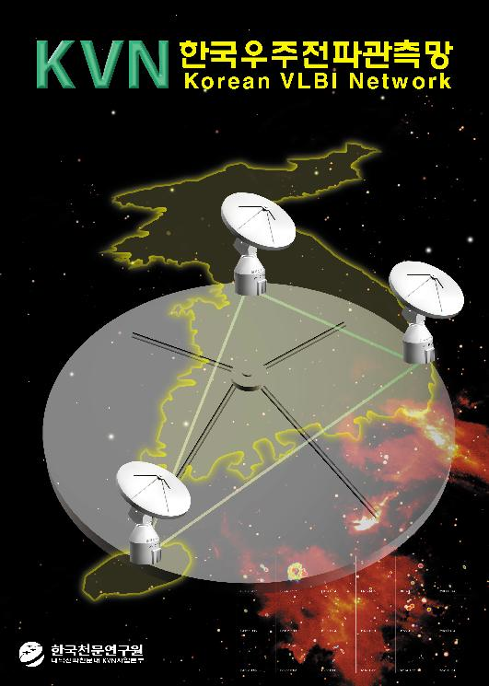
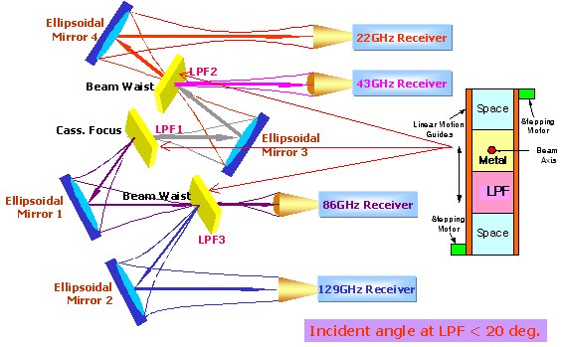
See poster #7 Miyazaki
Simultaneous Multi-Frequency Obs. -Phase Compensation, mm-VLBI

Slide 18
New Seoul correlator for KVN/EAVN
Mark5B
KVN/CVN
VLBI
Data
Buffer
(VDB2000)
Correlation
Subsystem
8Gbps
16 stations
Data
Archive
DIR-2000
VERA
K-5
JVN
Optical Fiber
Correlator Control & Operation S/W
From 2010, operation will be started !

Slide 19
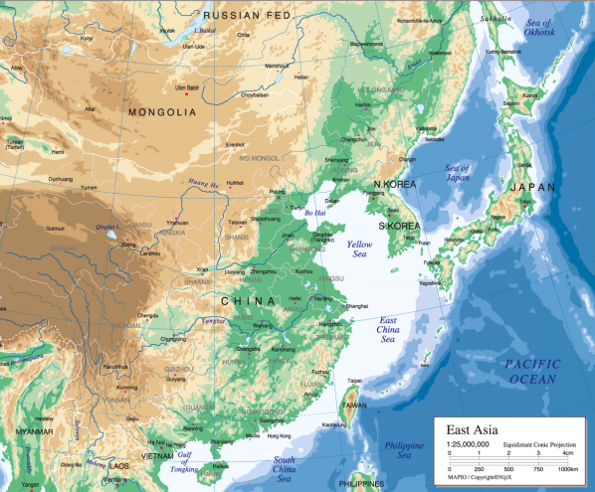
East VLBI Network array configuration

Slide 20
Possible collaborations with VLBA
Combination of different maser emissions
  VLBA: Methanol 6.7 / 1２ GHｚ
  VERA: Water 22 GHｚ、 SiO 43GHz
Share the objects
  Water ２２GHｚ； VLBA / VERA
  ー＞ more objects to compare with GAIA ・SIM

Slide 21
Summary
VERA has succeeded to measure trigonometric parallax for more than ten sources.
Final goal of operation is 250 days, 5,000 hours/year -> 50-60 objects per year with trigonometric parallax and proper motion measurements
Candidate list of VERA catalog will be defined and open use observations for observed data will be started.
In near future, we collaborate with KVN for astrometry research.
Need some considerations for collaborations with VLBA.

