Slide 1
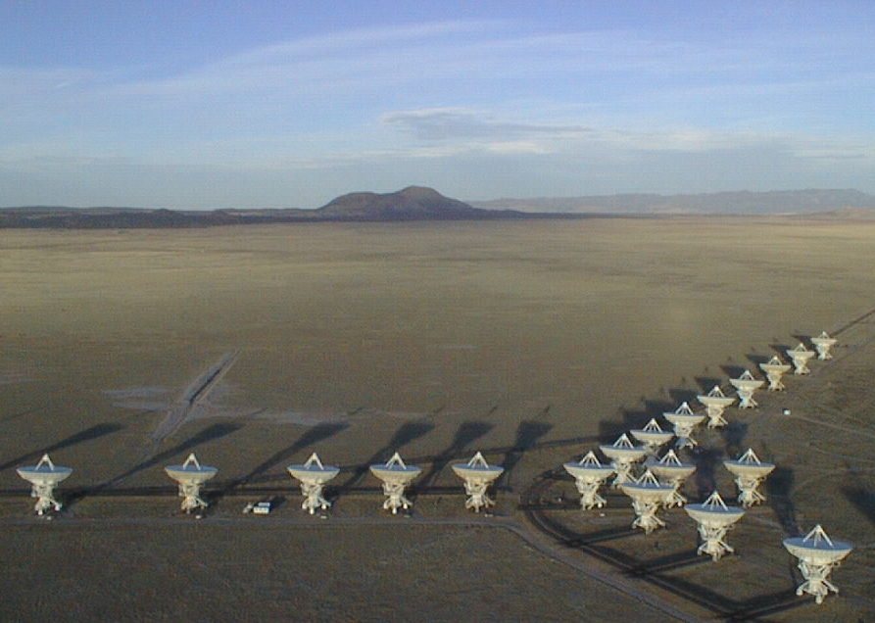
Cool gas in the distant Universe
Epoch of galaxy assembly (z~1 to 5)
Massive galaxy formation: imaging hyper-starbursts
Main sequence galaxies: gas dominated disks
Pushing toward first light: the role of [CII] observations
First light and cosmic reionization (z>6)
Carilli & Walter ARAA 2013, 51, 105

Slide 2
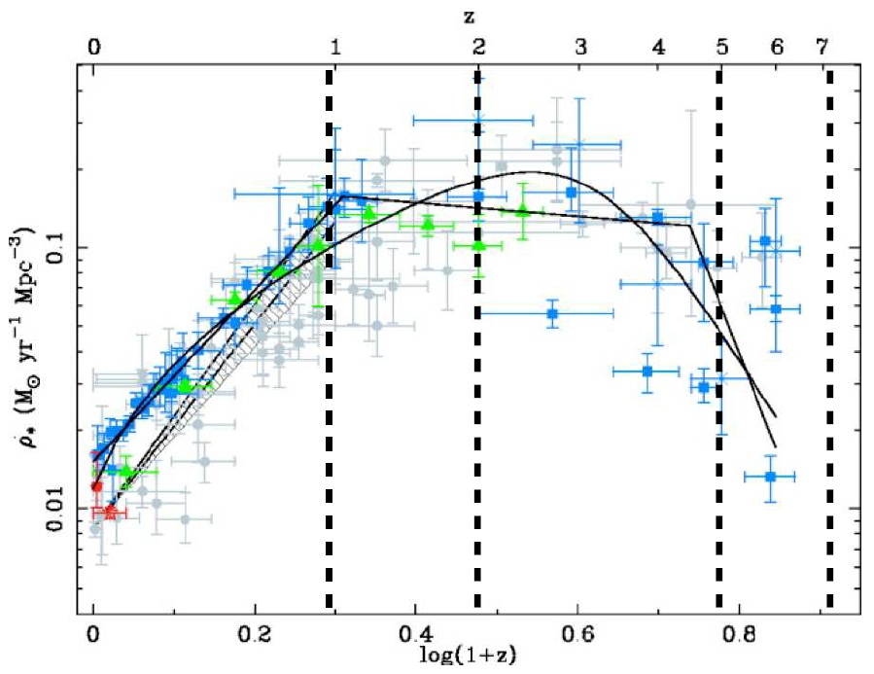
Star formation history of the Universe: UV, radio, IR…
UV, 24um
First light + cosmic reionization
‘epoch of galaxy assembly’
~50% of present day stellar mass produced between z~1 to 3
Cosmic demise

Slide 3
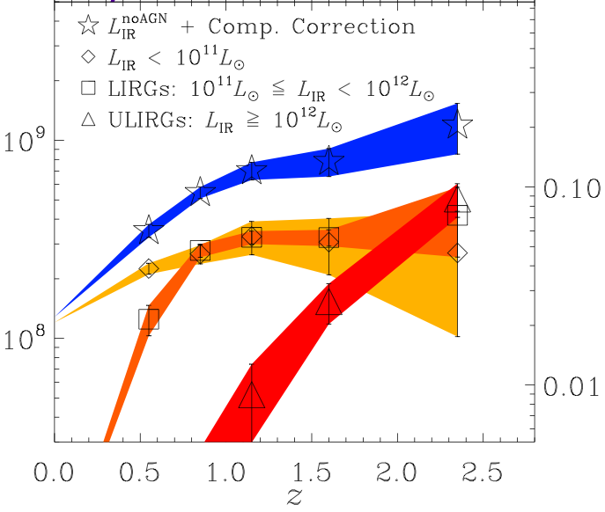


Star formation history as a function of L_{FIR} (~ SFR)
Murphy ea
SFR < 30 M_{o}/yr
SFR ~ 100 M_{o}/yr
SFR > 300 M_{o}/yr FIR > 10¹²L_{o}
SFRD shifts to higher SFR galaxies with redshift
Massive galaxies form most stars quickly and early
Stellar populations at z=0
Old, red galaxies at z~2 to 3

Slide 4
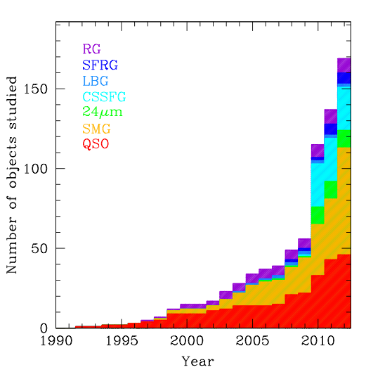
Cool gas detections at z>1 over time
Dec 2011 (pre-ALMA/JVLA)
Main sequence (FIR≤10¹² L_{o}):
SFR ≤ 10² M_{o}/yr,
ρ ≥ 10⁻⁴ Mpc⁻³
HyLIRG (FIR~10¹³ L_{o})
‘starburst’:
SFR ≥ 10³ M_{o}/yr
ρ ≤ 10⁻⁵ Mpc⁻³
Rapid rise 2009 – 2012
New instrumentation (Bure, VLA, GBT)
New CO discoveries: Main Sequence galaxies (sBzK/BX/BM…)

Slide 5
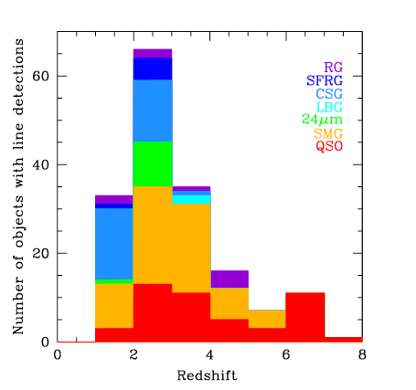
Low z: main seq + SB + quasar hosts
High z: luminous quasar host galaxies
All cases: preselected on other properties

Slide 6
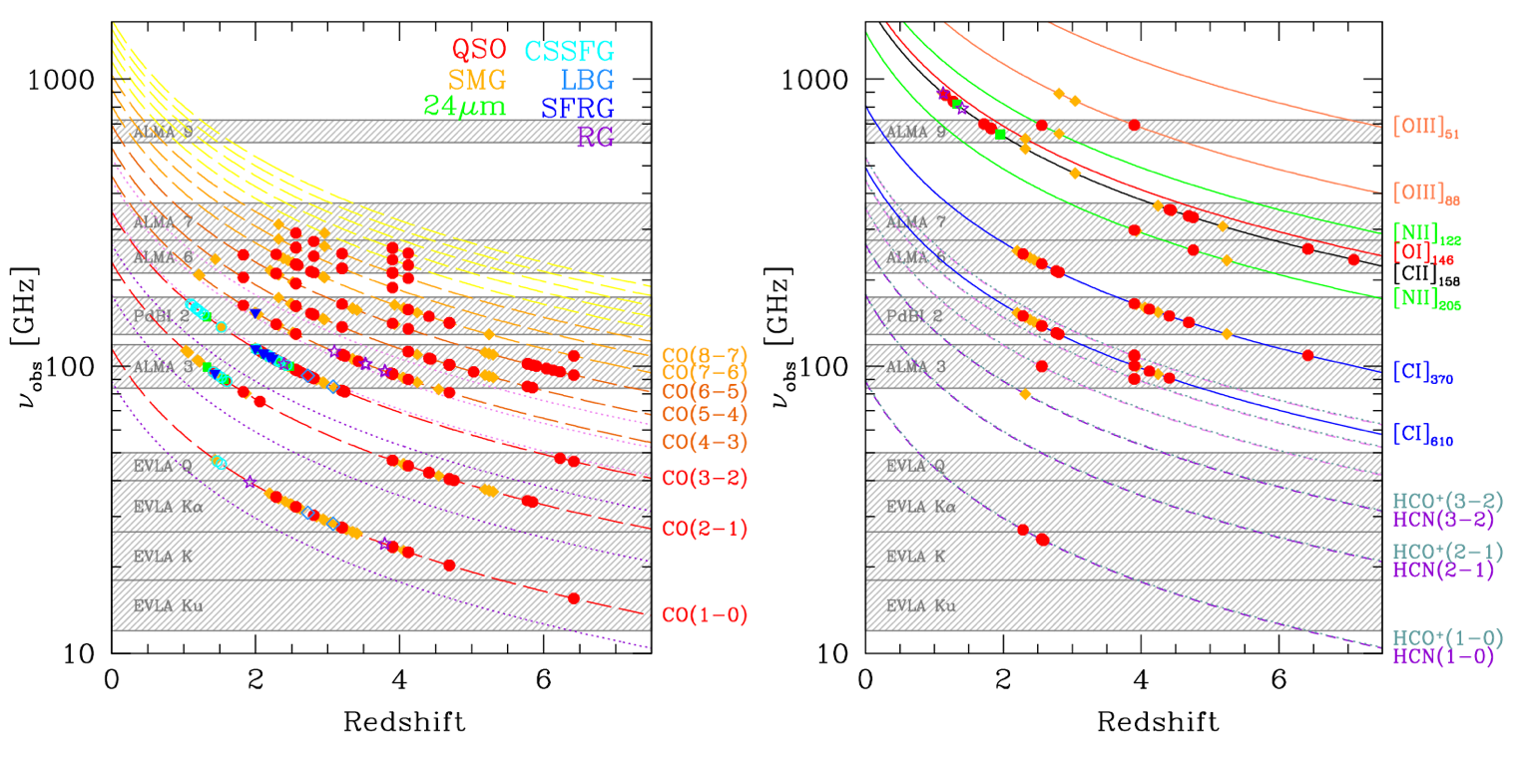
complementarity of different frequency bands
redshift coverage and detections: CO lines
redshift coverage and detections: other lines

Slide 7
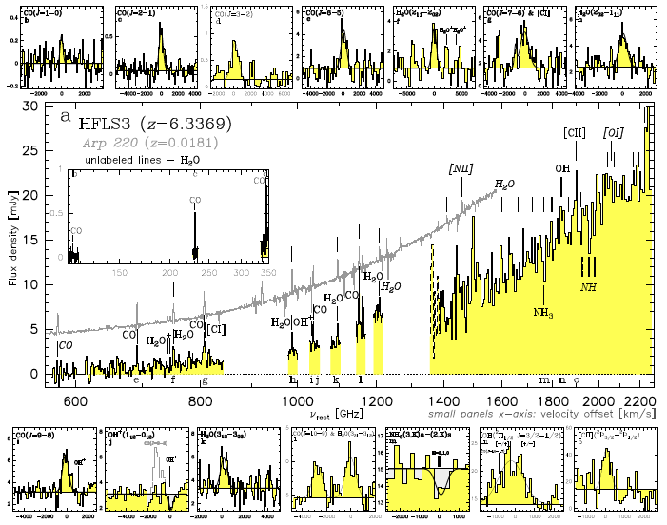
Multi-line spectroscopy

Slide 8
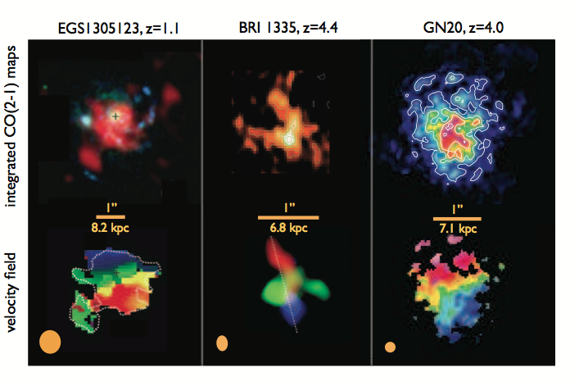
Spectroscopic imaging ‘n_{ch} x 1000 words’
Bure
VLA
VLA
CSG
Quasar
SMG

Slide 9
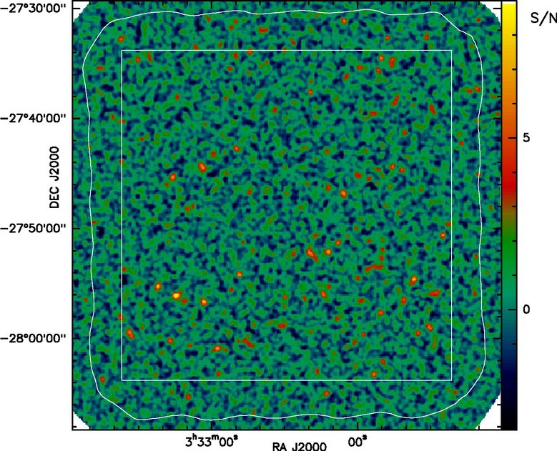
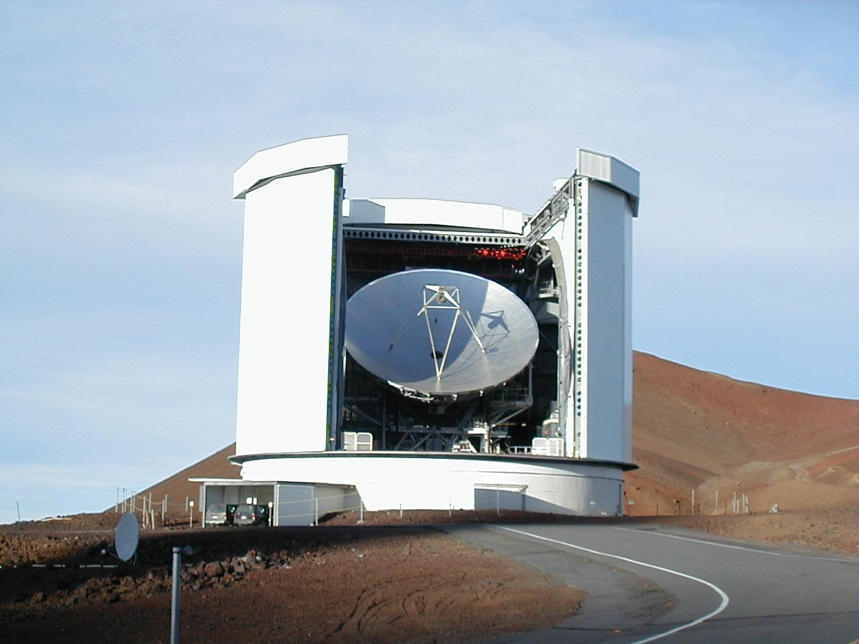
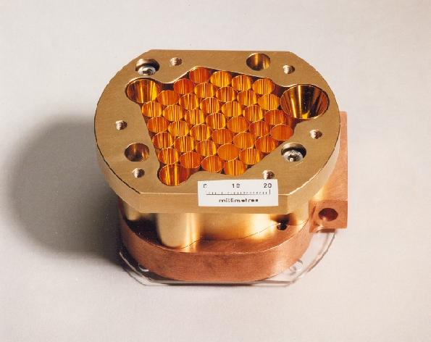
Submm galaxies
Sources identified with first 250/350 GHz bolometer surveys w. mJy sensitivity w. JCMT, IRAM 30m (1998)
What are they?
Distant galaxies?
Nearby galaxies?
Galactic dust?
Rocks in interplanetary medium?
SCUBA Bolometer camera: direct detector at submm wavelengths (850um)

Slide 10
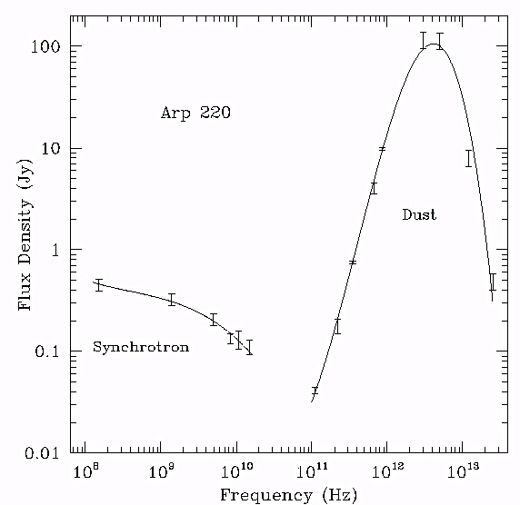
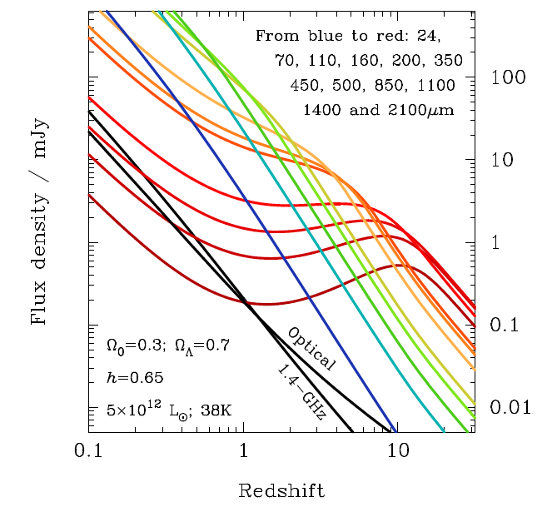
Dust and the Magic of (sub)mm ‘cosmology’: distance independent method of studying objects in universe from z=0.8 to 10
Similar, but less pronounced, for mol. lines: lines α_{RJ} ≤ 2, but dust α_{RJ} ≥ 3
Homework: make this plot and change your life!
α_{RJ}
1mm

Slide 11
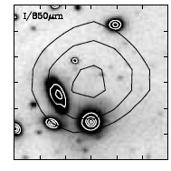
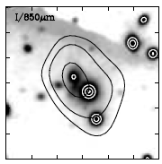
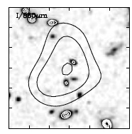
Difficulty: astrometry and confusion
1”
Typical resolution submm surveys ~ 3” – 5” => multiple candidate galaxies

Slide 12
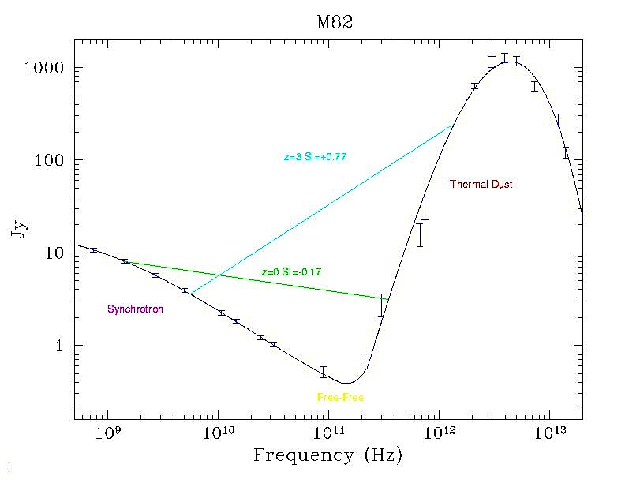
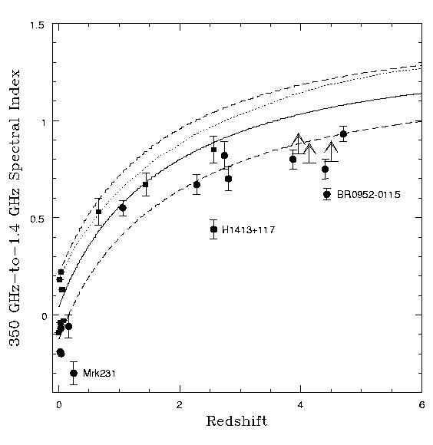
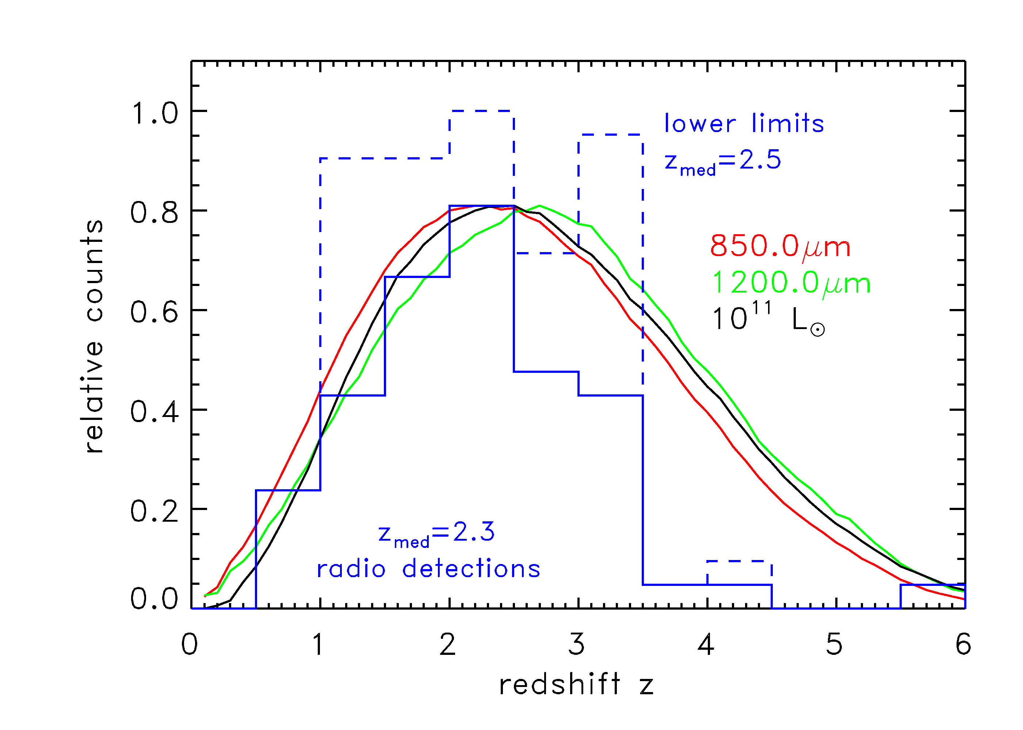
Redshift distribution: Radio photometric redshifts
70% detected at 1.4GHz at S_{1.4} > 30uJy
If high z starbursts following radio-FIR correlation: z_{peak} ~ 2.2, most at z=1 to 3

Slide 13
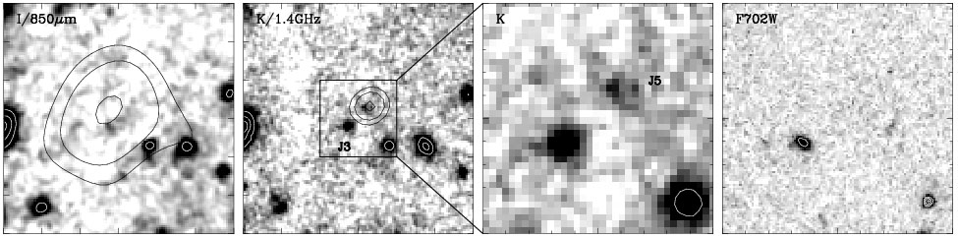
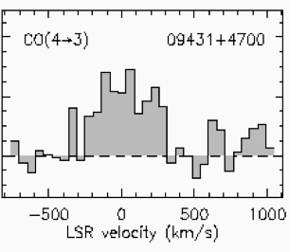
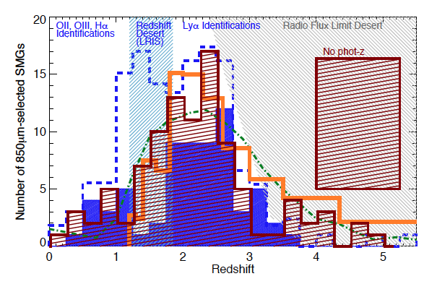
Spectroscopic confirmation
z=3
Radio IDs => arcsec astrometry
Blind Keck spectra of radio position
Confirmed via CO spectroscopy
Peak z ~ 2.5, substantial tail to high z
Factor 1000 increase in number density of HyLIRGs from z=0 to 2!

Slide 14
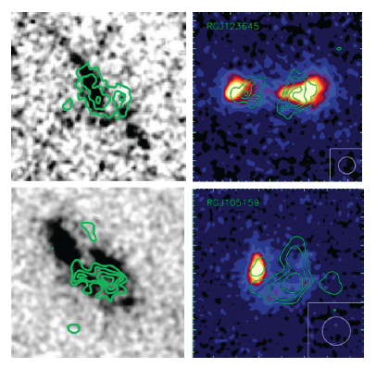
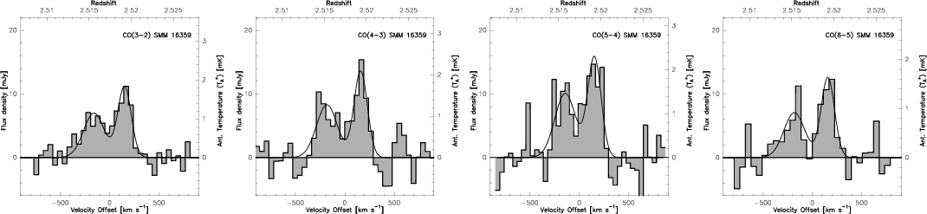
Submm galaxy properties
See: Narayanan et al. 2014, Phys Rep
SFR > 10³ M_{o}/yr (FIR > 10¹³ L_{o} HyLIRGs)
Often major gas rich mergers (but not always)
Usually dust obscured
Always detected in CO:
M_{gas} > 10¹⁰ (α/0.8) M_{o}
Clustering => massive halos
1.4GHz + i-band

Slide 15
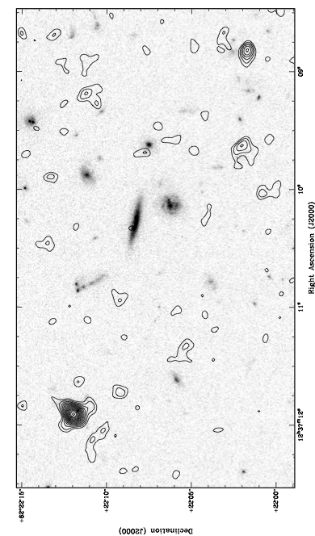
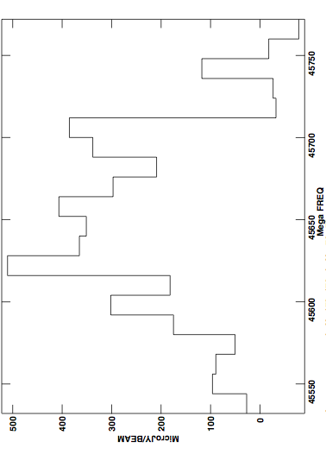
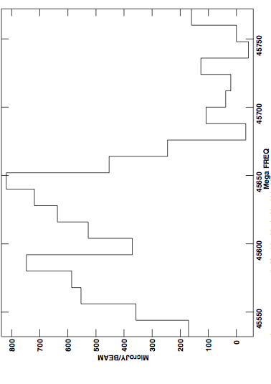
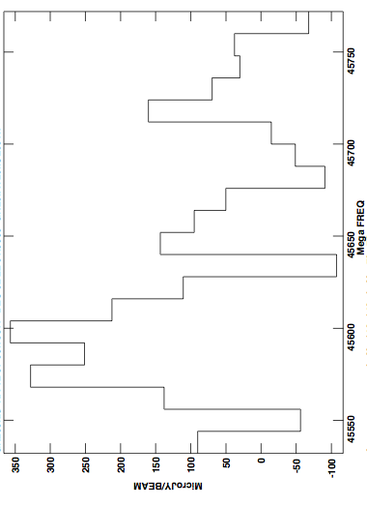
GN20 ‘SMG group’ at z=4.05: clustered massive galaxy formation
0.4mJy
0.7mJy
+
GN20 z=4.055
+
+
+
5”
0.3mJy
GN20.2b 4.056
+
+
+
+
GN20.2a 4.051
+
+
Over-density: 19 LBGs at z_{ph} ~ 4 within ~ 1 arcmin
VLA 45GHz, 256MHz BW: CO2-1 from 3 SMGs

Slide 16
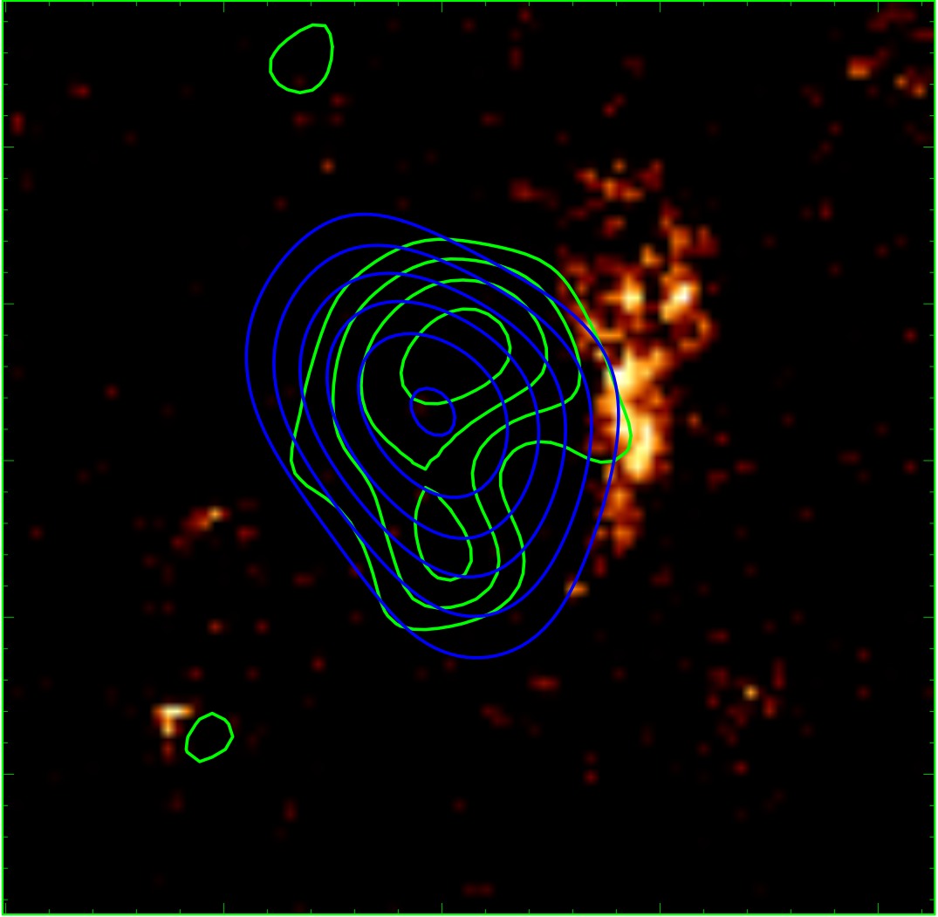
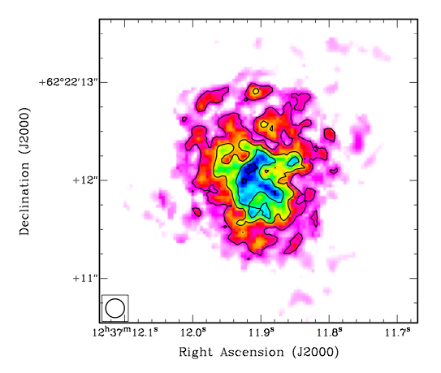
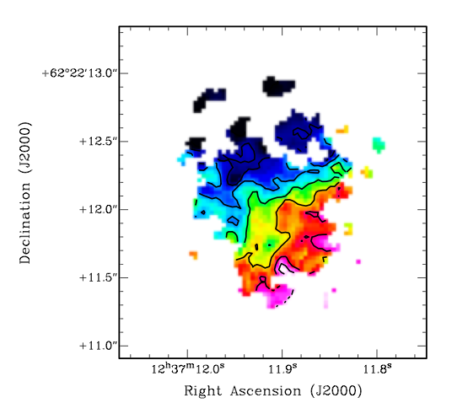
CO 2-1 Mom0
1”
1”
0.25”
HST/CO/SUBMM
Mom1
GN20 z=4.05
FIR = 2 10¹³ L_{o}
Highly obscured at I band
CO: large, rotating, disk ~ 14 kpc
M_{dyn} = 5.4 10¹¹ M_{o}
M_{gas} = 1.3 10¹¹ (α/0.8) M_{o}
-250 km/s
+
+250 km/s
Hodge ea 2012

Slide 17
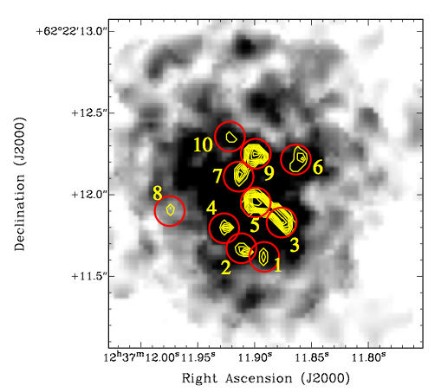
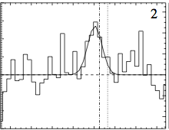
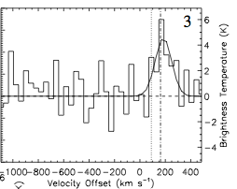
CO at HST-resolution: 0.15” ~ 1kpc
0.5”
T_{b} ~ 20K, σ_{v} ~ 100 km/s
Self-gravitating super-GMCs?
M_{dyn} ~ M_{gas} ~ 10⁹ (α/0.8) M_{o}
Hodge ea 2012

Slide 18
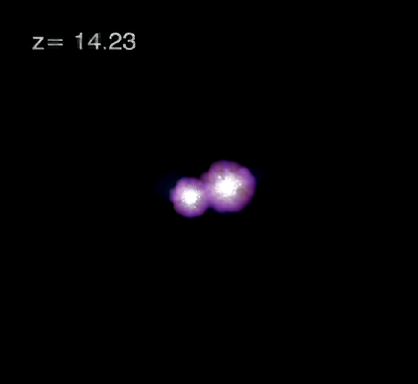
Submm galaxies: Building a giant elliptical galaxy + SMBH at t_{univ}< 2Gyr
10
Multi-scale simulation isolating most massive halo in 3 Gpc^3
Stellar mass ~ 1e12 Mo forms in series of major, gas rich mergers from z~14, with SFR ≥ 1e3 Mo/yr
SMBH of ~ 2e9 Mo forms via Eddington-limited accretion + mergers
Evolves into giant elliptical galaxy in massive cluster (3e15 Mo) by z=0
6.5
Li, Hernquist et al.
Rapid enrichment of metals, dust in ISM
Rare, extreme mass objects: 0.1 arcmin⁻²

Slide 19
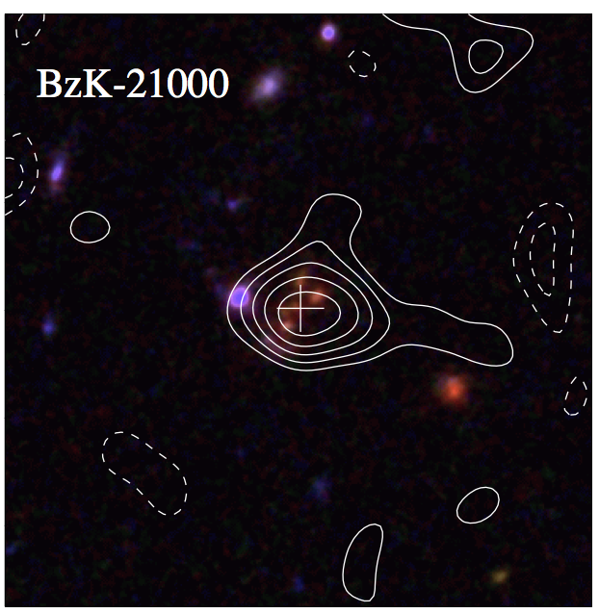
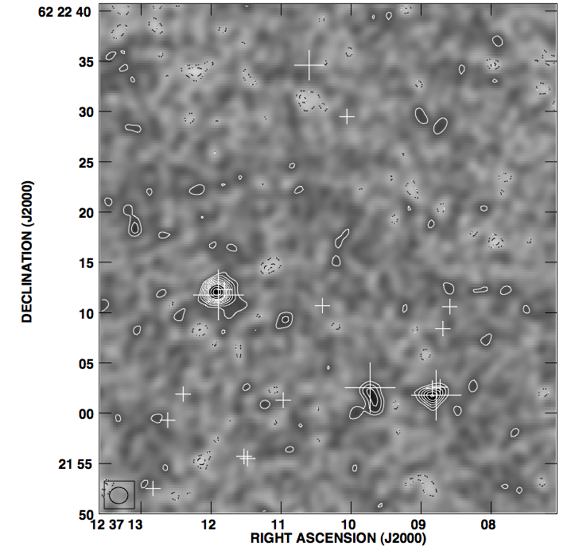
CO in Main Sequence galaxies
CO1-0
z=1.5
GN 20, 1’ field 256MHz BW
3 z=4 SMGs
1 sBzK at z=1.5
CO2-1 z=4.0
Serendipity becomes the norm!
Every observation with JVLA at ≥ 20GHz, w. 8 GHz BW will detect CO in distant galaxies

Slide 20
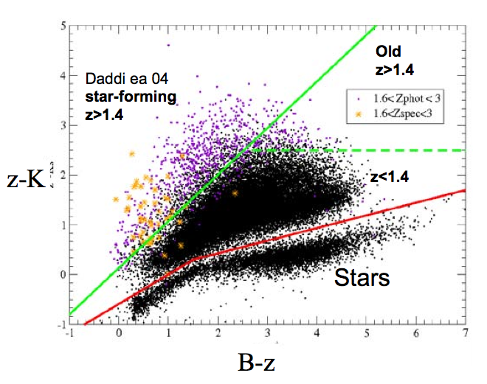
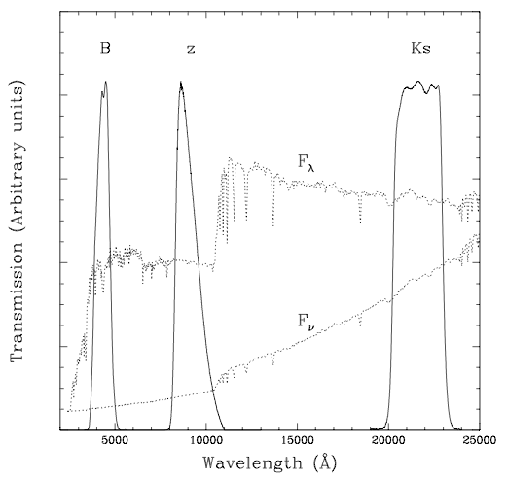
Main sequence: sBzK/BX/BM at z ~ 1 to 3
HST
4000A
z=1.7
Ly-break
color-color diagrams: thousands of z~ 2 star forming galaxies
SFR ~ 10 to 100 M_{o}/yr, M* ≥ 10¹⁰ M_{o} ~ ‘typical SF galaxies’
See Shapley 2011 ARAA, 49, 525

Slide 21
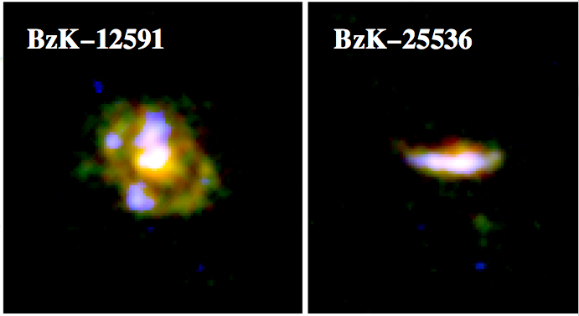
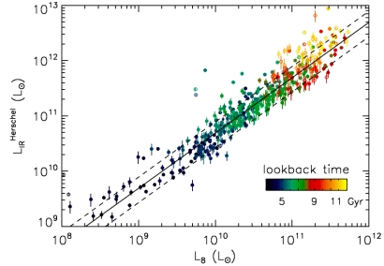
Color selected or ‘Main Sequence’ galaxies
Elbaz ea
SMGs
SFR
10kpc
sBzK/BX/BM – ‘main sequence’
M_{star}
Define a ‘main sequence’ in M_{star} – SFR, clearly delineated from SMGs (‘starburst’)
HST => clumpy disk, sizes ~ 1”, punctuated by massive SF regions

Slide 22
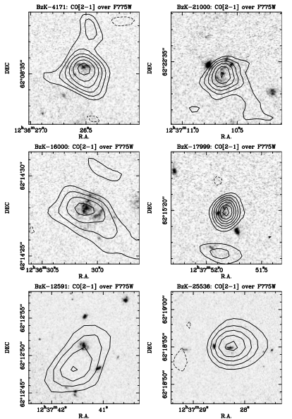
CO obs of Main Sequence galaxies
Daddi ea. 2010
6 of 6 sBzK detected in CO
CO luminosities approaching SMGs but,
FIR (SFR) ≤ 10% SMGs
Massive gas reservoirs without hyper-starbursts!

Slide 23
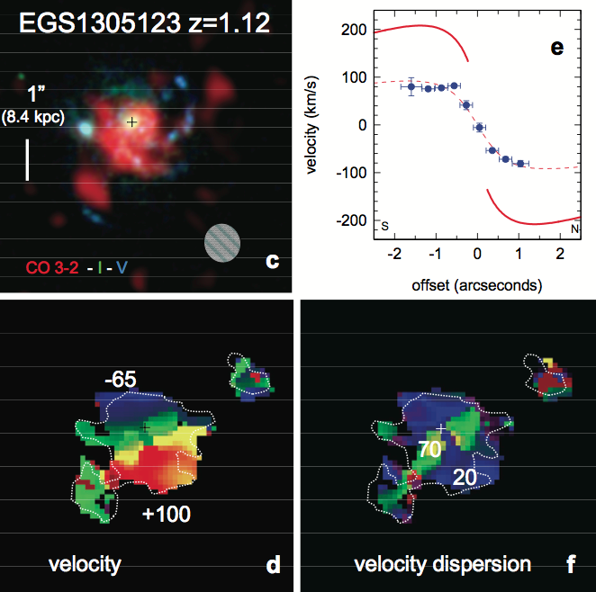
PdBI imaging (Tacconi)
CO galaxy size ~10 kpc
Clear rotation: v_{rot} ~ 200 km/s
SF clump physics
Giant clumps ~ 1 kpc
M_{gas} ~ 10⁹M_{o}
Turbulent: σ_{v} > 20 km/s

Slide 24
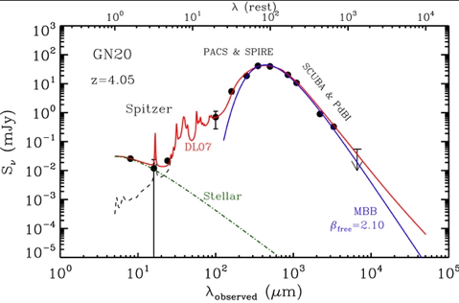
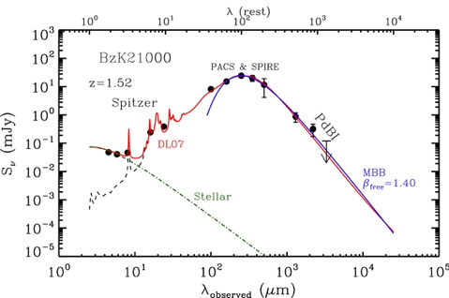
SMG (HyLIRG)
L_{IR} = 2e13 L_{o}
T = 33K, b = 2.1
M_{d} = 2e9 M_{o}
G/D = 75
Main sequence (ULIRG)
L_{IR} = 2e12 L_{o}
T = 33K, b=1.4 (larger dust)
M_{d} = 9e8 M_{o}
G/D = 104

Slide 25
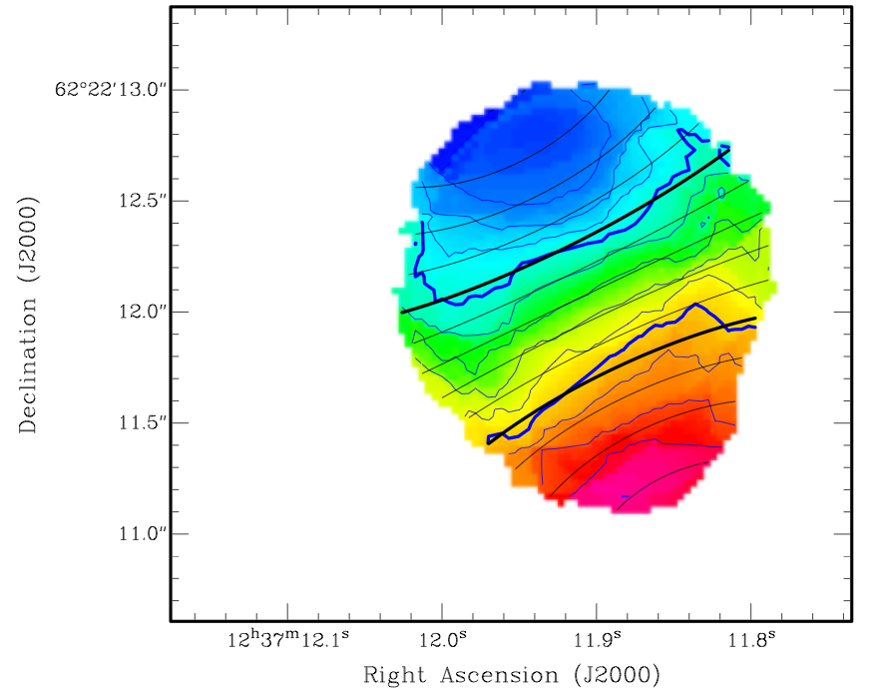
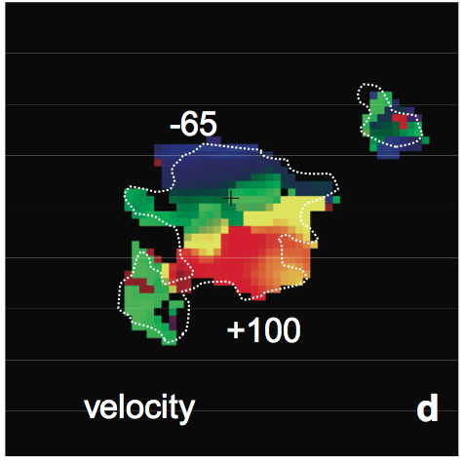
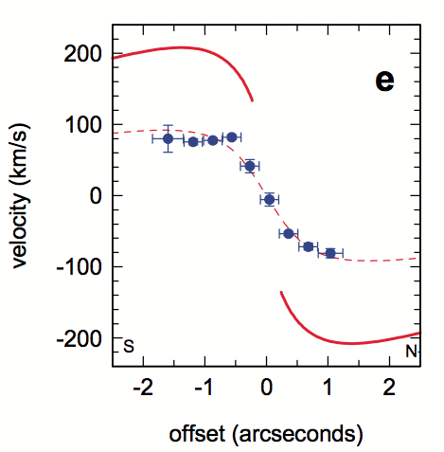
Conversion factor: L’_{CO} = α M_{H2}
Hodge ea.
-300 km/s
M_{dyn}: using CO imaging, w. norm. factors from simulations
Subtract M*, M_{DM} , assume rest is M_{gas} =>
CSG: α _{CO} ~ 4 ~ MW
SMG: α_{CO} ~ 0.8 ~ nuclear SB
7kpc
GN20 z=4.0
M_{dyn} = 5.4 10¹¹ M_{o}
+300 km/s
Consistent with:
Analysis based on SF laws (Genzel)
Analysis of dust-to-gas ratio vs. metallicity (Magdis ea)
Radiative transfer modeling (Ivison)
Likely increases w. decreasing metalicity (Tacconi, Genzel)
M_{dyn} = 2 10¹¹ M_{o}
z=1.1
Tacconi ea. 2010

Slide 26
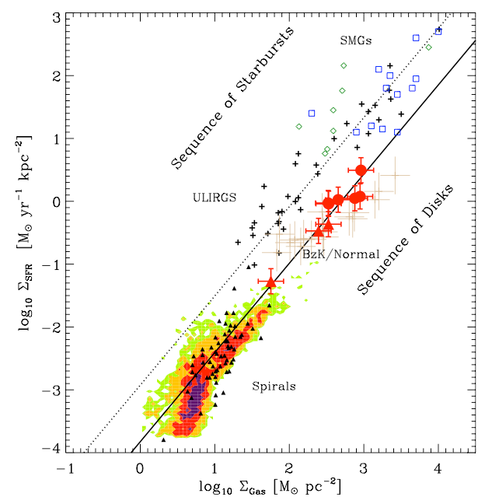
Star Formation Law: two sequences (disk – starburst)
PL index = 1.4
Gas depletion time t_{d} = M_{gas}/SFR
disk: t_{d} ~ few (α/4) x 10⁸ yrs
starburst: t_{d} ~ few (α/0.8) x 10⁷ yrs
SF efficiency = 1/t_{d}
N=1.42

Slide 27
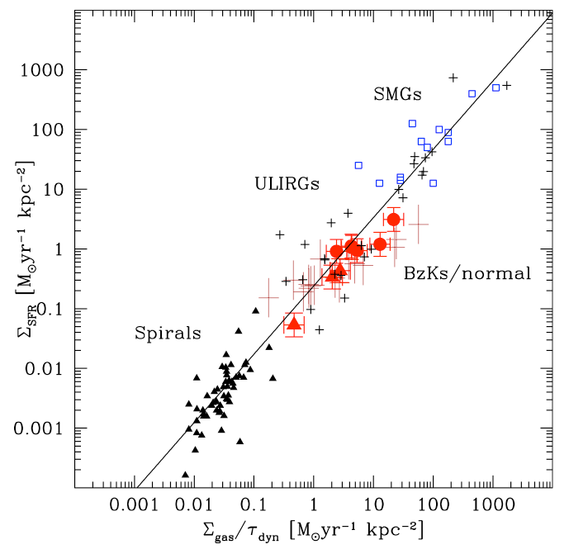
Why: All processed on dynamical time?
Normalize by dynamical time (~ rotation period)
Linear slope fits all => t_{deplete}/t_{dyn} ~ constant
The free fall time is shorter in denser SB disks:
t_{ff} ~ R/v_{rot} ~ ρ^{-1/2}
n=1.14+-0.03

Slide 28

CO excitation
z >1
quasars ~ constant T_{b} to high order ~ Arp220 nucl. ~ GMC SF core
SMGs: intermediate between nuc. SB and MW
Often large, cooler gas component
CSG ~ MW excitation (1 case)
quasars
ν²
Arp220
.
SMGs
.
.
Main Seq
MW
MW ~ GMC (30 pc), T ~ 20K, n_{GMC} ~ 10² cm⁻³
Arp220 ~ SF cores (1pc), n_{core} > 10⁴ cm⁻³ , T > 50K

Slide 29


MS: Baryon fraction is dominated by cool gas, not stars
Daddi ea 2010
Tacconi ea 2013
sBzK z~1.5
z~0 spirals
Possible increase with decreasing M_{star}

Slide 30


Emerging paradigm in galaxy formation: cold mode accretion (Keres, Dekel…)
Galaxies smoothly accrete cool gas from filamentary IGM onto disk at ~ 100 M_{o}/yr (high density allows cooling w/o shocks)
Fuels steady star formation for ~ 1Gyr
Form turbulent, rotating disks with kpc-scale star forming regions, which migrate inward over ~ 1 Gyr to bulge
‘Dominant mode of star formation in Universe’
Problems:
Circumstantial evidence: No direct observation of accreting gas
CMA challenged in recent cosmological simulations
T<10⁵K, N>10²⁰ cm⁻²
Cerverino + Dekel

Slide 31

Evolution of gas fraction: epoch of peak cosmic SF rate density (z~2) = epoch of gas-dominated disks
~ L’_{CO}/R
(1+z)²
All star forming disk galaxies w. M* ≥ 10¹⁰ M_{o}
All points assume α~ 4 => empirical ratio ~ L’_{CO}/R_{rest}

Slide 32



Good news for molecular deep fields
JVLA: 25% FBW 31 to 39 GHz => Large cosmic volume searches for molecular gas
CO 1-0 at z=1.9 to 2.7
CO 2-1 at z = 4.9 to 6.4
FoV ~ 1.5’

Slide 33





Good news for molecular deep fields: PdBI pilot search
Spectral scan: 80 to 115GHz
Detect 5 candidate CO galaxies
HDF 850.1: z = 5.2 (finally!)
CSG z = 1.78
JVLA/ALMA searches in progress
850.1
1’
z_{ph} = 1.78
850.1 z=5.2

Slide 34




CO deep fields: VLA GN, Cosmos
Goods North
50 arcmin²
150 hrs ; rms_{cont}~ 3uJy
30 – 38 GHz
10, 50 arcmin²
rms per 100km/s < 0.1mJy => M_{H2} = few e9 M_{o}
1st cool CO selected ~ dusty main sequence
SFR ~ 250 M_{o}/yr
z=2.5
M_{H2} = 7e10 M_{o}

Slide 35


Cool Gas History of the Universe
SF Law
SFR
M_{gas}
SFHU[environment, luminosity, stellar mass] has been delineated in remarkable detail back to reionization
SF laws => SFHU is reflection of CGHU: study of galaxy evolution is shifting to CGHU (source vs sink)
Epoch of galaxy assembly = epoch of gas dominated disks

Slide 36



Pushing back to first (new) light: Fine structure lines
Good news: CII is everywhere!
[CII] 158um line (1900GHz) is most luminous line from star forming galaxies from meter to FIR wavelengths:
0.3% of FIR luminosity of MW
[CII]/CO3-2 ~ 50
traces WNM, WIM, SF regions => Good dynamical tracer
z > 1 => redshifts to ALMA bands (< 900 GHz)

Slide 37

Bad news: CII is everywhere!
Mag. Clouds
CII luminosity is not quantitative tracer of anything: FIR > 10¹¹ => 20dB scatter!
[CII] powerful tool for:
Gas dynamics (CNM – PDR)
Redshift determinations z>6
Low metallicity: enhanced [CII]/FIR (lower dust attenuation => large UV heating zone)
Can be suppressed in SB nuclei: dust opacity?
MW
11

Slide 38





[CII] examples: New field (all within last year!)
Dust-obscured hyper-starbursts
Imaging massive galaxy formation
G3
B1202-07 z=4.7
SMG
G3
700km/s
G4
2”
QSO
G4
rms=100uJy
Two hyper-starbursts (SMG and quasar host): SFR ~ 10³ M_{o}/yr
Two ‘normal’ LAE: SFR ≤ 10² M_{o}/yr

Slide 39

SMG
[CII] in 1202: Imaging cool gas dynamics at z=4.7
Quasar, SMG: Broad, strong lines
Tidal bridge across G3, as expected in gas-rich merger
Possible quasar outflow, or further tidal feature, toward G4
G3
Q
G4

Slide 40


BRI1202: ‘smoking gun’ for major merger of gas rich galaxies
-500km/s
SMG
7kpc
G3
Q
G4
+500km/s
ALMA: 20min, 17ant
Tidal stream connecting hyper-starbursts
SMG: warped disk, highly optically obscured
HyLIRG QSO host, with outflow seen in [CII] and CO
G3: Ly-alpha + [CII] in tidal gas stream
G4: dust and [CII] in normal LAE

Slide 41



Aztec 3: massive cluster formation at z=5.3
ALMA 1hr, 17ant
Riechers ea
rms = 70uJy
Capak ea 2012
SMG SFR ~ 1800, M_{gas} ~ 5e10 (α/0.8) M_{o}
Most distant proto-cluster: 11 LBGs in ~ 1’; 5 w. z_{spec} ~ 5.30

Slide 42


ALMA observations [CII] 158um line from Aztec 3 group (Riechers)

Slide 43

SMG
Roughly face-on, size ~ 8kpc
M_{dyn} ~ 10¹¹ M_{o}
[CII]/FIR ~ 0.001 ~ ‘starburst/AGN’

Slide 44

Detect LBG group in [CII]
No FIR: S₃₀₀ < 0.2mJy => SFR < 50 M_{o}/yr
[CII]/FIR > 0.0023 ~ MW
Tidally disturbed gas dynamics in interacting LBG group

Slide 45


Representative sample Main Sequence galaxies z=5 – 6 (LBGs)
SFRs ~ 30 to 300 M_{o}/yr
10/10 detected in [CII] w. ALMA 1hr, 22 ants.
Only 4 detected in dust continuum

Slide 46

[CII]/FIR: similar large scatter to low redshift

Slide 47



Galaxy dynamics at z=5.7
-125 to +125 km/s

Slide 48


Cosmic reionization and beyond: redshifts for first galaxies
J1120+0641: z=7.084
Most distant z_{spec}
Mortlock ea;Venemans ea.
GP effect: damped profile of neutral IGM wipes-out Lya line: τ_{IGM} > 5
[CII] and dust detected with Bure => SFR ~ 300 Mo/yr
ISM of host galaxy substantially enriched (but not IGM; Simcoe ea.)

Slide 49

Pushing further into reionization: z~9 near-IR dropouts
Bouwens et al. 2012
Drop-out technique: z~9 galaxies?
SFR ~ few to ten M_{o}/yr: low SFR galaxies that reionize the Universe?
Difficulty: confirming redshifts (no Lya!)
ALMA: [CII] from 5M_{o}/yr at z=7 in 1hr; 8GHz BW => Δz ~ 0.3
Low Metalicities => [CII]/FIR increases!

Slide 50


Slide 51


Quasar hosts: Dynamics of first galaxies
Dust Wang ea
Gas
-200 km/s
+300 km/s
300GHz, 0.5” res
1hr, 17ant
ALMA Cycle 0: 5/5 detected [CII] + dust
Sizes ~ 2-3kpc, clear velocity gradients
M_{dyn} ~ 5e10 M_{o,} M_{H2} ~ 3e10 (α/0.8) M_{o}
Maximal SB disk: 1000 M_{o} yr⁻¹ kpc⁻²
Self-gravitating gas disk, support by radiation pressure on dust grains
‘Eddington limited’
eg. Arp 220 on 100pc scale, Orion < 1pc scale

Slide 52

M_{bh}/M_{dyn} vs. inclination for z=6 QSOs
Low z relation
All must be face-on: i < 20º
Need imaging!

Slide 53

Correlation has become scatter
Possibly sub-correlations
See Kormendy & Ho ARAA

Slide 54




Slide 55



Slide 56

Cooling flow problem
Tcool = ?? < thubble
Radio jet energy input is enough to keep the gas hot

Slide 57
CO in Main sequence
CO1-0
z=1.5
GN 20, 1’ field 256MHz BW
3 z=4 SMGs
1 sBzK at z=1.5
CO2-1 z=4.0
Serendipity becomes the norm!
Every observation with JVLA at ≥ 20GHz, w. 8 GHz BW will detect CO in distant galaxies

