Slide 1
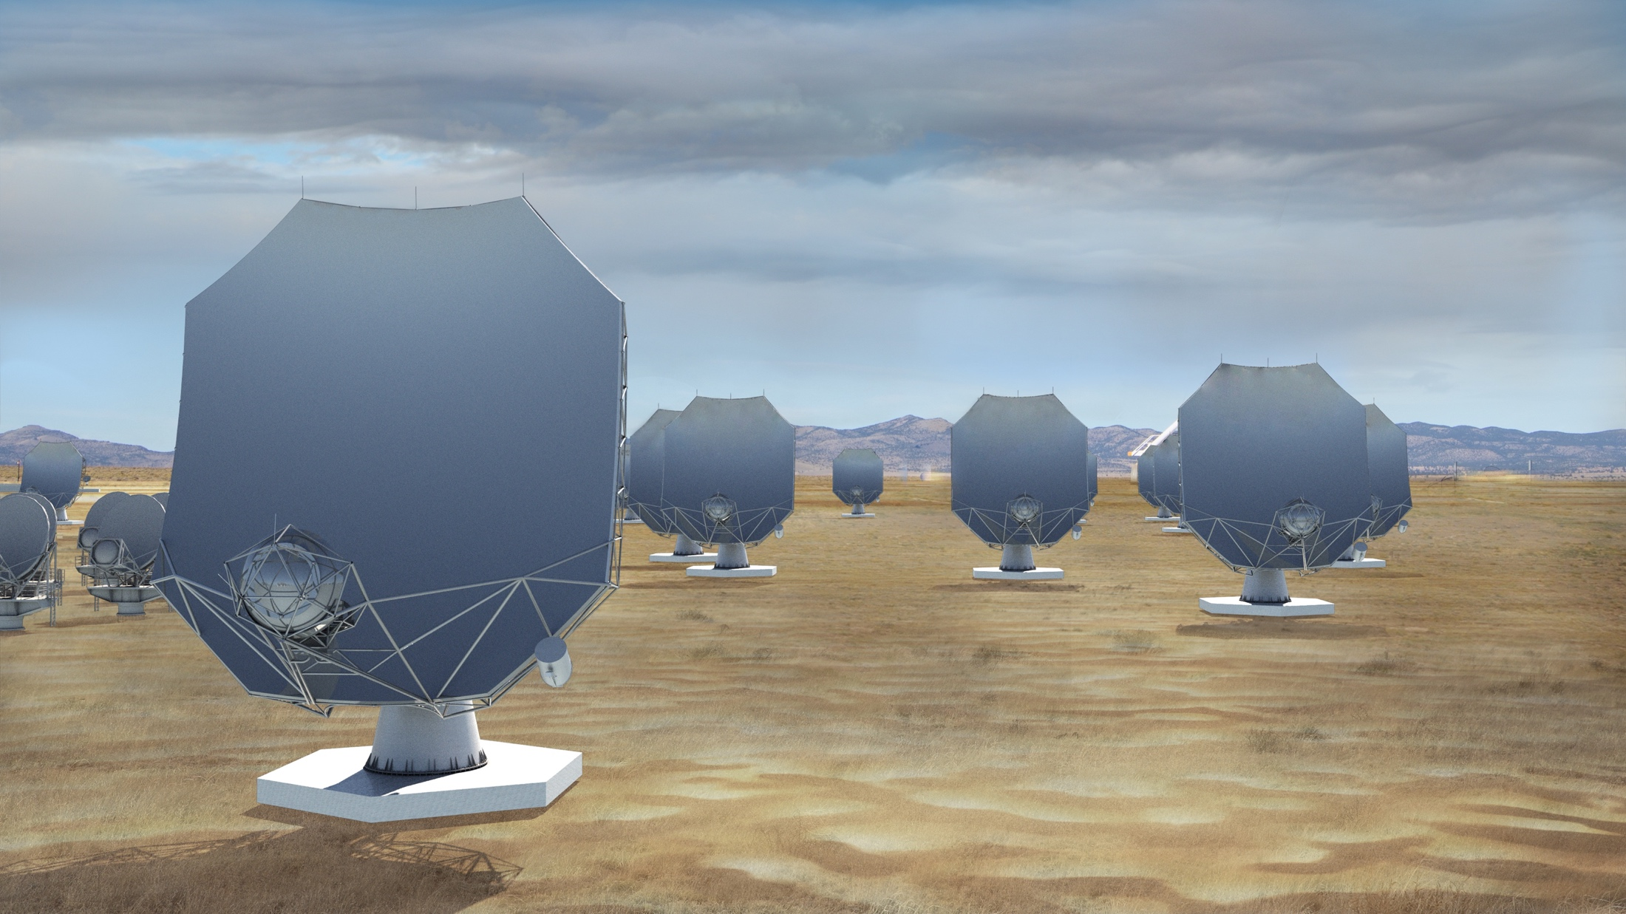
The next-generation Very Large Array (ngVLA)
A new facility for a new millennium: replace the VLA and VLBA to tackle new Scientific Frontiers into the mid-Century
Thermal imaging at milli-arcsec scales (<10K @ 7mas, 3mm)
10x area of JVLA/ALMA/VLBA
1.2 - 116 GHz Frequency Coverage
244 x 18m + 19 x 6m
  Centered at VLA site, extending over USA & MX
  High and dry sites for 115 GHz
  Fixed antenna locations
Notes:
Will be the next U.S. Flagship Radio Observatory.

Slide 2
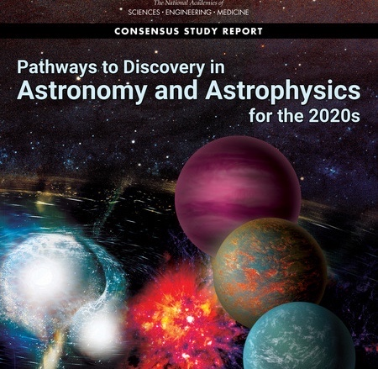
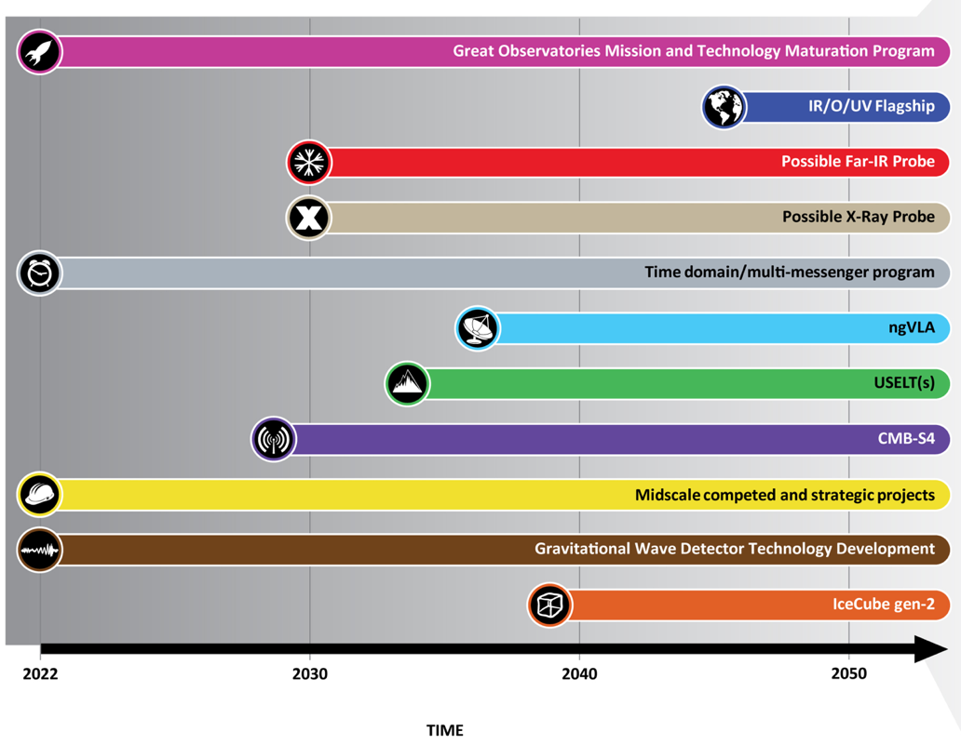
Astro2020 identified the ngVLA as a high-priority large, ground-based facility for science operations in 2030’s
Notes:
ngVLA essentially checked off every box of Astro2020 scientific priorities.

Slide 3
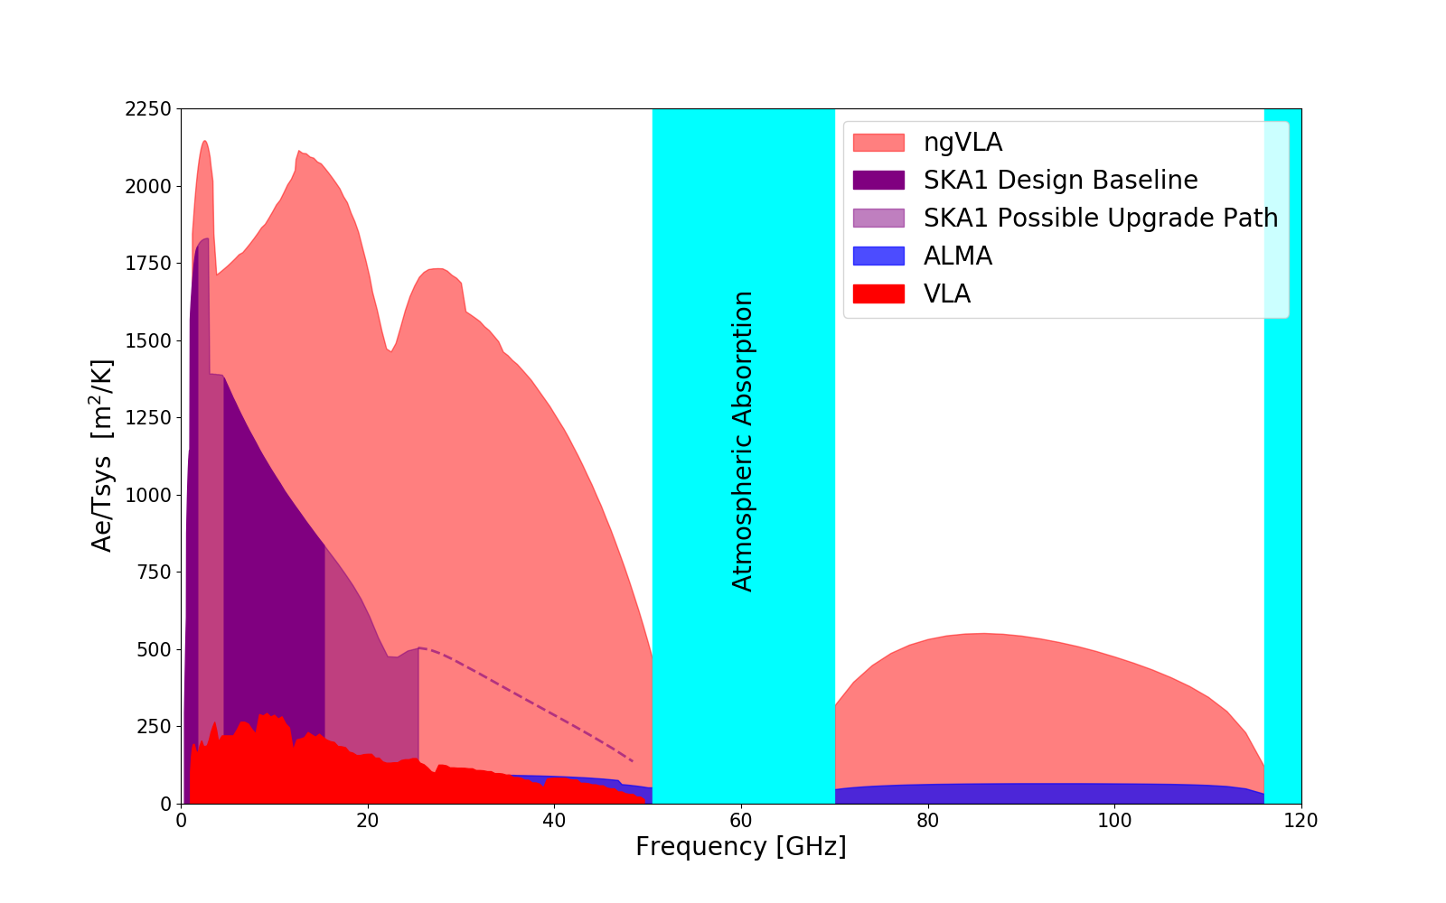
New Parameter (‘Discovery’) Space for the mid-Century
Complementary suite of arrays from meter to submm wavelengths
> 120GHz: ALMA 2030 superb for chemistry, dust, fine structure lines
  1.0 - 116GHz: ngVLA superb for terrestrial planet formation, dense gas history, black holes
  < 10 GHz: SKA superb for pulsars, reionization, HI + continuum imaging
Notes:
Snapshot comparison of effective collecting area for dish-arrays expected in the 2030’s.

Slide 4
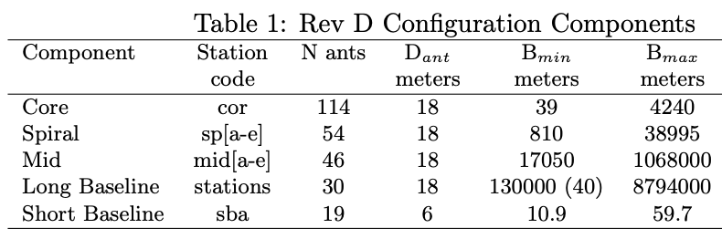
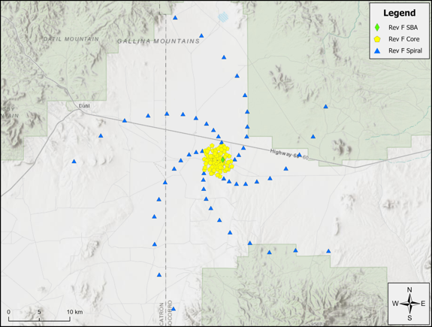
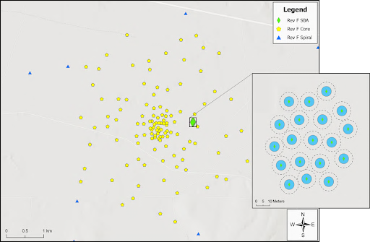
Resolution at 32GHz
0.44”
0.045”
0.018”
0.002”
34”
10m
1km
10km

Slide 5
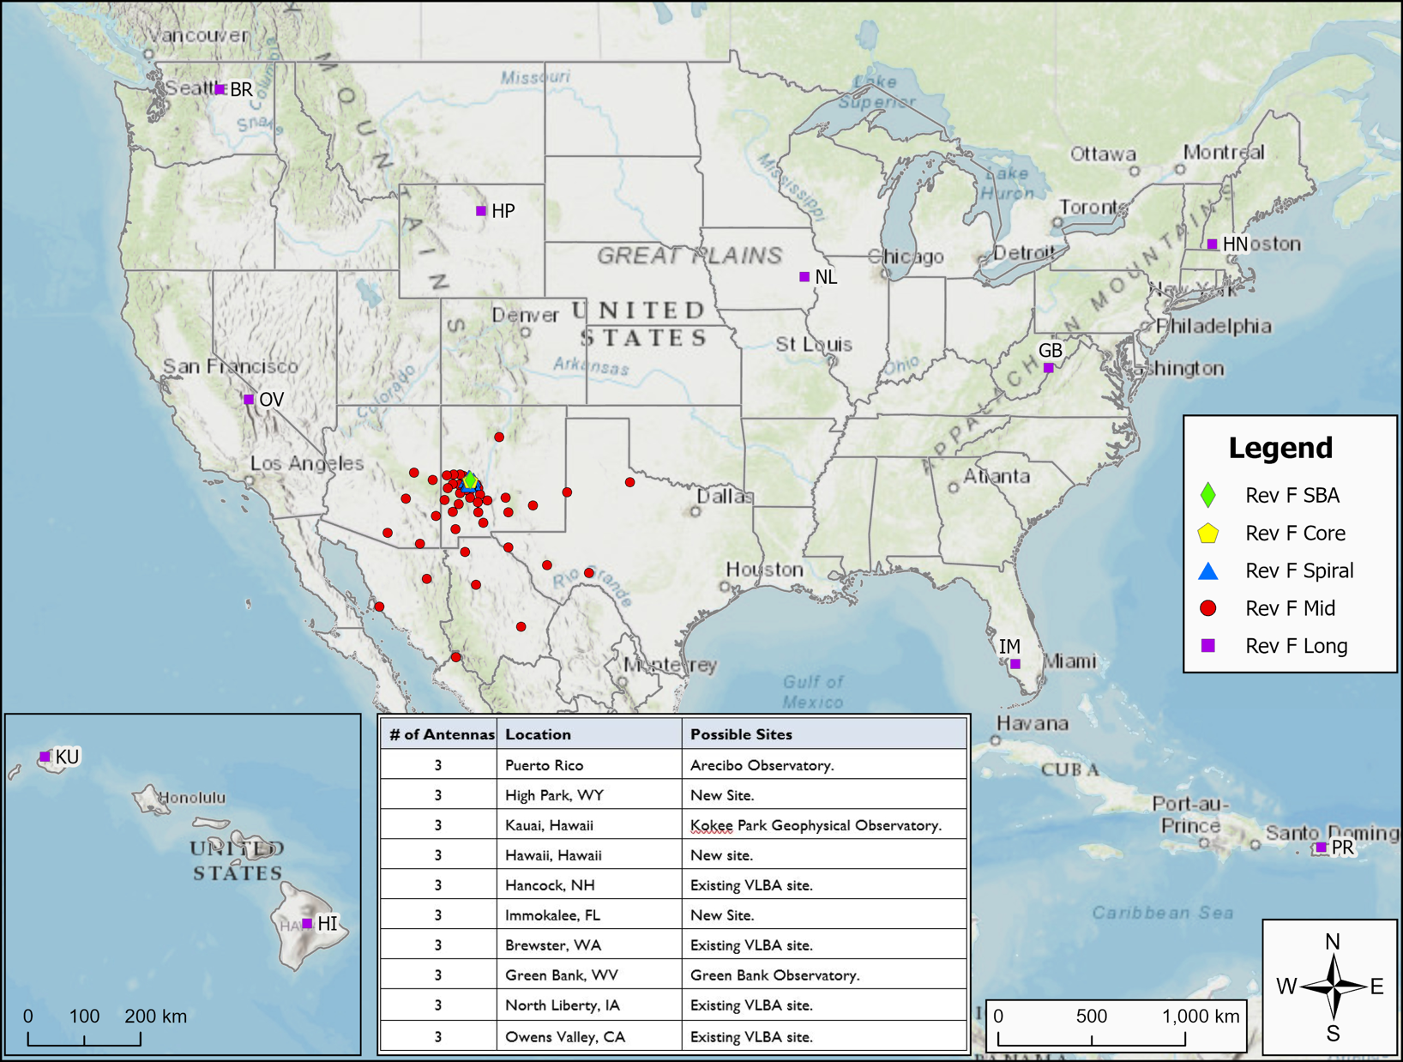
10m to 8000km => 200” to 0.2 mas @ 32GHz: subarrays will be key usage

Slide 6
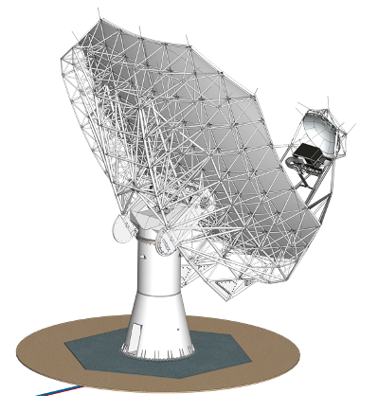

18m Prototype Antenna
Key Specifications
18m Aperture | Offset Gregorian
Shaped Optics | 3° Slew & Settle in 7 sec
Surface: 160 µm rms | Reference pointing: 3” rms
Precision conditions: | Total efficiency >80% (X..Q)
Status
Antenna proto-type contract 2022 to MTEX
Delivered to VLA site end 2025
Testing includes correlation with VLA

Slide 7
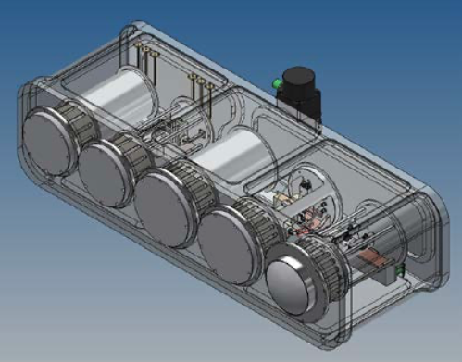
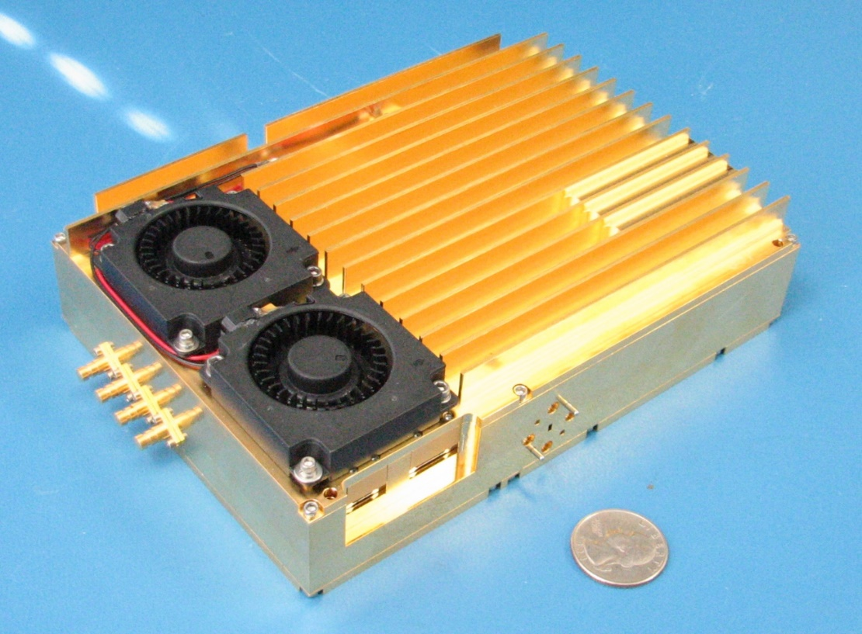
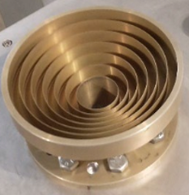
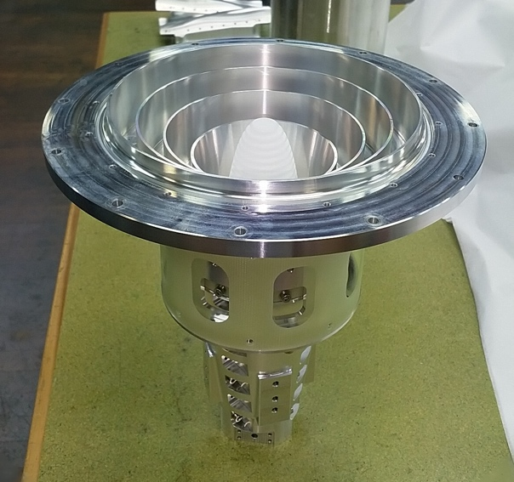
Technical Design: Well advanced and costed
Reference Design: Build on ALMA, JVLA, SKA development => low-technical-risk, well costed, optimize life-cycle cost
U.S. agencies (DOD, NASA): ICRF, Space Situational Awareness (radar), Spacecraft tracking/imaging, `burst-telemetry’
International partners: Mexico, Japan, others?
Integrated Receiver and Digitizer: RF signal -> mix to baseband; sampled and digitized (8bit) to fiber; 20 GHz BW
All compact and field replaceable
Band # | Freq. Range (GHz)
1 | 1.2 - 3.5
2 | 3.5 - 12.3
3 | 12.3 - 20.5
4 | 20.5 - 34
5 | 30.5 - 50.5
6 | 70 - 116
Correlator / Beamformer | Requirement (design)
digital efficiency | >95%
narrowest channel | <1 kHz
total # channels | >240,000
sub-band width | <250MHz (218.75)
total bandwidth | >14GHz/pol (20)
# formed beams | 10
Saxony, Germany

Slide 8
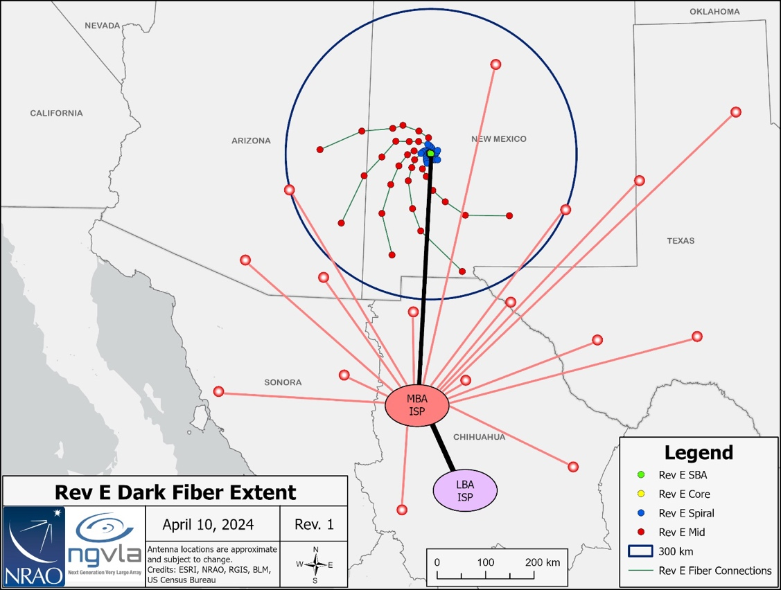
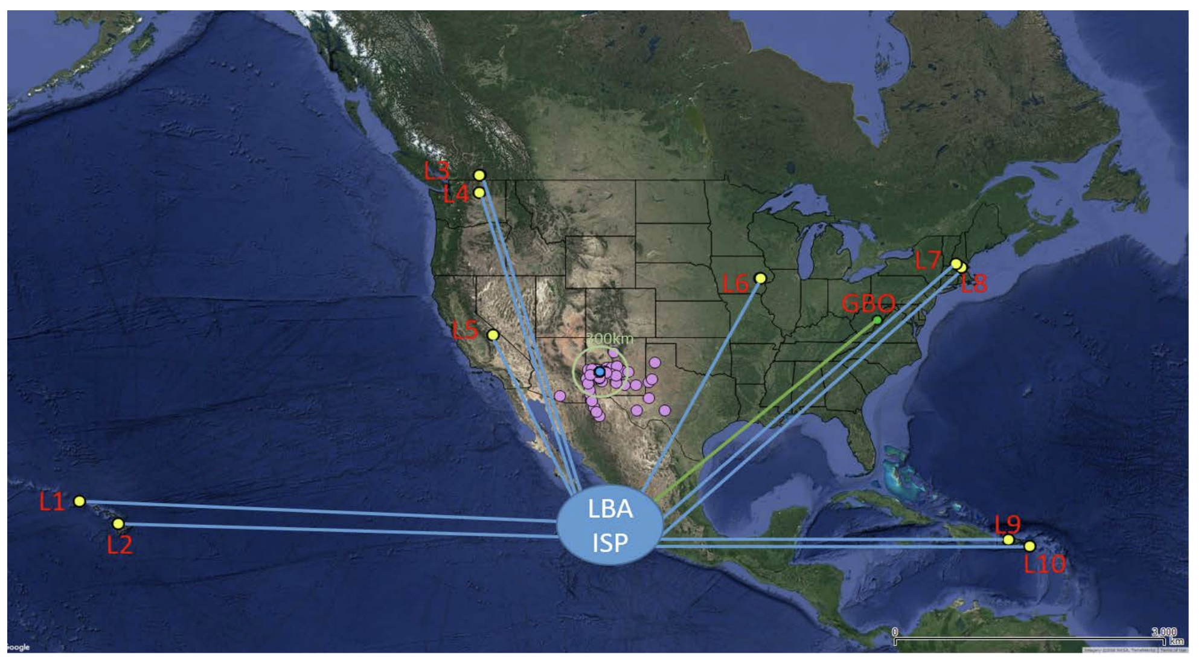
Fiber: real time VLBI
Dedicated lines < 300 km
ISP leased bandwidth > 300 km
Data Rates
Data rate into correlator ~ 800 Gbps per antenna => 210 Tbps total
Archive: 240 PB/yr
Power
Correlator ~ 1 MW, Antennas ~ 3.6MW
Exploring power purchasing agreement: on-site photovoltaic system
Long Haul Fiber Workgroup Preliminary Report 020.60.00.00.00-0002-REP-A-LONG_HAUL_FIBER_WORKGROUP_REPORT

Slide 9
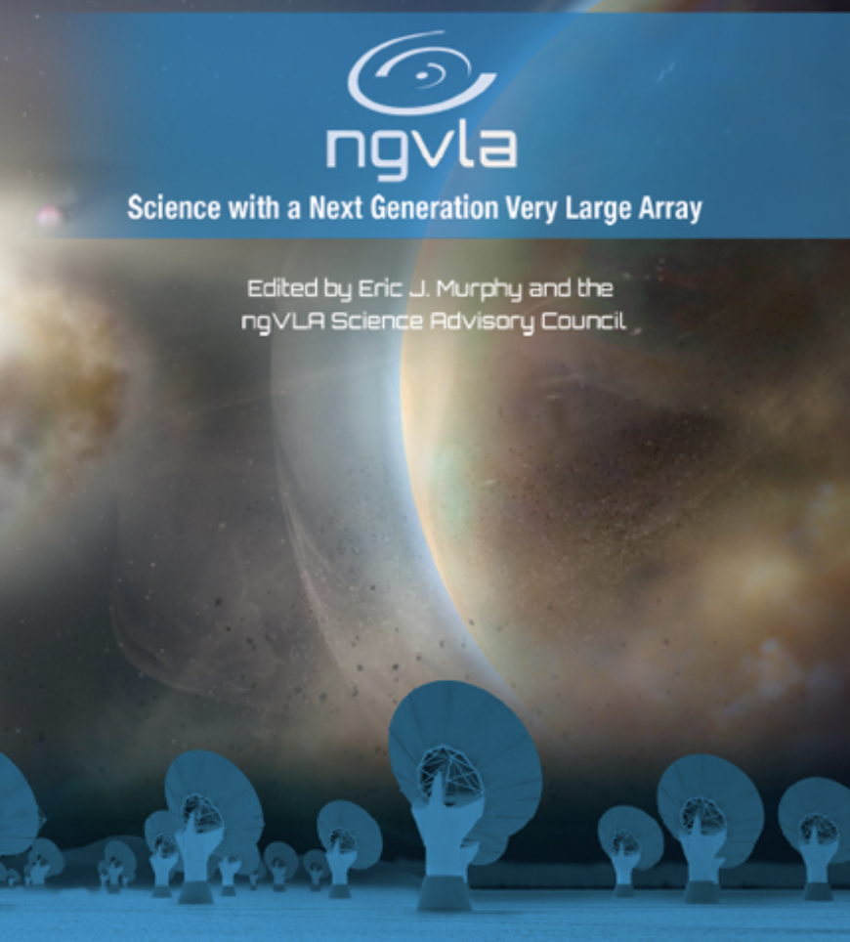
ngVLA Science
Strength in Versatility
Planets to Cosmology
Science Advisor Committee and Working Groups
Chairs: D. Wilner and B. Matthews
  SWG1: Stars, Planetary Systems, and their Origins
  SWG2: Astrochemistry and the Emergence of Life
  SWG3: Galaxies and Galaxy Evolution
  SWG4: Pulsars, Cosmology, and Fundamental Physics
  SWG5: Exploring the Dynamic Universe
2019 Science Book: 90 chapters, 300 authors
Key Science: SAC ngVLA Memo 125
Formation of Solar System Analogues on Terrestrial Scales
Probing the Initial Conditions for Planets and Life with Astrochemistry
Charting the Assembly, Structure, and Evolution of Galaxies
Galactic Center Pulars as Fundamental Tests of Gravity
Understanding the Formation and Evolution of Stellar and Supermassive in the Era of Multi-Messenger Astronomy

Slide 10
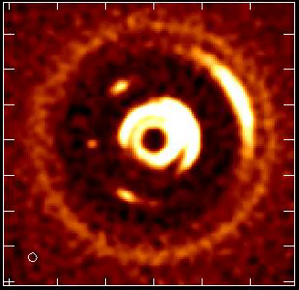
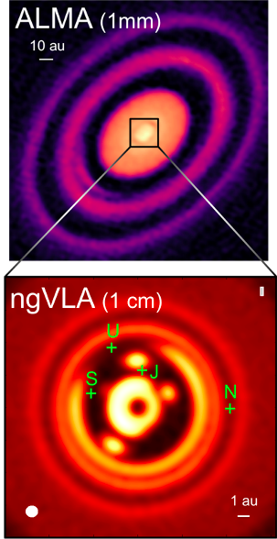
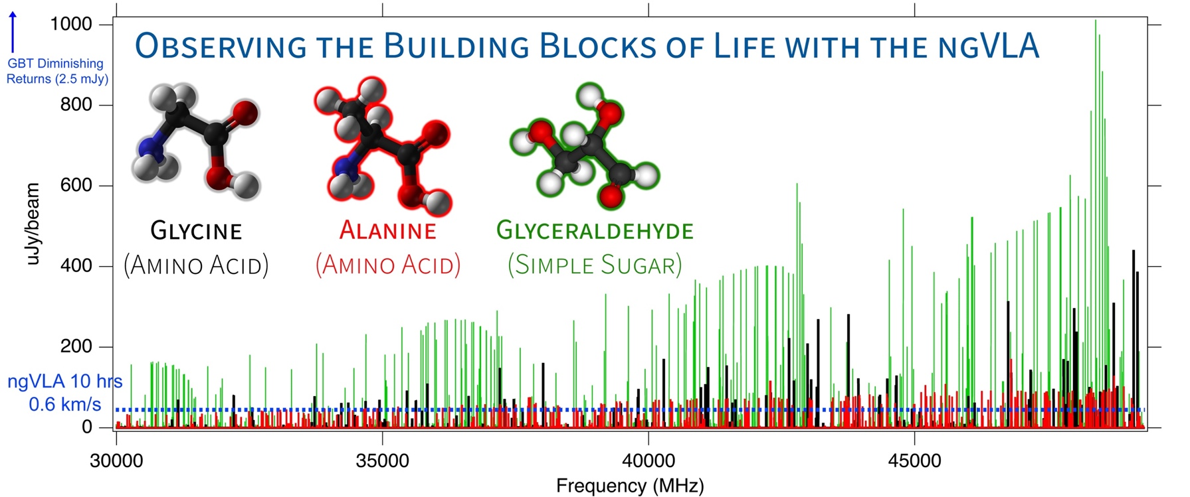
KSG1&2: Unveiling the Formation of Solar System Analogues and Life
Image Earth-mass planets in proto-Solar Systems
Resolution needed: 7mas = 1 AU at 140pc
ngVLA at 30 to 100 GHz resolves the inner few AU; optically thick to ALMA
Ideal freq range for pre-biotic molecules
Movies of planet formation
Forming Jupiter in 1Myr, 1M_{o} protostar and disk at 140 pc
Monthly obs over few years at 100 GHz, 7mas resolution
Image dust gaps and traps, and potentially the circumplanetary disk = accretion onto planet!
Notes:
HD 163296
ALMA observation of HD163296 at 1mm along with a simulated 1 cm ngVLA observations (Ricci et al. 2019) of the innermost 24 au region at 1 au resolution for Jupiter-, Saturn-, and Neptune-like planets.
The distribution of exoplanets and young planets embedded in circumstellar disks: Then ngVLA will discover many hundreds of planets with orbital periods <10 yr.
The ngVLA will measure the orbital motion of planets and related features on monthly timescales:
Simulated 100 GHz ngVLA observations of a newborn planetary system comprising a Jupiter analogue orbiting at 5 AU from a Solar type star.

Slide 11
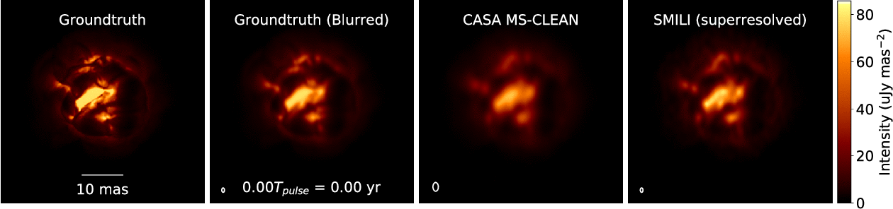
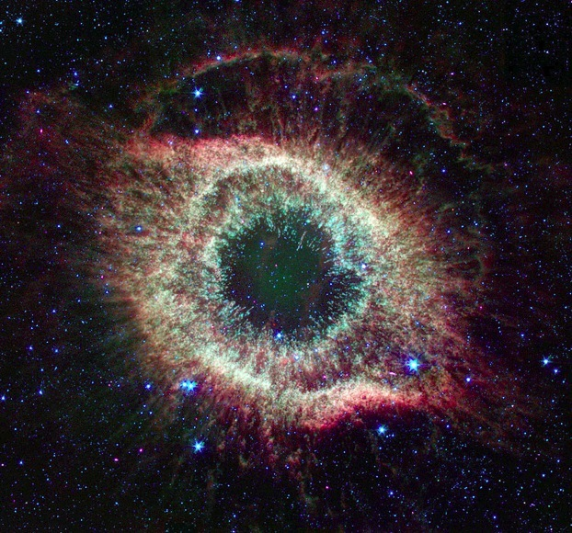
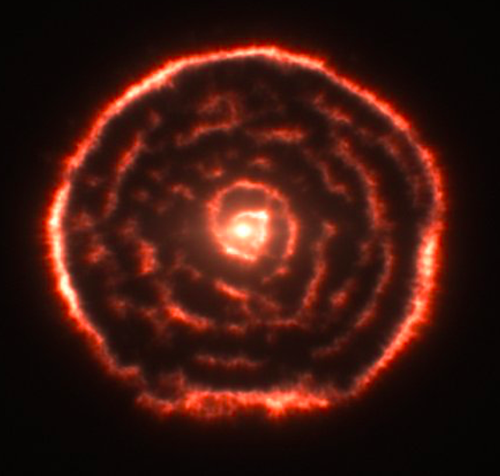
Stellar end-of-life: movies of stars
Movies of extreme mass-loss in evolved (AGB) stars
Primary enrichment mechanism of ISM
ngVLA
JWST
ALMA
ngVLA
Radio photosphere
80000 AU
8000 AU
8 AU
Petretti, Akiyama & Mathews 2021
ngVLA imaging of ‘boiling’ AGB star atmosphere
  ngVLA @ 46 GHz; 1.5 mas ~ 0.04 stellar radii at d=150pc
  1.3 year pulse period observed every 2-3 weeks
Notes:
Simulated movies of the gas motions in the radio photosphere of an asymptotic
giant branch (AGB) star as observed with the ngVLA Main Array at 46 GHz. The
angular resolution is ~1.5 mas, corresponding to roughly 0.04 stellar radii.
Each movie covers a single 1.3-year pulsation period for a model AGB star,
assuming observations every 2-3 weeks. The adopted distance was 150 pc.
AGB star atmospheres are highly dynamic owing to a combination of radial
pulsations, shocks, and large-scale convective processes. These stars also shed
large amounts of matter through cool, dense winds. Radio waves are emitted from
a portion of their atmospheres that lie at a radius of roughly twice the
visible photosphere, and just interior to the wind launch region.
The adopted brightness distribution for the radio photosphere model (the
"ground truth model" shown in the left hand frame) was based on a 3D
hydrodynamic model of an AGB star atmosphere from Freytag et al. (2017). The
Freytag et al. model is not specific to millimeter wavelengths, but was adapted
here for illustrative purposes. The second frame shows the ground truth model
blurred with a Gaussian kernel.
The two frames on the right show image reconstructions of the model based
on simulated ngVLA Main Array observations. The integration time was 2
hours per frame and the assumed bandwidth was 10 GHz in dual
polarizations. The second frame from the right shows a multi-scale CLEAN
reconstruction, while the frame on the right shows the result of a
regularized maximum likelihood reconstruction using the SMILI package of
Akiyama et al. (2019). While both methods do well at reproducing many of
the key features of the model, the SMILI version achieves superior angular
resolution.
These results underscore that the exquisite sensitivity and resolution of the
ngVLA will enable studies of the physical properties and kinematics of the
atmospheres of evolved stars in unprecedented detail.
Credit: K. Akiyama and L. D. Matthews, based on models adapted from B.
Freytag.

Slide 12
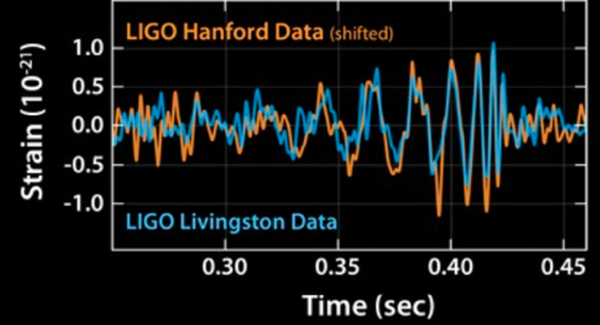
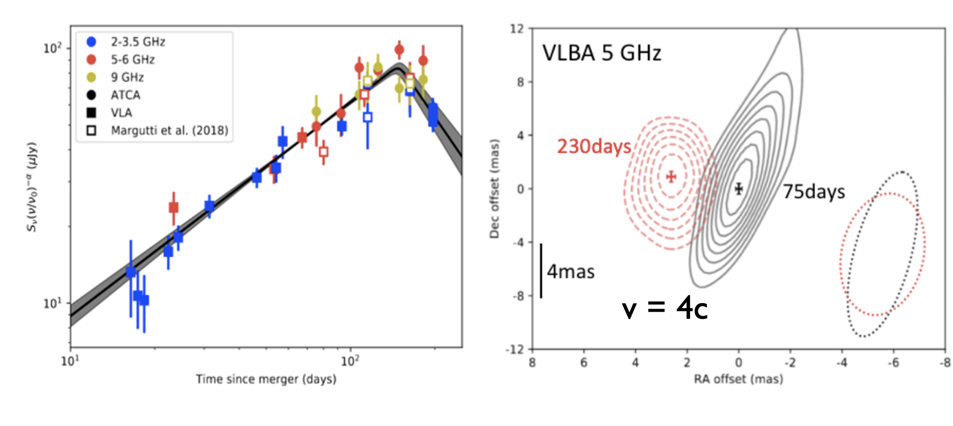
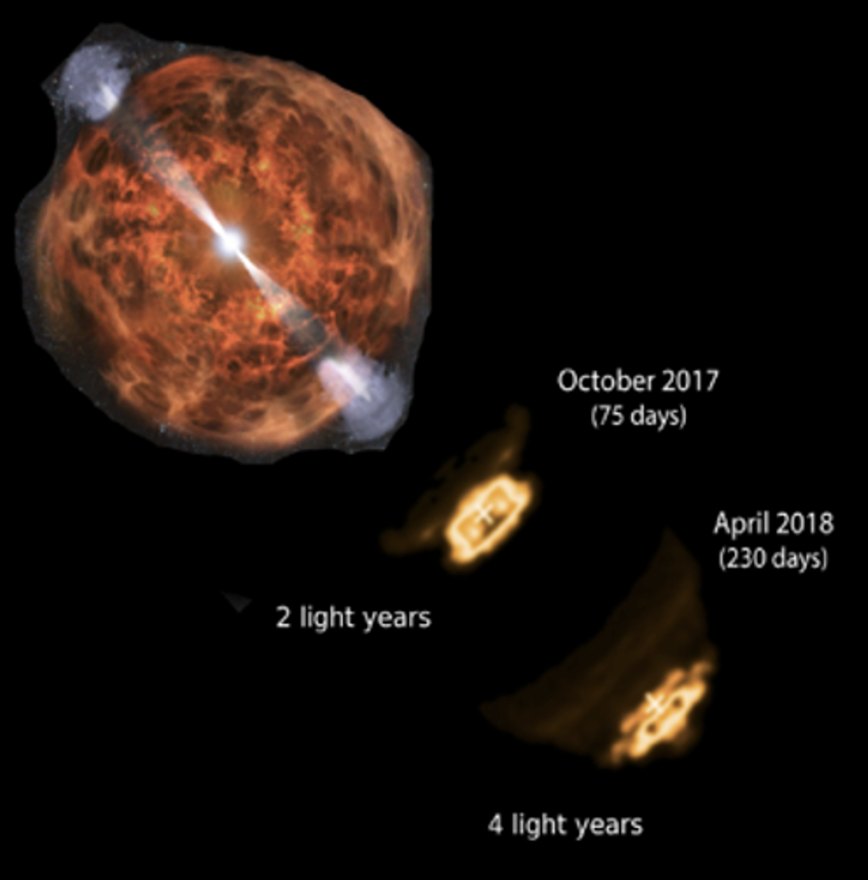
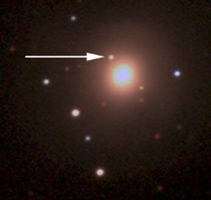
KSG 5: New Windows on the Dynamic Universe
Dobie ea. 2018;
Mooley ea. 2018
1st GW source: multi-wavelength campaign discovered the EM counter-part to merging binary ~ 30 M_{o} black-holes, identified with a galaxy at 430 Mpc
Radio light curve and VLBA imaging => emerging relativistic jet from merging binary black holes: a wide angle jet which is trapped by the explosion debris
ngVLA 30x search volume => Expect 10 to 20 searchable LIGO events/year
sub-mas resolution => ONLY method to determine EM source sizes and shapes on scales < 0.6 pc
Multi-messenger, time-domain astronomy (LIGO, neutrino sources, LSST and Euclid surveys, GRBs, TDEs…): radio provides unique tools to unlock physics of the ‘explosive universe’

Slide 13
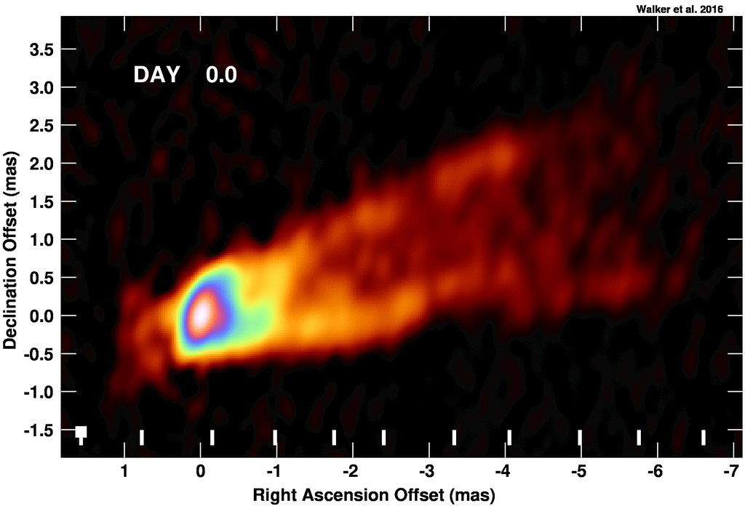
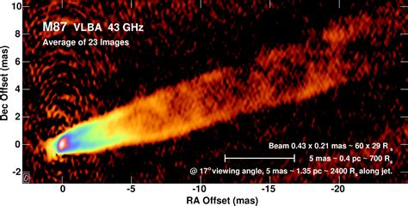
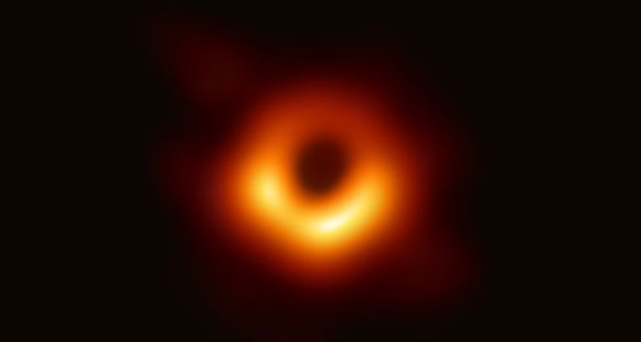
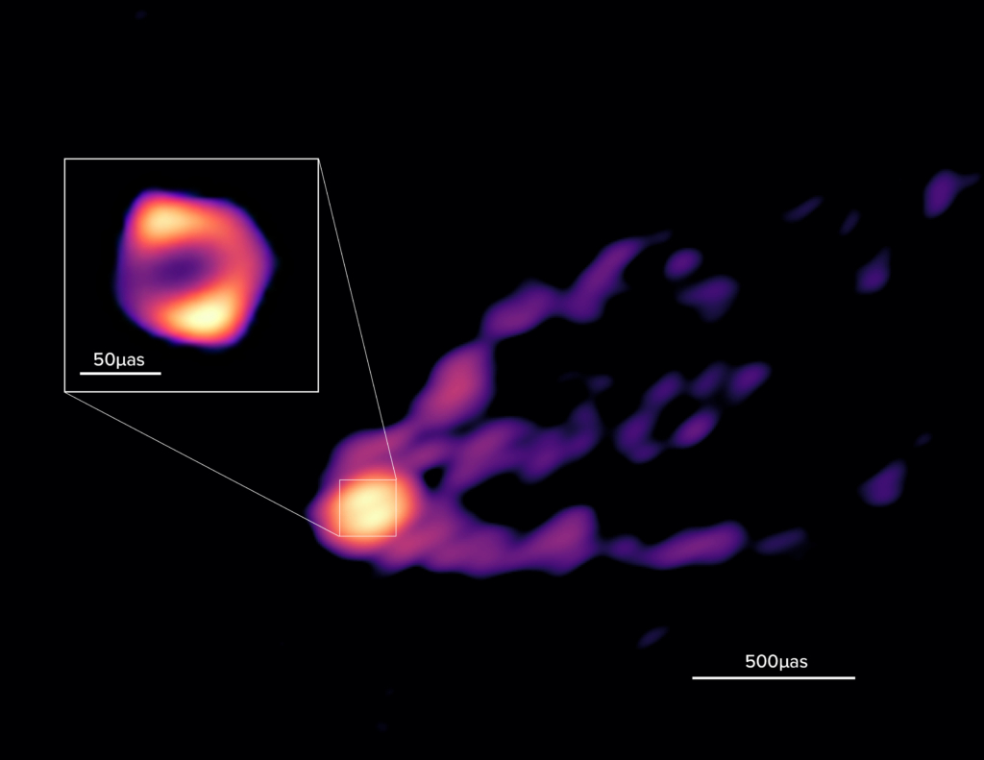
Imaging the Black Hole Disk – Jet connection
V_{app} up to 6c
M87 EHT 230 GHz @ 20uas resolution
M_{SMBH} = 6.5 x 10⁹ M_{o}
Walker + 2018
42uas = 5.6 R_{s}
90 GHz GMVA @ 40uas: R ~ 8.4 R_{s}
Event Horizon Telescope imaging of the general relativistic shadow of the SMBH in M87 and Sgr A* has reinvigorated interest in radio AGN and their accretion disks and relativistic jets.
GMVA 90 GHz imaging also shows ‘ring’ but 1.5x larger, plus jet on scales ~ 0.1 pc
M87 90 GHz results open a new ngVLA key science program: imaging the accretion disk – jet connection on scales ~ 10 R_{s}
50uas
Lu et al. 2023
0.5mas

Slide 14
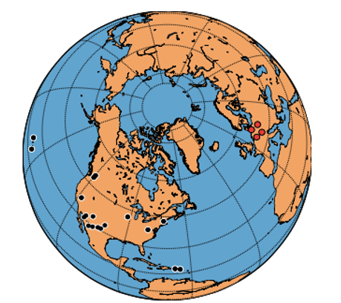
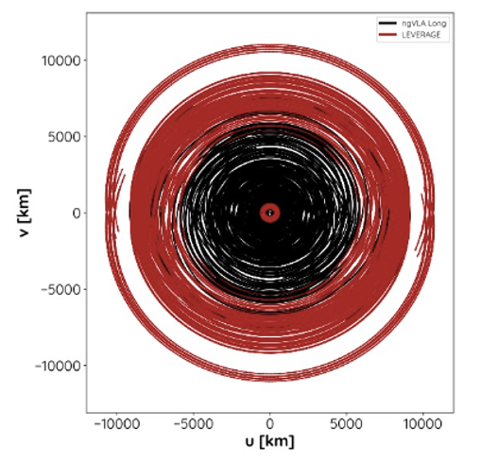
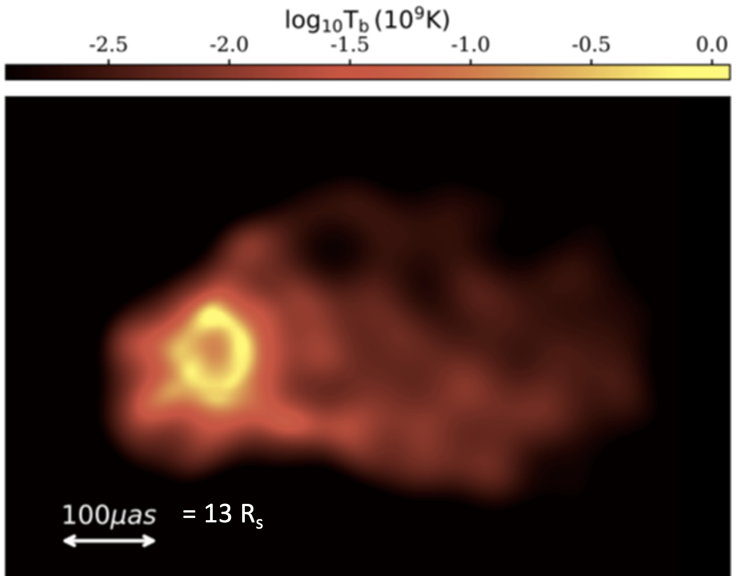
LEVERAGE: 4 ngVLA stations in Germany
Kadler et al.
Increase uv-coverage to baselines ~ 10000 km
Improve resolution to ~ 60 uas @ 90GHz
Image GR shadow on scales of 60 uas ~ 8 R_{s}
Image Jet – accretion disk transition out to 1mas ~ 0.07pc

Slide 15
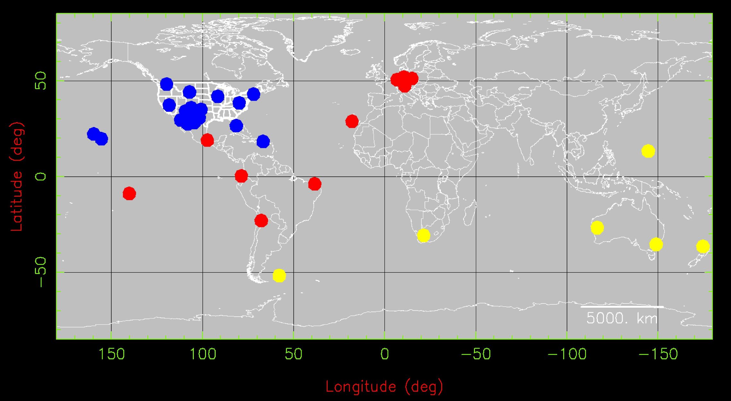
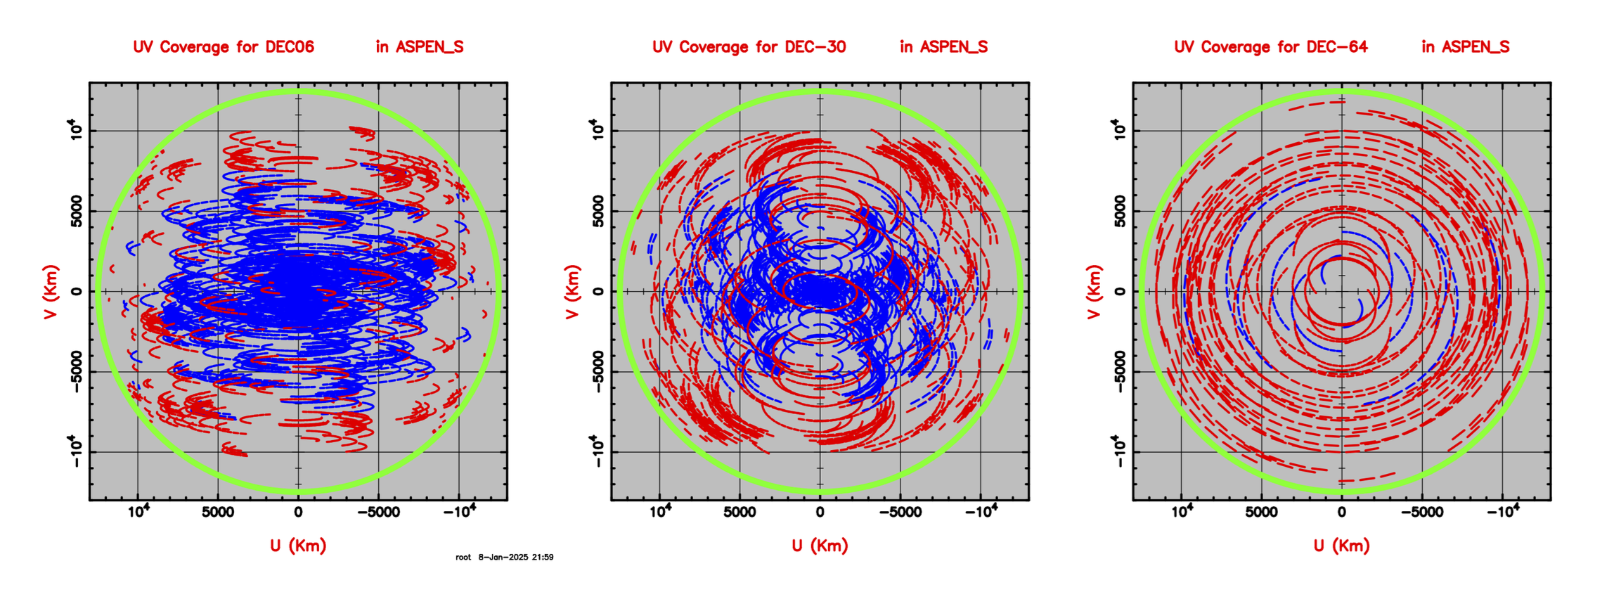
Walker ngVLA memo 128
ngVLA + GMVA + LEVERAGE + ‘Southern Stations’
Greatly improved u,v coverage for southern sources

Slide 16
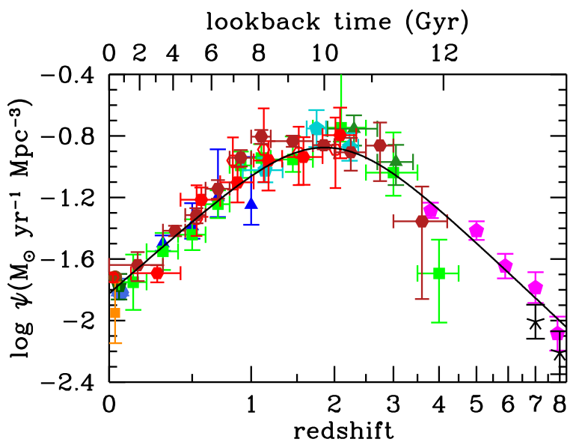
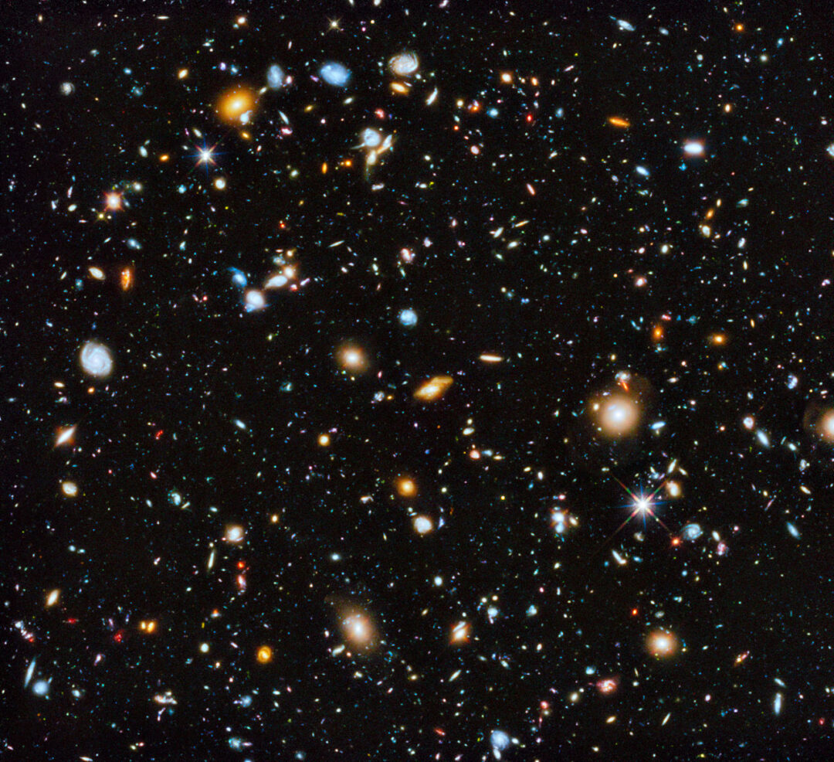
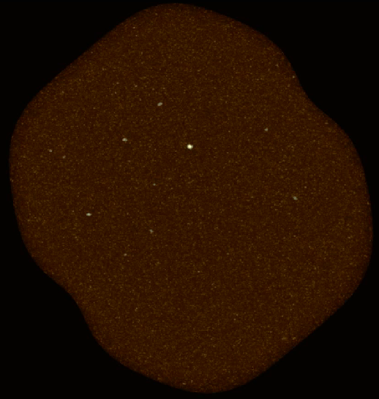
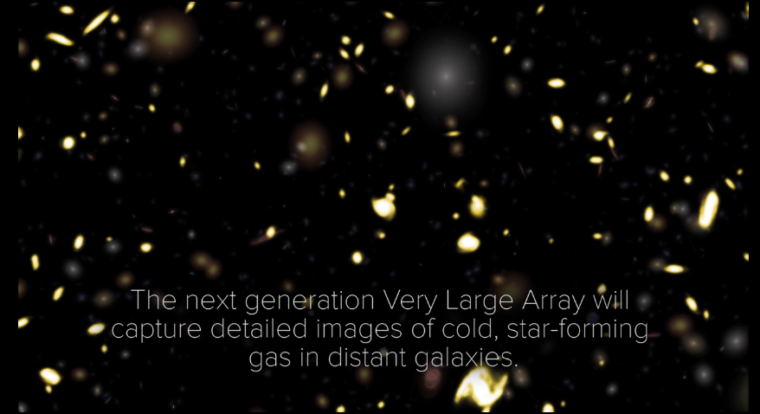
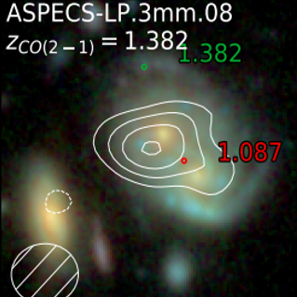
KSG3: Molecular Deep Fields in three dimensions
Revealing the ‘missing half’ of galaxy formation: the molecular gas = fuel for star formation
UDF JWST: 5000 galaxies to z = 15
ASPECS ALMA 200hrs: 36 CO galaxies z ~ 1 to 3
ngVLA ~ 3000 CO galaxies
10x sensitivity + 2.5x bandwidth => 100-fold increase in CO detection rate over VLA, ALMA => Galaxy counts in CO ~ deepest optical fields, with redshifts!

Slide 17
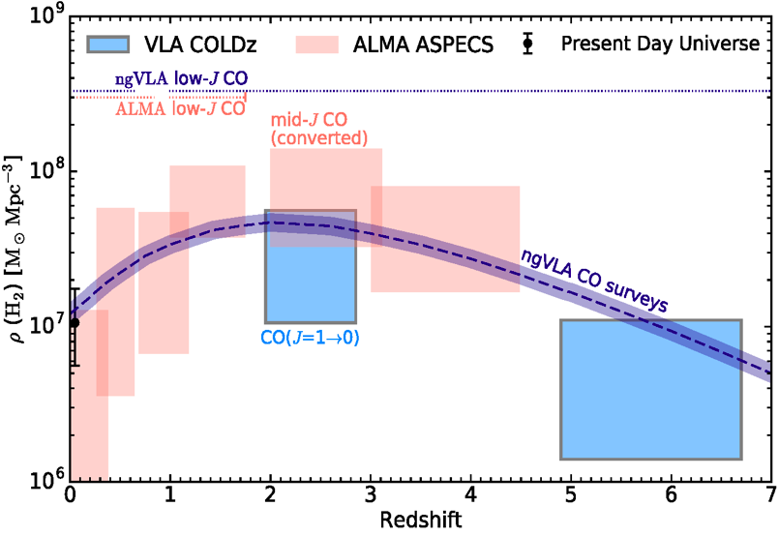
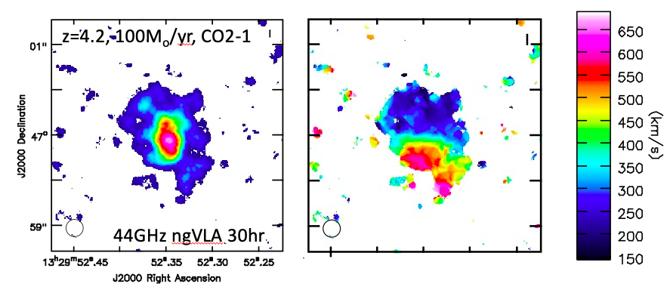
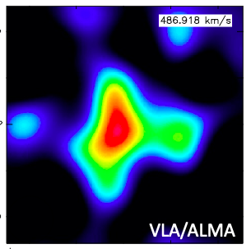
KSG3: Measuring the Dense Gas History of the Universe
Precise measurement of Dense Gas History of Universe
kpc-scale imaging of gas dynamics: Dark matter?

Slide 18
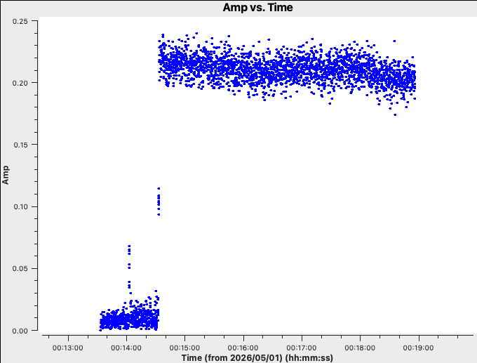
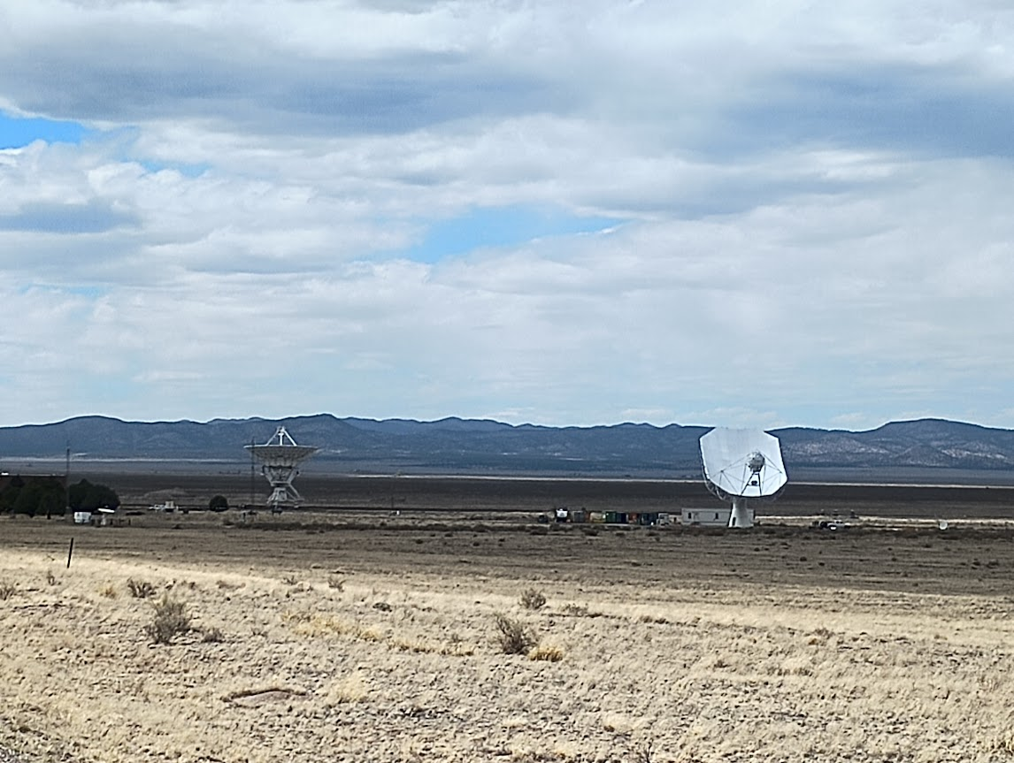
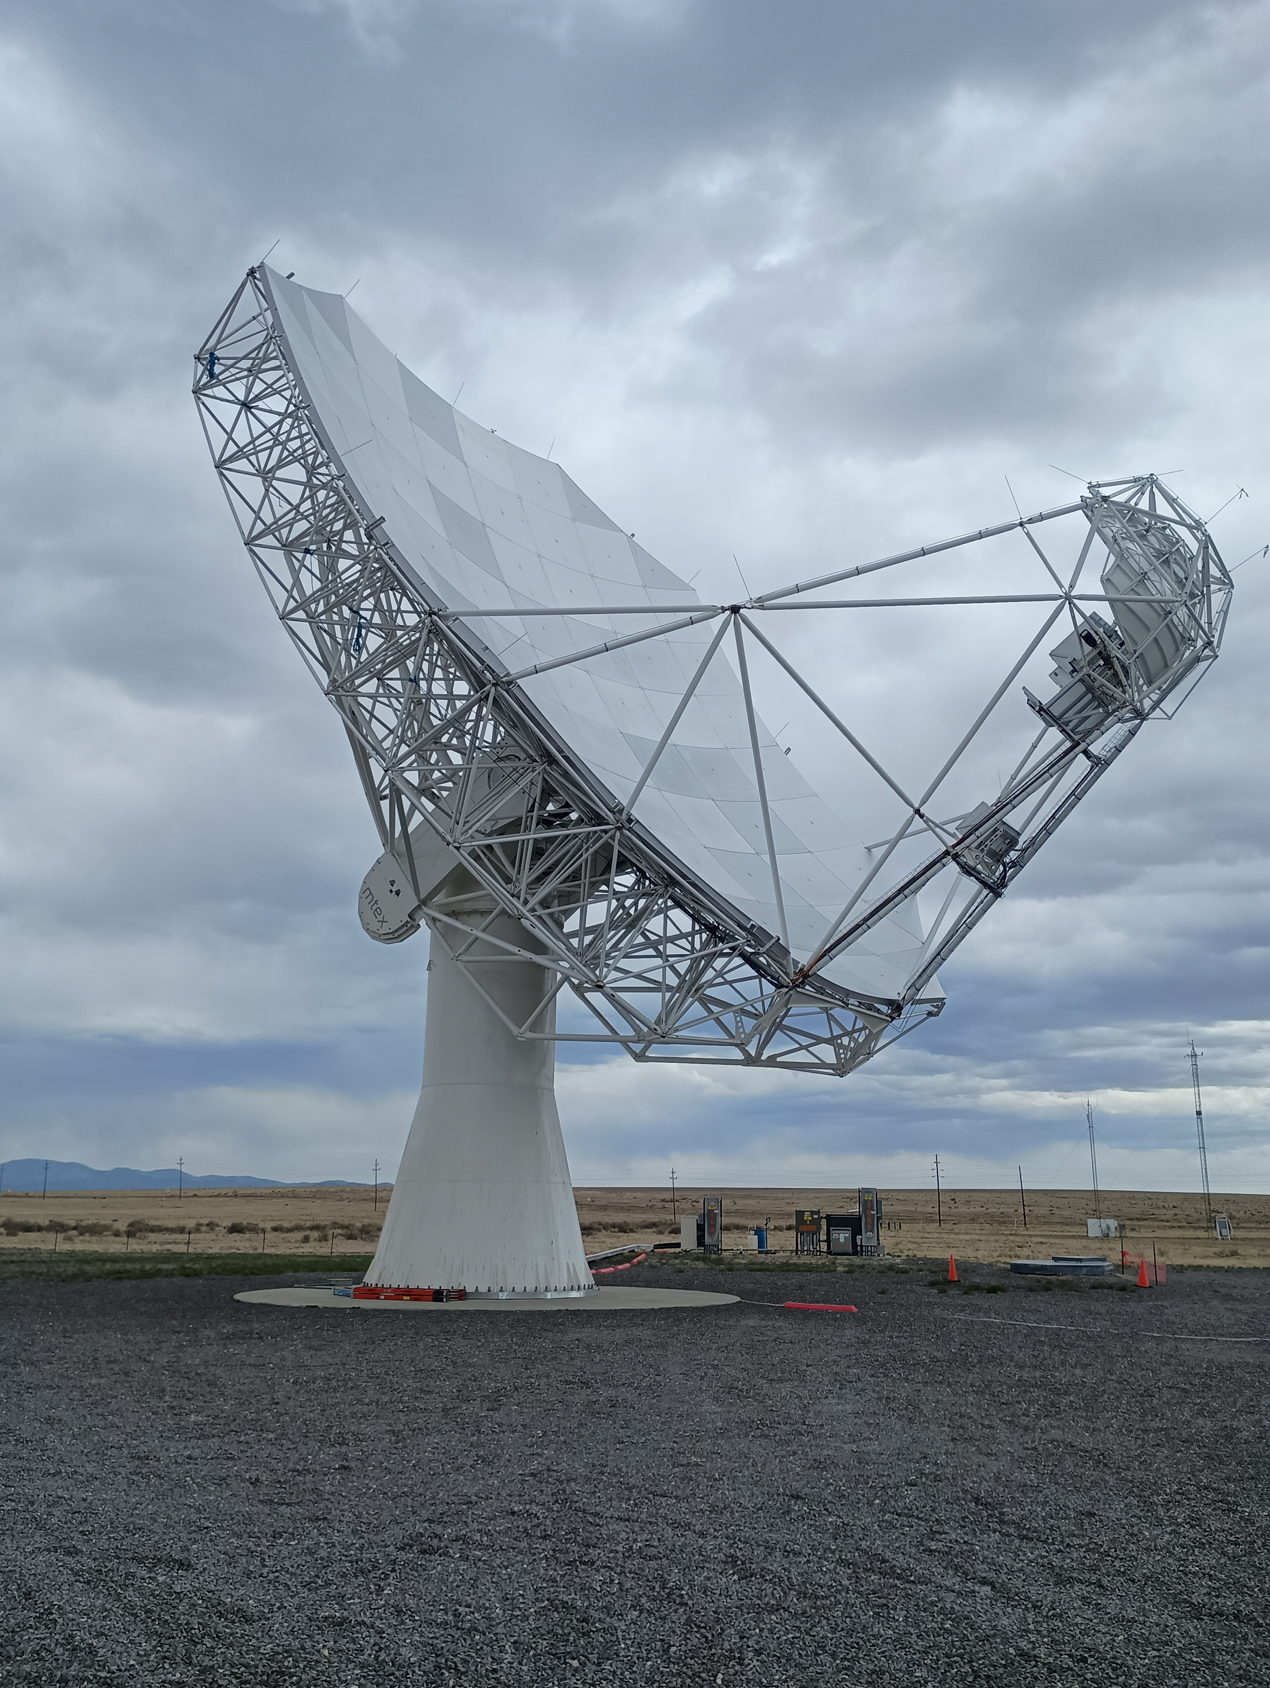
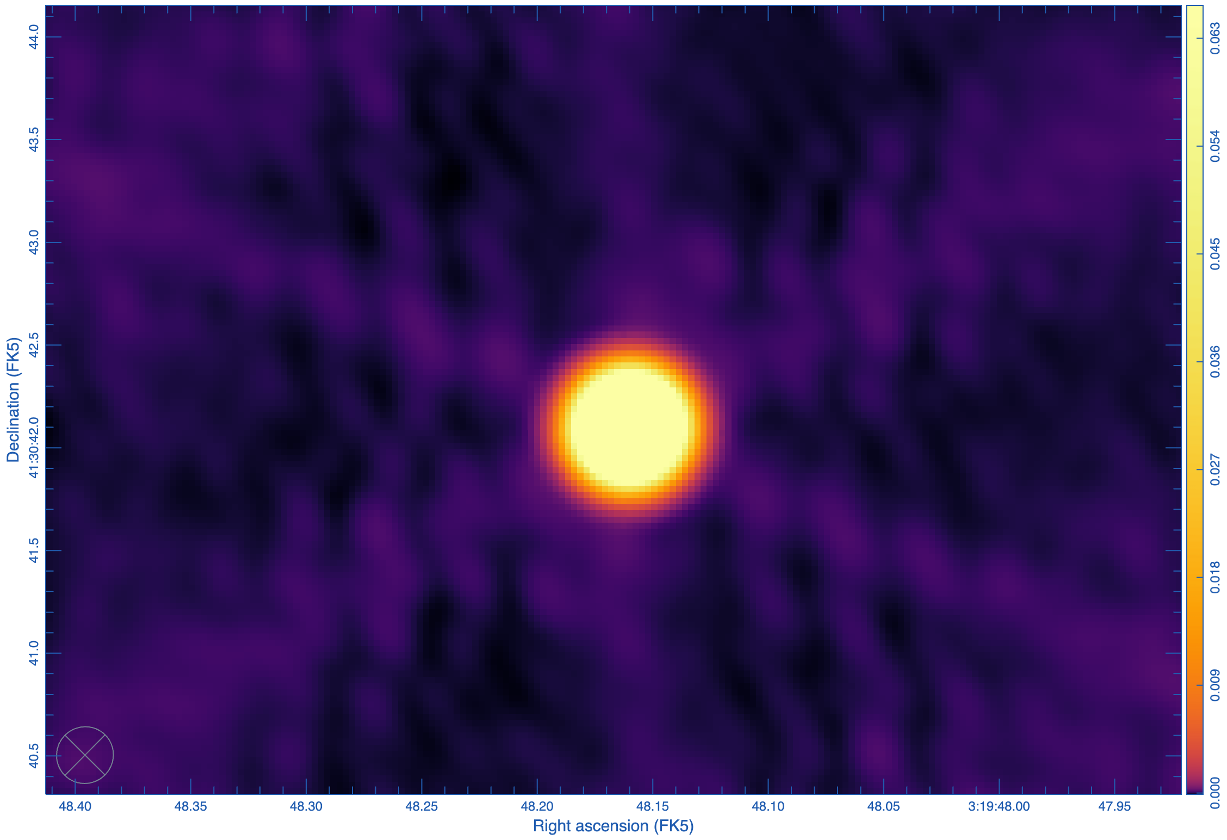
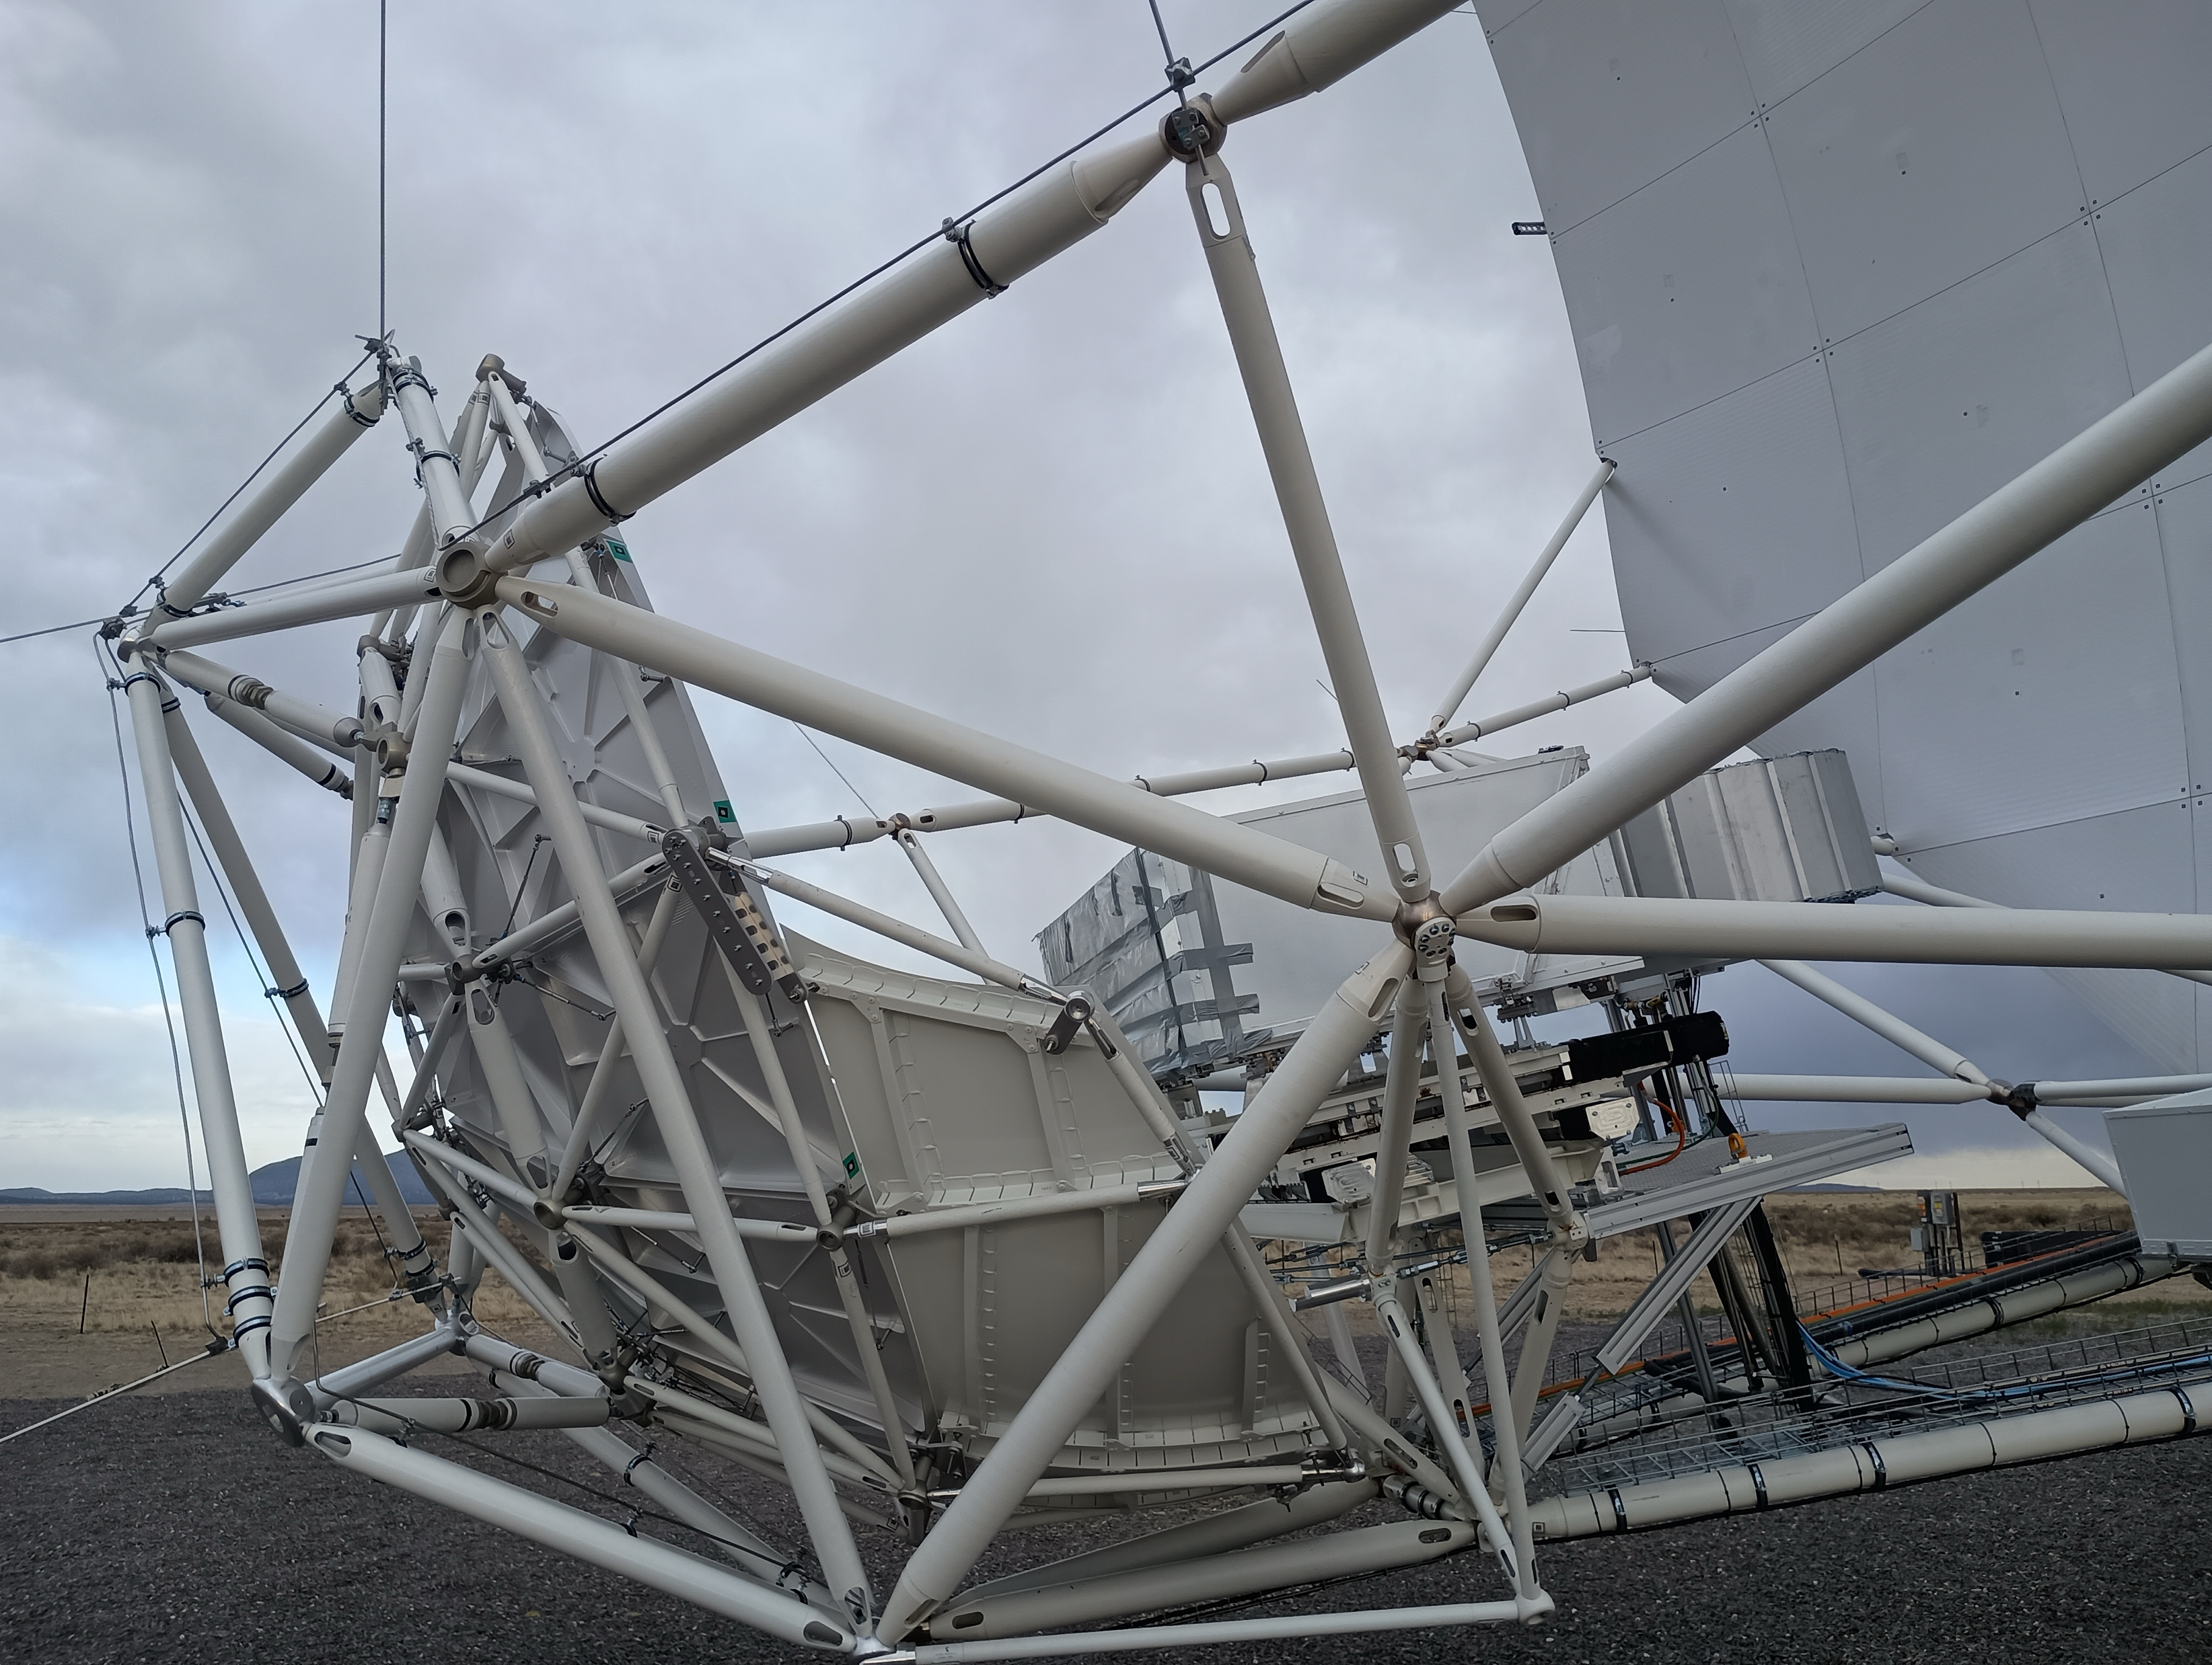
Prototype: First Fringes and Images May 1 2026
‘Start’ on source 3C84
Baseline: ngVLA – VLA/E08
First image 3C84 w. ngVLA+VLA
8.3 GHz, 0.3” res
DNR ~ 50k
System works from Rx through IF to correlator to CASA!

Slide 19
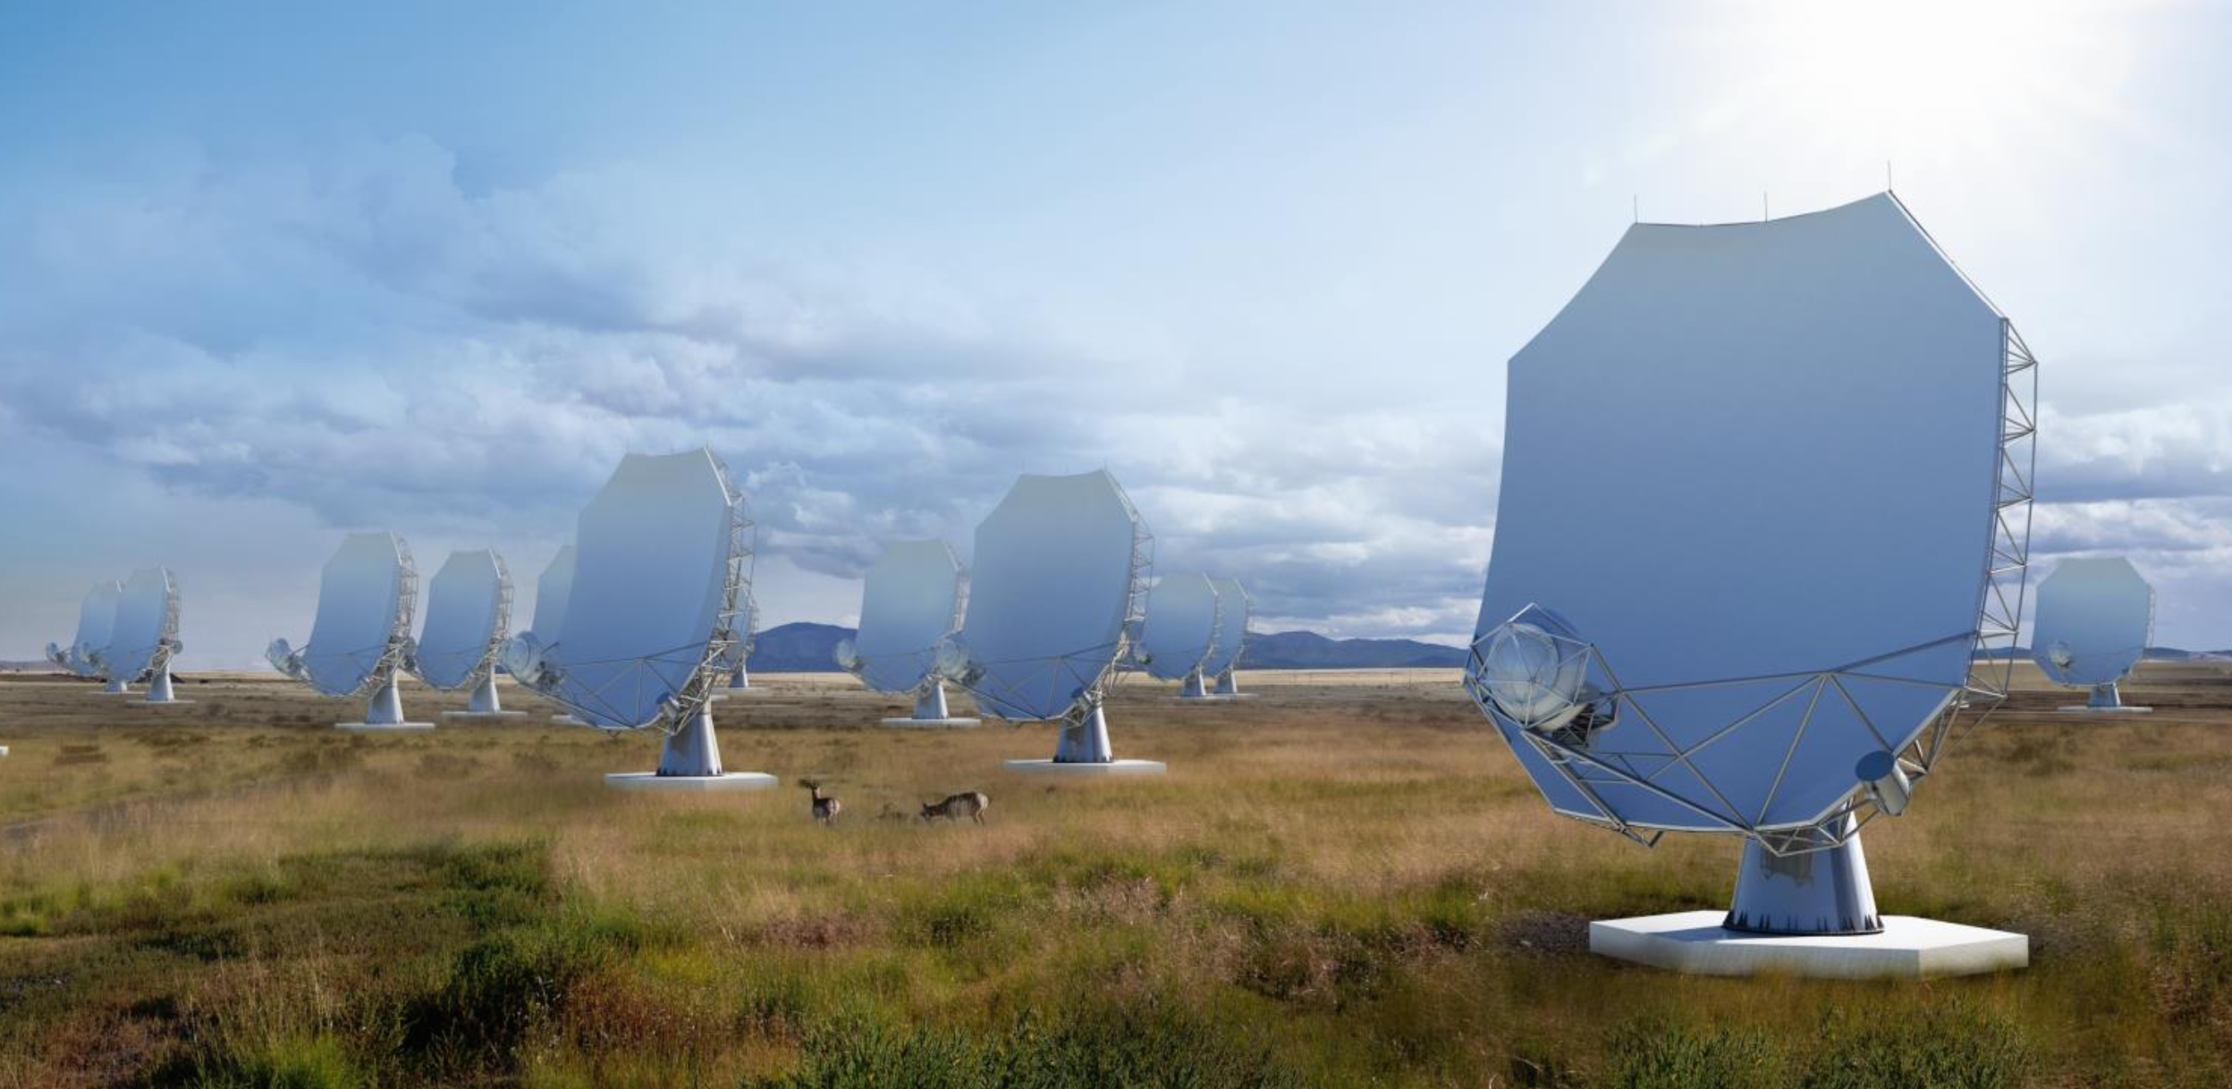
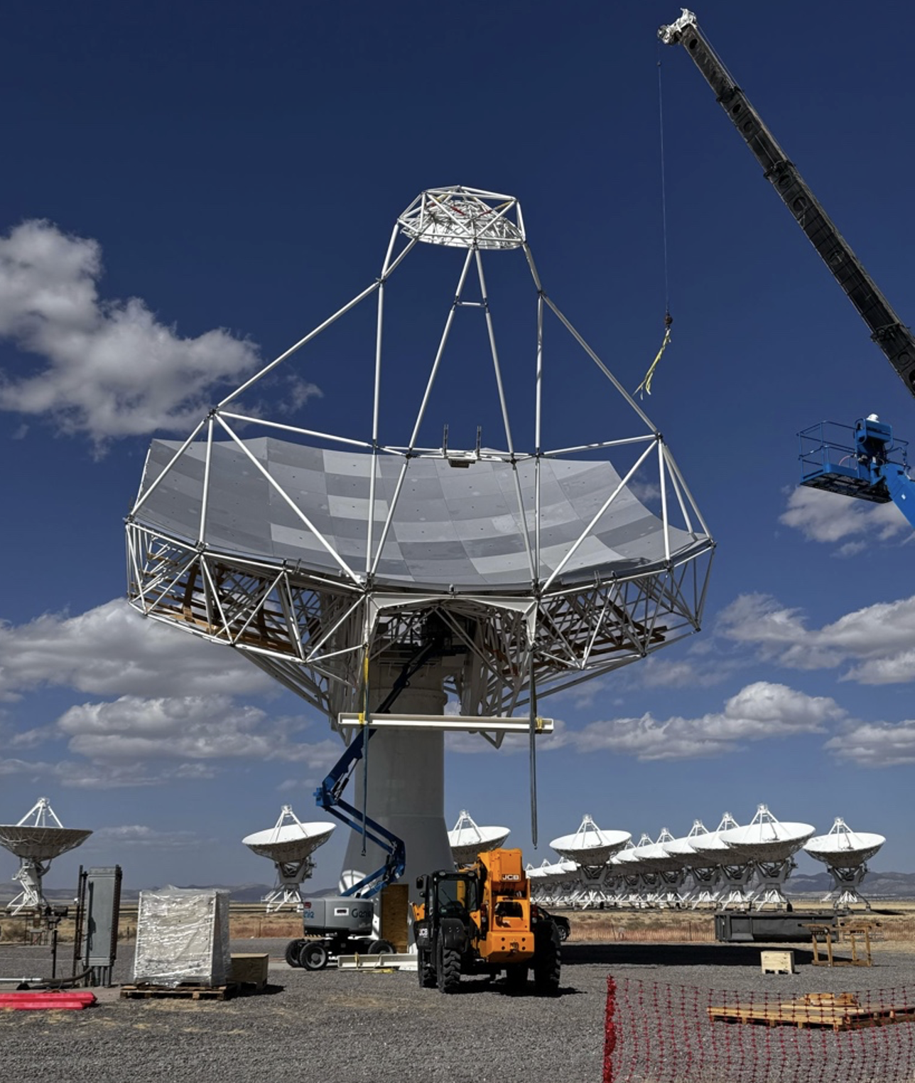






Project Timeline
2018
2019
2021
2023
2026
2029
2030
2033
2038
Astro2020 submission
1st fringes
Construction
Early Science
NSF/MREFC CoDR
Full Science Operations
Science Book
Ref. Design
NSF development funds
Prototype at VLA
NSF/MREFC FDR
Astro2020 Report

Slide 20

ngvla.nrao.edu
ngVLA Science Meetings
  2026: Multidisciplinary, Tohoku U., Japan
  2027: Long Baseline Science in DC Area

